Slide 2
Enabling People-Centric IT
FDN03
Andrew Conway
Director Product Marketing

Slide 3
The Cloud OS Modern platform for the world’s apps
CUSTOMER
Transforms the datacenter
Empowers people-centric IT
1
CONSISTENT PLATFORM
WINDOWS AZURE
SERVICE PROVIDER
Unlocks insights on any data
Enables modern apps
DEVELOPMENT
MANAGEMENT
DATA
IDENTITY
VIRTUALIZATION

Slide 4
Waves of Innovation
April 2012
June 2012
September 2012
December 2012
June 2013 Preview
User-centric application delivery
MDM via EAS
Unified management
MDM for Windows RT, Windows Phone 8, iOS
Mac OS X support
SP1
Comprehensive Settings Mgmt.
Company Portals
Certificate, VPN, Wi-Fi Provisioning
Selective Wipe
App sideloading for iOS, EAS support
RDS and RDP8.0 improvements
Dynamic Access Control
DA/Remote Access
Work Folders
Workplace Join
Web Application Proxy

Slide 5
Aston Martin Video

Slide 6
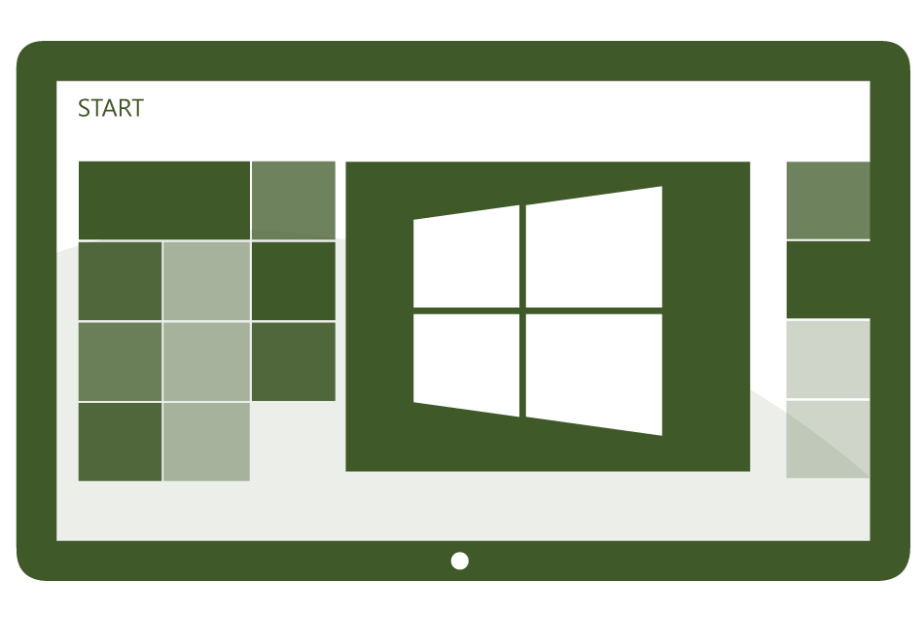
Today’s Challenges
Users
Devices
Apps
Data
Users expect to be able to work in any location and have access to all their work resources.
The explosion of devices is eroding the standards-based approach to corporate IT.
Deploying and managing applications across platforms is difficult.
Users need to be productive while maintaining compliance and reducing risk.

Slide 7
People-centric IT
Empower users
Allow users to work on the devices of their choice and provide consistent access to corporate resources.
Unify your environment
Deliver a unified application and device management on-premises and in the cloud.
Users
Devices
Apps
Data
Protect your data
Help protect corporate information and manage risk.
Management. Access. Protection.

Slide 8
Empower Users
Enable consumerization of IT without compromising compliance
Consistent Company Portal experiences across devices
Simplified registration and enrollment
Automatic connection to internal resources

Slide 9
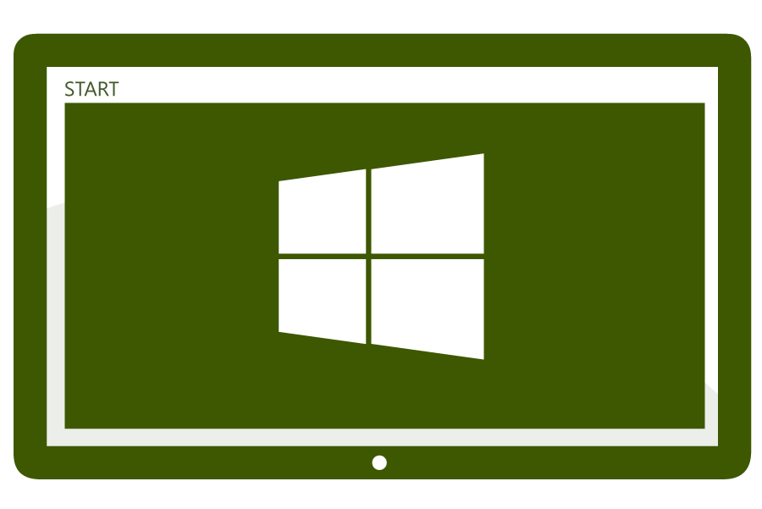
Empower Users Allow users to work the device of their choice and provide consistent access to corporate resources
IT can publish desktop virtualization resources for access to centralized resources.
Users can work from anywhere on their devices with access to their corporate resources.
Users can enroll devices for access to the company portal for easy access to corporate applications.
VDI
Session host
RD Gateway
Web Apps
LOB Apps
Files
Users can register devices for single sign-on and access to corporate data with Workplace Join.
IT can publish access to resources with the web application proxy based on device awareness and the users identity.
Firewall
Active Directory
IT can provide seamless corporate access.

Slide 10
Demo Empower Users
Paul Mayfield
Partner Program Manager

Slide 11
Unify Your Environment
Enable consumerization of IT without compromising compliance
Market-leading client management extended with cloud-based MDM
Simplified, user-centric application management
Comprehensive settings management across platforms
Common identity across on-premises and in the cloud

Slide 12
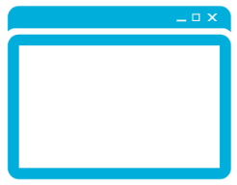
Unify Your Environment Deliver comprehensive application and device management
Single admin
console
IT
Users
Unified infrastructure enables IT to manage devices “where they live”
Comprehensive settings management across platforms, including certificates, VPNs, and wireless network profiles
IT can manage the device and application lifecycle

Slide 13
Demo Unify Your Environment
Dilip Radhakrishnan
Senior Program Manager

Slide 14
Protect Your Data
Enable consumerization of IT without compromising compliance
Policy-based access control to corporate applications and data
Increased security through multi-factor authentication
Selective wipe of corporate apps and data to protect information

Slide 15
Protect Your Data Help protect corporate information and manage risk
IT can provide a secure and familiar solution for users to access sensitive corporate data from anywhere with VDI and RemoteApp technologies.
Desktop Virtualization
Centralized Data
Devices
RD Gateway
Users can access corporate data regardless of device or location with Work Folders for data sync and desktop virtualization for centralized applications.
Access
Policy
Session
host
VDI
Files
Distributed Data
IT can publish resources using the web application proxy and create business-driven access policies with multi-factor authentication based on the content being accessed.
Web Apps
LOB Apps
IT can audit user access to information based on central audit policies.

Slide 16
Demo Protect Your Data
Sam Devasahayam
Principal Program Manager

Slide 17
People-centric IT Solution
Enable consumerization of IT without compromising compliance
Consistent Company Portal experiences across devices
Simplified registration and enrollment
Automatic connection to internal resources
empower users
Market-leading client management extended with cloud-based MDM
Simplified, user-centric application management
Comprehensive settings management across platforms
Common identity across on-premises and in the cloud
unify your environment
Policy-based access control to corporate applications and data
Increased security through multi-factor authentication
Selective wipe of corporate apps and data to protect information
protect your data

Slide 18
Related content
Breakout Sessions
WCA-B328 | Microsoft System Center 2012 SP1 - Configuration Manager Overview
WCA-B343 | Unified Modern Device Management with Microsoft System Center 2012 SP1 - Configuration Manager Integrated with Windows Intune
WCA-B204 | AD Enables End User Productivity & IT Risk Management Across a Variety of Devices
WCA-B207 | Understanding Access and Information Protection
WCA-B332 | Windows Server Work Folders – A Deep Dive Into The New Windows Server Data Sync Solution
WCA-B333 | Enable Work From Anywhere Without Losing Sleep: Remote Access With The Web Application Proxy and VPN
WCA-B334 | Secure Anywhere Access To Corporate Resources Such As Windows Server Work Folders Using ADFS
WCA-B215 | Using Dynamic Access Control and Rights Management for Information Protection

Slide 19
For More Information
System Center 2012 Configuration Manager
http://technet.microsoft.com/en-us/evalcenter/hh667640.aspx?wt.mc_id=TEC_105_1_33
Windows Intune
http://www.microsoft.com/en-us/windows/windowsintune/try-and-buy
Windows Server 2012
http://www.microsoft.com/en-us/server-cloud/windows-server
More Resources:
microsoft.com/workstyle microsoft.com/server-cloud/user-device-management

Slide 20
Resources
Learning
Sessions on Demand
Microsoft Certification & Training Resources
http://channel9.msdn.com/Events/TechEd
www.microsoft.com/learning
TechNet
msdn
Resources for IT Professionals
Resources for Developers
http://microsoft.com/technet
http://microsoft.com/msdn

Slide 21
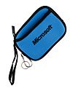
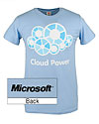
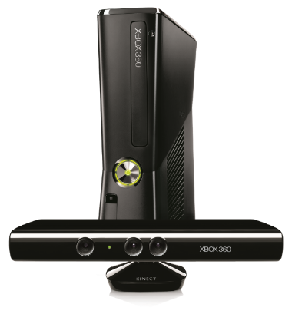
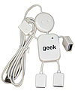
Complete an evaluation on CommNet and enter to win!

Slide 22
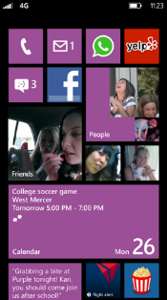
Evaluate this session
Required Slide
*delete this box when your slide is finalized
Your MS Tag will be inserted here during the final scrub.
Scan this QR code to evaluate this session and be automatically entered in a drawing to win a prize

Slide 23
© 2013 Microsoft Corporation. All rights reserved. Microsoft, Windows and other product names are or may be registered trademarks and/or trademarks in the U.S. and/or other countries.
The information herein is for informational purposes only and represents the current view of Microsoft Corporation as of the date of this presentation. Because Microsoft must respond to changing market conditions, it should not be interpreted to be a commitment on the part of Microsoft, and Microsoft cannot guarantee the accuracy of any information provided after the date of this presentation. MICROSOFT MAKES NO WARRANTIES, EXPRESS, IMPLIED OR STATUTORY, AS TO THE INFORMATION IN THIS PRESENTATION.

