Slide 1
Modern Application Lifecycle Management
FDN05
Brian Harry & Brian Keller

Slide 2
Visual Studio 2012 Wave
Frequent updates for on-premises/boxed products
Visual Studio 2012
Launch
Visual Studio 2012
Update 1
DevOps capabilities with
System Center 2012 SP1
Visual Studio 2012
Update 2
September 2012
October 2012
November 2012
December 2012
January 2013
March
2013
3-week service delivery sprints
Team Foundation Service
Free Plan

Slide 3
Application Lifecycle Trends
Multi Platform
Multi Device
Cloud Services
User-Centric
Social
Business Agility
Continuous Feedback
Continuous Quality
Continuous Delivery
Heterogeneous
development teams

Slide 4
Business Agility through Modern Lifecycle
BUILD | MEASURE | LEARN
BUILD | MEASURE | LEARN
Plan
Develop
Release
Operate

Slide 5
Business Agility through Modern Lifecycle
Build | Measure | Learn
Plan
Ideation
REQUIREMENTS
BUILD | MEASURE | LEARN
BACKLOG
Develop
Idea to working software
Release
Working software to production
Construct
Operate
Operate
BUILD | MEASURE | LEARN
Running software in production
RELEASE
WORKING SOFTWARE

Slide 6
Continuous Value
Challenges
Plan
Scaling agile
REQUIREMENTS
Allowing individual teams to be agile on their own terms
BACKLOG
Develop
Develop
Release
Release
Construct
Operate
Operate
Operate
RELEASE
WORKING SOFTWARE

Slide 7
Demo
Plan

Slide 8
Continuous Value
Solutions
Plan
Agile portfolio management
REQUIREMENTS
Kanban customization
BACKLOG
Work item tagging
Develop
Release
Construct
Operate
Operate
RELEASE
WORKING SOFTWARE

Slide 9
Continuous Value
Challenges
Plan
Agile portfolio management
REQUIREMENTS
Kanban customization
Develop
BACKLOG
Work item tagging
Managing distributed teams
Develop
Understanding complex code
Release
Scale testing often done too late
Construct
Operate
Operate
RELEASE
3
WORKING SOFTWARE

Slide 10
Demo
Develop

Slide 11
Continuous Value
Solutions
Plan
REQUIREMENTS
BACKLOG
Develop
Team Room
Flexible Source Control through Git and TFS
Load testing as a Service
Construct
Operate
Release
Operate
RELEASE
WORKING SOFTWARE

Slide 12
Continuous Value
Challenges
Plan
REQUIREMENTS
BACKLOG
Develop
Team Room
Flexible Source Control through Git and TFS
Load testing as a Service
Managing releases for continuous delivery
Construct
Operate
Release
Maintaining complex release workflows and environments
Operate
RELEASE
WORKING SOFTWARE

Slide 13
Demo
Release

Slide 14
Continuous Value
Solutions
Plan
REQUIREMENTS
BACKLOG
Develop
Release
Integrated Release Management
Construct
Operate
Configuration-based deployments
Operate
RELEASE
WORKING SOFTWARE

Slide 15
Continuous Value
Challenges
Plan
REQUIREMENTS
BACKLOG
Develop
Release
Integrated Release Management
Construct
Operate
Configuration-based deployments
Production incidents are difficult to troubleshoot
Operate
RELEASE
WORKING SOFTWARE

Slide 16
Demo
Operate

Slide 17
Continuous Value
Solutions
Plan
REQUIREMENTS
BACKLOG
Develop
Release
Construct
Operate
Operate
Team Foundation Server and System Center integration
RELEASE
IntelliTrace in production for actionable diagnostics
WORKING SOFTWARE

Slide 18
Continuous Value
Plan
Operate
REQUIREMENTS
Agile Portfolio Management
BACKLOG
Visual Studio and System Center integration
Kanban Customization
Work item tagging
Performance Events
Build | Measure | Learn
Collaborate
Construct
Operate
Develop
Release
Team Room
Integrated Release Management
Git
RELEASE
Code Information Indicators
Configuration-based deployments
.NET Memory Dump Analyzer
Load Testing as a Service
WORKING SOFTWARE

Slide 19
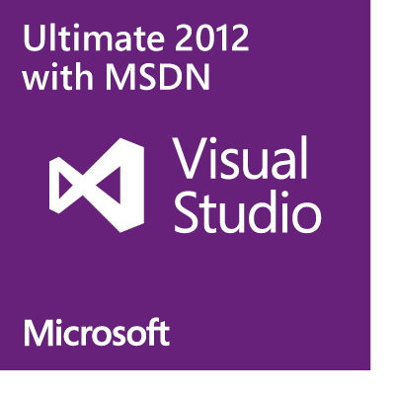
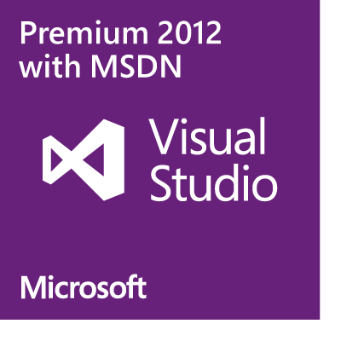
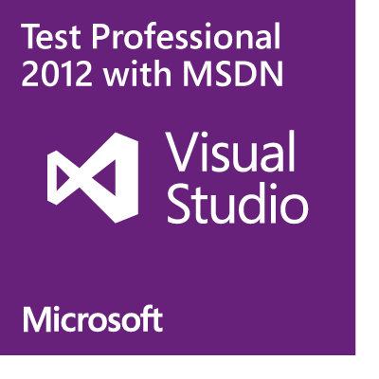
Team Foundation Service details
Free Plan for up to 5 users
Included for certain paid MSDN subscribers:
Version control (TFVC or Git)
Comment on changesets & commits
Work item tracking and tagging
Team rooms
Agile planning tools
Feedback Management
Agile Portfolio Management*
Build*
Web-based test case management*
Load testing*
New!
New!
New!
New!
Additional information at http://tfs.visualstudio.com
* Capability in preview – limits may apply. Authoring load tests requires Visual Studio Ultimate 2013 Preview.

Slide 20
ALM Sessions - Monday
WAD-B304: Cloud-powered Load Testing with Team Foundation Service Darshan Desai - 1:15 to 2:30 PM @ Room 298
DEV-B212: Agile Software Development with Microsoft Visual Studio ALM Aaron Bjork & Peter Provost - 1:15 to 2:30 PM @ Room 261
DEV-B330: Flexible Source Control with Team Foundation Service and Git Martin Woodward - 3:00 to 4:15 PM @ Room 295
DEV-B321: Improve Developer Productivity and Software Quality with Visual Studio Application Lifecycle Tools
Peter Provost - 4:45 to 6:00 PM @ Room La Nouvelle Ballroom C

Slide 21
ALM Sessions - Tuesday
DEV-B323: Deep Dive into the Team Foundation Server Agile Planning Tools
Aaron Bjork - 1:30 to 2:45 PM @ Room 353

Slide 22
ALM Sessions - Wednesday
DEV-B327: Software Testing with Microsoft Test Manager 2012 and Lab Management 2012
Brian Keller - 10:15 to 11:30 am @ Room 291

Slide 23
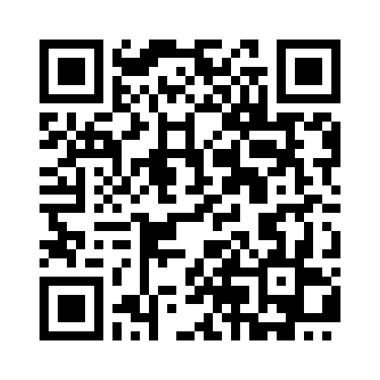
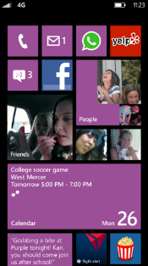
MS tag
Required Slide
*delete this box when your slide is finalized
Your MS Tag will be inserted here during the final scrub.
Scan the Tag to evaluate this session now on myTechEd Mobile

Slide 24
© 2013 Microsoft Corporation. All rights reserved. Microsoft, Windows and other product names are or may be registered trademarks and/or trademarks in the U.S. and/or other countries.
The information herein is for informational purposes only and represents the current view of Microsoft Corporation as of the date of this presentation. Because Microsoft must respond to changing market conditions, it should not be interpreted to be a commitment on the part of Microsoft, and Microsoft cannot guarantee the accuracy of any information provided after the date of this presentation. MICROSOFT MAKES NO WARRANTIES, EXPRESS, IMPLIED OR STATUTORY, AS TO THE INFORMATION IN THIS PRESENTATION.

