Slide 2
Deploying Applications in Microsoft System Center 2012 - Virtual Machine Manager Using Services
MDC-B203
John Messec
Program Manager
Microsoft

Slide 3
Session Objectives
Learn how and why to build services
Understand how to manage applications with multiple tiers
Be able to manage service lifecycle through Service updates

Slide 4
Agenda
Services
Why Services?
Building Blocks
Service Templates
Service Lifecycle

Slide 5
VM Templates
VM Template
Starting point for VMs
Specifies Hardware, Guest Profile, Disks
Specifies single machine
“Fire and Forget”
Service Template
Starting point for services
Defines multi-machine distributed application
Specifies multiple machines across multiple tiers
“Source of Truth”

Slide 6
Why Services and Service Templates?
Distributed Application Consisting of Multiple Tiers and Metadata
Lifecycle Management
Composability
Templatized Creation Reuse and Distribution
Manage Distributed Apps as a single Unit
Scale Management

Slide 7
Building Blocks The 10,000 foot view

Slide 8
Building Blocks
Hardware Profile
VM Template
Service Template
Service Tier
Guest OS Profile
Service Tier
Service Tier
Application Profile
SQL Server Profile

Slide 9
Demo High Level Building Blocks

Slide 10
Template Abstractions

Slide 11
Demo VM Template Design

Slide 12
Service Template
Service Template
Service Instance
Service Instance
Service Tier
Service Instance
Service Tier
Service Tier

Slide 13
Demo Service Template Design

Slide 14
Customize Deployment
Choose Host Group or Cloud deployment
Specify service settings
Run placement
Optionally force settings

Slide 15
Demo Service Deployment

Slide 16
Service Lifecycle

Slide 17
Service Lifecycle Management
Create Template
Customize Deployment
Deploy
Service Instance
Service Instance
Apply
Update Template

Slide 18
Deployment Process
Per Service
Per Host
Per Guest
Per Application
Select Tier Based on Deployment Order
Create New VM from Template
Power On and Wait for VM
Install VMM guest agent
Application Profile Level Pre-Install GCE
Application Pre-Install GCE
Install Application
Done
Add to Load Balancer
Application Profile Level Post-Install GCE
Application Post-Install GCE
Built-In Step
GCE Step

Slide 19
Custom Service Settings
%PropertyName%
Can be used as script parameters, profiles, etc
String or Run-As Account (RAA)
Predefined Settings
ServiceName, ServiceId, TierName, TierId, ComputerName, VMId, ServiceVMComputerNames

Slide 20
Demo Service Template Lifecycle Hooks

Slide 21
Service Instances
Services show VMs
Tiers can be scaled up and down
Actions can be performed on tiers, VMs, or service

Slide 22
Demo Deployed Services

Slide 23
Template Updates
Copy or change version first
Copy and Update option
Make changes

Slide 24
Update Types
In-Place Updates
Template changes applied without changing OS image
Image-Based Updates
OS Image Replaced
Applications reinstalled and state restored
GCE – Generic Command Execution
Server App-V
Stateless

Slide 25
Apply Updates
Associate new template with service
Apply update

Slide 26
In Place Update Process
Per Service
Per VM
Per Application
Select Tier Based on Deployment Order
Select VM Based On Upgrade Domain
Remove From Load Balancer
Application Profile Level Pre-Install GCE
Application Pre-UnInstall GCE
Application Pre-Install GCE
Uninstall Application
Install Application
Application Post-UnInstall GCE
Application Post-Install GCE
Done
Add to Load Balancer
Application Profile Level Post-Install GCE
Built-In Step
GCE Step

Slide 27
Image-Based Update Process
Per Service
Per VM
Per Application
Select Tier Based on Deployment Order
Remove From Load Balancer
Application Store State GCE
Application Pre-Install GCE
Add Data Disk
Server App-V Backup State
Select VM Based On Upgrade Domain
Install Application
Swap OS Disk
Application Post-Install GCE
Customize OS
Application Profile Level Pre-Install GCE
Server App-V Restore State
Done
Add to Load Balancer
Application Profile Level Post-Install GCE
Application Apply State GCE
Built-In Step
GCE Step

Slide 28
Demo Updating Services

Slide 29
© 2013 Microsoft Corporation. All rights reserved. Microsoft, Windows, Windows Vista and other product names are or may be registered trademarks and/or trademarks in the U.S. and/or other countries.
The information herein is for informational purposes only and represents the current view of Microsoft Corporation as of the date of this presentation. Because Microsoft must respond to changing market conditions, it should not be interpreted to be a commitment on the part of Microsoft, and Microsoft cannot guarantee the accuracy of any information provided after the date of this presentation. MICROSOFT MAKES NO WARRANTIES, EXPRESS, IMPLIED OR STATUTORY, AS TO THE INFORMATION IN THIS PRESENTATION.

Slide 30
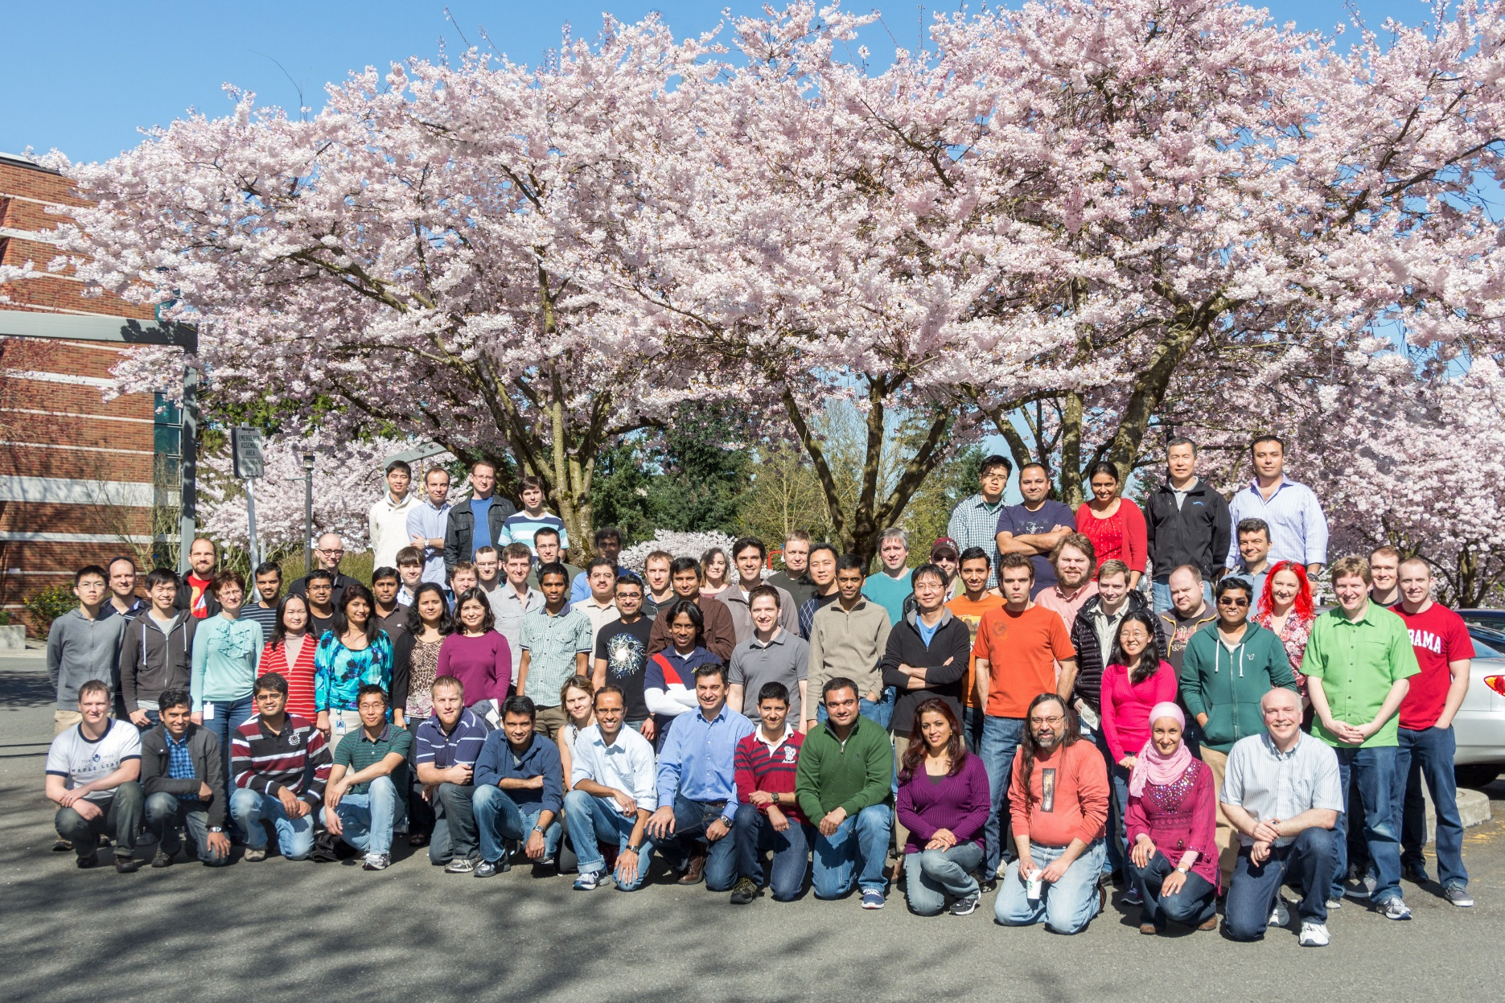
The Virtual Machine Manager Team

Slide 31
Related Sessions
MDC-B357 | What’s New in System Center 2012 R2 – Virtual Machine Manager
MDC-B202 | Running and Managing Linux and UNIX with Hyper-V and Microsoft System Center
MDC-B203 | Deploying Applications in Microsoft System Center 2012 – Virtual Machine Manager using Services
MDC-B318 | Enabling Multi-Tenant IaaS Clouds in Microsoft System Center and Windows Server
MDC-B344 | Storage Management: Spanning the Enterprise to Low Cost Scalable Solutions
MDC-B350 | How to Design and Configure Networking in Microsoft System Center - Virtual Machine Manager and HyperV (Part 1 of 2)
MDC-B351 | How to Design and Configure Networking in Microsoft System Center - Virtual Machine Manager and HyperV (Part 2 of 2)
MDC-B364 | Enabling on-premises IaaS solutions with “Windows Azure Services for Windows Server”

Slide 32
Resources
Learning
Sessions on Demand
Microsoft Certification & Training Resources
http://channel9.msdn.com/Events/TechEd
www.microsoft.com/learning
TechNet
msdn
Resources for IT Professionals
Resources for Developers
http://microsoft.com/technet
http://microsoft.com/msdn

Slide 33
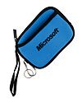
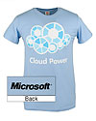
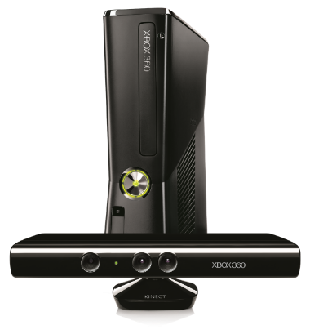
Complete an evaluation on CommNet and enter to win!

Slide 34
© 2013 Microsoft Corporation. All rights reserved. Microsoft, Windows and other product names are or may be registered trademarks and/or trademarks in the U.S. and/or other countries.
The information herein is for informational purposes only and represents the current view of Microsoft Corporation as of the date of this presentation. Because Microsoft must respond to changing market conditions, it should not be interpreted to be a commitment on the part of Microsoft, and Microsoft cannot guarantee the accuracy of any information provided after the date of this presentation. MICROSOFT MAKES NO WARRANTIES, EXPRESS, IMPLIED OR STATUTORY, AS TO THE INFORMATION IN THIS PRESENTATION.

