Slide 2
The Top Ten New Features You Really Care about in Windows Server 2012
MDC-B207
John Savill

Slide 3
The Cloud OS
CUSTOMER
1
CONSISTENT PLATFORM
WINDOWS AZURE
SERVICE PROVIDER

Slide 4
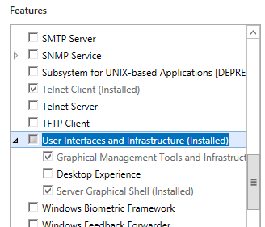
1. Server Core Usage
Server Core is the preferred and default installation option in Windows 2012
50% less patching historically than full install with less required reboots
The graphical shell and management tools are optional features which can be added and removed at any point in the servers lifecycle instead of being set at installation
Configure with the GUI then remove for a headless installation
Nearly all in-box roles supported
Future applications supported on Server Core making Server Core an application platform and not just an infrastructure platform

Slide 5
Reduced Footprint
All Roles and Features are copied to Windows Side by Side (Windows\winsxs) by default
Roles and Features can now be removed from disk reducing disk footprint
Added back using Features on Demand
Source can be
Windows Update
Mount the installation WIM or use WIM file directly
Another servers \Windows\winsxs folder
Set default location via registry or Group Policy

Slide 6
Key Windows 2012 Management Principle
“The Power of Many, the Simplicity of One”

Slide 7
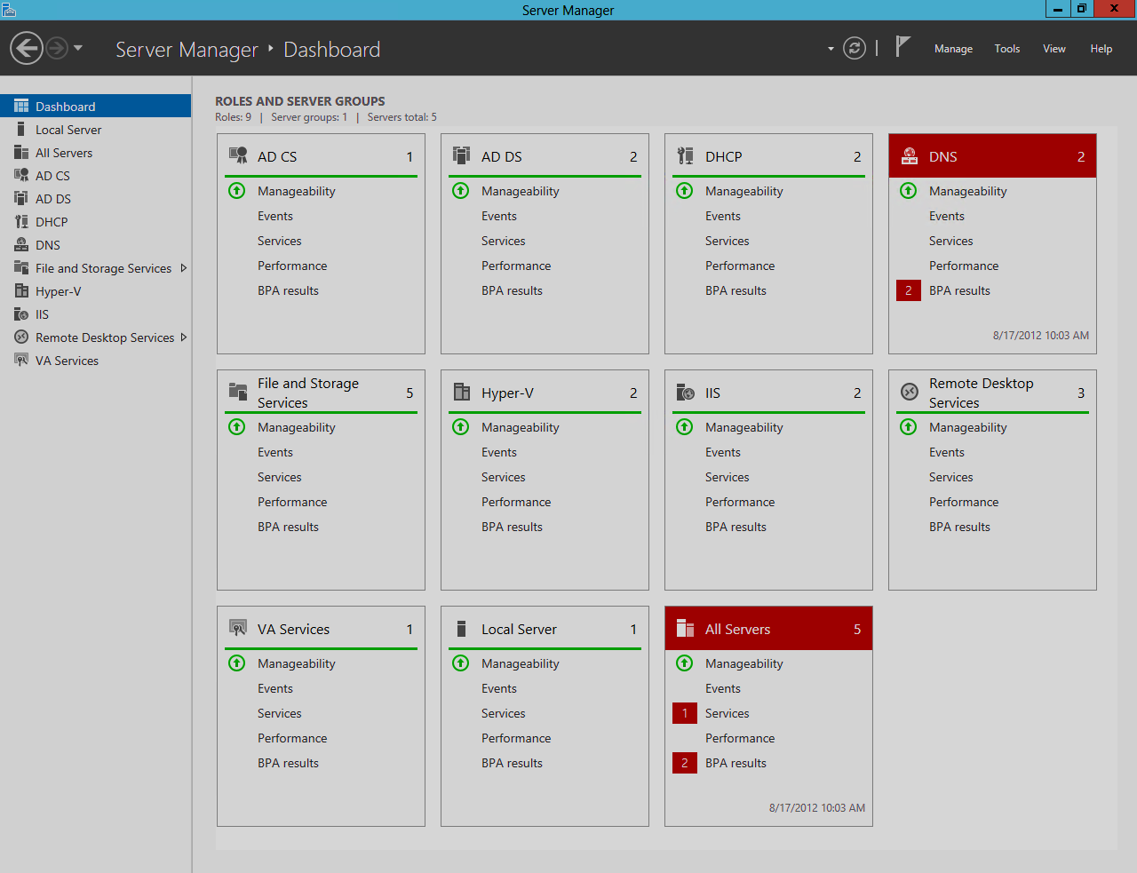
2. Shift in Management
Server Manager allows management of groups of machines
Dashboards and alerting
Remote add/remove of roles and features
Manage 2008 and 2008 R2 with Server 2012 Server Manager with WMF 3.0 installation
Remote Management enabled by default for Windows Server 2012

Slide 8
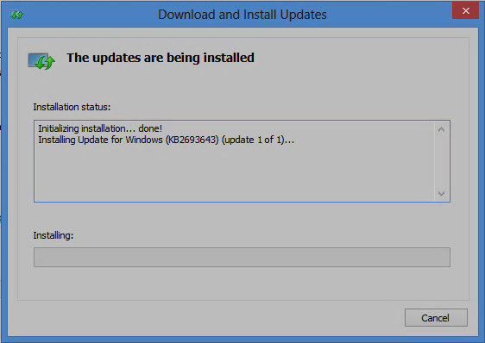
Remote Server Administration Tools
Available for Windows 8 only
Full management of servers from client
Preferred management approach
Think Server Core on the servers then remote management from Windows 8
http://www.microsoft.com/en-us/download/details.aspx?id=28972

Slide 9
3. PowerShell
PowerShell v3 introduces a huge number of new cmdlets
Consistent naming and usage to match natural language making usage intuitive
Full management of local and multiple remote machines
Powerful workflow and robust session capabilities
PowerShell Integrated Scripting Environment with IntelliSense
PowerShell is key to managing Windows Server 2012

Slide 10
4. Storage Innovation
SMB has undergone a huge change in Windows Server 2012 with new version 3.0
Required for Hyper-V and other applications like SQL Server that access their data over file shares
Active-Active configurations
Multichannel and RSS
Transparent Failover
SMB Direct (RDMA)
VSS Provider for Remote File Shares

Slide 11
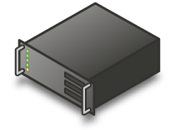
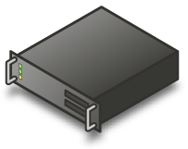
SMB Example
VHD
VHD
Windows Server 2012 SMB
File Share
Stand-alone
Host
Failover Cluster

Slide 12
Highly Available File Systems and new ways to interact
Storage Spaces
File system error checking and repair with only seconds of volume downtime
Data deduplication
iSCSI
NFS v4.1 server
File Classification
Dynamic Access Control based on domain-wide policies and file classifications

Slide 13
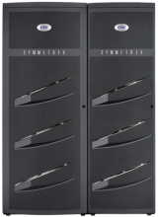
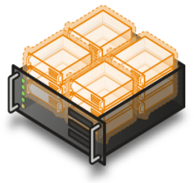
Think Windows 2012 as a storage platform
SAN
CSV
CSV Volume on a LUN containing VMs
Fibre Channel HBA
File Servers in Scale-out cluster
SMB 3.0 Share pointing to the CSV
SMB Access to share
100’s of servers

Slide 14
5. Remote Desktop Services
Simplicity
All management using Server Manager and PowerShell
Scenario deployment option which performs all configuration on multiple servers (preferred approach)
Session and VDI Improvements
VM Templates for VDI
Software rasterizer
User Disk for personalization within a pool (VDI or Session)
Fairshare of CPU, Disk and Network for sessions
Easy setup of RemoteApp and Desktop via email auto-discovery

Slide 15
RemoteFX Everywhere
Ubiquitous RemoteFX
WAN with UDP and TCP support
RemoteFX Network Auto Detect
Adaptive graphics with progressive rendering
Software rasterizer or GPU
Multitouch
USB Redirection for Session Host
New Metro Style Remote Desktop App
DirectX11 (CPU must be SLAT)

Slide 16
6. Active Directory and Group Policy
Ease of implementation and management
Virtualization-safe Domain Controllers
Clonable Domain Controllers
Active Directory Based Activation
With Windows 2012 Domain Controller
Dynamic Access Control
Group Managed Service Accounts

Slide 17
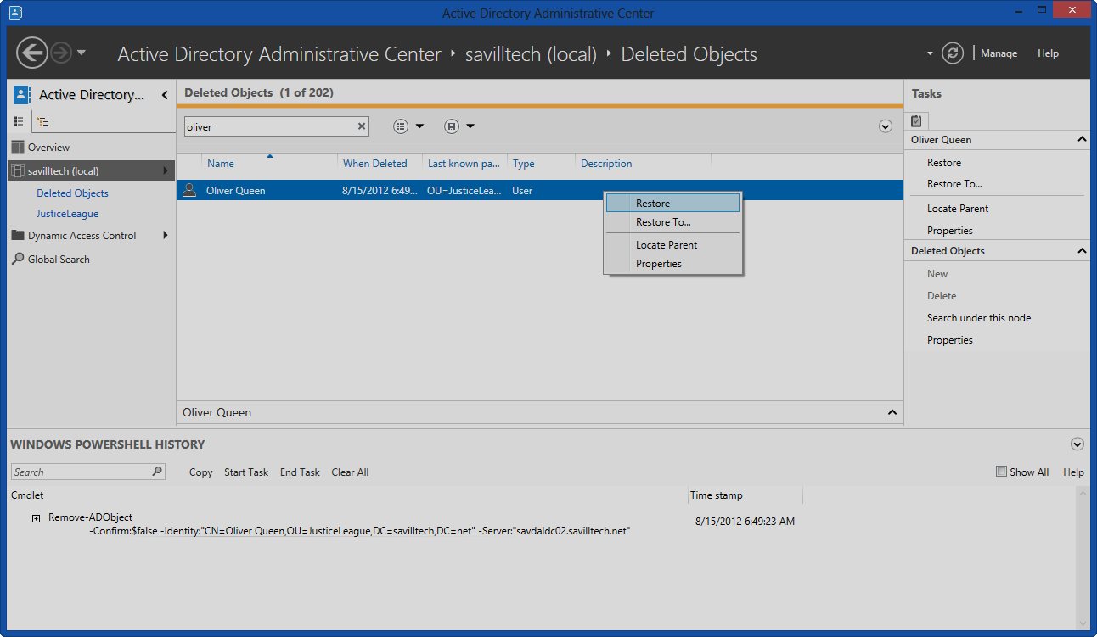
Active Directory Administrative Center
Can be used for most AD GUI actions
Can be used on pre Windows Server 2012 domains and domain controllers
Windows PowerShell History Viewer
Graphical Recycle Bin
Fine Grained Password Policy Management

Slide 18
Group Policy
Many additional settings for Windows 8, IE10 and above and packaged app rules in AppLocker
Focus on making management, reporting and troubleshooting easier
Reduction in number of tools
Remotable GPUpdate at OU level through GUI
More granular with invoke-gpupdate PowerShell cmdlet
Health of Group Policy checking through GPMC

Slide 19
7. Better with Windows 8
Two key technologies have undergone great improvements in Windows Server 2012 when used with Windows 8
BranchCache features simplified deployment without office specific GPOs and automated client configuration
DirectAccess has simplified deployment absorbing much of the UAG DirectAccess functionality. Addition geographically distributed DirectAccess deployment support.

Slide 20
8. Application and Web Services
Applications can be built once and run both on-premise and in the cloud using common tools, workflows and standards
Improved IIS features including centralized SSL certificate management

Slide 21
9. Failover Clustering
Clustering builds on the huge changes in Windows Server 2008 that really simplified the creation and management of clusters
One click patching of entire clusters with no service interruption
Virtual Machine priority
Health Monitoring
Enhanced placement logic

Slide 22
10. Hyper-V
Windows Server 2008 R2 SP1 delivers a great hypervisor
Windows Server 2012 offers a best of breed virtualization platform
Unmatched VM scalability – 64vCPU, 1TB RAM, 64TB VHDX per VM with
64 Hyper-V hosts in a cluster
Virtual Fibre Channel, SR-IOV and full NUMA support
Network Virtualization and native NIC teaming
SMB support and Live Storage Migration

Slide 23
Shared-nothing Live Migration
Migration of a virtual machine from one host to another with no shared infrastructure
Does not have to be in a cluster
Direct attached storage to direct attached or any storage combination
Just needs a single 1Gb connection
Combination of Live Storage Move and Live Migration

Slide 24
Hyper-V Replica
In-box replication of VM without needing shared infrastructure
Performs initial replica of VM over network, media or file share
Delta sync’d every 5 minutes
Application consistent snapshot with VSS performed once an hour
Manual activation or scripted
Alternate IP configuration for usage on replica side

Slide 25
10.1 System Center 2012 SP1
Data Protection & Recovery
Design, Configure & Deploy
IT Service Management
Monitor & Manage Service End to End
Virtualize, Deploy & Manage
IT Process Automation
App Controller
Orchestrator

Slide 26
Track resources
Learn more about Windows Server 2012 R2 Preview, download the datasheet and evaluation bits on http://aka.ms/WS2012R2
Learn more about System Center 2012 R2 Preview, download the datasheet and evaluation bits on http://aka.ms/SC2012R2

Slide 27
Resources
Learning
Sessions on Demand
Microsoft Certification & Training Resources
http://channel9.msdn.com/Events/TechEd
www.microsoft.com/learning
TechNet
msdn
Resources for IT Professionals
Resources for Developers
http://microsoft.com/technet
http://microsoft.com/msdn

Slide 28
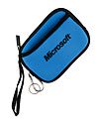
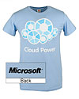
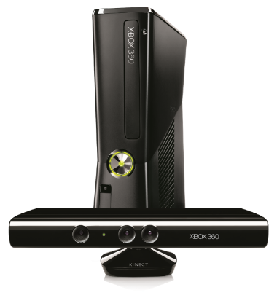
Complete an evaluation on CommNet and enter to win!

Slide 29
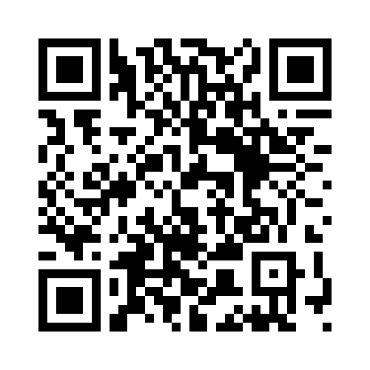
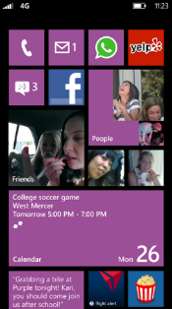
Evaluate this session
Required Slide
*delete this box when your slide is finalized
Your MS Tag will be inserted here during the final scrub.
Scan this QR code to evaluate this session and be automatically entered in a drawing to win a prize

Slide 30
© 2013 Microsoft Corporation. All rights reserved. Microsoft, Windows and other product names are or may be registered trademarks and/or trademarks in the U.S. and/or other countries.
The information herein is for informational purposes only and represents the current view of Microsoft Corporation as of the date of this presentation. Because Microsoft must respond to changing market conditions, it should not be interpreted to be a commitment on the part of Microsoft, and Microsoft cannot guarantee the accuracy of any information provided after the date of this presentation. MICROSOFT MAKES NO WARRANTIES, EXPRESS, IMPLIED OR STATUTORY, AS TO THE INFORMATION IN THIS PRESENTATION.

