Slide 2
What is Storage Spaces?
(and what’s new in R2?)
MDC-B218
Bryan Matthew
Program Manager

Slide 3
Agenda
Understanding the “what”, “why”, and “how” of a Storage Spaces platform
Presenting the solutions that are available and certified today
How customers today are using those solutions to solve real world problems and achieve:
  2x Increased throughput
  3x Reduced cost
  5x Increased capacity
  6x Reduction in servers

Slide 4


Storage platform design challenges
Design of large service platforms, such as Azure & Bing, share similar design goals
Need cost-effective hardware to meet budget requirements
New
apps/services
Device proliferation
Data explosion
Cloud computing
Minimize operational expenditure where possible, as inefficiencies can reduce scale
Need to build-in handling of resiliency, must reduce/eliminate individual points of failure

Slide 5
Infrastructure-as-a-Service Storage Vision
Dramatically lowering the costs and effort of delivering IaaS storage services
Disaggregated compute and storage
  Independent manage and scale at each layer
Industry standard servers,
networking and storage
  Inexpensive networks
  Inexpensive shared JBOD storage
Hyper-V Clusters
SMB
Scale-Out File Server Clusters
Storage Spaces Virtualization and Resiliency
PowerShell & SCVMM 2012 R2 Management
Shared JBOD
Storage

Slide 6
Familiar Deployment Model
Traditional Storage
with FC/iSCSI Storage Array
Windows File Server Cluster
with Storage Spaces
Hyper-V Compute Nodes
Hyper-V Compute Nodes
FC/iSCSI
(Block)
SMB
(File)
Embedded CPUs and Controllers
(proprietary hardware)
Windows File Server Cluster
(commodity hardware)
Storage Compute
Storage Compute
FC/SAS Disk Shelf
Shared SAS JBOD
FC/SAS Disk Shelf
Shared SAS JBOD
FC/SAS Disk Shelf
Shared SAS JBOD

Slide 7
Familiar Enterprise-Grade Capabilities
Traditional Storage
with FC/iSCSI Storage Array
Windows File Server Cluster
with Storage Spaces
Storage Tiering
Data deduplication
RAID resiliency groups
Pooling of disks
High availability
Persistent write-back cache
Copy offload
Snapshots
Storage Tiering (new with R2)
Data deduplication (enhanced with R2)
Flexible resiliency options (enhanced with R2)
Pooling of disks
Continuous availability
Persistent write-back cache (new with R2)
SMB copy offload
Snapshots

Slide 8
Case Study:
Windows Release Team

Slide 9
Case Study: Windows Release Team
Problems:
  Capacity
  Cost
  Resiliency
Needs:
  Capacity for a month of data
  Dramatically lower $/TB
  Scalable platform for future expansion

Slide 10
Case Study: Windows Release Team
2x increase…
3x increase…
5x increase…
6x reduction…
in total storage throughput
in raw capacity with same budget
Traditional Storage
$1,350/TB
Storage Spaces
$450/TB
in effective capacity with dedupe
in number of servers

Slide 11
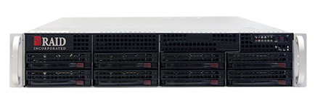
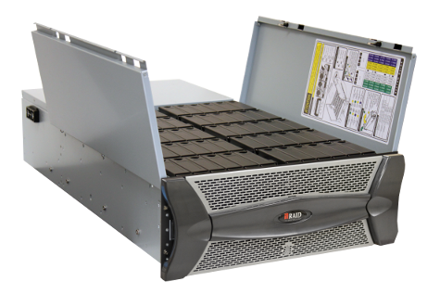



Case Study: Windows Release Team
720PB Weekly Data Volume
60-bay
SAS Array
60-bay
SAS Array
60-bay
SAS Array
60-bay
SAS Array
Windows Build Servers
20x File Servers
with 10GbE Links
20x 60-Bay JBODs
with 3TB 7200RPM HDDs
60-bay
SAS Array
60-bay
SAS Array
60-bay
SAS Array
60-bay
SAS Array
Aggregate 80Gbps Network
60-bay
SAS Array
60-bay
SAS Array
60-bay
SAS Array
60-bay
SAS Array
Dev
Test Dev
Partners
60-bay
SAS Array
60-bay
SAS Array
60-bay
SAS Array
60-bay
SAS Array
Hundreds of build servers generating data
Thousands of developers and test developers
Thousands of internal and external partners
60-bay
SAS Array
60-bay
SAS Array
60-bay
SAS Array
60-bay
SAS Array
Planning to double the deployment over the next year
…
60-bay
SAS Array
60-bay
SAS Array
60-bay
SAS Array
60-bay
SAS Array
60-bay
SAS Array
60-bay
SAS Array
60-bay
SAS Array
60-bay
SAS Array
60-bay
SAS Array
60-bay
SAS Array
60-bay
SAS Array
60-bay
SAS Array
60-bay
SAS Array
60-bay
SAS Array
60-bay
SAS Array
60-bay
SAS Array
60-bay
SAS Array
60-bay
SAS Array
60-bay
SAS Array
60-bay
SAS Array

Slide 12
Storage Spaces
Cost-Efficient Business Critical Storage

Slide 13
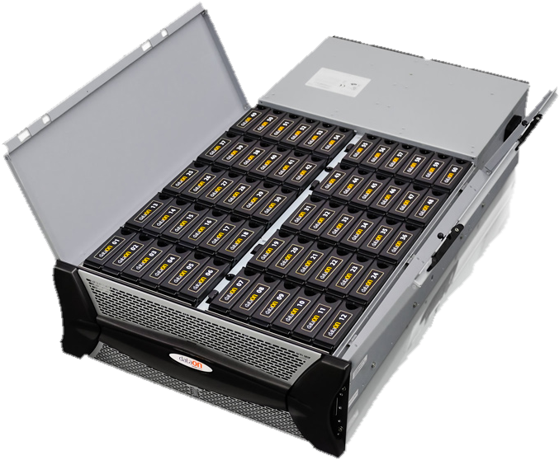
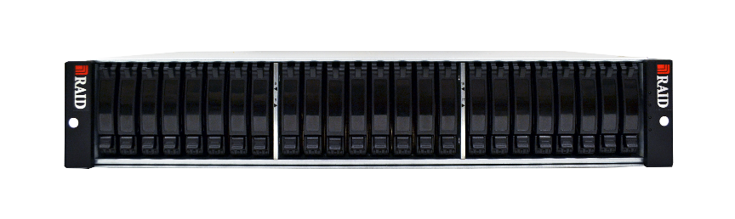
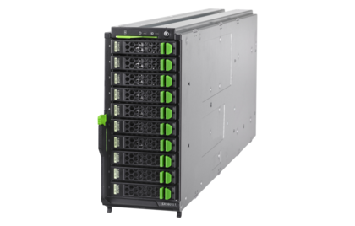
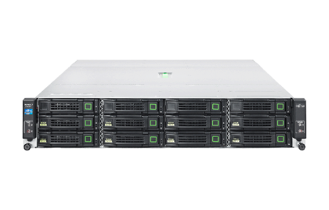
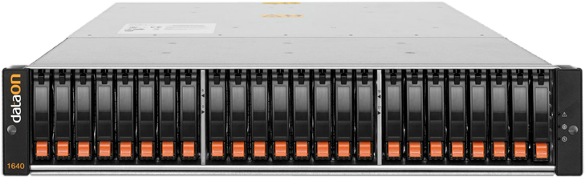
Component Overview
Industry standard commodity storage hardware
  Shared SAS JBOD arrays with enterprise-grade redundancy
  Dual-Port SAS drives
Sampling of available Spaces Certified Hardware

Slide 14

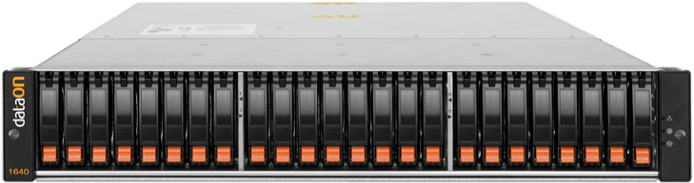
Capabilities Overview (1)
Pooling of disks
Flexible resilient storage spaces
Native data striping
Enclosure awareness with certified hardware
Parallelized rebuild utilizes spare pool capacity
Storage Spaces
Mirror Space
Mirror Space
Mirror Space
Parity Space
Data Copy 1
Data Copy 2
Physical Disks from Shared SAS JBODs
Storage Pool

Slide 15
Capabilities Overview (2)
Data Integrity Scanner
  Periodic background scan detects latent corruptions, auto-corrects where possible
  Integration with both NTFS and ReFS
Operational Simplicity
  PowerShell, Server Manager, and SCVMM 2012 R2
Continuous Availability with Windows File Server Cluster

Slide 16
Deployment Recommendations
Resiliency Name | Number of Data Copies Maintained | Deployment Recommendations
Mirror | 2 (two-way mirror) 3 (three-way mirror) | All Workloads
Parity | 2 (single parity) 3 (dual parity) | Sequential workloads with large units of read/write, such as Archival
Simple | 1 | Workloads which do not need resiliency, or provide alternate resiliency mechanism

Slide 17
Spaces & Windows File Server Cluster
Hyper-V Compute Nodes
SMB
Compute
Storage
CSV aggregates namespace for data access across volumes
Architecturally similar to traditional storage deployment
Unified Cluster Shared Volume Namespace
\\SRV\VDI
\\SRV\CRM
\\SRV\DB
Clustered Storage Pool & Storage Spaces
Mirror Space
Mirror Space
Mirror Space
Clustered File Servers
96Gbps Shared SAS Links
Shared SAS
JBOD Arrays
60-bay
SAS Array
60-bay
SAS Array

Slide 18
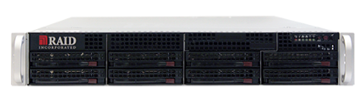
Scaling the Windows File Server Cluster
Hyper-V Compute Nodes
Physical or Virtualized Workloads
SMB
SMB
High Speed Network
(10GbE/InfiniBand)
Unified Cluster Shared Volume Namespace
\\SRV\VDI_Mrktg
\\SRV\VDI_Dev
\\SRV\Folders
\\SRV\DB
Clustered Storage Pool & Storage Spaces
Mirror Space
Mirror Space
Mirror Space
Mirror Space
Clustered File Servers with 10GbE/InfiniBand
786Gbps Shared SAS Links
60-bay Shared SAS JBOD Arrays
60-bay
SAS Array
60-bay
SAS Array
60-bay
SAS Array
60-bay
SAS Array

Slide 19
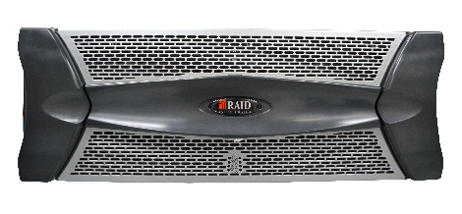
Further Scaling the Cluster
Hyper-V Compute Nodes
Physical or Virtualized Workloads
SMB
SMB
SMB
High Speed Network
(10GbE/InfiniBand)
Unified Namespace (CSV)
…
\\SRV\DB
\\SRV\VDI_Mktg
\\SRV\Ops
…
Clustered Storage Spaces
…
…
…
…
Mirror
Mirror
Mirror
Mirror
Mirror
Mirror
Mirror
Mirror
Clustered File Servers with 10GbE/InfiniBand
768Gbps Shared SAS Links
768Gbps Shared SAS Links
768Gbps Shared SAS Links
768Gbps Shared SAS Links
60-bay Shared SAS JBOD Arrays
0.96PB
0.96PB
0.96PB
0.96PB

Slide 20


“We’re able to use commodity hardware to achieve the same functionality [of traditional storage] at a far lower cost.”
“By using Storage Spaces, Hyper-V over SMB, and other new features, I eliminate big, lumpy capital expenditures… I can buy inexpensive storage, buy only what I need, and scale in a completely linear manner.”
Philip Moss
Chief Technology Officer
Jeremy Russell
Senior Development Lead

Slide 21
Storage Spaces
Window Server 2012 R2 Capabilities

Slide 22
Storage Spaces R2 Objectives
Building upon the foundation in
Windows Server 2012 to further deliver:
Minimize $/TB & Capex
Maximize IOPS/$
Continuous Availability
Minimized Opex

Slide 23
Dual Parity: Minimizing $/TB
Provides resiliency to two disk failures for archival workloads, while minimizing space utilization for resiliency
Efficient rebuild times
Supported with Windows Clustering
Integrated Journaling for power fault resiliency

Slide 24
Match workload characteristics to drives
Common Workload Characteristics
  Large data set, and majority of data is cold
  Minority of data is in active use, and is hot
    The hot data is the “working set”
  Working set changes over time
Common Drive Characteristics
  Hard Disk Drives, 7200RPM
    Capacity Optimized ( $/TB)
  Solid State Drives
    Performance Optimized ( IOPS/$)
Data Set
Current Working Set

Slide 25
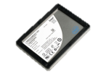
Tiered Storage: Maximizing IOPS/$
Hyper-V Compute Nodes
Utilize best characteristics of SSDs and HDDs in single storage space
Provides balance between capacity & performance
Admins can assign files to specific storage tiers
Reads/Writes Accumulates Data Activity
Storage Space
SSD Tier
400GB EMLC SAS SSD
Hot Data
Cold Data
HDD Tier
4TB 7200RPM SAS HDD

Slide 26
Write-Back Cache: Maximizing IOPS/$
Hyper-V Compute Nodes
Absorbs short-term spikes in random write activity
Seamless integration and familiar management
Complements Tiered Storage
Reads/Writes Accumulates Data Activity
Seamless Integration
Storage Space
SSD Tier & WBC
400GB EMLC SAS SSD
Hot Data
Cold Data
HDD Tier
4TB 7200RPM SAS HDD

Slide 27
Write-Back Cache &
Tiered Storage Demo

Slide 28
Windows Server 2012 File Server Cluster
Hyper-V Compute Nodes
Physical or Virtualized Workloads
SMB
SMB
High Speed Network
(10GbE/InfiniBand)
Unified Cluster Shared Volume Namespace
\\SRV\VDI_Mrktg
\\SRV\DB
\\SRV\Folders
\\SRV\Archive
Clustered Storage Pool & Storage Spaces
Mirror Space
Mirror Space
Mirror Space
Mirror Space
Clustered File Servers with 10GbE/InfiniBand
786Gbps Shared SAS Links
60-bay Shared SAS JBOD Arrays
60-bay
SAS Array
60-bay
SAS Array
60-bay
SAS Array
60-bay
SAS Array

Slide 29
Windows Server 2012 R2 File Server Cluster
Hyper-V Compute Nodes
Physical or Virtualized Workloads
SMB
SMB
High Speed Network
(10GbE/InfiniBand)
Unified Cluster Shared Volume Namespace
\\SRV\VDI_Mrktg
\\SRV\DB
\\SRV\Folders
\\SRV\Archive
Clustered Storage Pool & Storage Spaces
Tiered Mirror Space
Tiered Mirror Space
Tiered Mirror Space
Dual Parity Space
Clustered File Servers with 10GbE/InfiniBand
786Gbps Shared SAS Links
60-bay Shared SAS JBOD Arrays
with SSDs and HDDs
60-bay
SAS Array
60-bay
SAS Array
60-bay
SAS Array
60-bay
SAS Array

Slide 30
Windows File Server Cluster Configurations
Capacity Optimized
High Capacity
Balanced
Tiered Storage
Performance Optimized
Extreme Performance
Cost-Efficient
High Performance SSDs
High Capacity HDDs
Greatest throughput, highest IOPS
Best $/TB
Best IOPS/$

Slide 31
Windows File Server Cluster Configurations
Capacity Optimized
High Capacity
Balanced
Tiered Storage
Performance Optimized
Extreme Performance
Cost-Efficient
High Performance SSDs
High Capacity HDDs
Greatest throughput, highest IOPS
Best $/TB
Best IOPS/$

Slide 32
Windows File Server Cluster Configurations
Capacity Optimized
High Capacity
Balanced
Tiered Storage
Performance Optimized
Extreme Performance
Cost-Efficient
High Capacity HDDs
Greatest throughput, highest IOPS
Best $/TB
Best IOPS/$
High Performance SSDs

Slide 33



Windows File Server Cluster Solution Partners
Certified Storage Spaces Hardware
High-Performance Servers and Storage
http://www.raidinc.com/
http://www.fujitsu.com/fts/
http://www.dataonstorage.com/

Slide 34
Takeaways
Windows Server 2012 R2 is a key component in your public or private cloud deployment:
  Cost-Efficiency, Maximized IOPS/$
  Scale & Capacity, Minimized $/TB
  Continuous Availability, Windows File Server Cluster
You have seen customers who achieved:
  2x Increased throughput
  3x Reduced capital expenditure
  5x Increased capacity
  6x Reduction in servers to manage

Slide 35

Related content
Breakout Sessions
  MDC-B337, June 4 8:30-9:45AM: Failover Cluster Networking Essentials
  WCA-B314, June 4 5:00-6:15PM: Designing a Virtual Desktop Infrastructure Architecture for Scale & Performance
  ATC-B212, June 4 3:15-4:30PM: The Cloud Service Provider Architecture
  ATC-B203, June 5 8:30-9:45AM: Architecting a Cloud Infrastructure: A Practical Design ScenarioMDC-B311, June 5 5:00-6:15PM: Application Availability Strategies for the Private Cloud
  MDC-B342, June 5 3:15-4:30PM: Reduce Storage Costs with Data Deduplication
  MDC-B333, June 6 8:30-9:45AM: Storage and Availability Improvements in Windows Server 2012 R2
Find Me Later At... The Storage Booth

Slide 36

Resources
Learning
  Sessions on Demand
  Microsoft Certification & Training Resources
http://channel9.msdn.com/Events/TechEd
www.microsoft.com/learning
TechNet
msdn
  Resources for IT Professionals
  Resources for Developers
http://microsoft.com/technet
http://microsoft.com/msdn

Slide 37







Complete an evaluation on CommNet and enter to win!

Slide 38

© 2013 Microsoft Corporation. All rights reserved. Microsoft, Windows and other product names are or may be registered trademarks and/or trademarks in the U.S. and/or other countries.
The information herein is for informational purposes only and represents the current view of Microsoft Corporation as of the date of this presentation. Because Microsoft must respond to changing market conditions, it should not be interpreted to be a commitment on the part of Microsoft, and Microsoft cannot guarantee the accuracy of any information provided after the date of this presentation. MICROSOFT MAKES NO WARRANTIES, EXPRESS, IMPLIED OR STATUTORY, AS TO THE INFORMATION IN THIS PRESENTATION.

