Slide 2
IIS: new scalability & manageability features
MDC-B303
Erez Benari and Ahmed ElSayed

Slide 3
About the speakers
Erez Benari
Program Manager
Internet Information Server (IIS)
With Microsoft since 2000
Previously with Forefront (UAG and TMG)

Slide 4
About the speakers
Ahmed ElSayed
Software Development Engineer in Test
Internet Information Server (IIS)
Working on IIS since 2011

Slide 5
Microsoft Web Platform
Web Sites for Windows Server
Windows Azure Web Sites
Hosted and Private Cloud
Public Cloud
IIS
Web Server

Slide 6
What’s new?
Version 8.5
New features
Scalability
Manageability

Slide 7
New features in brief
Dynamic Site Activation
Idle Worker Process Page-out
Logging Enhancements
ETW logging

Slide 8
Dynamic Site Activation
The scenario:
Large number of sites

Slide 9
Dynamic Site Activation
The challenges:
Dealing with a large configuration
Improving run-time efficiency

Slide 10
Design (Classic)
WAS
WP
1
WP
2
WP
3
User
Mode
WP
Kernel
Mode
HTTP.SYS
Queue for: HTTP://CONTOSO1.COM:80
Queue for: HTTP://CONTOSO2.COM:80
Queue for: HTTP://CONTOSO3.COM:80
Queue for: HTTP://CONTOSO[n].COM:80

Slide 11
Design (Classic)
WAS
WP
1
WP
2
WP
3
User
Mode
WP
Kernel
Mode
HTTP.SYS
Queue for: HTTP://CONTOSO1.COM:80
Queue for: HTTP://CONTOSO2.COM:80
HTTP://CONTOSO3.COM:80
10.0.0.1
Queue for: HTTP://CONTOSO3.COM:80
Client
Queue for: HTTP://CONTOSO[n].COM:80

Slide 12
Design (Dynamic)
WAS
WP
1
WP
2
WP
3
User
Mode
WP
Kernel
Mode
HTTP.SYS
Queue for: *:80

Slide 13
Design (Dynamic)
WAS
WP
1
WP
2
WP
3
User
Mode
WP
Kernel
Mode
HTTP.SYS
Queue for: HTTP://CONTOSO3.COM:80
10.0.0.1
HTTP://CONTOSO3.COM:80
10.0.0.1
Queue for: *:80
Client

Slide 14
Dynamic Site Activation
What does it look like?

Slide 15
Demo
Dynamic Site Activation

Slide 16
Idle Worker Process Page-out
The scenario:
Improving site density

Slide 17
Testing Setup
The Internet
A Cluster
Load Balancer
IIS1
IIS2
IIS3
IIS4
NAS
Other Clusters
Other Clusters

Slide 18
Configuration
4,000 Sites with popular web applications
Runtime:
500 sites running
2 sites starting up
2 sites shutting down
NAS load from 7 machines total

Slide 19
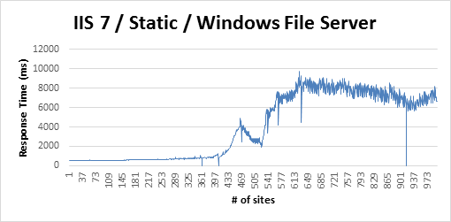
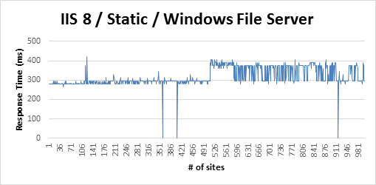
Graph 1

Slide 20
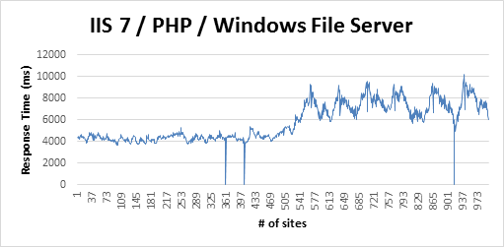
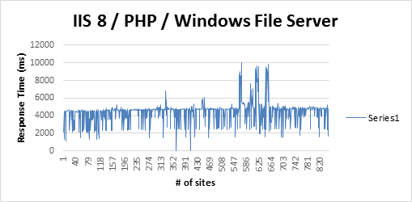
Graph 2

Slide 21
Idle Worker Process Page-out
The challenge:
Optimizing memory usage

Slide 22
Idle Worker Process Page-out
The solution:
Page-out WP, instead of terminating it

Slide 23
Idle Worker Process Page-out
What does it look like?

Slide 24
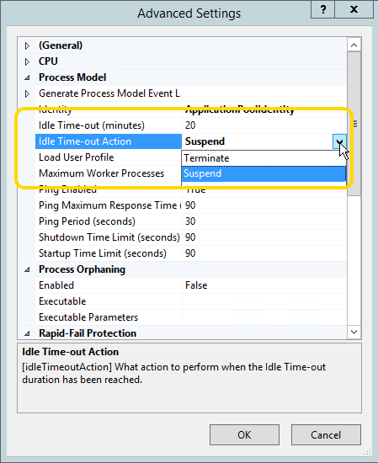

Slide 25
Demo
Idle Worker Process Page-out

Slide 26
Logging enhancements
The scenarios:
Debugging, troubleshooting, tracking

Slide 27
Logging enhancements
The challenge:
Data that isn’t logged can be hard to collect

Slide 28
Logging enhancements
The solution:
Define extra fields to log

Slide 29
Design (Classic)
User Mode
W3WP
Log files
2
3
Kernel Mode
Client
HTTP.SYS
1
5
4

Slide 30
Design (enhanced)
User Mode
W3WP
LOGSVC
(new)
Log files
8
10
9
2
3
7
6
Kernel Mode
Client
HTTP.SYS
ETW
(new)
1
5
4

Slide 31
Logging enhancements
What does it look like?

Slide 32
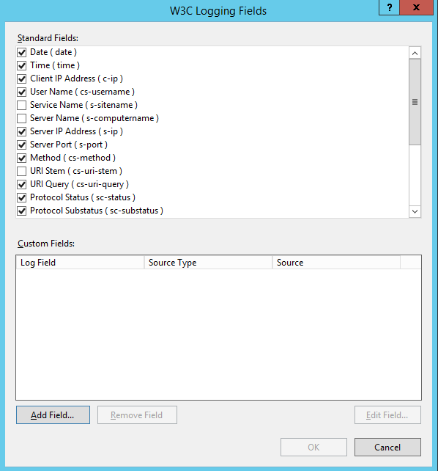
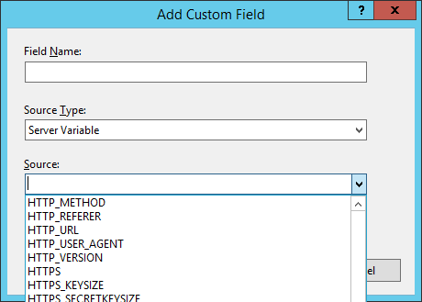
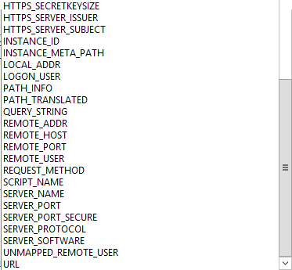

Slide 33
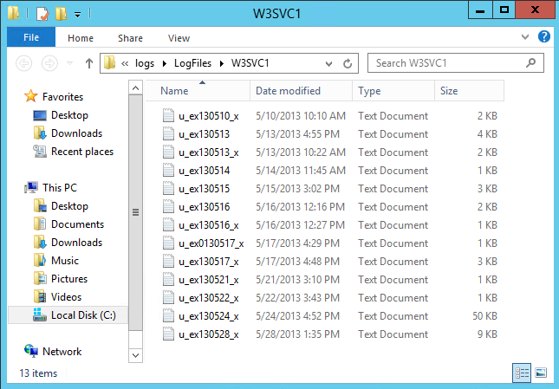

Slide 34
Demo
Logging enhancements

Slide 35
ETW events
The scenario:
Real time logging and custom handling

Slide 36
ETW events
The challenge:
Difficult to parse and analyze data in real time

Slide 37
ETW events
The solution:
Logging to ETW (Event Tracing for Windows)

Slide 38
Design (reminder!)
User Mode
W3WP
LOGSVC
(new)
Log files
8
10
9
2
3
7
6
Kernel Mode
Client
HTTP.SYS
ETW
(new)
1
5
4

Slide 39
ETW events
What does it look like?

Slide 40
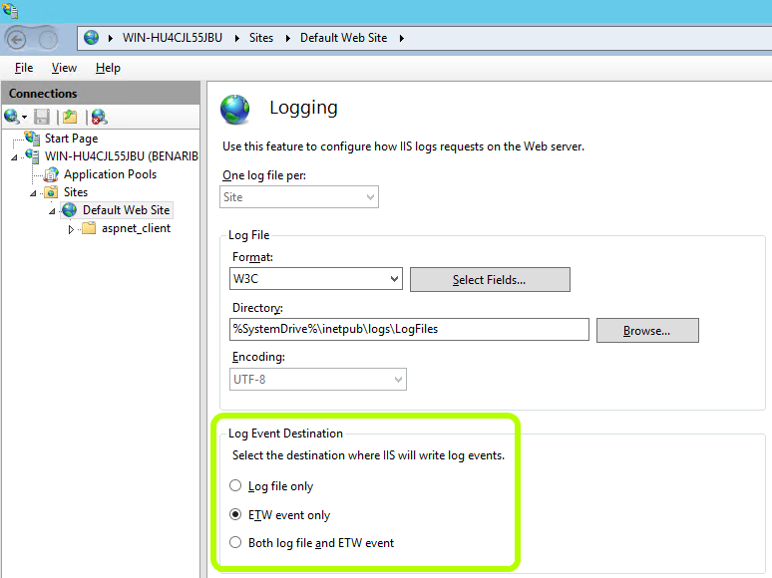

Slide 41
Demo
ETW events

Slide 42
Summary
Dynamic Site Activation
Idle Worker Process Page-out
Scalability!

Slide 43
Summary
Logging Enhancements
ETW logging
Manageability!

Slide 44
Related sessions
Session ID | Topic | Presenter | Date / Time / Location
MDC-B214 | Web Sites for Windows Server | Ryan Jones | 5 June 2013, 10:15am-11:30am in Rm. 391
WAD-B329 | Windows Azure Web Sites: An Architecture and Technical Deep Dive | Calvin Keaton | 6 June 2013, 8:30 am – 9:45 am in Rm. 298

Slide 45
Related sessions (TechEd Europe)
Session ID | Topic | Presenter | Date / Time / Location
MDC-B303 | Internet Information Services: What’s New in Window Server 2012 R2 | Wade Hilmo | 26 June 2013, 8:30 am - 9:45 am, Hall 7-3 (521)
WAD-B329 | Windows Azure Web Sites: An Architecture and Technical Deep Dive | Harsh Mittal Praveen T | 27 June 2013, 5:00 pm – 6:15 pm, N105
MDC-B214 | Web Sites for Windows Server | Ryan Jones | 28 June 2013, 10:15 am - 11:30 am in Hall 7-4 (521)

Slide 46
Related content
Erez’s blog:
http://blogs.technet.com/b/erezs_iis_blog/
WFetch
http://technet.microsoft.com/en-us/library/cc778443(v=ws.10).aspx
Windows Performance Analyzer:
http://msdn.microsoft.com/en-us/performance/cc752957.aspx
Message Analyzer:
http://blogs.technet.com/MessageAnalyzer

Slide 47
Track resources
Learn more about Windows Server 2012 R2 Preview, download the datasheet and evaluation bits on http://aka.ms/WS2012R2
Learn more about System Center 2012 R2 Preview, download the datasheet and evaluation bits on http://aka.ms/SC2012R2

Slide 48
Resources
Learning
Sessions on Demand
Microsoft Certification & Training Resources
http://channel9.msdn.com/Events/TechEd
www.microsoft.com/learning
TechNet
msdn
Resources for IT Professionals
Resources for Developers
http://microsoft.com/technet
http://microsoft.com/msdn

Slide 49
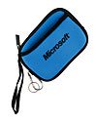
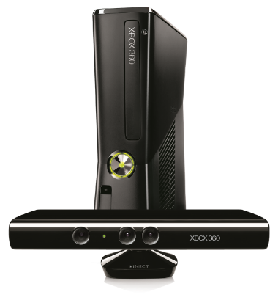
Complete an evaluation on CommNet and enter to win!

Slide 50
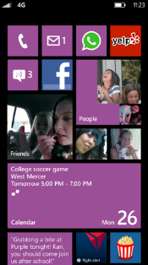
Evaluate this session
Required Slide
*delete this box when your slide is finalized
Your MS Tag will be inserted here during the final scrub.
Scan this QR code to evaluate this session and be automatically entered in a drawing to win a prize

Slide 51
© 2013 Microsoft Corporation. All rights reserved. Microsoft, Windows and other product names are or may be registered trademarks and/or trademarks in the U.S. and/or other countries.
The information herein is for informational purposes only and represents the current view of Microsoft Corporation as of the date of this presentation. Because Microsoft must respond to changing market conditions, it should not be interpreted to be a commitment on the part of Microsoft, and Microsoft cannot guarantee the accuracy of any information provided after the date of this presentation. MICROSOFT MAKES NO WARRANTIES, EXPRESS, IMPLIED OR STATUTORY, AS TO THE INFORMATION IN THIS PRESENTATION.

