Slide 2
Microsoft System Center 2012: Managing a Microsoft Exchange Infrastructure and Lync Server 2013 - Better Together
MDC-B310
Brad Bird – Senor System Center & VM Architect
Cistel Technology Inc.
Derek Kerr – Senior Solutions Architect
Cistel Technology Inc.

Slide 3
Agenda
Virtualizing MS Exchange 2013
Virtualizing Lync 2013
Managing Lync 2013 with OpsMgr
  Demo
Integration with ServiceMgr
  Demo
Managing Lync with Scorch
  Demo

Slide 4

Hyper-V for Microsoft Workloads
Greatest Host & Virtual Machine Scalability
Through support for hosts with up to 320 logical processors, and 4TB of memory, along with support for virtual machines with up to 64 virtual processors and 1TB memory, Hyper-V provides the greatest scalability for mission-critical Microsoft workloads such as SQL Server, SharePoint and Exchange.
Powerful Storage Capabilities
Hyper-V provides virtual machine storage capacity of up to 64TB per virtual disk, and provides deep integration with storage arrays, through features such as Offloaded Data Transfer, to drive the highest levels of performance for key workloads such as SQL Server, SharePoint & Exchange. In addition, customers now have complete flexibility for virtual machine storage, through integrated support for iSCSI, Fibre Channel and SMB 3.0
Comprehensive Networking Capabilities
Hyper-V provides a completely extensible networking switch, to enable granular security and performance controls to protect, and enhance the performance of key Microsoft workloads, such as SQL Server, SharePoint and Exchange. With inbox offload capabilities, such as Dynamic VMq, IPsec Task Offload, and SR-IOV, customers can drive the highest levels of networking performance, with the lowest latencies, all with no SKU-specific licensing restrictions

Slide 5
Why Virtualize MS Exchange 2013?
Virtualizing Exchange is not only possible but an attractive option
    Exchange is fully supported virtualized for ALL role servers
    Deploying Exchange is much quicker in a virtual environment
    More controlled resource allocation granularity
    Innate HA capabilities with virtualization using VM clustering for roles servers outside of MB and DAGs

Slide 6
Virtualizing Exchange | Performance
With Windows Server 2012 Hyper-V, ESG Lab performed hands-on testing of a virtualized tier-1 Exchange 2013 application workload. The workload used was designed to simulate thousands of Exchange users performing typical activities including sending and receiving e-mails, making calendar entries, updating contacts, and managing to-do lists.
An Exchange 2013 infrastructure deployed within 12 Hyper-V VMs, running on a single physical server, supported the I/O requirements of up to 48,000 simulated users, while average database read response times ranged between 5.02 and 15.31ms, well below the Microsoft recommended limit of 20 milliseconds
3 vCPU, 16GB RAM per VM, JetStress 2010

Slide 7
Key Virtual Hardware Considerations
Synthetic vNIC
DVMQ or SR-IOV
In-Guest Teaming
Network QoS
Weights & Reserves
vNUMA (SQL & IIS 8)
LP:VP Ratios:
Exch/SP – 1:1 (Max 2:1)
VM
Dynamic Memory
Exch/SP – No
SQL - Yes
Fixed VHDX (64TB)
Separate VHDXs
No Snapshots
Virtual FC
In Guest iSCSI
Hyper-V Replica
Exch/SP – No
SQL – Yes (Not AlwaysOn)
http://support.microsoft.com/kb/956893
Host Storage:
DAS, SMB, FC, iSCSI
SAS, SSD etc

Slide 8
Virtualizing MS Exchange 2013 - Takeaways
Considerations when virtualizing Exchange Servers
    Processor cores can’t be ignored
    Dynamic memory is NOT suggested. Application does not respond well to changes
    Disk IO is critical so don’t under allocate disks.
    Design for the Mailbox server role first.

Slide 9
Virtualizing Lync 2013
Virtualization in Lync 2013 supports the following workloads
      Front end servers in a pool (Enterprise deployment)
      Standard edition servers
      Edge servers for standard and Enterprise pool deployments
      Director’s
      R-Proxy Components

Slide 10
Lync 2013 Virtualization Restrictions
Cannot have mixed in the same front end pools (Must either all be physical or virtual)
Migration strategies such as live migration are not supported
Dedicate Network to Lync don’t Share

Slide 11
Virtualization of Lync
Lync 2013 supports the following hypervisors for virtualization:
Hyper- V 2/3.0
VMWare
Host Considerations
Get away from RAID5/6! More than 24 Cores
SSD can be your friend! Remember Host RAM!

Slide 12
What Elements of Lync Management to be Concerned About
Enabling Users
Disabling Users
Synthetic Transactions
Federation Allowance
Enabling Enterprise Voice
Usage Reports
Lync Management Shell
Performance
Metrics
Client Updates

Slide 13
Managing Lync 2013 with OpsMgr
What Elements of Lync Management to be Concerned About
      Call Quality
      Component Health
      Underlying Dependencies/Components
Lync and SCOM Integration
      Microsoft MP for Lync 2013
      Microsoft Remote Watcher Node integration with SCOM
        Synthetic Transactions are your Friend!!!

Slide 14
Lync and SCOM Integration
What’s New with Lync 2013 Management Packs
  Scenario availability from any location
  Synthetic transaction logs
  Increased call reliability coverage (IM and Conferencing)
  Dependency Monitoring
Software \ Hardware Requirements
  SCOM 2007 R2 or SCOM 2012
  Watcher Node
    Machine that execute the synthetic transactions (Not a Lync Server)
    8GB Memory
    CPU 64 bit quad core, 2.33 GHz; 64 Bit 2 way Processor dual core, 2.33 GHz
    Windows Server 2008 R2 or Windows Server 2012

Slide 15
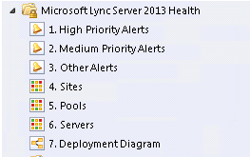
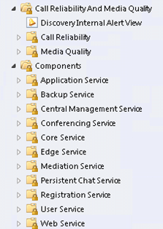
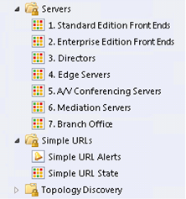
SCOM Views
Monitoring View Component View
Server View

Slide 16
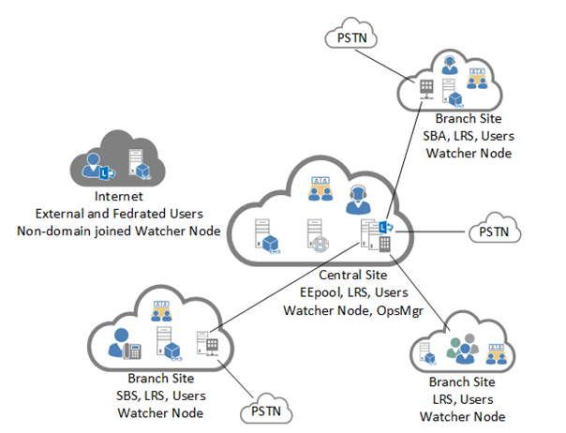
Watcher Topology Considerations

Slide 17
Demo
Managing Lync 2013 with OpsMgr

Slide 18
Integration with Scorch and ServiceMgr
Demonstrate how information from OpsMgr could potentially be transferred to ServiceMgr using connectors
Demonstrate a workflow with activities
Demonstrate a runbook operation

Slide 19
Demo
Integration with ServiceMgr

Slide 20
Demo
Managing Lync with Scorch

Slide 21
Summary
Virtualizing MS Exchange 2013
Virtualizing Lync 2013
Managing Lync 2013 with OpsMgr
  Demo
Integration with ServiceMgr
  Demo
Managing Lync with Scorch
  Demo

Slide 22

Track resources
Learn more about Windows Server 2012 R2 Preview, download the datasheet and
evaluation bits on
http://aka.ms/WS2012R2
Learn more about System Center 2012 R2 Preview, download the datasheet and evaluation bits on
http://aka.ms/SC2012R2

Slide 23

Resources
Learning
  Sessions on Demand
  Microsoft Certification & Training Resources
http://channel9.msdn.com/Events/TechEd
www.microsoft.com/learning
TechNet
msdn
  Resources for IT Professionals
  Resources for Developers
http://microsoft.com/technet
http://microsoft.com/msdn

Slide 24







Complete an evaluation on CommNet and enter to win!

Slide 25
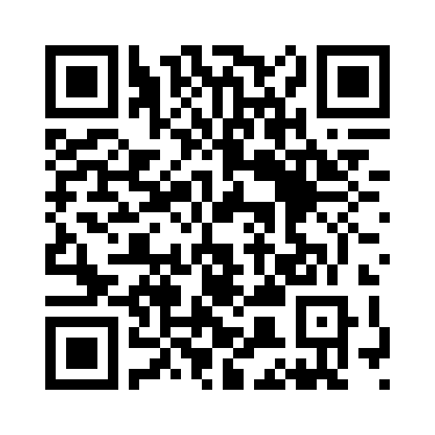


Evaluate this session
Required Slide
*delete this box when your slide is finalized
Your MS Tag will be inserted here during the final scrub.
Scan this QR code to evaluate this session and be automatically entered in a drawing to
win a prize

Slide 26

© 2013 Microsoft Corporation. All rights reserved. Microsoft, Windows and other product names are or may be registered trademarks and/or trademarks in the U.S. and/or other countries.
The information herein is for informational purposes only and represents the current view of Microsoft Corporation as of the date of this presentation. Because Microsoft must respond to changing market conditions, it should not be interpreted to be a commitment on the part of Microsoft, and Microsoft cannot guarantee the accuracy of any information provided after the date of this presentation. MICROSOFT MAKES NO WARRANTIES, EXPRESS, IMPLIED OR STATUTORY, AS TO THE INFORMATION IN THIS PRESENTATION.

