Slide 2
Hyper-V over SMB Scenario
(Overview, Configuration, and Performance)
MDC-B335
Jose Barreto
Principal Program Manager
Including what’s new in
Windows Server
2012 R2
Blog: http://smb3.info

Slide 3
Hyper-V over SMB Scenario
(Overview, Configuration, and Performance)
MDC-B335
Jose Barreto
Principal Program Manager
Including what’s new in
Windows Server
2012 R2
Blog: http://smb3.info

Slide 4
Session Objectives
  Describe the basics of the Hyper-V over SMB scenario,
  focusing on the new capabilities in Windows Server 2012 R2.
  Enumerate the most common performance bottlenecks in Hyper over SMB configurations.
  Outline a few Hyper-V over SMB configurations that can provide continuous availability, including details on networking and storage.

Slide 5
Agenda
Hyper-V over SMB - Overview
Basic Configurations
Performance Considerations
Sample Configurations

Slide 6
Overview

Slide 7
Focused Scenarios for 2012 R2 wave
Windows Server 2012 R2 is cloud optimized
Private Clouds
Hosted Clouds
Cloud Service Providers
Reducing capital and operational storage and availability costs

Slide 8
Infrastructure-as-a-Service Storage Vision
Dramatically lowering the costs and effort of delivering IaaS storage services
Disaggregated compute and storage
  Independent manage and scale at each layer
Industry standard servers,
networking and storage
  Inexpensive networks
  Inexpensive shared JBOD storage
Hyper-V Clusters
SMB
Scale-Out File Server Clusters
Storage Spaces Virtualization and Resiliency
Shared JBOD
Storage

Slide 9
Hyper-V over SMB
What is it?
Store Hyper-V files in shares over the SMB 3.0 protocol
(including VM configuration, VHD files, snapshots)
Works with both standalone and clustered servers
(file storage used as cluster shared storage)
Highlights
Increases flexibility
Eases provisioning, management and migration
Leverages converged network
Reduces capital and operational expenses
Supporting Features
SMB Transparent Failover - Continuous availability
SMB Scale-Out – Active/Active file server clusters
SMB Direct (SMB over RDMA) - Low latency, low CPU use
SMB Multichannel – Network throughput and failover
SMB Encryption - Security
VSS for SMB File Shares - Backup and restore
SMB PowerShell and VMM Support - Manageability
Hyper-V Cluster
Hyper-V
Hyper-V
Hyper-V
Hyper-V
Hyper-V
Hyper-V
Hyper-V
Hyper-V
Hyper-V
SQL
Server
SQL
Server
SQL
Server
IIS
IIS
IIS
VDI
Desktop
VDI
Desktop
VDI
Desktop
File Server
Cluster
File Server
File Server
Shared
Storage

Slide 10
SMB Transparent Failover
Failover transparent to server application
  Zero downtime – small IO delay during failover
Supports planned and unplanned failovers
  Hardware/Software Maintenance
  Hardware/Software Failures
  Load Rebalancing
Resilient for both file and directory operations
Requires:
  File Servers configured as Windows Failover Cluster
  Windows Server 2012 on both the servers running the application and file server cluster nodes
  Shares enabled for “continuous availability”
  (default configuration for clustered file shares)
  Works for both classic file server clusters (cluster disks) and scale-out file server clusters (CSV)
1
Normal operation
2
Failover share - connections and handles lost,
temporary stall of IO
3
Connections and handles auto-recovered
Application IO continues with no errors
Hyper-V
1
3
\\fs\share
\\fs\share
2
File Server Cluster
File Server
Node A
File Server
Node B

Slide 11
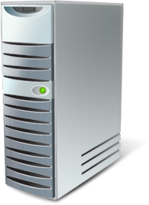
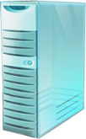

SMB Scale-Out
Targeted for server app storage
  Example: Hyper-V and SQL Server
  Increase available bandwidth by adding nodes
  Leverages Cluster Shared Volumes (CSV)
Key capabilities:
  Active/Active file shares
  Fault tolerance with zero downtime
  Fast failure recovery
  CHKDSK with zero downtime
  Support for app consistent snapshots
  Support for RDMA enabled networks
  Optimization for server apps
  Simple management
Hyper-V Cluster
(Up to 64 nodes)
Datacenter Network
(Ethernet, InfiniBand or combination)
Single Logical File Server (\\FS\Share)
Single File System Namespace
Cluster Shared Volumes
File Server Cluster
(Up to 8 nodes)

Slide 12
Automatic Scale-Out Rebalancing
New in
Windows Server
2012 R2
Scale-Out File Server clients are now redirected to the “best” node for access to a specific share
Avoids unnecessary redirection traffic
Driven by ownership of Cluster Shared Volumes
SMB connections managed per share, not server
Clients move as CSV volume ownership changes
Clustering now balances CSV automatically
Automatic behavior, no administrator action
Hyper-V host
\\SOFS\Share1
\\SOFS\Share2
SMB
Scale-out File Server
File Server 1
File Server 2
Share1
Share2
Share1
Share2
Storage Spaces
CSV and SMB shares automatically rebalanced
Improved network efficiency through drastically reducing redirection traffic

Slide 13
SMB Multichannel
Full Throughput
Bandwidth aggregation with multiple NICs
Multiple CPUs cores engaged when NIC offers Receive Side Scaling (RSS)
Automatic Failover
SMB Multichannel implements end-to-end failure detection
Leverages NIC teaming (LBFO) if present, but does not require it
Automatic Configuration
SMB detects and uses multiple paths
Sample Configurations
Single 10GbE
RSS-capable NIC
Multiple 1GbE NICs
Multiple 10GbE
in LBFO team
Multiple RDMA NICs
SMB Client
SMB Client
SMB Client
SMB Client
LBFO
NIC
10GbE
NIC
1GbE
NIC
1GbE
NIC
10GbE
NIC
10GbE
NIC
10GbE/IB
NIC
10GbE/IB
Switch
10GbE
Switch
1GbE
Switch
1GbE
Switch
10GbE
Switch
10GbE
Switch
10GbE/IB
Switch
10GbE/IB
SMB Server
SMB Server
SMB Server
SMB Server
NIC
10GbE
NIC
1GbE
NIC
1GbE
NIC
10GbE
NIC
10GbE
NIC
10GbE/IB
NIC
10GbE/IB
LBFO
Vertical lines are logical channels, not cables

Slide 14
SMB Direct (SMB over RDMA)
Advantages
    Scalable, fast and efficient storage access
    High throughput with low latency
    Minimal CPU utilization for I/O processing
    Load balancing, automatic failover and bandwidth aggregation via SMB Multichannel
Scenarios
    High performance remote file access for application servers like Hyper-V, SQL Server, IIS and HPC
    Used by File Server and Clustered Shared Volumes (CSV) for storage communications within a cluster
Required hardware
    RDMA-capable network interface (R-NIC)
    Three types: iWARP, RoCE and InfiniBand
    RDMA NICs should not be teamed (use SMB Multichannel)
SMB Client
SMB Server
Application
User
Kernel
SMB Client
SMB Server
Network w/
RDMA support
Network w/
RDMA support
NTFS
SCSI
R-NIC
R-NIC
Disk

Slide 15
SMB Direct v2 Performance
New in
Windows Server
2012 R2
Performance
50% improvement for small IO workloads with SMB over RDMA
Increased 8KB IOPs from ~300K IOPS to ~450K IOPS per interface
Hyper-V
Efficiency
Increased efficiency and density of hosting workloads with small I/O’s such as OLTP database in a VM
Optimizes 40Gbps Ethernet and 56Gbps InfiniBand
SMB Direct v2
Scale-out File Server
50% improvement for small IO workloads
VHD

Slide 16
Demo: SMB Scale-Out and SMB Performance
Jose Barreto
Principal Program Manager

Slide 17
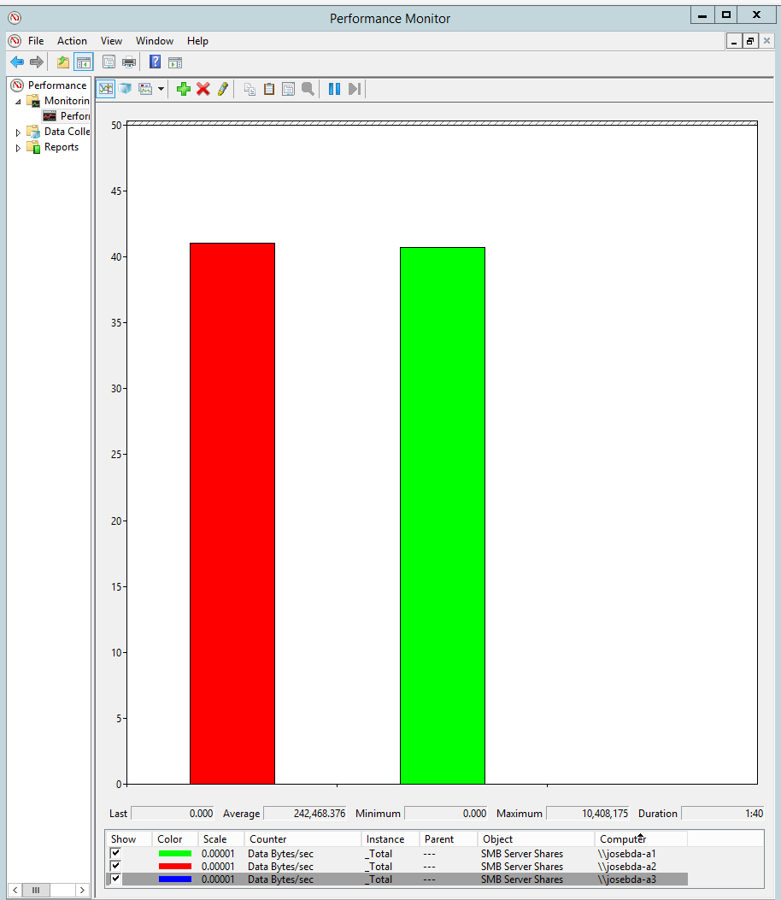
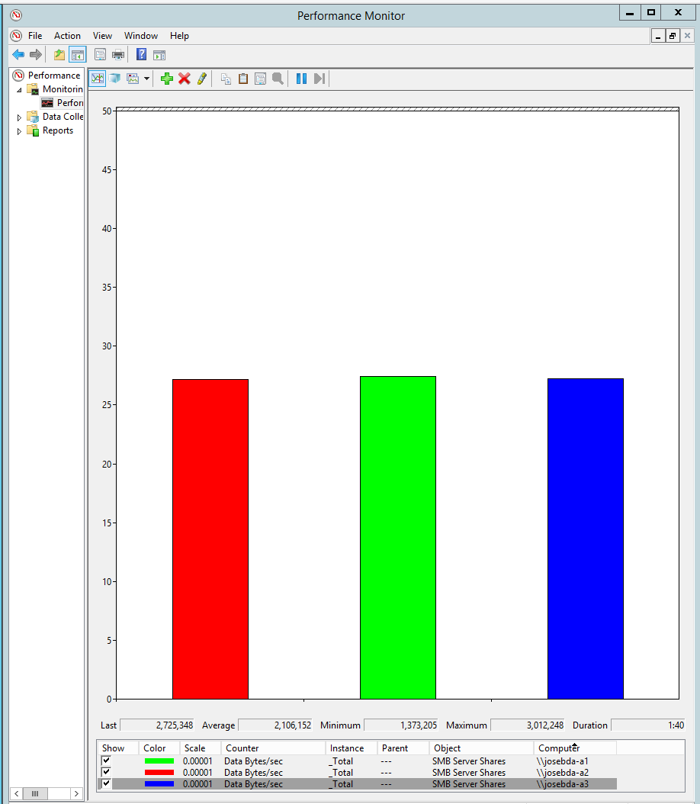
Demo Summary – Automatic Scale-Out Balancing

Slide 18
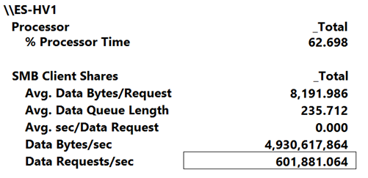
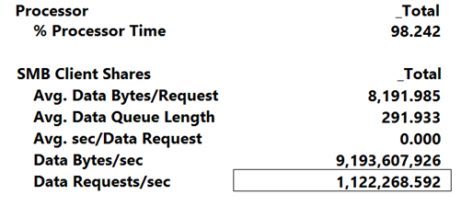
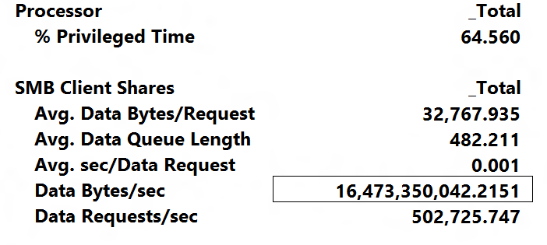
Demo Summary - Performance
8KB random reads
from a mirrored space (disk)
~600,000 IOPS
File Client
(SMB 3.0)
SQLIO
RDMA NIC
RDMA NIC
RDMA NIC
8KB random reads
from cache (RAM)
~1,000,000 IOPS
RDMA NIC
RDMA NIC
RDMA NIC
File Server
(SMB 3.0)
Storage Spaces
SAS
HBA
SAS
HBA
SAS
HBA
SAS
HBA
SAS
HBA
SAS
HBA
SAS
SAS
SAS
SAS
SAS
SAS
32KB random reads
from a mirrored space (disk)
~500,000 IOPS
~16.5 GBytes/sec
JBOD
JBOD
JBOD
JBOD
JBOD
JBOD
SSD
SSD
SSD
SSD
SSD
SSD
SSD
SSD
SSD
SSD
SSD
SSD
SSD
SSD
SSD
SSD
SSD
SSD
SSD
SSD
SSD
SSD
SSD
SSD
SSD
SSD
SSD
SSD
SSD
SSD
SSD
SSD
SSD
SSD
SSD
SSD
SSD
SSD
SSD
SSD
SSD
SSD
SSD
SSD
SSD
SSD
SSD
SSD

Slide 19
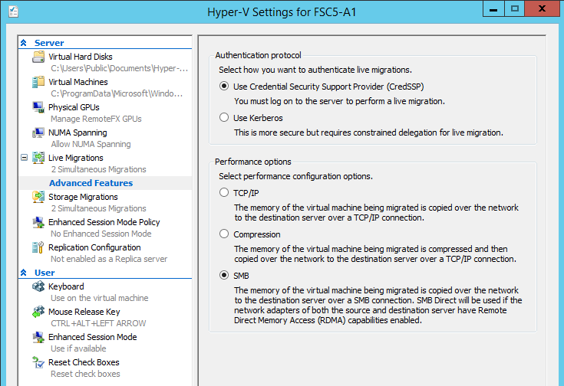
Hyper-V Live Migration over SMB
New in
Windows Server
2012 R2
SMB as a transport for Live Migration of VMs
Delivers the power of SMB to provide:
  RDMA (SMB Direct)
  Streaming over multiple NICs (SMB Multichannel)
Provides highest bandwidth and lowest latency
TCP/IP
Compression
SMB w/RDMA
(no compression)
Live Migration can take advantage of high speed networking
Live migration can stream over multiple networks for improved bandwidth
RDMA enables offloading CPU resources to NIC during live migration

Slide 20
SMB Bandwidth Management
New in
Windows Server
2012 R2
File Server for library Storage
Common Infrastructure
SMB being leveraged for VMs to access storage, distribution from VM library, and live migration
Desire to manage bandwidth of different types of SMB communication
Live Migration
Limit = 500 MB/s
Default
Limit = 100 MB/s
Hyper-V host 1
Hyper-V host 2
Control
Configurable SMB bandwidth limits per category
Three defined SMB categories:
Default, VirtualMachine and LiveMigration
Storage
No Limit
Scale-out
File Server
Enables hosters to control different SMB traffic types
VHDX

Slide 21
Demo: Live Migration
Jose Barreto
Principal Program Manager

Slide 22
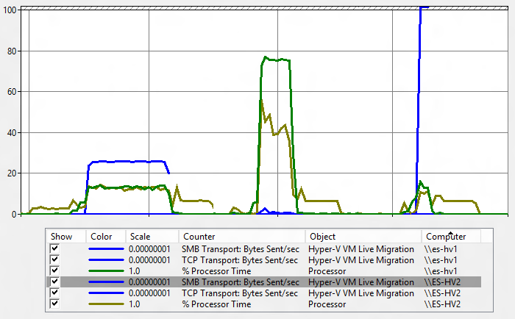
Demo Summary: Live Migration
Hyper-V Host 1
Hyper-V Host 2
VM
VM
TCP/IP
Compression
SMB/RDMA
RDMA NIC
RDMA NIC
RDMA NIC
RDMA NIC
RDMA NIC
RDMA NIC
Switch
RDMA NIC
RDMA NIC
RDMA NIC
File Server
(SMB 3.0)
Storage Spaces
SAS
HBA
SAS
HBA
SAS
HBA
SAS
HBA
SAS
HBA
SAS
HBA
SAS
SAS
SAS
SAS
SAS
SAS
JBOD
JBOD
JBOD
JBOD
JBOD
JBOD
SSD
SSD
SSD
SSD
SSD
SSD
SSD
SSD
SSD
SSD
SSD
SSD
SSD
SSD
SSD
SSD
SSD
SSD
SSD
SSD
SSD
SSD
SSD
SSD
SSD
SSD
SSD
SSD
SSD
SSD
SSD
SSD
SSD
SSD
SSD
SSD
SSD
SSD
SSD
SSD
SSD
SSD
SSD
SSD
SSD
SSD
SSD
SSD

Slide 23

SMB Encryption
End-to-end encryption of SMB data in flight
  Protects data from eavesdropping or snooping attacks on untrusted networks
Zero new deployment costs
  No need for IPsec, specialized hardware, or WAN accelerators
Configured per share or for the entire server
Can be turned on for a variety of scenarios where data traverses untrusted networks
  Application workload over unsecured networks
  Branch Offices over WAN networks
Client
Server
SMB Encryption

Slide 24
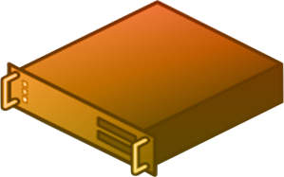
VSS for SMB File Shares
Backup Server
Application consistent shadow copies for server application data stored on Windows Server 2012 file shares
Backup and restore scenarios
Full integration with VSS infrastructure
Read from
Shadow Copy
Share
G
Backup
A
File Share Shadow Copy Agent
Backup Agent
E
Request Shadow Copy
B
Coordinate Shadow Copy
D
Volume Shadow Copy Service
Volume Shadow Copy Service
Relay Shadow Copy request
Create Shadow Copy
F
Create Shadow Copy
C
VSS Providers
File Share Shadow Copy Provider
\\fs\foo
Data volume
\\fs\foo@t1
Shadow Copy
Application Server
File Server

Slide 25
Multiple SMB Instances
New in
Windows Server
2012 R2
Additional instance on each node in a Scale-Out File Server for CSV traffic
Default instance handles incoming traffic from SMB clients accessing regular file shares
Other instance handles only inter-node CSV traffic (metadata access or redirected traffic)
Separate data structures (locks/queues) for regular client traffic and inter-node traffic
Improves scalability and reliability of inter-node traffic between CSV nodes
Hyper-V Host 1
Hyper-V Host 2
SMB Client
SMB Client
Scale-Out File Server
File Server 1
File Server 2
SMB Server
CSV Instance
SMB Server
CSV Instance
SMB Client
SMB Server
Default Instance
SMB Server
Default Instance
SMB Client
CSV1
(Metadata Owner)
CSV2
(Not Metadata Owner)
CSV1
(Not Metadata Owner)
CSV2
(Metadata Owner)
Shared SAS Storage

Slide 26
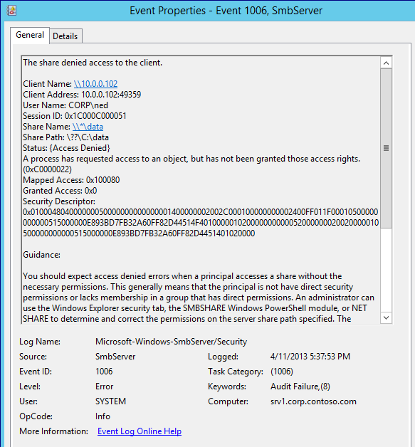
Improved SMB Diagnosability
New in
Windows Server
2012 R2
Scenario-based events containing inter-machine info that previously required network captures and logs.
Most useful events are turned on by default, so you capture the required information the first time.
Additional events include details on configuration and troubleshooting tips.
Less noisy event means that the logs won’t get full and start wrapping around as often

Slide 27
VMM and Scale-out File Server
New in
VMM
2012 R2
Capacity Management
Pool/volume/file share classification
File share ACL management
VM workload deployment to file shares
Hyper-V Clusters
Scale-out
File Server Deployment
Bare metal deployment of file server
Creation of scale-out file server cluster
Adding/removing file server nodes
File share management
SMB
Scale-Out File Server Clusters
Storage Spaces Virtualization and Resiliency
Spaces Provisioning
Discovery of physical spindles
Storage pool creation and deletion
Mirror and Parity Spaces creation and deletion
Shared JBOD
Storage

Slide 28
Basic Configurations

Slide 29
File Server Configurations
Dual-node File Server
  Low cost for continuously available shared storage
  Limited scalability
  (up to a few hundred disks)
Multi-node File Server
  Highest scalability
  (up to thousands of disks)
  Higher cost, but still lower than connecting all Hyper-V hosts with FC
Single-node File Server
  Lowest cost for shared storage
  Shares not continuously available
Hyper-V Parent 1
Hyper-V Parent N
Hyper-V Parent 1
Hyper-V Parent N
Hyper-V Parent 1
Hyper-V Parent N
Child 1
Child N
Child 1
Child N
Config
Child 1
Config
Child N
Config
Config
Config
Config
Disk
Disk
VHD
Disk
VHD
Disk
VHD
Disk
VHD
Disk
VHD
VHD
File Server
File Server 1
File Server 2
FS 1
FS 2
FS 3
FS 4
Share1
Share2
Share1
Share2
Share1
Share2
Share1
Share2
Share3
Share4
Disk
Disk
Shared SAS Storage
Fibre Channel Storage Array
Disk
Disk
Disk
Disk
Disk
Disk
Disk
Disk
Disk
Disk
Disk
A
B
C

Slide 30
Network Configurations
All 1GbE
Mixed 1GbE/High Speed
All High Speed (10GbE/40GbE/56GbIB)
Clients
Clients
Clients
1GbE
1GbE
1GbE
1GbE
High Speed
High Speed
Clients
Hyper-V 1
Hyper-V 2
Hyper-V 1
Hyper-V 2
Hyper-V 1
Hyper-V 2
High Speed
High Speed
Hyper-V 1
Hyper-V 2
1GbE
1GbE
High Speed
High Speed
High Speed
High Speed
File Server 1
File Server 2
File Server 1
File Server 2
File Server 1
File Server 2
File Server 1
File Server 2
A
B
C
D

Slide 31
Permissions for Hyper-V over SMB
# Create folder
MD F:\VMFolder
# Create Share with permissions
New-SmbShare -Name VMShare -Path F:\VMFolder `
-FullAccess Dom\HAdmin, Dom\HV1$, Dom\HV2$, Dom\HVC$
# Apply share permissions to NTFS permissions
Set-SmbPathAcl –Name VMShare
New in
Windows Server
2012 R2

Slide 32
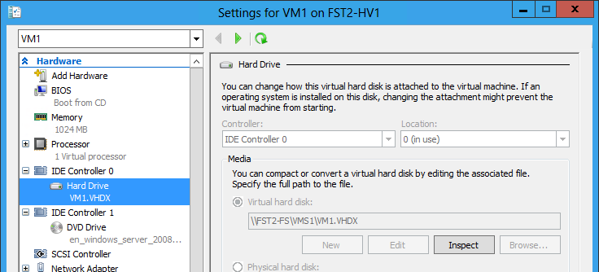
How to use it: simply type a UNC path

Slide 33
How to use it: simply type a UNC path
# Create VHDX file
New-VHD -Path \\FS\SH\VM1.VHDX -SizeBytes 100GB
# Create VM
New-VM -Name VM1 -Memory 4GB `
-Path \\FS\SH -VHDPath \\FS\SH\VM1.VHDX

Slide 34
Important notes on Hyper-V over SMB
Hyper-V supports SMB version 3.0 only
    That includes Windows Server 2012 (SMB 3.00) and Windows Server 2012 R2 (SMB 3.02)
    Thera are also 3rd-party SMB 3.0 solutions from storage partners like EMC and NetApp
    The Hyper-V Best Practices Analyzer (BPA) will check the version of SMB
Active Directory is required
    Computer accounts, which are required for configuring proper permissions, only exist in a domain
Continuously Available shares are recommended
Both Virtual Machine Manager 2012 SP1
and Virtual Machine Manager 2012 R2
support Hyper-V over SMB
Loopback configurations are not supported
    File Server and Hyper-V must be separate servers
    If using Failover Clusters, File Server and Hyper-V must be on separate clusters
Remote Management
    Use PowerShell
    Use Server Manager (for file shares)
    Use Remote Desktop (RDP)
    Use VMM 2012 SP1
    If using Hyper-V Manager remotely, Constrained Delegation is required

Slide 35
Tips and Answers (from the blog)
Switch to the High Performance power profile
Make sure your network interfaces are RSS-capable
Use multiple subnets when deploying SMB Multichannel in a cluster
Disable 8.3 Naming (and strip those short names too)
Continuous Availability does not work with volumes using 8.3 naming or NTFS compression
Enable CSV Caching on Scale-Out File Server Clusters
Avoid loopback configurations for Hyper-V over SMB
Run the File Services Best Practices Analyzer (BPA)
Use PowerShell to find the free space on the volume behind an SMB file share
New per-share SMB client performance counters provide great insight
Minimum version of Mellanox firmware required for running SMB Direct in Windows Server 2012
How much traffic needs to pass between the SMB Client and Server before Multichannel actually starts?
Is it possible to run SMB Direct from within a VM?
Can I use SMB3 storage without RDMA?
I only have two NICs on my Hyper-V host. Should I team them or not?
How to rebalance a Scale-Out File Server using a little PowerShell

Slide 36
Updates and KB articles for Windows Server 2012
KB 2709568: New SMB 3.0 features in the Windows Server 2012 file server
KB 2695839: Some SMB share properties are only available in updated tools
KB 2694998: File Server Cluster names longer than 15 chars are not supported
KB 2686098: SMB connections fail with error "Invalid Signature"
KB 2777646: SMB Multichannel skips non-routable IP addresses of a network interface if routable IP addresses are also configured
KB 2772113: Event 1801 is logged when you add a file share to a continuously available Windows Server 2012 cluster
KB 2801054: VSS_E_SNAPSHOT_SET_IN_PROGRESS error when you try to back up a virtual machine in Windows Server 2012
KB 2813630: Virtual machine enters a paused state or a CSV volume goes offline when you try to create a backup of the virtual machine on a Windows Server 2012-based failover cluster
KB 2838669: Update that improves cluster resiliency in Windows Server 2012 is available

Slide 37
Performance

Slide 38
Typical Configuration for Hyper-V over SMB
…
…
File
Server
2
SAS JBOD
NIC
SAS
Module
Disk
Disk
…
File
Server
Hyper-V
NIC
DHCP
DC/DNS
Management
Hyper-V
SAS HBA
SAS
Module
Disk
Disk
Hyper-V
R-NIC
Hyper-V
Host
VM
SAS HBA
VM
R-NIC
VM
Client
NIC
NIC
Virtual
Machine
Client
Client
Switch1
vNIC
vDisk
File
Server
1
SAS JBOD
NIC
Switch5
NIC
Space
SAS
Module
Disk
Disk
File
Share
Space
…
NIC
File
Share
vSwitch
SMB 3.0
Client
SAS
Module
Disk
Disk
Switch3
NIC Teaming
Switch6
Client
Router
SMB 3.0
Server
Storage
Spaces
Client
NIC
R-NIC
SAS JBOD
Client
Switch2
NIC
NIC
R-NIC
SAS
Module
Disk
Disk
R-NIC
SAS HBA
Disk
Disk
Switch4
R-NIC
SAS HBA
SAS
Module
Clients
Hyper-V
Cluster
File Server
Cluster
JBODs

Slide 39
Performance considerations
Number of clients
Speed of client NICs
VMs per host
Virtual processes per VM
RAM per VM
R-NICs per file server,
Speed of R-NICs
Number of Spaces
Columns per space
CSV cache config
Tiering config
SAS ports per module
SAS Speed
…
…
…
File
Server
Hyper-V
DHCP
DC/DNS
Management
Hyper-V
Hyper-V
File
Server
Hyper-V
Host
File
Server
VM
VM
NIC
Space
VM
Space
Client
Virtual
Machine
File
Share
Client
NIC
NIC
NIC
File
Share
Client
Switch1
vNIC
vDisk
NIC
SAS JBOD
…
SAS JBOD
vSwitch
SMB 3.0
Client
Switch5
SMB 3.0
Server
Storage
Spaces
SAS JBOD
Switch3
SAS
Module
Disk
Disk
NIC Teaming
Client
Router
R-NIC
SAS HBA
Disk
Disk
Client
NIC
R-NIC
SAS
Module
Client
Switch2
NIC
NIC
R-NIC
R-NIC
SAS HBA
Switch4
Switch6
NICs per Hyper-V host
Speed of NICs
Hyper-V hosts
Cores per Hyper-V host
RAM per Hyper-V host
R-NICs per Hyper-V host
Speed of R-NICs
SAS HBAs per File Server
SAS Speed
Disks per JBOD
Disk type and speed
SAS Speed

Slide 40
Designing a solution
The workload
  500 VDI VMs, 2GB RAM, 1 virtual proc
  ~50GB per VM, ~30 IOPS per VM
Some building blocks
  Disks: 900 GB HDD @ 10Krpm, ~140 IOPS
  JBOD: 24 or 60 disks per JBOD
  Hyper-V host, 16 cores, 128GB RAM
Working out the storage
  IOPS: 30 * 500 /140 = ~107 disks
  Capacity: 50GB * 2 * 500 / 900 = ~56 disks
Rounding up
  107 disks for IOPS, twice the required capacity
  2 JBODs x 60 disks → 120 disks (some spares)
Working out the Hyper-V hosts
  2GB VM/128GB ~ 50 VM/host (some RAM for host)
  50 VMs * 1 virtual procs / 16 cores ~ 3:1 ratio
  500 VMs/50 ~ 10 hosts (+1 as a spare)
Networking
  500 VMs*30 IOPS*64KB = 937 MBps required
  Single 10GbE = 1100 MBps . 2 for fault tolerance.
  Single 4-lane SAS 6Gbps = 2200 MBps. 2 for FT.
File Server
  500 * 25 = 12,500 IOPS. Single file server. 2 for FT.
  RAM = 64GB, good size CSV cache (up to 20% of RAM)
Homework:
Redo with tiering
New in
Windows Server
2012 R2

Slide 41
VDI workload (sample only, your requirements may vary)
500 clients
1 Gbps NICs
2GB per VM
50 VMs per host
500 VMs total
50GB VHD per VM
2 R-NIC @ 10Gbps
8 mirrored spaces
16 columns/space
12 GB CSV cache
4 SAS ports @ 6 Gbps
…
…
File
Server
Hyper-V
DHCP
DC/DNS
Management
Hyper-V
Hyper-V
File
Server
Hyper-V
Host
File
Server
VM
VM
NIC
Space
VM
Space
Client
Virtual
Machine
File
Share
Client
NIC
NIC
NIC
File
Share
Client
Switch1
vNIC
vDisk
NIC
…
Switch5
SAS JBOD
vSwitch
SMB 3.0
Client
SMB 3.0
Server
Storage
Spaces
SAS JBOD
Switch3
SAS
Module
Disk
Disk
NIC Teaming
8.8 GB/sec
2 x 6Gb SAS x4 x 2
Client
Router
~4.4 GB/sec
2 x 10GbE x 2
R-NIC
SAS HBA
Disk
Disk
Client
NIC
R-NIC
SAS
Module
Client
Switch2
NIC
NIC
R-NIC
R-NIC
SAS HBA
Switch4
Switch6
2 NICs @ 10Gbps
11 Hyper-V hosts
16 cores/host
128GB RAM/host
2 R-NIC @ 10Gbps
2 SAS HBAs @ 6Gbps
2 SAS ports/HBA
60 disks/JBOD
120 disks total
900GB @ 10Krpm

Slide 42
Speeds and Feeds – Maximum Theoretical Throughput
NIC | Throughput
1Gb Ethernet | ~0.1 GB/sec
10Gb Ethernet | ~1.1 GB/sec
40Gb Ethernet | ~4.5 GB/sec
32Gb InfiniBand (QDR) | ~3.8 GB/sec
54Gb InfiniBand (FDR) | ~6.5 GB/sec
HBA | Throughput
3Gb SAS x4 | ~1.1 GB/sec
6Gb SAS x4 | ~2.2 GB/sec
4Gb FC | ~0.4 GB/sec
8Gb FC | ~0.8 GB/sec
16Gb FC | ~1.5 GB/sec
Memory | Throughput
DDR2-400 (PC2-3200) | ~3.4 GB/sec
DDR2-667 (PC2-5300) | ~5.7 GB/sec
DDR2-1066 (PC2-8500) | ~9.1 GB/sec
DDR3-800 (PC3-6400) | ~6.8 GB/sec
DDR3-1333 (PC3-10600) | ~11.4 GB/sec
DDR3-1600 (PC3-12800) | ~13.7 GB/sec
DDR3-2133 (PC3-17000) | ~18.3 GB/sec
Bus Slot | Throughput
PCIe Gen2 x4 | ~1.7 GB/sec
PCIe Gen2 x8 | ~3.4 GB/sec
PCIe Gen2 x16 | ~6.8 GB/sec
PCIe Gen3 x4 | ~3.3 GB/sec
PCIe Gen3 x8 | ~6.7 GB/sec
PCIe Gen3 x16 | ~13.5 GB/sec
Intel QPI | Throughput
4.8 GT/s | ~9.8 GB/sec
5.86 GT/s | ~12.0 GB/sec
6.4 GT/s | ~13.0 GB/sec
7.2 GT/s | ~14.7 GB/sec
8.0 GT/s | ~16.4 GB/sec
Only a few common configurations listed. Numbers are rough approximations.
Actual throughput in real life will be lower than these theoretical maximums.
Numbers provided are for one way traffic only (double for full duplex). One interface/port only.
Numbers use base 10 (1 GB/sec = 1,000,000,000 bytes per second)

Slide 43
Sample Configurations

Slide 44
holSystems: Dell Servers, Cluster, 10GbE, FC Arrays
…
Configuration
50 Hyper-V Hosts (Dell, 72GB-400GB RAM each, 10TB total)
5 File Servers (Dell, 1 standalone, 2 x two-node clusters)
7 Fibre Channel arrays of varying sizes. 100TB total.
10GbE between Hyper-V and File Servers (120 ports)
8GbFC between File servers and FC arrays (2 switches)
Workload
Running Windows Server 2012 Virtual Labs and HOL/ILL labs for major Microsoft events including TechEd, TR, Lync Ignite, SharePoint Ignite, SQL Server Labs, Convergence
Each user spins up a new set of VMs in just seconds!
Commonly used by 500 users at 16GB each.
Capacity tested for up to 7,000 VMs.
Over 800,000 VMs just in the last 3 years.
New set of VMs deployed every 5-7 minutes (in average).
Try it yourself using the link above
HV 1
HV 2
HV 3
HV 4
HV 5
HV 50
10GbE
Switch 1
10GbE
Switch 2
10GbE
Switch 3
10GbE
Switch 4
Failover Cluster 1
Failover Cluster 2
FS 1
FS 2
FS 3
FS 4
FS 5
FC
Switch 1
FC
Switch 2
…
FC Array
1
FC Array
2
FC Array
2
FC Array
7
Thanks to Corey Hynes for the details!

Slide 45
Microsoft IT: HP Servers, Cluster, 6 x 10GbE, FC Array
…
Single Stamp Configuration
Microsoft IT Scale Unit v3 (Network and Infrastructure Services team)
28 Hyper-V Hosts (HP BL660, 1TB RAM each, 28TB total)
4 File Servers (HP BL660, 1TB RAM, 4-node scale-out file server)
EMC VMAX 40K in a 2+1 configuration (400 disks, 3 tiers)
Networking
2 x 10GbE Broadcom between Hyper-V and File Servers
4 x 10GbE Broadcom between every server and the outside world
2 x Cisco 3064 for East-West traffic, 2 x Cisco 5548 for North-South traffic
2 x 8GbFC Emulex HBAs per server, 24 FC ports + 8 iSCSI to VMAX
2 x Brocade 6510 FC Switches with 48 ports (up to 16GbFC)
Workload
Private cloud environment with LOB apps (SQL, IIS, others)
Average VM size is 16 virtual processors with 32GB of RAM
Largest VM supported is 32 virtual processors and 128GB of RAM
Built for high performance networking, including SR-IOV support
1,000 VMs projected for the “stamp” shown on the diagram
HV 1
HV 2
HV 3
HV 28
10GbE
Switch 1
10GbE
Switch 2
10GbE
Switch 3a
10GbE
Switch 3b
Failover Cluster
FS 1
FS 2
FS 3
FS 4
FC
Switch 1
FC
Switch 2
EMC VMAX
Thanks to Jeromy Statia for the details!

Slide 46
NTTX: Dell servers, Clusters, 10GbE, SAS JBODs
Cluster 5
4 x Dell R910
Hardware
48 Hyper-V hosts (10 R910, 18 R720, 24 M1000e)
Hyper-V hosts divided into 7 distinct clusters in 2 sites
10 File Servers, 5 clusters in 2 sites (4 R710, 6 Dell R320)
38 JBODs (Dell MD1200, 12 drives each)
Mostly 15K rpm 600GB SAS HDDs. Some 7.2K 2TB SAS for DPM. ~300TB total raw (~150TB usable in mirrored spaces).
Networking
1GbE: 4 PowerConnect 5548. 10GbE: PowerConnect 8164
Site 1 Scale-Out File Servers use 8x1GbE NICs, in a team
Site 2 Scale-Out File Servers use 4x10GbE NICs, in a team
Between sites, 4 NetASQ U450 (2 per site), 400 Mbps
Workload
Mixed workload (hosting) includes SQL, VDI, Exchange, Lync, SharePoint, CRM, other app servers, Backup.
~3,000 VMs total with varying storage, RAM, processors
Hyper-V Replica between the 2 sites, heavily customized
Highlights
Cost reduction. Efficiency. High scalability. Full HA (CA).
Delivers on varying and evolving workloads.
Built on industry standard hardware. 100% Microsoft stack.
Cluster 1
4 x Dell R910
Cluster 2
4 x Dell R910
Cluster 6
12 x Dell M1000e
Cluster 3
12 x Dell M1000e
Cluster 7
12 x Dell R720
Cluster 4
6 x Dell R720
NetASQ
U450
NetASQ
U450
NetASQ
U450
NetASQ
U450
1GbE Switch
1GbE Switch
10GbE Switch
1GbE Switch
Site 1
Site 2
1GbE Switch
FS1
FS2
FS3
FS4
FS5
FS6
FS7
FS8
FS9
FS10
8 JBODs
96 HDDs
6 JBODs
72 HDDs
8 JBODs
96 HDDs
8 JBODs
96 HDDs
8 JBODs
96 HDDs
Thanks to Philip Moss for the details!

Slide 47
In Review: Session Objectives
  Describe the basics of the Hyper-V over SMB scenario,
  focusing on the new capabilities in Windows Server 2012 R2.
  Enumerate the most common performance bottlenecks in Hyper over SMB configurations.
  Outline a few Hyper-V over SMB configurations that can provide continuous availability, including details on networking and storage.

Slide 48

Related content
Breakout Sessions
MDC-B311 Application Availability Strategies for the Private Cloud
MDC-B330 Hyper-V – What’s New in Windows Server 2012 R2
MDC-B333 Software-Defined Storage in Windows Server R2 and System Center 2012 R2
MDC-B335 Hyper-V over SMB Scenario (Overview, Configuration, and Performance)
MDC-B342 Reduce Storage Costs with Data Deduplication
MDC-B344 Storage Management: Spanning the Enterprise to Low Cost Scalable Solutions
MDC-B345 Windows Server 2012 Hyper-V Storage Performance
MDC-B349 Upgrading the Platform - How to Get There! Part 4: Your Fileservers and Storage Options
MDC-B357 What’s New in System Center 2012 R2 - Virtual Machine Manager
Hands-on Labs
MDC-H201 Implementing Storage Pools and Storage Spaces
MDC-H303 Configuring Hyper-V over Highly Available SMB Storage
Find Me Later at the Storage Booth

Slide 49
Track resources
Updated Links on File Server and SMB 3.0
  http://blogs.technet.com/b/josebda/archive/2013/05/05/updated-links-on-windows-server-2012-file-server-and-smb-3-0.aspx
Jose Barreto’s Blog
  http://smb3.info

Slide 50

Resources
Learning
  Sessions on Demand
  Microsoft Certification & Training Resources
http://channel9.msdn.com/Events/TechEd
www.microsoft.com/learning
TechNet
msdn
  Resources for IT Professionals
  Resources for Developers
http://microsoft.com/technet
http://microsoft.com/msdn

Slide 51







Complete an evaluation on CommNet and enter to win!

Slide 52

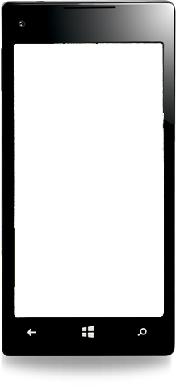

MS tag
Required Slide
*delete this box when your slide is finalized
Your MS Tag will be inserted here during the final scrub.
Scan the Tag
to evaluate this session now on myTechEd Mobile

Slide 53

© 2013 Microsoft Corporation. All rights reserved. Microsoft, Windows and other product names are or may be registered trademarks and/or trademarks in the U.S. and/or other countries.
The information herein is for informational purposes only and represents the current view of Microsoft Corporation as of the date of this presentation. Because Microsoft must respond to changing market conditions, it should not be interpreted to be a commitment on the part of Microsoft, and Microsoft cannot guarantee the accuracy of any information provided after the date of this presentation. MICROSOFT MAKES NO WARRANTIES, EXPRESS, IMPLIED OR STATUTORY, AS TO THE INFORMATION IN THIS PRESENTATION.

