Slide 2
Intel and Microsoft Software-Defined Networking Initiatives and Platforms
MDC-B346
Glenn Ward

Slide 3
Session Objectives and Takeaways
Session Objective(s)
  Understand the key needs in cloud networks
  Understand the value of Network Virtualization in building scalable multi-tenant clouds
  Understand the Intel strategies and component technologies for Software Defined Networking
Key Takeaways
  Network Virtualization is deployable in today’s datacenter
  Network Virtualization revolutionizes multi-tenant clouds (private, hybrid, public)
  Software Defined Networking brings datacenter flexibility, control, & automation

Slide 4



Evolution of the datacenter
Dedicated
Servers
Server Virtualization
Cloud
VM
VM
VM
VM
VM
VM
VM
VM
VM
Increased scalability
10 years ago
5 years ago
Today
Windows Server* 2003
Intel® Xeon® processor
(Single-core)
Windows Server 2008
Intel Xeon processor
(Quad-core)
Windows Server 2012
Intel Xeon processor
(8 plus-core)
Increased virtualization capability
Intel® Virtualization Technology (introduced in 2005)
Notes:
The datacenter has undergone a dramatic transformation in the last 10 years. In the era of Windows Server 2003 and single-core Intel Xeon processors, every workload in the datacenter was hosted on its own dedicated physical server. With Windows Server 2008 R2 and Intel quad-core Nehalem microarchitecture, IT began to embrace virtualization, running multiple workloads on each server to improve utilization and reduce space and power requirements.
Windows Server 2012 and the Intel Xeon processor E5 family take virtualization to the next level to provide the foundation for private and hybrid cloud computing. Compute, network, and storage resources are all virtualized to provide flexible pools that can be allocated to any workload. The datacenter becomes more dynamic, and manual processes can be automated to enable faster and more efficient service delivery and better utilization.
cloud definition:
Centralized resources
Automation
Dynamic resource management
Network centric
Standardization
Convergence
Simplification

Slide 5









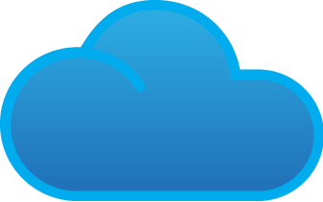
Growth & IT challenges drive need for cloud computing
Growth
IT Challenges
>3B
connected users by 2015¹
Improve Agility Reduce service delivery times, improve TCO
2X growth
in information every two years²
Greater Efficiencies Reduce complexity & deploy new workloads
15B
connected devices by 2015³
>11X
increase in mobile data traffic by 2015⁴
Gain Better Insights
Via intelligent analytics
Up to 2X or $27B⁵
in additional power costs by 2015
Avoid Lock-In
Seek interoperable solutions & services
1 Cisco Global Cloud Index Nov 2011
2 IDC Extracting Value from Chaos June 2011
3 Intel ECG – One Smart Network device forecast
4 Cisco Visual Networking Index: Global Mobile Data Traffic Forecast Update, 2011–2016, Feb 2012
5 Datacenter Dynamics Global Datacenter Energy Demand 2012 forecast http://www.datacenterdynamics.com/research/energy-demand-2011-12; projected to 2015 by Intel; Assume $0.10/kWh
Notes:
Key Message: Growth in users, devices, data and traffic & IT challenges drive need for cloud computing
There is significant growth projected in connected users, over 3 billion by 2015, along massive growth in data, everything from transactions and financial data to emails, text, video, and photos. In fact, there are forecasts of over 2X growth in information every 2 years, and 11X increase in mobile data traffic by 2015. Moreover, we project there will be 15 billion connected devices – from notebooks and desktops to smartphones, tablets, cars and more. To keep up, IT is expanding their datacenter deployments to handle the growth in users, data, devices, and traffic. This could lead to a 2X increase in datacenter power costs from 2011 to 2015, or an additional $27B (source – Intel: Incremental 30GW of power = ~10M homes (2011: 31GW, $27B in cost, estimate 2015: 62GW, $54B in cost)
In short, IT seeks to be more responsive, secure, and deliver the necessary solutions that enable companies to grow and gain competitive advantage, all while keeping costs in check. Cloud computing has developed to the point where it can provide a solution to meet these needs.

Slide 6


Cloud adoption growing & delivers benefits
IT Survey Results
    Hybrid Cloud
    Private
    Cloud
    Public
    Cloud
Today: 14%
2014: 42%
    Private
    Cloud
    Public
    Cloud
Today: 7%
2014: 23%
35% by 2015²
>40% of IT operations¹
>40% of IT operations¹
Intel IT example³
Traditional IT – 2009
Private cloud - 2011
Resource provisioning
90 days
45 minutes
Virtualized Platforms
12%
65%
Asset Utilization
10-20%
>60%
Capacity
Silos
Shared globally
Cost Savings
$9M in savings in 2 years
1 ODCA global member survey, Oct 2011, N=63
2 Gartner, Dec 2010, N=55 The Road Map From Virtualization to Cloud Computing (G00210845)
3 Source: Intel IT- http://premierit.intel.com/docs
Notes:
Key message: There are real benefits to be gained from cloud and company adoption is growing
Based on IT surveys, many companies are either adopting or have plans to adopt public clouds, private clouds, or hybrid clouds that combine both public and private and allow for usages, such as cloud bursting where businesses “burst” from their private cloud to consume public cloud resources such as servers and storage when needed. In fact, many companies view hybrid cloud as helping companies truly realize the benefits of cloud via flexibility and efficiency to use whatever form of cloud they choose based on business and IT requirements. You can see the stats here –
42% of IT surveyed and 23% will run over 40% of operations in public cloud by 2014^{2 (ODCA member survey)}
35% will use hybrid clouds by 2015^{1 (Gartner)}
Running Intel’s Business in the Cloud
Intel IT has had an aggressive evolution to cloud in the past 2 years via deployment of a private cloud behind the company’s firewall. In 2011, we continued to make rapid progress in transitioning to our enterprise private cloud. We focused on virtualizing more demanding applications, including Internet facing and mission-critical applications with higher security requirements, and migrating them to the private cloud. Sixty-five percent of our Office and Enterprise environment is virtualized, and we are on track to reach our target of 75 percent.
Building on a foundation of virtualized infrastructure, we dramatically decreased the time it takes to acquire new capacity
using self-service provisioning and extensive automation. Self-service is now the norm:
Most new services are now delivered within 45 minutes in our private cloud. In contrast, just two years ago, server provisioning in the traditional IT environment typically took as long as 90 days. And Intel IT has realized $9M in savings in the past 2 years via efficiency & agility gains.
There are several other industry examples where enterprises, universities, and governments are realizing significant benefits from cloud computing.
In spite of these gains, Intel is like many enterprises in that there remain many opportunities to more fully take advantage of cloud computing and realize its benefits

Slide 7



Barriers to cloud adoption
Cultural/
Organizational
Risk Aversion
Technology Maturity
Compliance
Quality of Service
Lock In
Security
Scale & Automation
Standards
Structure
New roles
Skills development
Scaling the Infrastructure
Cloud Security: Lack of control, manual auditing, identity theft
Resource Orchestration: Complex/management silos
Servers
Storage
Networking
Unpredictable demand
Space/power constrained
Massive data growth
Inflexible, hard to scale
Lack flexibility
Complex management
Notes:
Key Message: In terms of customer challenges to cloud adoption, there remain major barriers that imped IT’s ability to fully realize the promise of cloud computing.
Many companies that are deploying or have plans to deploy private clouds, use of public and eventually hybrid clouds have real concerns that remain, or hurdles to overcome, to fully take advantage of cloud.
They include maturity of technology, risk aversion, and organizational development/evolution.
Risk aversion
Compliance/audit is complex - For example, public cloud service providers could migrate data to another country where power is cheaper, but regulation laxer. Who will own the legal responsibilities for data management, data retention, record transparency and accounting accuracy as required by many regulatory agencies? Trying to manage audits across private and public clouds remains one of the chief issues for enterprises to use public clouds, especially in heavily regulated industries, such as financial services and healthcare.
Quality of service is not guaranteed – few public cloud providers offer reassurances on continuity of service, mean time to repair or data recovery, meaning services are unreliable for mission-critical applications
Interoperability and lock in – for cloud to be truly realized to provide for more automation, shared and dynamic resources and multiple cloud environments come together in a seamless way, in the form of hybrid clouds, requires interoperability and standards based hardware and software.
Technology maturity
Security remains one of the top concerns – security concerns exist when using private, public or hybrid clouds – among other issues, concerns include lack of control over data, lack of visibility into the infrastructure, user identity protection ensuring the right users are accessing the right information.
Scale and automation challenges - to drive greater efficiencies, there is a need for more flexible, automated resource pools that combine servers, storage and networks that scale dynamically to manage service level agreements, enable workload migration from server to server, and be more intelligent to migrate workloads based on power consumption, utilization rates, performance, and other factors. Today, there are management silos in handling virtualized servers, storage, networks, and datacenter facilities that limit true automation and thus many processes remain manual.
Standards – there has been progress in the development of standards that enable better integration between clouds, such as the DMTFs Open Virtualization Format (OVF), and best practices and checklists for cloud security from groups like the Cloud Security Alliance. However, the level of adoption and use is still limited today, which continues to challenge IT in their ability to fully embrace cloud computing. Having a consistent method for comparing cloud service levels among public providers to say an enterprise’s private cloud is very difficult to do today.
Cultural / Organizational
Historically, IT has been managed via functional silo’d experts who were masters of their domain expertise and responsibility. As companies move to a more service oriented model of delivering business services via cloud on a much faster timeline, these functional experts need to understand how they interact together, be aware of how they affect each other. There are seeing new roles emerging including an end to end business service owner. A cross functional, business, customer facing role across the domains. Cloud is also driving more collaborative operations teams to force working the interdependencies together.
Scaling the Infrastructure
Specifically regarding scaling the cloud infrastructure, cloud drives a need to have a scalable, flexible infrastructure that can meet the needs of end users, who have a perception of an infinite amount of resources available. Unpredictable demand, space and power constraints, being able to easily scale storage capacity in the face of massive data growth, and being able to dynamically re-route network traffic and reduce management complexity are some of the major challenges. Moreover, better orchestration of these IT resources and improving security are some of the key issues in deploying and managing a highly scalable infrastructure.
I’ll focus later in the presentation in more detail on Intel’s multi-year strategy to address challenges in scaling the infrastructure.

Slide 8
Evolving datacenter capabilities
2012
2013
2014
Server
Performance & efficiency optimized
Increasing application performance, reliability, scale, serviceability
Storage
Scalable converged storage servers + storage apps
SSD and NVM for low latency/high bandwidth
Enhanced distributed storage & file systems, erasure code
Add’l core data protection
NVM acceleration
Data mgmt optimizations
Network
Programmable network equipment, open interfaces
10GbE Unified Networking
Virtualization
Programmable control plane & 10/40GbE ToR switch
Management APIs
10/40/100GbE platform with CPU based network apps
Security
Automated controls, data protection, multi-tenant
Hardware-based data and multi-tenant workload integrity
Dynamic integrity assurance and recovery
Orchestration
Automated density/ efficiency
DC efficiency and density tuning via deep power and resource usage instrumentation
Increased intelligence on platform & VM resource usage /optimizations
Notes:
To achieve the Open Platform Architecture Intel is developing platform capabilities across the datacenter for Server, Storage, Network, Security and Orchestration.
Let’s take a moment to discuss the technologies and solutions that Intel is working with the industry to achieve.
Servers: For IT leaders the performance and optimization remain critical to the success of business agility. Compute demand continues to rise and Intel is continuing to accelerate Moore’s Law in our current E5 and E7 Xeon platforms by delivering increasing levels of application performance, new reliability features and continuing to work with our Industry partners to deliver industry scale. As we deliver these new capabilities we continue to develop new form factors and instrumentation that deliver increasing levels of serviceability and control.
Storage: The coming years will marked by the unprecedented growth in data and storage devices. The new emerging architectures for storage are providing IT leaders with the capabilities to deliver new storage tiers capable of providing multiple levels of storage performance. From high performance and lower power SSD technology to next generation low latency Non Volatile Memory architectures capable of transforming the way applications and operating systems are written. It is now time to begin the transition of building test and development environment to take advantage of these technologies to prepare for this explosion of data management and traffic.
Network: The 10Gbe transition is underway. The value of this transition is the ability to unify port management, scale bandwidth and cable reduction. However, as 10GbE port costs are reduced, the next generation of 40GbE Top of Rack switch solutions are providing a programmable control plan and new management API’s to take advantage of increased bandwidth and optimizations. By the end of 2014 these networking capabilities will become virtualized and scalable to meet the most demanding needs of your datacenter. Through our investments in Fulcrum, Qlogic and Cray interconnect, Intel is developing the available tools for the industry to meet their most demanding datacenter requirements for Cloud computing.
Security: Data protection, compliance, and multi-tenant datacenter present a new level of security concerns for IT leaders to address. Through our investments in Intel TXT and AESNI technologies we are working with industry leaders such as RSA, VMware, Microsoft, Symantec and our newest security acquisition MacAfee to deliver tools and solutions to address your security concerns.
Orchestration: One of the key to scaling your datacenter infrastructure is automation through the use of orchestration technologies. Today’s Intel Xeon-based platforms provide instrumentation capabilities of managing energy consumption, memory usage, hyper-threading and CPU utilization. Our future platforms begin to increase this intelligence and add additional optimizations for VM resource allocation, automated resource scheduling. This level of orchestration is a requirement to move to a more dynamic Cloud Computing infrastructure.
Let’s spend some time talking how these evolving platform capabilities enable flexibility for Cloud Computing.

Slide 9






Windows Server 2012 R2
Cloud optimize your IT
Beyond
virtualization
Scale and secure workloads, cost-effectively build a private cloud, and securely connect to cloud services.
The power of
many servers, the
simplicity of one
Efficiently manage infrastructure while maximizing uptime and minimizing failures and downtime.
Every app,
any cloud
Build on an open and scalable web platform that supports applications across premises.
Modern workstyle,
enabled
Support a mobile and flexible work style.
Notes:
Optimize your IT for the cloud with Windows Server 2012 R2
When you optimize your IT for the cloud with Windows Server 2012 R2, you take advantage of the skills and investment you’ve already made in building a familiar and consistent platform. Windows Server 2012 R2 builds on that familiarity. With Windows Server 2012 R2, you gain all the Microsoft experience behind building and operating private and public clouds, delivered as a dynamic, available, and cost-effective server platform.
Windows Server 2012 R2 delivers value in four key ways:
It takes you beyond virtualization. Windows Server 2012 R2 offers a dynamic, multitenant infrastructure that goes beyond virtualization technology to a complete platform for building a private cloud.
It delivers the power of many servers, with the simplicity of one. Windows Server 2012 R2 offers you excellent economics by integrating a highly available and easy-to-manage multiple-server platform.
It opens the door to every app on any cloud. Windows Server 2012 R2 is a broad, scalable, and elastic web and application platform that gives you the flexibility to build and deploy applications on-premises, in the cloud, and in a hybrid environment through a consistent set of tools and frameworks.
It enables the modern workstyle. Windows Server 2012 R2 empowers IT to provide users with flexible access to data and applications anywhere, on any device, and while simplifying management and maintaining security, control, and compliance.
With Windows Server 2012 R2, Microsoft has made significant investments in each of these four areas that allow customers to take their datacenter operations to the next level. Now, let’s take a look how Windows Server 2012 R2 helps customers to:
Build and deploy a modern datacenter infrastructure

Slide 10
What is Software-defined Networking (SDN)?
Enables software to dynamically manage the network
Abstracting the physical network with virtual networks
Spanning policies across physical and virtual networks
Controlling datacenter traffic flow
Notes:
Software-defined networking enhances the management of modern networks by providing the ability for applications to control access to network resources dynamically. These applications can be management consoles, streaming servers, transaction processing databases, or other programs for which network access and quality of service are critical to success.
Applications can then to adapt to workload needs by:
Abstracting workloads from the physical network so that services are delivered according to demand
Controlling datacenter traffic flow to maintain consistent QoS levels
Enabling integrated network management policies that span both physical and virtual networks
A key enabler with SDN is that it uses networking functionality that has been moved to the virtual switch, providing the ability to modify packets in transit and enabling integration of more advanced switch extensions. Finally, SDN also brings the benefit of unifying the management of both the physical and virtual infrastructure.

Slide 11
Microsoft’s approach to SDN
End-to-end solution
Promote industry innovation in software & hardware
Open, extensible and standards-based
Flexibility
Control
Automation

Slide 12
Delivering on SDN with Windows Server & System Center
Flexibility
Control
Automation
Virtual network abstraction with multitenant isolation
BYOIP for tenant onboarding & workload mobility
Secure cross-premises connectivity
Integrated control plane to co-relate workload placement and virtual network policy
Dynamic traffic control policies with Network QoS
Traffic monitoring and flow control with switch extensions
Dynamic, policy-driven network (re)configuration
Consistent, profile-based deployment of SDN traffic policies through distributed virtual switch
Provision load balancers, site-to-site VPNs and gateways
Notes:
A reasonable question to ask is - how did you come up with that? It turns out that the origins of our approach lies in our experiences designing, implementing and optimizing networks to run large scale online services like Azure.
Principles on network design
Shared pooled network infrastructure - Decoupling the network design from being tied to app/workoads and racks, workload/ application traffic to be flexibly directed through multiple paths…so you don’t need to overprovision at each connection point (port)…we’ve seen some tremendous improvement in CAPEX and OPEX through network utilization and aggregate capacity. Goes back to the first point.
Multitenancy demands flexibility – isolate customers as they on ramp to the cloud in a way that enables them to BYOIP….we had staging vs. production, multiple customers with different isolation needs etc.
Automation - Azure 50000 network changes per day… we learnt that there’s no way of scaling network operations manually and we needed automated configuration and change management that was centralized and drives simplicity and reliability.
These learnings directly informed our approach and in turn our promise with SDN - like I mentioned earlier, this is in line with our philosophy of using public cloud as the benchmark.
These principles indeed form the basis of our SDN promise to you and you see in subsequent chapters of this presentation as to how they manifest in WS and SC capabilities.
Built in and production ready – We want to take accountability to ensure that you have all the pieces of the puzzle to deliver hybrid cloud computing. We will innovate in-box as well as bring in the right level of integration and interoperability.
- Related to integration, we will step up and holistically shape industry thinking in terms of what hardware and software innovation do we need to make these promises real – there will be requirements that can best be met by hardware, others that the magic of software can deliver what should be delivered in software etc. so you have choice and your needs are best met. Drive innovation for you in a way that extends what you have. Our decision to support Open Daylight at Platinum level as an example of our commitment.
Open, extensible – Be it around partners building into our solution natively, providing virtual or physical appliances, or driving for standardization of interfaces at all appropriate places. We support our partners with certification tests, interoperability plug fests, development tools, and close engineering support.

Slide 13

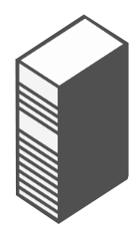












Application storage support – SMB 3.0
ENTERPRISE-CLASS FEATURES ON LESS EXPENSIVEHARDWARE
Hyper-V cluster
Microsoft SQL Server
  Highly available, shared
  data store for SQL
  Server databases and
  Hyper-V workloads.
  Increased flexibility,
  easier provisioning
  and management.
  Ability to take advantage
  of existing network infrastructure.
  No application downtime
  for planned maintenance
  or unplanned failures with failover clustering.
  Near line rate performance for both small and large IOs.
  Can work with existing storage investments.
  Built-in encryption support.
SMB
Single logical server \\foo\share
File server cluster
Single file system namespace
Cluster shared volumes
RAID
array
RAID
array
RAID
array
Windows
virtualized
storage
SAN
Storage space
Storage space
Storage space
Tiered physical
storage
SSD
Storage pool
Storage pool
HDD
Notes:
To cluster Hyper-V in Windows Server 2008 R2, you typically needed a SAN in the back-end – either an iSCSI or FC SAN. Setting up the SAN to support clustering has been challenging to some. We already have a solution for filebased storage in Windows which is the SMB fileshare that most of you are familiar with. These were traditionally your file repository for Office workers for storing powerpoint decks, word docs, videos and so on.
With WS 2012, we fully support using SMB fileshares for storing your Hyper-V VMs. Not the VM library or install ISOs, the live VHDs of your VMs. Not only that we also enable live SQL databases to reside in an SMB fileshare now.
<Click>
What this provides you is an additional file based storage option for your mission critical application that is very easy to provision at a fraction of the cost. You can now cluster your volumes together and expose them as a single file system name space to Hyper-V as a location to store the VMs or to your workload to store the SQL database. With SMB transparent failover, even if one of the nodes goes down, SMB transparently fails over to another node without down time.
<Click>
As you would see over the course of this presentation, we have augmented this with a lot of other functionality to provide real enterprise class performance and reliability with features like SMB Direct, SMB transparent failover, SMB multichannel, Clustered Share volumes and so on.
We also support encryption in SMB so that data that gets transferred over wire is safe and secure. And most importantly we have now changed Volume Shadow Service or VSS to support back-up of remote file storage. So any 3rd party back-up software that plugs into VSS can now back-up your SMB fileshares – backing up not only your documents but also your VMs and databases.
Finally, since SMB uses your existing network infrastructure – the need for a dedicated network is eliminated there by reducing management costs.
So no matter what your underlying storage subsystem is, SMB provides an easy and highly available repository for your SQL databases and Hyper-V VMs.
<Click>
Since all that you need for SMB is volumes – it really doesn’t matter how thse volumes are created – they could be a RAID attached storage solution,
<Click>
through a SAN.
<Click>
Or Storage Spaces

Slide 14
Using the speed of 10Gb Ethernet for storage
Hyper-V Cluster
Server Message Block (SMB) 3.0
Store Hyper-V files in shares over the Server Message Block (SMB) 3.0 protocol
Works with both standalone & clustered servers
Automatic configuration to detect and use multiple paths
Highlights
Increases flexibility
Eases provisioning, management & migration
Leverages converged network
Reduces CapEx and OpEx
Hyper-V
Hyper-V
Hyper-V
SQL
Server
SQL
Server
SQL
Server
IIS
IIS
IIS
VDI
Desktop
VDI
Desktop
VDI
Desktop
File Server
Cluster
Shared
Storage
Software and workloads used in performance tests may have been optimized for performance only on Intel microprocessors. Performance tests, such as SYSmark* and MobileMark*, are measured using specific computer systems, components, software, operations and functions. Any change to any of those factors may cause the results to vary. You should consult other information and performance tests to assist you in fully evaluating your contemplated purchases, including the performance of that product when combined with other products.
Notes:
What is it?
Store Hyper-V files in shares over the SMB 3.0 protocol
(including VM configuration, VHD files, snapshots)
Works with both standalone and clustered servers
(file storage used as cluster shared storage)
Highlights
Increases flexibility
Eases provisioning, management and migration
Leverages converged network
Reduces CapEx and OpEx
Supporting Features
SMB Transparent Failover - Continuous availability
SMB Scale-Out – Active/Active file server clusters
SMB Direct (SMB over RDMA) - Low latency, low CPU use
SMB Multichannel – Network throughput and failover
SMB Encryption - Security
VSS for SMB File Shares - Backup and restore
SMB PowerShell - Manageability

Slide 15
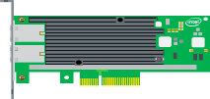
Sharing the load get 10Gb per second performance
Without Multichannel
With Multichannel
  Only one TCP/IP connection
  Only one CPU core engaged
  Receive Side Scaling (RSS) helps distribute load across CPU cores
CPU utilization per core
CPU utilization per core
Core 1
Core 2
Core 3
Core 4
Core 1
Core 2
Core 3
Core 4
Can’t use full 10Gbps
Full 10Gbps available

Slide 16
Combining LBFO teaming with multichannel for SMB 3.0
NIC Teaming with LBFO
Without Multichannel
NIC Teaming with LBFO
With Multichannel
LBFO
LBFO
LBFO
LBFO
Automatic NIC failover
But…
Can’t use full bandwidth
Only one NIC engaged
Only one CPU core engaged
Automatic NIC failover
With…
Combined NIC bandwidth available
Multiple NICs engaged
Multiple CPU cores engaged

Slide 17
Server Message Block (SMB) 3.0 multichannel performance
Source: Microsoft Sept 2012 white paper provides full details
See http://go.microsoft.com/fwlink/p/?LinkId=227841
Software and workloads used in performance tests may have been optimized for performance only on Intel microprocessors. Performance tests, such as SYSmark* and MobileMark*, are measured using specific computer systems, components, software, operations and functions. Any change to any of those factors may cause the results to vary. You should consult other information and performance tests to assist you in fully evaluating your contemplated purchases, including the performance of that product when combined with other products.
Notes:
Results using four 10GbE NICs simultaneously
Linear bandwidth scaling
1 NIC – 1150 MB/sec
2 NICs – 2330 MB/sec
3 NICs – 3320 MB/sec
4 NICs – 4300 MB/sec
Leverages NIC support for RSS (Receive Side Scaling)
Bandwidth for small IOs is bottlenecked on CPU

Slide 18
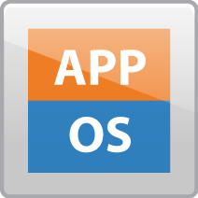


Comparing networking connections physical vs. virtualized servers
Physical Servers
Virtualized Servers
Microsoft* Windows Server 2012 with Hyper-V
VM
VM
Servers/Storage
Server Adapters
PG -A
PG -B
PG - Storage
PG - vMotion
PG - Mgmt
Management OS
Access Switch
Virtual Switch
VMBus
VMBus
Switch Uplinks
Aggression Switch
Notes:
Hyper-V Extensible Switch
Improved multitenant security for customers on a shared infrastructure as a service (IaaS) cloud through a layer-2 virtual interface that provides programmatically managed and extensible capabilities to connect virtual machines to the physical network
Hyper-V extensible switch is a virtual Ethernet switch that runs in the management operating system of the Hyper-V parent partition. Each instance of the extensible switch routes packets between the physical network interface in the host and the virtual network interfaces that are configured for the Hyper-V child partitions. These virtual network interfaces include Hyper-V external, internal, and private network interfaces.
Starting with Windows Server 2012, the extensible switch module supports an interface that allows NDIS filter drivers (known as extensible switch extensions) to bind within the extensible switch driver stack. This allows extensions to monitor, modify, and forward packets to extensible switch ports. This also allows extensions to inspect and inject packets in the virtual network interfaces that are used by the various Hyper-V partitions.
Extensions can be configured with switch and port policies to apply to packets that are routed through the extensible switch data path. This allows the driver to allow or deny a packet from being sent or received over a port.
In the extensible switch interface, the filter drivers are known as extensible switch extensions and the driver stack is known as the extensible switch driver stack.
The extensible switch interface supports the following types of extensions:
Capturing Extension An extension that captures and monitors packet traffic. This type of extension cannot modify packets or packet destinations through the extensible switch. However, capturing extensions can originate packet traffic, such as packets that contain traffic statistics that the extension sends to a host application.
Filtering Extension An extension that captures and monitors packet traffic. This type of extension can also inspect and reject packet delivery based on custom port or switch policy settings.
Forwarding Extension An extension that has the same capabilities as a filtering extension. This type of extension also determines the extensible switch destination ports that a packet is delivered to, as well as inject packet traffic to any extensible switch port. This type of extension also inspects and rejects packet delivery based on standard port policy settings.
Note If a forwarding extension is not installed and enabled in the extensible switch, the switch determines a packet's destination ports as well as filters packets based on standard port settings.
There are several extensions that offer exciting functionality for the Hyper-V Extensible Switch.
The highlight of this session was the number of partners that were looking for ways to build in new functionality here. Some of the extensions that were showcased are mentioned below:
Support for the Cisco Nexus 1000V for Hyper-V, in addition to the Cisco VM-FEX extension with direct I/O (SR-IOV).
Inmon with their traffic capturing &analysis and their sFlow product.
5Nine showed their Virtual Firewall.
Broadcom demonstrated a DoS Prevention extension.
NEC demonstrated an extension that converts Hyper-V to an OpenFlow virtual switch and integrates it with their Programmable Flow product.

Slide 19
Windows Server 2012 Virtual Switch Features
Tenant Isolation
Traffic Shaping
Security
Performance
Diagnostics
Network Controllers
Port ACL
Bandwidth
Minimum
DHCP
Guard
Dynamic
VMQ
Port
Mirroring
Stateless Offloads
PVLAN
Router
Guard
Event
Tracing
(ETW)
Virtual Machine Queues
Bandwidth
Cap
Trunk
mode
IPsec Task
Offload
Unified
Tracing
(UT)
SR-IOV Hypervisor Bypass
Notes:
Enable traffic control policies per VM or per host
Enable bandwidth policies real-time
Integrate physical switch with virtual switch and manage with single interface

Slide 20

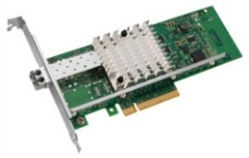
Microsoft* Windows* Server 2012 with Hyper-V* provides multiple options for 10GbE networking
Parent Partition
Child Partitions
Windows Server
VM 1
VM 2
Windows Kernel
Windows Kernel
Windows Kernel
Virtual Service Provider (VSP)
VSC
VSC
Miniport
VF Driver
Miniport Driver
Hyper-V
VMBus
Virtual Machine Bus (VMBus)
Intel® VT-d
PCI Express
Intel® Ethernet with VT-c Support
Default
Queue
Rx
Tx
Rx
Tx
VMQ1
Queue
VMQ2
Queue
Rx
Tx
Rx
Tx
Virtual Function
Rx
Tx
Rx
Tx
Virtual Function
Rx
Tx
Rx
Tx
Rx
Tx
Rx
Tx
Rx
Tx
Rx
Tx
Rx
Tx
Rx
Tx
Rx
Tx
Virtual Ethernet Bridge and Classifier (L2 Switch)
Dynamic Virtual Machine Queues (DVMQ)
Example: VM1 is traffic is assigned to VMQ1
SR-IOV¹ for VM Direct Assignment
Example: VM2 is directly assigned to a virtual function
¹PCI-SIG Single Root I/O Virtualization and Sharing (SR-IOV)
Notes:
Dynamic Virtual Machine Queues (DVMQ):
Dynamically spans processing VMQ network traffic across more than one CPU and automatically scale up and scale down the CPU utilization based on demand
Packets routing is handled by the Intel® Ethernet Controller queues enabled by VMDq. Packets are sorted and directed to each VM allowing concurrent receive processing for multiple VMs. Every queue is serviced by a different processor core using the controllers QoS round-robin scheduler. Routing to queues in the Ethernet controller avoids a copy step to copy data from the controllers receive buffers to the VM address space. DMVQ will dynamically span processing VMQ n/w traffic across more than one CPU. It will automatically scale up and scale down the CPU utilization based on demand.
SR-IOV for Direct Device Assignment to a VM
Windows Server 2012 supports direct device assignment to virtual machines without compromising flexibility
High traffic VMs can be assigned directly to a PCI Express* Virtual Function (VF) provided by SR-IOV support in the OS, Server Platform and Intel® Ethernet Controller by-passing the Hypervisor and Virtual Switch.

Slide 21
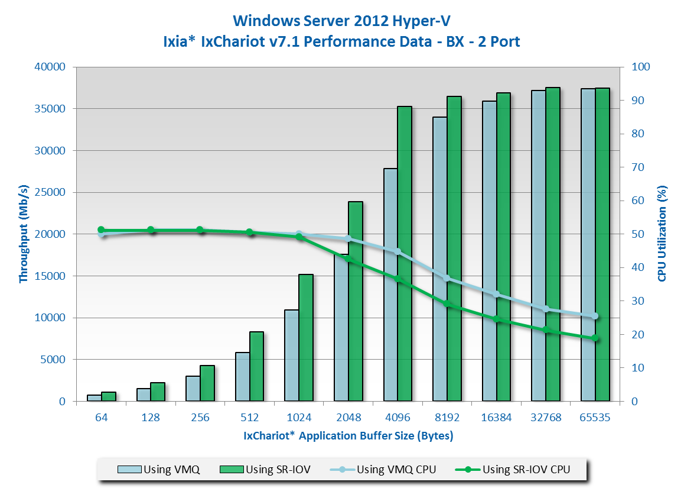


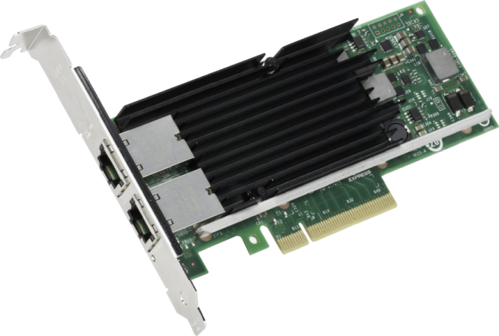
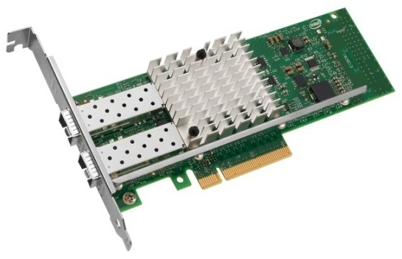
Higher throughput & lower CPU utilization
Intel® Ethernet Converged Network Adapter X520 using SR-IOV in Microsoft* Windows* Server 2012 with Hyper-V
Using SR-IOV can
improve Performance
Up to
47%
Up to
26%
Increase
in Throughput (Mb/s)
(64 Bytes)
Reduction
in CPU Utilization
(65535 Bytes)
LAD SW Performance Lab
July 2012
SUT Configuration |  | Client Configuration
Platform | Intel® Server Board S2600GZ | Client Platform | Supermicro* 6016TT-TF (10GbE clients)
OS | Windows Server 2012 Hyper-V | OS | Windows Server 2008 R2 x64
Processor | Intel® Xeon® processor E5-2690 (8C/16T, 20M Cache, 2.90 GHz, 8.00 GT/s Intel® QPI) | Processor | Intel® Xeon® Processor X5680 (12M Cache, 3.33 GHz, 6.40 GT/s Intel® QPI)
QPI Speed | 8.0 GT/s | Memory | 12GB DDR3 @1333 MHz
Memory | 128 GB @ 1333 MHz | BIOS | 2.0b
BIOS Version | SE5C600.86B.01.02.0006 | NIC | Intel® Ethernet CNA X520-T2 (Iron Pond)
NIC | Intel 82599 10 Gigabit Ethernet Controller | NIC Driver | 2.11.114.0
NIC Driver | ixn63x64-3.1.42.0 | Switch Configuration
NIC EEPROM | 0x18bf0001 | Switch Type | Force10 Networks* ExaScale* E1200i
System Slot # | PCI Slot 2 Bus 9 | Config | Each NIC port in it's own VLAN
Chipset | Intel® C602 Chipset
BIOS Changes | Power management disabled.
OS / Kernel Changes | Added Hyper-V role, for the VMQ tests, SR-IOV was not enabled in the Virtual Switch
Notes | used 8 VMs per port, for the WS2012 tests, the VMs were WS2012 build 8400
Intel® Ethernet Converged
Network Adapter X540
Intel® Ethernet Converged
Network Adapter X520
Software and workloads used in performance tests may have been optimized for performance only on Intel microprocessors. Performance tests, such as SYSmark* and MobileMark* are measured using specific computer systems, components, software, operations and functions. Any change to any of those factors may cause the results to vary. You should consult other information and performance tests to assist you in fully evaluating your contemplated purchases, including the performance of that product when combined with other products.

Slide 22
Challenges of traditional networking
Increasing operational complexity
Server and network provisioning
Controlling datacenter traffic flow

Slide 23
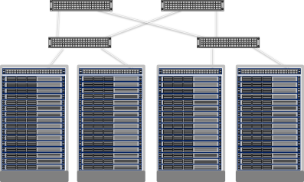
What is the next step?
VM
VM
Blue VM
Red VM
Blue network
Red network
Virtualization
Physical
server
Physical
network
Server virtualization
  Multiple virtual servers on a physical server
  Each VM has illusion it is running as a physical server
Network virtualization
  Multiple virtual networks on a physical network
  Each virtual network has illusion it is running as a physical network

Slide 24



Using VLANs to isolate VM traffic
Aggregation Switches
Top of Rack Switch (ToR)
VLAN tags
VM
VM
VM
VM
VM
VM
VM
VM
VM
Network Admin
VM
VM
VM
VM
VM
VM
Server Admin
Requires Network Admins to configure VLANs and Subnets

Slide 25
Hyper-V network virtualization benefits
To Workload Owners
Seamless migration to the cloud
Move n-tier topology to the cloud
Preserve policies, VM settings, IP addresses
To Enterprises
Private Cloud datacenter consolidation and efficiencies
Extension of datacenter into hybrid cloud
Incremental integration of acquired company network infrastructure
To Hosters
Bring Your own IP
Bring Your network topology
To Private/Public Cloud Datacenter Admins
Flexible VM placement without reconfiguration
Decoupling of server and network admin roles increases agility
Scalable multi-tenancy

Slide 26

Standards-based encapsulation - NVGRE
Better network scalability by sharing PA among VMs
Explicit Virtual Subnet ID for better multi-tenancy support
192.168.4.11➔
192.168.4.22
GRE Key 5001
MAC
10.0.0.5 ➔
10.0.0.7
192.168.4.11➔
192.168.4.22
GRE Key 6001
MAC
10.0.0.5 ➔
10.0.0.7
192.168.4.11
Provider Addresses
192.168.4.22
Virtual Switch
Virtual Switch
VM1
VM1
VM2
VM2
10.0.0.5
10.0.0.5
Customer Addresses
10.0.0.7
10.0.0.7
10.0.0.5➔
10.0.0.7
10.0.0.5➔
10.0.0.7
10.0.0.5 ➔
10.0.0.7
10.0.0.5➔
10.0.0.7

Slide 27
Using NVGRE for network virtualization
Provider Network
Encapsulated Traffic
datacenter Policy
Blue
VM₁: MAC₁, CA₁, PA₁
VM₂: MAC₂, CA₂, PA₃
VM₃: MAC₃, CA₃, PA₅
VM₄: MAC₁, CA₄, PA₇
VM₅: MAC₂, CA₅, PA₈
VM
VM
VM
VM
VM
VM
VM
VM
VM
Red
VM₁: MAC_{X}, CA₁, PA₂
VM₂: MAC_{Y}, CA₂, PA₄
VM₃: MAC_{Z}, CA₃, PA₆
VM
VM
VM
VM₄: MAC_{Z}, CA₃, PA₉
Green
VM₁: MAC_{a}, CA₁, PA₁
VM₂: MAC_{b}, CA₂, PA₂
VM₃: MAC_{c}, CA₃, PA₅

Slide 28
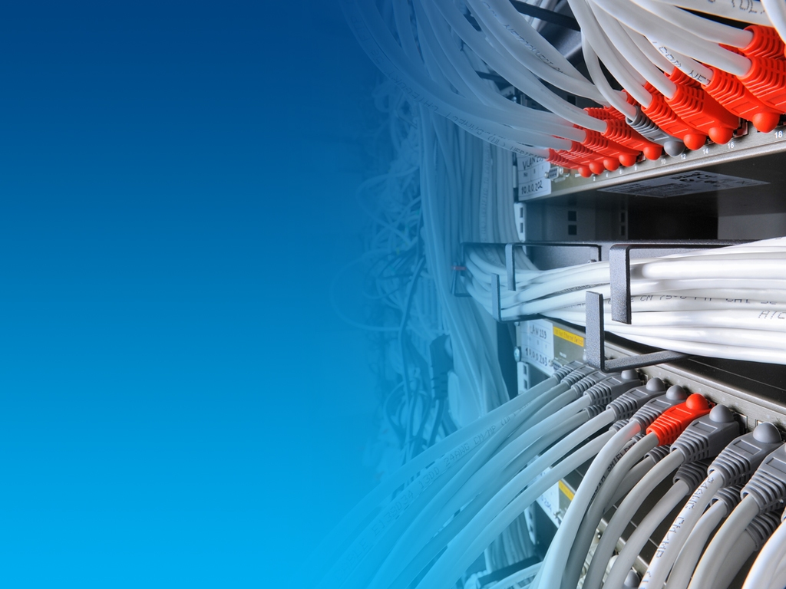
Why is SDN important in the Cloud?

Slide 29

Software Defined Networking
Three key virtues
  Decoupled
  Control and data planes are decoupled
Centralized
  Network intelligence and state are centralized
Abstracted
  Network infrastructure is abstracted from the applications
Notes:
An approach where software can dynamically manage the network, allowing it to adapt to changing workload needs by:
Enabling integrated policies that span physical and virtual networks
Controlling datacenter traffic flow
Abstracting workloads from the physical network

Slide 30
Property management
Rental House
Apartment
Hotel
# of Tenants | One | Several | Many
Change | Infrequent | Occasional | Daily
$$ | Long term | Utilization, low turnover | Utilization, low OPEX
Management | Individual | Building Manager | Staff, Systems, & Automation

Slide 31
Bringing it back to the datacenter
VM
VM
VM
VM
VM
VM
VM
VM
VM
Dedicated
Servers
Server Virtualization
Cloud
# of Tenants | One | Several | Many
Change | Infrequent | Occasional | Daily
$$ | Long term | Utilization, low turnover | Utilization, low OPEX
Management | Individual | Building Manager | Staff, Systems, & Automation

Slide 32
Benefits of Software Defined Networking
Programmability, automation and control
  Increased scale and flexibility
  Easily adaptable to new business needs
Significant reduction in OpEx and CapEx
  Provides centralized view of the network (at large scale)
  Automates mapping of network resources to changing workflows
  Supports uniform control of multi-vendor network environments

Slide 33
Evolution: Dis-aggregated network
App
App
App
Network Controller
App
App
App
App
App
App
Operating
System
Dis-aggregated Control Plane
Dis-aggregated Control Plane
Operating
System
App
App
App
Standard Switching Hardware
Operating
System
Standard Switching Hardware
Dis-aggregated Control Plane
App
App
App
Dis-aggregated Control Plane
Standard Switching Hardware
Operating
System
Standard Switching Hardware
App
App
App
Operating
System
Dis-aggregated Control Plane
Standard Switching Hardware

Slide 34

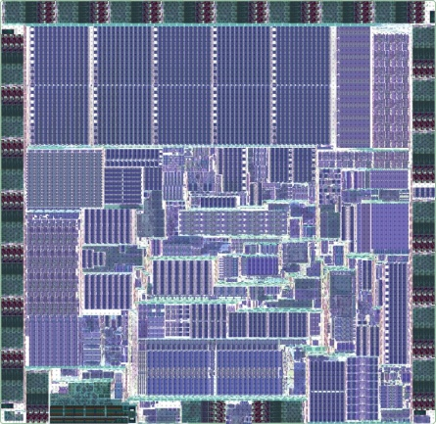
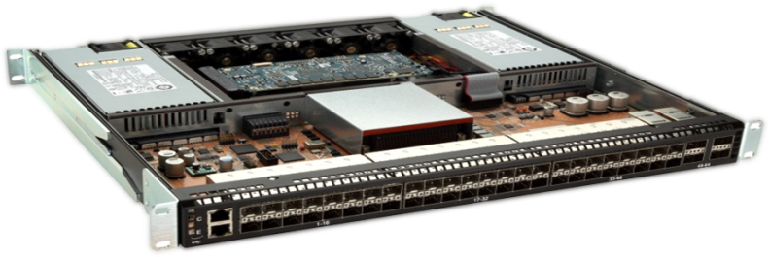


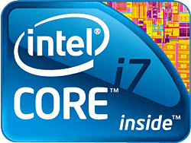

Intel® Open Network Platform Switch Reference Design
SDN Controller
SP App
OEM App
ISV App
Wind River* Open Network Software (ONS)
Software
HW
Hardware
Intel Architecture
Intel Communications
Chipset 89xx Series
Intel Ethernet FM6700 Switch
Intel Product
Wind River Product
3rd Party
*Other names and brands may be claimed as the property of others.
Notes:
ONP Software (ONS)
Scalable Control Plane Abstraction - Programmable Object Model
Flexible Data Plane Abstraction - Simplifies control plane and management application development for networking devices.
Robust & standards-based Layer 2/2+ Protocol
Open Source L3 Protocol Suite – Based on Quagga
Hardware-independence Layer (HAL) – Chipset variety
Toroki SimSwitch*
Simulation software allows development and test of applications on any size network topology without the expense of a real network
Test Suite
Automated testing framework and unit test cases that exercise all ONS Network Platform functionalities

Slide 35
Switch silicon designed for SDN
Simultaneously supports legacy and SDN networks
Designs can be optimized for flexibility or scale
Offers flexible tagging and overlay networks
Delivers uncompromising performance
Intel® Ethernet Switch
FM6000 Series
Notes:
Simultaneously supports legacy and SDN networks
Also supports NAT, load balancing, IP tunneling
Can be optimized for flexibility or scale
4K full OpenFlow* 12-tuple table entries (single pass)
100K table entries compiled from L2/L3/L4 and metadata
Offers flexible tagging and overlay networks
Can provide SDN and tunneling proxy for connected hosts
Delivers uncompromising performance
Single-pass lookups at line rate (no corner cases)
Highly-deterministic 400ns latency

Slide 36
Intel® FlexPipe™ Technology
Parser
Mapper
Channels
CM &
Sched
Modify
Header
TCAM &
BST
Nexthop
Table
L3
Actions
L2
Lookup
Global
Ports
Egress
Actions
Atomic Tables
Configurable Logic
Statistics
Sample Programmable Protocols
Tunneling TRILL, MPLS, NAT
Network Overlays VXLAN, NVGRE
Virtualization EVB, VEPA, VEPA+, VN-Tag
Proprietary Customer defined headers
Mux &
Transform
Mux &
Transform
CAM
Action
RAM
CAM
Action
RAM
Multiple Stages
Programmable and deterministic up to 960Mpps

Slide 37
Using gateways to bridge virtual and physical network
Intel® Open Network Platform Switch Reference Design
HW NVGRE gateway
VM
VM
VM
VM
VM
VM
VM
VM
VM
VM
VM
VM
Provider Network
VLAN tags
Encapsulated Traffic

Slide 38
Standards based switch management
CIM enabled switch
Automate deployment and management of both the tenant network and the hoster network
Standards based CIM model / schema to communicate with switch

Slide 39
Delivering Software-Defined Networking (SDN)
Windows Server 2012 R2
  Hyper-V Network Virtualization
  Hyper-V Extensible Switch
System Center 2012 R2
Intel® Ethernet Building Blocks
  Optimizations for Hyper-V Switch
  Network Virtualization gateways
  Intel® Open Network Platforms
Flexibility
Control
Automation

Slide 40
Summary
Network Virtualization is deployable today
Network Virtualization revolutionizes
multi-tenant clouds (private, hybrid, public)
Software Defined Networking brings datacenter flexibility, control, and automation

Slide 41

Related content
Intel and Microsoft Server and Cloud Platform Resources
Intel white paper “Game-Changing Capability for Your datacenter—and a Solid Foundation for Your Cloud”
http://www.intel.ie/content/dam/www/public/us/en/documents/white-papers/cloud-computing-xeon-e5-server-2012-paper.pdf
Intel solution brief “Microsoft Windows Server* 2012 and the Intel® Xeon® processor E5 family” http://www.intel.com/content/www/xa/en/cloud-computing/cloud-computing-xeon-e5-microsoft-server-solution-brief.html
Intel Cloud Computing Technology and Vision
http://www.intel.com/content/www/us/en/cloud-computing/intel-s-cloud-computing-vision.html
Intel Cloud Computing Solutions
http://www.intel.com/content/www/us/en/cloud-computing/intel-cloud-based-solutions.html
Intel® Xeon® Processor E5 Family
http://www.intel.com/content/www/xa/en/processors/xeon/xeon-processor-5000-sequence.html
Microsoft* Server and Cloud Platform (Windows Server, System Center, Azure)
http://www.microsoft.com/en-us/server-cloud/cloud-computing/
Microsoft Windows Server* 2012
http://www.microsoft.com/en-us/server-cloud/windows-server/
Find me at the Intel booth or on Twitter @thehevy

Slide 42
Track resources
Breakout Sessions
MDC-B350 How to Design and Configure Networking in Microsoft System Center - Virtual Machine Manager and HyperV Part 1
MDC-B351 How to Design and Configure Networking in Microsoft System Center - Virtual Machine Manager and HyperV Part 2
MDC-B380 Deep dive on Hyper-V Network Virtualization in Windows Server 2012 R2
MDC-B216 What’s new in Windows Server 2012 R2 Networking

Slide 43
Track resources
Learn more about Windows Server 2012 R2 Preview, download the datasheet and
evaluation bits on
http://aka.ms/WS2012R2
Learn more about System Center 2012 R2 Preview, download the datasheet and evaluation bits on
http://aka.ms/SC2012R2

Slide 44

Resources
Learning
  Sessions on Demand
  Microsoft Certification & Training Resources
http://channel9.msdn.com/Events/TechEd
www.microsoft.com/learning
TechNet
msdn
  Resources for IT Professionals
  Resources for Developers
http://microsoft.com/technet
http://microsoft.com/msdn

Slide 45

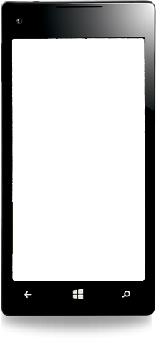

Evaluate this session
Required Slide
*delete this box when your slide is finalized
Your MS Tag will be inserted here during the final scrub.
Scan this QR code to
evaluate this session.

Slide 46
Summary of Intel Enablement and Optimization of Windows Server* 2012
Microsoft Pillar | Intel Technology | Windows Server* 2012 Technology | IT Benefit
Beyond Virtualization
Dynamic Resource Control | Virtual Machine Device Queues (VMDq) | Dynamic Virtual Machine Queue (DVMQ) | I/O virtualization with optimized balance of performance and IT control
 | PCI-SIG Single Root I/O Virtualization (SR-IOV) | SR-IOV | Alternative I/O virtualization option for lower latency and CPU utilization
Power of Many Servers, Simplicity of One
Continuous Availability | Machine Check Architecture (MCA) Recovery | Windows* Hardware Error Architecture (WHEA) Also supported in Hyper-V*, Microsoft SQL Server* 2012 | Recovery from uncorrectable errors for robust reliability. Delivered by Intel® Xeon® processor E7 family with MCA Recovery
 | Intel® Advanced Encryption Standard New Instructions (Intel® AES-NI) Intel® Secure Key Technology Intel® OS Guard Intel® XD Bit | Microsoft Crypto Next Generation* (CNG*) library | Fast, low-overhead encryption High-quality keys Enhanced protection from escalation of privilege attacks Secure key storage Reduce platform attack surface
Unified Networking | Fibre Channel over Ethernet (FCoE) datacenter Bridging (DCB) iSCSI with intelligent offloads | FCoE and iSCSI software initiators | Unified 10 GbE networking: High-bandwidth, low-latency Low cost Ethernet fabric
Breakthrough Storage Economics | Intel® Xeon® processor E5 family 10 Gb Intel® Converged Network Adapters NetEffect™ Ethernet Server Cluster Adapters (for RDMA) | Server Message Block (SMB) 3.0 SMB 3.0 Direct for remote direct memory access (RDMA) | SAN-like storage using low-cost file servers and disk arrays
Energy Efficiency | Intel® Intelligent Power Technology Intel® Node Manager 2.0 | Kernel optimizations Logical processor idling | 15 percent greater efficiency versus Windows Server 2008 R2 Improved power budgeting
Notes:
This slide provides a summary of specific Intel and Microsoft enablement efforts. Each of these technologies address a fundamental need in today’s datacenters, especially for customers who are increasing their use of virtualization and moving toward the cloud.
10GbE Intel Ethernet for a faster, simpler, and more cost-effective network.
VMDq and SR-IOV for near-native I/O performance—so servers and applications can take full advantage of that expanded and unified network.
Intel AES-NI, Intel Secure Key Technology so encryption is more secure and can be used pervasively to protect data on shared and public infrastructure, with less impact on application performance, and Intel OS Guard to help prevent escalation of privilege (EOP) security attacks
Intel MCA Recovery to enable high-end availability and data integrity on cost-effective Intel Xeon processor-based server platforms.

Slide 47
Empower Windows Server* 2012 with
Intel® Xeon® Processors
Windows Server* 2012 designed for cloud-optimized IT
      A cloud-optimized IT environment with support for multitenancy, dynamic resource control, unified 10 Gb networking, and breakthrough storage economics
Intel® Xeon® processor E5 family
      Enhanced security through fast, low-overhead encryption with Intel® Advanced Encryption Standard New Instructions (Intel® AES-NI) and associated Intel security technologies
      Superior energy efficiency via Intel® Intelligent Power Technology and Intel® Node Manager 2.0
10 Gigabit Intel® Ethernet Converged Network Adapter family
      Better I/O performance via Intel® Virtualization Technology for Connectivity (Intel® VT-c) (Virtual Machine Device Queues [VMDq] and Single Root I/O Virtualization [SR-IOV])
Intel® Open Network Platform family
      Intel® Ethernet Switch silicon, reference architectures and software for SDN & network virtualization to enable the network architecture transformation
Notes:
Windows Server 2012 provides a cloud-optimized operating environment that can help customers solve key datacenter challenges and move to the cloud in an incremental and cost-effective fashion.
Intel Xeon processors and Intel Ethernet Adapters deliver higher value for Windows Server 2012 deployments, in part due to their inherent performance and reliability advantages. A number of integrated technologies add additional value and have been extensively optimized and tested in collaboration with Microsoft. Some of the most important are shown in this slide:
Intel MCA Recovery, Intel AES-NI, and Intel Node Manager are unique to Intel Xeon processors and can help customers create a more resilient, secure, and energy-efficient datacenter that delivers higher value with lower costs and less effort. (Intel Secure Key Technology and Intel OS Guard will be provided on next-generation server platforms to further improve encryption security and to provide better protection against escalation of privilege security attacks.)
VMDq is implemented via hardware and software in Intel Ethernet Adapters to provide a solution that uniquely balances hardware I/O acceleration and software extensibility. It helps to eliminate a critical potential bottleneck in today’s virtualized datacenters and clouds, and it does so without bypassing critical functionality in Hyper-V that lets IT retain control of QoS.

Slide 48


Slide 49

© 2013 Microsoft Corporation. All rights reserved. Microsoft, Windows and other product names are or may be registered trademarks and/or trademarks in the U.S. and/or other countries.
The information herein is for informational purposes only and represents the current view of Microsoft Corporation as of the date of this presentation. Because Microsoft must respond to changing market conditions, it should not be interpreted to be a commitment on the part of Microsoft, and Microsoft cannot guarantee the accuracy of any information provided after the date of this presentation. MICROSOFT MAKES NO WARRANTIES, EXPRESS, IMPLIED OR STATUTORY, AS TO THE INFORMATION IN THIS PRESENTATION.

