Slide 2
Your Fileservers and Storage Options
MDC-B349
Upgrading the Platform - How to Get There!
Rick Claus
Sr. Technical Evangelist
@RicksterCDN
Andrew McMurray
Technical Evangelist
@MaccaMSOZ

Slide 3
What part of your IT Infrastructure are you the most concerned with upgrading?
* note: My completely unsubstantiated informal TWPoll: http://twtpoll.com/uuk37y

Slide 4
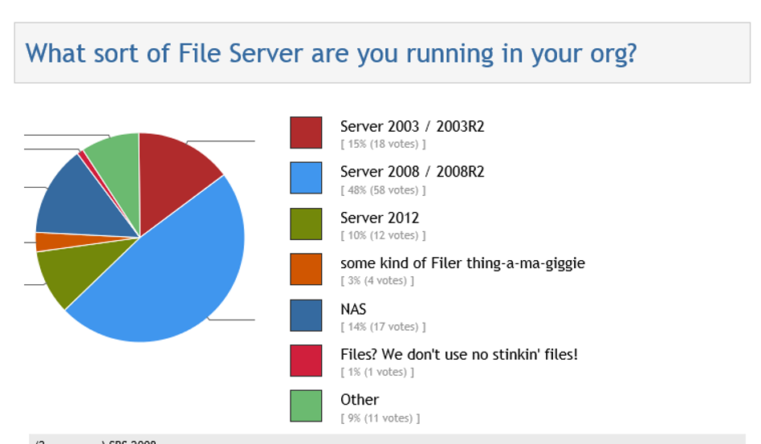

Slide 5
The workhorse in your server stables
When is the last time you actually touched a your File Server?
Tirelessly serves up files and data to your organization.
Probably one of your last physical boxes.
Often overlooked for “upgrades” in technology.

Slide 6
Why Windows Server 2012 FileServers
Storage Spaces
In Box Deduplication
SMB 3.0 (SMB Multichannel)
NIC Teaming in box
Scale Out File Server (Hyper-V and SQL)
Easiest path to Windows Server 2012 R2

Slide 7
Storage Spaces
Windows Application Server or File Server
Virtualization of storage with Storage Pools and Storage Spaces
Storage resilience and availability with commodity hardware
Resiliency and data redundancy through n-way mirroring (clustered or unclustered) or parity mode (unclustered)
Utilization optimized through thin and trim provisioning and enclosure awareness
Integration with other Windows Server 2012 capabilities
Serial Attached SCSI (SAS) and Serial AT Attachment (SATA) interconnects
Physical or virtualized deployments
Integrated with other Windows Server 2012 capabilities
File Server Administration Console
Hyper-V
SMB Multichannel
Failover Clustering
NTFS
SMB Direct
Cluster Shared Volume
NFS
Windows Storage Mgmt.
Windows Virtualized Storage
Storage Space
Storage Space
Storage Space
Storage Pool
Storage Pool
Physical Storage
(Shared) SAS or SATA

Slide 8
Save me some disk space mate!
Maximize capacity by removing duplicate data
2:1 with file shares, 20:1 with virtual storage
Less data to back up, archive, and migrate
Increased scale and performance
Low CPU and memory impact
Configurable compression schedule
Transparent to primary server workload
Improved reliability and integrity
Redundant metadata and critical data
Checksums and integrity checks
Increase availability through redundancy
Faster file download times with BranchCache
VHD Library
Software Deployment Share
General File Share
User Home Folder (My Docs)
0% 20% 40% 60% 80% 100%
Average savings with Data Deduplication by workload type
Source: “Microsoft Internal Testing"

Slide 9
Preparing the FileServers

Slide 10
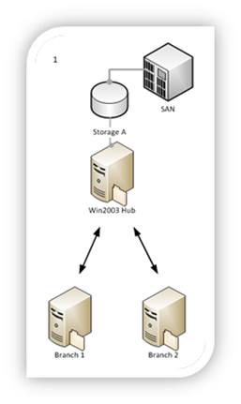
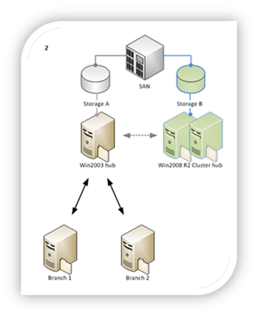
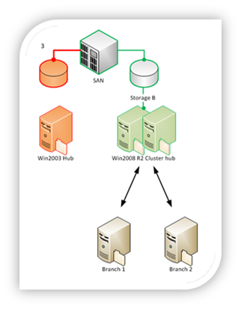

Slide 11
DFS Migration

Slide 12
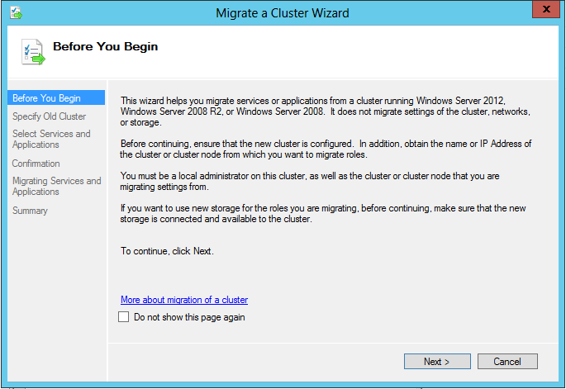
Copy Cluster Roles Wizard

Slide 13
Copy Cluster Roles Wizard: Testing
You can test the Copy Cluster Roles process without impacting customers / production
The process is reversible if you encounter any issues
Useful for copying roles on test clusters

Slide 14
Copy Cluster Roles Wizard: Storage
Assumes that storage will be re-used between the old (source) cluster and the new (target) cluster
Does not copy any data – just cluster role settings from the old (source) cluster to the new (target) cluster

Slide 15
Copy Cluster Roles Wizard Roles Supported:
Hyper-V VMs / VM Configuration
Scale-out File Server
CSV Disk
Storage Pools, Storage Spaces
File Server
Physical Disk
Cluster Registry Settings
DFS-Namespace
DHCP
DTC
Gen App / Script / Service
Hyper-V Replication Broker
iSCSI Target / iSCSI Target Disk Proxy
iSNS
MSMQ / MSMQ Triggers
Network Name
Distributed Network Name
NFS

Slide 16
Copy Cluster Roles Wizard Roles not Supported:
SQL Server
Exchange Server
Print Spooler
Remote Desktop Connection Broker
DFS-R
Volume Shadow Copy Service Tasks
Task Scheduler Tasks
Cluster Aware Updating (CAU)

Slide 17
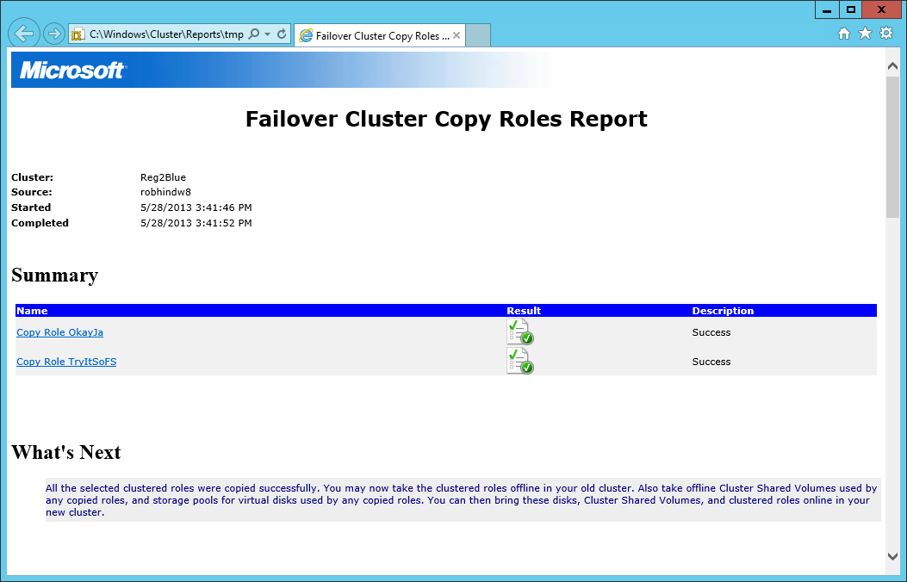
Copy Cluster Roles Wizard Copy Roles Report
Please Read Them!
Record of Role and Resource copies
Highlights any additional steps necessary
Shows changes in disk mapping / resource names
All Copy Roles Reports are saved in the Reports folder

Slide 18
Cluster Migration

Slide 19
What if I have \\server\share ?
Server Migration Tools:
Local group migration
Computer Name migration
IP address migration
Robocopy /?
RichCopy (if you prefer GUI)
Migration Tools (performance degraded)

Slide 20
Doin’ it the old fashioned way

Slide 21
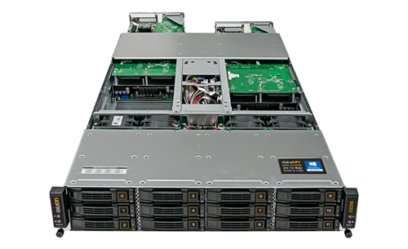
Cluster in a Box Design Considerations
1/10G E or Infiniband
1/10G E or Infiniband
Network
Network
Availability
At least one node and storage always available, despite failure or replacement of any component
Dual power domains
Server Enclosure
x8 PCIe
x8 PCIe
Server A
Server B
CPU
1/10G Ethernet cluster connect
(through midplane)
CPU
x8 PCIe
x8 PCIe
Storage Controller
x4 SAS (through midplane)
Simplicity
Pre-wired, internal interconnects between nodes, controllers, and storage
Storage Controller
x4 SAS
x4 SAS (through midplane)
x4 SAS
DataOn – DNS 9220
SAS Expander
0
1
23
B ports
SAS Expander
A ports
…
Flexibility
PCIe slots for flexible LAN options
External SAS ports for JBOD expansion
Office-level power, cooling, and acoustics to fit under a desk
External JBOD
SAS Expander
0
1
23
B ports
SAS Expander
A ports
…
Additional JBODs …

Slide 22
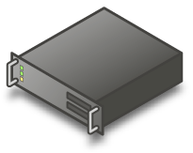
Extending the Market for Continuous Availability
New systems expand choices of cost and Features
Features
Additional scale out features
High Availability
Simple OOBE
Spaces configurations
HW RAID capability
SSD perf capability
Scale out Server Cluster
Cluster in a Box
iSCSI/FC
SMB/NFS
iSCSI/FC
SMB/NFS
iSCSI/FC
SMB/NFS
SAS/SATA
Storage Arrays
SAS/SATA
Extended scale out
Advanced replication
Advanced power management
Advanced performance options
…
Optional JBOD
storage expansion
Single node servers
Target markets for Cluster in a Box solutions
SMB
Branch
Private Cloud
SAS/SATA
$$
IT Expertise
JBOD storage
IT Generalist or remote only
IT Specialists

Slide 24
Related content
(MDC-B323) Re-Architecting Your Infrastructure with Windows Server 2012 and Microsoft System Center 2012 SP1
(WCA-B336) Reimagining and Migrating Your Active Directory
(MDC-B348) Networking Infrastructure and Management
(MDC-B349) Your Fileservers and Storage Options

Slide 25
Track resources
Resource 1
Resource 2
Resource 3
Resource 4

Slide 26
Resources
Learning
Sessions on Demand
Microsoft Certification & Training Resources
http://channel9.msdn.com/Events/TechEd
www.microsoft.com/learning
TechNet
msdn
Resources for IT Professionals
Resources for Developers
http://microsoft.com/technet
http://microsoft.com/msdn

Slide 27
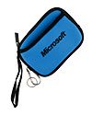
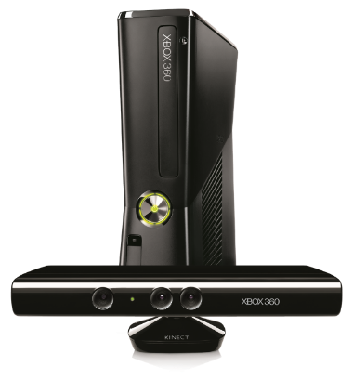
Complete an evaluation on CommNet and enter to win!

Slide 28
© 2013 Microsoft Corporation. All rights reserved. Microsoft, Windows and other product names are or may be registered trademarks and/or trademarks in the U.S. and/or other countries.
The information herein is for informational purposes only and represents the current view of Microsoft Corporation as of the date of this presentation. Because Microsoft must respond to changing market conditions, it should not be interpreted to be a commitment on the part of Microsoft, and Microsoft cannot guarantee the accuracy of any information provided after the date of this presentation. MICROSOFT MAKES NO WARRANTIES, EXPRESS, IMPLIED OR STATUTORY, AS TO THE INFORMATION IN THIS PRESENTATION.

