Slide 2
What’s new in System Center 2012 SP1
MDC-B354
Kenon Owens, Michael Leworthy Won Huh
Microsoft Technical Product Marketing

Slide 3
Session Objectives and Takeaways
Objective:
To provide an overview of the new features highlighted in System Center 2012 SP1
Virtual Machine Manager
Operations Manager
Data Protection Manager
Orchestrator
Service Manager
App Controller
Evaluate the new capabilities in your environment

Slide 4
Application Management
App Controller
Service Provider Framework
Application Performance Monitoring
Michael Leworthy, Senior Product Manager

Slide 5
New Capabilities in SP1
Monitoring MVC and WCF applications
Monitoring .NET apps hosted in Windows Services
Intellitrace and TFS integration
360o .NET application monitoring
Monitoring applications running in IIS8/Windows Server 2012
Global Services Monitoring
APM monitoring for Sharepoint 2010
Azure SDK support (storage, SQL Azure)

Slide 6
360º view of application health
Availability
Global Service Monitor
Internal Synthetic Transactions
Performance
NET Application Performance Monitoring
Global Service Monitor
Client-Side Monitoring
Reliability
.NET Application Performance Monitoring
Global Service Monitor
Resolution
Team Foundation Services Work Item Synchronization
Visual Studio
Diagnostics
NET Application Performance Monitoring
SCOM Infra Monitoring MPs
IntelliTrace integration

Slide 7
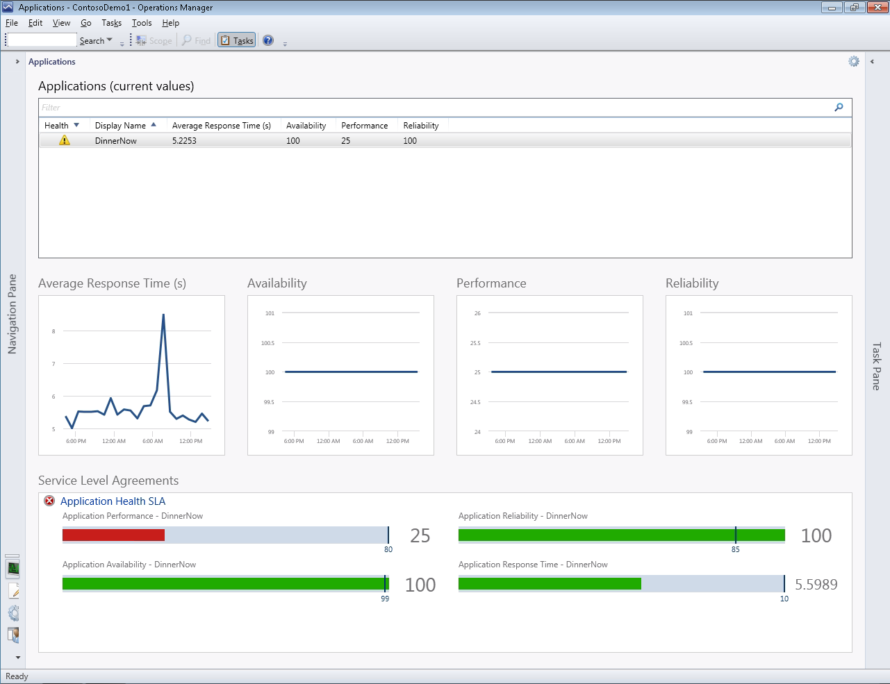
360º .NET application monitoring
Displays information from
Global Service Monitor,
.NET Application Performance Monitoring
Web Application Availability Monitoring
Summary of health and key metrics for 3-tier applications in a single view.

Slide 8
Predictable application SLA Global Service Monitor
Web Test + Schedule
Web Test
Microsoft Visual Studio 2012
Operations Manager
Global Service Monitor
Results
Workitem +
Results
!
Call Web App
Production Application
On-premises
Results

Slide 9
Demo
360° reporting
Global Service Monitoring

Slide 10
Service delivery and automation
Orchestrator
Service Manager
Kenon Owens, Senior Product Marketing Manager

Slide 11
New capabilities in SP1
Service delivery and automation
Partner extensibility
Deploy Windows Azure VM’s
Cloud Service Process Pack
Console, Windows PowerShell on Win7 SP1
Orchestrator Integration
Chargeback

Slide 12
Chargeback optimizes infrastructure usage
Chargeback
Driving behavior management
Needs
Resources
IT
Technical features
Monitor usage
(allocation)
Pricing
Insights through reporting
Business
capabilities
Planning and insight
Building infrastructure

Slide 13
Integration Packs for automation across clouds
Microsoft Cloud
Private Cloud
Service Provider
Out-of-the-box
Out-of-the-box
Partner enabled IP’s
Orchestrator integration enables Microsoft and third-party platforms to coordinate and use operational data in the infrastructure across varying cloud scenarios (on-premises, Microsoft cloud and service provider clouds)
Orchestrator integration enables Microsoft and third-party platforms to coordinate and use operational data in the infrastructure across varying cloud scenarios (on-premises, Microsoft cloud and service provider clouds)
BMC
Dell - AIM
NetApp - OCPM
Cisco
UCS
NCM JaxMP/Frysoft
Vision Solutions - DoubleTake
Kelverion
ServiceNow
Data Manipulation
HTTP Applications
All Systems Center Components
Active Directory
Exchange (User and Admin)
IBM Tivoli Netcool/Omnibus
HP (OM, SM, iLO)
All Systems Center Components
Active Directory
Exchange (User and Admin)
IBM Tivoli Netcool/Omnibus
HP (OM, SM, iLO)
Windows Azure
FTP
VMware vSphere
Windows Azure
FTP
VMware vSphere
New capabilities in SP1
13

Slide 14
Demo
Chargeback
Orchestrator integration with Azure

Slide 15
Operations and cross-platform management
Virtual Machine Manager
Operations Manager
Won Huh, Product Marketing Manager

Slide 16
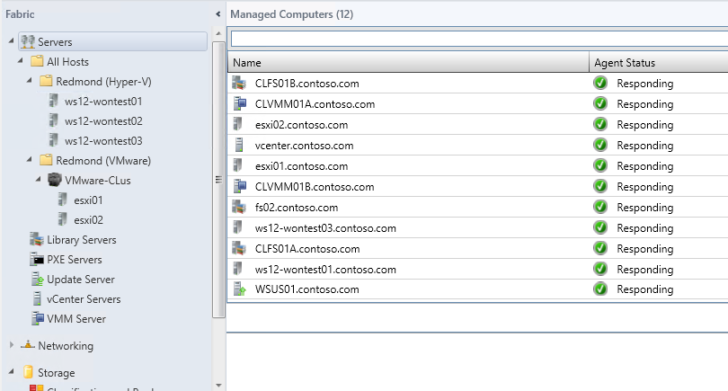
New Cross Plat Capabilities in SP1
Virtual Machine Manager
Personalize OS instances when deploying
Use service templates for multi-tier deployments
Scale out using service templates
Live migrate across Hyper-V hosts

Slide 17
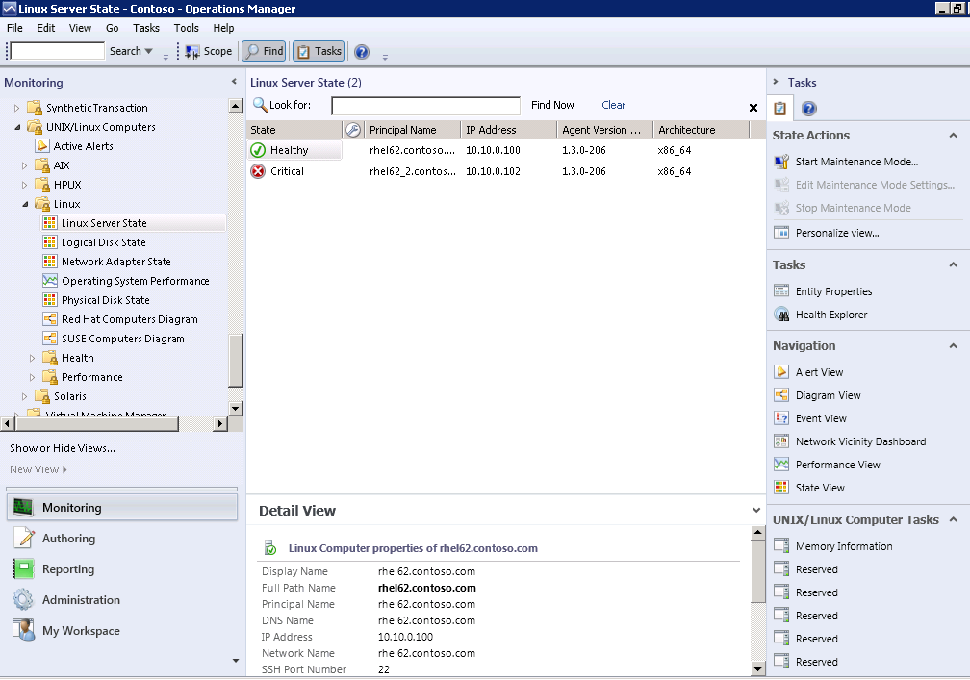
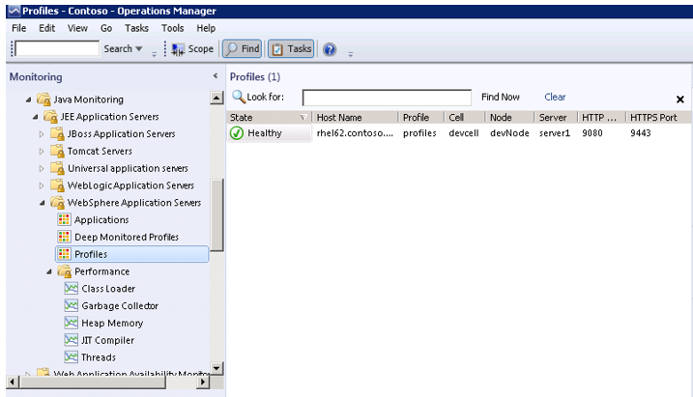
New Cross Plat Capabilities in SP1
Operations Manager
Monitor OS health & performance
Monitor log files
Monitor JEE app servers
Monitor line-of-business applications
Monitor databases and web servers
Audit security events

Slide 18
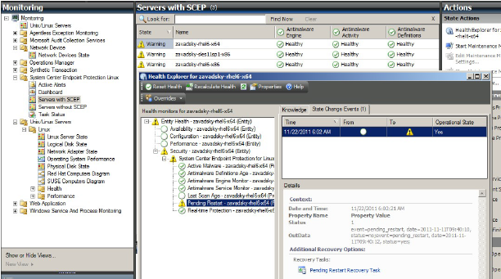
New Cross Plat Capabilities in SP1
Configuration Manager
Inventory hardware
Inventory installed applications
Create collections based on inventory
Distribute and install software
Report on inventory and software distribution
Endpoint Protection (anti-virus)

Slide 19
Supported Operating Systems
Red Hat Enterprise Linux
Version 4 (x86/x64)
Version 5 (x86/x64)
Version 6 (x86/x64)
Version 9 (x86)
Version 10 SP1 (x86/x64)
Version 11 (x86/x64)
SUSE Linux Enterprise Server
CentOS
Version 5 (x86/x64)
Version 6 (x86/x64)
Debian
Version 5 (x86/x64)
Version 6 (x86/x64)
Ubuntu Server
Version 10.04 LTS (x86/x64)
Version 12.04 LTS (x86/x64)
Oracle Linux
Version 5 (x86/x64)
Version 6 (x86/x64)
Version 11 (SPARC/x86)
Version 10 (SPARC/x86)
Version 9 (SPARC)
Solaris
Version 11iv3 (PA-RISC/IA64)
Version 11iv2 (PA-RISC/IA64)
HP-UX
Version 7.1 (Power)
Version 6.1 (Power)
Version 5.3 (Power)
AIX
UNIX
Linux
Version Support
New versions of operating systems supported within 180 days of release
Old versions supported as long as vendor provides support

Slide 20
Demo
Deploying Linux services, monitoring and running tasks

Slide 21
Back-up and Recovery
Data Protection Manager
Operations Manager

Slide 22
Continuous backup and protection for Microsoft workloads
System Center Operations Manager
Active Directory Hyper-V File Services
Disk-based recovery
Windows Azure Backup
Up to every 15 minutes
System Center Data Protection Manager
Windows Client
Data protection manager disaster recovery (with offsite replication and tape)
Tape-based backup

Slide 23
New capabilities in SP1
Data Protection Manager
Windows Server 2012 support
Back-up to Windows Azure
Office 2013 support
SQL 2012 Always-on support

Slide 24
SP1 Enhancements for WS 2012
Scale enhancements
64 nodes, 8000 VMs
Live Migration support
Deduplication support
Hyper-V over SMB support
DPM on WS 2012 VM

Slide 25
Virtualization
Virtual Machine Manager
Kenon Owens, Product Marketing Manager

Slide 26
New Capabilities in SP1 for VMM
Deep Discovery for Bare Metal Deployments
Broader SMI-S Support
Tenant Admins/Tenant Users
SMB 3.0
Linux Guest Customization
WS 2012
SQL Server 2012
VM Networks
Port Profiles
Network QoS
1000 Hosts 25,000 Guests
vSphere 5.1
Guest Customization against VMs not in the domain
Improved connectivity with OpsMgr
Switch Extension Manager
Port Profiles
Better Job Views
Console Add-ins
Greater Support of Guest Operating Systems
Larger Cluster Support
NIC Teaming
Better Script Support for Deploying Services
Failover Clustering Availability Options
Support for Share Nothing Live Migration
Support for Storage Live Migration
Concurrent Live Migrations

Slide 27
VM networks and network virtualization System Center 2012 SP1 Virtual Machine Manager
Connectivity
Multi-tenancy
Isolation
Bring your own IP
Mobility
Capability
Quality of service (QoS)
Security
Optimizations
Monitors
VM networks
Logical switch
Notes:
27

Slide 28
Logical Switch
Port Profile
Sets
Logical Switch “Building 44 Prod”
Native Switch Settings
Extension1
Extension2
Extension3
“DB” classification
“Web” classification
“iSCSI” classification
“ContosoDB” (Virtual)
Ext 1: Virtual Profile A
Ext 2: Virtual Profile B
Ext 3: Virtual Profile C
Native Virtual Profile A
“ContosoWeb” (Virtual)
Ext 1: Virtual Profile A
Ext 2: Virtual Profile D
Ext 3: Virtual Profile E
Native Virtual Profile A
“ContosoiSCSI” (Virtual)
Ext 1: Virtual Profile A
Ext 2: Virtual Profile F
Ext 3: Virtual Profile G
Native Virtual Profile A
“ContosoTeam” (Uplink)
Ext 1: Uplink Profile A
Ext 2: Uplink Profile B
Ext 3: Uplink Profile C
Native Virtual Profile C
Logical Switch “Building 27 Dev”
Native Switch Settings
“DB” classification
“Web” classification
“iSCSI” classification
“NativeDB” (Virtual)
Native Virtual Profile B
“NativeWeb” (Virtual)
Native Virtual Profile B
“NativeiSCSI” (Virtual)
Native Virtual Profile B
“NativeTeam” (Uplink)
Native Virtual Profile D

Slide 29
Demo
Network virtualization and storage management

Slide 30
In Review: Session Objectives and Takeaways
Objective:
To provide an overview of the new features highlighted in System Center 2012 SP1
Virtual Machine Manager
Operations Manager
Data Protection Manager
Orchestrator
Service Manager
App Controller
Evaluate the new capabilities in your environment

Slide 31
Resources
Learning
Sessions on Demand
Microsoft Certification & Training Resources
http://channel9.msdn.com/Events/TechEd
www.microsoft.com/learning
TechNet
msdn
Resources for IT Professionals
Resources for Developers
http://microsoft.com/technet
http://microsoft.com/msdn

Slide 32
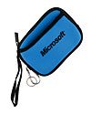
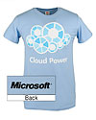
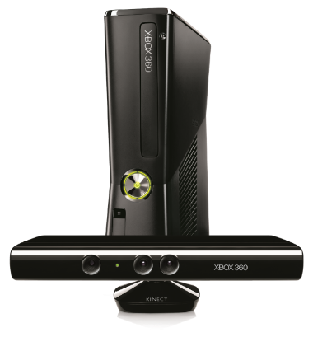
Complete an evaluation on CommNet and enter to win!

Slide 33
© 2013 Microsoft Corporation. All rights reserved. Microsoft, Windows and other product names are or may be registered trademarks and/or trademarks in the U.S. and/or other countries.
The information herein is for informational purposes only and represents the current view of Microsoft Corporation as of the date of this presentation. Because Microsoft must respond to changing market conditions, it should not be interpreted to be a commitment on the part of Microsoft, and Microsoft cannot guarantee the accuracy of any information provided after the date of this presentation. MICROSOFT MAKES NO WARRANTIES, EXPRESS, IMPLIED OR STATUTORY, AS TO THE INFORMATION IN THIS PRESENTATION.

