Slide 2
Enabling Virtual Machines: IaaS and Virtual Machine Role
MDC-B364
Marc Umeno
Eric Winner

Slide 3
Just a Reminder
All INFORMATION PRESENTED AS WELL AS ALL Sessions are Microsoft Confidential and under your Non-Disclosure Agreement (nda) and\or Technology preview agreement(tpa)
Do not share session content from this event in any manner including: tweeting, blogging, posting, or speaking with others
You are a very select group of Partners and customers that are involved in this process. We look to you as innovators, leaders in the It world and trusted customers

Slide 4
To Provide Feedback
Please go to: https://scenmgrtap.cloudapp.net/SignIn.aspx and log in with the invite code “WindowServerNext”. Fill out survey “Survey Name Here”
You will need a LiveID
You will need Silverlight loaded on your machine

Slide 5
Consistent experiences across the Cloud OS
MICROSOFT
1
CONSISTENT PLATFORM
ON-PREMISES
SERVICE PROVIDER
WEBSITES
SERVICE BUS
VIRTUAL MACHINES
SERVICE MGMT PORTAL & API
Web Application PaaS
Highly Scalable
Dev-ops optimized
Integrated SCC
Fully self-service
Reliable Messaging
Standards Based
Cross Cloud
Fully self-service
IaaS - Elastic Tiers
Virtual Networks
Window and Linux
Gallery of apps
Fully self-service
Azure Consistent
Federated Identities
Active Directory
Standards Based
Device Friendly

Slide 6
Customer Requests
Provide consistent user experiences
Enable templates to be deployed to any cloud
Support Scale-out applications
OS and Applications configuration
Provide a gallery of applications
Provide console access to remote VMs
Managing standalone VMs is not enough

Slide 7
Strategy and vision
A consistent service model amongst Windows Server, System Center and Windows Azure for composing, deploying and scaling virtualized applications and workloads
Deployment artifacts
Management APIs
Portal user experience
On-premises, hosted clouds, Windows Azure

Slide 8
Consistent IaaS Platform
Portal User Experience
Virtual Machine Role APIs
IaaS Gallery
Site to Site Networks
Windows and Linux
Deployment
Artifacts
Gallery Items
Virtual Machine Role
Application
VHDs
Management APIs
Clouds
Service Provider
On-premise

Slide 9
Demo – Using Virtual Machine Capabilities in the Tenant Portal
Marc Umeno

Slide 10
IaaS in System Center and Service Management Portal

Slide 11
IaaS Architecture
Tenant
Portal
Service Admin
Portal
Service Management API
Service Provider Foundation
(Tenant, Admin, Usage)
Virtual Machine Manager
Orchestrator
Operations Manager
Windows Server Hyper-V

Slide 12
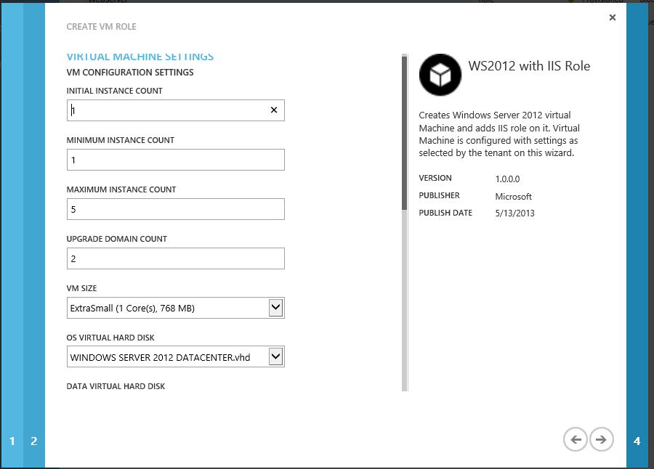
Using Virtual Machine Roles
Service Admin
Manage Gallery
Offer to Tenants
Tenant
Create Virtual Machine Role
Manage Virtual Machine Role
3
5
4
2
Gallery Wizard
Virtual Machine Role
Gallery Item
(Virtual Machine Role Template)
SPF
VM
VM
VM
Portal
Application
Extension
(App Profile and Payload)
1
VMM
Import Application Extension into VMM
Import Gallery Item into SPF
Offer to Tenants
Create Virtual Machine Role
Manage existing Virtual Machine Roles
Powershell

Slide 13
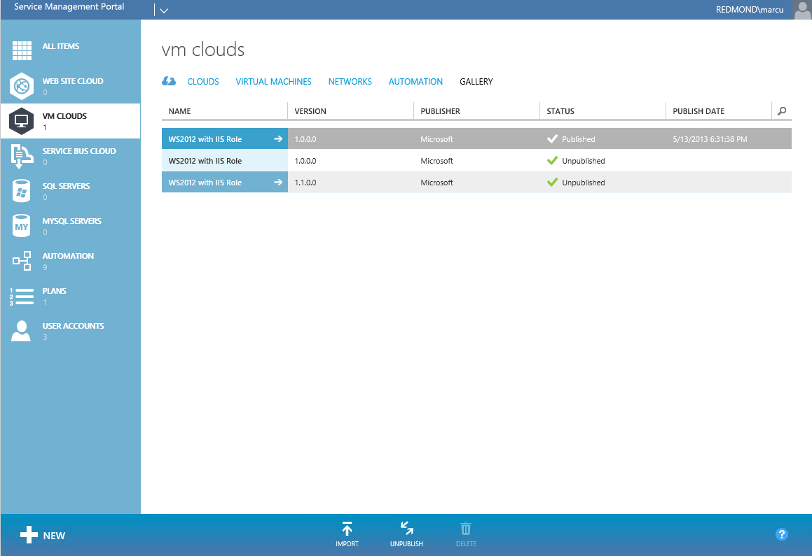
Service Admin Gallery
Import and Manage Gallery Items
Resource Definition Package
Publish / Unpublish Gallery Items to Tenants
Immediate impact when unpublishing
Add Gallery Items to Plans
Scopes access based on plan and subscription
Gallery Item authorization from SPF
Resource extension from VMM

Slide 14
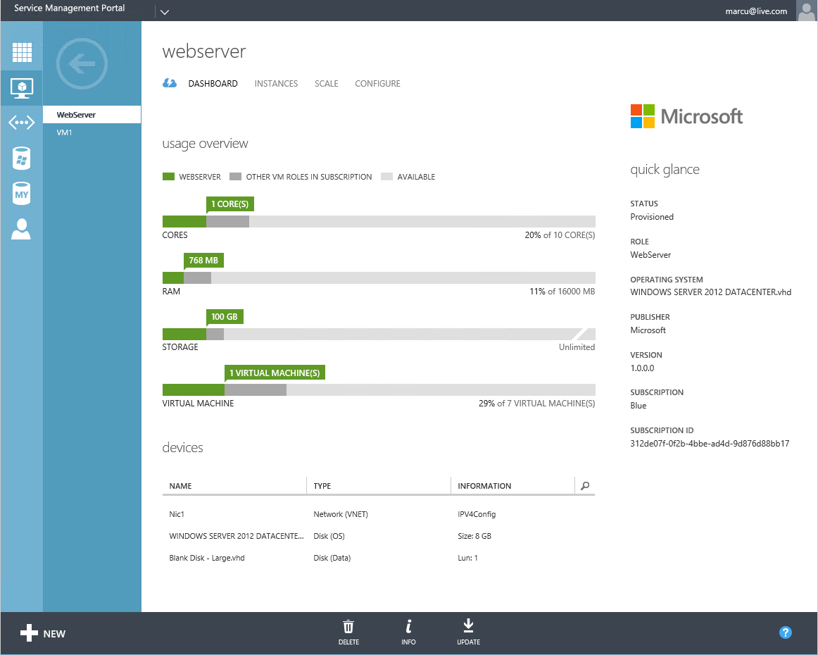
Tenant Virtual Machine Features
Cloud OS Virtual Machine Role
Scale-out and Scale-In of a Virtual Machine Role
Update settings
Upgrade to new version
Change networks
Start/Stop/Shutdown VMs
Add/Remove Devices
Support for VM Templates
Active Directory Authentication
Co-admins can share subscription

Slide 15
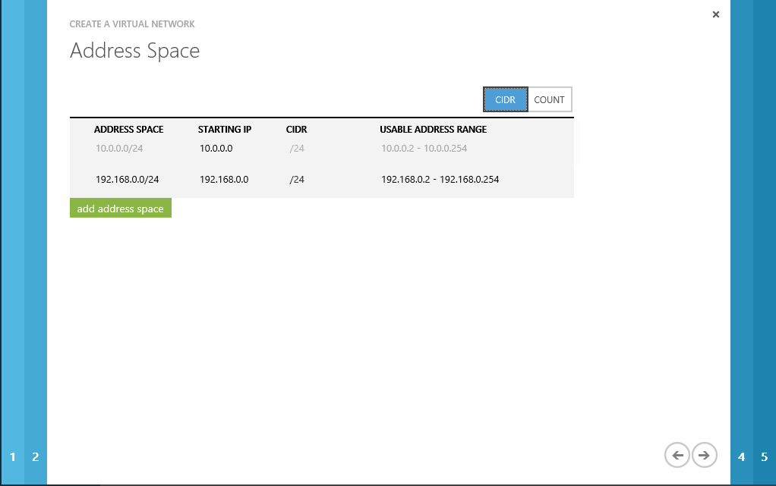
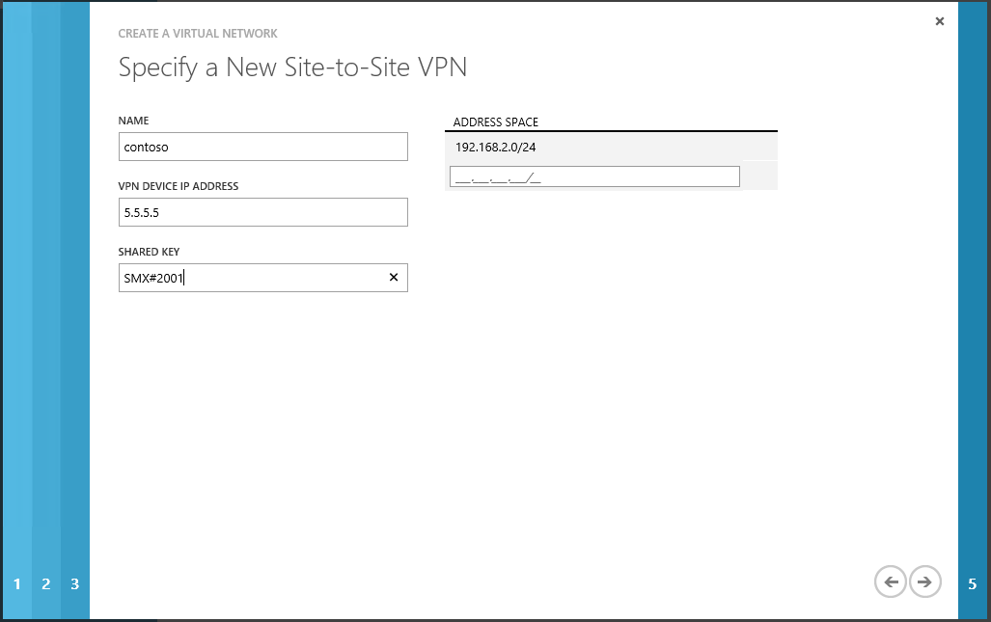
Tenant Networks
Tenants create their own networks
Site to Site VPN
Network Address Translation (NAT)
Configuration of topology and border gateway protocol (BGP)
Tenant IP addresses with network virtualization
Consistent user experience with Azure

Slide 16
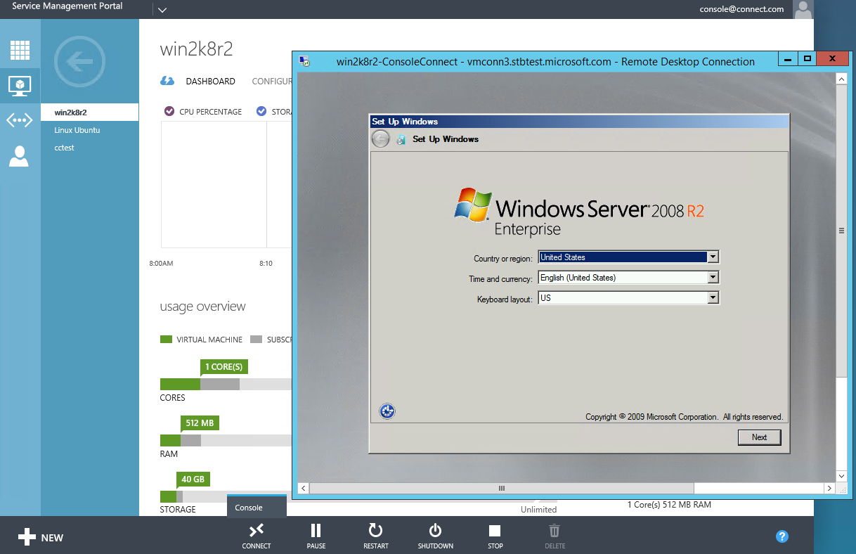
Enable Remote Console Access for Tenants
VMs can be:
On isolated network/no network
Windows/Linux/No OS
Requires
RDP client that support RDPTLSv2
Windows Azure Pack
Service Management Portal
System Center 2012 R2
Windows Server 2012 R2
Hyper-V
Remote Desktop Gateway

Slide 17
Remote Console Flow
Generate RDP file and embed tokens
Verify user access
Generate and sign tokens
Console Request
Browser
Windows Azure Pack
Portal
System Center 2012 R2
RDP File
Tokens (Host, VM)
RDP File
Trust
Trust
Remote Desktop Client
client supporting RDPTLSv2
Windows Server 2012 R2
Remote Desktop Gateway
Windows Server 2012 R2 Hyper-V
Validate token signature.
Validate token timestamp.
Authorize host & port only
Validate token VMID.
Authorize only specific VM.

Slide 18
Virtual Machine Role Technical Deep Dive
Eric Winner

Slide 19
Definitions
Virtual Machine Role Gallery
Virtual Machine Role Gallery Item
Virtual Machine Role
Virtual Machine Role View Definition (VIEWDEF)
Virtual Machine Role Resource Definition (RESDEF)
Virtual Machine Role Resource Extension (RESEXT)
A single Virtual Machine Role template
Catalog of Virtual Machine Role templates for tenants. Tenants view a curated and role-scoped list of Virtual Machine Role templates in the Tenant Portal, Powershell or APIs.
Homogenous scalable tier of Virtual Machines.
UI artifact for a gallery item. The VIEWDEF includes constructs to build the ui wizard in order for the tenant to enter values for deployment.
Template artifact for a Virtual Machine Role. The RESDEF includes hardware, network, OS, and Application configuration.
Application template and installation payload (MSI, scripts, SQL DAC, etc) used to deploy an application into a Virtual Machine Role.

Slide 20
Virtual Machine Role
Virtual Machine Role Resource Definition (RESDEF)
VM Container Specification
Templates
Definition - RESDEF
Extension - RESEXT
UI Wizard
View - VIEWDEF
Configuration
ResConfig
Instances
Cloud Service
Virtual Machine Role
VM(s)
Extension (RESEXT)
Application
UI Wizard (VIEWDEF)
Configuration
Application, Network, VM Settings
Cloud Service 1
Virtual Machine Role 1
VM1.1
VM1.2

Slide 21
Cloud Service Model: Virtual Machine Role
Application (RESEXT)
UI Wizard (VIEWDEF)
RESDEF Parameter Values
Single deployment
Versioned
VM settings (size)
OS Settings
OS Image Reference
RESEXT Reference
RESEXT Parameter bindings
RESDEF Parameters
Virtual Machine Role (RESDEF)
Roles and Features
Payload and scripts
OS Image requirements
Network IP and Load balancer
RESEXT Parameters
UI for RESDEF Parameters
Grouping
Ordering
Validation
Localization
Deployment Configuration (RESCONFIG)

Slide 22
Application Extension (RESEXT)
{
"Name": "IIS_Demo_2", "Publisher": "Microsoft, "Version": "1.0.0.0",
"ExtensionHostingContract": "MicrosoftCompute/VMRole/1.0.0.0", ", "SchemaVersion": "1.0.0.0",
"DataPackage" : { "Location" : "IISWS2012", "Version" : "1.0.0.0" },
"ResourceExtensionParameters": [ {
"Name" : "IISPort", “Type" : "String", "Description" : "IIS Port" } ],
"ResourceRequirements": {
"OSVirtualHardDiskRequirements": ["WindowsServer2012", "Datacenter" ] },
"ExtensionSettings": { "SchemaVersion": "1.0.0.0",
"WindowsServerRolesAndFeatures": [
"Web-Server", "Web-WebServer", "Web-Common-Http", "Web-Default-Doc", "Web-Dir-Browsing", "Web-Http-Errors“ ]
"ApplicationProfile": {
"ApplicationPayload": [ { "ID" : "123dbce1-8ccd-4fb1-af39-a2a3b69b4123", "RelativePath" : "IISConfiguration.cr" } ],
"Name": "389cb52d-a950-46d3-b021-48b7fe67267e",
"WindowsApplicationProfile": {
"ProvisioningScripts": [ {
"AlwaysReboot" : faalse, "ApplicationPayloadId" : "123dbce1-8ccd-4fb1-af39-a2a3b69b4123",
"DeploymentOrder" : 1, "ErrorPolicy" : "FailOnMatch",
"ExecutableAndParams" : {
"Executable" : "cmd.exe", "Parameters" : "/q /c iisconfig.cmd [Param.IISPort]"
},
"ExitCodeRegex" : "[[1-9][[0-9]*", "RebootExitCodeRegex" : null, "RestartOnRetry" : false, "ScriptBlock" : null, "ScriptCredential" : null,
"ScriptType" : "PreInstall", "StandardErrorPath" : "C:\\iisconfig-gceerr.txt", "StandardErrorRegex" : null, "StandardInput" : null,
"StandardOutputPath" : "C:\\iisconfig-gceout.txt", "StandardOutputRegex" : null, "TimeoutInSeconds" : 1200, "WorkingDirectory" : null
Identifers
Name, Publisher, Version
Parameters – “IISPort”
OS Image Requirements
Tags - “Windows Server 2012”, “Datacenter”
Operating System Roles / Features
Web-Server, Web-WebServer, Web-Common-Http,…
Script Application Deployment (Powershell DSC, Puppet, Chef, MSI, script)
“Cmd.exe /q /c iisconfig.cmd [Param.IISPort]"
Other profile types available
SQL Profile
SQL Dac Applications
WebDeploy
Run Scripts
Payload – bits and scripts
Parameterization with Basic Expressions
Import into VMM prior to Use
Packaged using Open Packaging Convention (OPC)

Slide 23
Virtual Machine Role Resource (RESDEF)
{
"Name": "IIS_Demo", "Publisher": "Microsoft", "Version": "1.0.0.0",
"Type": "MicrosoftCompute/VMRole", "SchemaVersion": "1.0.0.0",
"ResourceParameters": [
{
"Name": "RoleVMSize", "Type": "String",
"Description": "Platform-specific VM size (for Blue: XS | S | M | L | XL)"
},
{
"Name": "IISPort", "Type": "String", "Description": "IISPort desc."
}
],
"ResourceExtensionReferences": [
{
"ReferenceName": "IIS_Demo_2",
"Name": "IIS_Demo_2", "Publisher": Microsoft", "Version": "1.0.0.0",
"ResourceExtensionParameterValues" : '{
"IISPort" : "[Param.IISPort]"}'
}
],
"IntrinsicSettings": {
"SchemaVersion": "1.0.0.0",
"HardwareProfile": {
"VMSize": "[Param.RoleVMSize]"
}, "ScaleOutSettings": {
"InitialInstanceCount": "[Param.RoleInitialInstanceCount]",
Properties
Identity
Name, Publisher, Version
Parameters
RoleVMSize
IISPort
Extension References
Name, Publisher, Version
Parameter binding
IISPort
Size Profile (XS, S, M, L, XL)
Storage Profile (Data / OS Disk)
OS specialization
ComputerName, Timezone, other unattend
Network profile (LB Config, Network)
Scale settings
Parameterization with Expressions
Served from SPF Feed (Gallery)

Slide 24
Presentation UI Wizard (VIEWDEF)
{
"Label": "{{IISWS2012Label}}", "PublisherLabel": "Microsoft", "Description": "{{WS2012IISDescription}}",
"DefaultLanguageCode": "en-US",
"Sections": [
{ "Title": "{{WS2012IISVMSettings}}",
"Categories": [
{ "CategoryName": "{{ScaleOutSettingGroup}}",
"Parameters": [
{ "Name": "RoleVMSize", "Label": "VM Size",
"Type": "VMSize", "DefaultValue": "ExtraSmall", "Description": "{{RoleSizeDesc}}",
"Validation": {
"Required": true,
"Messages": { "Required": {{RoleSizeRequiredMessage}}“ } } },
{ "Name": "RoleOSVHDImageNameVersion", "Label": "OS Virtual Hard disk",
"Type": "OSVirtualHardDisk", "Description": "{{OSDisk}}",
"ImageTags": [ "WindowsServer2012", "Datacenter“ ],
"Validation": {"Required": true,
"Messages": {"Required": "OS Disk is Required" } } },
{ "Name": "RoleInitialInstanceCount", "Label": "Initial Instance Count",
"Type": "Number", "DefaultValue": "1", "Description": "{{RoleInitialInstanceCountDescription}}",
"Validation": {
"Required": true, "MinRange": 1, "MaxRange": 5, }
Grouping
Sections - Title
Categories - CategoryName
Ordering
Follows the order in the viewdef
Labels, Descriptions
Type
Boolean, Number, String, SecureString, Credential, ComputerNamePattern, Option, VMSize, OSVirtualHardDisk, Network, OSTimezone,
Default Value
Validation
Localization
Double-curly bracket notation
{{WS2012IISVMSettings}}
Package resource file per language
"WS2012IISVMSettings": "Virtual Machine Settings"

Slide 25
Deployment Configuration (ResConfig)
Generated by Portal
Not persisted as a file
Versioned to enable updates
Parameter binding to user input
{
"Version": "1.0.0.0",
“ParameterValues” : ‘ { “IISPort": “80", “RoleVMSize” : “Small”, “ComputerNamePattern” : null, "NetworkName" : "corp" }’
}

Slide 26
OSImage handling
OSImage should be parameterized for maximum reuse across environments
Parameter allows user to select image (see Tags below)
Tags
Viewdef – filters by Tags according to resext
Resext – Tags are application requirements
Guidance on “standard” tags – “WindowsServer2012”, “Datacenter”, “.NET4.5”
Deployment will be blocked if referenced image is not tagged to match RESEXT requirements
Reference is “Name:Version”
“WindowsServer2012DatacenterENU:1.0.0.0”
Name and Version map to VMM VHD FamilyName and Release properties
Version must by n.n.n.n – vmm Release is a string
If OSImage is not parameterized, set FamilyName and Release accordingly

Slide 27
Gallery Item Resource Packages
.ResdefPkg
Resdef file
.ResextPkg
Resext file
Viewdef file
Language directories and files
Script Payload
Icon
Application Payload

Slide 28
Importing a Gallery Item
Download or author resource and extension packages
Import .ResextPkg into VMM
Import .ResdefPkg into Portal
Verify Deployment dependencies
Load Balancer
VHD meets requirements
Network
Publish Gallery item to Plans

Slide 29
Configuring Virtual Machine Manager
Cloud
Library share containing VHD is accessible to cloud
Userrole
Tenant userrole has access to cloud
Virtual Hard Disks
Configure Virtual Hard Disk FamilyName, Release and Tags accordingly – see OSImage slide
Test in VMM using RESDEF
Powershell only
Read RESDEF, construct RESCONFIG
Submit resdef and resconfig via powershell to create a virtual machine role

Slide 30
Deploying a Gallery Item
Portal reads Gallery Item VIEWDEF to build wizard and gather user input
Portal produces a Resource Configuration (RESCONFIG)
Parameter Bindings for a single deployment
Portal creates a new Cloud Service or chooses existing
SPF reads RESDEF and calls VMM with RESDEF, RESCONFIG and Cloud Service
VMM combines RESCONFIG and RESDEF with referenced RESEXT to assemble deployment configuration
VMM deploys Virtual Machine Role instances into Cloud Services using RESCONFIG settings.
Portal calls SPF layer to deploy gallery item into Cloud Service using settings in the RESCONFIG

Slide 31
Demo – Service Admin Importing Gallery Items and Offering to Tenants

Slide 32
Resources
Sample Gallery Items
Windows Server
IIS on Windows Server
Authoring and Best Practice Guide to build your own gallery items

Slide 33
Related Sessions
MDC-B357 | What’s New in System Center 2012 R2 – Virtual Machine Manager
MDC-B202 | Running and Managing Linux and UNIX with Hyper-V and Microsoft System Center
MDC-B203 | Deploying Applications in Microsoft System Center 2012 – Virtual Machine Manager using Services
MDC-B318 | Enabling Multi-Tenant IaaS Clouds in Microsoft System Center and Windows Server
MDC-B344 | Storage Management: Spanning the Enterprise to Low Cost Scalable Solutions
MDC-B350 | How to Design and Configure Networking in Microsoft System Center - Virtual Machine Manager and HyperV (Part 1 of 2)
MDC-B351 | How to Design and Configure Networking in Microsoft System Center - Virtual Machine Manager and HyperV (Part 2 of 2)
MDC-B364 | Enabling on-premises IaaS solutions with “Windows Azure Services for Windows Server”

Slide 34
Wrap Up and Questions

Slide 35
Thank You!

Slide 36
Track resources
Learn more about Windows Server 2012 R2 Preview, download the datasheet and evaluation bits on http://aka.ms/WS2012R2
Learn more about System Center 2012 R2 Preview, download the datasheet and evaluation bits on http://aka.ms/SC2012R2

Slide 37
Resources
Learning
Sessions on Demand
Microsoft Certification & Training Resources
http://channel9.msdn.com/Events/TechEd
www.microsoft.com/learning
TechNet
msdn
Resources for IT Professionals
Resources for Developers
http://microsoft.com/technet
http://microsoft.com/msdn

Slide 38
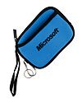
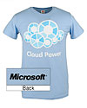
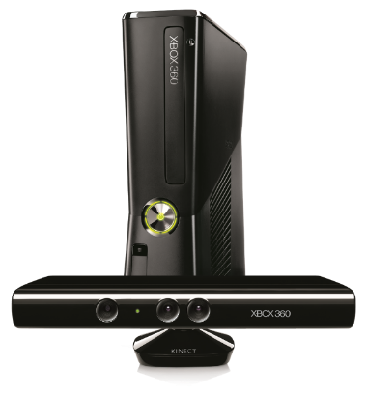
Complete an evaluation on CommNet and enter to win!

Slide 39
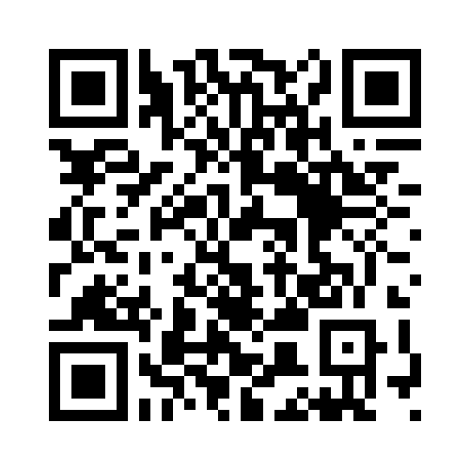
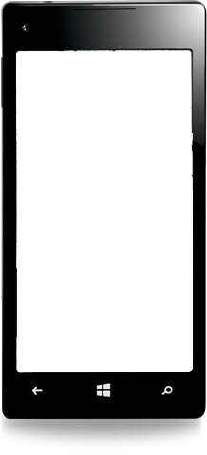
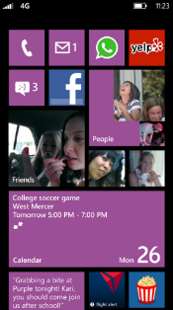
Evaluate this session
Required Slide
*delete this box when your slide is finalized
Your MS Tag will be inserted here during the final scrub.
Scan this QR code to evaluate this session and be automatically entered in a drawing to win a prize

Slide 40
© 2013 Microsoft Corporation. All rights reserved. Microsoft, Windows and other product names are or may be registered trademarks and/or trademarks in the U.S. and/or other countries.
The information herein is for informational purposes only and represents the current view of Microsoft Corporation as of the date of this presentation. Because Microsoft must respond to changing market conditions, it should not be interpreted to be a commitment on the part of Microsoft, and Microsoft cannot guarantee the accuracy of any information provided after the date of this presentation. MICROSOFT MAKES NO WARRANTIES, EXPRESS, IMPLIED OR STATUTORY, AS TO THE INFORMATION IN THIS PRESENTATION.

