Slide 2
Building Reliable and Resilient Apps on Windows Azure Infrastructure Services
MDC-B371
Yousef Khalidi
Distinguished Engineer
Microsoft Corporation

Slide 3
Agenda
Topics
  High Availability and Disaster Recovery for IaaS applications
  Azure as the DR site for your on-prem datacenter
Deep dive areas
  Virtual Machines
  Storage
  Database
  Management

Slide 4
The Cloud – from MTTF to MTTR
Focus Before: Mean Time Between Failures (MTTF)
    Gold plated systems
    Recovery time can be long
Focus Now: Mean Time to Restore (MTTR)
    Failures are expected, but service cannot be down
    Less expensive, commodity hardware
    Recovery must be quick
    Apps must be designed to embrace failure

Slide 5
Windows Azure Virtual Machines

Slide 6

Make VMs Resilient to Failures with Availability Sets
Fault Domain
Fault Domain
Get SLA by deploying multiple instances in availability sets
Ensure availability during updates & maintenance
Continue to architecture availability into the application
Rack
Rack
Virtual Machine
Virtual Machine
Web Availability Set
IIS1
IIS2
Virtual Machine
Virtual Machine
SQL Availability Set
SQL1
SQL2

Slide 7
Hybrid solutions in Windows Azure
CLOUD
ENTERPRISE
Data
Synchronization
Multiple Options
Application-Layer
Connectivity & Messaging
Service Bus
Secure Machine-to-Machine Network Connectivity
Windows Azure Connect
Secure Point-to-Site Network Connectivity
Windows Azure Virtual Network
Secure Site-to-Site
Network Connectivity
Windows Azure Virtual Network

Slide 8
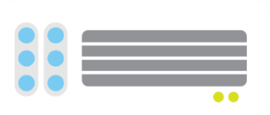

Extend your Infrastructure
Windows Azure
Virtual Network as your Datacenter extension
Create Subnets, Private IP addresses
Bring your own DNS
Domain join your VMs
<subnet 1>
<subnet 2>
<subnet 3>
Virtual Network
DNS Server
Site-to-Site
VPN
On-premises
VPN
Gateway
VPN Gateway
Route-based
VPN
Point-to-Site
VPN
Your datacenter
Individual
computers behind
corporate firewall
Remote workers

Slide 9


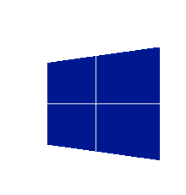
Extend your infrastructure
Windows Azure
Your Workloads and
Infrastructure Services
Design, implement, and develop on SharePoint 2010/2013 without hardware
Develop custom internet sites and collaboration apps
Apps with public web front ends, variable traffic
or sit in a demilitarized zone
Custom apps, specialty servers running workloads
with periodic spikes
Virtual Network
Active Directory
SharePoint
SQL
Server
Internet
Existing
Datacenter
On-premise

Slide 10

Demo: SharePoint HA and DR using Hybrid Networking
Windows Azure
Front End
Back End
SQL HA
US East Virtual Network
AD / DNS
VPN
Gateway
Customer premises
VPN Gateway
Windows Azure
Site-to-Site
VPN
Front End
Back End
SQL HA
US West Virtual Network
AD / DNS
VPN
Gateway
VPN Gateway

Slide 11
Storage

Slide 12
Windows Azure Storage: Durability
Highly durable and scalable
Multiple copies of your data
Financially backed SLAs
Storage for blobs, tables, VM disks
Supports REST APIs

Slide 13
Windows Azure Storage: DR
Windows Azure Storage
Defend against regional disasters
East DC
> 400 miles
West DC
asynchronous geo-replication

Slide 14



VM Disks: Built on Windows Azure Storage
WEST
DC
EAST
DC
> 400 miles
asynchronous geo-replication
Windows Azure Storage

Slide 15
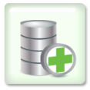



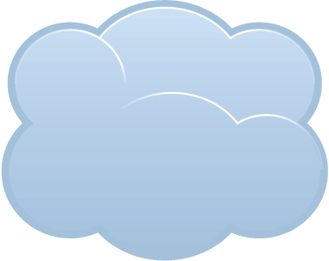
StorSimple: Extend your storage to Azure
Backup, Restore & DR Today: Inefficient, Complex, Laborious, and Risky
Primary
Volume
Snapshot
Virtual Tape/
Replication
Physical
Tape
Offsite Tape Storage
Backup, Restore & DR with StorSimple: Automated, Optimized, Reliable
Snapshots
Backup copy of data volume created in cloud
Changes to local volume automatically transferred
Cloud snapshots mountable for restore
Primary
Volume
Benefits
Backup now as easy as snapshots
Fast restores from off-site backups
Integrated, easy to test disaster recovery
Eliminates tape
Cloud Snapshots

Slide 16


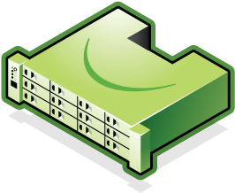
…Enables Seamless Scalability and Rapid Recovery
Cloud
Snapshots
Production Data
Production Data
Enterprise Data Center 1
Enterprise Data Center 2
Connect Many Servers to Cloud Storage and Scale Data Sets
with StorSimple Solution
Rapidly Recover to Any Data Center, Location-Independent, via Mounting the Cloud

Slide 17

System Center Data Protection Manager
Windows Azure Backup
Backup datacenter data to Windows using System Center Data Protection Manager
Backup and recover files/folders from Windows Server 2012
Your On-Premises Datacenter
Benefits
Reliable offsite data protection
Simple, familiar, integrated
Efficient backup and recovery
Easy set up
Windows Server 2012
Windows Server 2012 Essentials
Windows Server 2008 R2 (SP1)
System Center 2012 DPM SP1

Slide 18
Databases

Slide 19
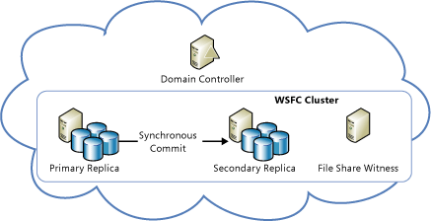
SQL Server 2012 on IaaS: High Availability
High availability within regions using SQL Availability Groups

Slide 20
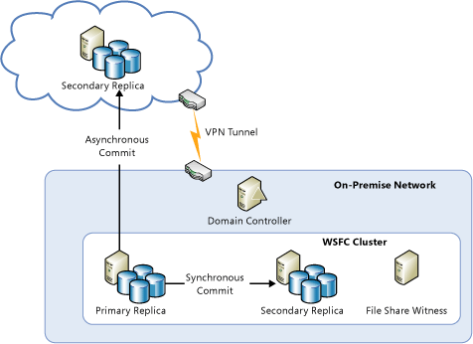
SQL Server 2012 on IaaS: Disaster Recovery
High availability and Disaster Recovery with Availability Groups across on-prem and cloud

Slide 21

Microsoft SQL Server backup and restore to the cloud
Backup and restore database
to the cloud
Direct URL backup
to Azure Storage
Restore in Azure Virtual Machine
SQL Server Management Studio
Benefits
Reliable off-site data backup
for SQL images
Easily restore databases
using VMs

Slide 22
Management

Slide 23









System Center: Unified management for the Cloud OS
Configure
App Controller
Orchestrator
Deploy
Self Service
Service Delivery and Automation
Virtual Machine Manager
Service Model
Operations Manager
MICROSOFT
ON
PREMISES
SERVICE
PROVIDER
App owner
Configuration Manager
DC
admin
Data Protection Manager
Service
Manager
Service
Manager
Monitor
Operate
Application Management
Service Delivery and Automation
Infrastructure Management
Notes:
23

Slide 24
PowerShell for Automation and Advanced Management
Automation
➔ Query, manage and configure – at scale:
  Virtual machines
  Storage across multiple subscriptions and storage accounts
  Tiered deployment workflows
Virtual Machines
Configure storage and networking
Domain join to AD DS on-premises
Bring your own machine images or disks
Use remote PowerShell
Virtual Network
Configure virtual network
Manage configuration and gateway
Connect to on-premises networks
Storage
➔ Upload and download VHDs from storage accounts to on-premises
➔ Copy VHDs between storage accounts and subscriptions

Slide 25


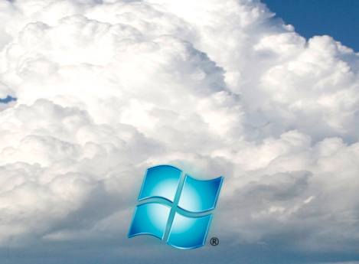
Managing Recovery with RightScale
Systems
Integrator
Higher Level PaaS-like Services
Ref. Architectures
Best Practices
Standard Builds
Repeatable
Predictable
Re-Usable
Onboarding
One-click cloud
backup environment
Extending the D/C
Support
SharePoint in Cloud
Training
Codify
Template Based
Dev / Test
Managed Services
Delivery
WISA Stack
Migration Services
HA / DR

Slide 26
Limitations
Customers can’t initiate an Azure Storage geo-failover
Compute capacity reservations with secondary deployments are recommended
SQL 2012 Availability Groups can’t be configured across Azure regions
  Mirroring or Log Shipping are alternative solutions

Slide 27
Summary
  VM Resiliency with Availability Sets
  Extend your infrastructure to the cloud with Azure Virtual Network
  Durable and geo-redundant data in the cloud with Azure Storage
  Highly available and geo-redundant VM Images with Azure VM Disks
  Extend SQL Server to the cloud with SQL 2012 Availability Groups
  Extend your on-prem storage to Azure with StorSimple
  Backup on-prem data to Azure with System Center Data Protection Manager
  Managing on-prem and cloud and automate recovery with PowerShell
  You can also use 3rd parties such as RightScale

Slide 28
Related content
Breakout Sessions
  MDC-B377: Windows Azure in the Enterprise
  MDC-B212: Infrastructure Services on Windows Azure: Virtual Machines and Virtual Networks with Mark Russinovich
  WAD-B402: Windows Azure Internals
  MDC-B360: Hybrid Networking offerings in Windows Azure
  MDC-B370: Building Your Lab, Dev, and Test Scenarios in Windows Azure Infrastructure Services
  MDC-B371: Building Reliable and Resilient Apps on Windows Azure Infrastructure Services
  MDC-B213: Hosting a Microsoft SharePoint 2013 Farm on Windows Azure
  MDC-B406: Achieve High Availability with Microsoft SQL Server on Windows Azure Virtual Machines
  DBI-B306: Microsoft SQL Server High Availability and Disaster Recovery on Windows Azure
  MDC-B405: Crash Course on "Automating deployments in Windows Azure Virtual Machines". How and which tools?
  MDC-B361: Best Practices from Real Customers: Deploying to Windows Azure Infrastructure Services (IaaS)
  WAD-B305: Take Control of the Cloud with the Windows Azure PowerShell Cmdlets

Slide 29
Resources
High Availability and Disaster Recovery for SQL Server in Windows Azure Virtual Machines
  http://msdn.microsoft.com/en-us/library/windowsazure/jj870962.aspx
Virtual Networks
  http://www.windowsazure.com/en-us/manage/services/networking/
System Center
  http://www.microsoft.com/en-us/server-cloud/system-center/default.aspx
Overview of Business Continuity in Windows Azure
  http://msdn.microsoft.com/en-us/library/windowsazure/hh873027.aspx

Slide 30

Track resources
Learn more about Windows Server 2012 R2 Preview, download the datasheet and
evaluation bits on
http://aka.ms/WS2012R2
Learn more about System Center 2012 R2 Preview, download the datasheet and evaluation bits on
http://aka.ms/SC2012R2

Slide 31

Resources
Learning
  Sessions on Demand
  Microsoft Certification & Training Resources
http://channel9.msdn.com/Events/TechEd
www.microsoft.com/learning
TechNet
msdn
  Resources for IT Professionals
  Resources for Developers
http://microsoft.com/technet
http://microsoft.com/msdn

Slide 32





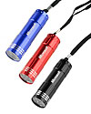

Complete an evaluation on CommNet and enter to win!

Slide 33



Evaluate this session
Required Slide
*delete this box when your slide is finalized
Your MS Tag will be inserted here during the final scrub.
Scan this QR code to evaluate this session and be automatically entered in a drawing to
win a prize

Slide 34

© 2013 Microsoft Corporation. All rights reserved. Microsoft, Windows and other product names are or may be registered trademarks and/or trademarks in the U.S. and/or other countries.
The information herein is for informational purposes only and represents the current view of Microsoft Corporation as of the date of this presentation. Because Microsoft must respond to changing market conditions, it should not be interpreted to be a commitment on the part of Microsoft, and Microsoft cannot guarantee the accuracy of any information provided after the date of this presentation. MICROSOFT MAKES NO WARRANTIES, EXPRESS, IMPLIED OR STATUTORY, AS TO THE INFORMATION IN THIS PRESENTATION.

