Slide 2
Windows Azure in the Enterprise
MDC-B377
Karri Alexion-Tiernan
Director, Product Marketing
Venkat Gattamneni
Senior Product Marketing Manager

Slide 3
Windows Azure
Bringing Cloud to your Enterprise

Slide 4
Why consider the cloud?
Public Cloud Platform
$30
Speed
Scale
Economics
$25
$20
Market Share (in Billions)
$15
$10
$5
2008
2009
2010
2011
2012
2013
2014
2015
2016
2017
2018
2019
2020

Slide 5
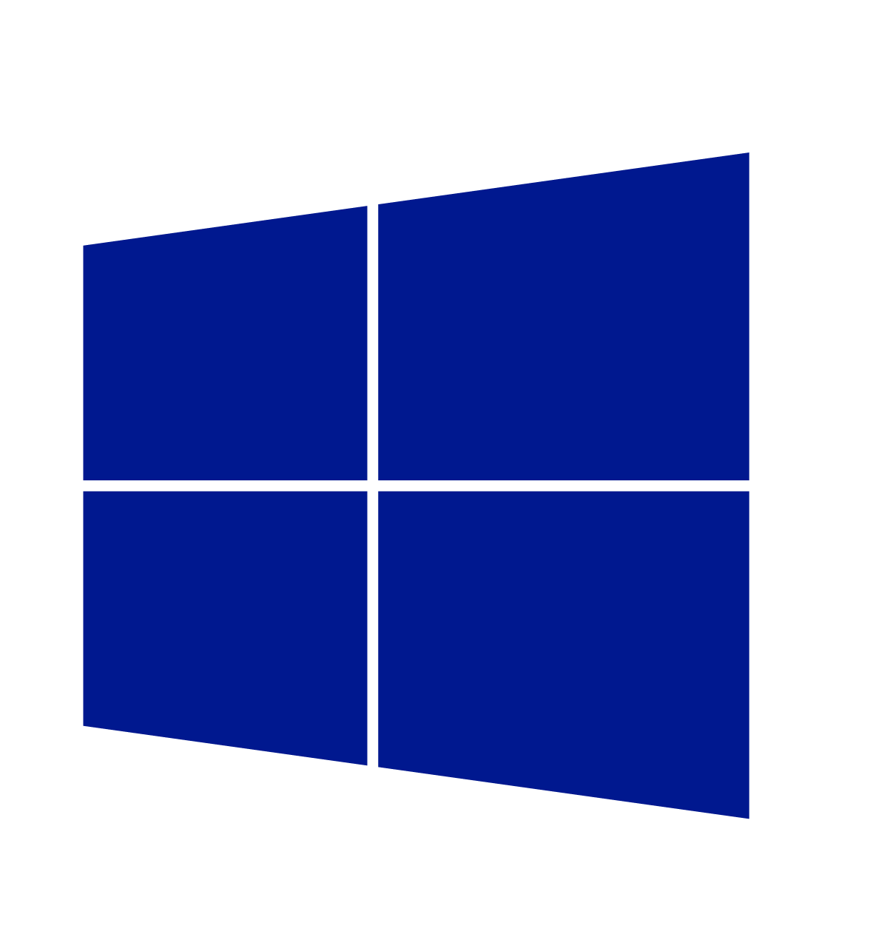
Cloud innovation presents challenges for IT
  How do I integrate
  with my existing
  IT investments?
  What about
  my heterogeneous,
  complex IT landscape?
  What about security
  and compliance?

Slide 6
Enterprise
needs
Integration
Heterogeneity
Security
On-premises
and Cloud
Broad
and flexible
Secure
and reliable

Slide 7

Enterprise
needs
Virtualization
Integration
Identity
Data
Platform
On-premises
Cloud
Windows Azure
fundamentals
On-premises
AND Cloud
Development
DevOps and mgmt

Slide 8





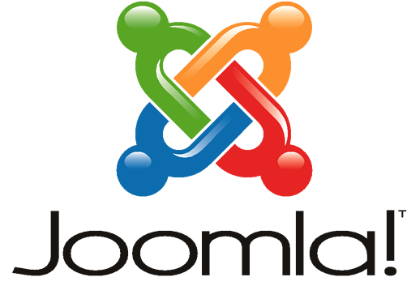





Enterprise
needs
Heterogeneity
Integration
Languages
CMS
Devices
Databases
Windows Azure
fundamentals
Operating
Systems
Open, Broad
and Flexible
On-premises
AND Cloud

Slide 9
Enterprise
needs
Heterogeneity
TRANSPARENCY
Security
Languages
CMS
Devices
Databases
Windows Azure
fundamentals
Operating
Systems
Open, Broad
and Flexible
Trustworthy

Slide 10
TRANSPARENCY
Enterprise
needs
RELATIONSHIP
EXPERIENCE
Security
Trust through transparency
ISO 27001 Cloud Security Alliance (STAR)
Industry standards
Regulatory compliance
Trust center
$
Monthly SLAs
Yearly audits
Independently verified
Real-time status
Service dashboard
Windows Azure
fundamentals
Trustworthy

Slide 11
Enterprise
needs
TRANSPARENCY
RELATIONSHIP
EXPERIENCE
Security
Count on your existing relationship
Attach to
your EA
Enterprise ready procurement
24x7x365
Enterprise-ready support
MCS, CSS, Partners
Trusted advisors
Windows Azure
fundamentals
Trustworthy

Slide 12
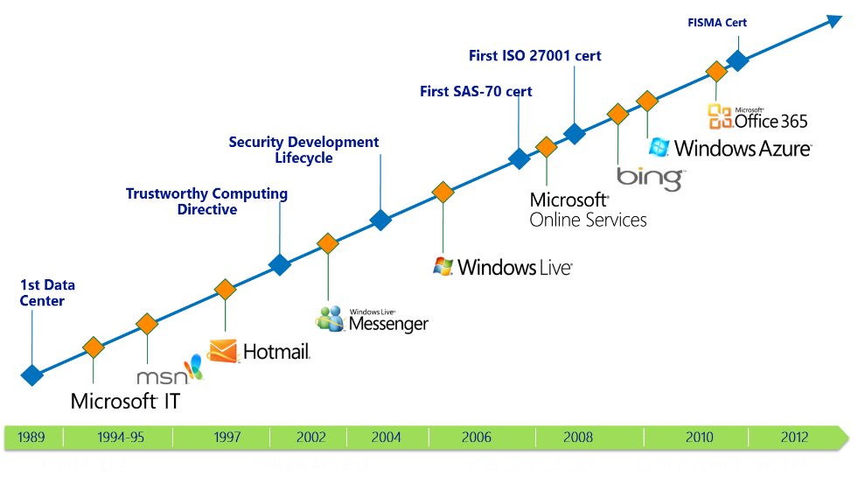
Enterprise
needs
TRANSPARENCY
RELATIONSHIP
EXPERIENCE
Security
Unparalleled experience in online security
Windows Azure
fundamentals
Today, we manage 200+ global services, running 24x7
9.9 billion messages a day via Windows Live Messenger
600 million unique users monthly on Windows Live and MSN
1 Petabyte+ of updates served monthly Windows Update
5M LiveMeeting conference minutes per year
200 billion+ authentications through Windows Azure AD
Trustworthy

Slide 13
delivers.
Integration
Heterogeneity
Security
On-premises
AND cloud
Open, Broad, Flexible
Trustworthy
On-premises
and Cloud
Broad
and flexible
Secure
and reliable
Enterprise ready by design.

Slide 14


Slide 15



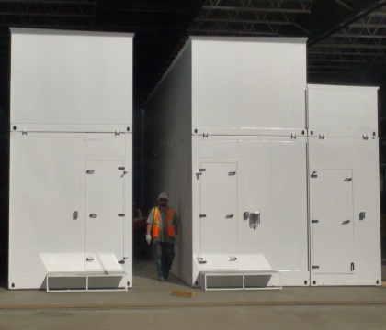
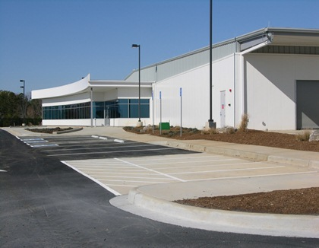

kr
kr
$
€
руб
£
chf
$
₩
¥
TL
$
Global datacenters
Global support
Rp
Local account teams
$
R
Local currencies
$
$
  24 x 7 x 365 support Over 1 billion customers, 20 million businesses 76 markets worldwide
  280 years of combined industry experience in infrastructure, security, product dev, and global ops

Slide 16






















^{app}
^{services}
cloud services
caching
identity
service bus
media
mobile services
web sites
integration
hpc
analytics
^{data}
^{services}
SQL database
HDInsight
table
blob storage
^{infrastructure}
^{services}
virtual machines
virtual network
vpn
traffic manager
cdn

Slide 17
^{app}
^{services}
cloud services
caching
identity
service bus
media
Apps
mobile services
web sites
integration
hpc
analytics
^{data}
^{services}
SQL database
HDInsight
table
blob storage
caching
identity
cloud
services
table
^{infrastructure}
^{services}
virtual
network
virtual machines
virtual network
vpn
traffic manager
cdn

Slide 18

Azure datacenters,
your datacenters.
^{app}
^{services}
cloud services
caching
identity
service bus
media
web sites
integration
hpc
analytics
virtual machines
virtual network
mobile services
vpn
^{data}
^{services}
SQL database
HDInsight
table
blob storage
^{infrastructure}
^{services}
virtual
network
virtual machines
virtual network
vpn
traffic manager
cdn
vpn

Slide 19
Store, backup, recover your data
1
Develop, test, run your apps
Develop, test, run your apps
Extend your infrastructure
Extend your infrastructure
Scenarios to
get started with Windows Azure
Reach where your datacenter won’t
Reach where your datacenter won’t

Slide 20
Store, backup, recover your data
Cloud
Storage
Opportunity
Capacity
Data grows
exponentially
(50 – 60% Annually)
However most I/O
happens to the
“Working Set” data
Local Storage
SAN storage cost = 4x Cloud storage
(source: Forrester)
Time

Slide 21
Store, backup, recover your data
Windows Azure Storage
7 Trillion Objects
“Azure Blob storage has taken a significant step ahead of last year’s leader Amazon S3, to take the top spot”
– Nasuni 2013 Cloud Storage Report

Slide 22
Store, backup, recover your data
Windows Azure Storage
Highly durable and scalable
Multiple copies of your data
Financially backed SLAs
Storage for objects, tables, drives
Supports REST APIs

Slide 23
Store, backup, recover your data
Windows Azure Storage
Defend against regional disasters.
East DC
> 400 miles
West DC
Geo replication

Slide 24
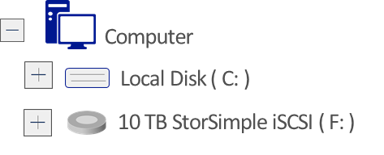

Store, backup, recover your data
Simple and fast on-ramp to Azure
Active data instantly available locally
Archives less used data to Windows Azure
Recover data from any internet connection
Reduce enterprise storage TCO by 60-80%
Physical or Virtual Servers
StorSimple
Your Data Center

Slide 25


Store, backup, recover
Microsoft SQL Server
Backup and restore database
to the cloud
Direct URL backup
to Azure Storage
Restore in Azure Virtual Machine
SQL Server Management Studio
Benefits
Reliable off-site data backup
for SQL images
Easily restore databases
using VMs

Slide 26
Store, backup, recover your data
Windows Azure Backup
Backup datacenter data to Windows using System Center Data Protection Manager
Backup and recover files/folders from Windows Server 2012 SP1
Your On-Premises Datacenter
Windows Server 2012
Windows Server 2012 Essentials
Windows Server 2008 R2 (SP1)
System Center 2012 DPM SP1
Benefits
Reliable offsite data protection
Simple, familiar, integrated
Efficient backup and recovery
Easy set up

Slide 27
Store, backup, recover your data
1
Store, backup, recover your data
Develop, test, run your apps
2
Develop, test, run your apps
Virtual datacenter
Extend your infrastructure
Scenarios to
get started with Windows Azure
Reach where your datacenter can’t
Reach where your datacenter won’t

Slide 28
Develop, test, run your apps
Test and development on-premises
Limited hardware budget
Limited software licensing
Resource contention with VMs
Compromised developer agility
Realistic scale tests often challenging
Developers
Use VMs
Your Datacenter
Provision VMs
VMs in test/dev environment
IT Admin

Slide 29
Develop, test, run your apps
Developers
Use VMs
Provision VMs
Test and development using Windows Azure
Pay for what you use, per-minute billing (NEW)
Extended MSDN benefits (NEW)
Improved developer agility with platform services
Ready to use gallery of images
Ship tested in realistic scale scenarios
Use existing development tools & languages
Access on-premise resources if necessary
Manage environment
IT Admin

Slide 30
Develop, test, run your apps
Start VMs and app development in Azure
Deploy anywhere with no lock-in
Your Datacenter,
or Your Hoster
Easy VM portability
If it runs on Hyper-V, it runs
in Windows Azure
Production environment

Slide 31

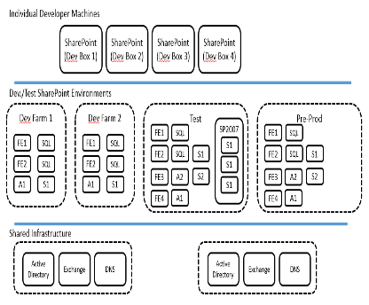
“We needed to take a new approach and Windows Azure Virtual Machines provided the right solution for our business.”
– Andreas Hogberg, Telenor
Challenges
Benefits
Move from SharePoint 2007
to SharePoint 20013 across
18 different business units,
spread across 12 countries
Quickly create a large Sharepoint farm for Dev/test within time
and cost limits
Limitless resources for Dev/Test
Speed: Build a Sharepoint farm
in days not weeks
Low cost, scale up and down
as needed
Familiar tools and automation
via PowerShell
Portability: On-premises or at
Hoster as needed

Slide 32
Store, backup, recover
Store, backup, recover your data
Develop, test, run your apps
2
Develop, test, run your apps
Extend your infrastructure
3
Extend your infrastructure
Scenarios to
get started with Windows Azure
Reach where your datacenter can’t
Reach where your datacenter won’t

Slide 33



Extend your infrastructure
Windows Azure
Windows Azure Infrastructure Services
Virtual Machines with on-demand scale & compute
Spin up and tear down in minutes, no hardware provisioning
Connect with on-premises Active Directory and domains
Integrates Windows Azure Virtual Networks
Use what you know, manage with System Center
Integrates with Azure Platform, Apps, and Storage Services
Virtual Network
Active Directory
SharePoint
SQL
Server
Internet
Your
Datacenter

Slide 34
Extend your infrastructure
Windows Azure Infrastructure Services
Windows Azure Virtual Network
Logical isolation with control over network
Create Subnets, Private IP addresses
Bring your own DNS
<subnet 1>
<subnet 2>
<subnet 3>
DNS Server
Virtual Network

Slide 35
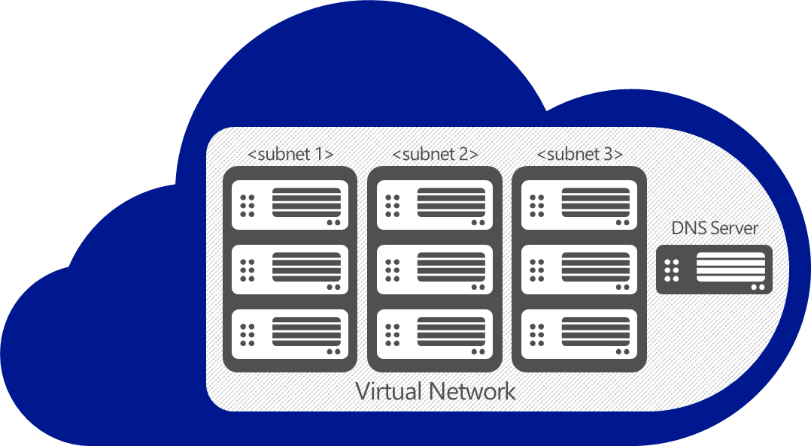
Extend your infrastructure
Windows Azure Infrastructure Services
Virtual Network as your Datacenter extension
Create Subnets, Private IP addresses
Bring your own DNS
Domain join your VMs
Site-to-Site VPN
VPN
On-premises
VPN

Slide 36
Extend your infrastructure
Securely connect to Virtual Network from anywhere
Uses VPN client in Windows OS
Traverses firewalls and proxies
Site-to-Site VPN
On-premises
VPN
VPN
Point-to-Site VPN NEW
Individual
computers behind
corporate firewall
Remote workers

Slide 37



Virtual Network workflow
1
MyOffice (10.1.0.0/16)
DemoVNet (10.10.0.0/16)
AffinityGroup DemoVnetAff
3
2
GatewaySubnet
(10.10.2.0/29)
FrontEndSubnet
(10.10.0.0/24)
BESubnet
(10.10.1.0/24)
VPN device
131.107.64.111
GW IP
168.61.6.50
DNS1
10.1.0.4
4

Slide 38

Extend your infrastructure
Windows Azure
Your Workloads and
Infrastructure Services
Design, implement, and develop on SharePoint 2010/2013 without hardware
Develop custom internet sites and collaboration apps
Apps with public web front ends, variable traffic
or sit in a demilitarized zone
Custom apps, Specialty Servers running workloads
with periodic spikes
Virtual Network
Active Directory
SharePoint
SQL
Server
Internet
Existing
Datacenter
On-premise

Slide 39
Store, backup, recover your data
Store, backup, recover your data
Test drive your apps
Develop, test, run your apps
3
Extend your infrastructure
Extend your infrastructure
Scenarios to
get started with Windows Azure
Reach where your datacenter won’t
4
Reach where your datacenter won’t

Slide 40
Reach where your datacenter won’t
Websites with global reach
Build websites with global scale
Built-in support for open web frameworks
Managed by Microsoft
Improve performance with Traffic Manager
Windows Azure
Websites

Slide 41


Reach where your datacenter won’t
Windows Azure Mobile Services
Turnkey backend for Mobile apps
Extend internal web apps to mobile devices
Quickly build and deploy consumer facing apps
Land your app on any platform or device
data
auth
push

Slide 42
Reach where your datacenter won’t
Partner integration
Integrate with partner IT systems
Use a highly available, scalable messaging infrastructure with ServiceBus
BizTalk Services provide EDI and EAI capabilities for integration

Slide 43

Power your business with Windows Azure
© 2013 Microsoft Corporation. All rights reserved. Microsoft, Windows, Windows Vista and other product names are or may be registered trademarks and/or trademarks in the U.S. and/or other countries.
The information herein is for informational purposes only and represents the current view of Microsoft Corporation as of the date of this presentation. Because Microsoft must respond to changing market conditions, it should not be interpreted to be a commitment on the part of Microsoft, and Microsoft cannot guarantee the accuracy of any information provided after the date of this presentation. MICROSOFT MAKES NO WARRANTIES, EXPRESS, IMPLIED OR STATUTORY, AS TO THE INFORMATION IN THIS PRESENTATION.

Slide 44

Related content
MDC-B377: Windows Azure in the Enterprise
MDC-B212: Infrastructure Services on Windows Azure: Virtual Machines and Virtual Networks with Mark Russinovich
WAD-B402: Windows Azure Internals
MDC-B360: Hybrid Networking offerings in Windows Azure
MDC-B370: Building Your Lab, Dev, and Test Scenarios in Windows Azure Infrastructure Services
MDC-B371: Building Reliable and Resilient Apps on Windows Azure Infrastructure Services
MDC-B213: Hosting a Microsoft SharePoint 2013 Farm on Windows Azure
MDC-B406: Achieve High Availability with Microsoft SQL Server on Windows Azure Virtual Machines
DBI-B306: Microsoft SQL Server High Availability and Disaster Recovery on Windows Azure
MDC-B405: Crash Course on "Automating deployments in Windows Azure Virtual Machines". How and which tools?
MDC-B361: Best Practices from Real Customers: Deploying to Windows Azure Infrastructure Services (IaaS)
WAD-B305: Take Control of the Cloud with the Windows Azure PowerShell Cmdlets

Slide 45

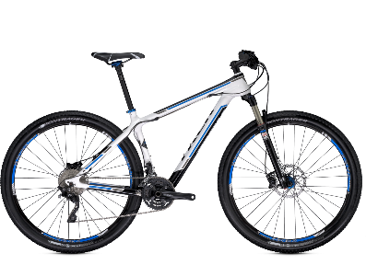
Track Resources & Calls To Action
Get Started with Windows Azure
Develop and Test in VMs, Build Websites, Extend on-premises applications
http://www.windowsazure.com
MSDN Subscribers: you’ve got it, now use it
Activate your MSDN Benefit & try it by 9/30
You could win* an Aston Martin V8 Vantage!
Go to: http://aka.ms/AzureContest
Drop by the Windows Azure booth to participate in the
Windows Azure Challenge for even more prizes!
*No purchase necessary. Open to eligible Visual Studio Professional, Premium or Ultimate with MSDN subscribers as of June 1, 2013. Ends 11:59 p.m. PT on September 30, 2013. For full official rules including odds, eligibility and prize restrictions see website. Sponsor: Microsoft Corporation. Aston Martin is a trademark owned and licensed by Aston Martin Lagonda Limited. Image copyright Evox Images. All rights reserved.

Slide 46
Track resources
Learn more about Windows Server 2012 R2 Preview, download the datasheet and
evaluation bits on
http://aka.ms/WS2012R2
Learn more about System Center 2012 R2 Preview, download the datasheet and evaluation bits on
http://aka.ms/SC2012R2

Slide 47

Resources
Learning
  Sessions on Demand
  Microsoft Certification & Training Resources
http://channel9.msdn.com/Events/TechEd
www.microsoft.com/learning
TechNet
msdn
  Resources for IT Professionals
  Resources for Developers
http://microsoft.com/technet
http://microsoft.com/msdn

Slide 48







Complete an evaluation on CommNet and enter to win!

Slide 49



Evaluate this session
Required Slide
*delete this box when your slide is finalized
Your MS Tag will be inserted here during the final scrub.
Scan this QR code to evaluate this session and be automatically entered in a drawing to
win a prize

Slide 50

© 2013 Microsoft Corporation. All rights reserved. Microsoft, Windows and other product names are or may be registered trademarks and/or trademarks in the U.S. and/or other countries.
The information herein is for informational purposes only and represents the current view of Microsoft Corporation as of the date of this presentation. Because Microsoft must respond to changing market conditions, it should not be interpreted to be a commitment on the part of Microsoft, and Microsoft cannot guarantee the accuracy of any information provided after the date of this presentation. MICROSOFT MAKES NO WARRANTIES, EXPRESS, IMPLIED OR STATUTORY, AS TO THE INFORMATION IN THIS PRESENTATION.

Slide 51

“Because management time and cost is so low with Windows Azure, we focus on growing the business, not on managing red tape. It’s important for us to be able to say that VAS is supported by Windows Azure, prospective customers don’t have to worry that their service is running on some anonymous group of servers or at a hoster. “
William K. Smyth - Global Business Manager, 3M VAS
Challenges
Benefits
3M is one of the largest manufacturers in the world but, when it comes to launching new businesses, it scrutinizes startup costs as closely as any entrepreneur.
Maximize IT agility and cost effectiveness of new ventures
Needed platform that would provide fast application response time
Minimizes Internal Management Time, Cost., and hardware acquisition
Revenue boosted by 50%
Accelerated application response time by 2-3 seconds
Familiar development environment allows for easy ramp to the cloud
Microsoft manages the platform,
3m grows their business

Slide 52







“We have customers in 60 countries around the world that need access to our business operations applications. They need to be trained and have immediate access. Windows Azure allows us to do offer that at instant scale.”
– Don Noonan, Blackbaud
Challenges
Benefits
Nonprofits in 60 countries
Schools and churches to hospitals and charities, rely on Blackbaud's nonprofit software to help them achieve their missions.
With Windows Azure IaaS they run their business operations software AND train customers at non-profits on how to use it.
An instant training environment for customers
Affordable solution that scales
up and down with needs
SQL Server backend that supports application data

Slide 53


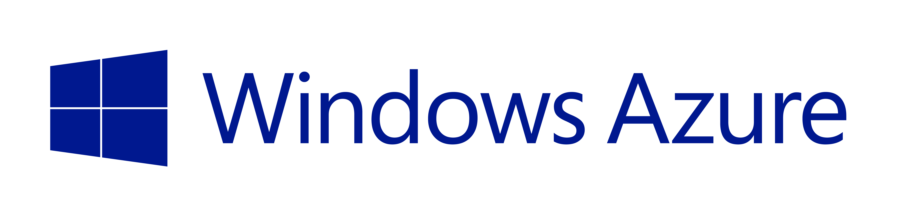
“We specifically chose Windows Azure over other cloud providers. The tools to be able to quickly build and deploy are a huge benefit. We are extensively using Infrastructure Services and Platform Services with Windows Azure and the combination fits our needs perfectly. It allows us to focus on serving our customers.
Jagdash Rajan
SVP, Technology, Digital Air Strike
Challenges
Benefits
GM wanted an integrated social and email feedback system for their dealers collecting information to and from multiple social and dealer sites and on premise data systems. A fully transparent process that allows instant communication and feedback for dealers from their customers.
Digital Air Strike built them a system that allows for integration of social feeds, an email feedback responses system and immediate information for dealers and consumers.
.
PaaS + IaaS allows for managing where you want to, and allowing Windows Azure to manage the rest
Familiar tools like PowerShell, and Visual Studio
Ability to instantly scale storage from large data sources at a significantly lower cost
Ease of development with shorter time to market

Slide 54

RadioShack wanted to enhance its capacity to deliver product-availability information and promotional coupons to its customers and sales partners. The retailer worked with Pariveda Solutions to develop store locator, inventory, and coupon management solutions based on Windows Azure.
As a result, RadioShack upgraded its marketing infrastructure, reduced costs, built better partnerships, enhanced customer satisfaction, and increased
their revenue.

