Slide 2
DevOps: Global Service Monitoring with System Center Operations Manager 2012 SP1
MDC-B381
Akin Olugbade, Laura Cruz
Program Managers
Microsoft

Slide 3
Agenda
Introduction
Global Service Monitor Value Proposition
Getting Started
What is DevOps
Demo Time

Slide 4
OM APPLICATION MONITORING PERSPECTIVES
Your Application: .NET Application Performance Monitoring
Mid-mile: Global Service Monitor
Last mile: client-side monitoring
First mile: internal synthetic transactions

Slide 5
GLOBAL SERVICE MONITOR – VALUE PROPOSITION
Availability
Provide monitoring of the availability of your external facing websites regardless of where they are hosted
SLAs
Enable accurate measurement of your SLA or the SLA provided by an external provider
Integration
GSM data seamlessly delivered into your OM environment
Facilitates DevOps cycle
Efficiency
Managed by Microsoft
Extends your OM infrastructure to the cloud – at no additional cost
Availability
SLA
Integration
Efficiency
Provide application and
service
health from an
“Outside In “perspective

Slide 6
Getting Started with Global Service Monitor

Slide 7
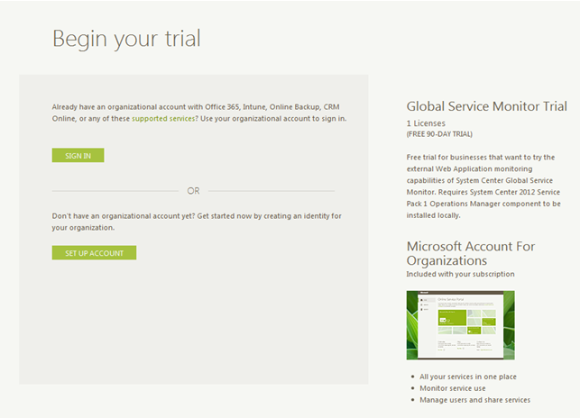
SIGN UP EXPERIENCE: STEP 1
Trial offer URL
https://orgaccount.microsoft.com/signup?offerIds=BE2A46EF-0639-43a4-8323-BB5E1D4340D3
Full offer URL
https://orgaccount.microsoft.com/signup?offerIds=C6FB044B-FE9E-4CD3-B3AF-B5FBE64068ED
Sign in with your OrgID account or create a new one
Step 1
Step 2
Step 3
Step 4
Done!

Slide 8
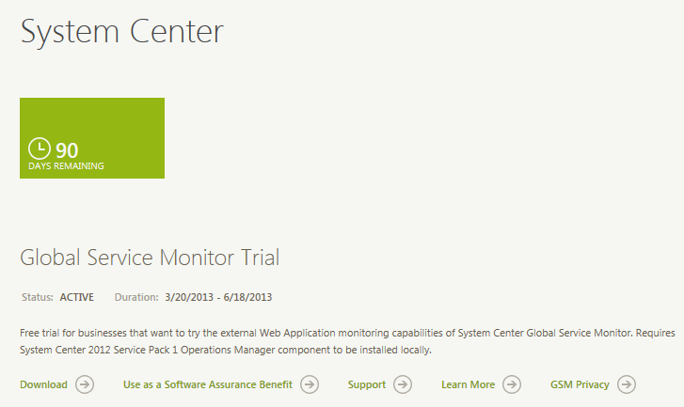
SIGN UP EXPERIENCE: STEP 2
Download the MPs
Step 1
Step 2
Step 3
Step 4
Done!

Slide 9
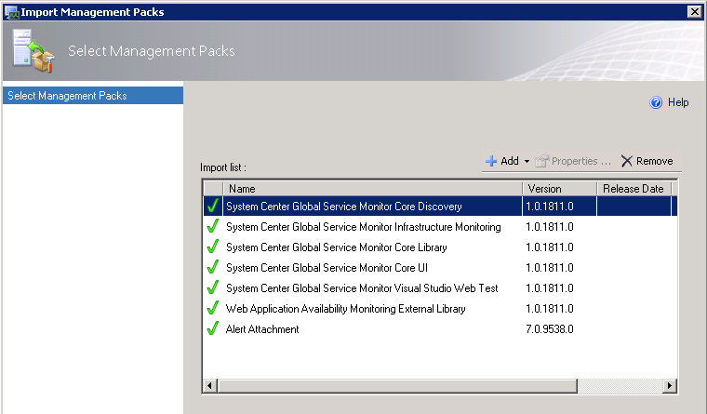
SIGN UP EXPERIENCE: STEP 3
Import MPs
Alert Attachment MP
Global Service Monitor MPs
Enable file attachments for alerts
http://technet.microsoft.com/en-us/library/jj899889.aspx
Step 1
Step 2
Step 3
Step 4
Done!

Slide 10
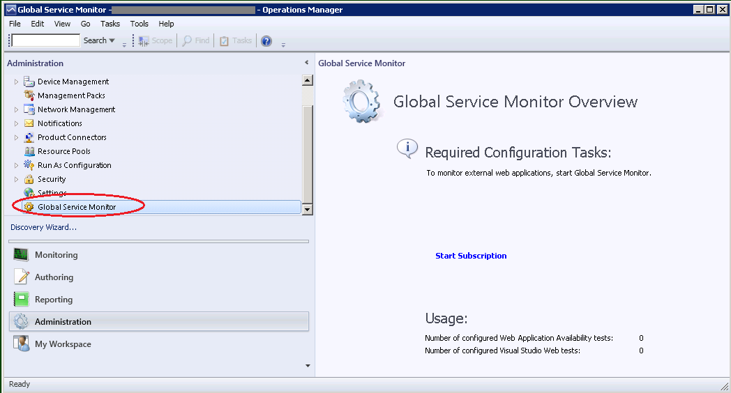
SIGN UP EXPERIENCE: STEP 4
Start Global Service Monitor subscription
Use your *.onmicrosoft.com user account
Step 1
Step 2
Step 3
Step 4
Done!

Slide 11
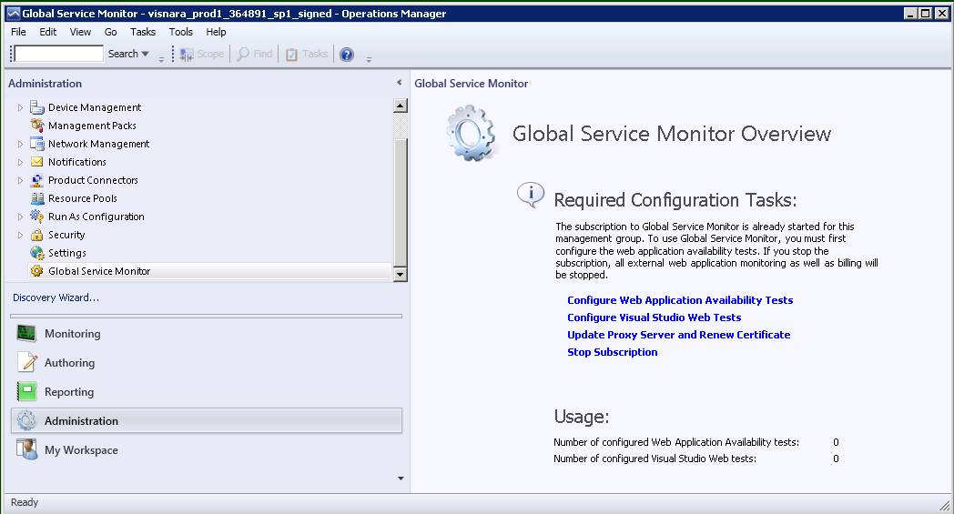
SIGN UP EXPERIENCE: DONE!
Step 1
Step 2
Step 3
Step 4
Done!

Slide 12
Reduce MTTR by facilitating DevOps cycle

Slide 13
Application Lifecycle – common challenges
No actionable feedback resulting in high MTTR
Operations
Production incidents are hard to debug
PROBLEM ASSIGNED TO ENGINEERING
Develop
Rapid reaction to feedback
Development & testing
Users detect defects in production
Fix
Monitor
Operate
Software to value delivery
Unable to reproduce error in development environment
OPS
BACKLOG
Isolated operations tools and workflows
Long deployment cycle times
WORKING SOFTWARE

Slide 14
DevOps drivers
Accelerating DevOps cycle
Data-driven (lean) development
End-user telemetry
Feature/ROI measurement
Agile methodologies
Continuous delivery
Dynamic monitoring and automation
Focus on customer satisfaction
Real end-user experience monitoring
Early problem detection and reducing MTTR

Slide 15
CHALLENGE: DIFFERENT WORLDS OF DEVS AND OPS
Developer
Operations Admin
Day job
Increase/Maintain business operational availability by eliminating/controlling change
Tools
System Center
Concepts
Alerts
SLAs
Availability
Latency
Day job
Increase/Maintain business viability by introducing change to support market demand
Tools
TFS
Visual Studio
Concepts
Bugs and TFS work items
Functionality
Code

Slide 16
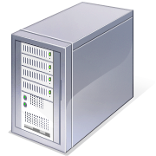
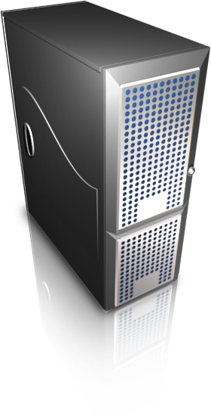
360º Application Monitoring
Global Service
Monitor
Webtest Upload
Operations Manager
Transaction
Performance
Real User Experience
Reliability
Availability
Webtest
Transaction
Alerts
Application
Build / Deploy
Team
Foundation
Server
Webtest
Work Items
Intellitrace
Visual Studio Developer

Slide 17
Demo
Reduce MTTR by facilitating DevOps cycle

Slide 18
Facilitating Devs and Ops collaboration
Developer
Operations Admin

Slide 19
WHAT’S NEXT?
Sign up for GSM in Microsoft Account for Organizations portal (https://orgaccount.microsoft.com/signup?offerIds=BE2A46EF-0639-43a4-8323-BB5E1D4340D3)
Configure GSM subscription
Add GSM tests and start monitoring
Provide feedback

Slide 20
Java APM

Slide 21
Java APM
Performance and Exception Events within SCOM Application Advisor
Method and Resource timing for Performance Events
Stack Traces for Exception Events
Java Specific counters for events (JVM Memory, Class Loader etc)
Subset of standard APM Reports Supported
Ops Manager Level Alerting on Java Application Server counters
Requests / Second
Perf Events / Second
Exception Events / Second
Average Request Time

Slide 22
Java APM – Supported Configurations
Tomcat (v 5.5,6,7)
Windows
Linux
Java JDK (5,6)
Web Technologies
GenericServlet
Struts
Struts2
Axis2

Slide 23
Java APM Preview
Laura Cruz

Slide 30
Track resources
Learn more about Windows Server 2012 R2 Preview, download the datasheet and evaluation bits on http://aka.ms/WS2012R2
Learn more about System Center 2012 R2 Preview, download the datasheet and evaluation bits on http://aka.ms/SC2012R2

Slide 31
Resources
Learning
Sessions on Demand
Microsoft Certification & Training Resources
http://channel9.msdn.com/Events/TechEd
www.microsoft.com/learning
TechNet
msdn
Resources for IT Professionals
Resources for Developers
http://microsoft.com/technet
http://microsoft.com/msdn

Slide 32
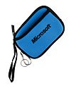
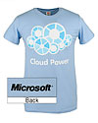
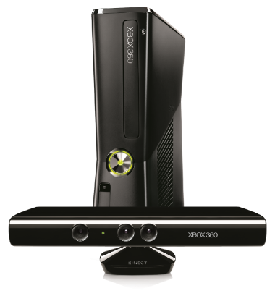
Complete an evaluation on CommNet and enter to win!

Slide 33
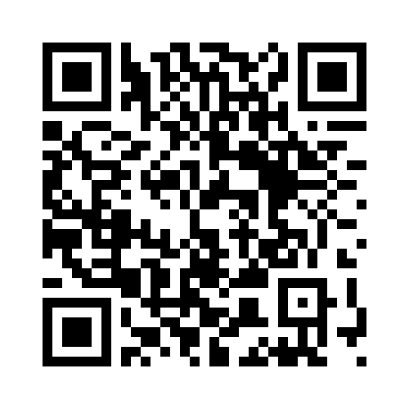
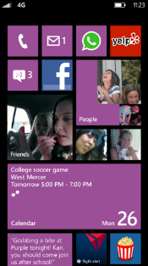
Evaluate this session
Required Slide
*delete this box when your slide is finalized
Your MS Tag will be inserted here during the final scrub.
Scan this QR code to evaluate this session and be automatically entered in a drawing to win a prize

Slide 34
© 2013 Microsoft Corporation. All rights reserved. Microsoft, Windows and other product names are or may be registered trademarks and/or trademarks in the U.S. and/or other countries.
The information herein is for informational purposes only and represents the current view of Microsoft Corporation as of the date of this presentation. Because Microsoft must respond to changing market conditions, it should not be interpreted to be a commitment on the part of Microsoft, and Microsoft cannot guarantee the accuracy of any information provided after the date of this presentation. MICROSOFT MAKES NO WARRANTIES, EXPRESS, IMPLIED OR STATUTORY, AS TO THE INFORMATION IN THIS PRESENTATION.

