Slide 2
Deliver IT Agility in the Modern Datacenter with Integration of Virtualization, Cloud
MDC-B392
Vaughn Stewart
Glenn Sizemore
NetApp

Slide 3
Agenda
Introduction to NetApp
The Emerging Software Defined Datacenter
Windows Server® 2012
System Center 2012

Slide 4
Customer and Partner Success Fuels Our Growth
Recognized as a FORTUNE 500® Company, 2012
77% are NetApp Customers
Data ONTAP: the industry's #1 storage OS
#3 World’s Best Multinational Workplaces 2012
#6 FORTUNE’s 2013 100 Best Companies to Work For
#51 Forbes World’s Most Innovative Companies 2012
FORTUNE’s 100 Fastest-Growing Companies 2012
Notes:
4

Slide 5
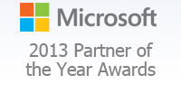
2013 Server Platform Partner of the Year

Slide 6
NetApp Integration for Microsoft
Administration
CMDB: Fabric state
UI: Initiate workflows
Sample Scripts
Orchestration
End-to-end Workflows
Orchestrator Integration Packs
OnCommand® Plug-In
Management
Management Packs SCVMM PRO Tips
OnCommand Plug-In
Manage Processes and Operations
Automation
Data ONTAP®
PowerShell Toolkit
Centralized Automation and Configuration
Virtualization
SnapDrive ® for Windows
SnapManager ® for Hyper-V
Virtualization and Resource Pools
Hardware
Management and Provisioning
WS-Man PowerShell SMI-S Interfaces
Data ONTAP®

Slide 7
Software Defined Datacenters

Slide 8
What is a Software-Defined Data Center?

Slide 9
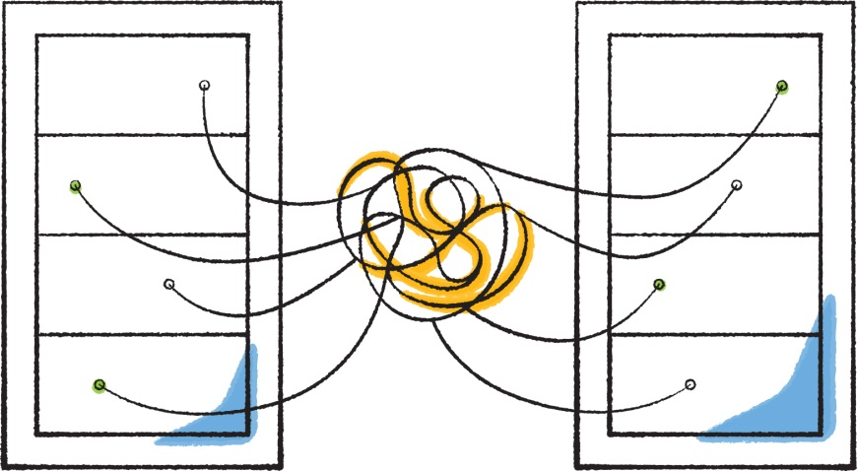
What’s Driving Software-Defined Storage?

Slide 10
Software-Defined Storage (SDS) Benefits
IT teams: More responsive
Provision based on priority and service level
Benefit from pre-set, policy-based security and delegation
Application owners: More autonomous
Dynamically respond to shifts in demand
Instantly deploy new applications and services
Purchasing decision makers: More flexible
Deploy on platform of choice
Extend capabilities of existing assets

Slide 11
NetApp SDS Vision & Approach
Application Self-Service
Deliver Applications without Compromise
Virtualized Storage Arrays
Provision Based on Service Levels
Multi-Vendor Hardware
Deploy on Platform of Choice

Slide 12
ONTAP: Virtualized Storage Services
Provision Based on Service Levels
Policy-based storage
Storage VMs
SAN and NAS
Storage efficiency
Multi-tenant
Granular QoS
Performance levels
Integrated data protection
Data mobility
ONTAP Storage Virtual Machines
Storage VM
SVM
Storage VM
SVM
NetApp
NetApp
NetApp
NetApp
Scale-out Storage Architecture

Slide 13
ONTAP: Multi-Vendor Hardware
Deploy on Platform of Choice
FAS
Unified and optimized
Integrated-stack: FlexPod
V-Series
Existing non-NetApp storage
ONTAP Edge
Commodity disk in servers
NetApp Private Storage for Amazon Web Services
Data ONTAP is the #1 storage operating system
Storage VM
SVM
Storage VM
SVM
NetApp
3rd Party
Commodity
Cloud SP

Slide 14
ONTAP: Application Self-Service
Deliver Services without Compromise
Empower the application owner and developer
OnCommand plug-ins and programmable APIs
Deep Integrations
Cisco, Citrix, Microsoft, OpenStack, Oracle, Red Hat, SAP, VMware, etc.
Desktop
Email
Database
Test-Dev
VM
VM
VM
VM
VM
VM
VM
VM
VM
Storage VM
SVM
Storage VM
SVM
NetApp
3rd Party
Commodity
Cloud SP

Slide 15
NetApp SDS Vision & Approach
Clustered Data ONTAP: Best SDS foundation
Only storage software that abstracts data access and services from pooled hardware
Broadest hardware support
NetApp-optimized, third-party, commodity and cloud
Most comprehensive application integrations and open programmable APIs
Storage based on SLAs
QoS, efficiencies, Policy-based security, governance and delegation, multi-tenancy, scale-out, and mobility support

Slide 16
Windows Server 2012

Slide 17
Management

Slide 18
Management
Data ONTAP PowerShell Toolkit
Windows PowerShell™ wrapper around the NetApp® Manage ONTAP SDK
Community
Quarterly release cycle
As of version 2.4 over 1,200 cmdlets
SMI-S 4.1
Supports Filers running DataONTAP 7.3.x, 8.0.x, and 8.1.x (7-mode)
Is agent based, can be run in Windows or Linux
Passed SNIA Conformance Testing Program (CTP) 1.4 and Supports SCVMM 2012 SP1
SnapDrive for Windows

Slide 19
Video
NetApp SMI-S Provider

Slide 21
Video
Data ONTAP PowerShell Toolkit

Slide 23
Performance

Slide 24
Offload Data Transfer (ODX)
Token Based
Cross Protocol
Automatically selects the maximum offload

Slide 25
Video
ODX

Slide 27
SnapManager 2.0 for Hyper-V
Hardware-based snapshot provider.
Crash and Application Consistent.
CSV
Distributed Backups
SMB 3.0
Remote VSS

Slide 28
Video
SnapManager 2.0 for Hyper-V

Slide 30
SnapManger Performance Improvements

Slide 31
VMware to Hyper-V Migrations
Windows Server® Server 2003 +
Order or magnitude faster than standard copy based methods
Space efficient
Windows PowerShell™ based

Slide 32
Portability

Slide 33
Video
NetApp Shift

Slide 35
System Center 2012 SP1

Slide 36
OnCommand Plug-In for Microsoft 3.2: SCOM integration

Slide 37
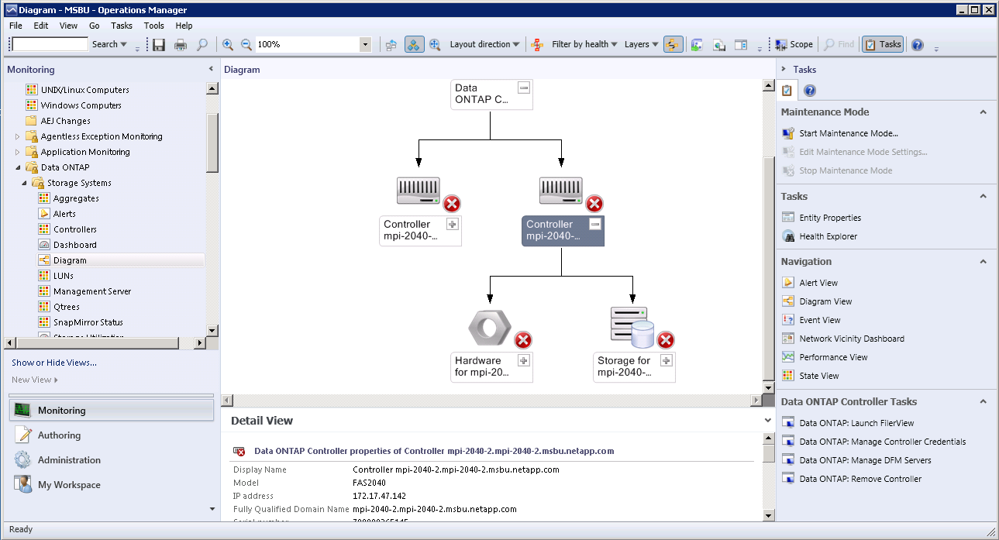
OnCommand Plug-in for Microsoft 3.2 Centralized Storage Management for Windows Admins

Slide 38
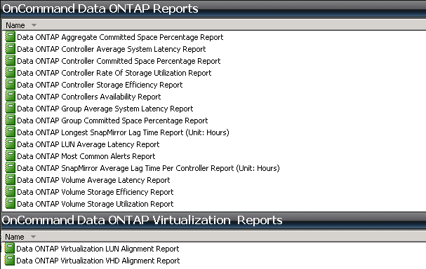
OnCommand Plug-in for Microsoft 3.2 SCOM Reporting
There are 17 reports total available if SCOM reporting is installed
Reports found under SCOM > Report (tab) > OnCommand Data ONTAP

Slide 39
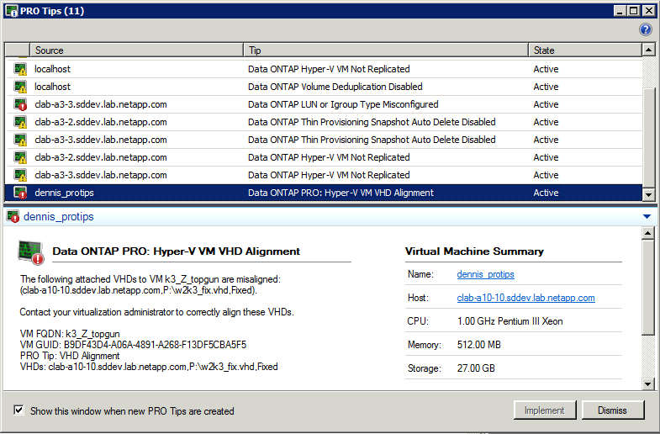
OnCommand Plug-in for Microsoft 3.2 SCVMM PRO Tips integration
Volume space utilization exceeded threshold
LUN-type igroup-type misconfiguration
Thin-provisioning LUN space reservation
Thin-provisioning Snapshot™ auto delete
Thin-provisioning volume autogrow
Hyper-V™ VM space utilization
Misaligned LUNs or misaligned unattached VHDs
And more…

Slide 40
OnCommand Plug-In for Microsoft 3.2: SCVMM integration

Slide 41
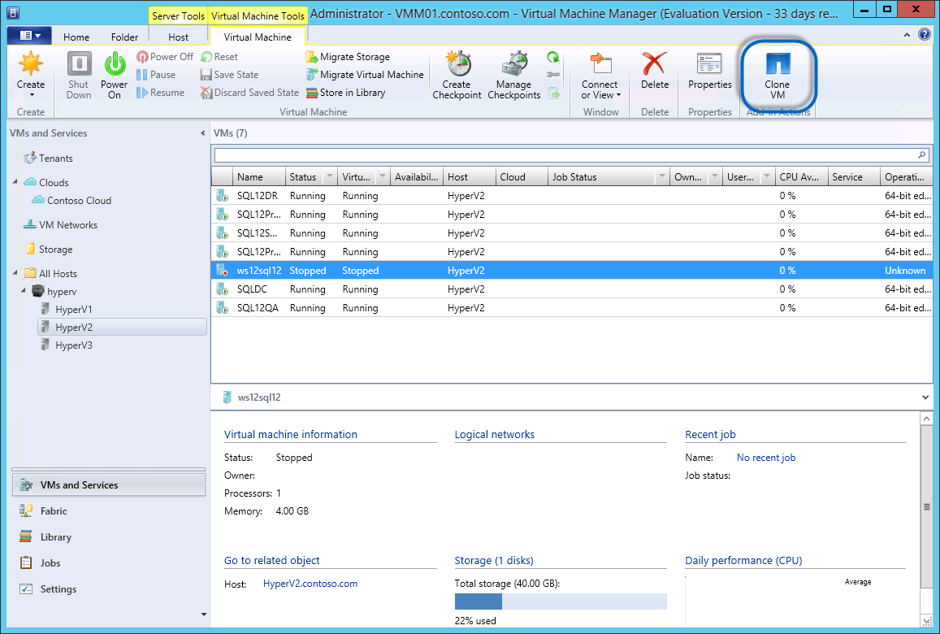
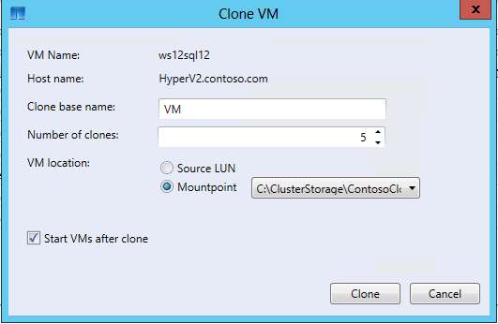
OnCommand Plug-in for Microsoft 3.2
Uses NetApp® FlexClone® technology
Both template and VM Cloning

Slide 42
OnCommand Plug-In for Microsoft 3.2: SCO integration

Slide 43
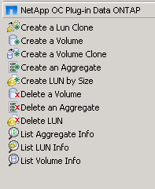
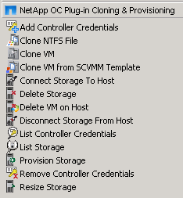
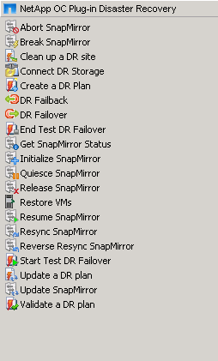
OnCommand Plug-In for Microsoft 3.2 SCO Integration

Slide 44
Video
Orchestrator

Slide 46
What If You Could . . .
Deploy a private cloud in days instead of months?
Cut storage, power/and space costs by 50%?
Rapidly provision VMs via orchestration?
Automate labor-intensive operations?
Achieve nondisruptive operations?
Backup and restore VMs instantly?
Integrate with self-service portals?
Notes:
46

Slide 47
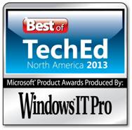
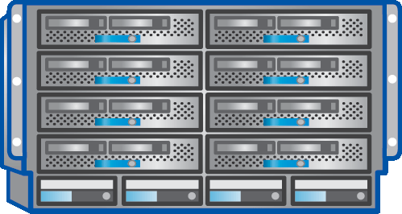
FlexPod with Microsoft Private Cloud Finalist for Best of TechEd Systems Management Category
Fast Track 3.0 Validated Design
Fully integrated with System Center 2012 SP1 and the Cloud Services Process Pack
Based on FlexPod®
The most scalable Hyper-V™ platform on the market
Accelerates private cloud deployments at reduced risk
All HW components are shipping now
Reference available now
Vote for FlexPod with Microsoft Private Cloud. Best of TechEd Systems Management Category
Cisco UCS ®Blade,
and Rack Servers
and UCS Manager
Cisco Nexus® Family Switches
NetApp® FAS
Storage Systems

Slide 48
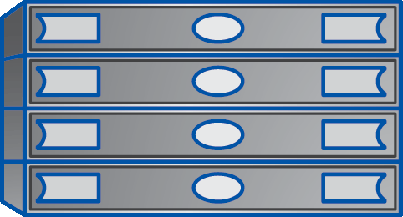
ExpressPod with Windows Server 2012
Entry level reference architecture
iSCSI only
Small and medium documented configurations
All HW components are shipping now
Reference implementation is available now
Cisco UCS ® C220 M3 Servers
Cisco Nexus® 3048
NetApp® FAS2220
Storage Systems
Cisco UCS C220 M3 Servers
Cisco Nexus 3048
NetApp FAS2240
Storage Systems

Slide 49
Summary
Software Defined Datacenter
Emerging Technology Trend
Deliver IT agility to Application Owners and Development Teams
Windows Server 2012
Management
Performance
Portability
System Center 2012 SP1
Operations Manger
Virtual Machine Manager
Orchestrator

Slide 50
Track resources
Learn more about Windows Server 2012 R2 Preview, download the datasheet and evaluation bits on http://aka.ms/WS2012R2
Learn more about System Center 2012 R2 Preview, download the datasheet and evaluation bits on http://aka.ms/SC2012R2

Slide 51
Resources
Learning
Sessions on Demand
Microsoft Certification & Training Resources
http://channel9.msdn.com/Events/TechEd
www.microsoft.com/learning
TechNet
msdn
Resources for IT Professionals
Resources for Developers
http://microsoft.com/technet
http://microsoft.com/msdn

Slide 52
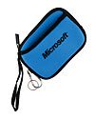
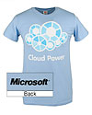
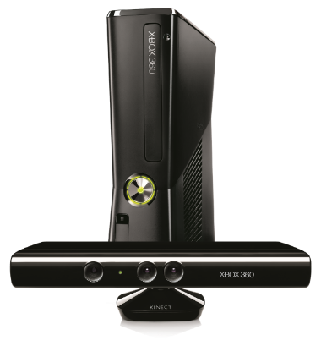
Complete an evaluation on CommNet and enter to win!

Slide 53
Evaluate This Session
Required Slide
*delete this box when your slide is finalized
Your MS Tag will be inserted here during the final scrub.
Scan the Tag to evaluate this session now on myTechEd Mobile

Slide 54
© 2013 Microsoft Corporation. All rights reserved. Microsoft, Windows and other product names are or may be registered trademarks and/or trademarks in the U.S. and/or other countries.
The information herein is for informational purposes only and represents the current view of Microsoft Corporation as of the date of this presentation. Because Microsoft must respond to changing market conditions, it should not be interpreted to be a commitment on the part of Microsoft, and Microsoft cannot guarantee the accuracy of any information provided after the date of this presentation. MICROSOFT MAKES NO WARRANTIES, EXPRESS, IMPLIED OR STATUTORY, AS TO THE INFORMATION IN THIS PRESENTATION.

