Slide 2
Advanced Automation using Windows PowerShell
MDC-B400
Jeffrey Snover
Don Jones

Slide 3
Welcome!
Jeffrey Snover Distinguished Engineer, Windows Server Microsoft Corporation
Don Jones PowerShell MVP and author, Concentrated Tech

Slide 4
Agenda
Mainly demo-driven
Advanced improvements in Microsoft Windows PowerShell 3 and in Microsoft Windows Server 2012
Along with some fun advanced tips ‘n’ tricks
We brought more than we’ll have time for… but we’ll get through as much as we can.

Slide 5
First Up: Make a “Cmdlet”
There’s a need to create packaged, reusable tools that comply with Windows PowerShell standards…
…but a desire to not become a full-time programmer in the process.
No problem: Advanced Functions make it pretty easy.

Slide 6
Create a “cmdlet” from a command – with almost no programming
Don Jones

Slide 7
Next: Jobs
Have always been an extension point in Windows PowerShell
Windows PowerShell v3 adds Scheduled Jobs
Different from operating system Scheduled Tasks, although Microsoft Windows 8 and Windows Server 2012 add cmdlets for managing those, too.
Some of the main job types have changed slightly since Windows PowerShell 2

Slide 8
Jobs, Jobs, Scheduled Jobs, and Jobs
Jeffrey Snover

Slide 9
Bundling Commands into Modules
Modules provide an easy way to add several commands into a reusable library
Comply with shell standards and you get a ton of free functionality

Slide 10
Package commands as script modules
Don Jones

Slide 11
Remoting Improvements
Remoting got a lot of additional investment in Windows PowerShell 3
Disconnected sessions
More robust sessions
Easier implicit remoting

Slide 12
Improvements to Remoting
Don Jones and Jeffrey Snover

Slide 13
Custom Session Configurations
You can also more easily create custom Remoting session configurations
These can be locked down:
Decide who can connect
Decide what they can run
These can run all commands under an alternate RunAs credential
Instant delegated administration

Slide 14
Delegated Administration via Constrained Endpoints
Jeffrey Snover

Slide 15
CIM vs WMI
WMI was always built on preliminary standards and remains a proprietary technology
RPC, DCOM, etc
CIM is the fully standards-based alternative
Works very similarly to WMI and accesses the same repository
Uses WinRM/WS-MAN (HTTP) for communications
Windows PowerShell 3 CIM commands support DCOM connections for backward connectivity

Slide 16
WMI vs CIM
Jeffrey Snover

Slide 17
Debugging
Always an important task for folks who make mistakes
The key approach is still to “get inside your script’s head,” mainly following logic and seeing what properties and variables really contain
Write-Debug… or PSBreakpoints? Discuss!

Slide 18
Debugging
Don Jones and Jeffrey Snover

Slide 19
Wrapping Up
Good time for final Q&A
Find Don in the Expo Hall / Community Area representing PowerShell.org
Post after-conference questions in the forums on PowerShell.org

Slide 20
Track resources
Learn more about Windows Server 2012 R2 Preview, download the datasheet and evaluation bits on http://aka.ms/WS2012R2
Learn more about System Center 2012 R2 Preview, download the datasheet and evaluation bits on http://aka.ms/SC2012R2

Slide 21
Resources
Learning
Sessions on Demand
Microsoft Certification & Training Resources
http://channel9.msdn.com/Events/TechEd
www.microsoft.com/learning
TechNet
msdn
Resources for IT Professionals
Resources for Developers
http://microsoft.com/technet
http://microsoft.com/msdn

Slide 22
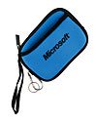
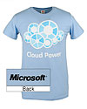
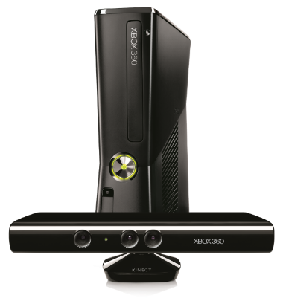
Complete an evaluation on CommNet and enter to win!

Slide 23
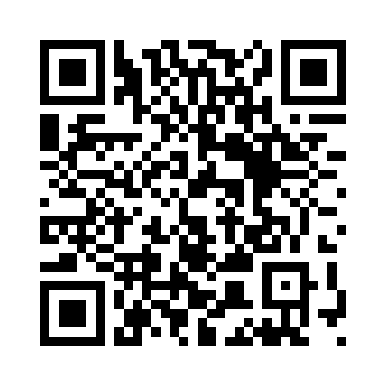
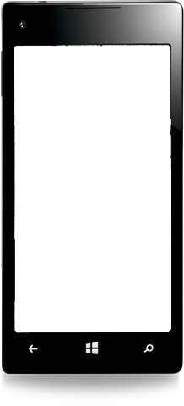
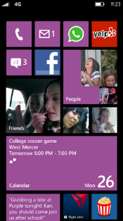
Evaluate this session
Required Slide
*delete this box when your slide is finalized
Your MS Tag will be inserted here during the final scrub.
Scan this QR code to evaluate this session and be automatically entered in a drawing to win a prize

Slide 24
© 2013 Microsoft Corporation. All rights reserved. Microsoft, Windows and other product names are or may be registered trademarks and/or trademarks in the U.S. and/or other countries.
The information herein is for informational purposes only and represents the current view of Microsoft Corporation as of the date of this presentation. Because Microsoft must respond to changing market conditions, it should not be interpreted to be a commitment on the part of Microsoft, and Microsoft cannot guarantee the accuracy of any information provided after the date of this presentation. MICROSOFT MAKES NO WARRANTIES, EXPRESS, IMPLIED OR STATUTORY, AS TO THE INFORMATION IN THIS PRESENTATION.

