Slide 2
Help small businesses seize the day with Office 365
OUC-B212
Andy O’Donald
Product Marketing Manager

Slide 3
Agenda
Small business challenges
What is Office 365
Choosing the right Office 365 plan
Small Business scenarios
Scheduling
Multiple office locations/branches
Outsourcing/Contract work
Small Business Admin overview

Slide 4
Small businesses face many challenges
“Not having professional e-mail services hurts my business as it makes me look less professional.”
“I can’t afford expensive maintenance contracts.”
“My ideas are my business, I need an easy way to share and work on these from anywhere.”
“When my technology goes down, my business shuts down…”

Slide 5
Technology that fits your needs
Look Professional
Best
Value
Anywhere
Access
No IT
Required

Slide 6
Office 365 | Your complete Office in the cloud
Familiar & full Office applications - available offline
IT controls and configuration
Optimized experiences
For common devices
Reliable service run at
scale with a 99.9% SLA
Industry trusted certifications
Continuous innovation

Slide 7
Choose the right plan for your business
Office 365 Small Business
Office 365 Small Business Premium
Office 365 Midsize Business
Office 365
Enterprise E3
Voicemail, Legal Hold, Data Loss Prevention
●
●
Rights Management
●
Advanced Services
●
InfoPath Forms, Access, Excel, Visio Services
●
Active Directory® Integration
●
●
●
●
Office Desktop Applications
●
●
●
Office
●
●
●
Click to Run Office Deployment
Pull
Pull
Push
Pull
Pull
Push
Office Web Applications
●
●
●
●
●
●
●
●
Standard
Services
Email, File Sharing, Website, Conferencing
●
●
●
●
IT Level Phone Support
Basic
Basic
Expanded
Full
Expanded
Basic
Expanded
Full
IT Administration Console
Basic
Basic
Expanded
Full
Seat targets
1-10
1–10
11–250
>250
Price (per user/month in US Dollars)
$6
$12.50
$15
$20

Slide 8
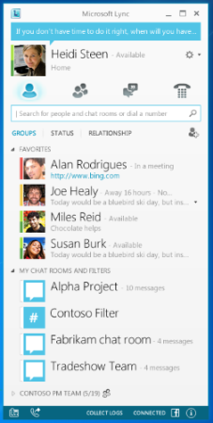
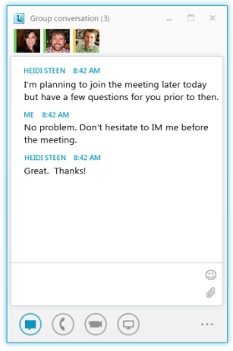
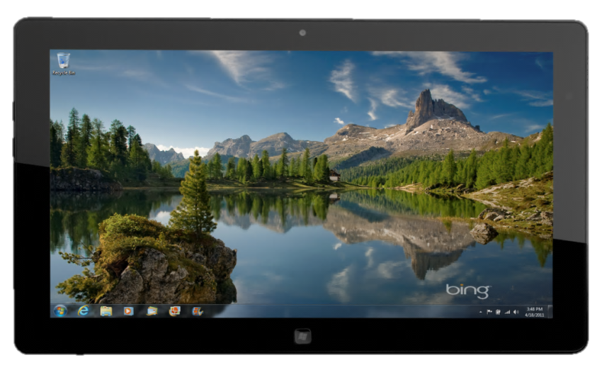
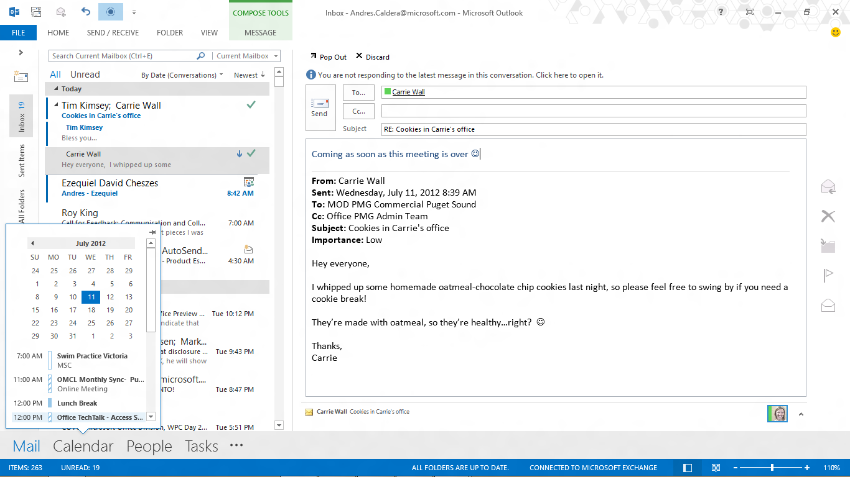
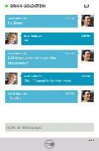
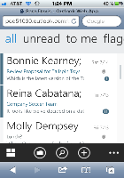
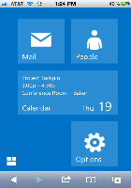
Use Office on your devices
Get the latest version of the familiar Office applications on all your devices: PC, Mac, tablet and smartphone.

Slide 9
Scheduling
Scenario
Aggregated schedule for the “Office”
Managed centrally often by admin/front desk
Consumed by the specialist
Situation
Frequently managed on paper today
Difficult to communicate changes
Solution
Shared calendaring
Apps for Office and SharePoint for deeper integration

Slide 10
Demo

Slide 11
Multiple office locations/branches
Scenario
Need to collaborate across multiple office locations
Rapidly growing or expanding small business
Situation
Owner is challenged on staying in the know with the other offices
Time spent managing
Solution
Use project sites to manage everyone’s keys tasks and deliverables
Lync Online for quick multiple location communications

Slide 12
Multiple locations

Slide 13
Outsourcing/Contract work
Scenario
Need to easily work with contractors or other small businesses
Consultants
Task work
Supplier
Situation
Today mostly managed through email attachments or USB file transfers
Decentralized, difficult to manage
Solution
Sharing with external users in SharePoint Online

Slide 14
External Sharing

Slide 15
Sharing is external
SharePoint Online Only
External Access
Sites or documents can be shared with external users
External users sign in using Microsoft Account or Office365 Account
Once inside, external users are treated similar to internal users
Guest Links
Documents can be shared using Guest Links
View or edit Guest Links
Whoever gets the link can access the content
Documents open in Office Web Apps

Slide 16
Administrative controls
Office 365 Enterprise
3 options to configure Guest Links & External Access
Switch at company level, separate switch for each site collection & Personal Sites
Defaults
Both Guest Links and External Access ON at company level
ON for pre-created site collections (My Sites, Team Site, Public)
Newly created site collections have External Sharing OFF
Office 365 Small business
1 switch for both Guest Links & External Access
Switch at company level – no separate switch per site collection
Defaults
Guest Links & External Access ON at company level

Slide 17
Office 365 ProPlus (Small Business Premium)
5 PC/Mac & mobile
Roaming
Upgrades included
Easy install
Office on demand
Save to cloud

Slide 18
Admin overview

Slide 19
Summary
Business-ready tools
Always up-to-date
Low upfront costs
One user, multiple devices

Slide 20
Track resources
Office 365 Blog: http://blogs.office.com/b/microsoft_office_365_blog/
Office Technology Blog: http://blogs.office.com/b/office365tech/
Follow: https://twitter.com/Office365
Connect: http://www.linkedin.com/groups/Microsoft-Office-365-3724282
Check out:
Garage Series for IT Pros: www.microsoft.com/garage
Office 365 FastTrack: http://fasttrack.office.com//

Slide 21
Resources
Learning
Sessions on Demand
Microsoft Certification & Training Resources
http://channel9.msdn.com/Events/TechEd
www.microsoft.com/learning
TechNet
msdn
Resources for IT Professionals
Resources for Developers
http://microsoft.com/technet
http://microsoft.com/msdn

Slide 22
© 2013 Microsoft Corporation. All rights reserved. Microsoft, Windows and other product names are or may be registered trademarks and/or trademarks in the U.S. and/or other countries.
The information herein is for informational purposes only and represents the current view of Microsoft Corporation as of the date of this presentation. Because Microsoft must respond to changing market conditions, it should not be interpreted to be a commitment on the part of Microsoft, and Microsoft cannot guarantee the accuracy of any information provided after the date of this presentation. MICROSOFT MAKES NO WARRANTIES, EXPRESS, IMPLIED OR STATUTORY, AS TO THE INFORMATION IN THIS PRESENTATION.

