Slide 2
Data Loss Prevention in Microsoft Exchange and Microsoft Outlook 2013
OUC-B301
Jack Kabat
Program Manager

Slide 3
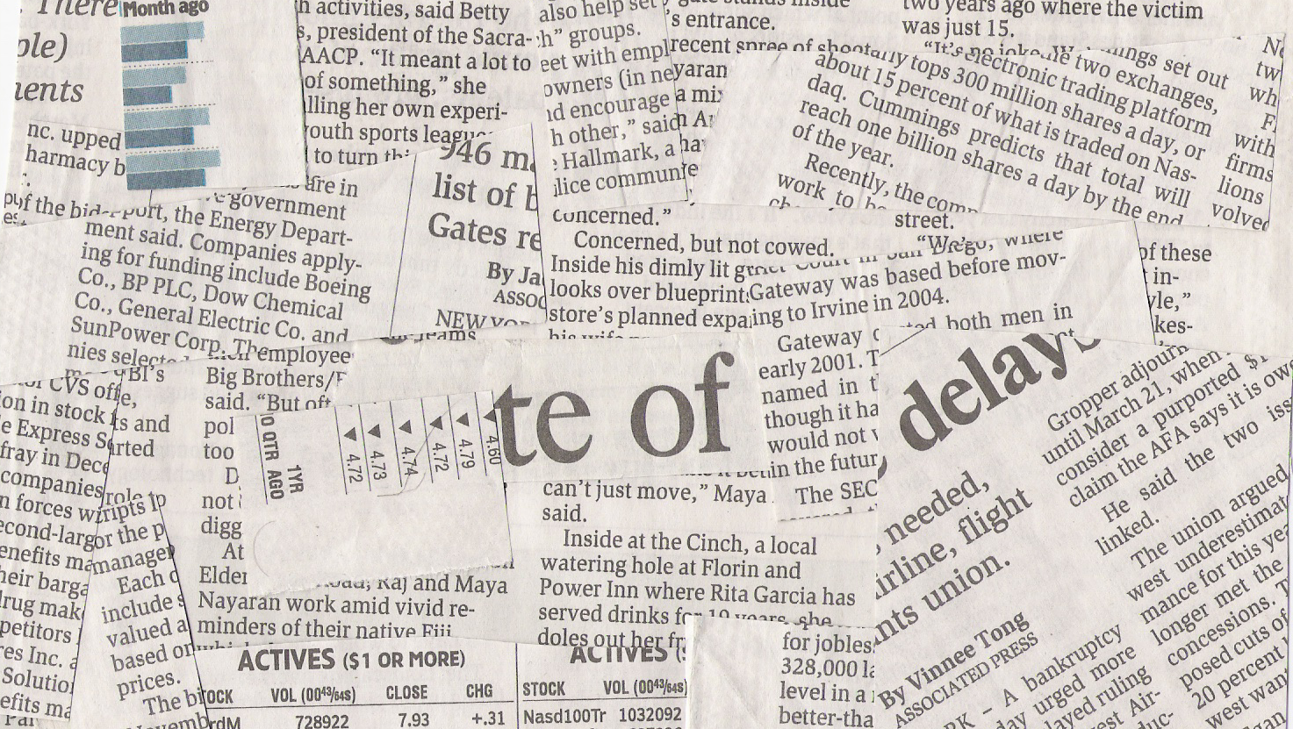
“
Large Retailer Leaks Payment Information via Email…
“
“
“
Accidental email with attachment exposed hundreds of individuals’ names and Social Security Numbers…

Slide 4
Data loss prevention in Office 2013
Identify
Monitor
Helps to
identify
monitor
protect
sensitive data through deep content analysis.
Protect
End user education

Slide 5
Demo
Outlook policy tips

Slide 6
User education
Empower users to manage their compliance
Contextual policy education
Doesn’t disrupt user workflow
Can work even when disconnected
Admin customizable text and actions

Slide 7
DLP system walkthrough
Backend policy evaluation
DLP policy configuration
Admin
Audit & incident data generation
Outlook policy distribution
Contextual policy education
Information workers

Slide 8
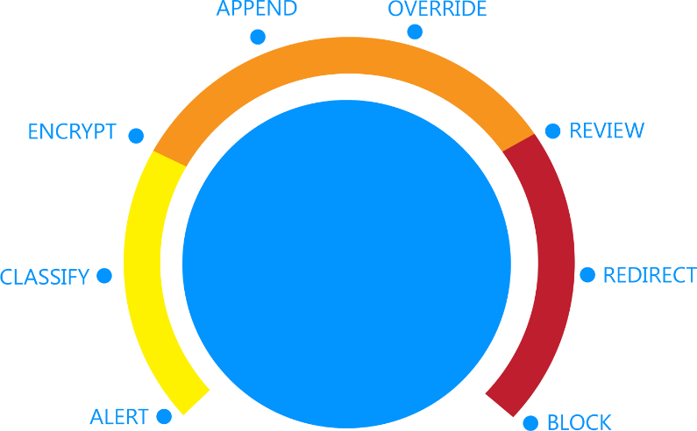
DLP policy enforcement
Flexible policy enforcement that provide the right level of control

Slide 9
DLP content detection architecture
SMTP receive
Integrated into Exchange Transport Rule (ETR) engine
Categorizer
Transport rule agent
Text extraction
Runs in categorizer during OnResolvedMessage
Integrated as a new ETR Predicate
Performs text extraction for body & attachments followed by classification
Can be combined with any existing Predicates & Actions
Classification
Queue management
Message delivery
Store driver

Slide 10
DLP policy templates
Built-in templates based on common regulations
Import DLP policy templates from security partners
Build your own

Slide 11
Conditions
DLP policy rules
Built on transport rules
Supports discovery phase of compliance
Take action to enforce policy
Hold, block, audit & provide notification for email that contains sensitive business data
Actions
Exceptions

Slide 12
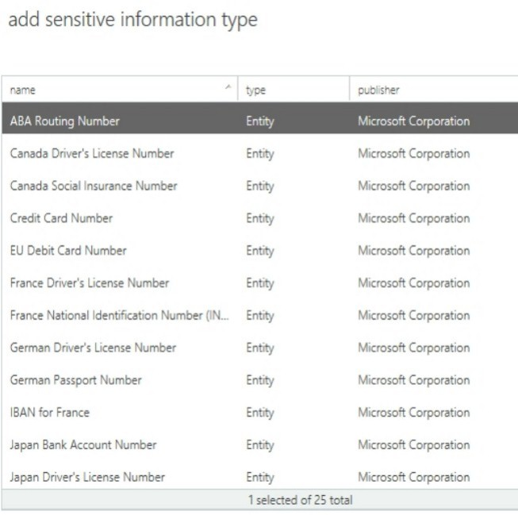
Sensitive content detection
Predefined rules targeted at sensitive data types
Advanced content detection
Combination of regular expressions, dictionaries, and internal functions (e.g. validate checksum on credit card numbers)
Extensibility for customer and ISV defined data types

Slide 13
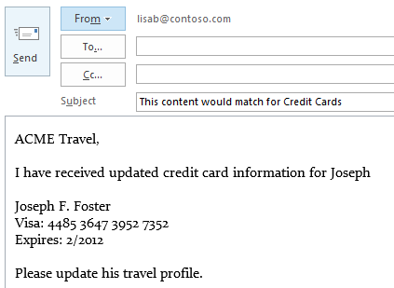
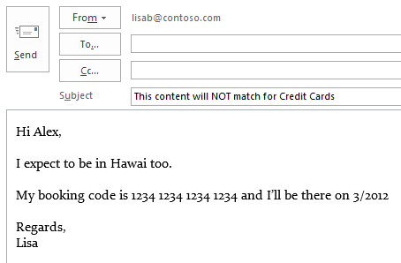
Content analysis process
Examples
Get Content
Joseph F. Foster
Visa: 4485 3647 3952 7352
Expires: 2/2012
RegEx Analysis
4485 3647 3952 7352 → a 16 digit number is detected
Function Analysis
4485 3647 3952 7352 → matches checksum
1234 1234 1234 1234 → does NOT match
Additional Evidence
Keyword Visa is near the number
A regular expression for date (2/2012) is near the number
Verdict
There is a regular expression that matches a check sum
Additional evidence increases confidence

Slide 14
Demo
DLP policy management

Slide 15
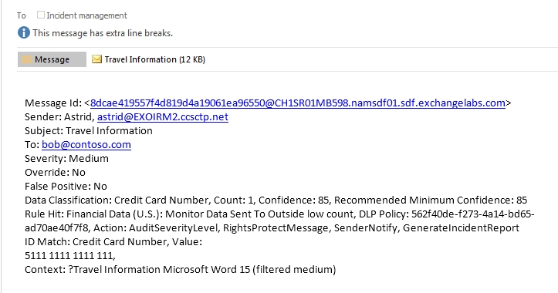
Incident reports
Match details
Audit data
Classification
Rule details

Slide 16
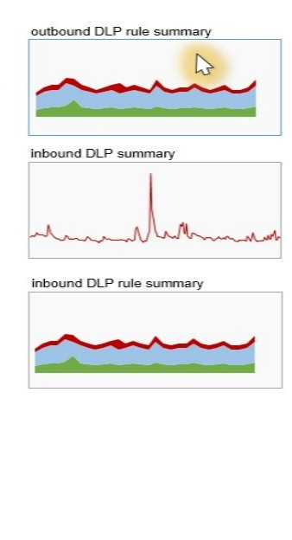
DLP reporting and auditing
Comprehensive view of DLP policy application
Drill into specific departures from policy to gain business insights
Downloadable excel workbook & email incident reports

Slide 17
Built-in DLP Content Areas
Country | PII | Financial | Health
US | US State Security Breach Laws, US State Social Security Laws, COPPA | GLBA & PCI-DSS (Credit, Debit Card, Checking and Savings, ABA, Swift Code) | Limited Investment: US HIPPA, UK Health Service, Canada Health Insurance card Rely on Partners and ISVs
Germany | EU data protection, Drivers License, Passport National Id | EU Credit, Debit Card, IBAN, VAT, BIC, Swift Code
UK | Data Protection Act, UK National Insurance, Tax Id, UK Driver License, Passport | EU Credit, Debit Card, IBAN, BIC, VAT, Swift Code
Canada | PIPED Act, Social Insurance, Drivers License | Credit Card, Swift Code
France | EU data protection, Data Protection Act, National Id (INSEE), Drivers License, Passport | EU Credit, Debit Card, IBAN, BIC, VAT, Swift Code
Japan | PIPA, Resident Registration, Social Insurance, Passport, Driving License | Credit Card, Bank Account, Swift Code
Australia | Drivers License, Passport, Social Insurance | Credit Card, Bank Account, Swift Code

Slide 18
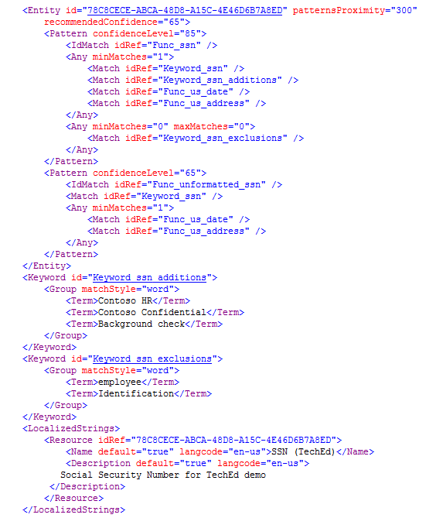
DLP extensibility points
Custom DLP content:
Supplemental DLP policy rules
Supplemental DLP classification rules
Incident reports integration with custom workflows
Custom reporting solutions

Slide 19
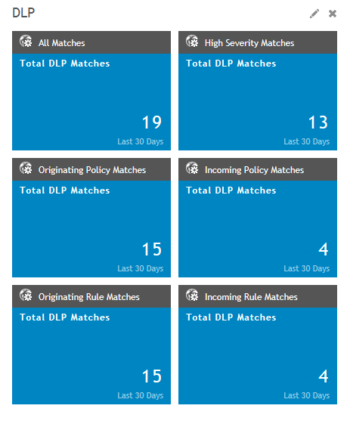
MessageStats Business Insights from Dell
Complements the native DLP reporting in Exchange Online for organizations using Exchange 2013 on-premises
Gathers DLP data from the message tracking logs and reports on policy violations
Generates customized reporting to deliver granular results

Slide 20
Identify
Monitor
Exchange 2013
DLP features
Education experience in Outlook 2013
Available in Exchange Server and Office 365
Out of the box DLP policy templates
Predefined sensitive content types
Support for 3rd party defined DLP policy templates
DLP administration in Exchange Admin Center
Rich reporting
Protect
End user education

Slide 21
Q&A

Slide 22
Track resources
Exchange 2013 DLP introduction
http://blogs.technet.com/b/exchange/archive/2012/09/28/introducing-data-loss-prevention-in-the-new-exchange.aspx
http://technet.microsoft.com/en-us/library/jj150527.aspx
DLP policy templates
http://technet.microsoft.com/en-us/library/jj657730
Managing DLP policies
http://technet.microsoft.com/en-us/library/jj673559
OOB DLP policy templates
http://technet.microsoft.com/en-us/library/jj150530
Policy tips in Exchange 2013
http://technet.microsoft.com/en-us/library/jj150512
Supported file types
http://technet.microsoft.com/en-us/library/jj674307

Slide 23
Related content
Exchange Team Blog
http://blogs.technet.com/b/exchange/
Twitter
Follow @MSFTExchange
Join the conversation, use #IamMEC
Check out
Microsoft Exchange Conference 2014: www.iammec.com
Office 365 FastTrack: http://fasttrack.office.com//
Technical Training with Ignite: http://ignite.office.com/

Slide 24
Resources
Learning
Sessions on Demand
Microsoft Certification & Training Resources
http://channel9.msdn.com/Events/TechEd
www.microsoft.com/learning
TechNet
msdn
Resources for IT Professionals
Resources for Developers
http://microsoft.com/technet
http://microsoft.com/msdn

Slide 25
Complete an evaluation on CommNet and enter to win!

Slide 26
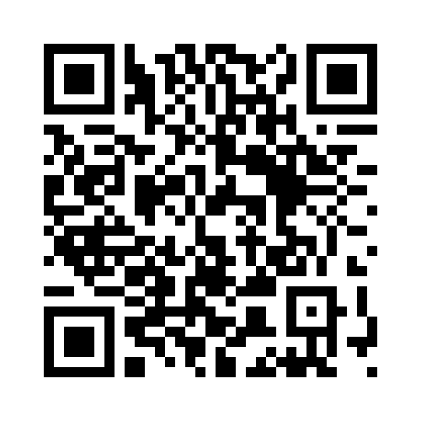
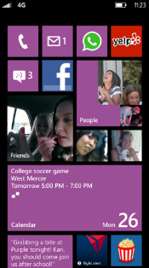
Evaluate this session
Required Slide
*delete this box when your slide is finalized
Your MS Tag will be inserted here during the final scrub.
Scan this QR code to evaluate this session and be automatically entered in a drawing to win a prize

Slide 27
© 2013 Microsoft Corporation. All rights reserved. Microsoft, Windows and other product names are or may be registered trademarks and/or trademarks in the U.S. and/or other countries.
The information herein is for informational purposes only and represents the current view of Microsoft Corporation as of the date of this presentation. Because Microsoft must respond to changing market conditions, it should not be interpreted to be a commitment on the part of Microsoft, and Microsoft cannot guarantee the accuracy of any information provided after the date of this presentation. MICROSOFT MAKES NO WARRANTIES, EXPRESS, IMPLIED OR STATUTORY, AS TO THE INFORMATION IN THIS PRESENTATION.

