Slide 2
Exchange Online Protection overview
OUC-B306
Wendy Wilkes
Senior Program Manager
Microsoft Corporation

Slide 3
“SaaS secure web and email gateways frequently provide efficiency and cost advantages, and a growing number of offerings are delivering an improved level of security that exceeds what most organizations can achieve with on-premises software or appliances.”
Gartner Report - Moving E-Mail and Web Security to the Cloud Author: Peter Firstbrook Published: 6 April 2011

Slide 4
1 billion messages per day

Slide 5
Exchange Online Protection (EOP) Next generation of Forefront Online Protection for Exchange (FOPE) Next generation of Forefront Online Protection for Exchange (FOPE)
Comprehensive protection
Multi-engine antivirus
Continuously evolving anti-spam protection
Enterprise class reliability
Geographically load-balanced datacenters
Queuing capabilities to help ensure no mail is lost
Live phone support
Streamlined administration console
Office 365 integration
Detailed reporting

Slide 6
EOP connection to Exchange
Exchange Online Protection
Save costly bandwidth by delivering only clean mail to your network
Maintain outbound server reputation
Exchange Server
Simple to deploy
Add and verify domain ownership, and setup MX record
Fine tune anti-malware and anti-spam settings
Create rules to meet business needs
Run Hybrid Wizard to configure connectors

Slide 7
Directory synchronization
Office 365 directory sync
Secure mail flow
Existing email environment
On-premises
Exchange Online Protection
Optional configuration to manage users/groups
Office 365 Active Directory Synchronization
Policy rules for specific users/groups
Synchronize Outlook safe/block sender lists

Slide 8
Anti-spam

Slide 9
Multi-layered anti-spam protection
Connection filtering Blocks up to 80% of all spam based on IP block/allow lists.
Sender-recipient filtering Blocks up to 15% of all spam based on internal lists and sender reputation.
Content filtering Blocks up to 5% of all spam based on internal lists and heuristics.

Slide 10
Granular anti-spam filtering controls
Connection filtering
Static IP allow/block list opt-in to Microsoft-maintained reputable sender list
Content spam categories
Obvious spam High confidence spam
Content filtering actions
Delete Quarantine Add x-header
Move to Junk Email folder Prepend subject line with text Redirect to email address

Slide 11
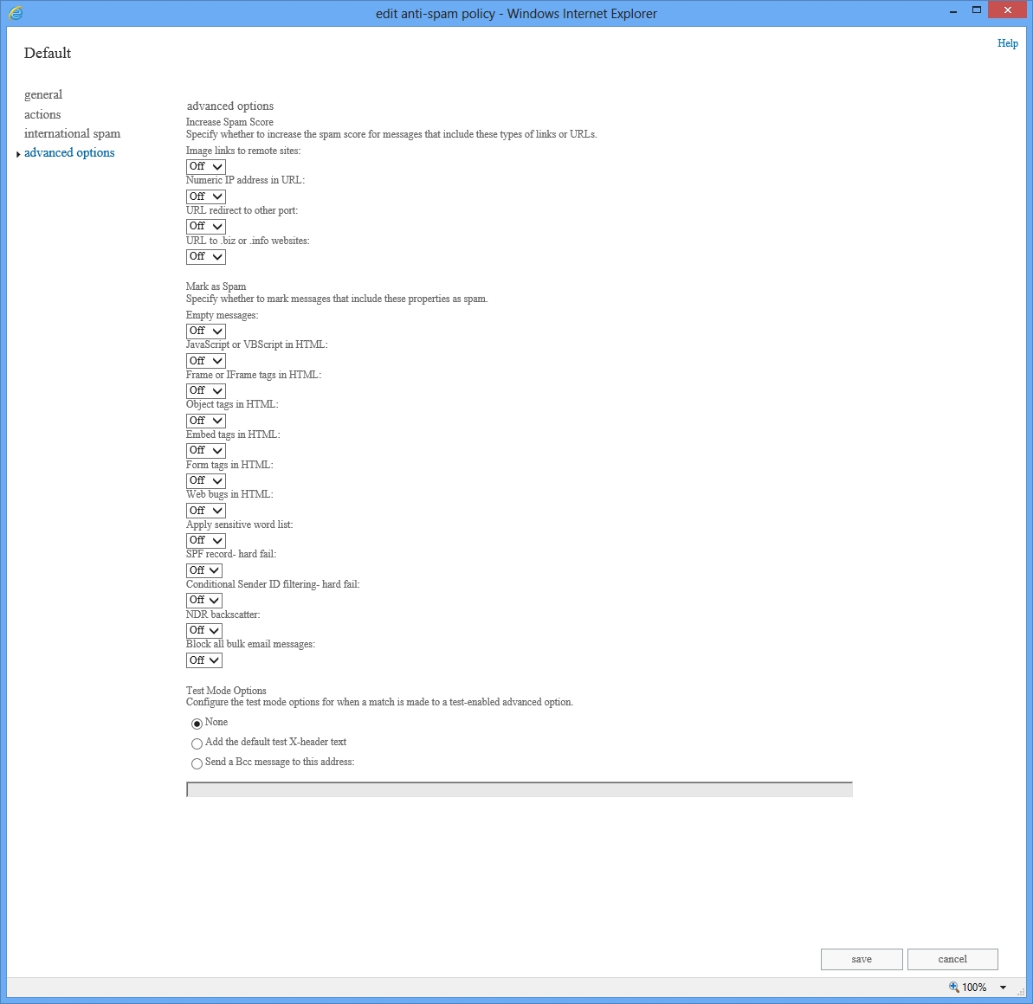
Improved spam blocking
Bulk mail control
Mark all bulk messages as spam
Block external threats quickly
Advanced fingerprinting technologies that identify and stop new spam and phishing vectors in real time
Block all bulk email messages
On

Slide 12
International spam
Block email based on language
Block unwanted email based on language or geographic origin
Block email based on geography

Slide 13
Junk mail management Junk mail folder
Recommendation: Send suspected junk mail to the Outlook junk mail folder.
Users can manage safe senders and block lists through Directory Sync or through Outlook.

Slide 14
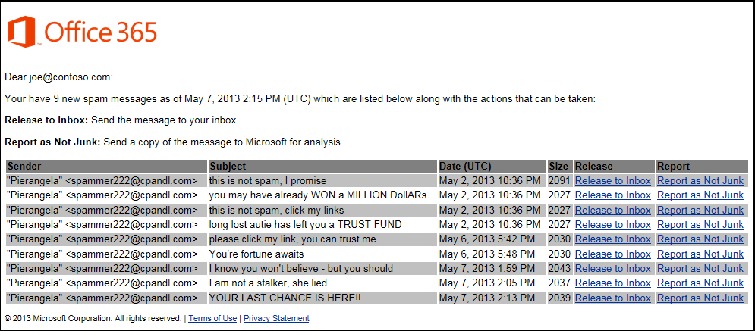
Junk mail management Quarantine
Spam quarantine managed by administrators.
Users safe senders and block lists applied through Directory Sync.
Coming soon: Users can receive spam notifications on a schedule.

Slide 15
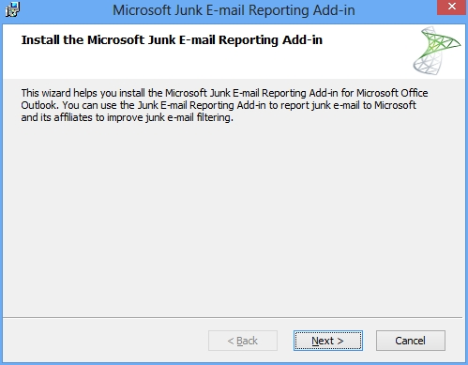
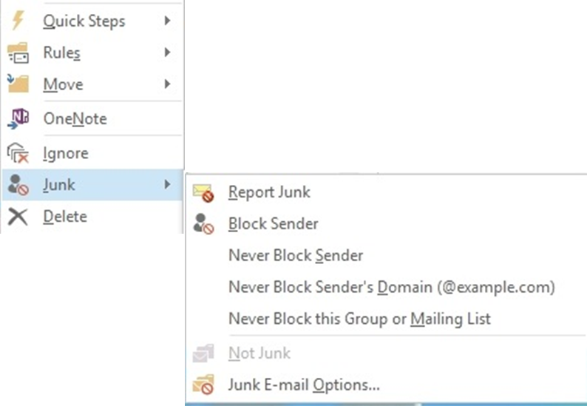
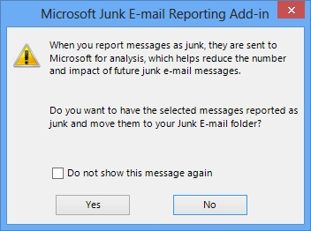
Reporting false negatives & false positives
Outlook Junk Mail Reporting Tool for missed spam http://www.microsoft.com/en-us/download/details.aspx?id=18275
Send spam email as an attachment to abuse@messaging.microsoft.com
Send false positive messages to false_positive@messaging.microsoft.com

Slide 16
EOP inbound filtering
Spam analysts
Customer feedback
False positives & false negatives
Email is routed to EOP DC based on MX record resolution
(Contoso com.mail.protection.outlook.com)
EOP network
Virus scanning
Policy enforcement
SPAM protection
IP-based edge blocks
Multiple AV engines
Custom rules
Safe sender/recipient
Envelope blocks
Corporate network
Content scanning and heuristics
SPF & sender ID filter
Bulk mail filtering
Quarantine
International spam
Advanced spam management

Slide 17
EOP outbound filtering
Corporate network
Outbound pool
EOP network
Virus scanning
Policy enforcement
Spam protection
Low score
Internet
Multiple AV engines
Custom rules
Content scanning and heuristics
Bulk mail
Bulk delivery pool
Advanced spam management
High score
High risk delivery pool
Quarantine
Spam analysts

Slide 18
Anti-malware

Slide 19
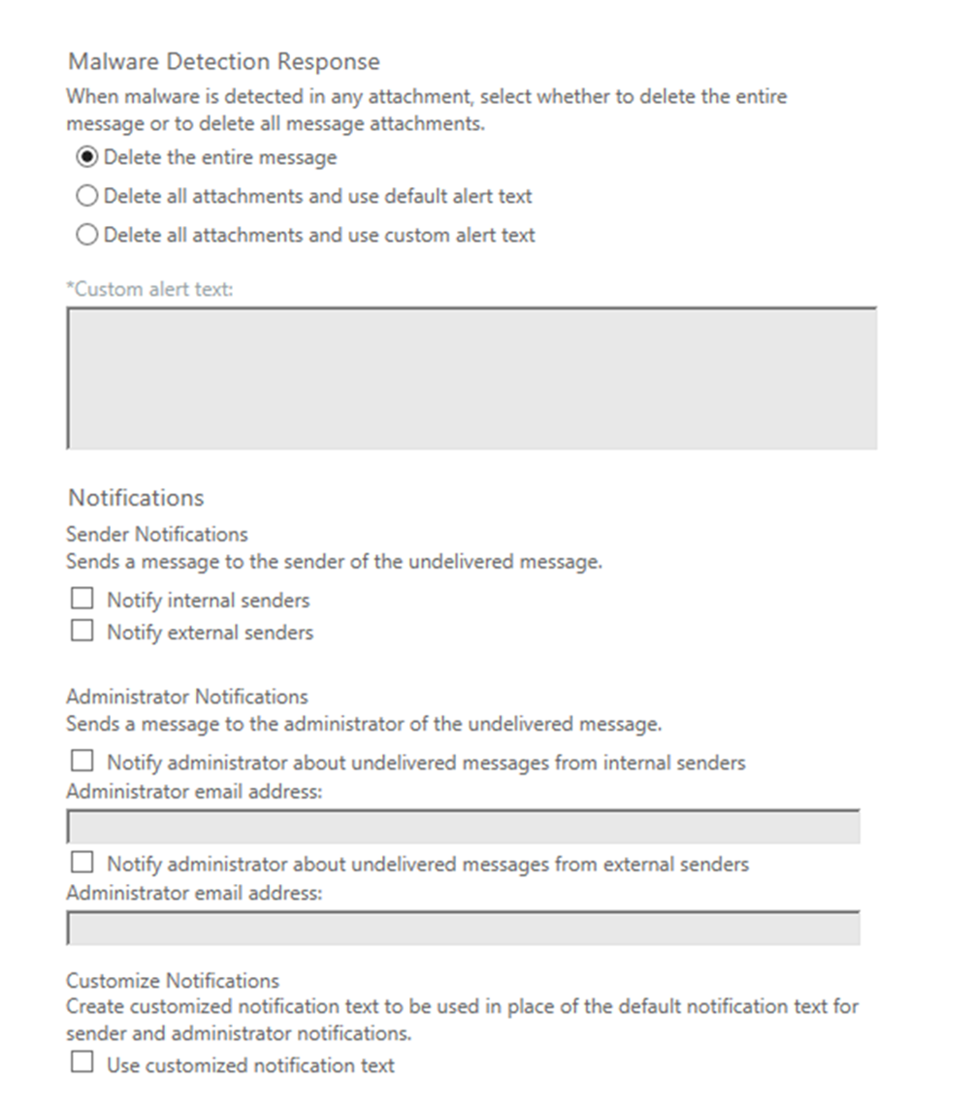
Simple configuration
Delete messages
Delete attachments
Robust, customizable notifications
Sender notifications
Admin notifications

Slide 20
Managing policy

Slide 21
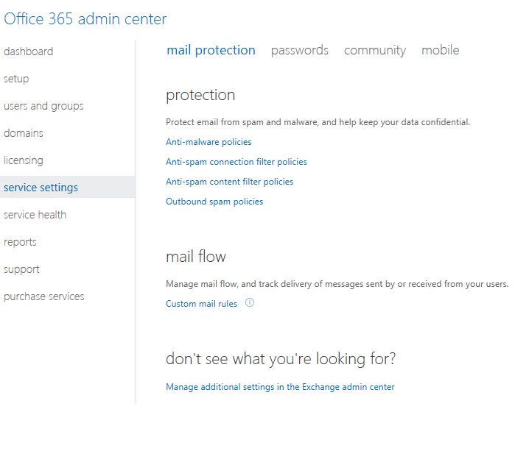
Streamlined management console
Anti-spam and anti-malware controls accessed through the Office 365 Admin Center

Slide 22
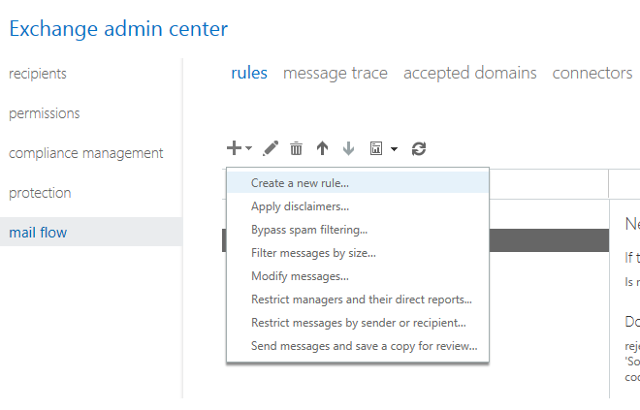
Simple policy management
Built on Exchange transport rules engine
Conditions
Actions
Exceptions

Slide 23
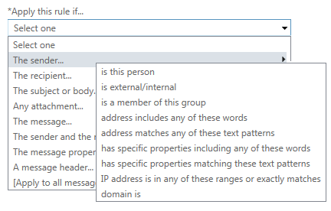
Flexible rule conditions
The sender…IP matches any of these addresses
Attachment scanning
Any attachment…has executable content
The message…size exceeds

Slide 24
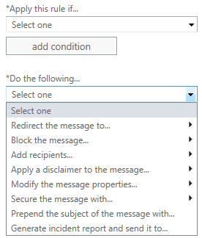
Flexible rule actions
Redirect or block messages (route messages through specific outbound connectors)
Modify messages
Apply additional security

Slide 25
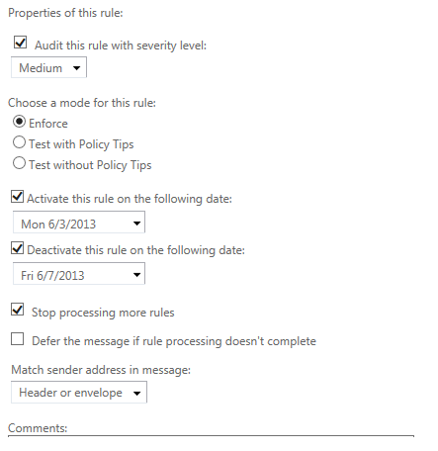
Rule options
Rules can be run in Test Mode
Rules can be configured to run for a specific time period time

Slide 26
Administration demo

Slide 27
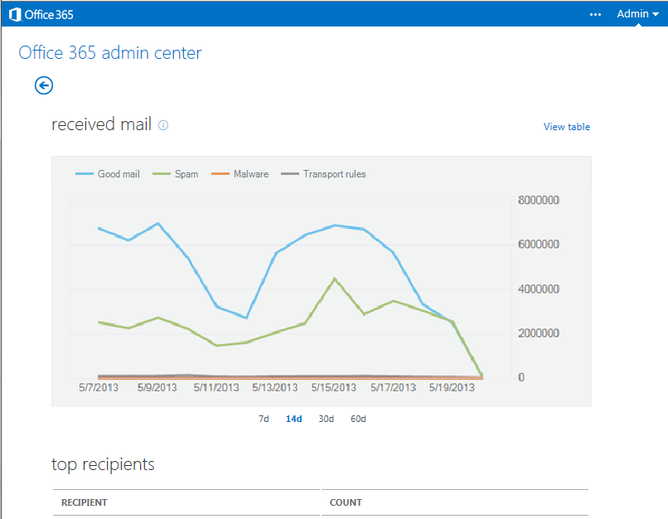
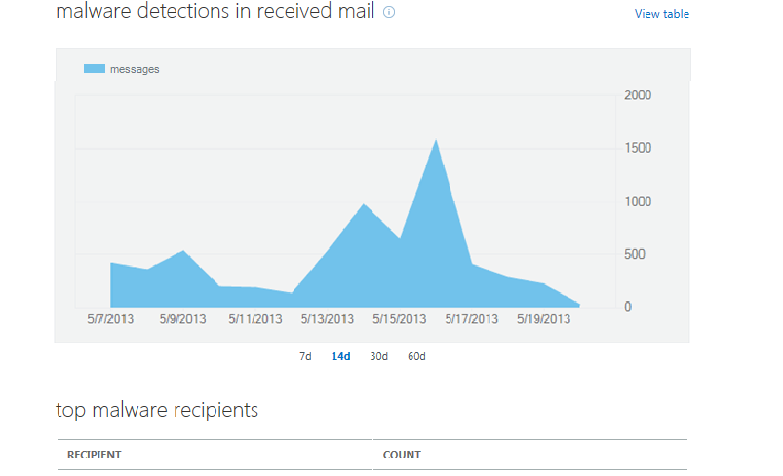
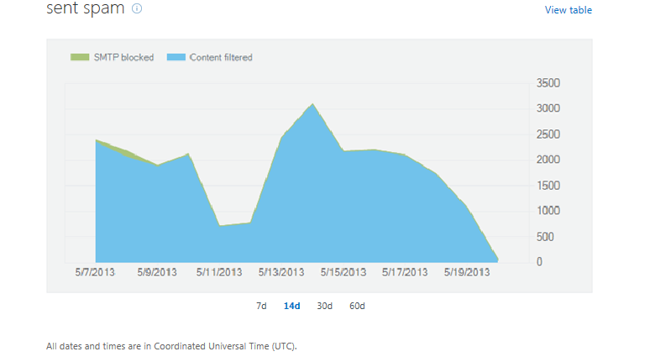
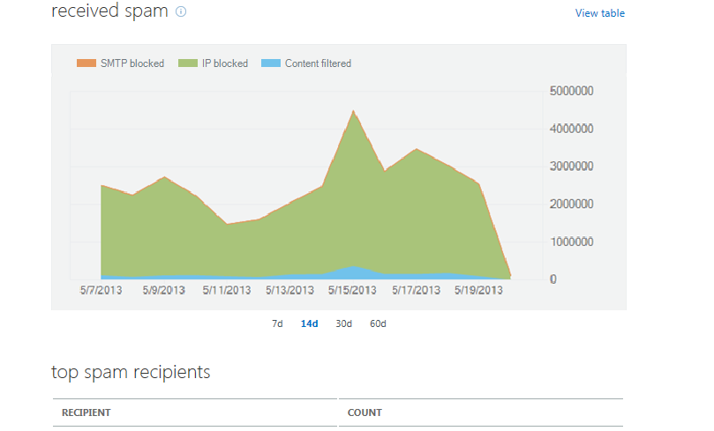
Built-in granular reporting options
Provides a clear view on spam filtering and malware attacks

Slide 28
Excel mail protection reports
Excel Workbook available to enable self-service analysis
Connects to the reporting web service
Data can be refreshed from within the workbook at any time
Drill through from recent summary data to the underlying detailed information

Slide 29
Message tracing
Powerful troubleshooting tools for mail flow issues
Simple search interface (no required fields)
Top 1000 of the last 48h of message results
Wildcard support for multiple email addresses or domain names.
Results include date, from, to, subject, summary status

Slide 30
Differences between EOP and FOPE
 | FOPE | EOP
Administration console | Web-based admin console | Web-based admin console with similar look/feel to Exchange 2013 and Office 365
Policy rules | FOPE-specific policy rules | Flexible rules based on Exchange Transport Rules engine with attachment content scanning
RegEx | Basic RegEx | .Net RegEx Engine
Regional routing | US Only | EU and US routing
Intelligent routing | Virtual domains | Criteria based routing
Reporting | Online and downloadable reports | Detailed online reports and downloadable excel workbook that pulls from a reporting API
Spam management | Granular spam management | Granular spam management including bulk mail and international spam blocking
Malware | Multi-engine anti-malware scanning | Multi-engine anti-malware scanning with attachment blocking
Quarantine | End user and Admin access | Admin-only access (end user notifications coming soon)

Slide 31
EOP availability
Available with the current version of Office 365
Try - 30 day trial from web site
Buy
Standalone version
Exchange ECAL with Services
Part of all Office 365 plans
Migration from FOPE
Customer communication prior to migration
Policy settings will be automatically migrated
New administration console

Slide 32
Exchange Online Protection (EOP)Next generation of Forefront Online Protection for Exchange (FOPE)
Protect communications
Multi-engine anti-malware and enhanced spam filtering to help protect your email environment from threats
Enforce policy
Flexible tools for policy enforcement that provide the right level of control
Streamlined management
Flexible administration of anti-spam, anti-malware and policy rules

Slide 33
Track resources
Exchange Team blog:
http://blogs.technet.com/b/exchange/
Twitter:
Follow @MSFTExchange
Join the conversation, use #IamMEC
Check out:
Microsoft Exchange Conference 2014: www.iammec.com
Office 365 FastTrack: http://fasttrack.office.com//
Technical Training with Ignite: http://ignite.office.com/

Slide 34
Resources
Learning
Sessions on demand
http://channel9.msdn.com/Events/TechEd
Learning
Microsoft certification & training resources
www.microsoft.com/learning
TechNet
Resources for IT professionals
http://microsoft.com/technet
msdn
Resources for developers
http://microsoft.com/msdn

Slide 35
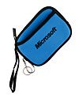
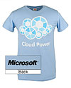
Complete an evaluation on CommNet and enter to win!

Slide 36
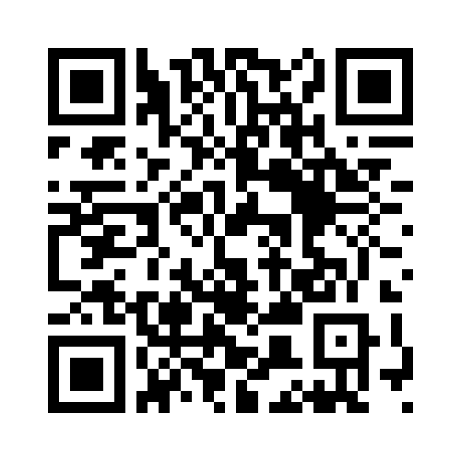
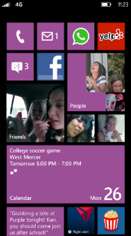
Evaluate this session
Required Slide
*delete this box when your slide is finalized
Your MS Tag will be inserted here during the final scrub.
Scan this QR code to evaluate this session and be automatically entered in a drawing to win a prize

Slide 37
© 2013 Microsoft Corporation. All rights reserved. Microsoft, Windows and other product names are or may be registered trademarks and/or trademarks in the U.S. and/or other countries.
The information herein is for informational purposes only and represents the current view of Microsoft Corporation as of the date of this presentation. Because Microsoft must respond to changing market conditions, it should not be interpreted to be a commitment on the part of Microsoft, and Microsoft cannot guarantee the accuracy of any information provided after the date of this presentation. MICROSOFT MAKES NO WARRANTIES, EXPRESS, IMPLIED OR STATUTORY, AS TO THE INFORMATION IN THIS PRESENTATION.

Slide 38
All statements in this report attributable to Gartner represent Microsoft interpretation of data, research opinion or viewpoints published as part of a syndicated subscription service by Gartner, Inc., and have not been reviewed by Gartner. Each Gartner publication speaks as of its original publication date (and not as of the date of this presentation). The opinions expressed in Gartner publications are not representations of fact, and are subject to change without notice.

Slide 39
© 2013 Microsoft Corporation. All rights reserved. Microsoft, Windows and other product names are or may be registered trademarks and/or trademarks in the U.S. and/or other countries.
The information herein is for informational purposes only and represents the current view of Microsoft Corporation as of the date of this presentation. Because Microsoft must respond to changing market conditions, it should not be interpreted to be a commitment on the part of Microsoft, and Microsoft cannot guarantee the accuracy of any information provided after the date of this presentation. MICROSOFT MAKES NO WARRANTIES, EXPRESS, IMPLIED OR STATUTORY, AS TO THE INFORMATION IN THIS PRESENTATION.

