Slide 2
Exchange hybrid deployment and migration on your terms
OUC-B311
Neil Axelrod
Principal Technology Specialist
Microsoft

Slide 3
Agenda
Office 365 migration and hybrid deployment choices
Deployment process and tools
How hybrid mail flow works
Managing an Exchange hybrid deployment through the new Exchange Administration Center
Migrating mailboxes to Office 365

Slide 4
Office 365 migration & hybrid fundamentals

Slide 5
Migration options
Migration
IMAP migration
Supports wide range of email platforms
Email only (no calendar, contacts, or tasks)
Cutover Exchange migration
Good for fast, cutover migrations
No Exchange upgrade required on-premises
Staged Exchange migration
No Exchange upgrade required on-premises
Identity federation with on-premises directory
Migration
Hybrid deployment
Manage users on-premises and online
Enables cross-premises calendaring, smooth migration, and easy off-boarding
 | IMAP migration | Cutover migration | Staged migration | Hybrid
Exchange 5.5 | X
Exchange 2000 | X
Exchange 2003 | X | X | X | X*
Exchange 2007 | X | X | X | X
Exchange 2010 | X | X |  | X
Exchange 2013 | X | X |  | X
Notes/Domino | X
GroupWise | X
Other | X
* Additional options available with tools from migration partners

Slide 6
Cutover vs. staged
Cutover
Cutover is designed for small/fast migrations to Office 365.
Mailbox data and address book data is synced from on-premises to Exchange Online via Outlook Anywhere (RPC over https).
As the name sounds it’s an “all at once” move.
Limited to a maximum of 1000 mailboxes total.
Staged
Staged uses the same migration engine as cutover but in conjunction with Office 365 directory synchronization to allow you to move a few users at a time.
Mailbox data is copied via Outlook Anywhere.
Users/contacts & groups are synchronized via Directory Sync.
Exchange 2010 or later is not supported (but hybrid based moves are).

Slide 7
Cutover migration server roles
On-premises Exchange organization
Office 365
Mailbox data via Outlook Anywhere (MAPI)
Users, contacts & groups via Outlook Anywhere (NSPI)
Existing Exchange environment (Exchange 2003 or later)

Slide 8
Staged migration server roles
On-premises Exchange organization
Office 365 Active Directory synchronization
Office 365
Users, contacts & groups via Outlook Anywhere (NSPI)
Mailbox data via Outlook Anywhere (MAPI)
Existing Exchange environment (Exchange 2003 or 2007)

Slide 9
Staged vs. cutover summary
Cutover is all at once.
Staged is a few users at a time.
Both use the Outlook Anywhere protocol (rpc over https) to copy mailbox data from on-premises to the cloud.
Both work for Exchange 2003 and 2007 deployments without upgrades.
Both staged and cutover are copies of the mailbox and require a new Outlook profile and download offline folders.

Slide 10
Hybrid overview
Federation trust
Delegated authentication for on-premises/cloud web services
Enables free/busy, calendar sharing, message tracking & online archive
Native mailbox move
Online mailbox moves
Preserve the Outlook profile and offline folders
Leverages the Mailbox Replication Service (MRS)
Integrated
admin experience
Secure mail flow
Authenticated and encrypted mail flow between on-premises and the cloud
Preserves the internal Exchange messages headers, allowing a seamless end user experience
Support for compliance mail flow scenarios (centralized transport)
Manage all of your Exchange functions, whether cloud or on-premises from the same place; Exchange Administration Center

Slide 11
Hybrid server roles
On-premises Exchange organization
Office 365 Active Directory synchronization
Office 365
Existing Exchange environment (Exchange 2007 or later)
User, contacts, & groups via dirsync
Secure mail flow
Exchange 2013
client access &
mailbox server
Sharing (free/busy, Mail Tips, archive, etc.)
Mailbox data via Mailbox Replication Service (MRS)

Slide 12
How to pick a migration solution
Hybrid
Migration solutions
Staged
Cutover
Organizational size in users
small medium large
Time for migration incl. planning
<1 week 2 weeks 3 weeks several months
Features
none mailflow/GALSync free/busy, archive in cloud

Slide 13
Deployment Cutover & staged

Slide 14
Cutover deployment process
Sign up for Office 365
Register your domains with Office 365
Publish Outlook Anywhere
Create a migration service account, assign permissions
Commonly already enabled for remote access

Slide 15
Staged deployment process
Sign up for Office 365
Register your domains with Office 365
Publish Outlook Anywhere
Create a migration service account, assign permissions
Deploy Office 365 Directory Sync

Slide 16
Deployment Hybrid

Slide 17
Hybrid deployment process
Sign up for Office 365
Register domains with Office 365
Deploy Office 365 Directory Sync
Install Exchange 2013 CAS & MBX Servers
(Edge opt)
Publish the CAS Server
(Assign SSL certificate, firewall rules)
Run the Hybrid Wizard
General Office 365 deployment tasks
Exchange specific deployment tasks
(deep dive on next slide)
Demo

Slide 18
Exchange 2013 hybrid deployment From an existing Exchange 2007 or 2010 environment—no Edge Transport server
Clients
Office 365
Prepare
Install Exchange SP and/or updates across the ORG
Prepare AD with E2013 schema
Deploy Exchange 2013 servers
Install both E2013 MBX and CAS servers
Set an ExternalUrl and enable the MRSPRoxy on the Exchange Web Services vdir
Obtain and Deploy Certificates
Obtain and deploy certificates on E2013 MBX and CAS servers
Publish protocols externally
Obtain and deploy certificates on E2013 MBX and CAS servers
Switch autodiscover namespace to E2013 CAS
Change the public autodiscover DNS record to resolve to E2013 CAS
Run the Hybrid Configuration Wizard
Move mailboxes
autodiscover.contoso.com
mail.contoso.com
5
EWS
SMTP
5
1
1
2
2
4
4
E2010 or 2007 Hub
E2010 or 2007 CAS
E2013 CAS
Exchange 2010 or 2007 Servers
3
SP/RU
3
SP/RU
6
6
7
E2010 or 2007 MBX
E2013 MBX
Internet-facing site
Intranet site

Slide 19
Exchange 2013 hybrid deployment From an existing Exchange 2007 or 2010 environment—with Edge Transport server
Clients
Office 365
Prepare
Install Exchange SP and/or updates across the ORG Prepare AD with E2013 schema
Deploy Exchange 2013 servers
Install both E2013 MBX and CAS servers
Install E2010 EDGE servers
Set an ExternalUrl & enable MRSProxy on the Exchange Web Services vdir
Obtain and Deploy Certificates
Obtain and deploy certificates on E2013 MBX and CAS servers & E2010 EDGE servers
Publish protocols externally
Create public DNS A records for the EWS and SMTP endpoints
Validate using Remote Connectivity Analyzer
Switch autodiscover namespace to E2013 CAS
Change the public autodiscover DNS record to resolve to E2013 CAS
Run the Hybrid Configuration Wizard
Move mailboxes
autodiscover.contoso.com
mail.contoso.com
5
EWS
SMTP
5
1
1
4
4
2
2
E2010 or 2007 Hub
E2010 or 2007 CAS
E2013 CAS
E2013 EDGE
Exchange 2010 or 2007 Servers
3
SP/RU
3
SP/RU
6
6
7
E2010 or 2007 MBX
E2013 MBX
Internet-facing site
Intranet site

Slide 20
Deployment Hybrid

Slide 21
Exchange 2013 tenant compatibility
Exchange Server 2013 (with CU1) hybrid is supported against a new Exchange Online tenant (Wave 15).
Tenants still running on the legacy release of Exchange Online (Wave 14) are not compatible with hybrid deployments configured with Exchange Server 2013 on-premises.
Tenants still running on the legacy release of Exchange Online need to be fully upgraded to the new release of the service before they can be supported by Exchange Server 2013 on-premises hybrid.
Exchange Server 2013 Setup and Hybrid Configuration Wizard include a tenant version check.
The setup check occurs once during the PrepareAD phase.

Slide 22
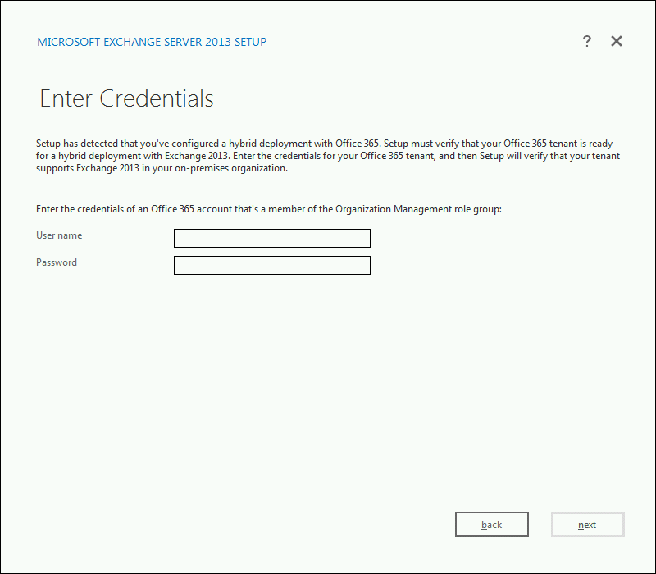
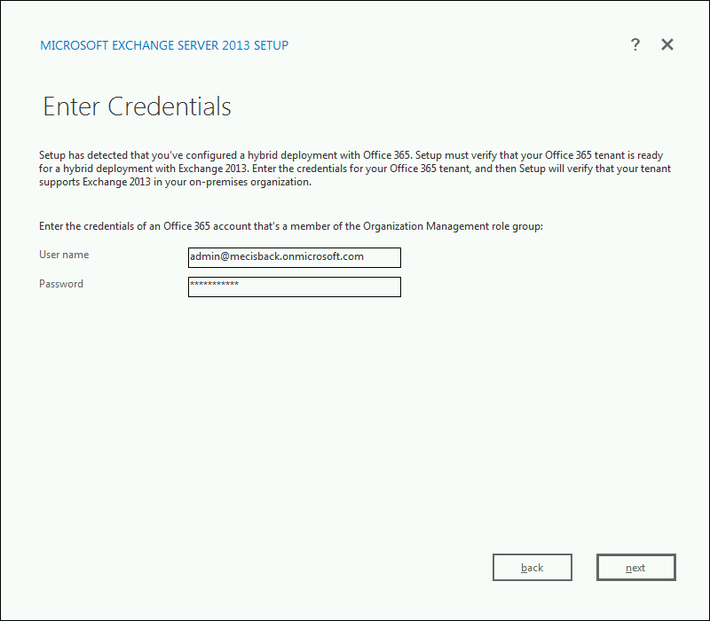
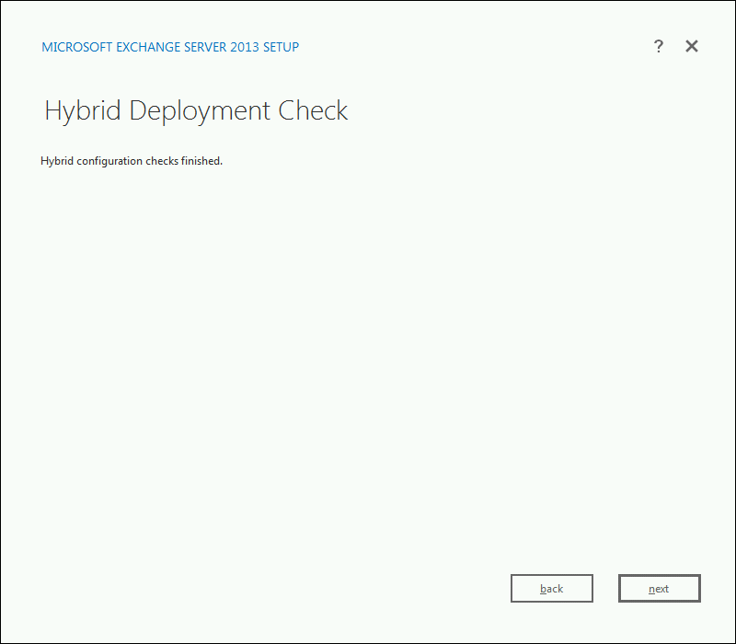

Slide 23
Exchange 2010 hybrid support
Exchange Server 2010 SP3 based hybrid will be compatible with all Office 365 tenants (Wave 14 and 15).
Exchange Server 2010 SP3 based hybrid deployments will continue to support Exchange 2003 coexistence with all Office 365 tenants.
Unless you are migrating from Exchange 2003, Exchange Server 2013 (with CU1) based hybrid is recommended for all new deployments.

Slide 24
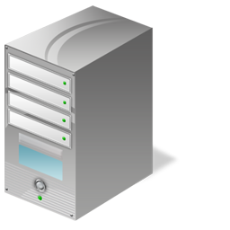
Hybrid Configuration Engine
The Update-HybridConfiguration cmdlet triggers the Hybrid Configuration Engine to start.
ON-PREMISES EXCHANGE ORGANIZATION
EXCHANGE ONLINE ORGANIZATION
Step 1
The Hybrid Configuration Engine reads the “desired state” stored on the HybridConfiguration Active Directory object.
Step 2
Exchange Server Level Configuration
(Mailbox Replication Service Proxy, Certificate Validation, Exchange Web Service Virtual Directory Validation, & Receive Connector)
Domain Level Configuration Objects
(Accepted Domains, Remote Domains, & E-mail Address Policies)
Organization Level Configuration Objects
(Exchange Federation Trust, Organization Relationship, Availability Address Space, & Send Connector)
Organization Level Configuration Objects
(Exchange Federation Trust, Organization Relationship, Forefront Inbound Connector, & Forefront Outbound Connector)
The Hybrid Configuration Engine connects via Remote PowerShell to both the on-premises and Exchange Online organizations.
Step 3
INTERNET
The Hybrid Configuration Engine discovers topology data and current configuration from the on-premises Exchange organization and the Exchange Online organization.
Step 4
4
REMOTE POWERSHELL
5
2
5
Hybrid Configuration Object
Desired State
Topology & Current Configuration State
Execute Configuration Tasks
Based on the desired state, topology data, and current configuration, across both the on-premises Exchange and Exchange Online organizations, the Hybrid Configuration Engine establishes the “difference” and then executes configuration tasks to establish the “desired state.”
REMOTE POWERSHELL
Domain Level Configuration Objects
(Accepted Domains & Remote Domains)
Step 5
1
Exchange Management Tools
4
Hybrid Configuration Engine

Slide 25
Hybrid mail flow changes

Slide 26
Hybrid mail flow enhancements
Enhanced Secure Mail feature
Certificate based attribution for mail flow connectors - no more static IP address lists
Explicit TLS certificate selection - Avoids certificate conflicts
Remote domains no longer required for secure mail - Simpler configuration and troubleshooting
Centralized Transport feature supports more mail flow paths
Edge Server support – Edge Transport Server 2010

Slide 27
Secure Mail
MX resolves to on-premises gateway
MX is switched to Exchange Online Protection
Outbound Exchange Online traffic is delivered direct
On-premises organization
Internet
You can choose to route outbound on-premises mail via EOP
External recipient
Third Party Email Security System
Secure Mail
Exchange Online Protection
Encrypted & authenticated mail flow
DAVID On-premises mailbox
Exchange
Exchange Online
CHRIS Cloud mailbox

Slide 28
Things to remember about Secure Mail
All email between Exchange on-premises and Exchange Online is encrypted and authenticated.
Internal mail flow going from Exchange to Exchange must go direct and not through 3rd party gateways.
External (Internet) mail can be routed to wherever you choose – on premises, 3rd party service, EOP
The MX record for the domain controls where inbound external email is received.
The hybrid wizard’s “OnPremisesSmartHost” property controls the flow of internal mail from Exchange Online to Exchange on-premises.
The FQDN defined within OnPremisesSmartHost can be:
A single Exchange 2013 CAS or 2010 Edge server
Multiple round robin Exchange 2013 CAS or 2010 Edge servers
Multiple load balanced Exchange 2013 CAS or 2010 Edge servers (recommended)
If you want outbound email from on-premises to the Internet to go through EOP you need to create an extra “*.*” send connector that forwards all mail to EOP.

Slide 29
Centralized Transport
MX resolves to on-premises gateway
MX is switched to Exchange Online Protection
On-premises organization
Internet
All email in and out of the Exchange Online tenant must go via on-premises
External recipient
Third-party email security system
Exchange Online Protection
Secure Mail
Encrypted & authenticated mail flow
DAVID On-premises mailbox
Exchange
Exchange Online
CHRIS Cloud mailbox

Slide 30
Things to remember about Centralized Transport
It is built on top of Secure Mail. You cannot enable Centralized Transport without it.
All email in and out of Exchange Online is routed via on-premises.
Unless you have a business requirement to route mail via on-premises you do not need to enable it.
You can now route inbound Internet email to Exchange Online Protection even when Centralized Transport is turned on.
No more need for FOPE “duplicate domains”, multiple FOPE companies. It simply works out of the box.

Slide 31
Demo Hybrid configuration wizard

Slide 32
Feedback…Answered
Autodiscover domain
You can now specify which domain is used for the federated autodiscover query.
Get-FederationInformation fallback logic
If the on-premises autodiscover endpoint is not published properly when the wizard executes, it will warn not fail.
Email address policy protection measures
New “UpdateSecondaryAddressesOnly” parameter added to Update-EmailAddressPolicy.
Protects customers that have manually edited their directory.
Only missing proxies will be added. No addresses will be changed/removed.
Note: This is still a very bad state to be in.

Slide 33
Management

Slide 34
Managing Exchange in hybrid mode
Exchange Administration Center (EAC) is your one stop shop for managing Exchange Server 2013 on-premises, your Exchange Online tenant, hybrid settings, and mailbox migrations.
EAC is 100% browser based, so you can manage on-premises and cloud from anywhere (subject to your access controls).
Exchange Admin Center provides a single consolidated set of Exchange Notifications across all premises.
Support for a merged recipient views for helpdesk staff.
Hybrid depends on Office 365 Directory Synchronization. That means you create new Office 365 mailboxes via the Enterprise “pivot” within EAC.

Slide 35
Migration

Slide 36
Mailbox migration
All mailbox migration paths are now supported from the Exchange Administration Center through a unified mailbox move wizard.
Moves are “pulled” from on-premises to the cloud. This means that you schedule a migration from the cloud.
All move types now support the new “batch” architecture. This allows for easier creation and management of multiple mailbox moves.
As with Exchange 2010, hybrid (MRS based) mailbox moves support off-boarding from the cloud to on-premises.

Slide 37
Demo The new mailbox move wizard

Slide 38
Things to remember about the new mailbox move wizard
There is a new easy single wizard for all of your mailboxes, regardless of protocol or process.
We support autodiscover for cutover, staged and hybrid (MRS) mailbox moves.
It’s the same wizard used for on-premises mailbox moves.
Alerting for all moves, on-premises or cloud, are integrated.

Slide 39
Summary
Exchange 2013 and the new Office 365 support a range of ways for moving to the cloud; cutover, staged and hybrid.
Hybrid is now more flexible and easier to deploy.
The new Exchange Administration Center is your one-stop shop for all Exchange 2013 and Office 365 administration tasks.

Slide 40
Related content
Breakout sessions
EXO321 - Deploying Exchange Online Archiving – Wednesday 16:30-17:45
Product demo stations (demo station title and location)
Related certification exam
Find me later at...

Slide 41
Track resources
Exchange team blog:
http://blogs.technet.com/b/exchange/
Twitter:
Follow @MSFTExchange
Join the conversation, use #IamMEC
Check out:
Microsoft Exchange Conference 2014: www.iammec.com
Office 365 FastTrack: http://fasttrack.office.com//
Technical Training with Ignite: http://ignite.office.com/

Slide 42
Resources
Learning
Sessions on Demand
Microsoft Certification & Training Resources
http://channel9.msdn.com/Events/TechEd
www.microsoft.com/learning
TechNet
msdn
Resources for IT Professionals
Resources for Developers
http://microsoft.com/technet
http://microsoft.com/msdn

Slide 43
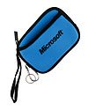
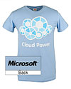
Complete an evaluation on CommNet and enter to win!

Slide 44
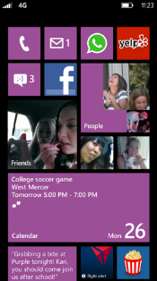
Evaluate this session
Required Slide
*delete this box when your slide is finalized
Your MS Tag will be inserted here during the final scrub.
Scan this QR code to evaluate this session and be automatically entered in a drawing to win a prize

Slide 45
© 2013 Microsoft Corporation. All rights reserved. Microsoft, Windows and other product names are or may be registered trademarks and/or trademarks in the U.S. and/or other countries.
The information herein is for informational purposes only and represents the current view of Microsoft Corporation as of the date of this presentation. Because Microsoft must respond to changing market conditions, it should not be interpreted to be a commitment on the part of Microsoft, and Microsoft cannot guarantee the accuracy of any information provided after the date of this presentation. MICROSOFT MAKES NO WARRANTIES, EXPRESS, IMPLIED OR STATUTORY, AS TO THE INFORMATION IN THIS PRESENTATION.

