Slide 2
Exchange Server 2013 Managed Availability
Ross Smith IV
Principal Program Manager
Microsoft

Slide 3
Session Objectives And Takeaways
Session Objective(s):
Understand How the Exchange Server 2013 architecture forced monitoring changes
Understand Monitoring-related improvements in Exchange Server 2013
Exchange Server 2013 monitoring is cloud trained!
Exchange Server 2013 monitoring is detecting and attempting to recover service thus reducing operational costs

Slide 4
Service Health Landscape
Exchange 2013 architecture
For a given mailbox’s connectivity, the protocol being used is always served by the server that hosts the active database copy
Exchange Online service changed the engineering approach to monitoring
Scale drives automation
Component based monitoring does not tell the story
User
Layer 4LB
CAS
DAG1
MBX-A
MBX-A
MBX-B
MBX-B

Slide 5
Innovating Service Management

Slide 6
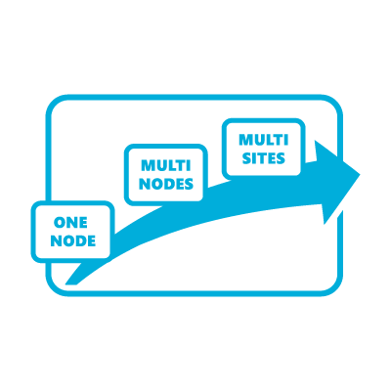
Exchange 2013 Managed Availability
Cloud Trained
User Focused
Recovery Oriented
Bringing the learnings from the service to the enterprise
Monitoring based on the end user’s experience
Protect the user’s experience through recovery oriented computing

Slide 7
Cloud Trained
5+ Years of Directly Operating the Service
Since 2007, the Exchange Engineering Team has been operating a cloud version of Exchange
Learnings Are Put Back Into the Product
Engineers are on-call for service related issues
Drives the right accountability for awareness (noise/gap ratio) and motivates the team toward auto-healing and recovery
Scale, Auto-Deployment, Optics, High Availability are key tenets
Decentralized complex processing
Rollouts don’t require extra configuration

Slide 8
User Focused
If you can’t measure it, you cannot manage it
Availability
Can I access the service?
Latency
How is my experience?
Errors
Am I able to accomplish what I want?
Customer Touch Points
Availability
Latency
Errors

Slide 9
Managed Availability In Action
Demo: Recovery Oriented Part 1

Slide 10
Recovery Oriented
“stuff breaks and the Experience does not”
LB
CAS-1
DAG
OWA send
OWA failure
OWA fast recovery
OWA verified as healthy
OWA send
OWA failure
OWA fast recovery
Failover server’s databases
OWA verified as healthy
Server becomes “good” failover target (again)
MBX-1
DB1
DB2
DB1
OWA
OWA
OWA
OWA
MBX-2
DB1
DB2
DB1
OWA
CAS-2
MBX-3
DB1
DB2
OWA

Slide 11
Under the Hood
Demo: Recovery Oriented Part 2

Slide 12
Managed Availability Overview
ESCALATE
“take human driven action”
Exchange 2013 Server
PROBE
Managed Availability
MONITOR
“state of the world”
RECOVER
“restore service or prevent failure”
CHECK
SCOM
NOTIFY
Managed Availability

Slide 13
Monitoring Layers
20s
5min
20min
PROACTIVE
REACTIVE
PROTOCOL PROXY
System Level Checks
Mailbox Self Test
(e.g. OWA MST) [detection 5m]
Protocol Self Test
(e.g. OWA PST) [detection 20 secs]
Proxy Self Test
(e.g. OWA PrST) [detection 20 secs]
End User Experience Level Checks
Customer Touch Point – CTP
(e.g. OWA CTP) [detection 20m]
CAS
3
4
PROTOCOL
MBX
2
1
STORE

Slide 14
Probes
PROBES
The key goal is to measure the customer’s perception of the service
These are typically synthetic end to end customer transactions
CHECKS
The key goal is to measure actual customer traffic and become aware when they are experiencing issues
These are typically implemented as performance counters where thresholds can be set to detect spikes in customer failures
NOTIFY
The key goal is to take action immediately based on a critical event
These are typically exceptions or conditions that can be detected without a large sample set
PROBE
CHECK
NOTIFY

Slide 15
Monitors
Monitors query the data collected by the probes and determine if an action needs to occur based on a rule set
Depending on the rule, a monitor can escalate or initiate a responder
Monitors can be Healthy, Degraded, Unhealthy, Repairing, Disabled, or Unavailable
Defines the time from failure that a responder is executed
ESCALATE
“take human driven action”
MONITOR
“state of the world”

Slide 16
Responders
A responder is a “plug-in” that executes a response to an alert generated by a monitor
There are several types of responders
Restart Responder – Terminates and restarts service
Reset AppPool Responder – Cycles IIS application pool
Failover Responder – Takes a MBX server out of service
Bugcheck Responder – Initiates a bugcheck of the server
Offline Responder- Takes a protocol on a machine out of service
Online Responder – Places a machine back into service
Escalate Responder – escalates an issue
Specialized Component Responders
Built-in sequencing mechanism to control recovery actions
ESCALATE
“take human driven action”
RECOVER
“restore service or prevent failure”

Slide 17
Managed Availability Pipeline
Sampling
Detection
Recovery
Probe Results (Samples)
Monitor Results (Alerts)
Responder Results (Responses)
Probe Definition
Monitor Definition
Responder Definition
Probe
Monitor
Responder
Monitor States
Healthy
Notification Item
Restart Responder
Reset AppPool Responder
00:00:00
T1
00:00:10
T2
Failover responder
Bugcheck responder
Offline Responder
Sequenced HA Responder Pipeline
Example
00:00:30
T3
Escalate Responder
Named Times

Slide 18
Tuned In the Cloud
Office365 service experiences incorporated into Exchange Server 2013
Running at scale has high monitoring expectations
Cloud is the place to prove our monitoring
Simple protocol self test provides meaningful detection
A protocol restart is the right first action the majority of the time
Scoping mailbox self test per server vs. per database copy

Slide 19
Responder Throttling
Throttling is a means to ensure the entire service isn’t compromised
All responders can throttle in some fashion
Some take into account minimum number of servers within a group
Some take into account time
Some take into account number of occurrences
Some may use a combination of the above
Depending on the responder, when throttling occurs, the responder’s action may be delayed or simply skipped
For example, when the Bugcheck Responder is throttled, the action is skipped, not delayed

Slide 20
Responder Throttling in RTM CU2
Prior to RTM CU2, several responders were throttled per server; with RTM CU2, several responders will now be throttled per group
RecoveryAction | Enabled | Per Server |  |  | Per Group
 |  | Minutes Between Actions | Max Allowed Per Hour | Max Allowed Per Day | Minutes Between Actions | Max Allowed Per Day
ForceReboot | True | 720 | N/A | 1 | 600 | 4
SystemFailover | True | 60 | N/A | 1 | 60 | 4
RestartService | True | 60 | N/A | 1 | 60 | 4
ResetIISPool | True | 60 | N/A | 1 | 60 | 4
DatabaseFailover | True | 120 | N/A | 1 | 120 | 4
ComponentOffline | True | 60 | N/A | 1 | 60 | 4
ComponentOnline | True | 5 | 12 | 288 | 5 | Large
MoveClusterGroup | True | 240 | N/A | 1 | 480 | 3
ResumeCatalog | True | 5 | 4 | 8 | 5 | 12
WatsonDump | True | 480 | N/A | 1 | 720 | 4

Slide 21
Management Surfaces

Slide 22
Health Groups
Reporting is structured into four health groups:
Customer Touch Points – components which effect the real time, customer facing interactions (OWA, OLK, Mobile, UM, etc.)
Service Components – components without direct real time, customer interactions (MRS, OABGen)
Server Components – physical resources of the physical server (disk space, memory, network)
Dependency Availability – server’s ability to call out to dependencies (AD, DNS, etc.)
Health groups are exposed in SCOM
USER
SYSTEM

Slide 23
Health Sets
A health set is a group of monitors, probes and responders that determine whether a component within the system is healthy
The health of the set will be evaluated by a “worst of” evaluation of the monitors in the health set
For example, OWA has these types of health sets.
Proxy Health Set
PROTOCOL PROXY
CTP Health Set
3
CAS
OWA.Proxy
4
PROTOCOL
OWA
Protocol Health Set
MBX
2
1
STORE
OWA.Protocol
*See slide 13 to view monitoring layer details

Slide 24
Using the Command Line
Get-ServerHealth can be used to see raw health data for a server or a set of servers
Get-HealthReport operates on the raw health data and provides a snapshot report
How do you determine what probes, monitors and responders are associated with a given health set?
Get-MonitoringItemIdentity –Identity <HealthSet> -Server <ServerName>

Slide 25
Overrides
Admins can alter the thresholds and parameters used by the probes, monitors and responders
Enables emergency actions
Enables fine tuning of thresholds specific to the environment
Can be deployed for specific servers or for the entire environment
Server related overrides are stored in the registry
Global overrides are stored in Active Directory
Can be set for a specified duration or to apply to a specific version of the server
Are not immediately implemented; Exchange Health Service only reads configuration every 10 minutes (and global changes depend on AD replication)
Wildcards are not supported (cannot override entire health set in one activity)

Slide 26
Override Management
View Overrides
Get-ServerMonitoringOverride –Server <Server>
Get-GlobalMonitoringOverride
Create Override
Add-ServerMonitoringOverride <HealthSet>\<Name> -Server <Server> -ItemType <Monitor,Probe,Responder> [-Duration <Time> -ApplyVersion <Version>] -PropertyName <Property> -PropertyValue <Value>
Add-GlobalMonitoringOverride <HealthSet>\<Name> -ItemType <Monitor,Probe,Responder> [-Duration <Time> -ApplyVersion <Version>] -PropertyName <Property> -PropertyValue <Value>
Remove Override
Remove-ServerMonitoringOverride
Remove-GlobalMonitoringOverride
See Appendix for property name definitions

Slide 27
SCOM Portal
SCOM is used as a portal to see health information related to the Exchange environment
Escalate responder writes event to event log which is consumed by monitor within SCOM
Note that when an alert is exposed in SCOM, it may not be the sum total of problems at a given point in time
Dashboard is broken down into three areas
Active Alerts
Organization Health
Server Health
Management Pack support: SCOM 2007 R2, SCOM 2012

Slide 28
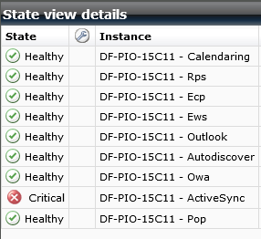
Viewing Health in SCOM
The state of a health group is computed based on the health of the monitors within the group
A health group can have one of six states: Healthy, Degraded, Unhealthy, Repairing, Disabled or Unavailable
The health of the grouping will be evaluated by a “worst of” evaluation of the monitors in the group

Slide 29
The Bottom Line
Managed Availability + Retries…“stuff breaks and the Experience does not”
NLB
CAS-1
DAG
OWA send
OWA failure
OWA failure detected
OWA restart App pool
OWA restart complete
OWA verified as healthy
OWA send
OWA failure
OWA failure detected
OWA restart App pool
OWA restart failed
Failover server’s databases
OWA service restarts
OWA verified as healthy
Server becomes “good” failover target (again)
MBX-1
DB1
DB2
DB1
OWA
OWA
OWA
OWA
MBX-2
DB1
DB2
DB1
OWA
CAS-2
MBX-3
DB1
DB2
OWA

Slide 30
Exchange 2013 Managed Availability
Cloud Trained
User Focused
Recovery Oriented
Bringing the learnings from the service to the enterprise
Monitoring based on the end user’s experience
Protect the user’s experience through recovery oriented computing

Slide 31
Questions?

Slide 32
Related content
Breakout Sessions
OUC-B314 – Microsoft Exchange Server 2013 High Availability and Site Resilience
Hands-on Labs
OUC-H304 - Deploying and Managing Exchange Mailbox High Availability

Slide 33
Track resources
Exchange Team Blog:
http://blogs.technet.com/b/exchange/
Twitter:
Follow @MSFTExchange
Join the conversation, use #IamMEC
Check out:
Microsoft Exchange Conference 2014: www.iammec.com
Office 365 FastTrack: http://fasttrack.office.com//
Technical Training with Ignite: http://ignite.office.com/

Slide 34
Resources
Learning
Sessions on Demand
Microsoft Certification & Training Resources
http://channel9.msdn.com/Events/TechEd
www.microsoft.com/learning
TechNet
msdn
Resources for IT Professionals
Resources for Developers
http://microsoft.com/technet
http://microsoft.com/msdn

Slide 35
Complete an evaluation on CommNet and enter to win!

Slide 36
© 2013 Microsoft Corporation. All rights reserved. Microsoft, Windows and other product names are or may be registered trademarks and/or trademarks in the U.S. and/or other countries.
The information herein is for informational purposes only and represents the current view of Microsoft Corporation as of the date of this presentation. Because Microsoft must respond to changing market conditions, it should not be interpreted to be a commitment on the part of Microsoft, and Microsoft cannot guarantee the accuracy of any information provided after the date of this presentation. MICROSOFT MAKES NO WARRANTIES, EXPRESS, IMPLIED OR STATUTORY, AS TO THE INFORMATION IN THIS PRESENTATION.

Slide 37
APPENDIX

Slide 38
Mandatory Definitions
Enabled: 1 if in enabled, 0 if disabled
RecurrenceIntervalSeconds - The frequency at which work item runs
MaxRetryAttempts - The number of times the framework should retry work item on a failure
TimeoutSeconds - The number of seconds work item can run before the framework cancels it

Slide 39
Monitor Definition
MonitoringIntervalSeconds - The number of seconds back from the time the monitor runs in which it should examine probe results
MonitoringThreshold - The threshold that causes the monitor to kick off a responder

Slide 40
Responder Definition
WaitIntervalSeconds - The amount of time to throttle the responder after it performs an action

Slide 41
Demo: System Center Integration

Slide 42
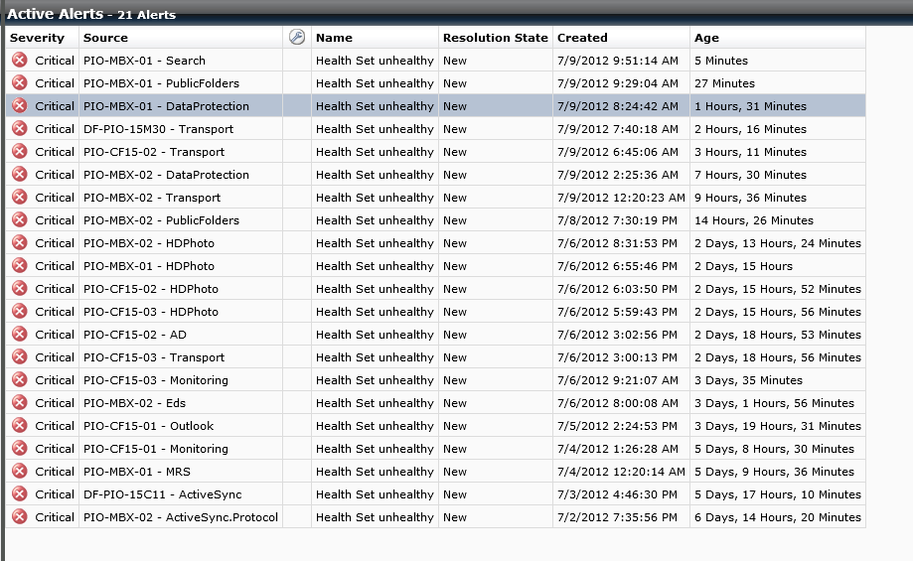

Slide 44
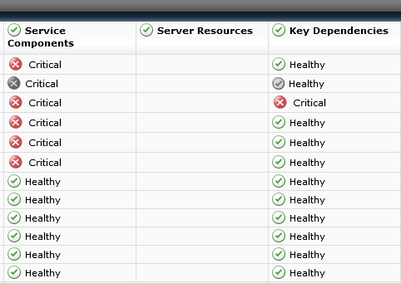

Slide 45
Viewing Server Health
Demo
Using Powershell to View Exchange 2013 Server Health

Slide 46
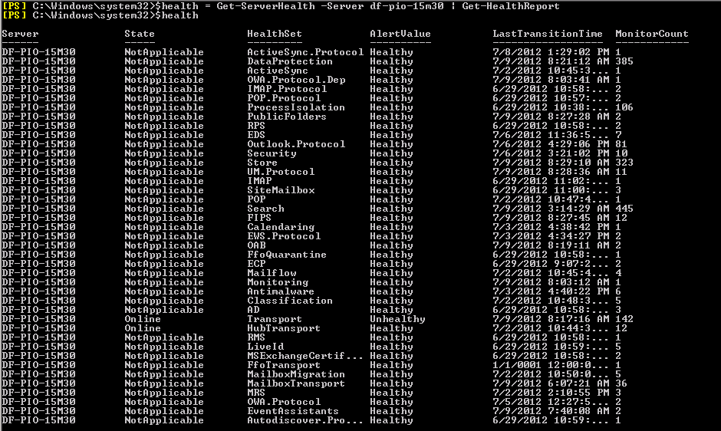

Slide 48
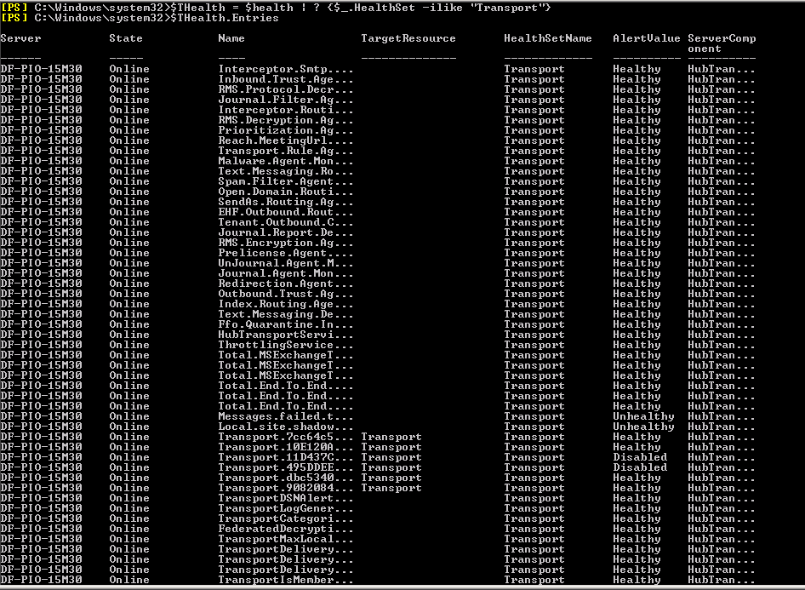

Slide 49
