Slide 2
Planning and Deploying your Enterprise Voice
OUC-B324
Geoff Clark

Slide 3
Agenda
Choosing your project sponsors
Planning voice integration
Lync and your network
Selecting the right Lync device mix for your users
Engaging for ongoing Lync Voice support
Deploying Enterprise Voice Features
Completing a successful pilot

Slide 4
Sponsors

Slide 5
Get support for your project
Executive sponsorship must be appropriate and accountable for the scale of deployment planned. The level and intensity of sponsorship will also change as projects progress from pilot to full deployment.
  Is the executive sponsorship appropriate and properly accountable for the scale of the next phase of the deployment?
  Is the anticipated return on investment clear and measurable?
  Is the sponsoring executive accountable to achieve the ROI and the overall value of the Lync deployment?

Slide 6
Planning Lync voice integration

Slide 7
Connecting to the PSTN
Typical starting point at many Enterprises
  Strong PBX presence
  PSTN Termination at the Legacy PBX
  Existing numbering plan
  Typical dialing habits that originate from the PBX
  Class of Service that define the destinations users can call to
The PBX team wants you to connect Lync to the PBX
  Should you?
  Why? Why not?
  An Important choice to make
+31-20-500 1000 to
+31-20-500 1999
Numbering Plan
Existing PBX
Class of Service
No premium
Local, National
International
No premium
Local, National
Existing Phone Handsets
4 digit Internal extensions
9 for an outside line
3 digits + extension for other locations
…..
Dialing Habits

Slide 8


An important choice to make
Connect to the Legacy PBX
Why?
  That is what we always do
  PBX owns number plan
  User can keep own number
  Internal calling at no cost
  Benefit from the existing PBX infrastructure
  Benefit from existing trunk capacity
Why not?
  PBX Dependencies
  Additional PBX cost
  Requires PBX configuration
  What happens when migration is done?
  Migrating a user = changes in the PBX
Connect directly to the PSTN
Why?
  Easy and fast
  No additional PBX investments and configuration
Why not?
  New numbers for the end-user
  How about internal calling
  Need additional trunk capacity
  Migrating a user = changes at the Provider
Using Lync session management can mitigate some of the disadvantages.
Existing
PBX
Existing
PBX
Lync 2013
Lync 2013

Slide 9
Connecting to the PSTN via gateway
Use supported gateways (UCOIP)
A gateway is a physical device that connects two incompatible networks
A gateway translates signaling and media between Lync and the PSTN
Allows gateway to act as B2BUA/transcoding resource for calls between Lync Server 2013 and the PSTN
TDM Trunking benefits
  More broadly understood
  No WAN dependency
  Local carrier choice
  Branch resiliency

Slide 10
Connecting to the PSTN via SIP trunk
Use supported SIP Trunking Provider (UCOIP)
IP connection that establishes a SIP communications link between your organization and an Internet telephony service provider (ITSP) beyond your firewall
SIP Trunking benefits
Consolidation & Numbering flexibility
Disaster recovery
Provides end-to-end SIP call flow to enable
features and supplementary services
Can deploy central trunking for management
or routing purpose
Eliminates per-channel model to provide
more flexibility in trunk provisioning
no need for intermediary gateway
Note
Topologies may vary depending on Service Provider. For example SBC’s are frequently deployed on Customer Site

Slide 11
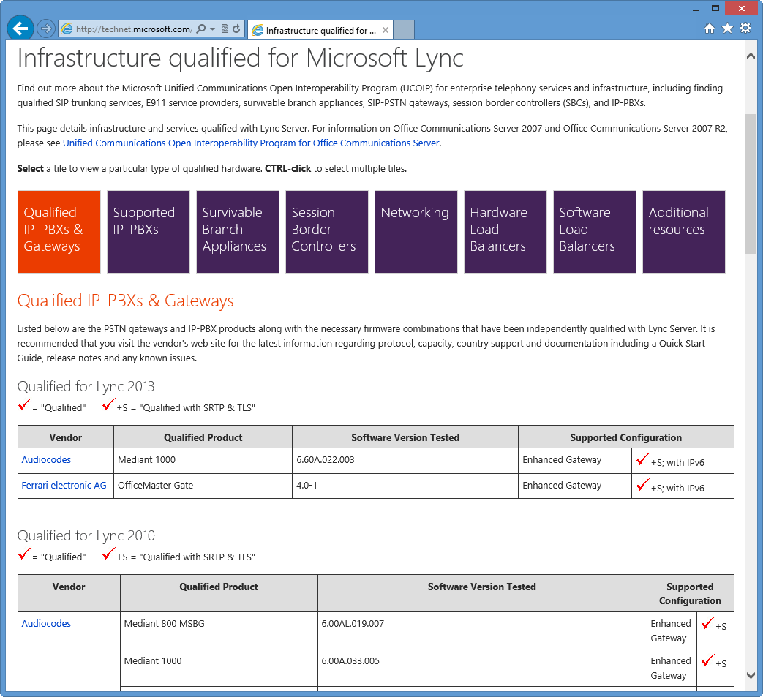
Open Interoperability Program
http://technet.microsoft.com/ucoip
Testing and qualification of third party solutions for interoperability with Microsoft UC
Independent testing by third party labs based on standards based open documentation
Rich scope of program
  SIP-PSTN gateways
  Direct SIP with IP-PBX
  SIP trunking with carriers
Enhanced gateways:
  Audio quality certification
  REFER support
  TLS/SRTP

Slide 12
Connecting to the PBX
Direct SIP
Only for supported PBX systems (UCOIP)
Interop between IP-PBX and Lync Server 2013
Provides voice capabilities between endpoints on either call control server
Allows endpoints on both sides to utilize features on the other call control server
Simplest method of interoperability, relying on standard SIP protocols
Via a Gateway
Use supported gateways (UCOIP)
Use gateway as intermediary in scenarios such as SIP to TDM/H323, or to nonqualified third-party call control
Allows gateway to act as B2BUA/transcoding resource for calls between Lync Server 2013 and third party

Slide 13
Session-Management - Overview
A possible alternative for PBX Integration scenario’s
“Better integration with systems certified to connect with Lync”
Lync Server 2013: Support call routing from an incoming trunk to an outgoing trunk to provide routing functionalities to other systems
By enabling inter-trunk routing, the following routing paths
(among others) are enabled:
    Incoming PSTN calls to an IP-PBX system via Lync
    Outgoing IP-PBX calls to a PSTN network via Lync
    Outgoing IP-PBX calls to another IP-PBX system via Lync

Slide 14
Inter Trunk Routing
Routing of IP-PBX Calls to PSTN via Lync
      Incoming call from the PBX trunk
      Validate incoming trunk associated PSTN usages
      Determine a route
      Apply outbound translation rules
      Route to outgoing gateway trunk
Routing of IP-PBX Calls to Another IP-PBX System via Lync
      Incoming call from the PBX trunk
      Validate incoming trunk associated PSTN usages
      Determine a route
      Apply outbound translation rules
      Route to outgoing PBX trunk via Lync

Slide 15
Planning for voice resiliency
Native voice resiliency ensures voice functionality even in the event of a data center, pool-level, or WAN failure
Voice resiliency in Lync Server 2013 builds on the resiliency functionality introduced in Lync Server 2010
  Backup Registrars & Registrar failover.
  Limited Functionality mode
  Survivable Branch Appliances (SBA) enabling users to continue placing and receiving voice calls in a remote branch site during a WAN failure
Lync Server 2013 DR scenarios add voice resiliency across data centers without reduced functionality

Slide 16


Survivable Branch Appliances
A purpose-built appliance optimized to provide resilient
multi-modal communication for maximizing branch office
user productivity
Hardware device that includes a subset of Lync capabilities,
including a set of services which run the SBA applications and a Gateway.
Enables users to continue placing and
receiving voice calls in a remote branch during
a Wide Area Network (WAN) failure
Built by partners (Audiocodes, HP, Dialogic, Sonus/NET, Ferrari)
Depends on a Lync Pool for User Services and Management

Slide 17
Planning for emergency calling
Location Policies
Defines security desk phone number for conference
Location Information Server (LIS)
Takes BSSID, MAC, Subnet, Switch/Port and returns validated location.
Validates addresses against the Master Street Address Guide (MSAG)
Defines emergency call routing to basic gateway, ELIN gateway, or E9-1-1 service provider
Defines IM notification destination
Defines emergency numbers
Validated LIS address returned is passed to
E9-1-1 provider via PIDF-LO
Can be “location aware” or static assignment
17

Slide 18
Lync and your network

Slide 19
Plan for network readiness
Bandwidth planning exercises completed
End-to-end QoS in place
QoS markings validated
Network Assessment completed

Slide 20
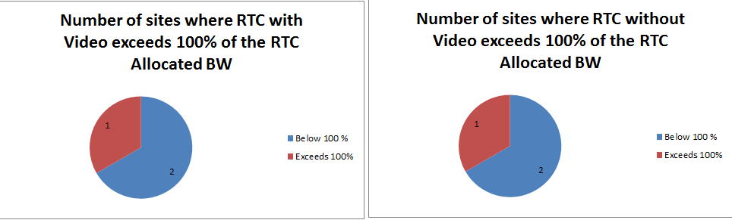
Network Planning Goals
Estimate WAN impact for Branch Sites, and WAN impact on Data Center sites of Branch Users.
Provide Traffic Modelling for use during Network Engineering
  Understanding of Call Flows and BW Usage
Provide business with information needed for network capacity planning.

Slide 21
Required Network information
Existing traffic levels on each remote site
  Max Peak level over last 3 months
  Busy Hour Average traffic.
QoS Policies
  BW allocations, Queuing methods
Network Topology
  Star topology, Inter-Site links, Regional bottlenecks

Slide 22
Network Performance Goals
The further performance deviates from these goals, the more likely that users will experience poor voice quality
For great voice quality, pair good network performance with:
    UC Logo–certified devices and gateways
    Server roles running on recommended spec hardware
Network conditions | Acceptable quality | Optimal quality
Interarrival packet jitter (avg) | ≤ 5 ms | ≤ 2 ms
Interarrival packet jitter (max) | ≤ 40 ms | ≤ 20 ms
Packet loss rate (avg) | ≤ 1% | ≤ 0.5%
Network latency RTT | ≤ 200ms | ≤ 120ms
22

Slide 23
What is a Network Assessment?
Services offering that provides an application-centric assessment that pinpoints problems that could affect your future Microsoft unified communications solution
Discovery Session
Understand what network environment exists
Usage Modelling
Model proposed bandwidth using user profiles, and usage patterns
Traffic Simulation
Using a UC Traffic simulator apply real traffic to production network and monitor factors that affect the quality of UC traffic, Delay, Jitter, and Packet Loss
Recommendations
Analyze factors affecting quality, and produce a full report with recommendations

Slide 24
Why you need a Network Assessment
Network Impact
How does real-time communication affect your network?
User Experience
Network as fundamental to success
How does your network impact real-time communication?
“Perfect” Lync deployment can fail because of network
“The technology is only as good as the last call”

Slide 25
How to identify the need
Proactive
What are your plans on Voice & Video?
Reactive
Are you having call quality issues?
Is your network ready for RTC\UC?
Have you considered RTC\UC when planning and building your network?
What are your expectations on usage?

Slide 26
Network Assessment - Benefits
Validates an Enterprise’s Readiness for UC
Quantitative assessment of current Infrastructure metrics that impact UC
Reduces deployment risk
Highlights areas that might impact UC readiness
Protects customer’s investment in UC
Promotes the best possible end user experience

Slide 27
QoS – DiffServ recommendations
Configure separate port ranges for audio, video, app sharing, and file transfer traffic
    Use same port range for audio on AV Conferencing Servers, Mediation Servers, Conferencing Auto Attendant (CAA), PVA, Response Group Service (RGS), Call Park
    Use separate port range for video on AV Conferencing Server
    Use separate port range for app sharing on AS Conferencing Server
    Make Client audio/video port ranges subset of Servers
      E.g. Server audio port range = 49,152 – 57,500
      Client audio port range = 57,480 – 57,500
Environmental factors
  Windows® 7/8 and Windows Vista ® OC users only use Windows Policy based QoS to mark based on application and port ranges
  Windows XP® OC user then marks at router based on port ranges only (or use Generic QoS)
  Lync Phones mark at endpoints

Slide 28
Audio/Video Bandwidth Controls
End User maximum allowed bandwidth per modality
  Applied whether or not bandwidth is available
  Configured via in-band provisioning at sign-in
Wide-area network (WAN) link bandwidth policies (aka Call Admission Control (CAC))
  Applied dynamically when session crosses network link with policy set
  Limits to maximum allowed level when bandwidth available
  Re-routes or fails session when bandwidth not available

Slide 29
What Is Call Admission Control?
Limit number of calls
Provide better user experience
Manages bandwidth for audio and video
Based on subnet of endpoint
  Enforce policies on links between sites
  Seamless support for roaming users moving between different sites
    Rerouting behavior when bandwidth limited exceeded

Slide 30
Media bypass with branch site
SIP
WAN
G.711
Lync Server 2013
PSTN
Data Center Site
Branch Site

Slide 31
Media Bypass Settings
Media bypass is configured differently based on whether the gateway supports receiving a SIP REFER from the mediation server.
OIP-qualified “Enhanced Gateway” supports REFER
Notes for IP-PBX gateways will indicate if they support REFER

Slide 32
Lync device mix

Slide 33
USB Device vs. IP Phone
Let “choice” be your theme
Trend is toward softphone + USB device
  Better UC experience
    Office integration and CEBP
  Lower cost
  Supports mobile/remote worker
Are the employees using headsets purchased in their own cost centers?
  Telephony department buys $400 IP phone, IW plugs $150 headset into it
Plan for 20% of users to have IP phone
  Discover user preferences during pilot

Slide 34
Why Chose Devices Qualified and Optimized for Lync?
Devices enable communication and collaboration
Which drives value to users and technology adoption
Leading to successful deployments and implementations
Easy of use - familiar and easy in-device control
Easy to deploy
Scalability and investment protection
Quality of sound and image
Choice for different users needs

Slide 35
IP Phone Infrastructure Requirements
LLDP-MED supported (but not required) for VLAN and location discovery
  Will pass switch/port ID to LIS for E9-1-1
Power-over-Ethernet (PoE) supported
  Not required but make sure to order adapters
DNS requirements are roughly the same as R2
DHCP requirements are new
  Enterprise DHCP servers must support option 43 with MSUCClient vendor class and option 120
  Registrar can be enabled to provide these options

Slide 36
Common Area Phone Support
Enables low-cost IP phones to be placed in common (shared) areas.
Base Requirements
  Ability for admin to pre-provision phones for installation by Move-Add-Change (MAC) tech
  Ability to configure call control behavior
  Ability to block external usage, compromised accounts
  Least user intervention e.g. 100% recovery from power outages
Support for hot-desking scenario
  Temporary use by an enterprise voice user

Slide 37
Analog Device Support
Enables Lync voice policies to be applied to non-Lync endpoints for routing and CDR.
Take opportunity to evaluate continued analog port requirements
  Central fax solution
  Remove modems
“Best” option may be to leave existing analog devices connected as they are and integrate via gateway
Integrate remaining analog devices via gateways

Slide 38
Lync voice support

Slide 39

Lync voice support model
Single Point of Contact
One Call
Any Lync issue
Quality Experience
Certified Partners
Microsoft Communications Gold Competency
Stringent Requirements
Program Compliant
Support Beyond Software
Hardware
Devices
Network
Backed By Microsoft
Partner Training
Escalation Engineers
Proactive Services
Flexible and Customizable Solution Support

Slide 40
Planning for Solution Support
Initial Planning
Align to project execution
Identify support requirements
Support Solution Development
Support process definition
Vendor selection
Support Execution
Support Contracts
Remediation Activities

Slide 41



























Microsoft Lync Certified Partners
Global
Business
Services
North America
South America
Europe
Asia

Slide 42
Deploying Enterprise voice features

Slide 43
Enterprise Voice Features
Exchange Unified Messaging
Call Admission Control
Emergency Services Routing
Response Group Service
Unassigned Numbers

Slide 44
Voice Mail – Exchange UM
ExUM is the only voice mail solution for Lync
Lync leverages AD settings for ExUM for discovery, trust, enablement, and routing purposes
SIP signaling features (UM and OWA) do not use the OAuth mechanisms for server-server communication
Capabilities
Call Answering, Missed Call Notifications, Active Directory Based Auto-Attendant, Outlook Voice Access, Play on Phone
Single Store for email and voicemail
Exchange Topologies
On Premise Lync
On Premise Exchange – multiple forests
Hosted Exchange (O365 Mutli-Tenant)
Partner hosted Lync
Hosted Exchange

Slide 45
Exchange UM Dial Plan
Dial Plan
The original concept was designed around PBX’s and legacy voicemail
Dial rules for every PBX (generally each office)
Short extensions / passwords for mailbox access
Language, SA’s and AA’s
Not as relevant in the UC world
Lync essentially ignores the dialing rules
Minimal mailbox access via the telephone dialpad
Larger deployments
Good time to clean up / simplify configuration
E.164 extension length may work for some deployments
Many AA/OVA access numbers can be assigned to the same DialPlan

Slide 46
Call Admission Control - Overview
WAN Link Admission Control for Voice and Video
  Network links are generally not infinite resources – particularly WAN links
Capabilities
  Allows voice/video bandwidth and session capacity restrictions
    Application Sharing is not controlled
  Provide controls for real-time traffic entering congested links
  PSTN re-routing, Internet re-routing, or fails session
  Seamlessly supports roaming between sites
Network Integration
  CAC does not reserve layer 2 and layer 3 bandwidth – used in conjunction with Quality of Service (QoS)
  CAC does not control layer 3 routing – is aware of the origination and destination

Slide 47
Call Admission Control Planning
Identify network topology
  Identify the hubs/backbones > network regions
  Identify the offices or locations > network sites
  Determine the network route between every pair of network regions
Determine bandwidth limits
Identify the IP subnets assigned to each network site
This network definition is also used for media bypass

Slide 48
Call Admission Control Requirements
Network Sites require IP Subnet Information
  Ensure that the Subnet Masks are correctly gathered
Link bandwidth available for audio and video
Discuss and agree on session limits and their implications for codec availability
CAC leverages Lync Edge servers if they are present
  To ensure that CAC is resilient, you must ensure that your Edge server is resilient

Slide 49
Call Admission Control - Architecture
Regions, Sites, Subnets, and Links
  Part of Lync Network Configuration Settings
  Subnets – IPv4; associated to a Site
  Site – physical locations where Lync endpoints are connected to the Network; associated to a Region
  Region – network backbone; associated with a Lync server topology site
  Network Links – WAN links between regions/sites with bandwidth policies
Bandwidth Policy Server
  Activated on one pool in a Lync Central Site
  Synchronized between other Policy Servers
  Callee client passes the caller and callee subnets to the Policy Server
  Actions – yes, no, re-route to PSTN/Internet

Slide 50
Emergency Calling - Overview
Providing accurate routing and location to first responders for emergency calls
  Dynamic location acquisition by Lync clients
  Routing of callers to the appropriate emergency network
Capabilities
  Multiple clients
  Roaming
  External user support
2 Deployment Models
  Next gen location conveyance
  ELIN mapping

Slide 51
Emergency Calling - Architecture
Location
  Location Information Services is included with all pools
  Network / location identifiers – WAP, Subnet, LLDP-Switch, LLDP-Port
  Address validation interface to emergency service routing providers
  Location acquisition function can be used independent of E911
  Client LIS – rich clients also support user entered locations and cache for future
Enablement
  Location Policy is associated to sites – emergency dial string and route
  Any client at a site automatically inherits the emergency calling policy
  Direct user enablement – external user scenario
Routing
  Emergency Routing Service Provider – location conveyed with call
  ELIN Gateway – calling party swapped with ELIN which has already been uploaded

Slide 52






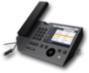



E911 – Next Generation End to End
Lync Infrastructure
E911 Service Provider
1
3
SIP Trunk
3
Mediation
Server
SBC
Call-Center
2
3
Internet
Lync
2
LIS DB
MSAG validation DB
3-4
1
4
1
1
2
5
PSTN
1- Client sends subnet information to registrar
2- Registrar returns LIS URI (and E911 Enablement data) during Registration. This is because Subnet 172.24.33.132 is enabled for E911
3- Client sends subnet to LIS – locations by subnet.
4- LIS does subnet/location match and returns the location in PIDF-LO format
3
5
Corporate Security Desk
1-Client dials 911 – includes PIDF-LO in SIP INVITE
2-IM notification of emergency call, party, and location sent to security group (optional)
3-E911 call routed over SIP trunk
4-Routing Provider connects to appropriate PSAP
5-Voice path connected to security group (optional)
1
1
1-Provisioning
a) Populate LIS with network element and location records
b) SIP trunk connected to SP
c) Enable sites or users
2- Addresses are sent for validation
3-Report back valid/invalid addresses
Enterprise User
2
Redmond PSAP
Bob
172.24.33.132
Operator

Slide 53
Emergency Calling – Feature Details
Security Desk Integration
  Instant Message to distribution groups is now supported – includes location
  Audio bridging is a partner feature
Locations
  Database is global – all are pushed to all Front End Servers
  ELIN’s can be added to locations
  LLDP is supported in Windows 8
Routing
  Emergency Routing Service Providers provide coverage in the United States
  ERSP’s generally have a user based fee structure
Other LIS Interfaces
  3rd party location server
  MAC Scanning

Slide 54
Response Group Application - Overview
Capabilities
  Recorded Messages, IVR, MoH, Anonymous Outbound Calling
  Presence Integrated Flexible Routing
  Manager and Administrator Roles
  Formal and informal agents
Is not a replacement for contact center applications
  Limited Management Capabilities
    No real time views
    No monitoring / barge-in / whisper
    No Agent reporting
  Limited Integration
    No IVR dips, skills matching, weighted routing

Slide 55
Response Group Service - Architecture
Response Group Service
  Server side voice application that runs on all Front End Servers
  Installed with Enterprise Voice
  Call Detail Records and Reporting
Designed for Moderate Scale (EE Pool Numbers)
  1200 active agents
  480 concurrent sessions – reduced if agents are anonymous
  600 Workflows with a max of 200 being IVR
Resiliency
  Pool – each Front End is running matchmaker server with one active
  Data Center – not integrated into the backup service; import/export mechanism

Slide 56
Unassigned Numbers - Overview
Call treatment for numbers not currently assigned
  Entire DID ranges can be entered or unique numbers
    Announcement
    Exchange Auto Attendant
  Incoming calls that don’t match a user or an outgoing route will be routed to the unassigned number table
  Different announcements can be uploaded
Planning Considerations
  Overlapping entries are matched from top down
    Unique DID entry needs to be above any inclusive range

Slide 57
Enterprise voice pilot

Slide 58
Who should be in the pilot?
A broad spectrum of skill levels
Representatives from a variety of roles
Enthusiastic individuals willing to participate and provide feedback
Users for every targeted workload/scenario
Individuals located near a Lync Champion
Remote users with a higher technical skill

Slide 59
Plan for a successful pilot
Have a plan and assemble the right team
Include the right combination of users
Focus on user experience
Define goals and measurable success criteria
Provide detailed communications and set expectations
Ask for feedback & use it to improve

Slide 60
Lync Rollout and Adoption Success Kit
Combines the Adoption & Training Kit and Pilot Success Kit
Focused on Lync 2013
Introduces a 5 phased approach to the deployment lifecycle
  Project Scope, Proof of Concept, Pilot, Enterprise Rollout, Run State
Focuses on 5 areas within each phase
  Planning, Help Desk, Awareness, Training, Operations

Slide 61
Q&A

Slide 62

Related content
Breakout Sessions
  OUC-B332 – Planning and Deploying Conferencing
  OUC-B323 - Monitoring Microsoft Lync Server
Hands on Labs
  OUC-H205 – Deploying Microsoft Lync Server 2013
Related Certification Exam
  70-336
  70-337
Find Me Later At: Lync 2013 Booth

Slide 63

Resources
Learning
  Sessions on Demand
  Microsoft Certification & Training Resources
http://channel9.msdn.com/Events/TechEd
www.microsoft.com/learning
TechNet
msdn
  Resources for IT Professionals
  Resources for Developers
http://microsoft.com/technet
http://microsoft.com/msdn

Slide 64







Complete an evaluation on CommNet and enter to win!

Slide 65



Evaluate this session
Required Slide
*delete this box when your slide is finalized
Your MS Tag will be inserted here during the final scrub.
Scan this QR code to evaluate this session and be automatically entered in a drawing to
win a prize

Slide 66

© 2013 Microsoft Corporation. All rights reserved. Microsoft, Windows and other product names are or may be registered trademarks and/or trademarks in the U.S. and/or other countries.
The information herein is for informational purposes only and represents the current view of Microsoft Corporation as of the date of this presentation. Because Microsoft must respond to changing market conditions, it should not be interpreted to be a commitment on the part of Microsoft, and Microsoft cannot guarantee the accuracy of any information provided after the date of this presentation. MICROSOFT MAKES NO WARRANTIES, EXPRESS, IMPLIED OR STATUTORY, AS TO THE INFORMATION IN THIS PRESENTATION.

