Slide 2
Modern Public Folders Overview, Migration and Microsoft Office 365
OUC-B329
Siegfried Jagott
Principal Consultant, MVP, Author
Xiopia, Germany
E-mail: Siegfried.Jagott@xiopia.com
Twitter: @SigiJ

Slide 3
Topics in this session…
Modern Public Folders Architecture
How to migrate to Modern Public Folders
Demo: Migrating and Managing Modern Public Folders
Public Folders Experiences

Slide 4
Modern Public Folder Architecture

Slide 5
Modern Public Folders in Exchange 2013
User Perspective
No change - same as with legacy public folders
Admin Perspective
Public folders are stored in public folder mailboxes
Each public folder mailbox includes the complete public folder hierarchy
Multi-master replication is replaced by single-master replication of folder hierarchy
Public folder mailboxes are stored in regular mailbox databases
Use DAGs for high availability and data redundancy
Cannot coexist with legacy public folders

Slide 6
Supported versions
Clients
- Outlook 2013, 2010, 2007
- OWA2013 (RTM CU1 or later)
Exchange Server
- E2013 users can access E2013 / E2010 / E2007 Public Folders
- E2007/E2010 users cannot access E2013 Public Folders
Migration support
- Cutover migration from Exchange 2007 and 2010
- Same on-premises and cross-premise

Slide 7
When should you use Public Folders?
Working together as a team
Working towards a shared outcome/purpose
Working together on shared deliverables
Need to get all the tools we need to be successful
Working on behalf of a virtual entity
Team appears as virtual identity (e.g., sales@contoso.com)
Working on shared queue of incoming requests
Answering as the virtual identity, not the individual
Discoverable/searchable for everyone
Accessible to everyone
History of public conversations
Public, unobtrusive conversations
Can include mails, notes, calendars, tasks, contacts,…
Site Mailboxes
Public Folders
Shared Mailboxes

Slide 8
Comparing Legacy vs. Modern Public Folders
 | Legacy Public Folders | Modern Public Folders
Content storage | Public Folder database | Public Folder mailbox
Public Folder content replication | Can be replicated between databases | Replication is not possible
High availability | PF replication | DAG
PF Hierarchy storage | One per PF database, multi-master | Per PF mailbox, one master only
PF Hierarchy synchronization | Based on e-mail | Direct mailbox sync
Search | Items only | Items and attachments (full-text)
Public Folder permission management | Access Control Lists (ACLs) | Role-based Access Control (RBAC)
Public Folder Client permissions | Access Control Lists (ACLs) | Access Control Lists (ACLs)
Admin Platform | PF Management Console + EMS | EAC + EMS
Outlook client support | Any Outlook version | Outlook 2007 - 2013
OWA support | OWA 2007, OWA 2010 | OWA 2013
Exchange Server support | Exchange 2010 or earlier | Exchange 2013

Slide 9
Modern Public Folders Architecture
Architecture
Public folders are based on the mailbox architecture
Hierarchy is stored in all public folder mailboxes
Content can be broken up and placed across multiple mailboxes
Similar administrative features
Public Folder permission management in RBAC
Public
logon
Public Logon
Public
logon
CAS 2013
Hierarchy
Hierarchy
Hierarchy
Red Folder
Green Folder
Blue Folder
Pink Folder
Yellow Folder
Secondary PF Mailbox
Primary PF Mailbox
Secondary PF Mailbox

Slide 10
Public Folder Hierarchy Synchronization
Client connects to a PF mailbox (secondary)
Client creates a public folder called Folder2
Request is proxied to the primary PF mailbox where Folder2 is written to PF hierarchy
After 15 minutes, PF hierarchy is updated on all PF mailboxes where users are connected
After 1 hour, PF hierarchy is updated on all PF mailboxes where no users are connected
CAS 2013
Hierarchy
Hierarchy
Hierarchy
Folder1
Folder1
Folder1
Folder2
Secondary PF Mailbox
Primary PF Mailbox
Secondary PF Mailbox

Slide 11
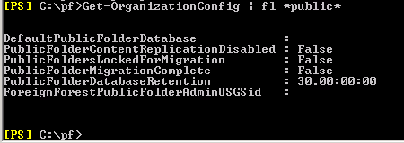
Coexistence Matrix
Public Folders on: Mailbox on: | Exchange 2007 (on-prem) | Exchange 2010 (on-prem) | Exchange 2013 (on-prem) | Exchange Online (Wave 15)
Exchange 2007 | Yes | Yes | No | No
Exchange 2010 | Yes | Yes | No | No
Exchange 2013 | Yes | Yes | Yes | Yes
Exchange Online | Yes | Yes | Yes | Yes
Exchange 2013 on-prem / online:
Exchange 2010 on-prem:

Slide 12
Deploying Modern Public Folders
Create a mailbox in a DAG
New-Mailbox -PublicFolder
Users create folders and messages
Users and user access grows
Create more PF mailbox(s)
PF hierarchy is copied automatically
Users create more folders and messages
PF mailbox reaches quota: Split it!
Script: Split-PublicFolderMailbox.ps1

Slide 13
Exchange Online Public Folders
Public Folder space is provided at no additional cost!
1.25 TB (50 PF mailboxes with 25 GB quota each)
One single Public Folder can be as large as 19 GB
Microsoft manages PF mailboxes
When PF mailbox quota is reached, or active hierarchy connection count is exceeded, Exchange will create another PF mailbox, and move PF content
Auto-split process is not available in Exchange 2013 on-prem
Cross-premises access
Exchange Online users can still access on-premise Public Folders
Exchange 2013 on-premises users can access Public Folders in Exchange Online

Slide 14
What is Auto-split (Exchange Online only)
When PF mailbox warning quota (24.5 GB) is exceeded, auto-split does the following:
Creates a new PF mailbox (if needed)
Moves half of the PF content to new PF mailbox
When active hierarchy connection count (2,000 connections) for a PF mailbox is exceeded:
Creates a new PF mailbox
Equally distribute client connections among all PF mailboxes

Slide 15
Backup and Restore Considerations
Public Folder mailboxes are part of mailbox databases thus can belong to a DAG
Provide single item recovery functionality
PF mailboxes provide the following recovery options
Deleted public folder restore
Deleted public folder mailbox restore
Public folder mailbox restore from a recovery database

Slide 16
How to migrate to Modern Public Folders

Slide 17
How to Migrate to Modern Public Folders
First to remember
No coexistence! Either the public folders are legacy or modern. The migration is a cutover migration!
Before considering a PF migration, all mailboxes must be on Exchange 2013 and/or Exchange Online
Public folder migrations are PowerShell based, the is no GUI!
Migrations to Exchange 2013 (on-premises)
Support for Exchange 2007 and 2010 Public Folders
Migrations to Exchange Online
Support for Exchange 2007, 2010 and 2013 Public Folders
No Exchange Hybrid Deployment required
Public Folders are migrated using Outlook Anywhere, thus OA must be available from Internet

Slide 18
Migration requirements
Make sure you run Exchange 2010 SP3 or 2007 RU8
Make sure replication between legacy public folder databases is healthy
All Public Folders must cut-over together
There will be a short PF downtime while the migration is finalized
You can choose to switch some users first for validation
Once migration completes, everyone switches at the same time
Roll-back is possible

Slide 19
The PF Migration Process
1. Prepare & Analyze
Verify existing PFs
Export-PublicFolderStatistics.ps1
PublicFolderToMailboxMapGenerator.ps1
2. Create public folder mailbox(s)
New-Mailbox -PublicFolder -HoldForMigration:$true
3. Begin migration
New-PublicFolderMigrationRequest -SourceDatabase PFDB1 –CSVData $folderMapFile
Hierarchy + content copying
Request autosuspended
4. Finalize Migration Request
Lockout users: Set-OrganizationConfig -PublicFoldersLockedForMigration:$true
Allow for replication on source (hierarchy/content)
Set-PublicFolderMigrationRequest -PreventCompletion:$false
Resume-PublicFolderMigrationRequest
Copies final hierarchy and content changes
5. Finalize PF migration
Set-Mailbox -PublicFolder -IsExcludedFromServingHierarchy:$false
Set-OrganizationConfig –PublicFolderMigrationComplete:$true
Remove legacy PF databases
PFDB1
Mailbox Replication Service
PFDB2
PFDB3

Slide 20
Step 1: Prepare & Analyze (1/2)
Prepare
Cleanup any Public Folder that includes a Backslash (“\”) in the name
Cleanup any Public Folder that is larger than 25 GB (recommendation)
Download Microsoft Exchange 2013 Public Folder Migration Scripts
http://www.microsoft.com/en-us/download/details.aspx?id=38407
Analyze (optional)
Get-PublicFolder -Recurse –Resultsize unlimited | Export-CSV C:\PFMigration\PFStructure.csv
Get-PublicFolder -Recurse | Get-PublicFolderStatistics | Export-CSV C:\PFMigration\PFStatistics.csv
Get-PublicFolder -GetChildren | Get-PublicFolderClientPermission | Select-Object Identity,User -ExpandProperty AccessRights | Export-CSV C:\PFMigration\PFPerms.csv

Slide 21
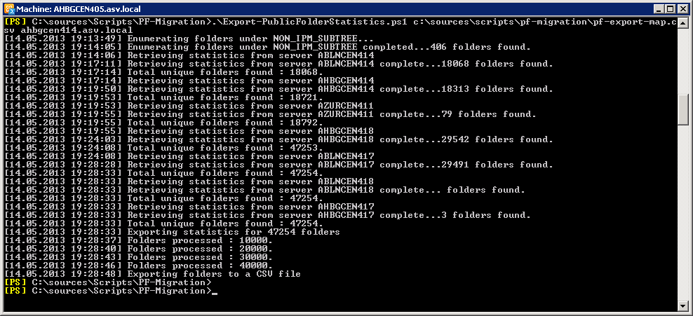
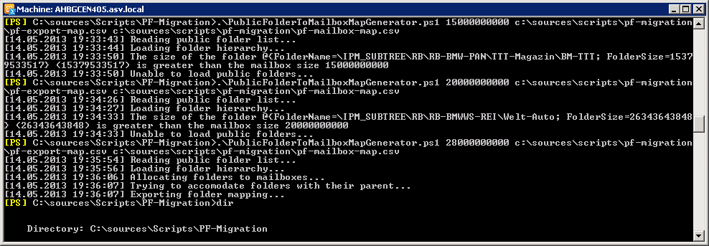
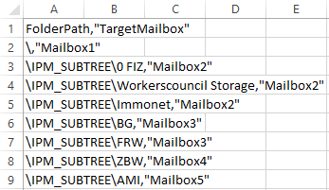
Step 1: Prepare & Analyze (2/2)
Run Public Folder Migration Scripts
Export-PublicFolderStatistics.ps1 <map.csv> <Public Folder server>
PublicFolderToMailboxMapGenerator.ps1 <maxPFmbxsize> <map.csv> <PFtoMbx.csv>
Output example:

Slide 22
Step 2: Create public folder mailboxes
Create required Public Folder mailboxes
Amount of mailboxes is defined in PFtoMBX matching file
First public folder mailbox must be in HoldForMigration mode
Create at least one public folder mailbox per 2.000 mailbox users
CMDlets to create PF mailboxes:
First:
New-Mailbox -PublicFolder “Mailbox1” -HoldForMigration:$true -IsExcludedFromServingHiearchy:$true
All others:
New-Mailbox -PublicFolder “MailboxXX” -IsExcludedFromServingHiearchy:$true
Configure Quotas on PF mailboxes
On-premises: 2 GB default, 25 GB recommended, 100 GB maximum
Online: 25 GB configured / maximum

Slide 23
Step 3: Begin migration
Create PF migration request(s)
New-PublicFolderMigrationRequest -SourceDatabase (Get-PublicFolderDatabase -Server <Source server>) -CSVData (Get-Content <map file.csv> -Encoding Byte) -BadItemLimit $BadItemLimitCount
Verify PF migration request
Get-PublicFolderMigrationRequest | Get-PublicFolderMigrationRequestStatistics -IncludeReport | fl
Verify that Migration Request will stop by 95%
Regularly run the following cmdlet:
Resume-PublicFolderMigrationRequest \PublicFolderMigration

Slide 24
Step 4: Finalize Migration Request
Lock out users from legacy Public Folders:
Set-OrganizationConfig -PublicFoldersLockedForMigration:$true
(Legacy Public Folders will be locked – wait until replicated to all databases!)
Complete PF Migration Request and restart sync:
Set-PublicFolderMigrationRequest \PublicFolderMigration -PreventCompletion:$false
Resume-PublicFolderMigrationRequest \PublicFolderMigration
Get-PublicFolderMigrationRequestStatistics \PublicFolderMigration –IncludeReport |fl
Issue:
Run: Set-OrganizationConfig -PublicFoldersLockedForMigration:$true (+ restart MSExchangeIS)
Resume-PublicFolderMigrationRequest again until request is 100% completed!

Slide 25
Step 5: Finalize Public Folder migration
Verify Modern Public Folders
Set-Mailbox <Mailbox> –DefaultPublicFolderMailbox Mailbox1
Use Outlook or OWA to verify Public Folders
Allow general Access to Modern Public Folders
Get-Mailbox -PublicFolder | Set-Mailbox -PublicFolder -IsExcludedFromServingHierarchy $false
Run on legacy server:
Set-OrganizationConfig -PublicFolderMigrationComplete:$true
(Allows e-mail delivery to Modern Public Folders)
Remove Legacy Public Folder Databases
Don’t remove them too quickly, otherwise you cannot roll-back anymore!

Slide 26
Roll-back to legacy Public Folders
Run on Exchange server (on-prem):
Set-OrganizationConfig –PublicFoldersLockedForMigration:$false
Set-OrganizationConfig –PublicFolderMigrationComplete:$false
(Restart Microsoft Exchange Information Store service to speed up access)
Remove Public Folder Mailboxes (option)
Key consideration
May loose new content when users already were working in Modern Public Folders

Slide 27
Demo
Migrating and Managing Modern Public Folders

Slide 28
What’s different when migrating to Exchange Online?
Configure routing to Exchange Online for mail-enabled Public Folders
Export + Import Scripts for mail-enabled folders
Run New-PublicFolderMigrationRequest with the following additional parameters:
- OutlookAnywhereHostname: OA external host name
- RemoteCredential: Public Folder Admin with access to all folders
- RemoteMailboxLegacyDN: LegacyExchangeDN of PF Admin
- RemoteMailboxServerLegacyDN: FQDN of Public Folder server
- Authentication: Basic or NTLM, depending on your OA authentication

Slide 29
Public Folders Experiences

Slide 30
Public Folder Experience
Large Company:
1.2 Million Public Folders
173 Public Folder stores
~34 TB combined PF storage
PF hierarchy in public folder database: ~20 GB
Division:
~ 700,000 Public Folders
~10.7 TB of combined Public Folder storage
Mayor issues:
PF hierarchy was designed 10+ years ago and does not reflect the current organizational structure, thus hard to understand nowadays
No automatic removal process of never used or obsolete public folders in place
Growth rate of 10,000 folders per month

Slide 31
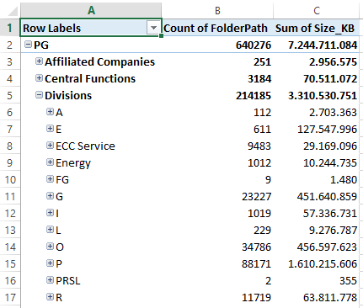
How to analyze a large PF structure?
Issue
700,000+ folders
No hierarchical information is available in Exchange
Solution
Export Public Folder hierarchy to a .CSV file
Use Microsoft Excel, create a PIVOT table
Investigate Public Folder structure (Owner, usage, etc)

Slide 32
Public Folder Analysis
Public folders are used as follows:
Mails are moved from mailboxes to public folders so they are stored together with a project, offer or order project. Old projects are used for new, upcoming projects as templates (very often)
Central storage of shared calendars or contact lists (seldom)
Public Folders are only used manually (by copying messages), no applications are found yet
Possible alternatives identified
Reduce Public Folder replicas when folder is “old”
Move non-needed Public Folders to PST and store them on cheaper storage
Move public folders to a functional mailbox
Move public folders to Sharepoint

Slide 33
Modern Public Folder Planning Aspects
Do you want to migrate your Public Folders at all?
How many Public Folder mailboxes do you need? Remember, minimum one mailbox per 2,000 users
Where do you place the Public Folder mailboxes? Place the primary PF mailbox to a database that is member of a DAG!

Slide 34
How to migrate a large PF structure?
Start cleanup of existing Public Folders and introduce alternatives
Reduce PF replicas where possible
Start to migrate all mailboxes to Exchange 2013 first, your Public Folders stay where they are today
Start Public Folder migration sync(s)
When all Mailboxes are migrated, define a weekend or more to lock-down the existing Public Folder structure
Do a final delta-sync
Switch PF structure to Modern Public Folders

Slide 35
Cmdlets/Scripts to remember…
Cmdlet / Script | Purpose
Update-PublicFolderMailbox | Manually update the Public Folder hierarchy
New-PublicFolderMoveRequest | Move Public Folders between Public Folder mailboxes
Set-PublicFolderMoveRequest <Request> -PreventCompletion:$false | Allows the move request to go beyond 95%, to open up the Public Folder mailbox that was created with –HoldforMigration. Requires legacy Public Folders to be locked.
Resume-PublicFolderMigrationRequest | Restart a Public Folder migration request to synchronize any changes that were made until now.
Set-OrganizationConfiguration –PublicFoldersLockedForMigration: $true -PublicFolderMigrationComplete: $true | Locks the access to legacy Public Folders, at the same time allows the Public Folder move request to finish. Enables mail enabled Public Folders to receive e-mails.
Get-PublicFolderMailboxDiagnostics | Receive diagnostic information about hierarchy syncs, etc.
Split-PublicFolderMailbox.ps1 | Is used to split a Public Folder mailbox that reached a quota of 60% or more into another PF mailbox. Can be found in <Exchange directory>\Scripts folder

Slide 36
Web Links to remember…
TechNet Help Article and FAQs
http://technet.microsoft.com/en-us/library/jj150538%28v=exchg.150%29
Microsoft Exchange 2013 Public Folder Migration Scripts
http://www.microsoft.com/en-us/download/details.aspx?id=38407
Migrate Public Folders to Exchange 2013 From Previous Versions
http://technet.microsoft.com/en-us/library/jj150486(v=exchg.150).aspx
Migrate Legacy Public Folders to Exchange Online
http://technet.microsoft.com/en-us/library/jj983799(v=exchg.150).aspx

Slide 37
Related content
Breakout Sessions
OUC-B322 - Using Windows PowerShell Magic to Manage Microsoft Office 365
Find Me Later At Exchange Expo (TLC)
Thursday, 6th: 2:45 PM - 4:00 PM

Slide 38
Track resources
Exchange Team Blog:
http://blogs.technet.com/b/exchange/
Twitter:
Follow @MSFTExchange
Join the conversation, use #IamMEC
Check out:
Microsoft Exchange Conference 2014: www.iammec.com
Office 365 FastTrack: http://fasttrack.office.com//
Technical Training with Ignite: http://ignite.office.com/

Slide 39
Resources
Learning
Sessions on Demand
Microsoft Certification & Training Resources
http://channel9.msdn.com/Events/TechEd
www.microsoft.com/learning
TechNet
msdn
Resources for IT Professionals
Resources for Developers
http://microsoft.com/technet
http://microsoft.com/msdn

Slide 40
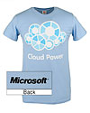
Complete an evaluation on CommNet and enter to win!

Slide 41
Evaluate this session
Required Slide
*delete this box when your slide is finalized
Your MS Tag will be inserted here during the final scrub.
Scan this QR code to evaluate this session and be automatically entered in a drawing to win a prize

Slide 42
© 2013 Microsoft Corporation. All rights reserved. Microsoft, Windows and other product names are or may be registered trademarks and/or trademarks in the U.S. and/or other countries.
The information herein is for informational purposes only and represents the current view of Microsoft Corporation as of the date of this presentation. Because Microsoft must respond to changing market conditions, it should not be interpreted to be a commitment on the part of Microsoft, and Microsoft cannot guarantee the accuracy of any information provided after the date of this presentation. MICROSOFT MAKES NO WARRANTIES, EXPRESS, IMPLIED OR STATUTORY, AS TO THE INFORMATION IN THIS PRESENTATION.

