Slide 2
Microsoft SharePoint 2013 and Office 365 Upgrade and Migration: Strategy and Tactics
SES-B203
Dan Holme Microsoft Technologies Analyst & Evangelist
MVP, SharePoint Server dan.holme@intelliem.com

Slide 3
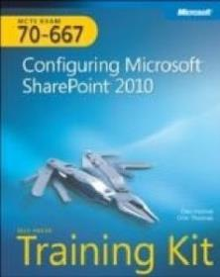
Dan Holme
DAN HOLME
MAUI, HAWAII
CONSULTANT
AvePoint
INTELLIEM
AUTHOR
danholme http://tiny.cc/danholmepresentations dan.holme@intelliem.com

Slide 4
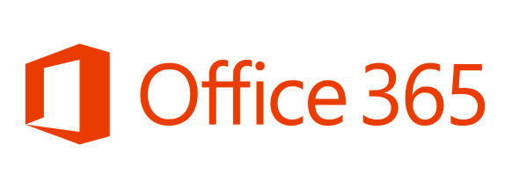

Slide 5
About This Session
Roadmap to SharePoint 2013 & Office 365
What is SharePoint 2010? What is new at Microsoft? What is SharePoint 2013?
When should I upgrade?
On-premise or Office 365?
Insight, clarity & balance
What are enterprises planning and doing?
Technical guidance
How do I upgrade or migrate?
What do I need to know to successfully upgrade?
Answer questions

Slide 7
Why SharePoint?

Slide 8
Business Matters
SharePoint Doesn’t Matter

Slide 9
Business Matters
SharePoint Matters
VALUE
RISK

Slide 10
Why should I consider SharePoint 2013?

Slide 11
Ancient History

Slide 12
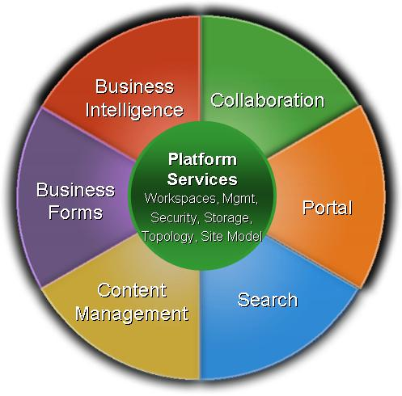
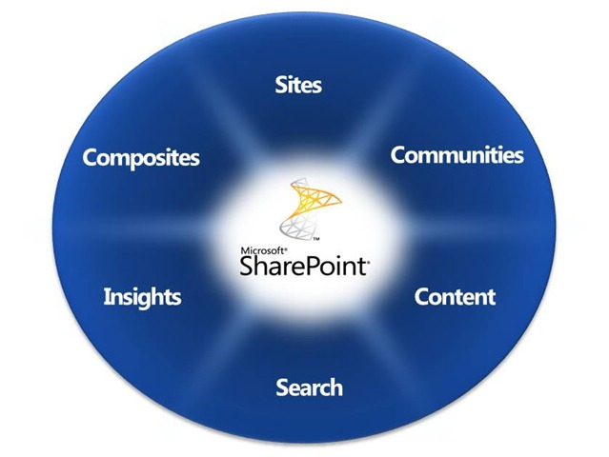
2006
SharePoint 2007
Facebook
iPhone
SharePoint 2010

Slide 13
2007 – 2012: Revolutionary Trends
People
Devices
Social
Cloud
Control

Slide 14
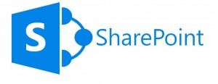
SharePoint 2013
People
Devices
Social
Cloud
Control

Slide 15
SharePoint 2010
SharePoint 2013

Slide 16
SharePoint 2010 is so 2006!
SharePoint 2013

Slide 17
When should I begin moving to 2013?

Slide 18
Service Pack 1
Don’t Wait

Slide 19
Business Won’t Wait
Don’t Wait

Slide 20
When should I upgrade?

Slide 21
Business Won’t Wait
Don’t Delay

Slide 22
Upgrade projects have delivered little or no value

Slide 23
Don’t Upgrade

Slide 24
Move Forward
Don’t Upgrade
VALUE
RISK

Slide 25
Move Forward
Upgrade
VALUE
RISK
VALUE
RISK

Slide 26
How should I move forward?

Slide 27
Roadmap to 2013
Collab
Services
Intranet
LOB
2010
SQL
SharePoint
Virtual Servers
Data
Servers
Network

Slide 28
Roadmap to 2013
Deploy 2013 into your service portfolio now

Slide 29
Roadmap to 2013
Collab
Intranet
LOB
2013
2010
SQL
SharePoint
Virtual Servers
Data
Servers
Network

Slide 30
Roadmap to 2013
Deploy 2013 into your service portfolio now
The “real” hybrid: 2010 / 2013, Foundation / Server, on-premise / cloud
Don’t wait for SP1 but ensure your vendors are ready
SharePoint 2013 service farm
Cross-version federated services
Search
Profile
Metadata
BCS
Secure store
Other services remain in 2010 farm

Slide 31
Roadmap to 2013
Services
Collab
Intranet
LOB
2013
2010
SQL
SharePoint
Virtual Servers
Data
Servers
Network

Slide 32
Roadmap to 2013
Deploy 2013 into your service portfolio now
The “real” hybrid: 2010 / 2013, Foundation / Server, on-premise / cloud
Don’t wait for SP1 but ensure your vendors are ready
SharePoint 2013 service farm
Search Center, My Sites

Slide 33
Roadmap to 2013
Deploy 2013 into your service portfolio now
The “real” hybrid: 2010 / 2013, Foundation / Server, on-premise / cloud
Don’t wait for SP1 but ensure your vendors are ready
SharePoint 2013 service farm
Search Center, My Sites
Get Office 365 into your service portfolio now

Slide 34
Roadmap to 2013
Deploy 2013 into your service portfolio now
The “real” hybrid: 2010 / 2013, Foundation / Server, on-premise / cloud
Don’t wait for SP1 but ensure your vendors are ready
SharePoint 2013 service farm
Search Center, My Sites
Get Office 365 into your service portfolio now
Deliver innovative solutions to drive business value
Business users won’t wait for the next “big jump” upgrade project
Deploy new workloads to 2010 or 2013, Foundation or Server, on-prem or cloud farm as appropriate

Slide 35
Roadmap to 2013
Services
New Workload
Collab
Intranet
LOB
2013
2010
SQL
SharePoint
Virtual Servers
Data
Servers
Network

Slide 36
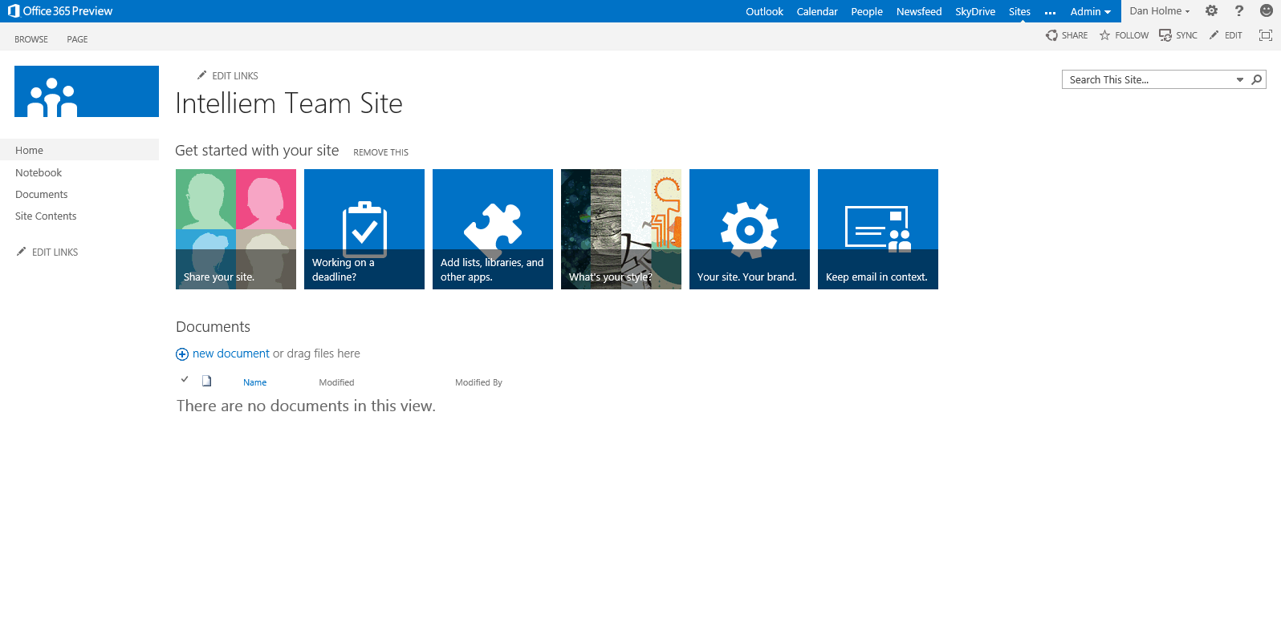

Slide 37
Roadmap to 2013
Deploy 2013 into your service portfolio now
The “real” hybrid: 2010 / 2013, Foundation / Server, on-premise / cloud
Don’t wait for SP1 but ensure your vendors are ready
SharePoint 2013 service farm
Search Center, My Sites
Get Office 365 into your service portfolio now
Deliver innovative solutions to drive business value
Business users won’t wait for the next “big jump” upgrade project
Deploy new workloads to 2010 or 2013, Foundation or Server, on-prem or cloud farm as appropriate
Don’t deploy “big bet” workloads on 2010
If a workload involves SharePoint 2013’s “big bets”, you guarantee risk, pain, cost, or failure
Social, search, mobile devices, WCM (public facing web site, published content intranet or extranet)

Slide 38
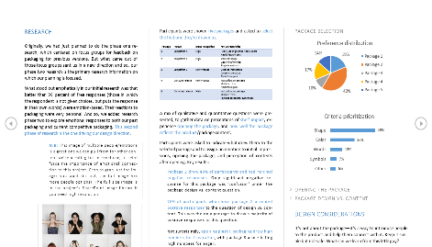
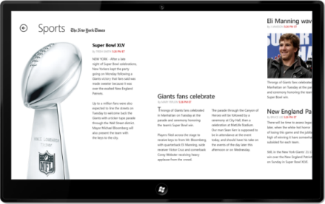
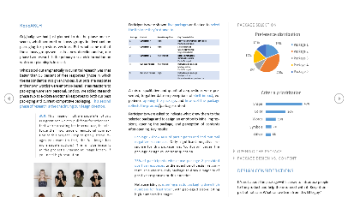
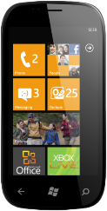
Mobile

Slide 39
Social Networking

Slide 40
Search

Slide 41
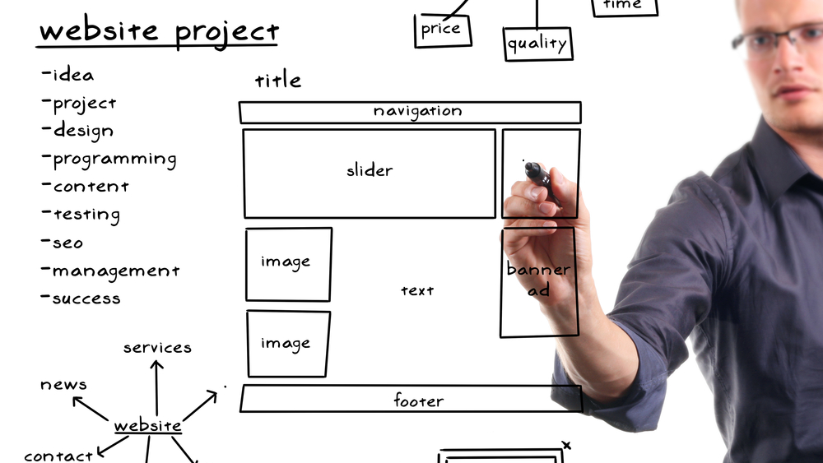
Web Content Management

Slide 42
Roadmap to 2013
Services
New Workload
Social
Collab
Intranet
LOB
2013
2010
SQL
SharePoint
Virtual Servers
Data
Servers
Network

Slide 43
Roadmap to 2013
Deploy 2013 into your service portfolio now
The “real” hybrid: 2010 / 2013, Foundation / Server, on-premise / cloud
Don’t wait for SP1 but ensure your vendors are ready
SharePoint 2013 service farm
Search Center, My Sites
Get Office 365 into your service portfolio now
Deliver innovative solutions to drive business value
Business users won’t wait for the next “big jump” upgrade project
Deploy new workloads to 2010 or 2013, Foundation or Server, on-prem or cloud farm as appropriate
Don’t deploy “big bet” workloads on 2010
If a workload involves SharePoint 2013’s “big bets”, you guarantee risk, pain, cost, or failure
Social, search, mobile devices, WCM (public facing web site, published content intranet or extranet)

Slide 44
Roadmap to 2013
Services
New Workload
Social
Collab
Intranet
LOB
2013
2010
SQL
SharePoint
Virtual Servers
Data
Servers
Network

Slide 45
I have SharePoint 2007… Should I skip 2010?

Slide 46
The 2010/2013 Workload Decision Tree
Can it be done in 2010?
Define Business Need
It can be done better in 2013
Can it be done in 2013?
SharePoint 2013

Slide 47
OK, now can we upgrade?

Slide 48
Migrate
Don’t Upgrade

Slide 49
Migrate
Upgrade is Dead

Slide 50
Upgrade: A High Level View
Server Farm Administrators
4
Site Collection Admins
Create SharePoint 2013
Production farm
Copy databases to new farm
Upgrade Databases
1
2
3
Site collections remain in 2010 mode
4
Upgrade site collections to 2013 mode
5
2010 mode available
2010 workflow engine
2010 customization models (Full Trust, Sandbox)

Slide 51
Upgrade: A High Level View
B2B (Build-to-Build)
V2V (Version-to-Version)
2010 SP1
2010 SP2
2010
2013
Database attach upgrade
In-place upgrade
Database attach upgrade

Slide 52
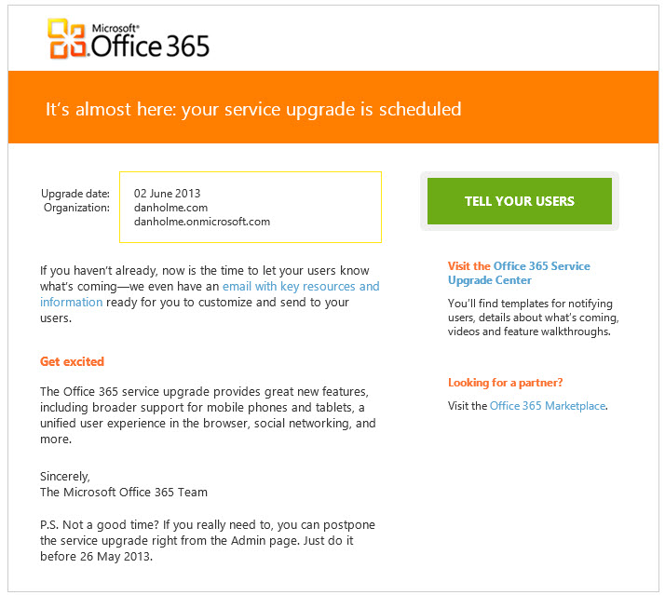

Slide 53
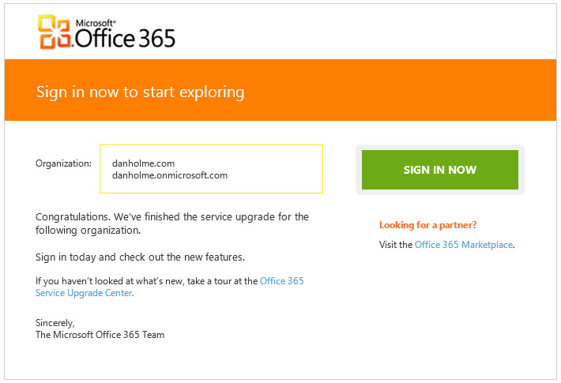

Slide 55
Office 365 or On-Prem?

Slide 56
Office 365
On-Prem

Slide 58
Which Cloud?
SaaS
Hosted IaaS
Managed IaaS
Private Cloud

Slide 59
But what about _________ in the cloud?

Slide 60
Cloud Concerns
Lack of Flexibility
Security
Data Sovereignty
Data Loss
Difficult Choice
Perception vs Reality
Incomplete Knowledge
Job Loss

Slide 61
Cloud Considerations
Business requirements
Service levels
Features
Migration
No out-of-box toolset
Third-party tools required
Management of the cloud
Administration
Backup, restore, disaster recovery
Management of hybrid environments
Content publication & replication
Search
Compliance
Social
Metadata

Slide 62
When should I move to the cloud?

Slide 63
Move Forward
Don’t Move Up
VALUE
RISK

Slide 64
Workload
Workload
Solution
Service
Application
Business outcome
Business need
What you are doing
VALUE
RISK

Slide 65
Workloads and Clouds
Private Cloud (“On Prem”)
SaaS (Office 365)
Collaboration
Extranet Scenarios
Social
User-driven solutions
IaaS (Windows Azure VMs)
Public-facing websites
Small farms for remote users or projects
Dev environments
Disaster recovery
Custom or third-party applications (full-trust)

Slide 66
Journey to the Cloud
Microsoft wants you in the (their) cloud
Aggressive pricing
But there are (many) alternatives
Tools and guidance are missing
Journey is inevitable
Workload-based determination of platform
Address challenges of hybrid service architecture early on
Architect on-premise implementations to reflect Office 365
Build customizations for cloud, whenever possible

Slide 67
So what I end up with is…

Slide 68
Service
Solution
Application
Foundation
Server
2013
2010
Saas
IaaS
Private

Slide 69
MAHALO! (thank you!)
http://tiny.cc/danholmepresentations
http://bit.ly/danholmearticles
http://bit.ly/danholmebooks
A HUI HO! (‘til next time!)
dan.holme@intelliem.com
@danholme

Slide 70
Related content
Breakout Sessions (session codes and titles)
SES-B312: The Only Way to Go Is Up! Upgrade to Microsoft SharePoint 2013
Hands-on Labs (session codes and titles)
SES-H313: Deferred Site Collection Upgrade in Microsoft SharePoint Server 2013

Slide 71
Resources
Learning
Sessions on Demand
Microsoft Certification & Training Resources
http://channel9.msdn.com/Events/TechEd
www.microsoft.com/learning
TechNet
msdn
Resources for IT Professionals
Resources for Developers
http://microsoft.com/technet
http://microsoft.com/msdn

Slide 72
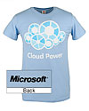
Complete an evaluation on CommNet and enter to win!

Slide 73
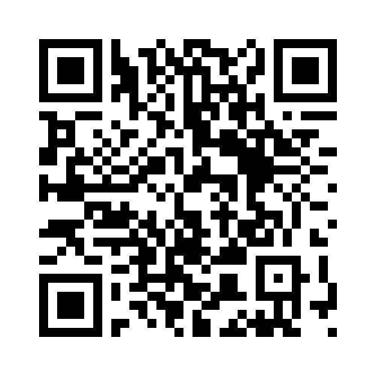
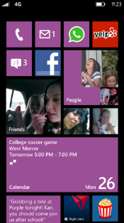
Evaluate this session
Required Slide
*delete this box when your slide is finalized
Your MS Tag will be inserted here during the final scrub.
Scan this QR code to evaluate this session and be automatically entered in a drawing to win a prize

Slide 74
© 2013 Microsoft Corporation. All rights reserved. Microsoft, Windows and other product names are or may be registered trademarks and/or trademarks in the U.S. and/or other countries.
The information herein is for informational purposes only and represents the current view of Microsoft Corporation as of the date of this presentation. Because Microsoft must respond to changing market conditions, it should not be interpreted to be a commitment on the part of Microsoft, and Microsoft cannot guarantee the accuracy of any information provided after the date of this presentation. MICROSOFT MAKES NO WARRANTIES, EXPRESS, IMPLIED OR STATUTORY, AS TO THE INFORMATION IN THIS PRESENTATION.

