Slide 2
The only way to go is up! Upgrade to Microsoft SharePoint 2013
SES-B312
Chris McNulty

Slide 3

Intro

Slide 4


Meet Chris McNulty @cmcnulty2000
12 years in SharePoint, 20+ in IT
10 years at Boston College & Fairfield University
<Insert Head Shot>
21 years in Milton Massachusetts
3 children (Devin Nate Rachel) and my wife Hayley

Slide 5
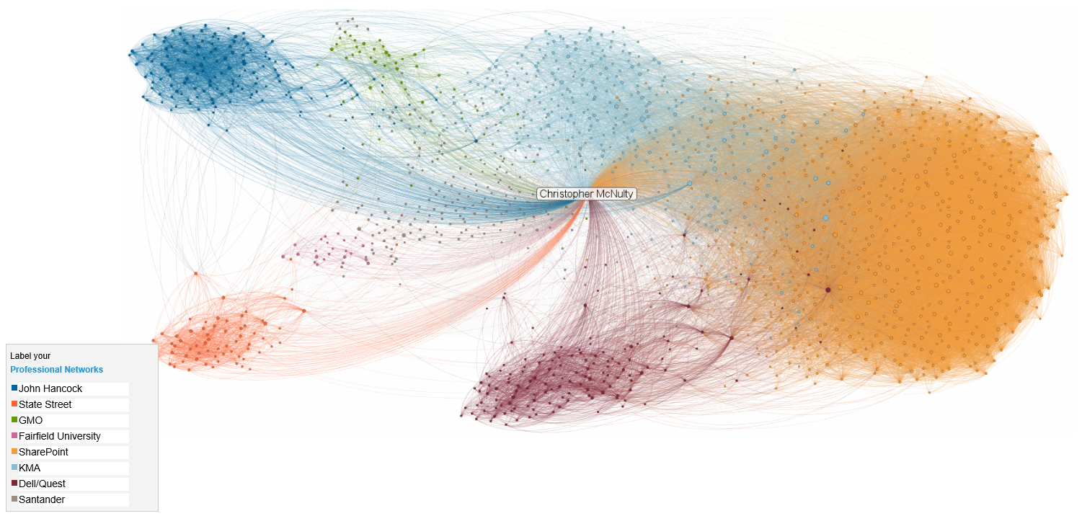

Slide 6
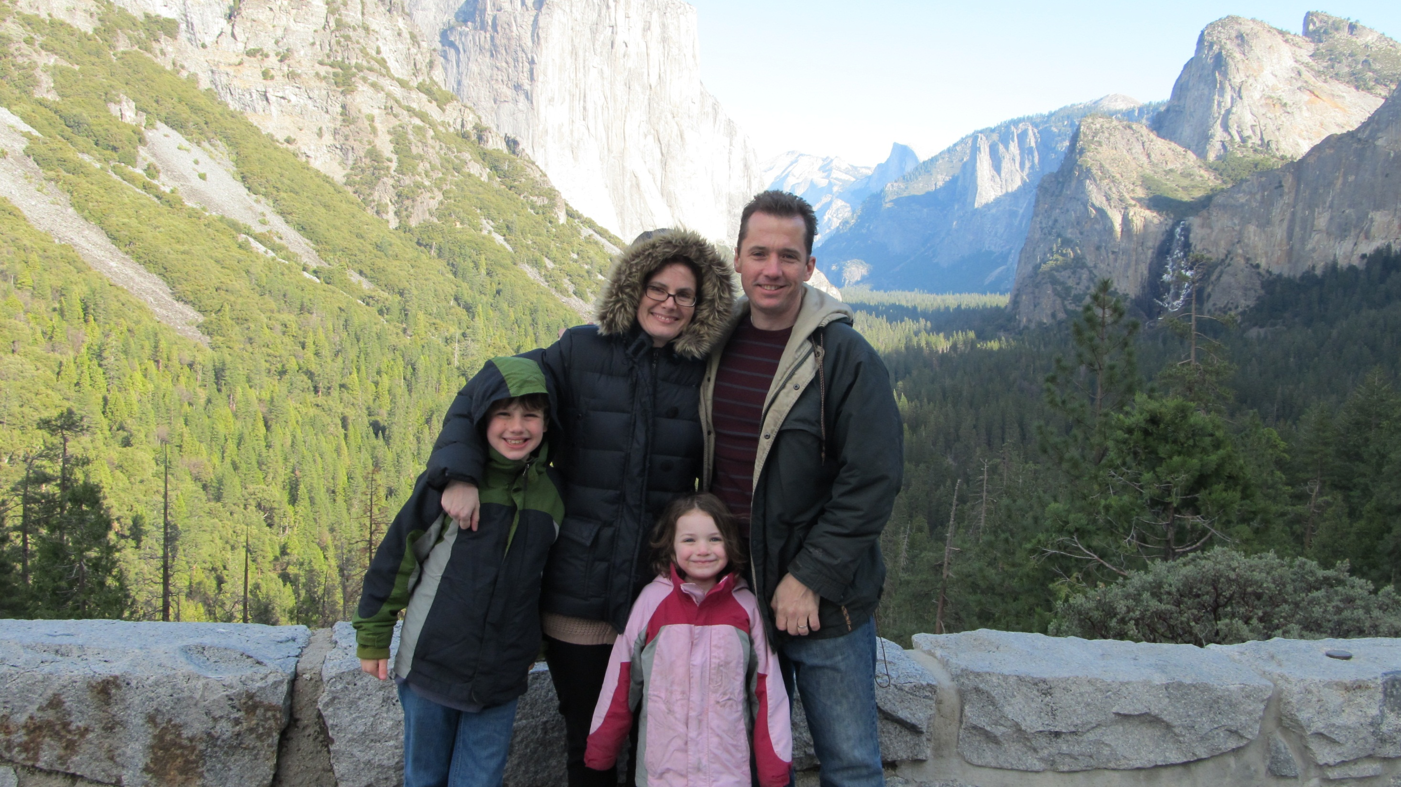


Slide 7
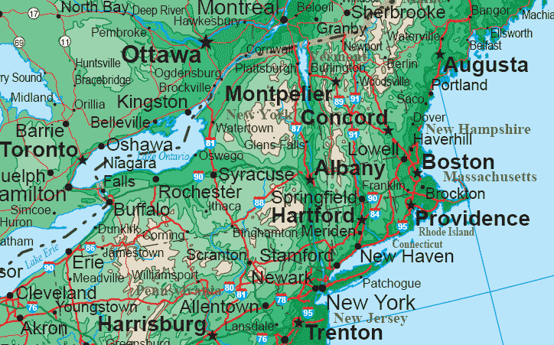

Slide 8
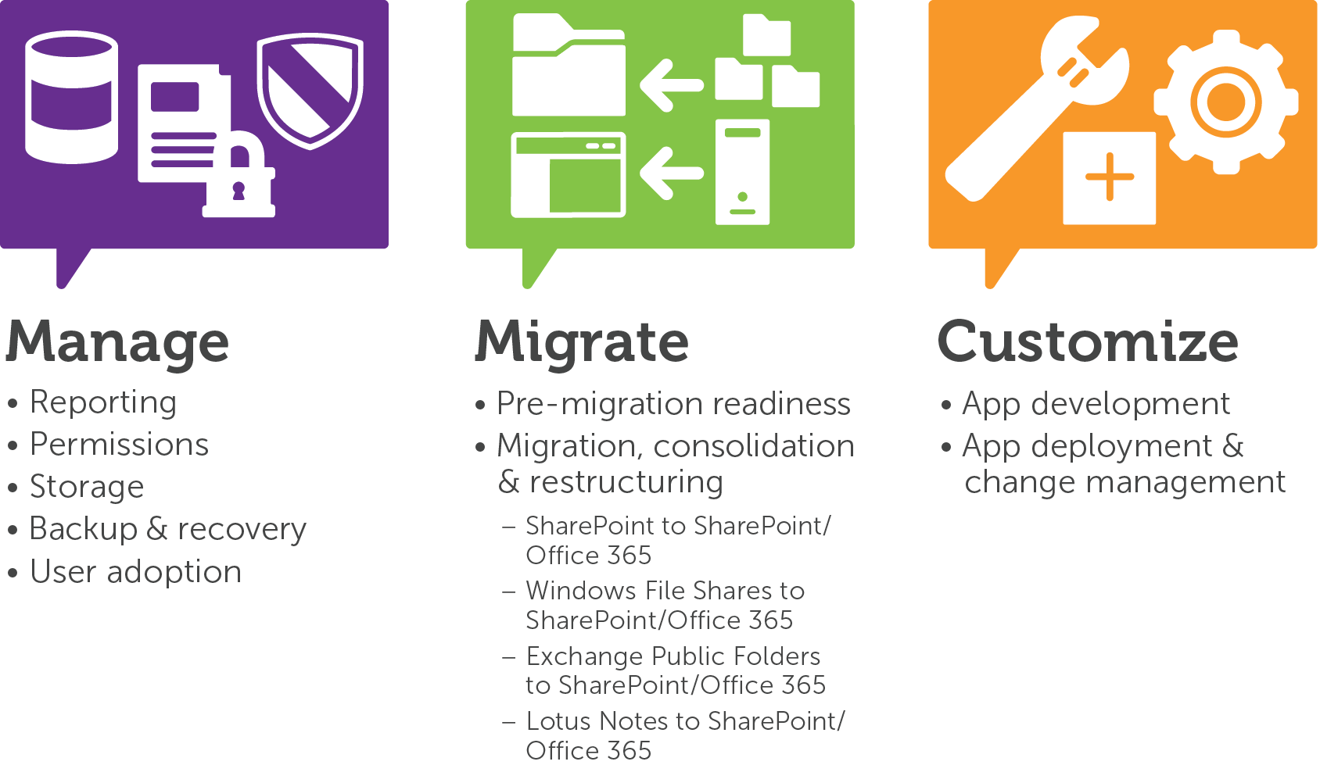
Dell Software | SharePoint

Slide 9

Key Topics
Case for SharePoint
Upgrade Planning
Preparation
Schema and Site Collection Upgrade
Special Cases

Slide 10

Presentation governance
Out of scope
  Custom solution/code creation
  Installation and SSA creation
  Upgrade deep dives
  Dell products…
Rules
  Questions – time permitting during session
  Any time after session – email etc. - @cmcnulty2000

Slide 11
Why SharePoint?

Slide 12
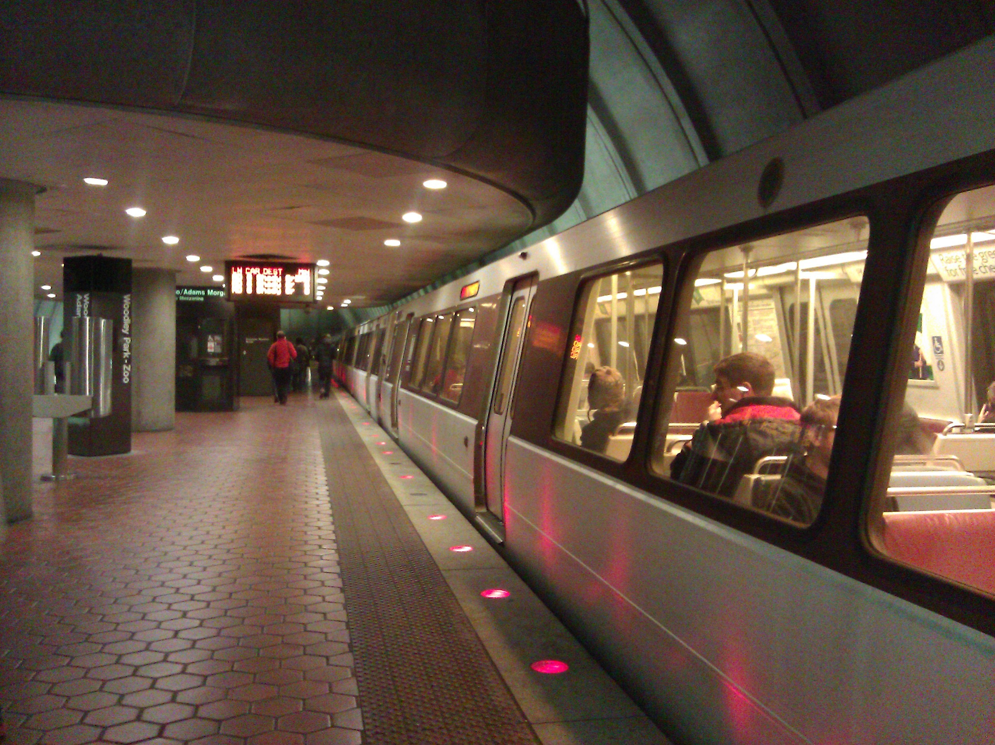
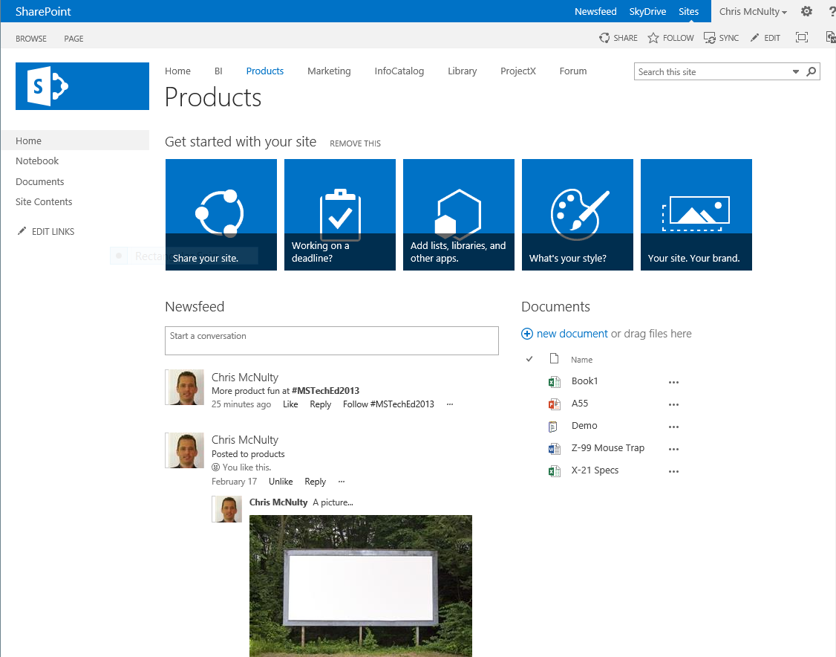
Document-centric collaboration
Multi-browser, multiplatform
Massive capacity for document management, version, search, and storage!
“Modern” UI
SkyDrive Pro

Slide 13

Why care about SharePoint 2013?
Social
Search
Apps & Store

Slide 14
Migration/Upgrades

Slide 15

Upgrade methods
Database attach upgrade
  Only available method for version to version (V2V) upgrades
  Only available 2010-2013
  Works for both version to version (V2V) and build to build (B2B) upgrades
  Works for content and services databases
In-place farm upgrade
  Only available for build to build (B2B) upgrades

Slide 16
Prepare

Slide 17




Pre-readiness roadmap
Upgrade Windows
Upgrade SQL
Content Consolidation

Slide 18

Mission zero
Server operating systems
  Windows Server 2008 R2
  Windows Server 2012
  8GB RAM (Foundation)
  12GB RAM (Farm server)
  24GB RAM (Single server)
  http://technet.microsoft.com/en-us/library/cc262485.aspx
Database servers
  SQL Server 2008 R2
  SQL Server 2012 “Denali”
  8GB RAM PLUS

Slide 19
SQL Server in-place upgrade– Matrix
From
SQL Server 2000 SP4
To
SQL Server 2005 SP2
SQL Server 2008 R2
SQL Server 2008
SQL Server 2005 SP4
SQL Server 2008 SP2
SQL Server 2012/Denali
SQL Server 2008 R2

Slide 20
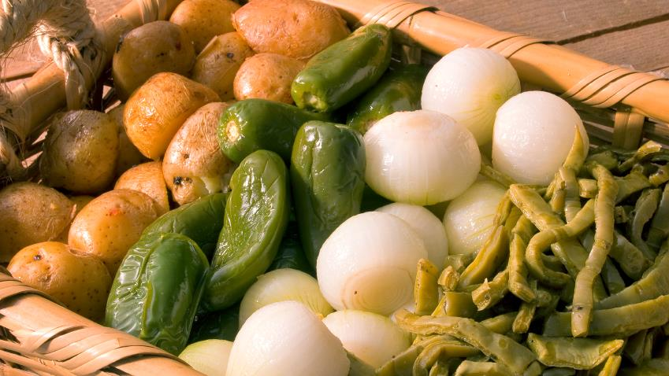
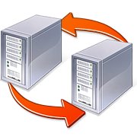



Content consolidation in 2010
Why, why, why?
Re-migration
Fix cut and paste or finish a platform update
M&A
Unify legacy knowledge
Forge new identity
Aggregation
Dep’t portals
Findabilty
Retire legacy ECM
Information rearchitecture
New structures
Depts -> Teams
Upgrade readiness
One hop better than many
Use ECM now

Slide 21

Content Assessment
Define the content selection criteria
  Where is it stored? Who owns it? Is it still relevant?
  Size? Duplicates? ‘Bad’ for SharePoint?
Assess how much content is left when criteria is applied
Go back to 1.

Slide 22
Application assessment challenges
WSP/Jscript; managed and unmanaged
Documentation and Purpose
Test upgradability
Third-party components
Ask:
  Was code release a “governed” process?
  Relevance and mission criticality?
  Risk/reward relative to test and upgrade efforts
  How many separate elements need to be tested?

Slide 23

Documentation process
Examine existing farm for useful information
Gathered information informs new version
Keep all information for future use
Content databases:
  Names
  Issues
  Referenced customizations
Services:
  Cross farm topology
  Database names
  Service Settings
  Installed customizations
Farm/Web Application:
  Alternate Access Mappings (AAM)
  Authentication Methods/Providers
  Managed paths
  Installed/registered features
  Installed customizations
  Web.config modifications

Slide 24
Settings gathering
Some settings are farm specific
Most are referenced for new farm
Simple PowerShell scripts can gather settings data
  Get-SPFeature | Format-List | Out-File features.txt
  Get-SPFarm | Format-List
  Get-SPFarm.buildversion (www.chrismcnulty.net/blog)
  Get-SPSite –limit all | Get-SPWeb –limit all | Select URL, name, theme, SiteLogoURL, WebTemplate, WebTemplateID | Out-GridView
Test-SPContentDatabase (2010 & 2013)
Third-party solutions
STSADM -o PreUpgradeCheck no longer exists

Slide 25
Planning

Slide 26

Database attach upgrade
Supported
  Content databases
  Project Server databases
    Note: Four DBs merge to one
  Search admin database
  Profile database
  Social database
  Managed Metadata database
  Secure Store database
    Note: Passphrase required
  Access databases
    Note: Supported for B2B upgrades only
Not supported
  Configuration database
    Unsupported for both V2V and B2B upgrades
    Never supported in prior versions
  Search index databases
    Unsupported for V2V only
  Sync database
    Unsupported for V2V only

Slide 27
Change management – auth & URLs
Authentication changes
Windows Classic support (Legacy)
  SP2013 supports this with some issues
Windows Claims support
  2010 supports this with a few exceptions
  Migration before upgrade recommended
Database to Web Application authentication mode mismatches
  Database attach in SP2013 detects mismatched auth support
  Test-SPContentDatabase in SP2013 also detects this
  Fix before attaching is best advice
Don’t stack with upgrade!
URL Changes
AVOID! (User impact)
  WebDav does not follow redirects so Microsoft Office applications may not work against new URLs
  Bookmarks to “old” URLs break
  Don't use host names – use DNS alias
Stacking URL changes with upgrade can complicate experience
  Recommend to do them as separate events with user noticeable time gap between
  Could make users blame upgrade as cause of experience change
  Shouldn’t even use different URLs in test environment

Slide 28

Choosing migration vs. upgrade
Self service migration
  Cut and paste
System-based upgrade
  Database Attach
Tools-based migrations
  Manually using tools
Complex migration including custom code
  Invoke experts
Considerations
  Downtime and IA transformation (migrate)
  Forced abandonment of ’worst’ modification practices (migrate)

Slide 29
Disk Sizing
Content |  | Search
Initial Content Size | XXX GB | External Crawl Size | YYY GB
Initial User Pool | U
User Collab Size | .25GB
n YR Growth Rate – Archive Rate | G%
End Content Size | XXX (1+G)^{n} = ECS | End Search Size | YYY (1+G)^{n} = ESS
End User Collab Size | .25 * U * (1+G)^{n} = EUCS
Content DBs | ECS + EUCS
Search DBs |  |  | .05 * (ECS + EUCS + ESS)
Search Index Files |  |  | .05 * (ECS + EUCS + ESS)
Content will grow!
Searching remote stores saves disk but isn’t free.
RBS reduces database size, not total storage
Shredded storage only reduces growth from versioning
Inputs: Size of SharePoint content and non-SharePoint content included in search
For DBs, don’t forget t- logs, disk dumps (if used for backup) which can add 1-3X.
In SAN or virtual environments, not all disk need be provisioned early

Slide 30

Advantages of code-free solutions
Improve time-to-delivery
Reduce cost of ownership
  Easier to build, maintain and support
Optimize resource utilization
Reuse across entire organization
Simplify upgrade path

Slide 31
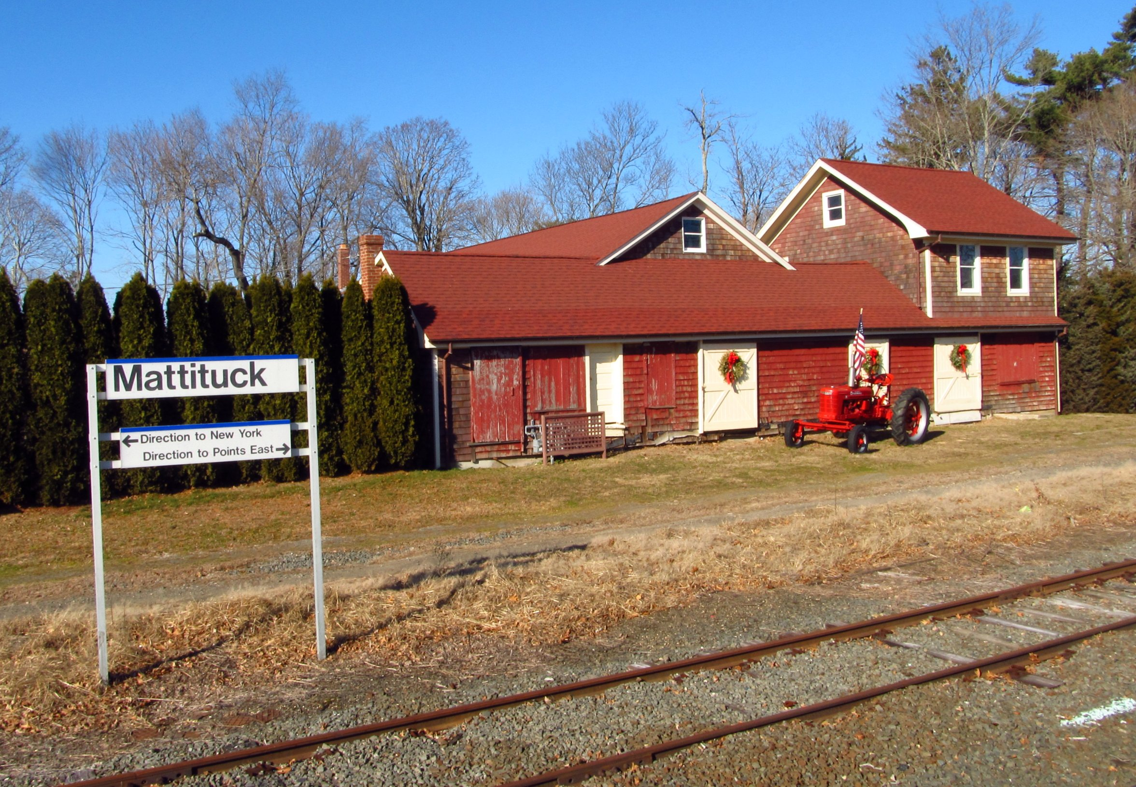
Don’t move a mess!

Slide 32
Best practices for testing upgrade
Know what is in your environment.
Make your test environment match* production
Use real data
Run multiple tests
Do not ignore errors or warnings
Test the upgraded environment, not just the upgrade process. (Service apps, full crawl, etc.)

Slide 33

Two modes converged in a wood…

Slide 34

Unsupported in 2010 mode
All new 2013 specific features
  Upgrade SP Site to 2013 mode first
2010 Web Analytics
  Existing features must be removed
  New web analytics features supported only in 2013 mode
2010 Office Web Applications (WAC)
  Replaced with SP2013 WAC for both modes
  PowerPoint Broadcast sites must be removed
    No replacement available, use Lync instead
Project Web Access Sites (PWA Template)
  Must upgrade to 2013 mode to use
  Project Sites (PWS) supported in both 2010 and 2013 mode

Slide 35

Office Web Apps Server
Off-server installation
Prerequisites
  .NET Framework 4.5/ASP.NET 4.5
  Ink and Handwriting
  Windows Authentication, NET Extensibility 4.5
  ISAPI Extension, ISAPI Filters
  Server Side Includes
Default installation (DNS, https)
PowerShell
  Import-Module OfficeWebApps
  New-OfficeWebAppsFarm –InternalURL http://SP2013Demo-WAC –ExternalURL http:// SP2013Demo-WAC.spdemo.corp –AllowHttp –EditingEnabled –ClipArtEnabled
Test - http://servername/hosting/discovery
On SharePoint
  New-SPWOPIBinding -ServerName <WacServerName> -AllowHTTP
Set zone to regular http
  Set-SPWopiZone –zone “internal-http”
Troubleshooting:
  No system account usage!
  Configure system to allow OAuth over http
    $config = (Get-SPSecurityTokenServiceConfig)
    $config.AllowOAuthOverHttp = $true
    $config.Update()

Slide 36
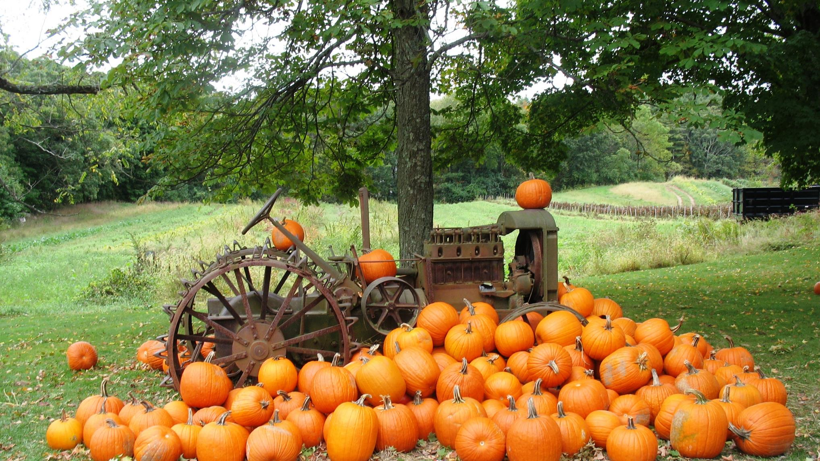
Cleanups are beautiful, really!

Slide 37
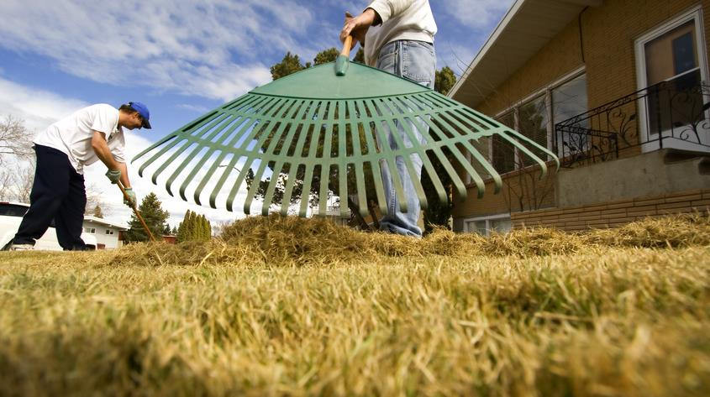
SharePoint “raking”
Remove stale SPSites and SPWebs
  Remove-SPSite
  Remove-SPWeb
Remove unneeded versions
  Primarily user driven, OM operations or SiteAdmin help
Cleanup templates, features, & web parts
  Primarily user driven, OM operations or tools help
Finish 2010 visual upgrades
Fix data issues
  stsadm -o DatabaseRepair [-deletecorruption]
  stsadm -o ForceDeleteList
  stsadm -o VariationsFixupTool
Database alignment
  Move-SPSite

Slide 38

Site collection end of life
PowerPoint Broadcast Sites
Power Pivot v1
  2013 Default is v2
  Upgrade in advance or prune and migrate the models

Slide 39
Claims Conversion PowerShell
Add-PSSnapIn Microsoft.SharePoint.PowerShell -ErrorAction SilentlyContinue
$WebAppName = "http://SPC1"
#THIS SHOULD BE THE ACCOUNT THAT IS RUNNING THIS SCRIPT, WHO SHOULD ALSO BE A LOCAL ADMIN
$account = "qwpba13\Administrator"
$wa = get-SPWebApplication $WebAppName
Set-SPwebApplication $wa -AuthenticationProvider (New-SPAuthenticationProvider) -Zone Default
# this will prompt about migration, CLICK YES and continue
#This step will set the admin for the site
$wa = get-SPWebApplication $WebAppName
$account = (New-SPClaimsPrincipal -identity $account -identitytype 1).ToEncodedString()
#Once the user is added as admin, we need to set the policy so it can have the right access
$zp = $wa.ZonePolicies("Default")
$p = $zp.Add($account,"PSPolicy")
$fc=$wa.PolicyRoles.GetSpecialRole("FullControl")
$p.PolicyRoleBindings.Add($fc)
$wa.Update()
#Final step is to trigger the user migration process
$wa = get-SPWebApplication $WebAppName
$wa.MigrateUsers($true)

Slide 40
Migration preparation in SharePoint 2010
Chris McNulty

Slide 41
Implement upgrade

Slide 42


Upgrade process
Only one in-the-box technique!
Upgrade 2010 Web App in advance
  Convert-SPWebApplication* or PowerShell!
Build a new, clean SharePoint 2013 farm
Pre-position required solutions at 2013 target
Copy/attach/upgrade Managed Metadata and other SSAs
New web application
Attach Source Content Databases
Evaluation SC Upgrade
Final Site Collection Upgrade
Content migration still supported via code and third-party tools (hint)

Slide 43

Account requirements for upgrades
Database upgrades
  Active SQL Server login on the computer that runs SQL Server
  Login must be member of the DB_Owner database security role on the database being upgraded
  Login must be member of the WSS_Admin_WPG database security role on the farm configuration database
  Member of Farm Admin group
Site collection upgrades
  Member of site collection administrator group
  Both primary and secondary site collection owners have this automatically
  Can also be member of full control web application policy instead
Farm upgrades
  Member of the Administrators local group on each server on which upgrade is run

Slide 44

Configuring web applications
Before attaching content databases
  Ensure web applications are setup correctly
    Using correct managed account for application pool
    Correct managed paths exist
    Same AAM zones and URLs are configured
    Solutions and other customizations are installed
  Ensure service instances are connected to web application
    Some content database upgrades attempt to use service instances
      Service unavailability should not block upgrade
      Service issues during upgrade may require additional work afterwards
        To finish the specific service interaction missed during upgrade
        Check log to look for issues

Slide 45
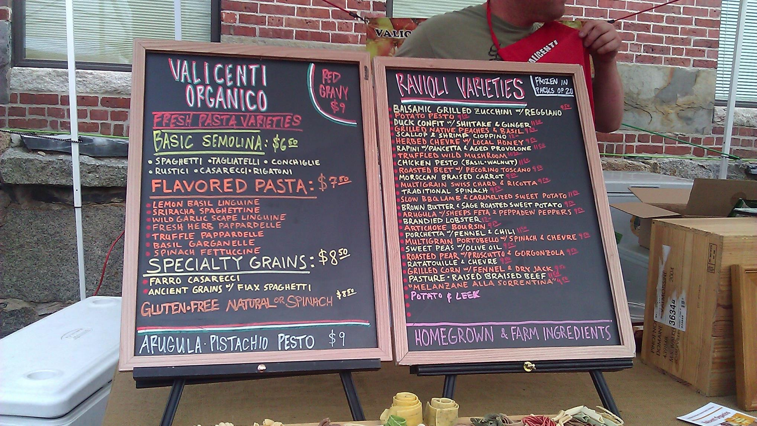
Upgrade-related PowerShell commands
Content database
  Mount-SPContentDatabase
  Test-SPContentDatabase
  Upgrade-SPContentDatabase
Site
  Test-SPSite
  Repair-SPSite
  Upgrade-SPSite
  Request-SPUpgradeEvaluationSiteCollection
Farm
  Upgrade-SPFarm
Queue management
  Get-SPSiteUpgradeSession
  Remove-SPSiteUpgradeSession
Services
  New-SPBusinessDataCatalogServiceApplication
  Restore-SPEnterpriseSearchServiceApplication Upgrade-SPEnterpriseSearchServiceApplication
  Upgrade-SPEnterpriseSearchServiceApplicationSiteSettings
  New-SPMetadataServiceApplication
  New-SPPerformancePointServiceApplication
  New-SPProfileServiceApplication
  New-SPProjectServiceApplication
  New-New-SPSecureStoreApplication
  New-SPSubscriptionSettingsServiceApplication

Slide 46

Test-SPContentDatabase
Finds issues with content databases when compared to a specific web application
  Can test a database not connected to the farm
  Can test a database already connected to the farm
List out issues including orphans
  Missing referenced server side customizations:
    Missing Features
    Missing Templates/Site Definitions
    Missing Web Parts
  Site collections in content database but not in the configuration database site map and vice versa
Use –ShowRowCounts option to find database row sizing metrics

Slide 47

Mount-SPContentDatabase
Initiates content database upgrade
Runs internal consistency/orphans check
Runs web application compatibility checks
  Customization references
    Web parts
    Features
    Site Definitions
    Event handlers
  Authentication/security migration references
    Installed to reference auth provider mismatch

Slide 48
Best practices for upgrading to 2013
Ensure that the environment is fully functioning before you begin to upgrade.
Perform a trial upgrade on a test farm first.
Plan for capacity.
Clean up before you upgrade
Back up your databases.
Optimize your environment before upgrade.
(Optional) Set the original databases to read-only if you want to keep your original environment available while you upgrade.
After upgrade, review the Upgrade Status page, logs and sites
Defer upgrade for site collections until you can get updated customizations to support 2013 mode.
Make sure that the appropriate service packs/update is applied to your 2010 environment. RBS means SP1 for 2010 minimum!

Slide 49
Database attach demo
Chris McNulty

Slide 50
Site collection upgrade

Slide 51
Site collection health checks
Rule based health checks
Looks for common known issues:
  Blocking upgrade issues
    Missing SP2013 templates, database changes
  Information issues
    Content type renaming (Video)
  Post upgrade issues
    Un-ghosted files
Site collection level scoped tool
  UI exists for Site Collection Admins
  PowerShell cmdlet for Farm Admins Test-SPSite
Runs automatically before site collection V2V upgrade
  Prevents upgrade if blocking issues detected
  Does not run before any build to build upgrades

Slide 52
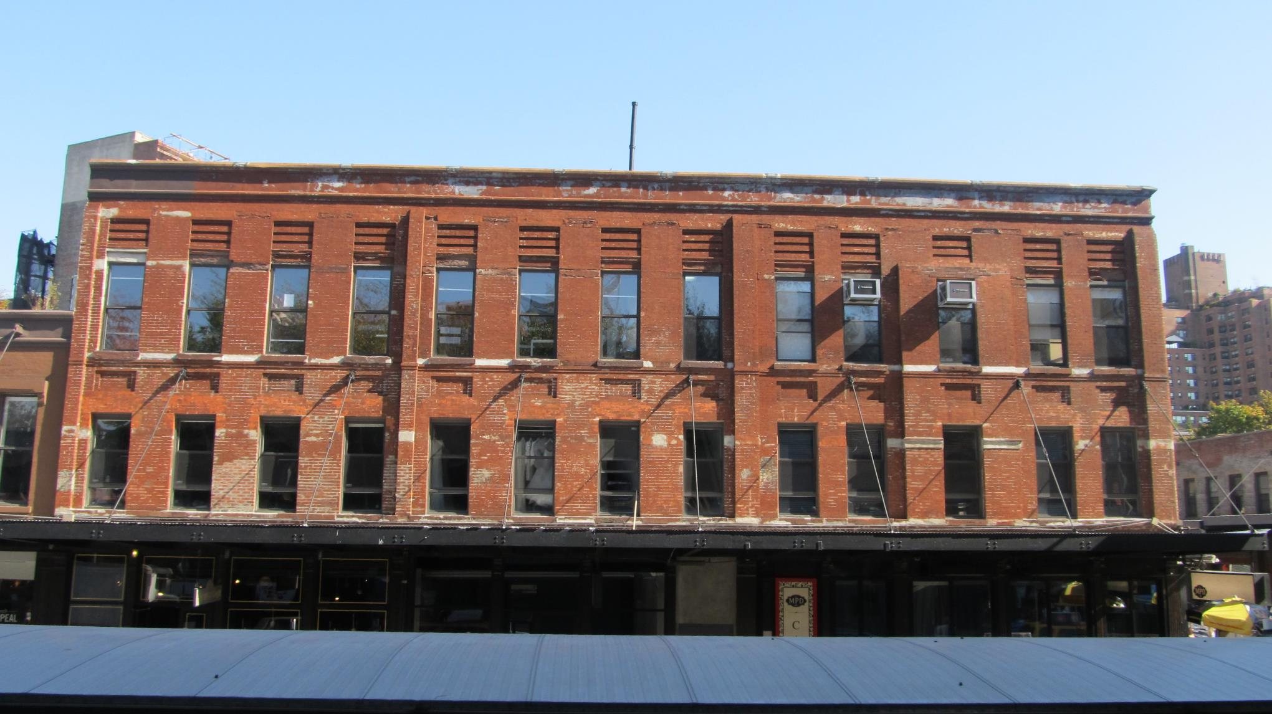
Upgrade evaluation site collections
Allows upgraded preview of existing site in 2013 mode
Makes side by side copy of existing site collection
  Takes advantage of SQL Snapshot capability if present
    Causes no read-only outage as source is snapshot
    Available in SQL Enterprise and SQL Developer editions
  Otherwise uses site collection backup process
    Causes read-only outage during copy
  Occurs in scheduled Timer Job process
  Considered an expensive operation
Sends email notification when copy and upgrade is completed
  Requester and all site collection administrators
  Email is optional if request occurs via PowerShell

Slide 53
Snapshot creation of upgrade evaluation sites
Timer Job:
Create Evaluation Sites
4
SPSite
“/sites/foo”
Site Map
SPSite
“/sites/foo”
4
Evaluation
SPSite
“/sites/foo-eval”
Clone
SPSite
“/sites/foo-eval”
SPSite
Cloning
5
3
/
6
1
/sites/foo
2
/sites/foo-eval
R/O Content Database
Content Database
AllSites
Filtered Copy Of AllSites
AllSites
Snapshot
Database
Configuration
Database
AllWebs
Filtered Copy Of AllWebs
AllWebs
Sites
AllDocs
Filtered Copy Of AllDocs
AllDocs
…
Filtered Copy Of …
…

Slide 54
Site collection upgrades
Chris McNulty

Slide 55
Validate upgrade
Troubleshooting

Slide 56

Upgrade troubleshooting steps
Determine cause of failure
  Review status page & upgrade Logs:
    Upgrade error log (now uses ULS format!)
    Full upgrade log
    ULS log if necessary
  Find issue instances using commands:
    Test-SPContentDatabase
    stsadm -o EnumAllWebs
Fix issues
  Install missing or updated customizations
  Activate missing services; farm, web app settings
Resume upgrade
  Farm upgrade command
  Content database specific upgrade command
  Service specific upgrade commands
Validate that upgrade is successful
  Any errors or warnings means an issue still exists
  If not, go over troubleshooting again
Document upgrade errors to make future troubleshooting easier
  Make a note of what you changed even when it didn’t lead to success

Slide 57
Post-upgrade best practice
Re-run Site Collection Health Checks
  Helps identify errors
  Resetting pages to site definition WILL LOSE PAGE CUSTOMIZATIONS

Slide 58
Special scenarios

Slide 59
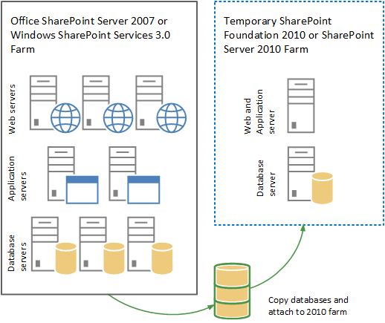
N+2: SharePoint 2007 – 2013
Step one:

Slide 60
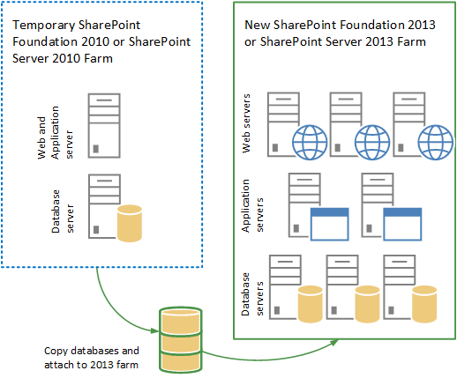
N+2: SharePoint 2007-2013
Step Two

Slide 61
Upgrading with MMS Content Type Hubs
Goal – support sites across 2010 farm and 2013 farm (in both 2010 and 2013 modes)
Content type syndication uses the backup/restore mechanism to publish the content types across site collections.
  Backup/restore doesn’t work across versions
    Between 2010 and 2013
    Between sites in 2010 mode on 2013 and those in 2013 mode on 2013

Slide 62
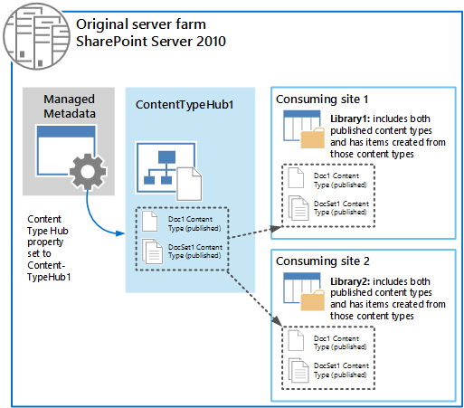
Initial state
The following Managed Metadata connection properties are selected:
  This service application is the default storage location for Keywords.
  This service application is the default storage location for column specific term sets.
  Consumes content types from the Content Type Gallery at <URL>.
  Push-down Content Type Publishing updates from the Content Type Gallery to sub-sites and lists using the content type.

Slide 63
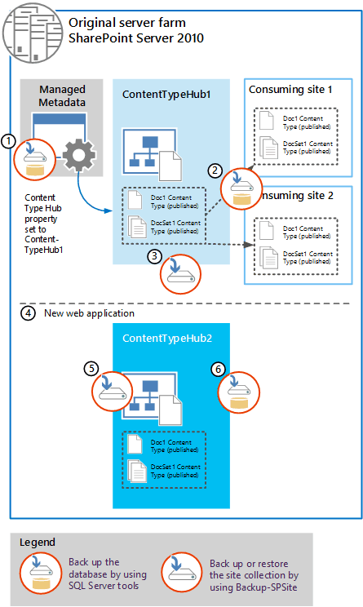
Duplicate CTH in 2010
Upgrade needs to create 2010 and 2013 versions of CTH
Backups for upgrade: MMS, CTH, and site collections
Clear MMS connection properties:
  default storage location for Keywords
  default storage location for column specific term sets.
  Consumes content types from the Content Type Gallery
  Push-down Content Type Publishing updates from the Content Type Gallery to sub-sites and lists using the content type.
Create a web application to host a duplicate of the content type hub.
  Restore-SPSite <URL> -path <path>
  Change name to ContentTypeHub2.
Back up the new CTH content DB

Slide 64
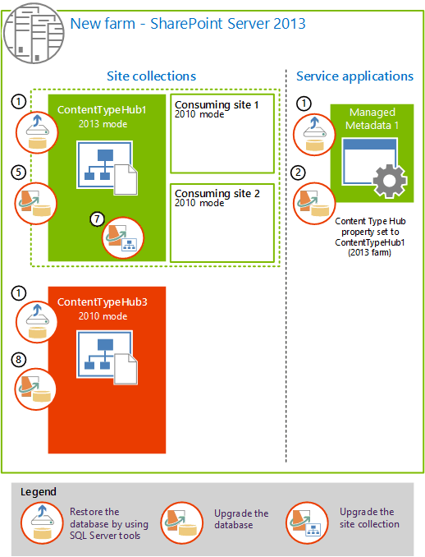
2013 Twin Hubs
Restore DBs
Create new MMS SSA with restored DB. Clear settings
Create a web app for upgraded CTH1 (same auth as 2010)
Attach DB with CTH1 and its SCs to upgrade DB
  Keep sites in 2010 mode
Set upgraded MMS to upgraded CTH
  Set-SPMetadataServiceApplication -Identity "<ServiceApplication>" -HubURI "<HubURI>"
Upgrade CTH1 to 2013 mode
Upgrade DB for CTH2 and name CTH3, leave in 2010 mode

Slide 65
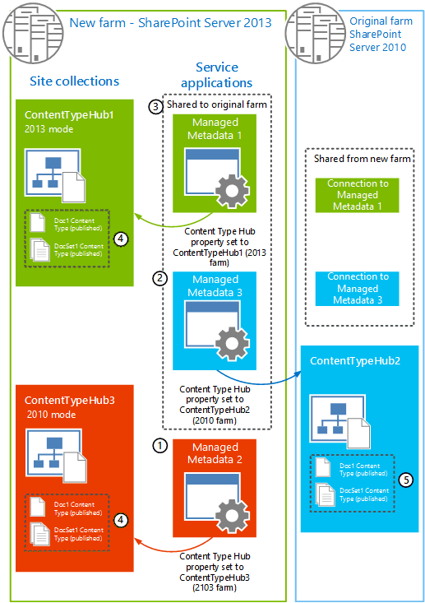
Create SSAs
Create MMS2 and set hub to CTH3,
  Clear proxy properties
Create new MMS3 and set hub to CTH1 in 2010
  Clear proxy properties
Share MMS1/MMS3 to 2010
Do not share MMS2
Republish content types

Slide 66

Proxies/connections
On the 2010 farm, set MMS3 properties for syndication
On 2010 set properties for MMS1 to store keywords and column term sets
On 2013 farm, for MMS3 clear properties (CTH3 is just for syndication)
On 2013, set MMS2/CTH3 properties for syndication
On 2013 set MMS1 properties to enable MMS and syndication

Slide 67
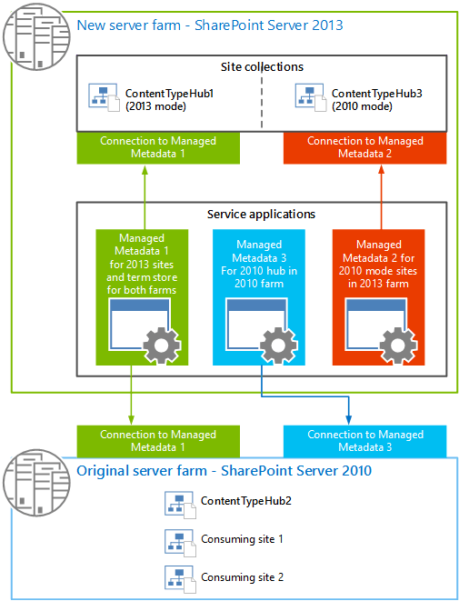
End state
MMS1 SSA syndicates to 2013 sites on 2013 farm (and term store for all)
MMS2 SSA syndicates to 2010 sites on 2013 farm
MMS3 syndicates to 2010 farm

Slide 68
MMS Syndication Rules
Need to sync content type and field IDs on all three Content Type Hubs
Create and publish new content type on CTH1.
  Identify the content type ID for that content type URL on gallery
    ctype=0x010100C0EE90869D5B8B46A4448713A9F8984C.
  Create and publish a content type that uses that ID on CTH2 and CTH3
  To create a content type that has a specific ID requires XML or object model
On CTH1 create new field and republish content type
  Use object model or PowerShell to get SchemaXML property of SPContentType.
  Add the property to the corresponding content type on CTH2 and CTH3
  Republish the updated content type from the other content type hubs (ContentTypeHub2 and ContentTypeHub3).

Slide 69

SharePoint 2013…the infinite frontier
Eastern Long Island, August 2012
All photography © 2013 Christopher F. McNulty or Microsoft Office Public Domain License

Slide 70

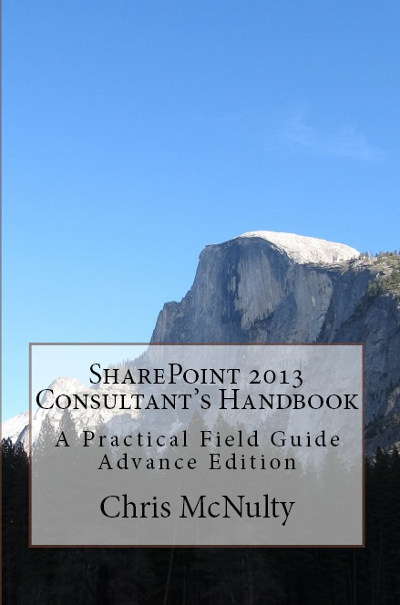

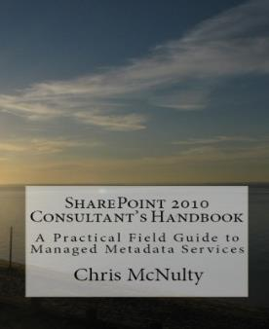
Thank you!
Chris McNulty
  Email chris.mcnulty@quest.com
  Blog www.chrismcnulty.net/blog
    Also www.sharepointforall.com
  Twitter: @cmcnulty2000
Upcoming:
  WWPC, SPSNYC, SPTechCon Boston, SharePoint Fest DC
  SharePoint Connections, SharePoint Fest Chicago, SharePoint Intersections, SharePoint Symposium
SES-B312
http://sdrv.ms/10OaMLu

Slide 71
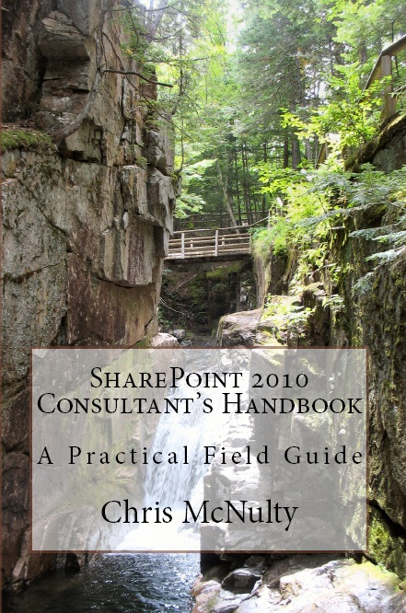
More information
SharePoint architecture design patterns in Chris’ e-book entitled SharePoint 2010 Consultant’s Handbook – A Practical Field Guide
  Get your free copy here http://www.quest.com/get-chris-book

Slide 72
Q&A

Slide 73

Related content
SES-B203 SP2013 Admin Thurs 8:30a
SES-B321 O365 Migration Thurs 1:00p
SES-H203 Lab Configuring Enterprise Social
SES-H206 Lab Exploring Enterprise Social
SES H313 Lab Deferred Site Collection Upgrades
Find Me Later At…SES-B208 Social 5:00p Wed

Slide 74
Track resources
Upgrade http://technet.microsoft.com/en-us/library/cc303420.aspx
Resource Center http://technet.microsoft.com/en-US/sharepoint/fp142375
Chris’ Blog www.chrismcnulty.net/blog

Slide 75

Resources
Learning
  Sessions on Demand
  Microsoft Certification & Training Resources
http://channel9.msdn.com/Events/TechEd
www.microsoft.com/learning
TechNet
msdn
  Resources for IT Professionals
  Resources for Developers
http://microsoft.com/technet
http://microsoft.com/msdn

Slide 76







Complete an evaluation on CommNet and enter to win!

Slide 77
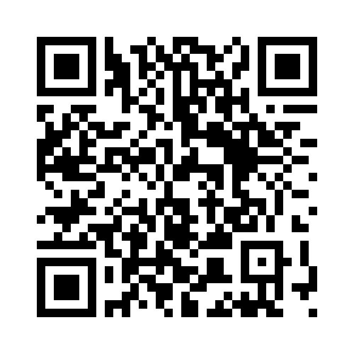


Evaluate this session
Required Slide
*delete this box when your slide is finalized
Your MS Tag will be inserted here during the final scrub.
Scan this QR code to evaluate this session and be automatically entered in a drawing to
win a prize

Slide 78

© 2013 Microsoft Corporation. All rights reserved. Microsoft, Windows and other product names are or may be registered trademarks and/or trademarks in the U.S. and/or other countries.
The information herein is for informational purposes only and represents the current view of Microsoft Corporation as of the date of this presentation. Because Microsoft must respond to changing market conditions, it should not be interpreted to be a commitment on the part of Microsoft, and Microsoft cannot guarantee the accuracy of any information provided after the date of this presentation. MICROSOFT MAKES NO WARRANTIES, EXPRESS, IMPLIED OR STATUTORY, AS TO THE INFORMATION IN THIS PRESENTATION.

