Slide 2
Understanding Claims Based Authentication
SES-B314
Georgiana Badea
Microsoft Consulting Services

Slide 3
Agenda
Introduction to Claims
  Why Claims
  Claims Fundamental Concepts
SharePoint Claims Based Authentication
  Components and architecture
  Active Directory Federation Services
  Trade-offs and Limitations
SharePoint 2013 Authentication Changes
Q & A

Slide 4
Introduction

Slide 5
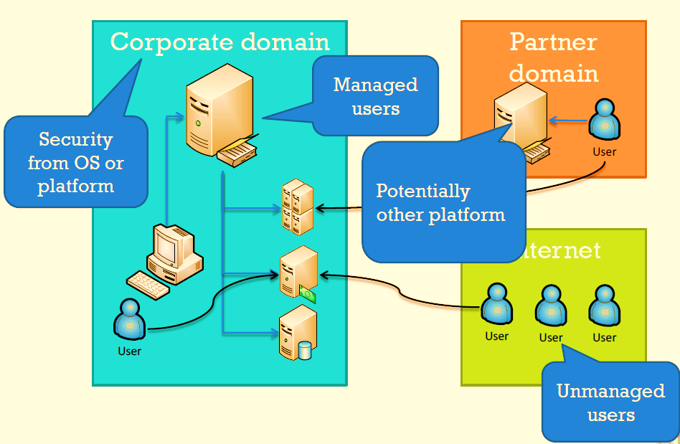
Why Claims
Identity generalization and abstraction
Privacy
Beyond just user and roles
Interoperability across platforms and security domains

Slide 6
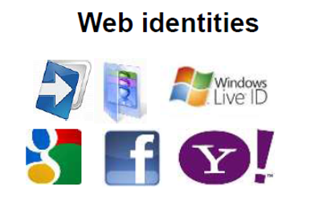
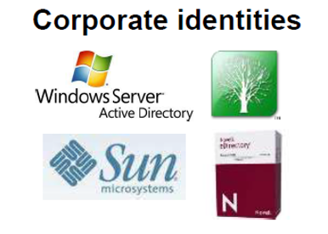
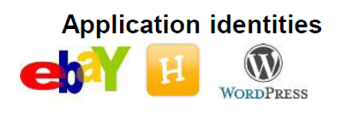
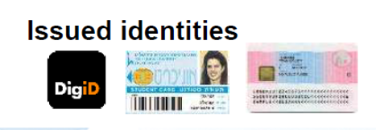
Fundamental Concepts
Identity providers
Standards and Protocols
  Security Assertion Markup Language (SAML), OpenID, Oauth

Slide 7
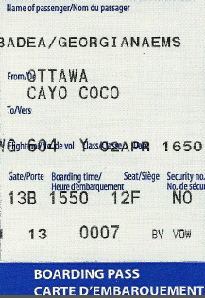
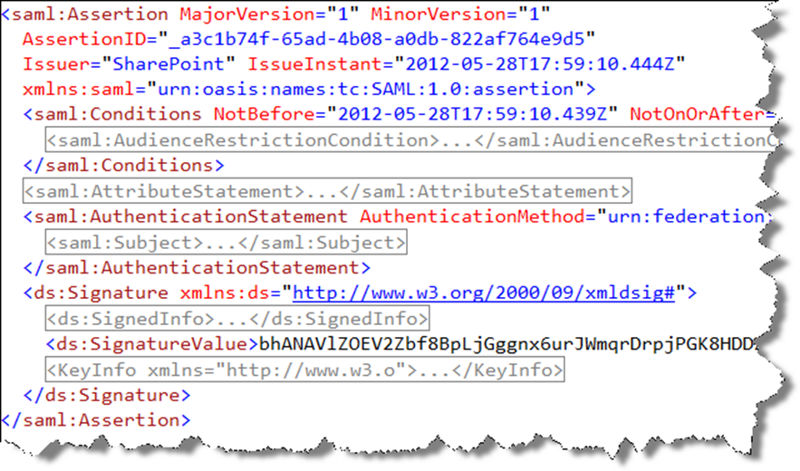
Fundamental Concepts (cont’ed)
Claim Set

Slide 8
SharePoint Claims Based Authentication

Slide 9
3 Types of Claim Providers in SharePoint
Windows
Forms Based Auth
SAML
Claim Type | Value
Nameidentifier | Contoso\gbadea
Primarysid | S-1-5-21-2564101533
Upn | g.badea@contoso.com
Userlogonname | Contoso\gbadea
IsAuthenticated | True
Claim Type | Value
Nameidentifier | gbadea
Role | Readers
Role | Authors
Userlogonname | gbadea
IsAuthenticated | True
Claim Type | Value
Nameidentifier | gbadea
Upn | g.badea@contoso.com
Audience | Sales Managers
Audience | Sales Team
IsAuthenticated | True
SAML Token
Claims Based Identity

Slide 10
Claims Based Authentication Terminology
Identity Provider (IdP) – ADFS, Windows Live ID, Facebook
  Authenticates users
  Creates the set of claims granted to a user
  Returns the claim set to a relying party
Relying Party (RP) – SP Web App, Custom .NET App
  Consumes claims to make authorization decisions
Security Token Service (STS) – SP STS, ADFS STS
  Issues claims and packages them in signed security tokens
Claims Provider (CP) – Built-in SP CP, Custom CP
  Claims augmentation
  Name resolution

Slide 11
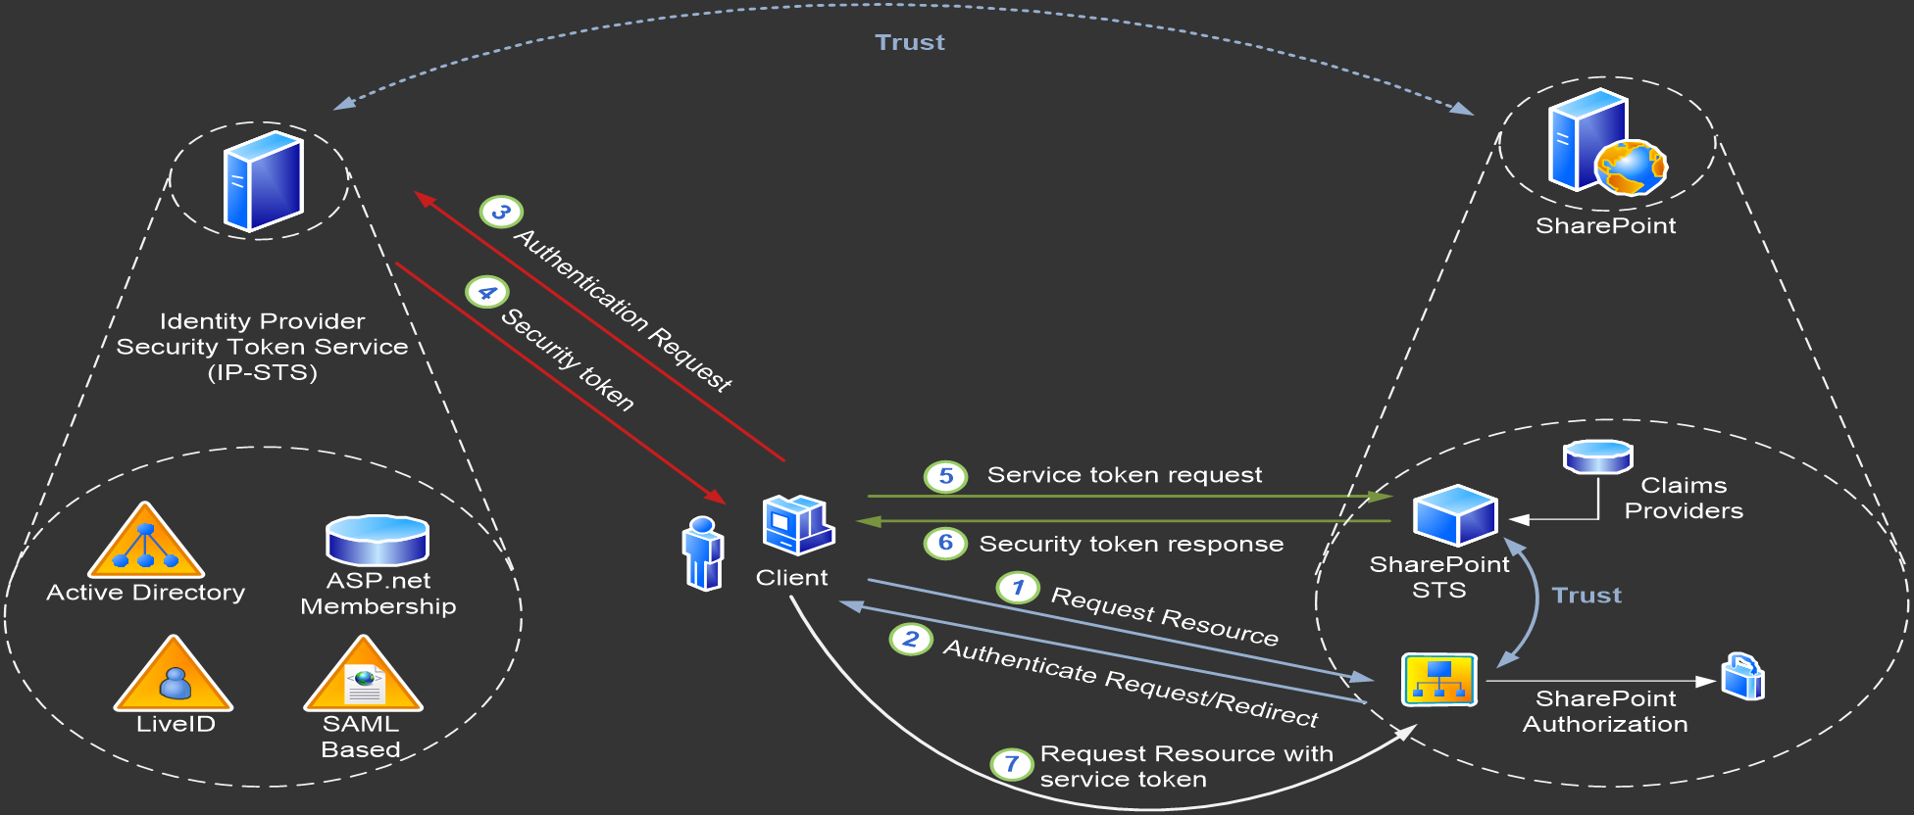
SharePoint with Trusted Identity Provider

Slide 12
ADFS 2.0
Enables claims-based identity through
Security Token Server (STS) > issues tokens
Claims processing engine > transforms incoming and outgoing claims
Support for a variety of attribute sources:
  out of the box
  custom
Administrative trust management capabilities > manage federated trusts

Slide 13
ADFS 2.0 (cont’ed)
Related components
  Windows Identity Framework (WIF) > use for building claims-aware applications
  Azure AppFabric Access Control Service > use for issuing claims from public identity providers

Slide 14
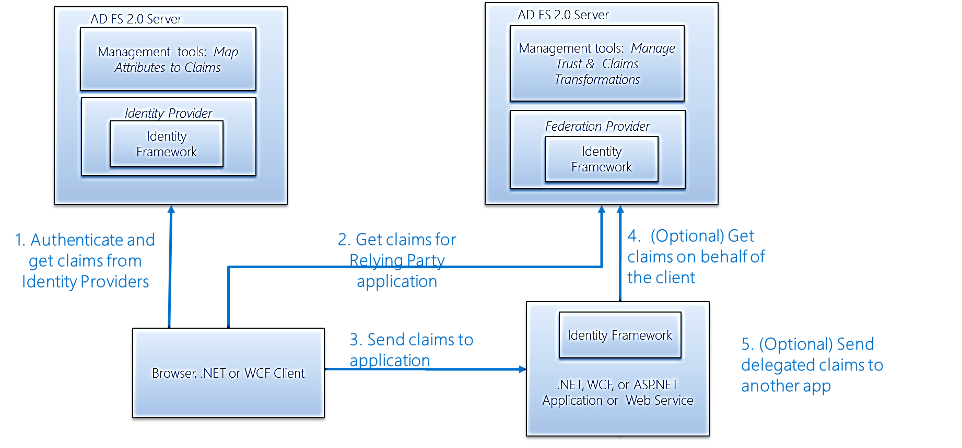
ADFS 2.0 Architecture
1. Authenticate and get claims from identity providers
2. Get claims for Relying Party application
4. Get claims on behalf of the client (optional)
5. Send delegated claims to another app (optional)
3. Send claims to application

Slide 15
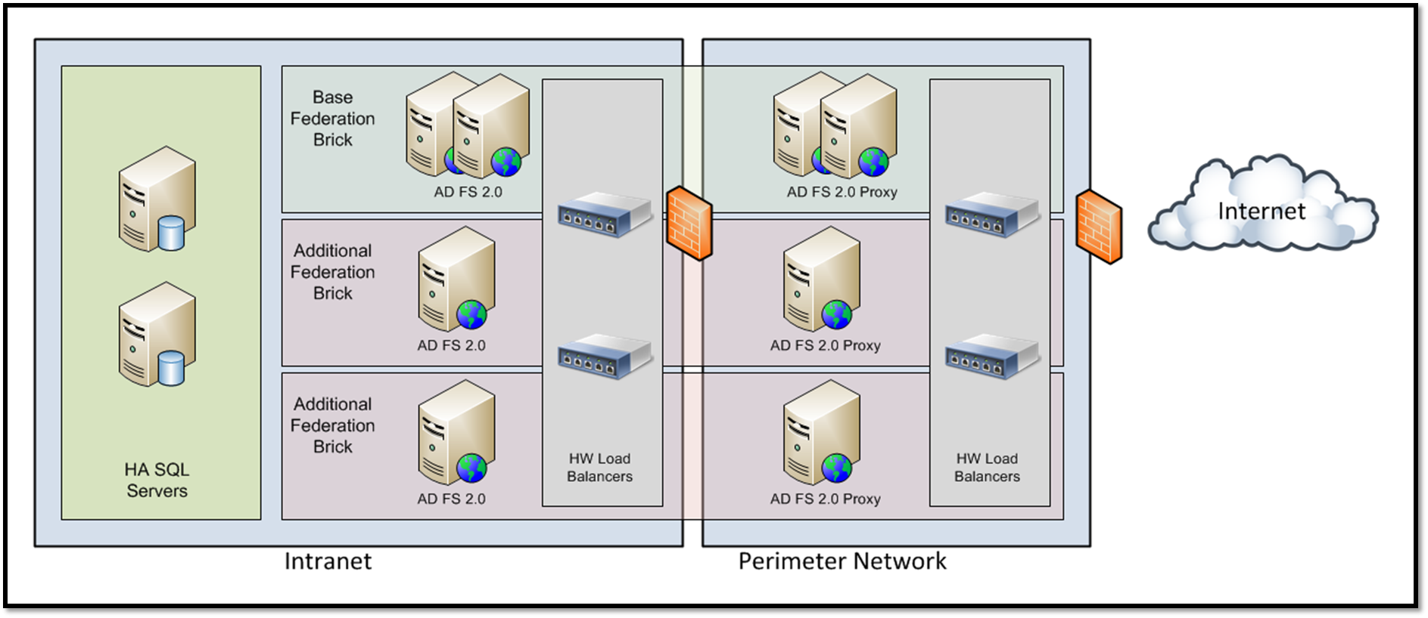
ADFS Enterprise Deployment Architecture

Slide 16
ADFS Configuration Steps
Acquire or generate self-signed certificates for:
  The ADFS endpoint
  The ADFS token-signing
  The SSL enabled web application
Create ADFS service account in AD
Install the ADFS service
Run the ADFS 2.0 Federation Server Configuration Wizard
Configure ADFS to use the token signing cert
Configure Relying Party

Slide 17
ADFS Configuration Demo
Georgiana Badea
Microsoft Consulting Services

Slide 18
SharePoint Configuration Steps
Get a copy of the ADFS token signing cert and any other parent cert(s) in the chain
Setup Trusted Identity Provider in SharePoint
$root = New-Object System.Security.Cryptography.X509Certificates.X509Certificate2("c:\root.cer")
New-SPTrustedRootAuthority -Name "Token Signing Root Authority" -Certificate $root
$cert = New-Object System.Security.Cryptography.X509Certificates.X509Certificate2("c:\ADFS.cer")
New-SPTrustedRootAuthority -Name "Token Signing Cert" -Certificate $cert
$map = New-SPClaimTypeMapping -IncomingClaimType "http://schemas.xmlsoap.org/ws/2005/05/identity/claims/emailaddress" -IncomingClaimTypeDisplayName "EmailAddress" –SameAsIncoming
$map2 = New-SPClaimTypeMapping -IncomingClaimType "http://schemas.microsoft.com/ws/2008/06/identity/claims/role" -IncomingClaimTypeDisplayName "Role" -SameAsIncoming
$realm = "urn:sharepoint:team"
$ap = New-SPTrustedIdentityTokenIssuer -Name "ADFS" -Description "SAML Token Issuer" -realm $realm -ImportTrustCertificate $cert -ClaimsMappings $map,$map2 -SignInUrl "https://myAdfsServer/adfs/ls" -IdentifierClaim "http://schemas.xmlsoap.org/ws/2005/05/identity/claims/emailaddress"

Slide 19
SharePoint Configuration Steps
Create a new web application
  Select Claims Based Authentication as the authentication type and the ADFS provider previously configured
  Select port 443
  Assign a host header
Setup SSL certificate for the web application
Verify that everything works

Slide 20
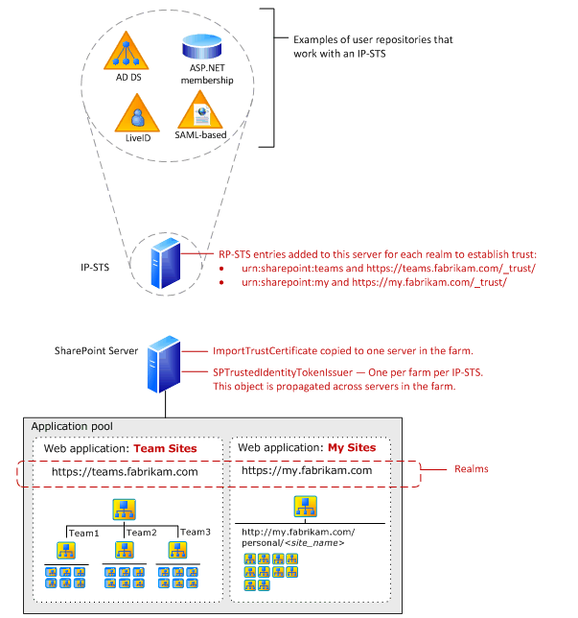
SAML Token Claims Architecture

Slide 21
Trade-offs and Limitations of Claims Authentication
Classic to claims > one way only
HTTPS and multiple redirects > slower than Windows Authentication
Search crawl > requires Windows Auth
SAML-based authentication > custom claim provider

Slide 22
Trade-offs and Limitations of Claims Authentication
Not supported:
  Search alerts
  Explorer View
  Infopath Forms Services
  Claims to Windows Token Service (C2WTS)

Slide 23
Trade-offs and Limitations of Claims Authentication
Excel Services > Secure Store Service (SSS) and Unattended Service Account.
Visio Services > SSS or Unattended Service Account option for drawings that use an ODC file to specify the connection.
PowerPivot > will ONLY work with classic.
PerformancePoint > must use the Unattended Service Account in SSS
SQL Server 2008 R2 Reporting Services Integration > not claims aware
Project Server – supports claims but migration requires special handling when migrating users from Forms-authentication or Mixed-mode Project Server instances.

Slide 24
SharePoint 2013 Authentication Changes

Slide 25
SharePoint 2013 Authentication Changes
Claims authentication is THE default authentication option now
Convert-SPWebApplication replaces MigrateUsers
  Run Convert-SPWebApplication -Identity "http://yourWebapp" -To Claims –RetainPermissions [-Force]
Can migrate only a single content database
  New SPWebApplication.MigrateUsersToClaims method

Slide 26
SharePoint 2013 Authentication Changes
SharePoint tracks FedAuth cookies in the new Distributed Cache Service
Custom claim providers are not used by default upon installation
The SharePoint STS now supports a federation metadata endpoint
There is significantly more logging provided to help troubleshoot authentication issues

Slide 27

Related content
Breakout Sessions
  SES-B308 Microsoft SharePoint 2013 Sharing and Security
  OUC-B205 Security in Microsoft Office 365
  Find Me Later At Ask the Experts Session on Tuesday, June 4, 6:30pm – 8:30pm, Hall GH (MCCNO)

Slide 28

Resources
Learning
  Sessions on Demand
  Microsoft Certification & Training Resources
http://channel9.msdn.com/Events/TechEd
www.microsoft.com/learning
TechNet
msdn
  Resources for IT Professionals
  Resources for Developers
http://microsoft.com/technet
http://microsoft.com/msdn

Slide 29







Complete an evaluation on CommNet and enter to win!

Slide 30
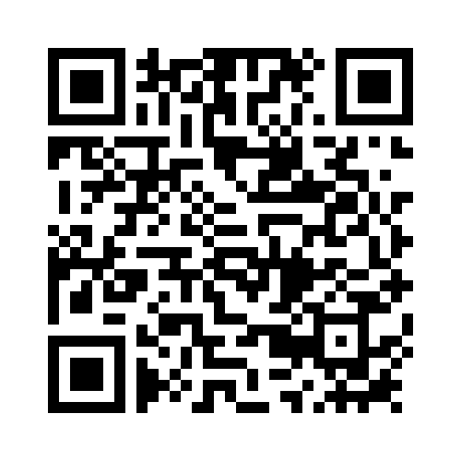


Evaluate this session
Required Slide
*delete this box when your slide is finalized
Your MS Tag will be inserted here during the final scrub.
Scan this QR code to evaluate this session and be automatically entered in a drawing to
win a prize

Slide 31

© 2013 Microsoft Corporation. All rights reserved. Microsoft, Windows and other product names are or may be registered trademarks and/or trademarks in the U.S. and/or other countries.
The information herein is for informational purposes only and represents the current view of Microsoft Corporation as of the date of this presentation. Because Microsoft must respond to changing market conditions, it should not be interpreted to be a commitment on the part of Microsoft, and Microsoft cannot guarantee the accuracy of any information provided after the date of this presentation. MICROSOFT MAKES NO WARRANTIES, EXPRESS, IMPLIED OR STATUTORY, AS TO THE INFORMATION IN THIS PRESENTATION.

