Slide 2
Tips You Need to Know for Creating Apps for Microsoft Office and SharePoint 2013
SES-B401
Chris Johnson

Slide 3


whoami?
www.provokesolutions.com
Chris.Johnson@provokesolutions.com
Blog: www.looselytyped.net
@LoungeFlyZ
Ex-10yr Microsoftie, SharePoint Product Management,
Program Management and Consulting Services

Slide 4
Agenda
DEMO
DEMO
DEMO
DEMO
DEMO
DEMO
DEMO
DEMO
DEMO
DEMO

Slide 5
#1 Use SignalR for App tracing and debugging

Slide 6
#2 Cache tokens if you need to

Slide 7
#3: Use OAuth to access SharePoint from apps for Office

Slide 8
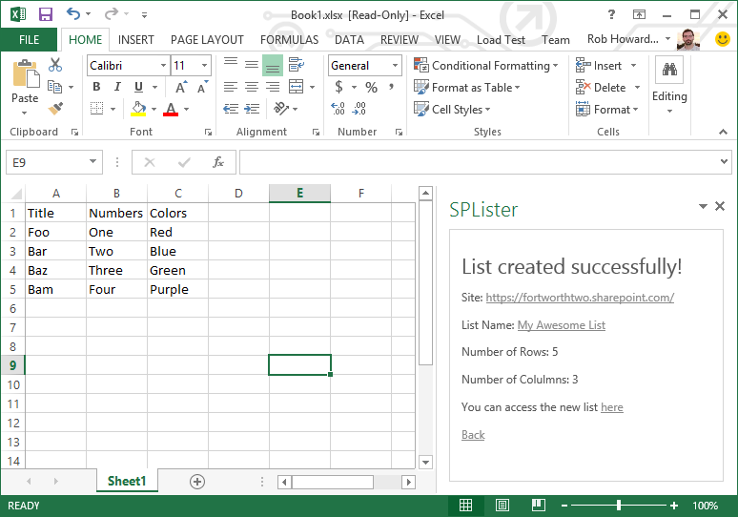


OAuth in apps for Office
App Server
OAuth
SharePoint

Slide 9
#3 & 4: Use the SharePoint cross-domain library

Slide 10

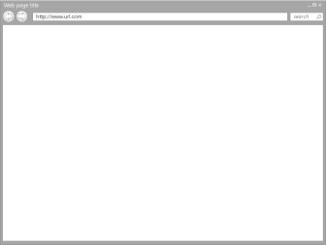




Cross-Domain Library
App Server
SharePoint
Firewall

Slide 11
#5: Bring Office documents into your SharePoint apps with WACs

Slide 12
#6: Single Page Apps in SharePoint

Slide 13
SPA?
Single HTML page
Client script for everything
Communicates with server via JS
Integrates with Browser for navigation

Slide 14
SPA Resources
Learn: http://www.johnpapa.net/spa/
Framework: Durandal
Databinding: Knockout
Layout: Bootstrap
Icons: FontAwesome
Data Queries: LinqJS
Notifications: Toastr

Slide 15
#7: App CSS makes your app look like part of the experience

Slide 16
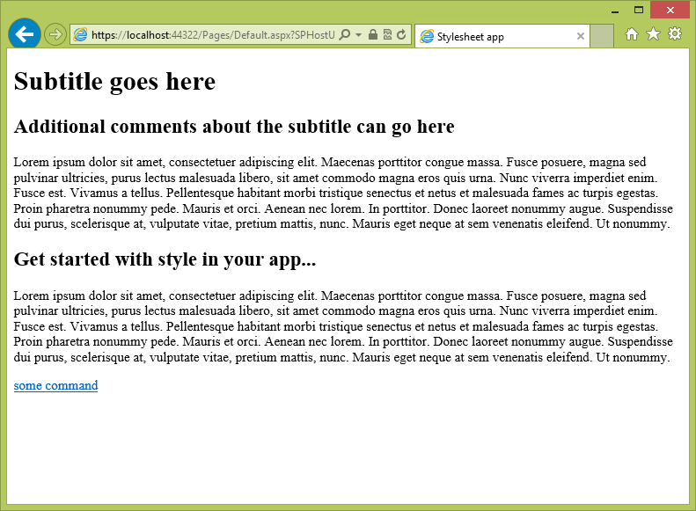
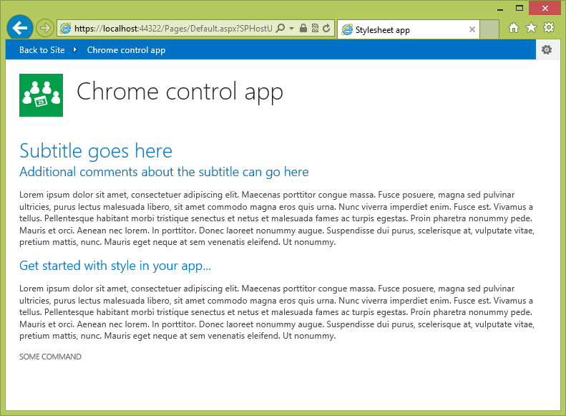
App UX design guidelines

Slide 17
#8: Elevate your SharePoint app’s permissions with app-only calls

Slide 18
#9: Bring your app to where users are by integrating with Yammer

Slide 19
#10: Azure web sites + O365 + tfs.VisualStudio.com = ☺

Slide 20

Related content
0-60: Developing Apps for Microsoft SharePoint 2013
Single Page Applications with Microsoft ASP.NET
Office pavilion, Build Apps
Find Me Later At... the Build Apps booth (12:30 – 15:15)

Slide 21

Resources
Learning
  Sessions on Demand
  Microsoft Certification & Training Resources
http://channel9.msdn.com/Events/TechEd
www.microsoft.com/learning
TechNet
msdn
  Resources for IT Professionals
  Resources for Developers
http://microsoft.com/technet
http://microsoft.com/msdn

Slide 22







Complete an evaluation on CommNet and enter to win!

Slide 23
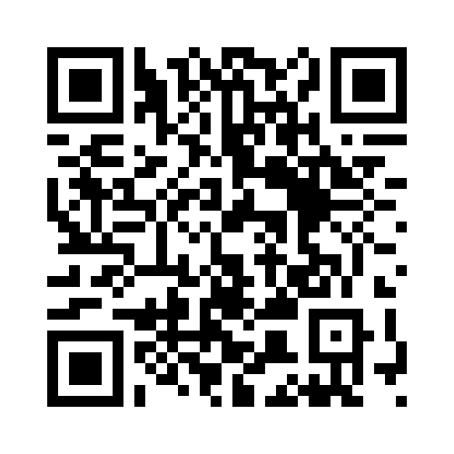


Evaluate this session
Required Slide
*delete this box when your slide is finalized
Your MS Tag will be inserted here during the final scrub.
Scan this QR code to evaluate this session and be automatically entered in a drawing to
win a prize

Slide 24

© 2013 Microsoft Corporation. All rights reserved. Microsoft, Windows and other product names are or may be registered trademarks and/or trademarks in the U.S. and/or other countries.
The information herein is for informational purposes only and represents the current view of Microsoft Corporation as of the date of this presentation. Because Microsoft must respond to changing market conditions, it should not be interpreted to be a commitment on the part of Microsoft, and Microsoft cannot guarantee the accuracy of any information provided after the date of this presentation. MICROSOFT MAKES NO WARRANTIES, EXPRESS, IMPLIED OR STATUTORY, AS TO THE INFORMATION IN THIS PRESENTATION.

