Slide 2
TechEd 101
Presented by Three Distinguished TechEd Alums
Ordinary

Slide 3
TechEd 101
@RichCampbell
@JoeySnow
@RicksterCDN
Richard Campbell
Joey Snow
Rick Claus

Slide 4

What is TechEd?
  TechEd is the Microsoft premiere technical education and networking event for any technology professional interested
  in learning, connecting and exploring a broad set of current
  and soon-to-release Microsoft technologies, tools, platforms
  and services.
Learn
Connect
Explore

Slide 5





Why Are You Here?
Education
Community
Evaluation

Slide 6
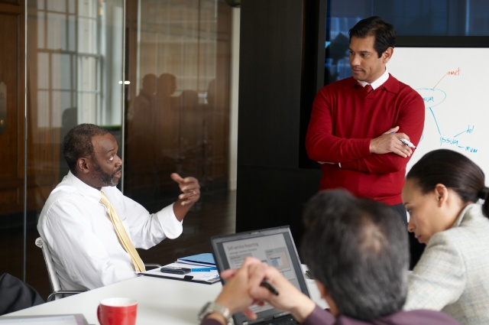


Overview
Explore
Connect
Learn
Get your hands dirty in our hands-on labs, technical learning center and partner solutions pavilion.
Enjoy unique networking opportunities with other delegates that share your technology interests and business challenges.
Immerse yourself in over hundreds of technical sessions
delivered by Microsoft and
industry experts.

Slide 7
Explore…
Hands-on Labs (HOL)
Instructor-led Labs
TechExpo
Ask the Experts Night

Slide 8
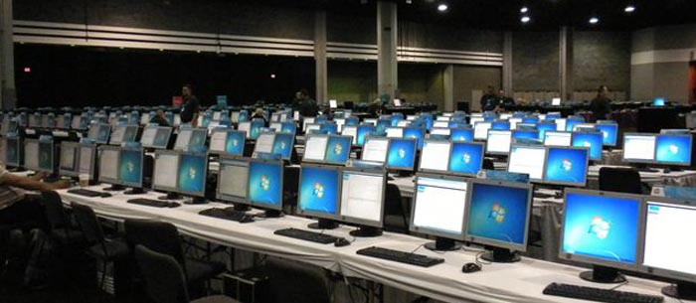
Hands-on Labs
180 Different On-Demand Hands-on Labs
Approximately 300 PCs for HOL use
~9,000 labs were started at last year’s TechEd

Slide 9
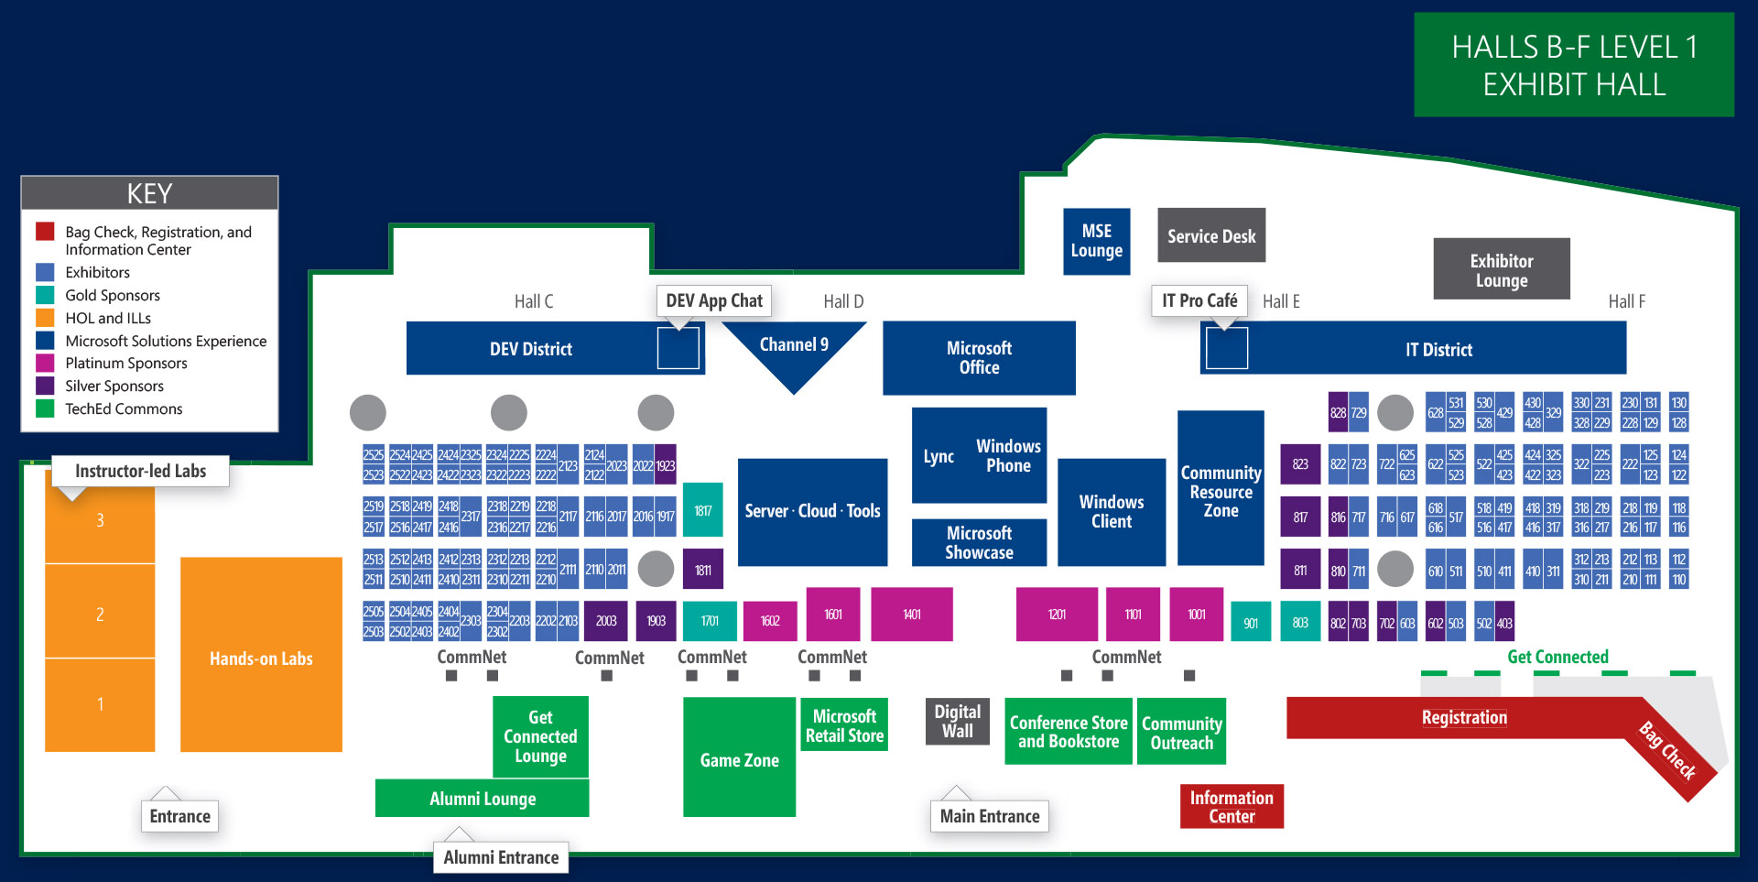
Hands-on Labs Location

Slide 10
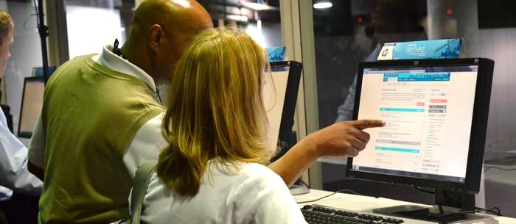
Instructor-led Labs
38 Scheduled Instructor-led Labs
Guided Tour Through a Technical Process
Get One on One Attention With an Expert

Slide 11
Instructor-Led Labs Location

Slide 12
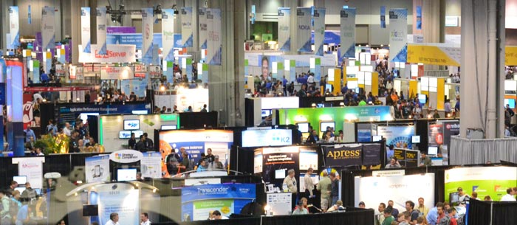
TechExpo
211 TechExpo Sponsors and Partners
Great Place to Learn about New Solutions
Best of TechEd Attendees' Pick: Make Your Vote Count!

Slide 13
TechExpo Location

Slide 14
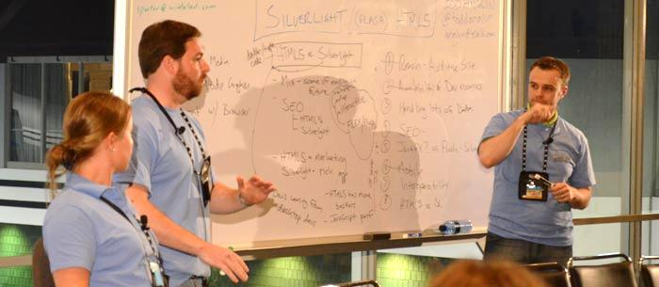
Ask the Experts Night
Tuesday Evening at Community Night
Several Hundred Tables in the Meal Hall
Push Your Knowledge to the Next Level

Slide 15
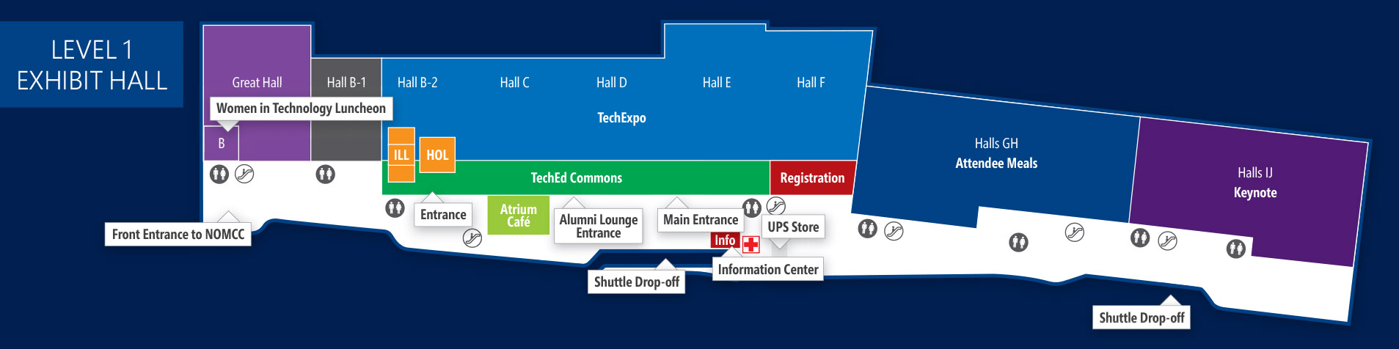
Ask the Experts Location

Slide 16
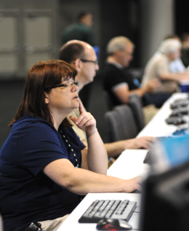
Much, Much More…
  Certification Testing Center
  Connect Zone
  Conference Store and Book Store
  Alumni Lounge
  Women in Technology Luncheon

Slide 17
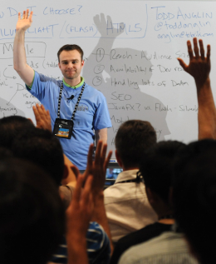
Call to Action
  Try to Have a Plan
  Push it to the Next Level
  Open Up and Ask Questions
  Have Fun!

Slide 18
Overview
Explore
Connect
Learn
Get your hands dirty in our hands-on labs, technical learning center and partner solutions pavilion.
Enjoy unique networking opportunities with other delegates that share your technology interests and business challenges.
Immerse yourself in over hundreds of technical sessions
delivered by Microsoft and
industry experts.

Slide 19
Connect… Where Do You Start?
You’ve made the first step to connecting…
  YOU ARE HERE…And you are Not alone!
Determine your Goals for the week
  What do you want to learn?
  Who do you want to talk to?
  What do you want to leave with?
Have a solid game plan for each day
  Re-evaluate every morning

Slide 20
Where to Connect
  Dev and IT Pro Districts
  Birds-of-a-Feather Sessions
  TechExpo
  Women in Technology Luncheon

Slide 21

Where to Connect (cont)
Ask The Experts
Jam sessions
Vendor and Community events during the week
Lunch Tables
TechEd Discussion Forum on Channel 9

Slide 22



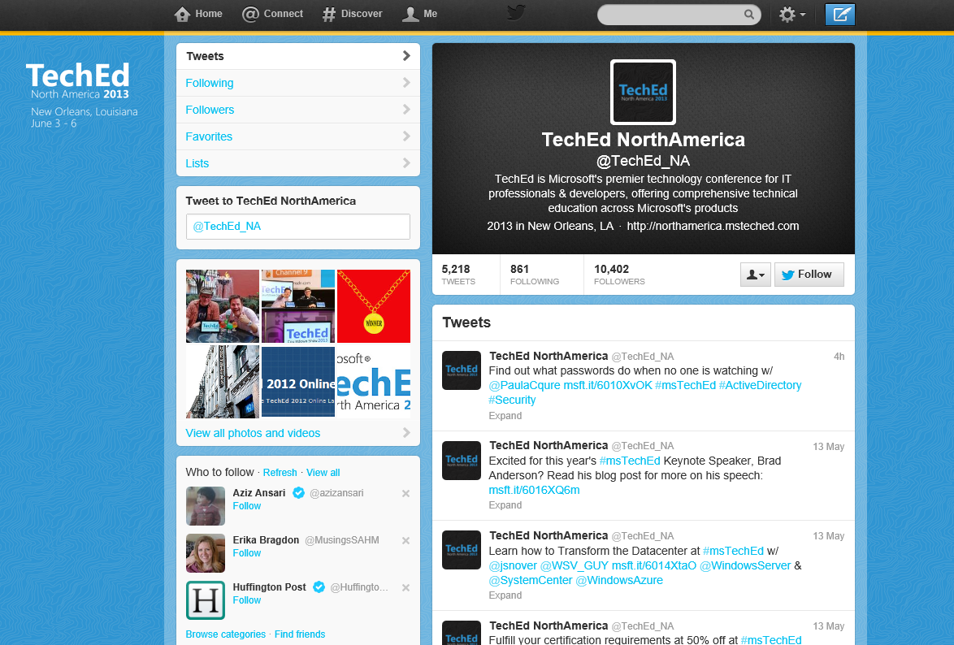



How to Connect…
LIKE US ON
Facebook.com/teched
Find like-minded people, share photos, keep up to date on all the on-site activities
FOLLOW US ON
@TechEd_NA, for up to the minute conference updates including
parties and geeky swag
Include #msteched in your tweets,
& connect with your fellow attendees

Slide 23
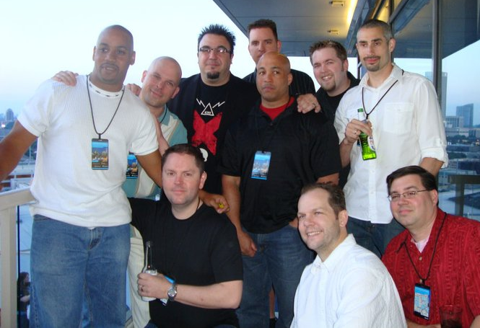
Our Challenge to You…
Connect with 5 people each day
  It should be easy
  to meet 20 people this week
For each connection,
learn one thing about that person

Slide 24

Resources
Learning
  Sessions on Demand
  Microsoft Certification & Training Resources
http://channel9.msdn.com/Events/TechEd
www.microsoft.com/learning
TechNet
msdn
  Resources for IT Professionals
  Resources for Developers
http://microsoft.com/technet
http://microsoft.com/msdn

Slide 25
Overview
Explore
Connect
Learn
Get your hands dirty in our hands-on labs, technical learning center and partner solutions pavilion.
Enjoy unique networking opportunities with other delegates that share your technology interests and business challenges.
Immerse yourself in over hundreds of technical sessions
delivered by Microsoft and
industry experts.

Slide 26

Learn - Content Framework
1
Keynote
7
Foundational Sessions
13
180
426
30
38
Pre-Con
Seminars
Hands-on
Labs
Breakout
Sessions
Birds-of-a-Feather
Sessions
Instructor
Led Labs
Keynote
whole audience, executive speaker
Foundational Sessions
main educational themes by top notch speakers
Breakouts
large and small classroom by product experts
HOLs, Workshops
hands-on, talk to the experts

Slide 27
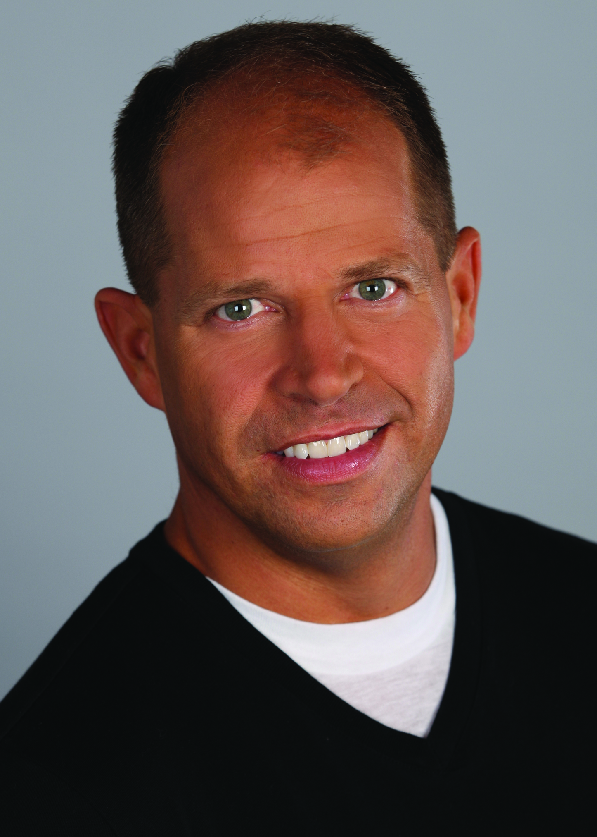
Keynote
Day 1: 8:30am to 10:30am | Halls IJ
Brad Anderson
Corporate Vice President,
Windows Server
and System Center
Program Management

Slide 28
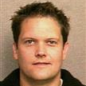








Foundational Sessions
Day 1: 11:00am to Noon
Transform Your Datacenter With Microsoft’s Server
and Management Solutions
Big Data. Small Data.
All Data.
FDN06
FDN01
Microsoft Office &
SharePoint 2013 Development: Introduction to the New Cloud App Model
FDN04
Shawn Bice
Director of Program Management,
Database Systems Group
Brian Jones
Group Program Manager, Office Developer
Platform Team
Jeffrey Snover
Distinguished Engineer, Windows Server Division
Jeff Woolsey
Principal Program Manager Lead, Windows Server
& Cloud Division
Building Modern
Business Applications
Windows in the Enterprise
FDN05
FDN07
FDN02
Modern Application
Lifecycle Management
Scott Woodgate
Senior Director,
Technical Marketing Team,
Windows Azure
Brian Harry
Technical Fellow,
Visual Studio
Michael Niehaus
Senior Product
Marketing Manager
Erwin Visser
General Manager,
Windows
Commercial Business
Enabling
People-Centric IT
FDN03
Andrew Conway
Director of Product Marketing,
Server & Tools Division

Slide 29
Tracks
Track | Code
Architecture & Trustworthy Computing | ATC
Data Platform & Business Intelligence | DBI
Developer Tools & Application Lifecycle Management | DEV
Modern Datacenter | MDC
Office 365 & Unified Communications | OUC
SharePoint & Enterprise Social | SES
Windows Azure Application Development | WAD
Windows Client, Access & Management | WCA
Windows Phone | WPH

Slide 30
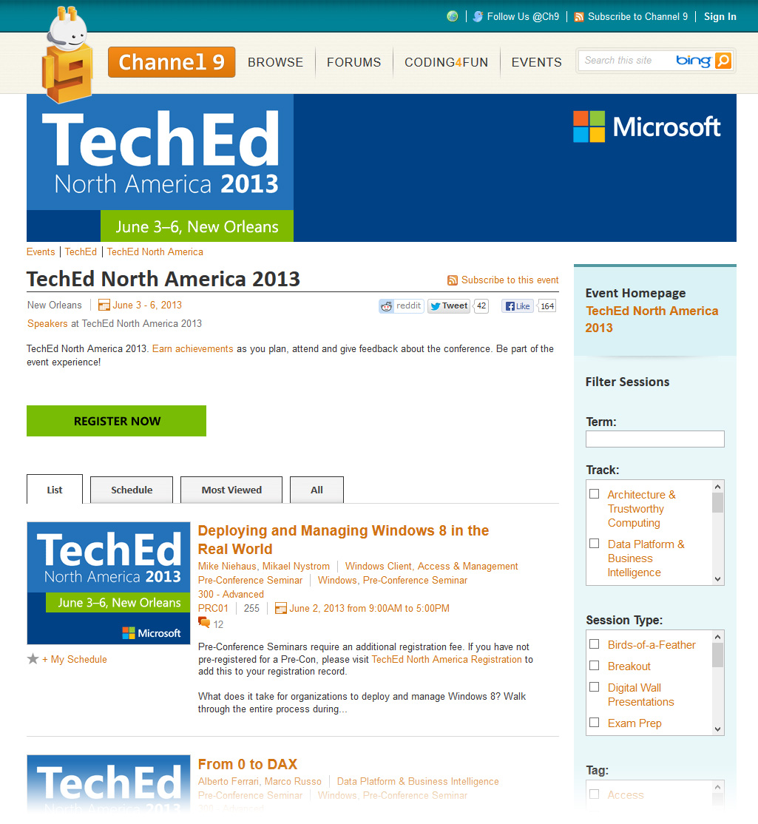

Attendees Find Session Information Here:
Online Session Catalog
Mini Guide

Slide 31
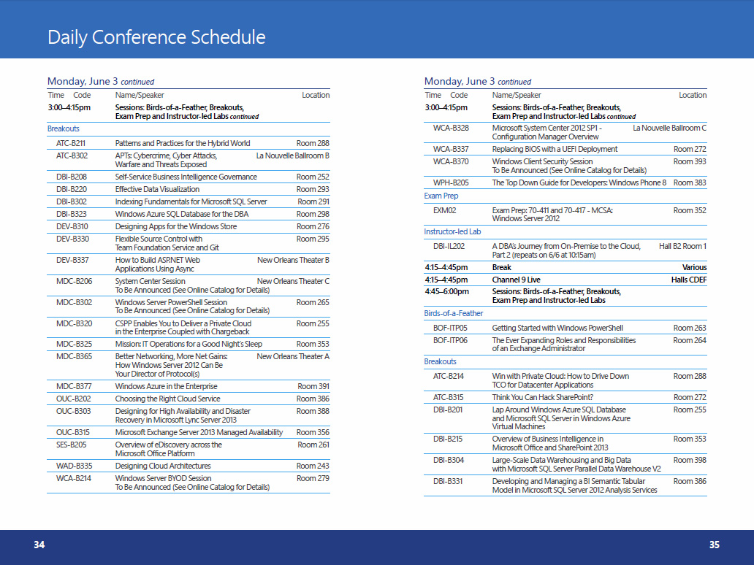
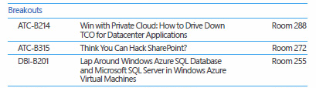
Display in the Mini Guide
Mini Guide
ATC
B
214
Track
Code
Session
Code
Sequential
Session
Number
    B=Breakout
    H=Hands-on Lab
    IL=Instructor-led Lab
= Intermediate
300 = Experienced
400 = Advanced

Slide 32




Complete an Evaluation and Enter to Win!
Submit an evaluation for every session and lab that you attend.
Make your voice heard.

Slide 33
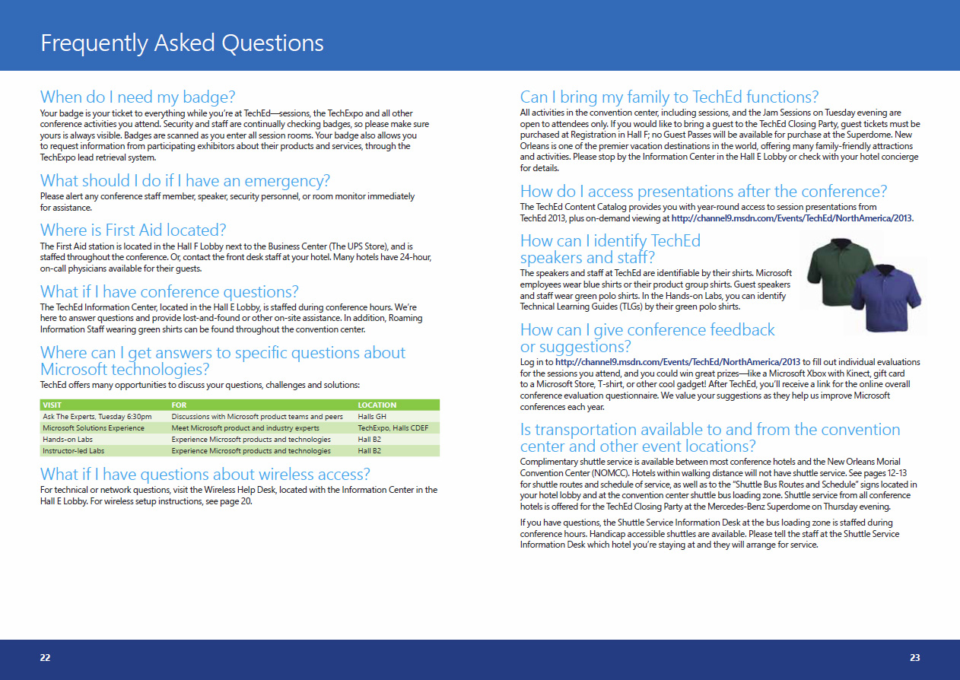

What if You Have a Question?
Online Resources
    Website FAQ
    Social
Thank you for joining us in New Orleans

Slide 34

© 2013 Microsoft Corporation. All rights reserved. Microsoft, Windows and other product names are or may be registered trademarks and/or trademarks in the U.S. and/or other countries.
The information herein is for informational purposes only and represents the current view of Microsoft Corporation as of the date of this presentation. Because Microsoft must respond to changing market conditions, it should not be interpreted to be a commitment on the part of Microsoft, and Microsoft cannot guarantee the accuracy of any information provided after the date of this presentation. MICROSOFT MAKES NO WARRANTIES, EXPRESS, IMPLIED OR STATUTORY, AS TO THE INFORMATION IN THIS PRESENTATION.

