Slide 2
Messaging with Windows Azure Service Bus
WAD-B310
Ziv Rafalovich (@zivraf)
Senior Program Manager,
Windows Azure, Microsoft

Slide 3
Agenda
  Introduction to Service Bus brokered messaging
New Capabilities for new Scenarios
Improved Reliability and Resiliency
Interoperability across platforms and protocols
Simplified, Efficient APIs
  Service Bus for Windows Server

Slide 4
Telling the story of MyLib.org (based on a true story)
MyLib has embraced the cloud
Introduced a rich web site
Library engine
Still, personnel and billing remained on-prem

Slide 5
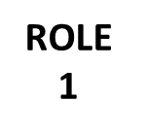
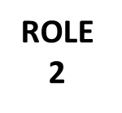
Core Messaging
Hybrid Services
Connected Clients
Forward reservations from myLib.org to the library
Queue
Subscription
Topic
Subscription
ROLE 3
Resiliency
Scale Out
Messaging Patterns

Slide 6

Core Messaging
Hybrid Services
Connected Clients
Validate technician’s identity from on-prem AD
Cloud-Hosted Service
Queue
On-Premises
Resources
Relay
Subscription
Topic
ROLE 3
Service
Subscription
Resiliency
Scale Out
Messaging Patterns
Location Transparency
Turnkey Cloud Connect
Scale Out

Slide 7
Core Messaging
Hybrid Services
Connected Clients
Queue up requests for an on-prem billing system
Cloud-Hosted Service
Queue
On-Premises
Resources
Service
Location Transparency
Decoupled
Scale Out

Slide 8
New Features

Slide 9
We have been busy lately…
New Capabilities for new Scenarios
Improved Reliability and Resiliency
Interoperability across platforms and protocols
Simplified, Efficient APIs
SDK 1.8 – 10/12
Message Lock Renewal
Entity Query
Forward Messages between entities
Batch APIs
Browse Sessions
Updating Entities (enable\disable)
Notification Hub
Preview – 1/13
Scalable, cross-platform, push notification
SDK 2.0 – 4/13
Shared Access Secrets (SAS)
Auto-delete Idle Entities
Event-Driven Model
Task-based Async APIs
Browsing Messages
SDK 2.1 – 5/13
AMQP
SB1.1 Preview

Slide 10
Shared Access Signature (SAS) authentication
Expect simple way to authenticate.
No need for ‘users’ nor federation
Integrated API for management
Complex portal experience
Authenticate using an access key
Namespace & Entity level
Integrated API for management
Management with Azure Portal
Up to 12 rules per entity
Regenerate & Revoking keys
// The endpoint for creating a SAS rule on a namespace is:
https://management.core.windows.net/{subscriptionId}/services/ServiceBus/namespaces/{namespace}/AuthorizationRules/
// The endpoint for retrieving the SAS rules on the namespace is:
https://management.core.windows.net/{subscriptionId}/services/ServiceBus/namespaces/{namespace}/AuthorizationRules/

Slide 11
Demo
Shared Access Secret (SAS)

Slide 12
Event-Driven Message Programing Model
Expect Push\Event model
Avoid writing receive loop
Challenges managing receive loop
Handling async calls efficiently
Processing exceptions
Event-like/push semantics
Replaces the receive loop
Supports concurrent processing
OnMessageOptions options = new OnMessageOptions();
options.AutoComplete = true; // call complete on messages after the callback has completed processing.
options.MaxConcurrentCalls = 1; // number of concurrent calls to the callback the pump should initiate
options.ExceptionReceived += LogErrors; // Allows users to get notified of any errors encountered by the message pump
// Start receiveing messages
// Calling close on the client will stop the pump.
Client.OnMessage((receivedMessage) =>
{ // Process the message
Console.WriteLine(string.Format("Processing recived Message: Id = {0}, Body = {1}",
receivedMessage.MessageId, receivedMessage.GetBody<string>()));
}, options);

Slide 13
Entity Query API
How to monitor large number of Service Bus entities ?
Application SLA violation
Query API on the entire namespace
Filter out Service Bus entities by:
  Path, AccessedAt, CreatedAt,
  ModifiedAt, MessageCount
.NET and REST
IEnumerable <QueueDescription> queueList = nameSpaceManager.GetQueues ("messageCount Gt 10");
IEnumerable<TopicDescription> topicList = nameSpaceManager.GetTopics(
"startswith(path, 'foo') eq true AND AccessedAt Lt '" + startTime + "'");
IEnumerable<SubscriptionDescription> subscriptionList = nameSpaceManager.GetSubscriptions(
topicName, "messageCount Gt 0 AND AccessedAt Lt '" + startTime + "'");
http://<serviceBusAddress>/$Resources/Topics?$filter=startswith(path, ‘foo/bar’) eq true

Slide 14
Message Browse
Visibility into messages in the queue
A way to debug message
View available messages without receiving
Returns all properties and message body
Message is not locked
QueueClient queueClient = QueueClient.Create("myQ");
var message = queueClient.Peek(); // does not lock the message
var message = queueClient.Peek(fromSequenceNumber: 4); //specific starting point
var messages = queueClient.PeekBatch(messageCount: 10); // supports batching

Slide 15
Tasks Based APIs
Simplify usage of async APIs
Task to replace IAsyncResult
Allows usage of await semantics
Client library targets .NET 40
QueueClient queueClient = QueueClient.Create("myQ");
await queueClient.SendAsync(currentOrder);

Slide 16
Service Bus support with
AMQP 1.0

Slide 17

Proprietary messaging protocols
Difficult to port applications
Requires re-coding all applications
Difficult to integrate
Application level bridges to move messages and translate message formats
Restricted platform support
Limited to whatever vendor provides

Slide 18

Proprietary messaging protocols
Open, standard messaging protocol
Enables cross-platform apps to be built using brokers, libraries and frameworks from different vendors
Features
Efficient – binary connection-oriented protocol
Reliable – fire-and-forget to reliable, exactly-once delivery
Portable data representation – cross-platform
Flexible – client-client, client-broker, and broker-broker
Broker-model independent – no requirements on broker
AMQP

Slide 19

AMQP 1.0 Standardization
OASIS Standard since October 2012
The culmination of several years effort by more than 20 companies
Technology vendors: Axway Software, Huawei Technologies, IIT Software, INETCO Systems, Kaazing, Microsoft, Mitre Corporation, Primeton Technologies, Progress Software, Red Hat, SITA, Software AG, Solace Systems, VMware, WSO2, Zenika.
User firms: Bank of America, Credit Suisse, Deutsche Boerse, Goldman Sachs, JPMorgan Chase
Next is standardization via ISO/IEC JTC1

Slide 20


Announcement:
Service Bus AMQP 1.0 GA
AMQP 1.0 support in Service Bus has today Support for a range of third-party client libraries
Supported in SDK2.1
(*) More platforms will be supported as libraries become available

Slide 21

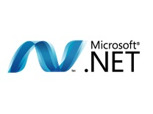


Interoperability with Service Bus
Linux
Windows
python
Topic
MyTopic
Subs
php
Linux
java
Windows
Windows

Slide 22
Demo
Interoperability with AMQP1.0

Slide 23
Service Bus for
Windows Server

Slide 24
The case Service Bus Server
 | Why & What
Messaging Middleware | Enterprise applications developed and deployed on-premise. Scale ; HA ; Manageability ; Rich messaging feature set
Develop On-premise | Develop on-prem; deploy to the cloud (or vice versa) DevBox deployment (HW&SF pre-reqs) ; Tools (VS); debug mode ; symmetry
Flexible Deployment | ISVs looking for a consistent service to deploy both on-prem and in cloud Full symmetry ; Ease of migration
On-premises
Windows Azure
Develop&
Deploy
Develop&
Test
Deploy
Deploy
Deploy

Slide 25
Announcement:
Service Bus 1.1 Preview
Service Bus 1.0 (RTM) – October 2012
Consistent & Supported with SDK1.8
Service Bus 1.1 (Preview) – June 2013
Brokered Messaging: Queues and Topics
Management experience
AMQP 1.0 Support
Consistent & Supported with SDK2.1

Slide 26
Service Bus Server – The platform
Enterprise Ready
ISV Friendly
Developers Choice
Windows Server 2008 R2 SP1 and higher
SQL Server 2008 R2 SP1 and higher
Highly Available
Scale Out & Scale Up
Windows Authentication (AD)
SystemCenter Management Pack
Administrator PowerShell
Admin & Tenant Portals
SDK Symmetry
Use Connection string
IaaS (Azure VM) support
Share Access (SAS) authentication
1 Box topology
Client OS (64 bit)
SQL Express
Relaxed timeouts

Slide 27
Demo
Service Bus for
Windows Server 1.1 (preview)

Slide 28
Service Bus Release Cadence
SDK 1.8 – 10/12
Message Lock Renewal
Entity Query
Forward Messages between entities
Batch APIs
Browse Sessions
Updating Entities (enable\disable)
Notification Hub
Preview – 1/13
Scalable, cross-platform, push notification
SDK 2.0 – 4/13
Shared Access Secrets (SAS)
Auto-delete Idle Entities
Event-Driven Model
Task-based Async APIs
Browsing Messages
SDK 2.1 – 5/13
AMQP
SB1.1 Preview
SB1.0 – 10/12
Brokered Messaging: Queues and Topics
Consistent & Supported with SDK1.8
SB1.1 Preview – 6/13
Consistent & Supported with SDK2.1
Interoperability with AMQP1.0
Shared Access Signature (SAS)
Admin & Tenant Management Portal

Slide 29

Related content
WAD-B312: Microsoft Integration Vision and Roadmap; June 4th, 8:30
WAD-B310: Messaging with Windows Azure Service Bus, June 4th 10:15
WAD-B405: Developing Hybrid Solutions with Microsoft BizTalk Server 2013 and Windows Azure; June 5th, 8:30
BoF: Towards a Lightweight Integration Bus; June 5th 10:15
WAD-B336: Connected Clients and Continuous Services with Windows Azure Service Bus, June 6th 10:15
WAD-B340: Building Private Clouds Using Windows Azure Services for Windows Server; June 6th 2:45

Slide 30
Agenda
  Introduction to Service Bus brokered messaging
New Capabilities for new Scenarios
Improved Reliability and Resiliency
Interoperability across platforms and protocols
Simplified, Efficient APIs
  Service Bus for Windows Server

Slide 31

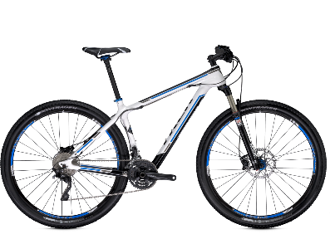
Track Resources & Calls To Action
Get Started with Windows Azure
Develop and Test in VMs, Build Websites, Extend on-premises applications
http://www.windowsazure.com
MSDN Subscribers: you’ve got it, now use it
Activate your MSDN Benefit & try it by 9/30
You could win* an Aston Martin V8 Vantage!
Go to: http://aka.ms/AzureContest
Drop by the Windows Azure booth to participate in the
Windows Azure Challenge for even more prizes!
*No purchase necessary. Open to eligible Visual Studio Professional, Premium or Ultimate with MSDN subscribers as of June 1, 2013. Ends 11:59 p.m. PT on September 30, 2013. For full official rules including odds, eligibility and prize restrictions see website. Sponsor: Microsoft Corporation. Aston Martin is a trademark owned and licensed by Aston Martin Lagonda Limited. Image copyright Evox Images. All rights reserved.

Slide 32
Windows Track Resources
Windows Enterprise: windows.com/enterprise
Windows Springboard: windows.com/ITpro
Microsoft Desktop Optimization Package (MDOP): microsoft.com/mdop
Desktop Virtualization (DV): microsoft.com/dv
Windows To Go: microsoft.com/windows/wtg
Outlook.com: tryoutlook.com

Slide 33






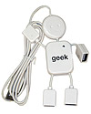
Complete an evaluation on CommNet and enter to win!

Slide 34
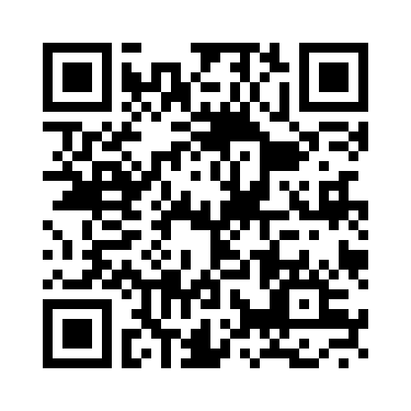
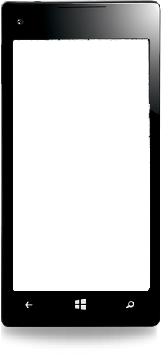

Evaluate this session
Required Slide
*delete this box when your slide is finalized
Your MS Tag will be inserted here during the final scrub.
Scan this QR code to evaluate this session and be automatically entered in a drawing to
win a prize

Slide 35

© 2013 Microsoft Corporation. All rights reserved. Microsoft, Windows and other product names are or may be registered trademarks and/or trademarks in the U.S. and/or other countries.
The information herein is for informational purposes only and represents the current view of Microsoft Corporation as of the date of this presentation. Because Microsoft must respond to changing market conditions, it should not be interpreted to be a commitment on the part of Microsoft, and Microsoft cannot guarantee the accuracy of any information provided after the date of this presentation. MICROSOFT MAKES NO WARRANTIES, EXPRESS, IMPLIED OR STATUTORY, AS TO THE INFORMATION IN THIS PRESENTATION.

