Slide 2
Microsoft BizTalk Server 2013 in Windows Azure IaaS
WAD-B314
Stephen W. Thomas
me@BizTalkGuru.com
@StephenWThomas

Slide 3
About Me
9 Year MVP
BizTalkGurus.com and BizTalkGuru.com
Co-author “Applied Architecture Patterns on Microsoft Platform”
Pluralsight author (eventually)
Community speaker

Slide 4
A tail of two Stephen / Steven Thomas’s
Expecting a talk on App-V?
Why do I use the “W”
Why it is great to be a Stephen Thomas

Slide 5
Overview
Primer
Pain Points
Basics of IaaS
BizTalk & Iaas
Development & Test Scenarios
Sample Scenarios

Slide 6
Primer

Slide 7
Infrastructure Pain Points
Resource onboarding
  Speed
  Space
  Support
Upgrades
Multi-server environment
Short lived solutions
Bursting

Slide 8
What is Windows Azure IaaS?
Infrastructure should be easy!
Microsoft’s pay-per-use infrastructure offering
Two components
  Virtual Machines
  Virtual Networks
Enables developers
Eliminating “I don’t have an environment for that”

Slide 9
Site to IaaS Connection Options
VPN
  Point-to-Site (easy)
  Site-to-Site
Traditional
  Use Service Bus endpoints
  Other approved protocols

Slide 10
Why BizTalk and IaaS?
Biggest WOW since BizTalk 2004
Pre-built images
Pay-per-hour pricing & software mobility
Did someone say BizTalk was hard to install?

Slide 11
Development and Test Scenarios

Slide 12
IaaS Announcements Yesterday
No charge stopped VM
Per-minute billing
Free trial $200 per month

Slide 13
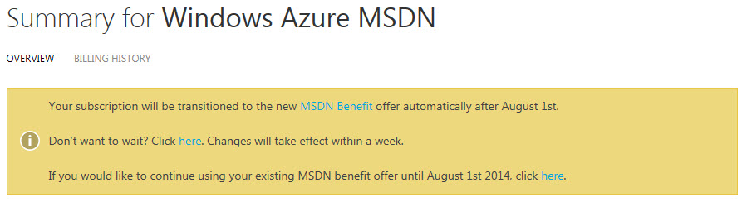
MSDN Benefits
Cash credit model
  $50 extra first month
33% off VM’s
All premium disks at base-VM prices
  Large BizTalk Enterprise $0.24 cents / hr
Use MSDN Software

Slide 14
Dev and test solutions
Pre-built or custom images
API for extension
Included with MSDN
Lead time - at least 7 minutes
Out of server space – never
Support – by developers

Slide 15
Demo
Creating a Development Environment using the Portal

Slide 16
Holy grail of Dev / Test

Slide 17
Quest for the Holy Grail
One-Click (at least in spirit)
  PowerShell
  Custom Image
  Bootstrapping
  Remote PowerShell
  BizTalk Provisioning Tool
Three R’s
  Repeatable!
  Resizable!
  Right Now!

Slide 18
Introducing BizTalk Provisioning Tool
Installed on all Windows Azure BizTalk VMs
Command line tool
Using XML configuration file to auto create a BizTalk Group

Slide 19
Demo
Creating and Configuring a Multi-Server BizTalk Environment

Slide 20
Sample Scenarios

Slide 21
What is different now?
Per-per hour licensing
License mobility
Easy scaling in the cloud
Geographic locations
Not for every solution

Slide 22
Low utilization scenarios
Only needed during working hours
Short lived
Costing
Compliance

Slide 23
Low utilization architecture
Option 1
Option 2

Slide 24
Low utilization costing
Pay-per-hour or license mobility (PPH BEST)
Upgrade or downgrade hardware with 3 minute outage
Schedule whole environment to go up or down

Slide 25
Demo
Resize a Windows Azure Domain

Slide 26
Hybrid
Does not always mean direct connection
Bring endpoints close to customers
Disaster recovery

Slide 27
Hybrid architecture
Option 1
Option 2

Slide 28
Hybrid costing
Pay-per-hour
Log files in storage till needed
Configure VM then stop them

Slide 29
Burst & unlimited scale scenarios
Better options with site-to-site connections
Pay-per-hour instances
  Great way to plan for extra capacity
  Configure once then stop the VM
  Only pay for storage until turned on
Overflow messages to Azure
  Service bus
  Queues
  Load balancing

Slide 30
Burst & unlimited scale architecture
Windows Azure Workgroup 1
Windows Azure Workgroup 2
Add unlined number of Workgroups to process on-premise work queue

Slide 31
Burst & unlimited scale costing
Per-per-hour likely best
Using site-to-site connection
Best with queuing

Slide 32
Management and Monitoring
System Center 2012
  Support for Windows Azure Virtual Machines
BizTalk 360
  Web-based tool for BizTalk admin and governance

Slide 33
IaaS Tips and Tricks
Don’t like the portal use API
Learn PowerShell
Disks are charged only for actual storage
Some properties can’t be changed once in use

Slide 34
Summary
IaaS is easy
Use right now for Dev / Test
New possibilities seen in sample scenarios

Slide 35

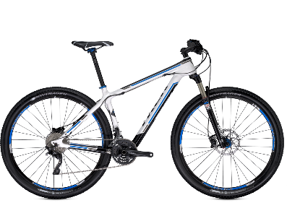

Track Resources & Calls To Action
Get Started with Windows Azure
Develop and Test in VMs, Build Websites, Extend on-premises applications
http://www.windowsazure.com
MSDN Subscribers: you’ve got it, now use it
Activate your MSDN Benefit & try it by 9/30
You could win* an Aston Martin V8 Vantage!
Go to: http://aka.ms/AzureContest
Drop by the Windows Azure booth to participate in the
Windows Azure Challenge for even more prizes!
*No purchase necessary. Open to eligible Visual Studio Professional, Premium or Ultimate with MSDN subscribers as of June 1, 2013. Ends 11:59 p.m. PT on September 30, 2013. For full official rules including odds, eligibility and prize restrictions see website. Sponsor: Microsoft Corporation. Aston Martin is a trademark owned and licensed by Aston Martin Lagonda Limited. Image copyright Evox Images. All rights reserved.

Slide 36
Windows Track Resources
Windows Enterprise: windows.com/enterprise
Windows Springboard: windows.com/ITpro
Microsoft Desktop Optimization Package (MDOP): microsoft.com/mdop
Desktop Virtualization (DV): microsoft.com/dv
Windows To Go: microsoft.com/windows/wtg
Outlook.com: tryoutlook.com

Slide 37

Resources
Learning
  Sessions on Demand
  Microsoft Certification & Training Resources
http://channel9.msdn.com/Events/TechEd
www.microsoft.com/learning
TechNet
msdn
  Resources for IT Professionals
  Resources for Developers
http://microsoft.com/technet
http://microsoft.com/msdn

Slide 38







Complete an evaluation on CommNet and enter to win!

Slide 39
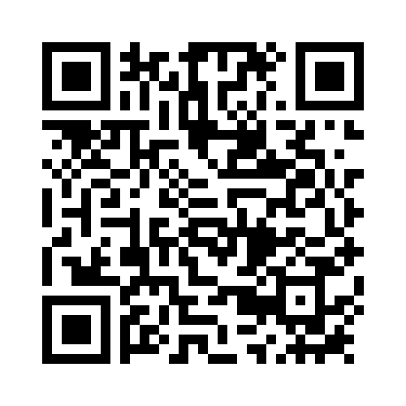


Evaluate this session
Required Slide
*delete this box when your slide is finalized
Your MS Tag will be inserted here during the final scrub.
Scan this QR code to evaluate this session and be automatically entered in a drawing to
win a prize

Slide 40

© 2013 Microsoft Corporation. All rights reserved. Microsoft, Windows and other product names are or may be registered trademarks and/or trademarks in the U.S. and/or other countries.
The information herein is for informational purposes only and represents the current view of Microsoft Corporation as of the date of this presentation. Because Microsoft must respond to changing market conditions, it should not be interpreted to be a commitment on the part of Microsoft, and Microsoft cannot guarantee the accuracy of any information provided after the date of this presentation. MICROSOFT MAKES NO WARRANTIES, EXPRESS, IMPLIED OR STATUTORY, AS TO THE INFORMATION IN THIS PRESENTATION.

