Slide 2
Key Ingredients for Building Hybrid (Cross-Premise) Cloud Applications
WAD-B320
Annur Sumar [MVP]
Regional Team Leader
Concurrency Inc

Slide 3
Agenda
A look into the different types of cloud models
Understanding where, when and how to leverage them for hybrid application scenarios
Building connectivity for cross-premise functionality
Leveraging System Center for end to end (deployment/configuration/operations) management
Business benefits, lessons learned and next steps

Slide 4
The changing cloud continuum
SaaS
software as a service
PaaS
platform as a service
COST-EFFICIENCY
Simpler Management
IaaS
infrastructure as a service
Virtualized
data center
CONTROL
ABSTRACTION

Slide 5
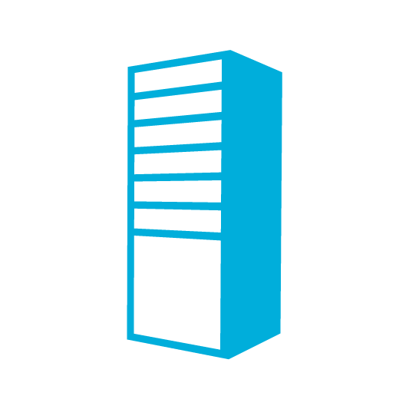
Hybrid Cloud Ingredients
Hybrid Cloud
Traditional
NON-VIRTUALIZED
Private
CLOUD: On-premises Cloud
Public
CLOUD: Off-premises Cloud
Non-virtualized Applications
with Traditional Infrastructure
Pooled, Virtualized, Scalable, On-Premises and On-Demand
External, Scalable, On-Demand IT Service
Hybrid Application
Portions of applications and data on-premises and off-premises

Slide 6
Application Portfolio Management
The highest level of choice, flexibility for managing your applications
Hybrid Cloud
Relevance of Application to Organization
Performance of Application
Age/Maturity of Application
Ensure Compliance
Rewrite or Migration Potential of Application
Hardware Refresh
Cycle
Traditional
NON-VIRTUALIZED
Private
CLOUD: On-premises Cloud
Public
CLOUD: Off-premises Cloud

Slide 7
Private Cloud Application Ingredients
Standardized services
Delegated capacity
Development
Production
Resources (cloud) abstraction
Assign dedicated and shared resources
Logical and standardized
Diverse infrastructure
Production
Datacenter One
Datacenter Two
Development

Slide 8
Demo
Private Cloud Application Deployment

Slide 9
Public Cloud Application Ingredients
big data
database
storage
traffic
VMs
caching
messaging
identity
media
CDN
networking
websites

Slide 10
Demo
Public Cloud Application Deployment

Slide 11
Hybrid Cloud (Cross-Premise) Enablement
PUBLIC
Identity
Virtualization
Management
Development
PRIVATE
Traditional Datacenter
Highly Virtualized Datacenter

Slide 12
Windows Azure Cross-Premises Connectivity
Cloud
Enterprise
App Monitoring & Management
System Center
Data Synchronization
SQL Azure Data Sync
Application-Layer
Connectivity & Messaging
Service Bus
Secure Machine-to-Machine Connectivity Windows Azure Connect
Secure Site-to-Site
Network Connectivity
Virtual Network

Slide 13
Windows Azure Connect For developers
Simple to setup
Rapidly provisioned
Windows Azure Roles
Easy to manage
On premises machines

Slide 14
Windows Azure Virtual Network For network administrators
Provides network admins the control to setup subnets in the cloud and manage them as extensions of on-premise datacenters
Complete control
Scalable
Subnets in Windows Azure
Complex scenarios
On-premise subnets

Slide 15
Windows Azure Virtual Network Scenarios
Hybrid Public/Private Cloud
Enterprise app in Windows Azure requiring connectivity to on-premises resources
Enterprise Identity and Access Control
Manage identity and access control with on-premises resources (on-premises Active Directory)
Monitoring and Management
Remote monitoring and trouble-shooting of resources running in Windows Azure
Advanced Connectivity Requirements
Cloud deployments requiring persistent IP addresses and direct connectivity across services

Slide 16
Demo
Cross Premises Connectivity

Slide 17
Sample Scenario: Web Application
Public Internet
Windows Azure
On Premises
10.10.20.2
10.10.20.3
Persistent VM Role
Persistent VM Role
Corporate Proxy
Web App Frontend
SQL
52.2.2.2
SSL Authenticated Traffic
Load Balancer
54.0.0.1
SQL Mirroring
10.10.11.1
10.10.20.4
10.10.20.5
Persistent VM Role
Persistent VM Role
Web App Frontend
SQL
On Premises
10.10.10x
VPN Device
10.10.20.1
DC
DNS
IPSEC Tunnel
Gateway
Cloud
DC
DNS

Slide 18
The power of VHD mobility…
Windows Azure
Your Data Center

Slide 19
The power of VHD mobility…
Windows Azure
Your Data Center

Slide 20
The power of VHD mobility…
Windows Azure
Other Service Providers
Your Data Center

Slide 21
Monitoring Hybrid Applications with System Center
Read app roles
and structure
Windows Azure Service API
Worker Role
Performance data,
events, logs
Web Role
Performance data,
events, logs
Read operational
data and grooming
Table storage
On-Premises Operations Manager
Windows Azure Application
On-premises
Windows Azure
Operations Manager Console Diagram View

Slide 22
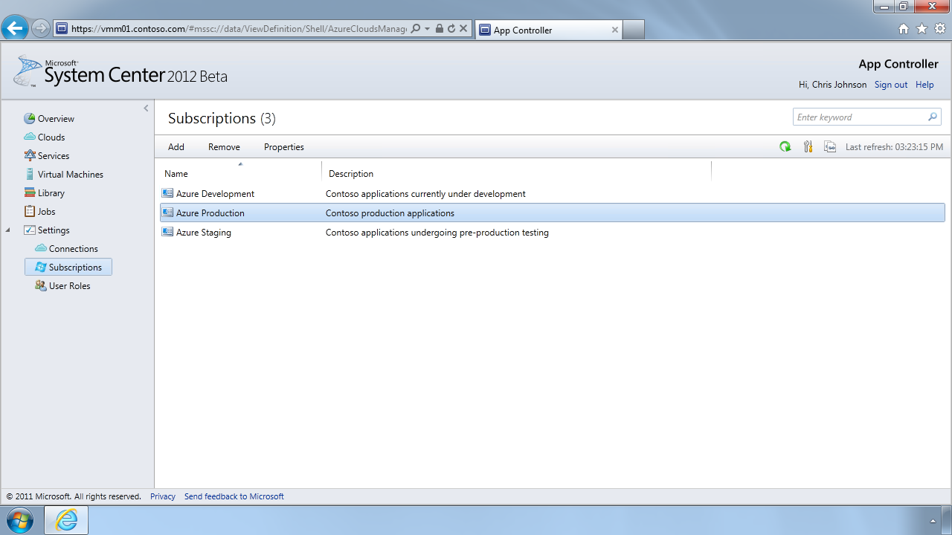
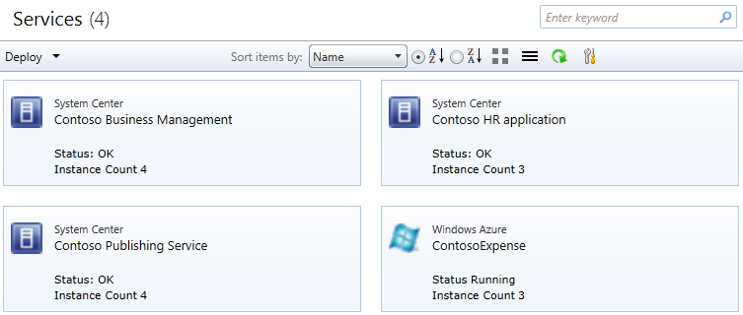
Managing Hybrid Applications with System Center
Deploy
Monitor
Service Templates
Package and Configuration
Hyper-V
VMware
Xen
Windows Azure
Private Cloud
Manage
Application management across private and public
Notes:
TechReady13
6/4/2013
© 2011 Microsoft Corporation. All rights reserved. Microsoft, Windows, Windows Vista and other product names are or may be registered trademarks and/or trademarks in the U.S. and/or other countries.
The information herein is for informational purposes only and represents the current view of Microsoft Corporation as of the date of this presentation. Because Microsoft must respond to changing market conditions, it should not be interpreted to be a commitment on the part of Microsoft, and Microsoft cannot guarantee the accuracy of any information provided after the date of this presentation. MICROSOFT MAKES NO WARRANTIES, EXPRESS, IMPLIED OR STATUTORY, AS TO THE INFORMATION IN THIS PRESENTATION.
22

Slide 23
Protecting Hybrid Applications
Online Snapshots
Active Directory
Disk-Based
Recovery
Up to
Every 15 minutes
Data Protection Manager
Data Protection Manager
Disaster Recovery
with offsite replication and tape
Tape-Based
Backup

Slide 24
Demo
Hybrid Cloud Management and Automation

Slide 25
Hybrid IT as a Service
Configure
App Controller
Orchestrator
Deploy
Public Cloud
Self Service
Service Delivery & Automation
Virtual Machine Manager
Service Model
Operations Manager
Private Cloud
Data Protection Manager
App
Owner
IT Admin
Service Manager
Service Manager
Virtual
Monitor
Operate
Physical
Application Management
Service Delivery & Automation
Infrastructure Management
Notes:
25

Slide 26
Starting Points Common Use Case Scenarios *
Cloud
Native
Applications
Web
Based Business Applications
E-business
Hosting and Applications
Test
Development Prototyping
Disaster
Recovery /
Business Continuity
Batch Computing
Architected specifically for cloud
Custom and commercial, general purpose
SaaS Apps, Commerce Sites
Project oriented resourcing, timing
Storage & DB replication, failover sites
HPC, data analytics, modeling
Growing fast
Predictable bursting, usage seasonality
Unpredictable bursting, peak intervals
Unpredictable bursting,
demand
Provisioning for growth/scale
Large
on-demand capacity
Potential for mixed mode PaaS and IaaS optimization of Applications
* Source: Gartner, Lydia Leong, March 2012

Slide 27
Service Bus Messaging Easily connect applications – from anywhere – at any time
Queues for occasionally connected devices
Topics & Subscriptions publish messages to multiple subscribers
Mobile
Delivery Workers
Cloud
Web Frontend
Backend Workers
Store Branches
Relay to securely call into applications hosted behind firewalls and NATs
Suppliers, Partners

Slide 28
SQL Data Sync
Application
On-Premises
Cloud
One-way publish or two-way sharing
Application
SQL Database
Geo-located web applications
Use with Windows Azure Traffic Manager
SQL Server
Application
Application
SQL Database
SQL Database
Share data between locations and/or aggregate data in cloud
Application
Application
Scale-out via multiple copies of data
E.g. Separate reporting & OLTP workloads; multiple web sites
SQL Database
SQL Server

Slide 29
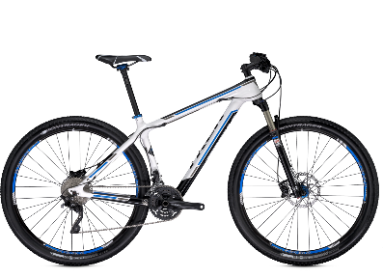
Track Resources & Calls To Action
Get Started with Windows Azure
Develop and Test in VMs, Build Websites, Extend on-premises applications
http://www.windowsazure.com
MSDN Subscribers: you’ve got it, now use it
Activate your MSDN Benefit & try it by 9/30
You could win* an Aston Martin V8 Vantage!
Go to: http://aka.ms/AzureContest
Drop by the Windows Azure booth to participate in the Windows Azure Challenge for even more prizes!
*No purchase necessary. Open to eligible Visual Studio Professional, Premium or Ultimate with MSDN subscribers as of June 1, 2013. Ends 11:59 p.m. PT on September 30, 2013. For full official rules including odds, eligibility and prize restrictions see website. Sponsor: Microsoft Corporation. Aston Martin is a trademark owned and licensed by Aston Martin Lagonda Limited. Image copyright Evox Images. All rights reserved.

Slide 30
Windows Track Resources
Windows Enterprise: windows.com/enterprise
Windows Springboard: windows.com/ITpro
Microsoft Desktop Optimization Package (MDOP): microsoft.com/mdop
Desktop Virtualization (DV): microsoft.com/dv
Windows To Go: microsoft.com/windows/wtg
Outlook.com: tryoutlook.com

Slide 31
Resources
Learning
Sessions on Demand
Microsoft Certification & Training Resources
http://channel9.msdn.com/Events/TechEd
www.microsoft.com/learning
TechNet
msdn
Resources for IT Professionals
Resources for Developers
http://microsoft.com/technet
http://microsoft.com/msdn

Slide 32
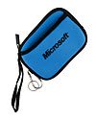
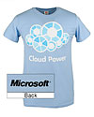
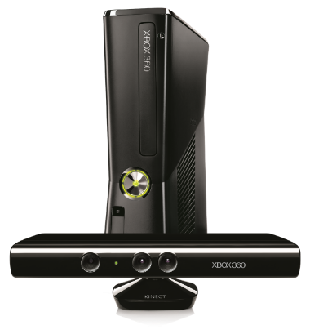
Complete an evaluation on CommNet and enter to win!

Slide 33
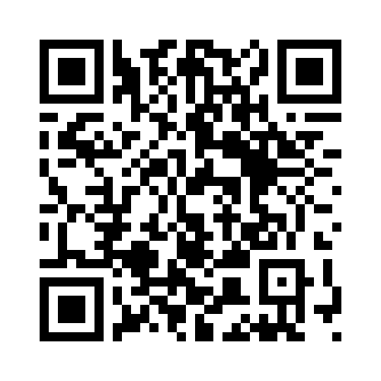
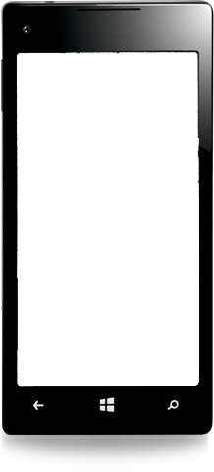
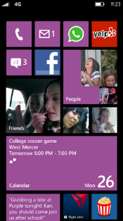
Evaluate this session
Required Slide
*delete this box when your slide is finalized
Your MS Tag will be inserted here during the final scrub.
Scan this QR code to evaluate this session and be automatically entered in a drawing to win a prize

Slide 34
© 2013 Microsoft Corporation. All rights reserved. Microsoft, Windows and other product names are or may be registered trademarks and/or trademarks in the U.S. and/or other countries.
The information herein is for informational purposes only and represents the current view of Microsoft Corporation as of the date of this presentation. Because Microsoft must respond to changing market conditions, it should not be interpreted to be a commitment on the part of Microsoft, and Microsoft cannot guarantee the accuracy of any information provided after the date of this presentation. MICROSOFT MAKES NO WARRANTIES, EXPRESS, IMPLIED OR STATUTORY, AS TO THE INFORMATION IN THIS PRESENTATION.

