Slide 2
Maximum Performance: Accelerate Your Cloud Services Applications with Windows Azure Caching
WAD-B326
Steve Danielson
Senior Programming Writer
Microsoft

Slide 3
Session Objectives And Takeaways
Session Objective(s):
  To review Caching value for Windows Azure cloud services
  To focus on Caching configuration and programming examples
  To understand the capacity planning tool
  To understand diagnostics options
Caching is easy to add/use in cloud services
Caching has deep configuration/API model
Understand capacity planning and diagnostics options

Slide 4
Why Caching?
Performance
Scalability

Slide 5
Customer Advisory Team (CAT) Engagement
Scenario
  Windows Azure web application
  Tracks election results during local and national elections
Problem – Scalability
  State primary elections pushed the limits of the SQL Database
  Each web page made an average of 10 database calls
  SQL Database begins to experience soft (slowness) and hard (exceptions) throttling
  Upcoming presidential election could overwhelm the database (millions of views in a peak hour)

Slide 6
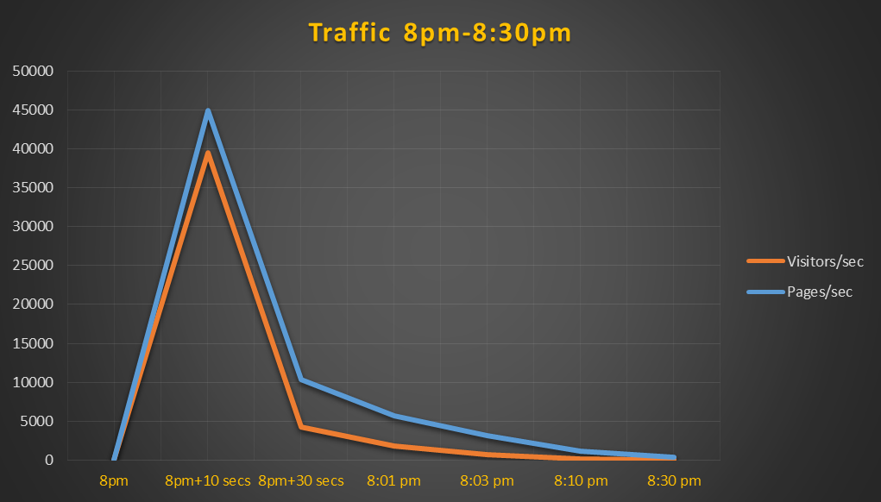
Solution: Windows Azure Caching
Windows Azure Caching added to application
  Database was only updated as results came in (every 3 -15 minutes)
  Results were loaded into the cache
  The web front end accessed the cache for the results
Result
  Decreased calls to the database
  Improved performance
  Improved scalability
  Fast time-to-solution
  Success on election night!

Slide 7
Architecture
Shared
Co-located
Dedicated

Slide 8
Shared Caching
Original multitenant Caching service
  April 2011 release with tiered offerings from 128 MB ($45/month) to 4GB ($325/month)
  Challenges: performance, features, throttling, cost
Web1
Worker1
Cache
Web1
Worker1

Slide 9
Caching on roles: co-located topology
Host caching on an existing role in your cloud service
  Released with the October 2012 release of the Azure SDK (1.8)
Web1
Worker1
Cache
Cache
Web1
Worker1

Slide 10
Caching on roles: dedicated topology
Host caching on a dedicated role in your cloud service
Web1
Worker1
Cache1
Cache
Web1
Worker1
Cache1

Slide 11
Developer Basics
Configure
Code
ASP.NET Providers

Slide 12
Configure the Caching Role
Configure a role in your cloud service to host Caching
Enable Caching on an existing role (co-located) or add a new role (dedicated)
Configure named caches and their properties
%
Web1
Worker1
Cache1
Caching Memory
default
NamedCache1 (HA)
NamedCache2 (>TTL)
Web1
Worker1
Cache1

Slide 13
Configure the Caching Clients
Use NuGet to configure cache client roles
Caching settings are placed in the web.config or app.config file
Important: use the latest NuGet installer: http://nuget.codeplex.com/
Modify the
web.config or
app.config files
Point to the role
that hosts Caching
Assemblies
Web1
Worker1
Cache1
Cache
Web.Config
Assemblies
Web1
Worker1
Cache1
Web.Config

Slide 14
Demo: Add Caching to an existing cloud service
Steve Danielson

Slide 15
Coding basics: create a cache client
Web.Config or App.Config:
Create a cache client:
<dataCacheClients>
<dataCacheClient name=“default">
<autoDiscover isEnabled="true" identifier="CacheWorker" />
</dataCacheClient>
<dataCacheClient name=“customClient">
<autoDiscover isEnabled="true" identifier="CacheWorker" />
<localCache isEnabled="true" sync="TimeoutBased" objectCount="100000"
ttlValue="300" />
</dataCacheClient>
</dataCacheClients>
// using Microsoft.ApplicationServer.Caching
DataCache cache = new DataCache();
cache = new DataCache("default");
cache = new DataCache("default", "default");
cache = new DataCache("default", "customClient");

Slide 16
Coding basics: Put, Get, and Remove
Put an object into the cache:
Get an object out of the cache:
Remove an object from the cache:
DataTable table = new DataTable("AnyTable");
cache.Put("Table1", table);
DataTable table = null;
object objTable = cache.Get("Table1");
if (objTable != null)
table = (DataTable)objTable;
cache.Remove("Table1");

Slide 17
ASP.NET Providers: session state & output
Web.Config
<sessionState mode="Custom" customProvider="AFCacheSessionStateProvider">
<providers>
<add name="AFCacheSessionStateProvider" type="Microsoft.Web.DistributedCache.DistributedCacheSessionStateStoreProvider, Microsoft.Web.DistributedCache" cacheName="default" dataCacheClientName="default" applicationName="AFCacheSessionState"/>
</providers>
</sessionState>
Use session state
Session.Add("Table1", table);
object objTable = Session["Table1"];
Use output caching (directive in ASP.NET page)
<%@ OutputCache Duration="60" VaryByParam="*" %>

Slide 18
Demo: NFL Standings
Steve Danielson
http://aka.ms/TechEdCacheDemo

Slide 19
Advanced Features
High
Availability
Regions
Local Cache
Notifications

Slide 20
High Availability (disabled)
WebRole
Cache
A
CacheRole
CacheRole
A
C
WebRole
B
C
CacheRole
CacheRole
B

Slide 21
High Availability (enabled)
WebRole
Cache
A
CacheRole
B
CacheRole
C
A
A
C
WebRole
B
A
C
B
CacheRole
CacheRole
B

Slide 22
Demo: High Availability
Steve Danielson
http://aka.ms/TechEdCacheDemo

Slide 23
Regions
cache.Put(“key”, object, “CustomRegion”);
cache.CreateRegion(“CustomRegion");
WebRole
Cache
A
A
B
C
C
WebRole
B

Slide 24
Regions: tagging, searching, & clearing
// Create a custom region
cache.CreateRegion("CustomRegion");
// Use custom tagging
List<DataCacheTag> tags = new List<DataCacheTag>();
tags.Add(new DataCacheTag("customtag1"));
cache.Put("key1", "object1", "CustomRegion");
cache.Put("key2", "object2", tags, "CustomRegion");
cache.Put("key3", "object3", tags, "CustomRegion");
IEnumerable<KeyValuePair<string, object>> returnedObjects =
cache.GetObjectsByTag(tags[0], "CustomRegion");
// Clear all objects in a region
cache.ClearRegion("CustomRegion");

Slide 25
Demo: Regions
Steve Danielson
http://aka.ms/TechEdCacheDemo

Slide 26
Local Cache
<dataCacheClient name="default">
<autoDiscover isEnabled="true" identifier="CacheWorker" />
<localCache isEnabled="true" sync="TimeoutBased" objectCount="100000" ttlValue="300" />
</dataCacheClient>
WebRole
Cache
A
A
A
CacheRole
CacheRole
B
CacheRole
C
WebRole
CacheRole

Slide 27
Demo: Local Cache
Steve Danielson
http://aka.ms/TechEdCacheDemo

Slide 28
Notifications
<dataCacheClient name=“default">
<autoDiscover isEnabled="true" identifier="CacheWorker" />
<localCache isEnabled="true" sync="NotificationBased" objectCount="100000" ttlValue="300" />
<clientNotification pollInterval="30" />
</dataCacheClient>
WebRole
Cache
CacheRole
CacheRole
Notification
Poll
WebRole
CacheRole
CacheRole

Slide 29
Notifications: local cache & cache events
Local cache
  NotificationsBased local cache invalidation potentially results in faster updates to the local cache
  NotificationsBased local cache works in conjunction with the timeout for local cache
  The poll interval for notifications must be shorter than the local cache timeout to see any benefit
Cache events
Cache
AddCacheLevelCallback
Region
AddRegionLevelCallback
Item
AddItemLevelCallback
DataCacheOperations: AddItem, ClearRegion, CreateRegion, RemoveItem, RemoveRegion, ReplaceItem

Slide 30
Demo: Notifications
Steve Danielson
http://aka.ms/TechEdCacheDemo

Slide 31
Capacity Planning
Cache Requirements
Deployment Topology
Co-located Planner
Dedicated Planner

Slide 32
Determine Cache Requirements
Amount of data to be cached
Average size of objects
Number of objects
Frequency of reads/writes
Bandwidth of VM Size
Cache Performance
Caching Features such as Regions and HA
That part is up to you. Capacity Planning Tool can help you with...
  What settings to use to configure the cache cluster
  Where to set the slider
  How many instances and what VM size

Slide 33
Capacity Planning Tool
Co-located Role Capacity Planner
  Do I have enough space on my roles to host a cache cluster
  Where to set the slider
Dedicated Role Capacity Planner
  How many instances
  What size VM
    Memory
    Bandwidth

Slide 34
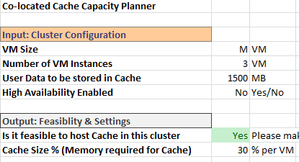
Co-located Capacity Planner
VM Size
VM Instances
Cache Capacity
HA Enabled
Feasible
Slider Setting
http://aka.ms/CacheCapacityPlanning

Slide 35
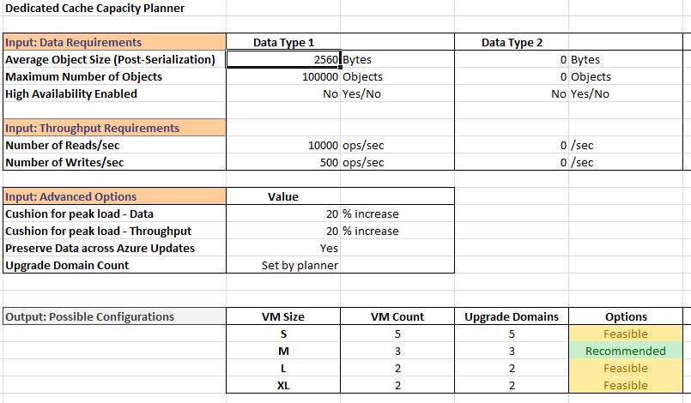
Dedicated Role Capacity Planner
Requirements
  Data size
  Bandwidth
Peak Load Buffer
  Bandwidth
  Rolling Updates
Cache Cluster Configurations
  VM Size
  Instance Count
  Upgrade Domains
http://aka.ms/CacheCapacityPlanning

Slide 36
Demo:
Capacity Planning
Steve Danielson
http://aka.ms/CacheCapacityPlanning

Slide 37
Diagnostics
Diagnostic Level
Configure
Deploy
Monitor

Slide 38
Diagnostic Level
Provides a single setting for cache servers and clients that configures collection levels for logs, traces, performance counters, and crash dumps
Diagnostic Level | Diagnostic Data Collected
0 | Very critical/catastrophic server logs only
1 (default) | Diagnostic data that helps in assessing usage patterns, health of the cache system, and any potential errors
2 | Diagnostic data at fine grain granularity of all requests and important system information
3 | Diagnostic data with more verboseness and system information
4 | Highest verbosity logs for all requests and system information
Detailed list at http://aka.ms/CacheDiagnostics

Slide 39
Configuring Diagnostic Level
DiagnosticLevel
  Configures cache cluster diagnostic settings
ClientDiagnosticLevel
  Configures cache client diagnostic settings
Configuring
  Set in ServiceConfiguration.cscfg or in portal
  Can be updated at runtime
Starting Data Collection
  Add code to role startup to enable diagnostic collection
  If not done, no diagnostics are collected

Slide 40
Set Diagnostic Level in cscfg
Cache Server Diagnostic Level
Cache Client Diagnostic Level

Slide 41
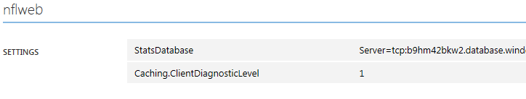
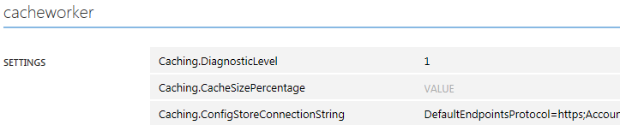
Set Diagnostic Level in Portal

Slide 42
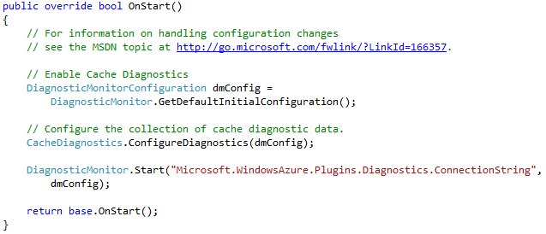
Start Diagnostic Collection

Slide 43
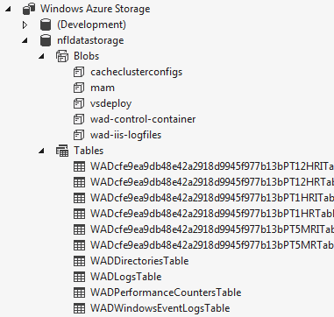
View Collected Diagnostic Data
Performance Counters
  View in Portal
  Download from configured storage
Traces, Log files, and Crash Dumps
  Download from configured storage
Increase Diagnostic Level in response to issues
  Deploy new cscfg
  Update in portal

Slide 44
Demo: Caching Diagnostics
Steve Danielson

Slide 45
Patterns & Guidelines

Slide 46
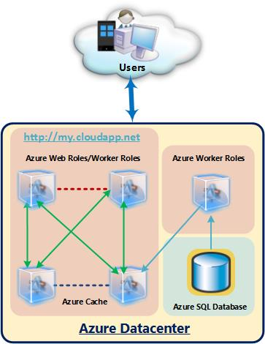
Cache Population/Update Strategy
Population
  Consider preloading cache
  Consider separate process for read only data
Update
  Carefully choose expiration and eviction settings
State Elections Architecture

Slide 47
Guidelines
Configuration
  A dedicated Caching topology is recommended
  Cache different types of data strategically:
    Multiple configuration sections for different cache client settings (local cache, timeouts, etc.)
    Multiple named caches for different cache settings (high availability, notifications, ttl, etc.)
Features
  Local cache trade-offs:
    Fastest performance
    Stale data (use notification base invalidation to compensate)
    Client memory pressure

Slide 48
Guidelines
Features (continued)
  High availability trade-offs:
    More durable cached data
    2 times the writes (memory / performance)
  Regions trade-offs:
    Supports organization, tagging, and searching
    Regions live on one cache server
Capacity planning
  Use the capacity planning spreadsheet
Diagnostics:
  Start at Level 1 and increase as needed for troubleshooting

Slide 49
In Review: Session Objectives And Takeaways
Session Objective(s)
  To review Caching value for Windows Azure cloud services
  To focus on Caching configuration and programming examples
  To understand the capacity planning tool
  To understand diagnostics options
Caching is easy to add/use in cloud services
Caching has deep configuration/API model
Understand capacity planning and diagnostics options

Slide 50
Resources
Documentation
  http://aka.ms/Caching
How to guide
  http://aka.ms/CachingHowTo
Samples
  http://aka.ms/CachingSamples
NFL Standings Demo
  http://aka.ms/TechEdCacheDemo
  Capacity Planning
  http://aka.ms/CacheCapacityPlanning
  MSDN Caching Forum
  http://aka.ms/CachingForum
steve.danielson@microsoft.com

Slide 51



Track Resources & Calls To Action
Get Started with Windows Azure
Develop and Test in VMs, Build Websites, Extend on-premises applications
http://www.windowsazure.com
MSDN Subscribers: you’ve got it, now use it
Activate your MSDN Benefit & try it by 9/30
You could win* an Aston Martin V8 Vantage!
Go to: http://aka.ms/AzureContest
Drop by the Windows Azure booth to participate in the
Windows Azure Challenge for even more prizes!
*No purchase necessary. Open to eligible Visual Studio Professional, Premium or Ultimate with MSDN subscribers as of June 1, 2013. Ends 11:59 p.m. PT on September 30, 2013. For full official rules including odds, eligibility and prize restrictions see website. Sponsor: Microsoft Corporation. Aston Martin is a trademark owned and licensed by Aston Martin Lagonda Limited. Image copyright Evox Images. All rights reserved.

Slide 52
Windows Track Resources
Windows Enterprise: windows.com/enterprise
Windows Springboard: windows.com/ITpro
Microsoft Desktop Optimization Package (MDOP): microsoft.com/mdop
Desktop Virtualization (DV): microsoft.com/dv
Windows To Go: microsoft.com/windows/wtg
Outlook.com: tryoutlook.com

Slide 53

Resources
Learning
  Sessions on Demand
  Microsoft Certification & Training Resources
http://channel9.msdn.com/Events/TechEd
www.microsoft.com/learning
TechNet
msdn
  Resources for IT Professionals
  Resources for Developers
http://microsoft.com/technet
http://microsoft.com/msdn

Slide 54







Complete an evaluation on CommNet and enter to win!

Slide 55



Evaluate this session
Required Slide
*delete this box when your slide is finalized
Your MS Tag will be inserted here during the final scrub.
Scan this QR code to evaluate this session and be automatically entered in a drawing to
win a prize

Slide 56

© 2013 Microsoft Corporation. All rights reserved. Microsoft, Windows and other product names are or may be registered trademarks and/or trademarks in the U.S. and/or other countries.
The information herein is for informational purposes only and represents the current view of Microsoft Corporation as of the date of this presentation. Because Microsoft must respond to changing market conditions, it should not be interpreted to be a commitment on the part of Microsoft, and Microsoft cannot guarantee the accuracy of any information provided after the date of this presentation. MICROSOFT MAKES NO WARRANTIES, EXPRESS, IMPLIED OR STATUTORY, AS TO THE INFORMATION IN THIS PRESENTATION.

