Slide 2
Windows Azure Web Sites & On-Premises Connectivity
WAD-B327
Brady Gaster
Microsoft Windows Azure Evangelist

Slide 3

Introductions
It always helps to know who you’re dealing with, so here’s a little background on me.
Windows Azure
Technical Evangelist
@bradygaster
bradygaster.com
1 Wife (Gina)
2 Sons (Gabe & Lucas)
2 Chihuahuas (Lola & Nico)
2 Guitars (Fender, Gretsch)
Originally from NC
(hence the funny accent)

Slide 4

“Web Sites is a Toy”
Web Sites is a frequently underestimated platform
Blogs & CMS’s
Only for startups
No middle tier
Lacks on-premises integration
No logging or monitoring

Slide 5
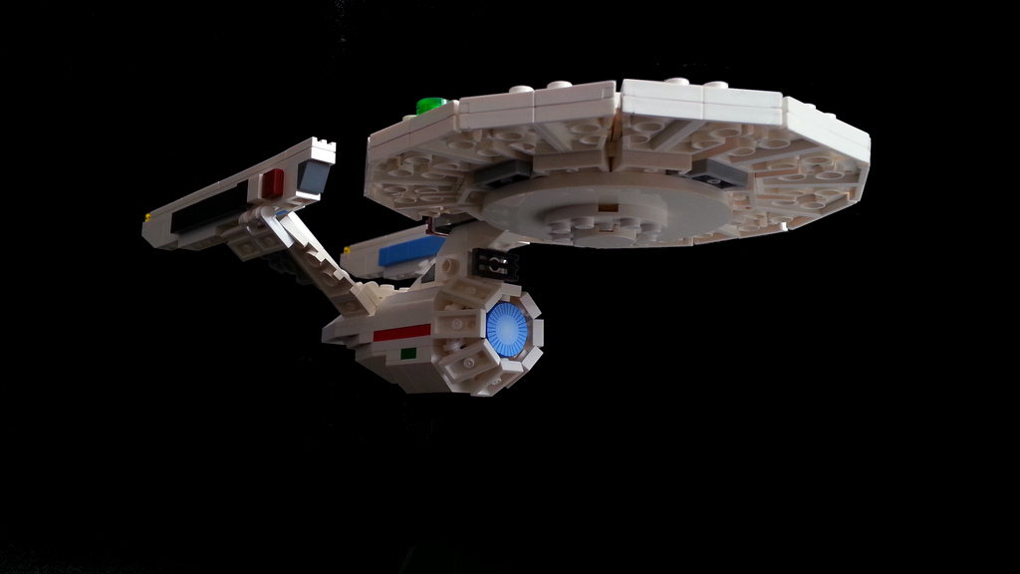
Web Sites is a Tool
Perfectly capable of helping you build your enterprise.

Slide 6





What Makes a Platform Enterprisey?
The minimal requirements for enterprise are…
Distributed Processing Support
Vast
Storage Capability
Process Integration
Asynchronous Messaging
Federated Identity & Access Control

Slide 7




Enterprising Web Sites
Problems solved by using Windows Azure functionality.
Cloud Services
SQL/Storage
TFS/Git/Hg
Service Bus
WAAD
Distributed Processing Support
Vast
Storage Capability
Process Integration
Asynchronous Messaging
Federated Identity & Access Control

Slide 8

Scenario: Enterprise Pizza
Pizza-ordering site that currently saves order data
Windows Azure
Web Site
SQL
Data sent to SQL database
Web Site Collects Data

Slide 9
Demo
Saving Data to the Database

Slide 10
Developing a Middle Tier
Processing Web Site data using Cloud Services
Windows Azure
Web Site
Queue
Worker
Stored
Data Pulled from Queue and Processed
Web Site Collects Data
Data Sent to Queue
Data Stored

Slide 11
Demo
Adding a Middle Tier to a Web Site using Cloud Services

Slide 12
Developing an On-Premise Middle Tier
Processing Web Site data using an internal app
Windows Azure
Corporate Network
Web Site
Queue
Worker
Stored

Slide 13
Demo
Adding a Middle Tier to a Web Site using On-Premise Apps

Slide 14

Service Bus Topics
Collecting data from a Web Site using Subscriptions
Windows Azure
Corporate Network
Web Site
Service Bus
Application
On-premise App
Web Site Collects Data
Results Published to Service Bus
Internal Application Subscribed to Service Bus Gets Messages
On-premise Application Displays Message

Slide 15
Demo
Subscribing to Service Bus Topics using On-Premise Apps

Slide 16
Service Bus Relays
Sending messages between tiers with Service Bus
Windows Azure
Corporate Network
Web Site
Service Bus
On-premise App
On start, Web Site hosts a WCF service using a Service Bus Relay binding
On start, on-premise app hosts a WCF service using a Service Bus Relay binding
Web Site sends a message to the WCF service hosted by the on-premise app
Service Bus relays the message to the on-premise app
On-premise application executes functionality
On-premise app sends a message to the WCF service hosted by the Web Site
Service Bus relays the message to the Web Site

Slide 17
Demo
Relaying Events to the Web Site using Service Bus

Slide 18
Data Marts
Using data from an enterprise in a Web Site using Service Bus
Windows Azure
Corporate Network
SQL
Web Site
Service Bus
Application
Database
WCF Service in Web Site is hit using Service Bus Relays
Internal Application Sends Data to Service Bus
Data persisted to SQL database
Web site has access to data

Slide 19
Demo
Updating the Web Site Data with On-Premise Apps

Slide 20


Identity with Office 365
Authenticating users who are members of your O365 domain
Visual Studio authenticates against O365 domain
O365 domain configuration added to Web.config of web site project
Web site published to Windows Azure
Users authenticate using their O365 credentials and are validated against the domain

Slide 21

Multi-tenant Identity with WAAD
Federate with O365 or On-Premise Active Directory

Slide 22

Related content
WAD-B336 - Connected Clients and Continuous Services with Windows Azure Service Bus
WAD-B320 - Key Ingredients for Building Hybrid (Cross-Premises) Cloud Applications
WAD-B310 - Messaging with Windows Azure Service Bus
WAD-B309 - Introduction to Windows Azure Active Directory
Find Me Later At the Web Development Booth

Slide 23
Track resources
Connecting Web Sites to On-Premise Databases using Windows Azure Service Bus (link)
Service Bus Relay Demo from the WATK (link)
Service Bus Messaging HOL from the WATK (link)

Slide 24

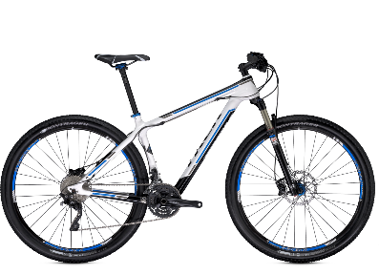
Track Resources & Calls To Action
Get Started with Windows Azure
Develop and Test in VMs, Build Websites, Extend on-premises applications
http://www.windowsazure.com
MSDN Subscribers: you’ve got it, now use it
Activate your MSDN Benefit & try it by 9/30
You could win* an Aston Martin V8 Vantage!
Go to: http://aka.ms/AzureContest
Drop by the Windows Azure booth to participate in the
Windows Azure Challenge for even more prizes!
*No purchase necessary. Open to eligible Visual Studio Professional, Premium or Ultimate with MSDN subscribers as of June 1, 2013. Ends 11:59 p.m. PT on September 30, 2013. For full official rules including odds, eligibility and prize restrictions see website. Sponsor: Microsoft Corporation. Aston Martin is a trademark owned and licensed by Aston Martin Lagonda Limited. Image copyright Evox Images. All rights reserved.

Slide 25
Windows Track Resources
Windows Enterprise: windows.com/enterprise
Windows Springboard: windows.com/ITpro
Microsoft Desktop Optimization Package (MDOP): microsoft.com/mdop
Desktop Virtualization (DV): microsoft.com/dv
Windows To Go: microsoft.com/windows/wtg
Outlook.com: tryoutlook.com

Slide 26

Resources
Learning
  Sessions on Demand
  Microsoft Certification & Training Resources
http://channel9.msdn.com/Events/TechEd
www.microsoft.com/learning
TechNet
msdn
  Resources for IT Professionals
  Resources for Developers
http://microsoft.com/technet
http://microsoft.com/msdn

Slide 27







Complete an evaluation on CommNet and enter to win!

Slide 28
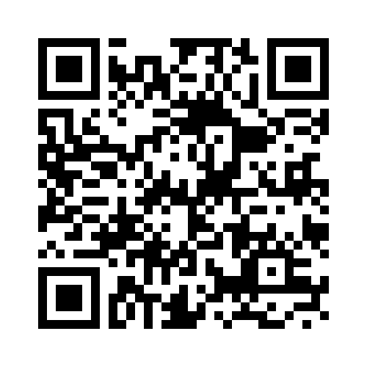


Evaluate this session
Required Slide
*delete this box when your slide is finalized
Your MS Tag will be inserted here during the final scrub.
Scan this QR code to evaluate this session and be automatically entered in a drawing to
win a prize

Slide 29

© 2013 Microsoft Corporation. All rights reserved. Microsoft, Windows and other product names are or may be registered trademarks and/or trademarks in the U.S. and/or other countries.
The information herein is for informational purposes only and represents the current view of Microsoft Corporation as of the date of this presentation. Because Microsoft must respond to changing market conditions, it should not be interpreted to be a commitment on the part of Microsoft, and Microsoft cannot guarantee the accuracy of any information provided after the date of this presentation. MICROSOFT MAKES NO WARRANTIES, EXPRESS, IMPLIED OR STATUTORY, AS TO THE INFORMATION IN THIS PRESENTATION.

