Slide 2
Developing iOS and Android Apps with Windows Azure Mobile Services
WAD-B339
Chris Risner

Slide 3
Introduction
Just a little bit about me
Windows Azure Technical Evangelist
@chrisrisner
Chrisrisner.com
Sailor
Founder of Detroit GDG
Co-Organizer of Seattle GDG
Originally from Michigan
Live in Washington

Slide 4
Agenda
What are we talking about today?
Options for iOS / Android development
Building with Mobile Services
Data Storage
Push Notifications
Security and Authentication
Questions

Slide 5
How do you develop for iOS / Android?

Slide 6
Three ways
Native | Objective-C | Java
PhoneGap | HTML/JS | HTML/JS
Mono | C# / MonoTouch | C# / MonoDroid

Slide 7
Which should I use?
?

Slide 8
What is Windows Azure Mobile Services?
Auth
Server Logic
Notifications
Logging & Diag
Data
Scheduler
Scale

Slide 9
Demo
Getting started

Slide 10
Structured Storage
Structured Storage with SQL Database
Same DB – multiple Mobile Services
AppX.Todoitem
AppY.Todoitem
Manage data in
Portal, SQL Portal
SQL Management Studio
REST API
CLI Tools

Slide 11
REST API to SQL mappings
JSON Value | T-SQL Type
Numeric values (integer, decimal, floating point) | Float
Boolean | Bit
DateTime | DateTimeOffset(3)
String | Nvarchar(max)

Slide 12
Server Logic
Automatic REST API generated for storage
Dynamic Schema on/off
Ability to customize server logic that intercepts table requests

Slide 13
Script Modules
Supported Modules + Globals
request
console
push.*
tables
mssql
statusCodes
azure
store (pusher, sendgrid, twilio, etc)

Slide 14
Demo
Server Logic

Slide 15
Push Notification Lifecycle Overview
iOS
Mobile Services
Register for push notifications
Register with your send token to Mobile Service
Push from server side scripts
App
(2)
(3)
(3)
(1)
Push Provider

Slide 16
Demo
Push Notifications

Slide 17
User Auth

Slide 18
Auth: Data and Scripts
Table level permissions for each CRUD operation
Everyone
Anyone with the Application Key
Only Authenticated Users
Only Scripts and Admins
More granular control with server side scripts
user.level: {admin, authenticated, anonymous}
user.userId: id or undefined if not authenticated

Slide 19
Demo
Adding authentication

Slide 20
Command Line Tools
Create services
Delete services
Create (with auth options), update, delete, list tables
Upload, delete, download, list scripts
Get configuration

Slide 21
Demo
Using the CLI

Slide 22
Scheduler
Execute scripts on a Schedule
by Minutes
by Hours
by Days
By Months
Execute scripts on Demand
Examples
Periodic purge of old data
Poll and aggregate from 3rd party (Twitter, RSS, others)
Process/resize images
Schedule sending push notifications for a given time of day

Slide 23
Demo
Scheduling a Task

Slide 24
Diagnostics, Logging, and Scale
Diagnostics
API calls
CPU Time
Data Out
Logging
console.error(…)
console.log(…)
Scale - Compute
Scale out instance count
Scale up VM size
Scale - Storage
Scale out mobile service tenant to dedicated SQL DB
Scale up SQL DB

Slide 25
Demo
Diagnostics, Logging, Scale

Slide 26
What is Windows Azure Mobile Services?
Auth
Server Logic
Notifications
Logging & Diag
Data
Scheduler
Scale

Slide 27
Useful Resources
Get a Windows Azure Free Trial Account
http://www.windowsazure.com/
Tutorials
Find videos, tutorials and more at https://www.windowsazure.com/mobile
Contact me
Web: http://chrisrisner.com
Twitter: @chrisrisner
Presentations, demos, hands on labs
Windows Azure Training Kit: Download here

Slide 28
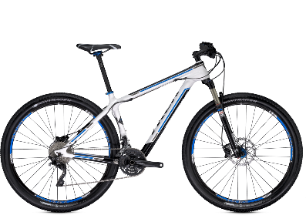
Track Resources & Calls To Action
Get Started with Windows Azure
Develop and Test in VMs, Build Websites, Extend on-premises applications
http://www.windowsazure.com
MSDN Subscribers: you’ve got it, now use it
Activate your MSDN Benefit & try it by 9/30
You could win* an Aston Martin V8 Vantage!
Go to: http://aka.ms/AzureContest
Drop by the Windows Azure booth to participate in the Windows Azure Challenge for even more prizes!
*No purchase necessary. Open to eligible Visual Studio Professional, Premium or Ultimate with MSDN subscribers as of June 1, 2013. Ends 11:59 p.m. PT on September 30, 2013. For full official rules including odds, eligibility and prize restrictions see website. Sponsor: Microsoft Corporation. Aston Martin is a trademark owned and licensed by Aston Martin Lagonda Limited. Image copyright Evox Images. All rights reserved.

Slide 29
Windows Track Resources
Windows Enterprise: windows.com/enterprise
Windows Springboard: windows.com/ITpro
Microsoft Desktop Optimization Package (MDOP): microsoft.com/mdop
Desktop Virtualization (DV): microsoft.com/dv
Windows To Go: microsoft.com/windows/wtg
Outlook.com: tryoutlook.com

Slide 30
Resources
Learning
Sessions on Demand
Microsoft Certification & Training Resources
http://channel9.msdn.com/Events/TechEd
www.microsoft.com/learning
TechNet
msdn
Resources for IT Professionals
Resources for Developers
http://microsoft.com/technet
http://microsoft.com/msdn

Slide 31
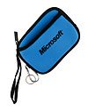
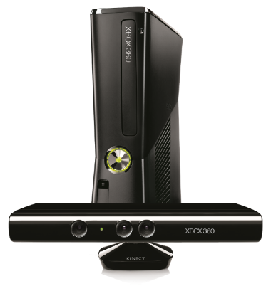
Complete an evaluation on CommNet and enter to win!

Slide 32
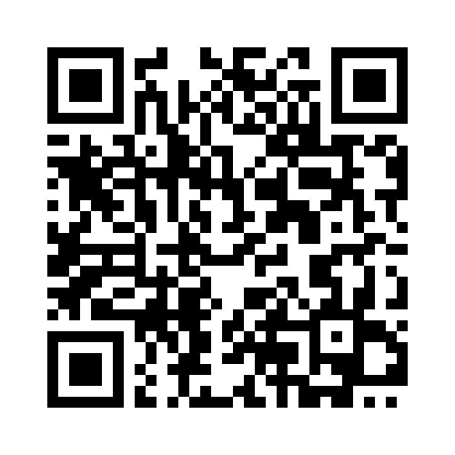
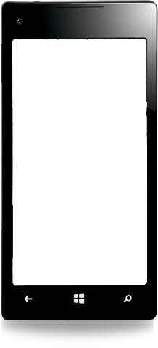
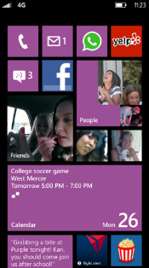
Evaluate this session
Required Slide
*delete this box when your slide is finalized
Your MS Tag will be inserted here during the final scrub.
Scan this QR code to evaluate this session and be automatically entered in a drawing to win a prize

Slide 33
© 2013 Microsoft Corporation. All rights reserved. Microsoft, Windows and other product names are or may be registered trademarks and/or trademarks in the U.S. and/or other countries.
The information herein is for informational purposes only and represents the current view of Microsoft Corporation as of the date of this presentation. Because Microsoft must respond to changing market conditions, it should not be interpreted to be a commitment on the part of Microsoft, and Microsoft cannot guarantee the accuracy of any information provided after the date of this presentation. MICROSOFT MAKES NO WARRANTIES, EXPRESS, IMPLIED OR STATUTORY, AS TO THE INFORMATION IN THIS PRESENTATION.

