Slide 2
B2B collaboration on Windows Azure BizTalk Services
WAD-B343
Karthik Bharathy

Slide 3
Key Takeaways
BizTalk Services on Azure announced for public preview
B2B is a key scenario on BizTalk Services
Partners going live on the platform to deliver end-to-end solutions!
This session goes deeper into the what & why of B2B capabilities on Azure

Slide 4
What is B2B...?

Slide 5


Slide 8
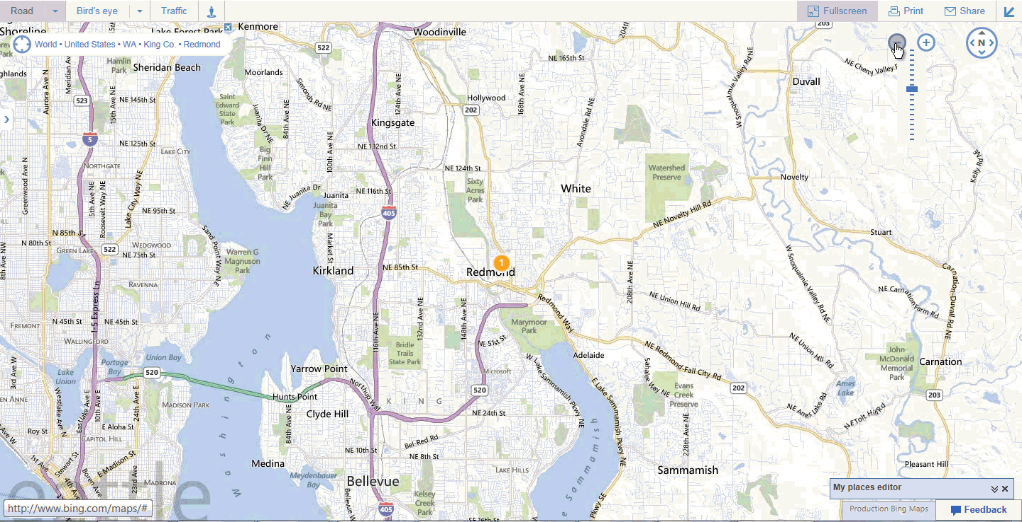

Slide 9
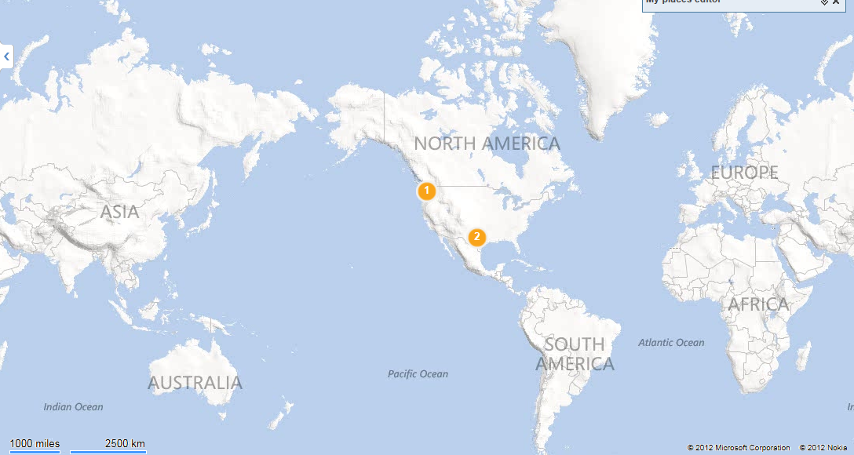
P
P
P
P
P
P
P
P
P
P
P
P
P
P
P
P

Slide 10
B2B is about partners, agreements and partnerships

Slide 11








B2B is one of the biggest workloads on BizTalk Server
Healthcare
Banking
Manufacturing
Retail
Insurance
Automotive
Education
Energy
BizTalk Server 2013 carries host of B2B improvements

Slide 12
Cloud opportunity – B2B
Lower Onboarding Cost
Partner self-service
Address Impedance mismatch
Business Analytics
Elastic Scale
Managed Infrastructure
High Availability
Increased Reach

Slide 13


What are customers asking…
We would like to reduce transaction cost by 25-50% currently incurred through low server utilization
We want to reduce partner onboarding time from weeks to a matter of days
Would like more out-of-box capabilities like archiving built-into the platform
Ease management of certificates
Simplify TPM configuration & setup
I need to be able to build a self-service solution

Slide 14

Who are we building this for?
Service Providers
CSV
Supplier1
EDI
TXT
Supplier2
Retailer
Service Provider
XML
Supplier3

Slide 15
Who are we building this for?
Enterprises and SI
EDI
Distributor1
EDI
Distributor2
Enterprise Manufacturer
EDI
Distributor3
VAN
EDI

Slide 16
Windows Azure BizTalk Services
Common
Hybrid Applications
Enable applications that span Cloud and On-premises
Configuration Driven Experience
Lower time to market & cost of development
Managed Service
Focus on business challenges
Extensible platform
Reduce partner onboarding & management cost
Cloud-scale ESB
Cost effective, scalable infrastructure
Connectivity to on-premises LOB
Seamless connectivity to BizTalk Server
Direct or queued connectivity
Visual Studio based bridge designer
Inbuilt support for common integration patterns
Enhanced transformation tooling
Built-in support for partner onboarding and management
Management integrated with Windows Azure Portal
Easy provisioning
Dedicated deployment managed by Microsoft
Rich, extensible monitoring
Extensible bridge infrastructure
Pipeline support for custom code
Trading Partner Management API
Tracking API
Rich Message Brokering & Mediation in the Cloud
Scalable secure robust infrastructure
Ease of scale

Slide 17
Moving the needle…
B2B on Windows Azure BizTalk Services
Existing benefits
Cloud benefits
  Agreement OM
  EDI protocols
  Integrate with EAI
  Templates
  Batching
  Ack correlation
  Config driven
  Managed Service
  Dedicated Service
  OM API
  Web Portal
  Rich Tracking

Slide 18
What is B2B on
Windows Azure BizTalk Services...

Slide 19


Slide 20


Slide 21

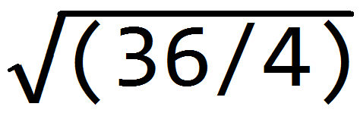
[ x+2x]= ?
3 + 2 = 5

Slide 22
B2B in Windows Azure BizTalk Services
is about “making B2B simple”

Slide 23


Slide 24



Slide 25
B2B in Windows Azure BizTalk services is also about
“making B2B powerful”

Slide 26
B2B on BizTalk Services is…
Simple
Powerful

Slide 27
Demo: Simple yet powerful
Connect to GXS from BizTalk Services

Slide 28
B2B in Windows Azure BizTalk services is also about
“making B2B extensible”

Slide 29
Demo: Extensible
Partner self-service from SharePoint Online

Slide 30
Existing investments
Migration from BizTalk Server
  Hybrid model
  Move to Cloud
Migration from other platforms (e.g. Gentran)
  Legacy formats and software
  Lack of functionality like batching/tracking

Slide 31
Demo: Migration
From BizTalk Server and Gentran

Slide 32
Rich Tracking
Gain insight into message flows from the tracking
  UI in BizTalk portal for EAI and EDI scenarios
Tracing information for custom code
Build your own analytics accessing the tracking data

Slide 33
Demo: Tracking
Windows 8 alerts

Slide 34
Key Takeaways
BizTalk Services on Azure announced for public preview
B2B is a key scenario on BizTalk Services
Simple: Configure your system in minutes not weeks!
Powerful: Platform capabilities for rich interactions (with tracking and archiving)
Extensible: Programmatic access for deployment, TPM automation
Partners going live on the platform to deliver end-to-end solutions!

Slide 35
Links
SDK, schemas and tools downloads
http://www.microsoft.com/en-us/download/details.aspx?id=39087
BizTalk Service Forums
http://social.msdn.microsoft.com/Forums/en-US/azurebiztalksvcs
Samples MSDN Code Gallery
http://code.msdn.microsoft.com/windowsazure/
BizTalk Portal
https://portal.biztalk.windows.net
MSDN documentation
http://msdn.microsoft.com/en-us/library/windowsazure/hh689864.aspx
BizTalk Team Blog
http://blogs.msdn.com/b/biztalk_server_team_blog

Slide 36

Related content
Breakout Sessions
  WAD-B312 Microsoft Integration Vision and Roadmap
  WAD-B313 Introduction to Windows Azure BizTalk Services
  WAD-B315 Extending Windows Azure BizTalk Services
  WAD-B344 Introducing Microsoft BizTalk Server 2013
  WAD-B405 Developing Hybrid Solutions with BizTalk and Windows Azure
  WAD-B314 Microsoft BizTalk Server 2013 in Windows Azure IaaS
  ATC-B220 Patterns of Cloud Integration
Find Me Later At
    Email: karthikb@microsoft.com
    Twitter: @kb_chirps

Slide 37

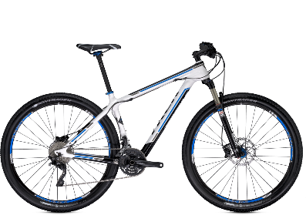
Track Resources & Calls To Action
Get Started with Windows Azure
Develop and Test in VMs, Build Websites, Extend on-premises applications
http://www.windowsazure.com
MSDN Subscribers: you’ve got it, now use it
Activate your MSDN Benefit & try it by 9/30
You could win* an Aston Martin V8 Vantage!
Go to: http://aka.ms/AzureContest
Drop by the Windows Azure booth to participate in the
Windows Azure Challenge for even more prizes!
*No purchase necessary. Open to eligible Visual Studio Professional, Premium or Ultimate with MSDN subscribers as of June 1, 2013. Ends 11:59 p.m. PT on September 30, 2013. For full official rules including odds, eligibility and prize restrictions see website. Sponsor: Microsoft Corporation. Aston Martin is a trademark owned and licensed by Aston Martin Lagonda Limited. Image copyright Evox Images. All rights reserved.

Slide 38
Windows Track Resources
Windows Enterprise: windows.com/enterprise
Windows Springboard: windows.com/ITpro
Microsoft Desktop Optimization Package (MDOP): microsoft.com/mdop
Desktop Virtualization (DV): microsoft.com/dv
Windows To Go: microsoft.com/windows/wtg
Outlook.com: tryoutlook.com

Slide 39

Resources
Learning
  Sessions on Demand
  Microsoft Certification & Training Resources
http://channel9.msdn.com/Events/TechEd
www.microsoft.com/learning
TechNet
msdn
  Resources for IT Professionals
  Resources for Developers
http://microsoft.com/technet
http://microsoft.com/msdn

Slide 40






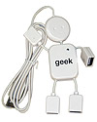
Complete an evaluation on CommNet and enter to win!

Slide 41
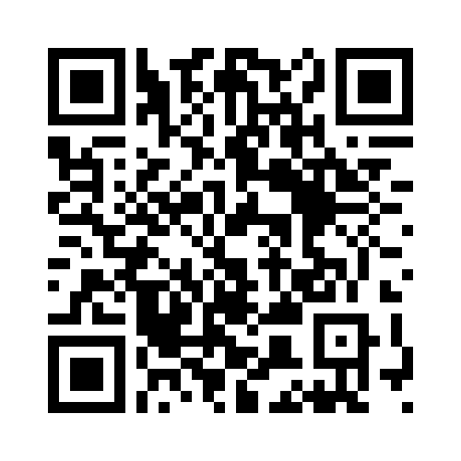


Evaluate this session
Required Slide
*delete this box when your slide is finalized
Your MS Tag will be inserted here during the final scrub.
Scan this QR code to evaluate this session and be automatically entered in a drawing to
win a prize

Slide 42

© 2013 Microsoft Corporation. All rights reserved. Microsoft, Windows and other product names are or may be registered trademarks and/or trademarks in the U.S. and/or other countries.
The information herein is for informational purposes only and represents the current view of Microsoft Corporation as of the date of this presentation. Because Microsoft must respond to changing market conditions, it should not be interpreted to be a commitment on the part of Microsoft, and Microsoft cannot guarantee the accuracy of any information provided after the date of this presentation. MICROSOFT MAKES NO WARRANTIES, EXPRESS, IMPLIED OR STATUTORY, AS TO THE INFORMATION IN THIS PRESENTATION.

