Slide 2
Windows Azure from the Pulpit to the Whiteboard
WAD-B351
Ryan Dunn & Wade Wegner

Slide 3
What we do at Aditi
ACCELERATE INNOVATIONS USING CLOUD
TO THE CLOUD.
THE RIGHT WAY.
DIFFERENTIATE WITH DESIGN AND USER EXPERIENCE
DELIVER SCALE AND AGILITY

Slide 4
Our clients are technology leaders …

Slide 5
… who trust us with their transformation
52% of our customers rate us 5/5.
45 + active customers.
1200+ engagements.
1600 people, globally
18 years, 12 locations
Best companies to work for
Top 10 IT Workplace
Three Windows Azure MVPs
Top 50 Cloud influencers
1:114 hiring ratio
The Best ‘OF’ Vendor Award
2012 Partner of the year
Windows Azure , Finalist
2011 Partner of the year
Windows Azure SI, Finalist
2010 Partner of the year
Windows Azure , Winner

Slide 6
What we will cover today
Building for Scale
DevOps
Automation
Monitoring
Testing
Handling Disaster/Downtime

Slide 7
AzureOps.com
Monitors deployments in Windows Azure
At peak, monitored ~3000 VMs in 6 datacenters
Processed TBs of trace data per month, GBs of perf counters
Consumed half-billion storage transactions per month
Ran on 2 S, 4 M + (2 M x DC), and 12 XS instances.
Auto-scales based on custom metrics
Alerts based on custom rules

Slide 8
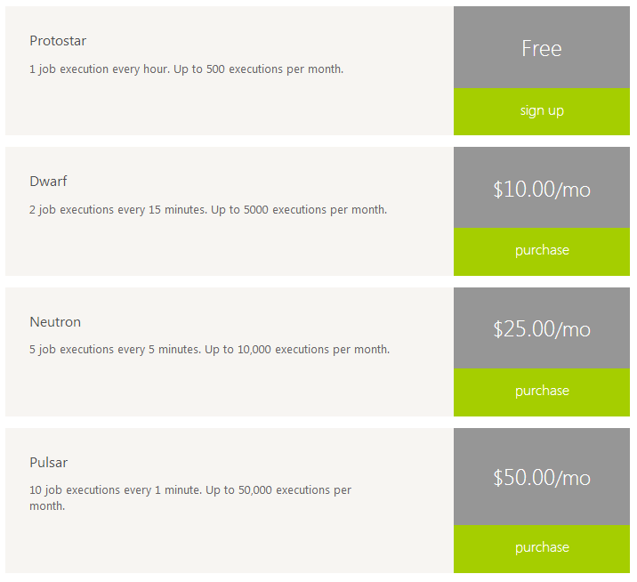
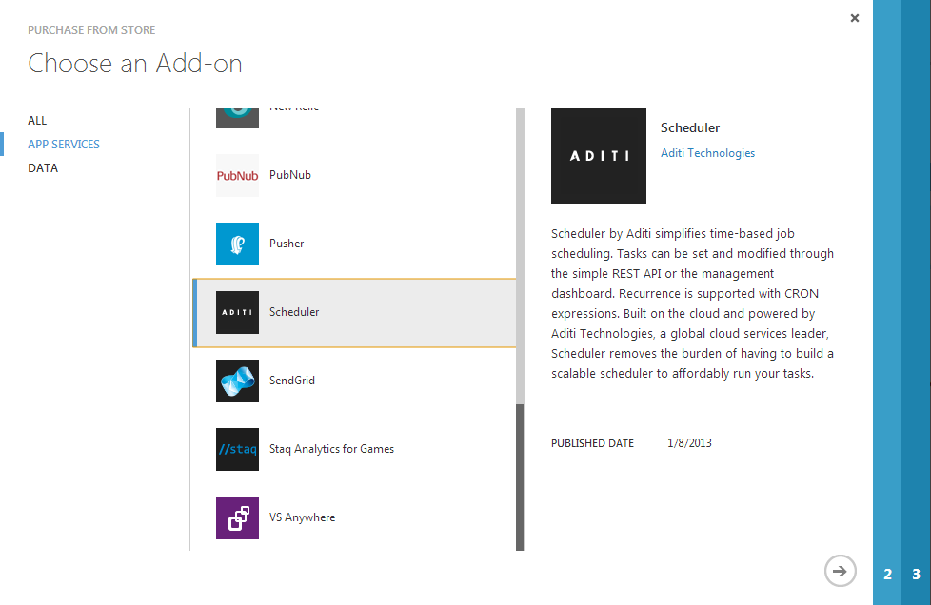
Scheduler

Slide 9
Scheduler
Time-based job scheduling
Features
Webhooks (GET, POST), Windows Azure Queues
Basic Auth & None
NuGet
500,000 job executions
Live API documentation
Four plans available in store

Slide 10
High Level Architecture
Web
Scheduler
Schedule Repo
Service Client
Queries
Commands
Query Svc
Denormalizers
Data Access Layer
Command Handlers
Event Bus
Domain Model
Events
Event Handlers
View Data
Event Data

Slide 11
Building for Scale
Asynchronous
Learn to live with stale data
Stabilize
Work close to your data
Push your hard work to queues
Optimize for reads
Data
Geolocate

Slide 12
Optimize for reads
Events raised from commands are dispatched to denormalizers from event bus
Create a view for each ‘task’ on the UI
Static views versus dynamic views
Static data
E.g. account details, current balance, or settings
Ideal for JSON files sitting in blob storage
Queryable data
E.g. last X hours of trace information with Y level
Served efficiently from table storage.

Slide 13
Work close to your data
Bandwidth becomes limiting factors
Between datacenters
Between VM and NIC
Employ a message routing strategy
Messages can get routed to geo-specific queues

Slide 14
Example
Customer with > 300 VMs deployed and 100’s of SQL Azure databases.
Error in DB connection logic and tight loop retry. Each error is traced with full stack trace.
Table storage data format is verbose to begin with, but…
1 GB NIC completely saturated on 16 workers trying to keep up
Timeout during read due to too much data, which caused RETRY
Autoscale noticed high queue levels stacking – scaled to max

Slide 15
Solution
Throttle! Protect your service.
Read first 50,000 traces in 5 mins and raised Throttled event
Be very cautious on Retry policies
Virtuous cycles can bite

Slide 16
Push your hard work to queues
Applies almost universally in CQRS world
Allows for asynchronous dispatch and eventual handling
Prioritize queues
E.g. VIP Queues for UI commands
Prevents stacking of high priority messages that update views
Alleviates front-end from blocking calls
HTTP requests become highly efficient and scalable when combined with Read Optimization

Slide 17
Example
Autoscale system would periodically kick up 4 new instances based on queue length
Queues would bleed down, repeat every 2 hours (as 2 instances would scale away)
Unknown reason why command queue length was increasing on cyclical 2 hour cycle

Slide 18
Solution
Added custom counters by type of command
Found that calls to SMAPI would have average of 60 seconds and as long as 240 seconds (fastest was 30).
Routed SMAPI refresh commands to own queue and put 12 XS workers on it to process
Same cost as 2 S workers
6x as many commands processed

Slide 19
Identifying Bottlenecks
Instrumentation is key
Custom performance counters is nice
Simple timer that traces long commands works well too
Watch for trends over time
Snapshots might not help until you look at them over time

Slide 20
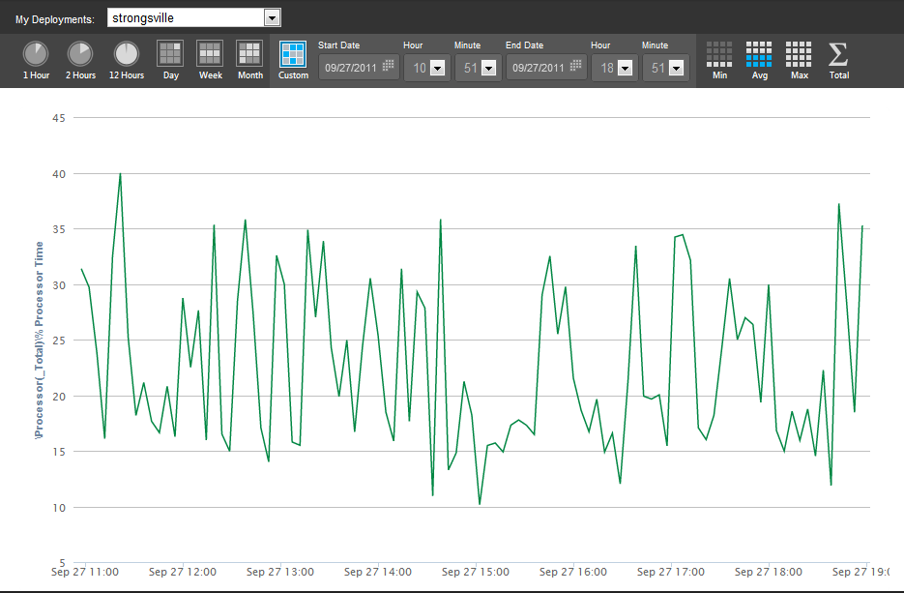
Snapshot 1

Slide 21
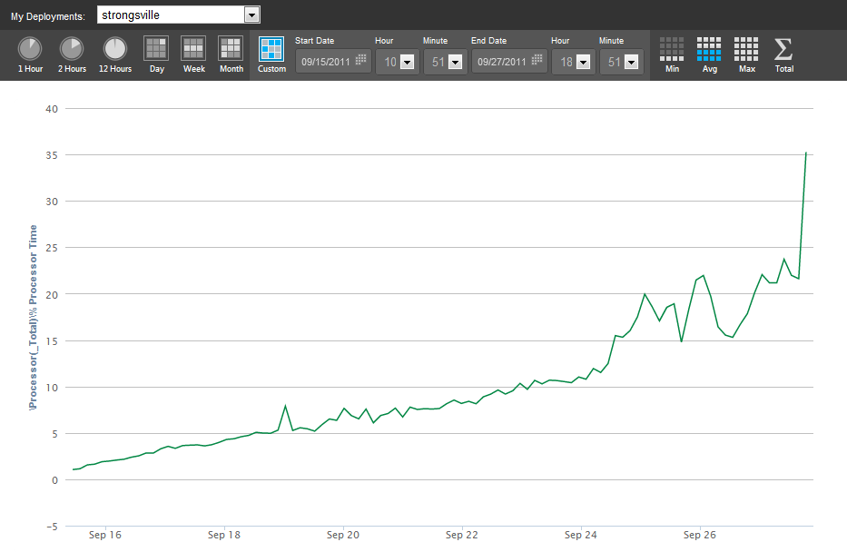
Snapshot 2

Slide 22
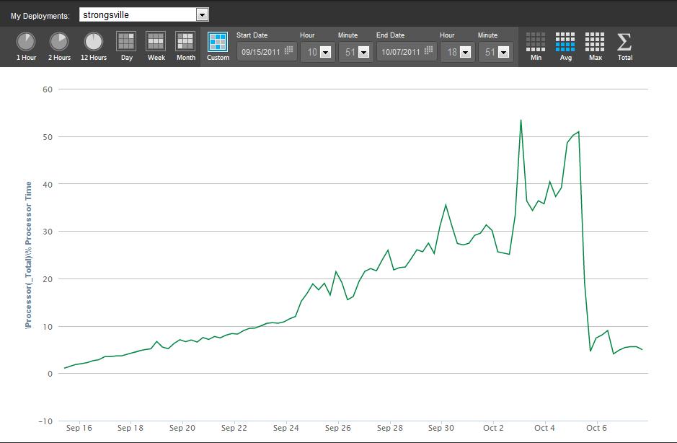
Snapshot 3

Slide 23
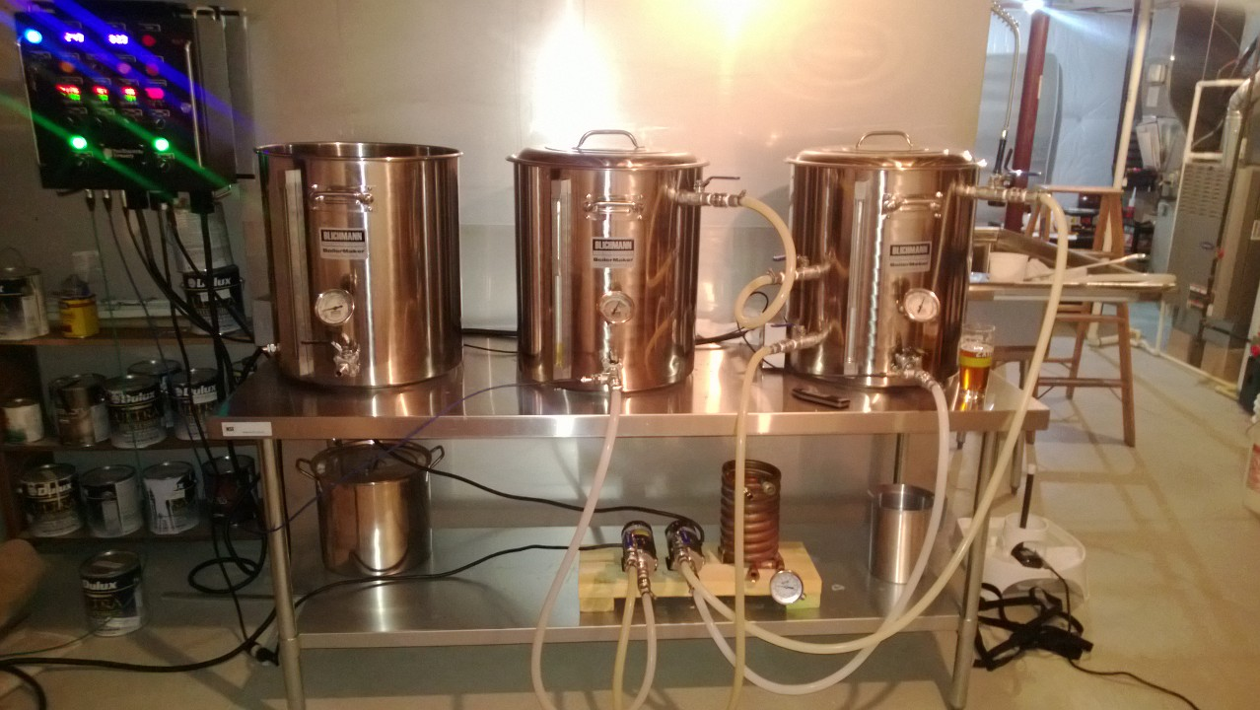
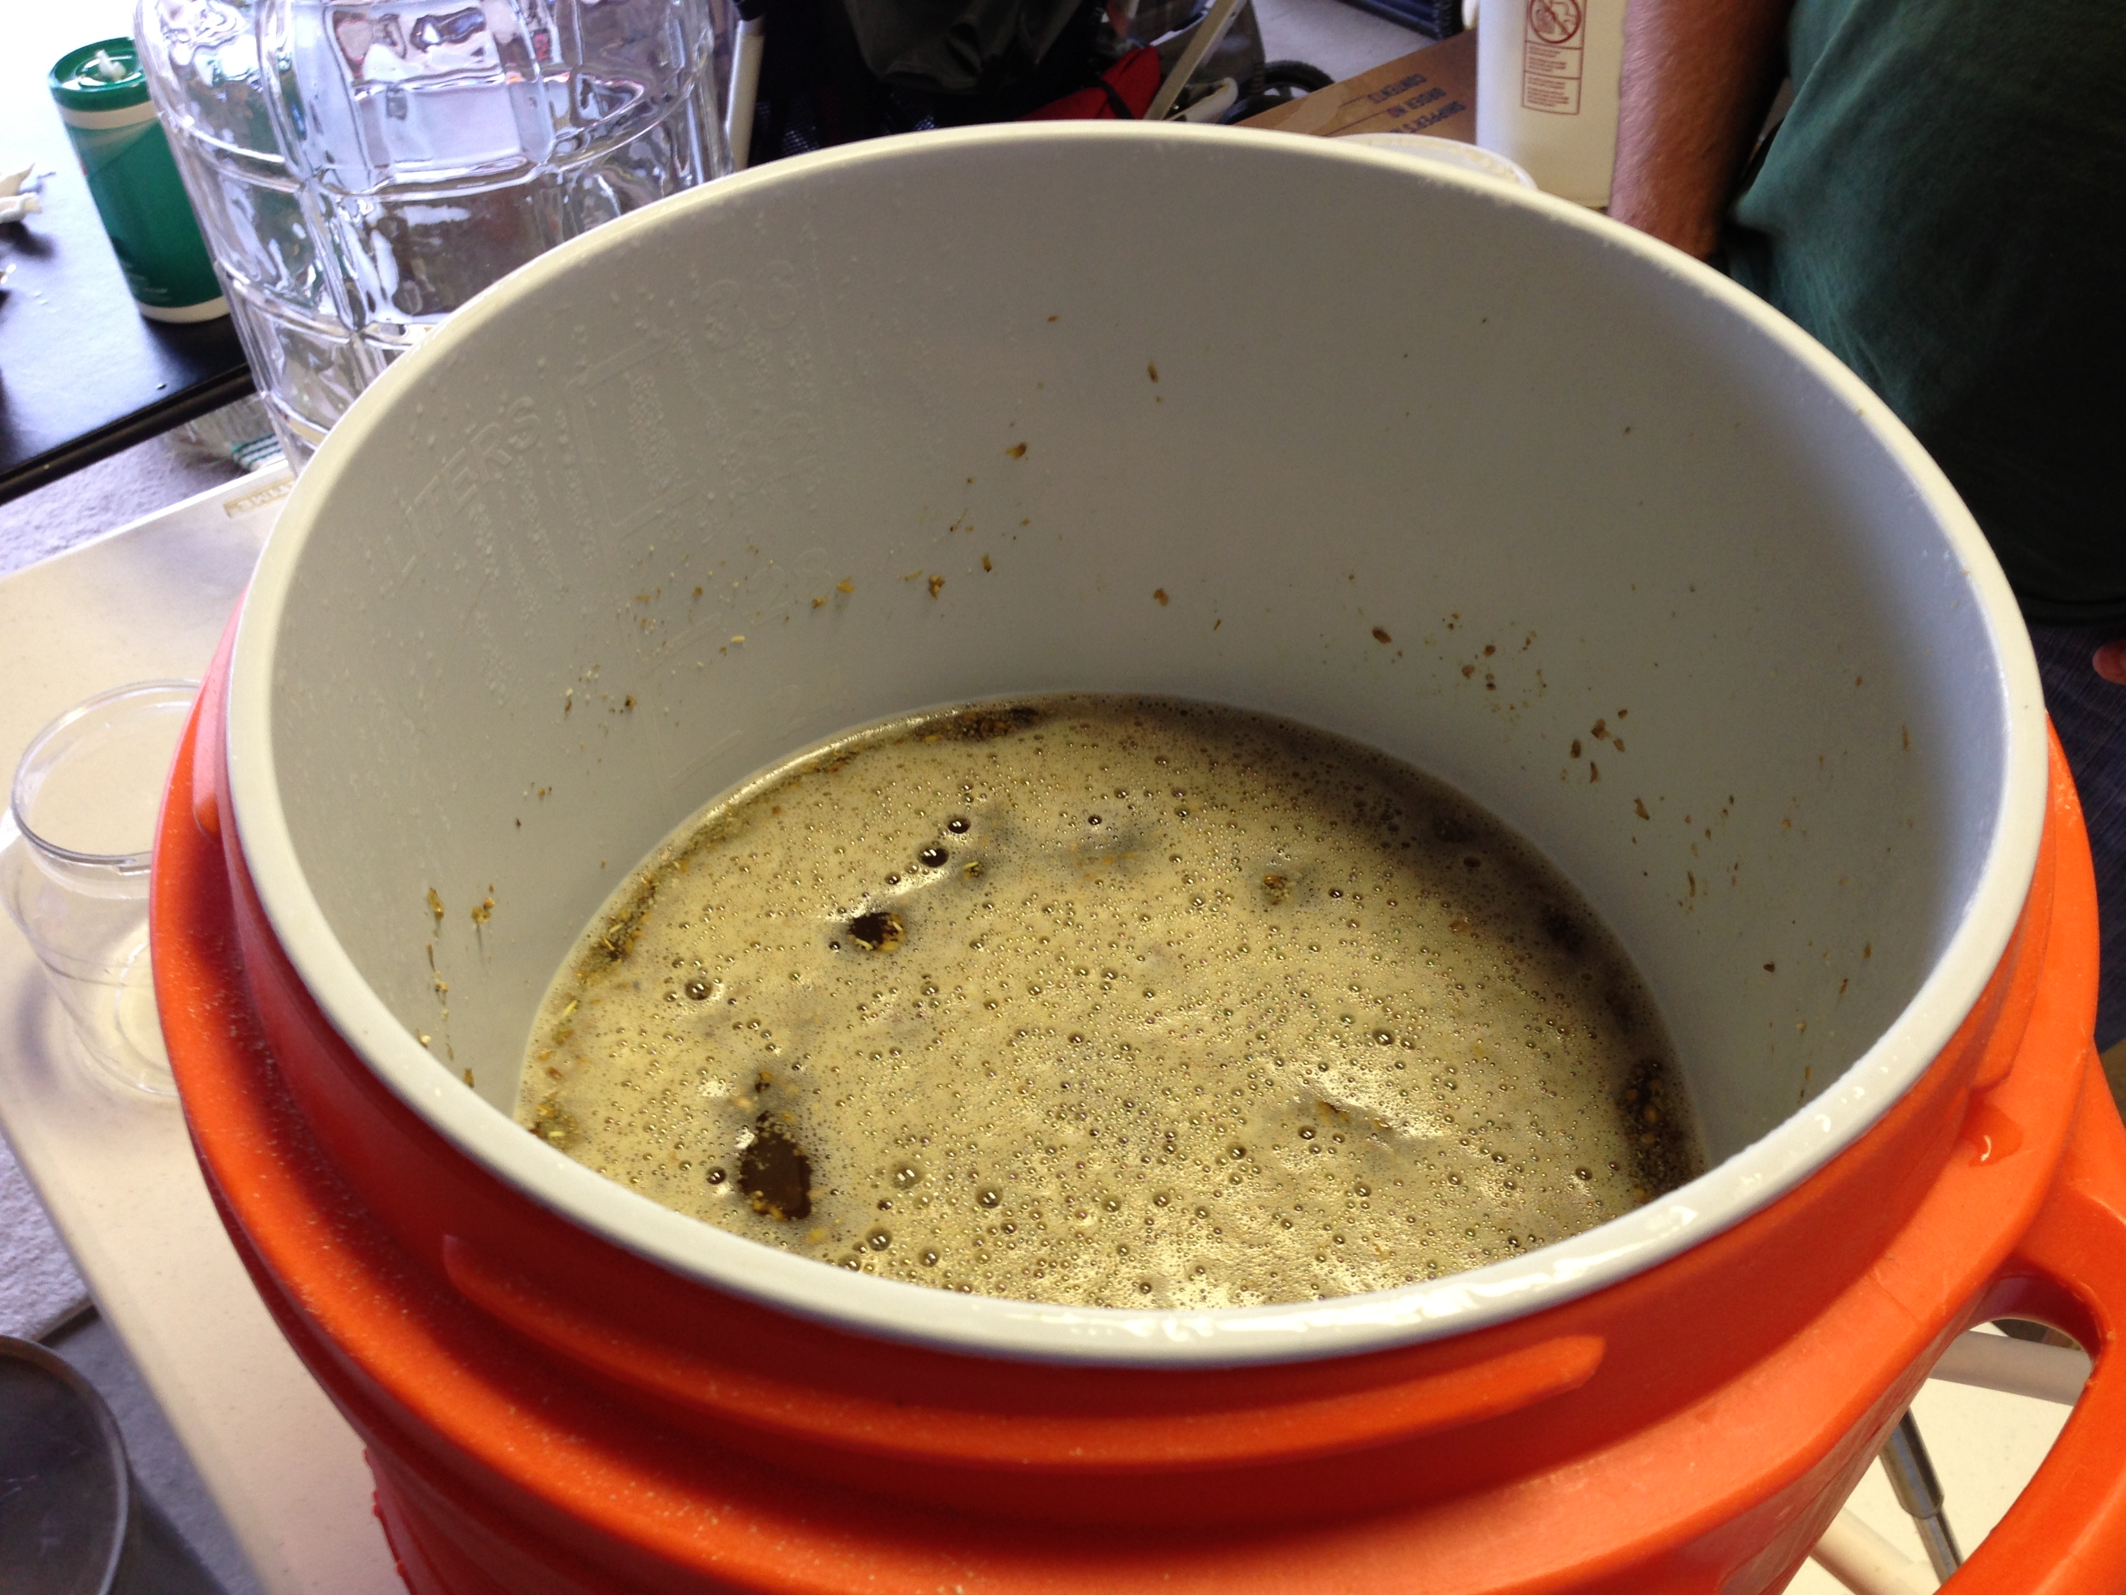
Homebrewing

Slide 24
CQRS In Action
BeerMe : a scalable platform for distributing beer

Slide 25
What worked well
REST APIs using WebAPI
Lokad.CQRS
J. Oliver Eventstore

Slide 26
What didn’t work well
WCF
Binary serialization formats
Entity Framework

Slide 27
Automation
Build Automation
Deployment Automation
Data Migrations

Slide 28
Why automate?
Reproducibility, Reproducibility
Takes the ‘I forgot to…’ out of it.
Automate
Visual Studio deploys verboten.
Continuous builds raise the quality bar.
Data migrations tie it together.

Slide 29
Build Demo
Automating builds & deployments

Slide 30
Deployment Patterns
PaaS vs IaaS
Extra Small VMs
Azure Websites vs WebRoles
Single Deployment vs many

Slide 31
Websites versus WebRoles
Git deployment on Windows Azure Websites is very nice
Ability to use RoleEntry point on WebRoles can be more important than ease of deployment
Ability to control dependencies
Scale beyond websites and VMs
SSL support is free
WebRoles FTW

Slide 32
Single vs Many Deployments
Many deployments required to have geo-redundancy.
Coordinating upgrades becomes challenging
Ability to dynamically route messages works to your advantage
Just ‘turn off’ geo-route until upgrade complete

Slide 33
Handling outages and disaster
Outages are extremely common
Trust me
Service degradations
Every service you use has its own SLA
The best you can do is the multiplication of each SLA
E.g. 99.95 * 99.9 * 99.9 = 99.75

Slide 34
Remediation Strategies
Weigh your risk
Tradeoffs abound, what is your single point of failure?
Queues can help
Distributed Queues might be necessary
Geo-Distribution
Fault domains
Multi-datacenter
Multi-cloud

Slide 35
Recap
Building for Scale
DevOps
Handling Disaster/Downtime

Slide 36
Web | Blog | Facebook | Twitter | LinkedIn

Slide 37
Windows Track Resources
Windows Enterprise: windows.com/enterprise
Windows Springboard: windows.com/ITpro
Microsoft Desktop Optimization Package (MDOP): microsoft.com/mdop
Desktop Virtualization (DV): microsoft.com/dv
Windows To Go: microsoft.com/windows/wtg
Outlook.com: tryoutlook.com

Slide 38
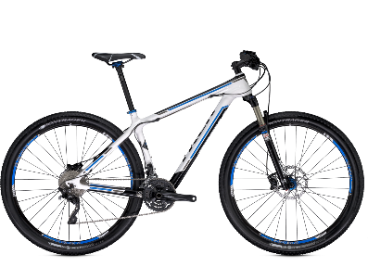
Track Resources & Calls To Action
Get Started with Windows Azure
Develop and Test in VMs, Build Websites, Extend on-premises applications
http://www.windowsazure.com
MSDN Subscribers: you’ve got it, now use it
Activate your MSDN Benefit & try it by 9/30
You could win* an Aston Martin V8 Vantage!
Go to: http://aka.ms/AzureContest
Drop by the Windows Azure booth to participate in the Windows Azure Challenge for even more prizes!
*No purchase necessary. Open to eligible Visual Studio Professional, Premium or Ultimate with MSDN subscribers as of June 1, 2013. Ends 11:59 p.m. PT on September 30, 2013. For full official rules including odds, eligibility and prize restrictions see website. Sponsor: Microsoft Corporation. Aston Martin is a trademark owned and licensed by Aston Martin Lagonda Limited. Image copyright Evox Images. All rights reserved.

Slide 39
Resources
Learning
Sessions on Demand
Microsoft Certification & Training Resources
http://channel9.msdn.com/Events/TechEd
www.microsoft.com/learning
TechNet
msdn
Resources for IT Professionals
Resources for Developers
http://microsoft.com/technet
http://microsoft.com/msdn

Slide 40
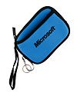
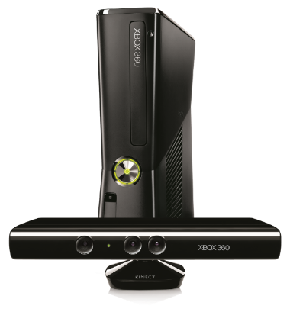
Complete an evaluation on CommNet and enter to win!

Slide 41
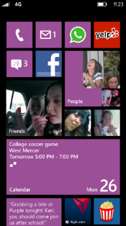
Evaluate this session
Required Slide
*delete this box when your slide is finalized
Your MS Tag will be inserted here during the final scrub.
Scan this QR code to evaluate this session and be automatically entered in a drawing to win a prize

Slide 42
© 2013 Microsoft Corporation. All rights reserved. Microsoft, Windows and other product names are or may be registered trademarks and/or trademarks in the U.S. and/or other countries.
The information herein is for informational purposes only and represents the current view of Microsoft Corporation as of the date of this presentation. Because Microsoft must respond to changing market conditions, it should not be interpreted to be a commitment on the part of Microsoft, and Microsoft cannot guarantee the accuracy of any information provided after the date of this presentation. MICROSOFT MAKES NO WARRANTIES, EXPRESS, IMPLIED OR STATUTORY, AS TO THE INFORMATION IN THIS PRESENTATION.

