Slide 2
P0wn3d! What’s Next?
WCA-B220
Raymond Comvalius &
Erdal Ozkaya

Slide 3
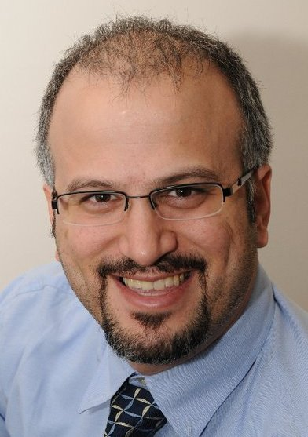


About the speakers
Erdal Ozkaya
  Regional Director – Kemp Technologies
  MVP Windows Expert IT Pro since 2009
  eozkaya@kemptechnologies.com
  Blog: www.YourMCT.com
MVP
@Erdal_Ozkaya

Slide 4

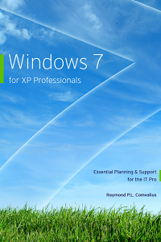
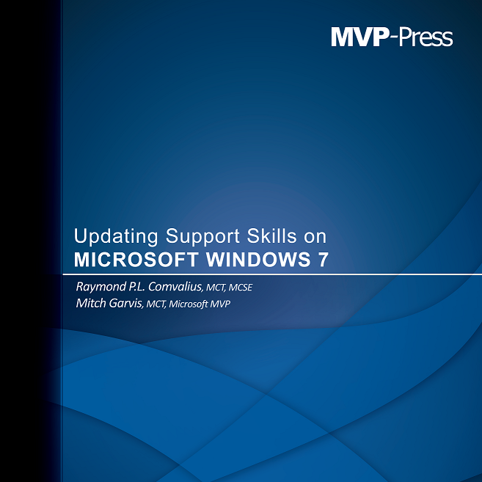
About the speakers
Text/Icon/Pic
Raymond P. L. Comvalius
  Consultant, trainer and author
  MVP Windows Expert IT Pro since 2011
  raymond.comvalius@nextxpert.nl
MVP
@nextxpert

Slide 5
Agenda
Why this Session?
Look for Weakness
Take Action!

Slide 6


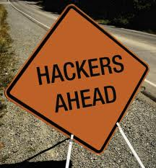


To prevent this.!

Slide 7
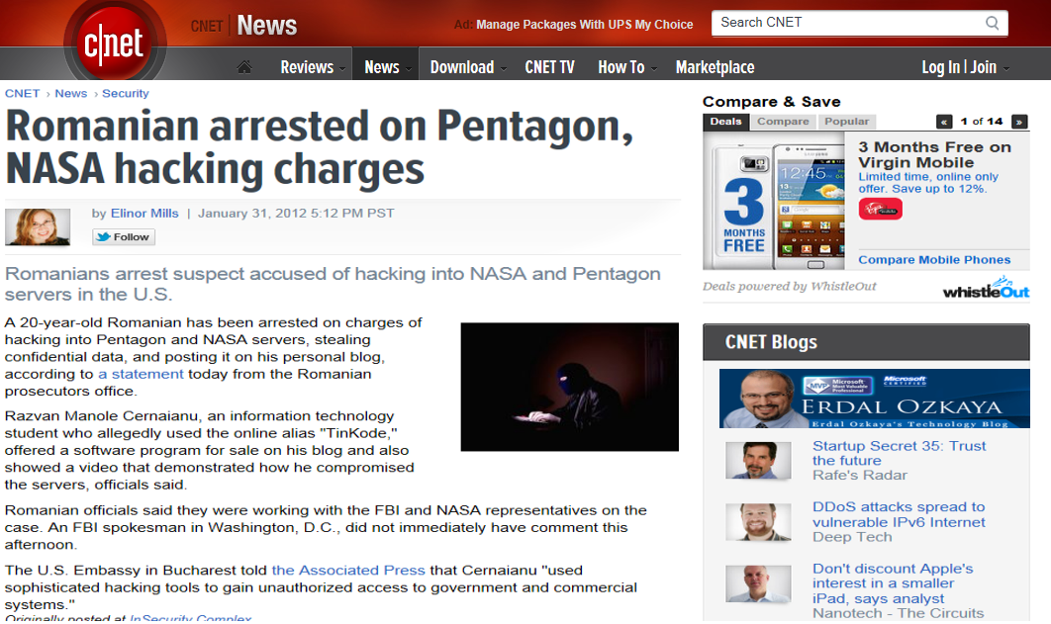
May be this will look more realistic!

Slide 8
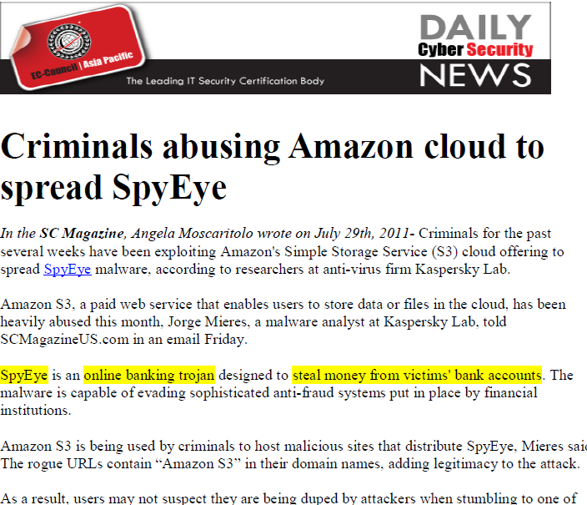
Or this ?

Slide 9
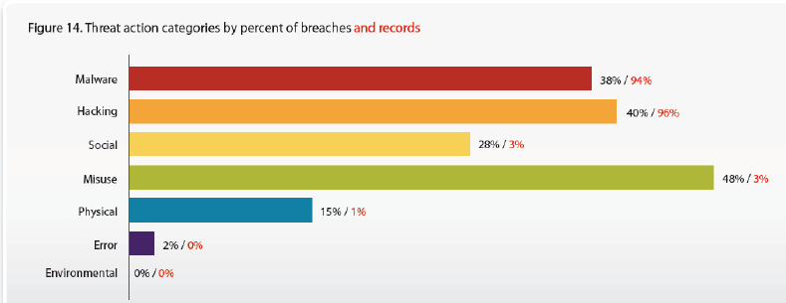

Slide 10


Slide 11
Best Practices to Keep Your Systems SAFE!
Golden Rule!
There is no way to STOP a Hacker, you can only make their job
HARDER !

Slide 12
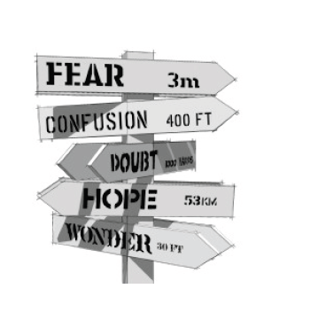

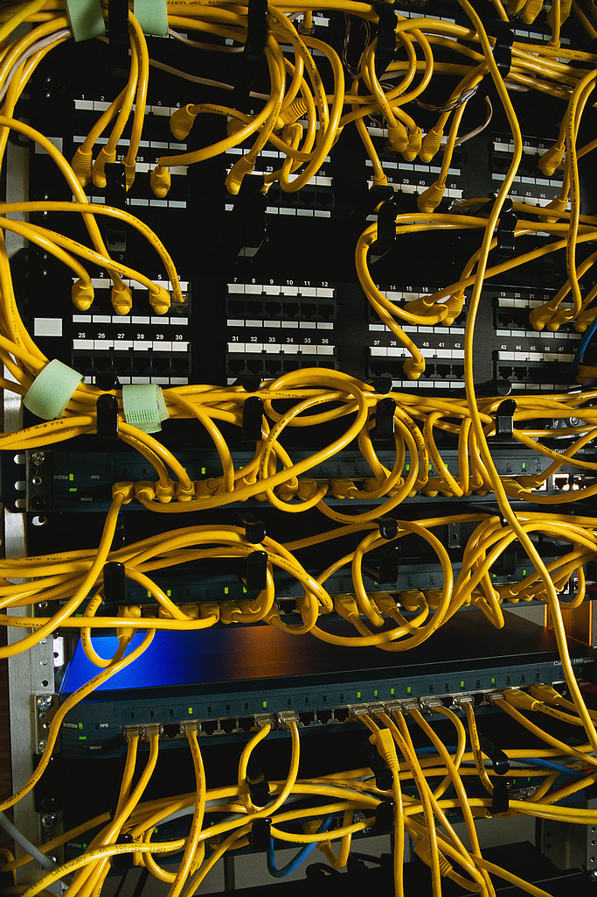
Sounds familiar ?
Costs too much money!
Too complicated
Not worth the bother!!
My SIMPLE firewall protects me ☺
We have got “A” Solution

Slide 13
Learn to look for weakness

Slide 14
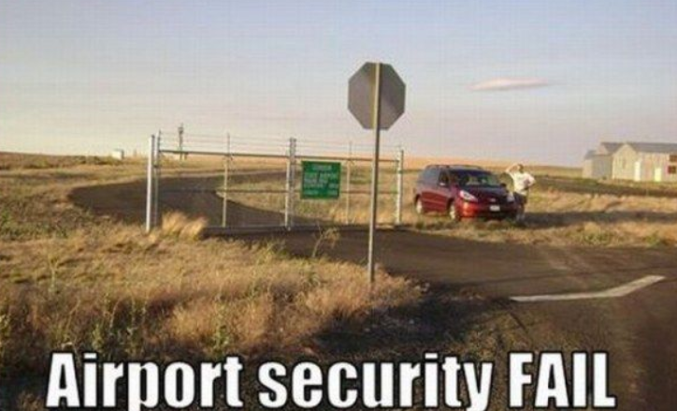

Slide 15

XXXXXXXX

Slide 16
Just Look Careful

Slide 17
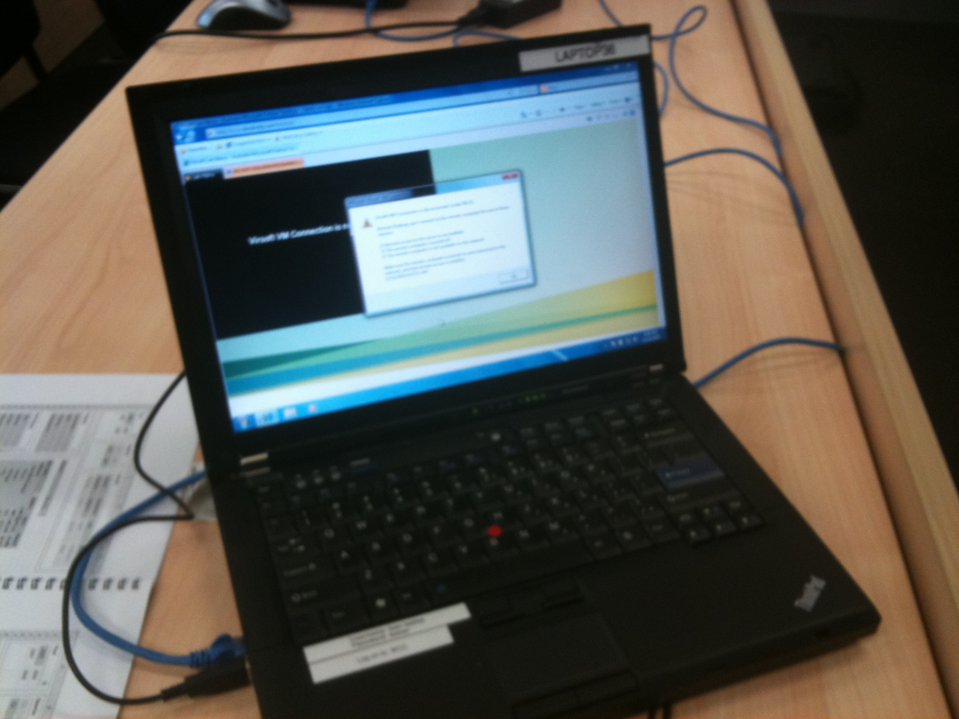

Slide 18
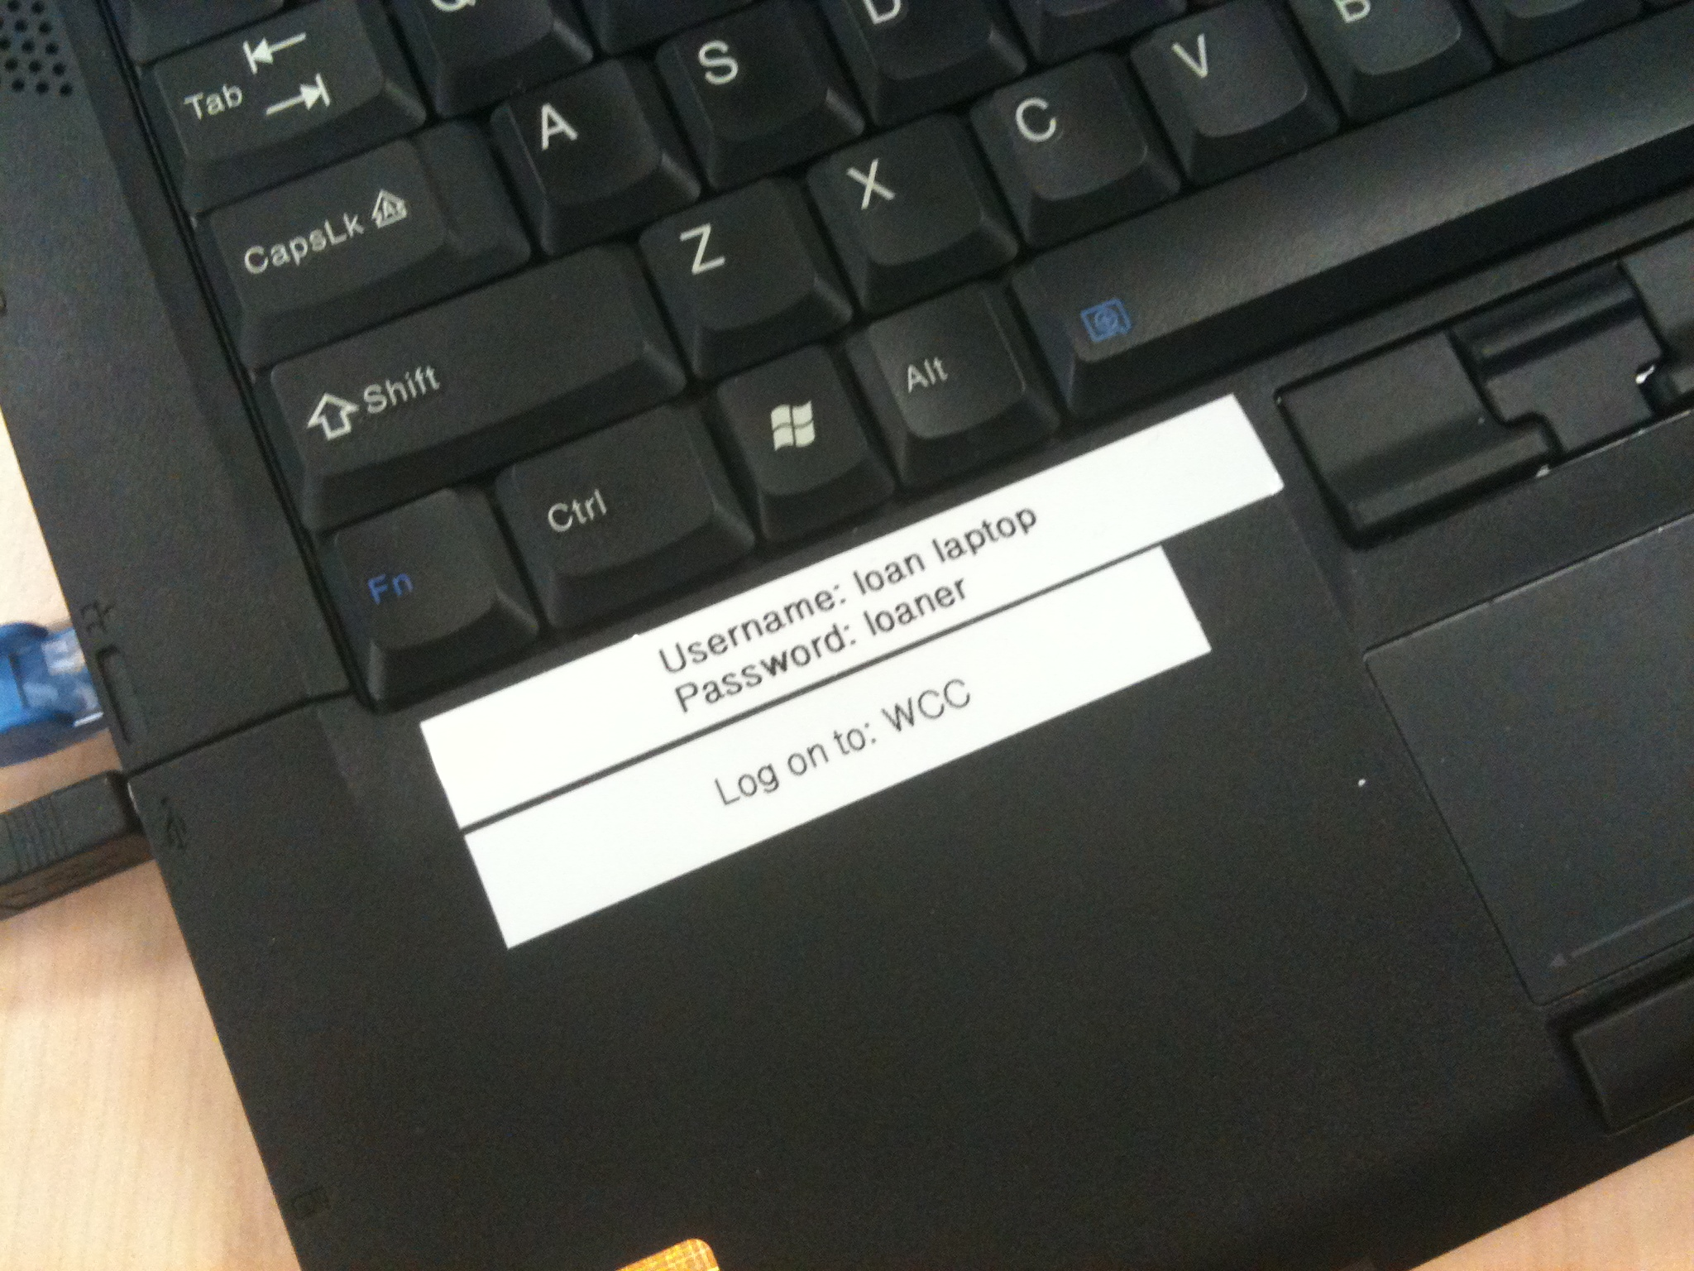

Slide 19
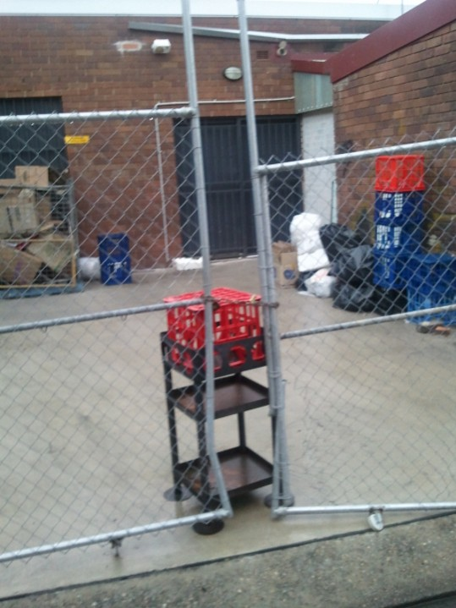
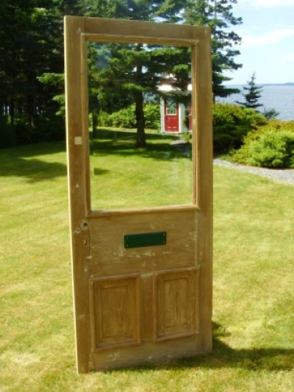
This was NOT a Good Idea!

Slide 20


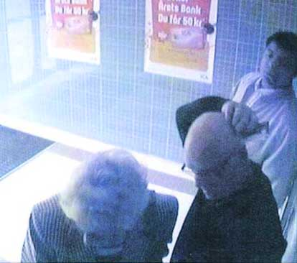

Could This Be You?

Slide 21
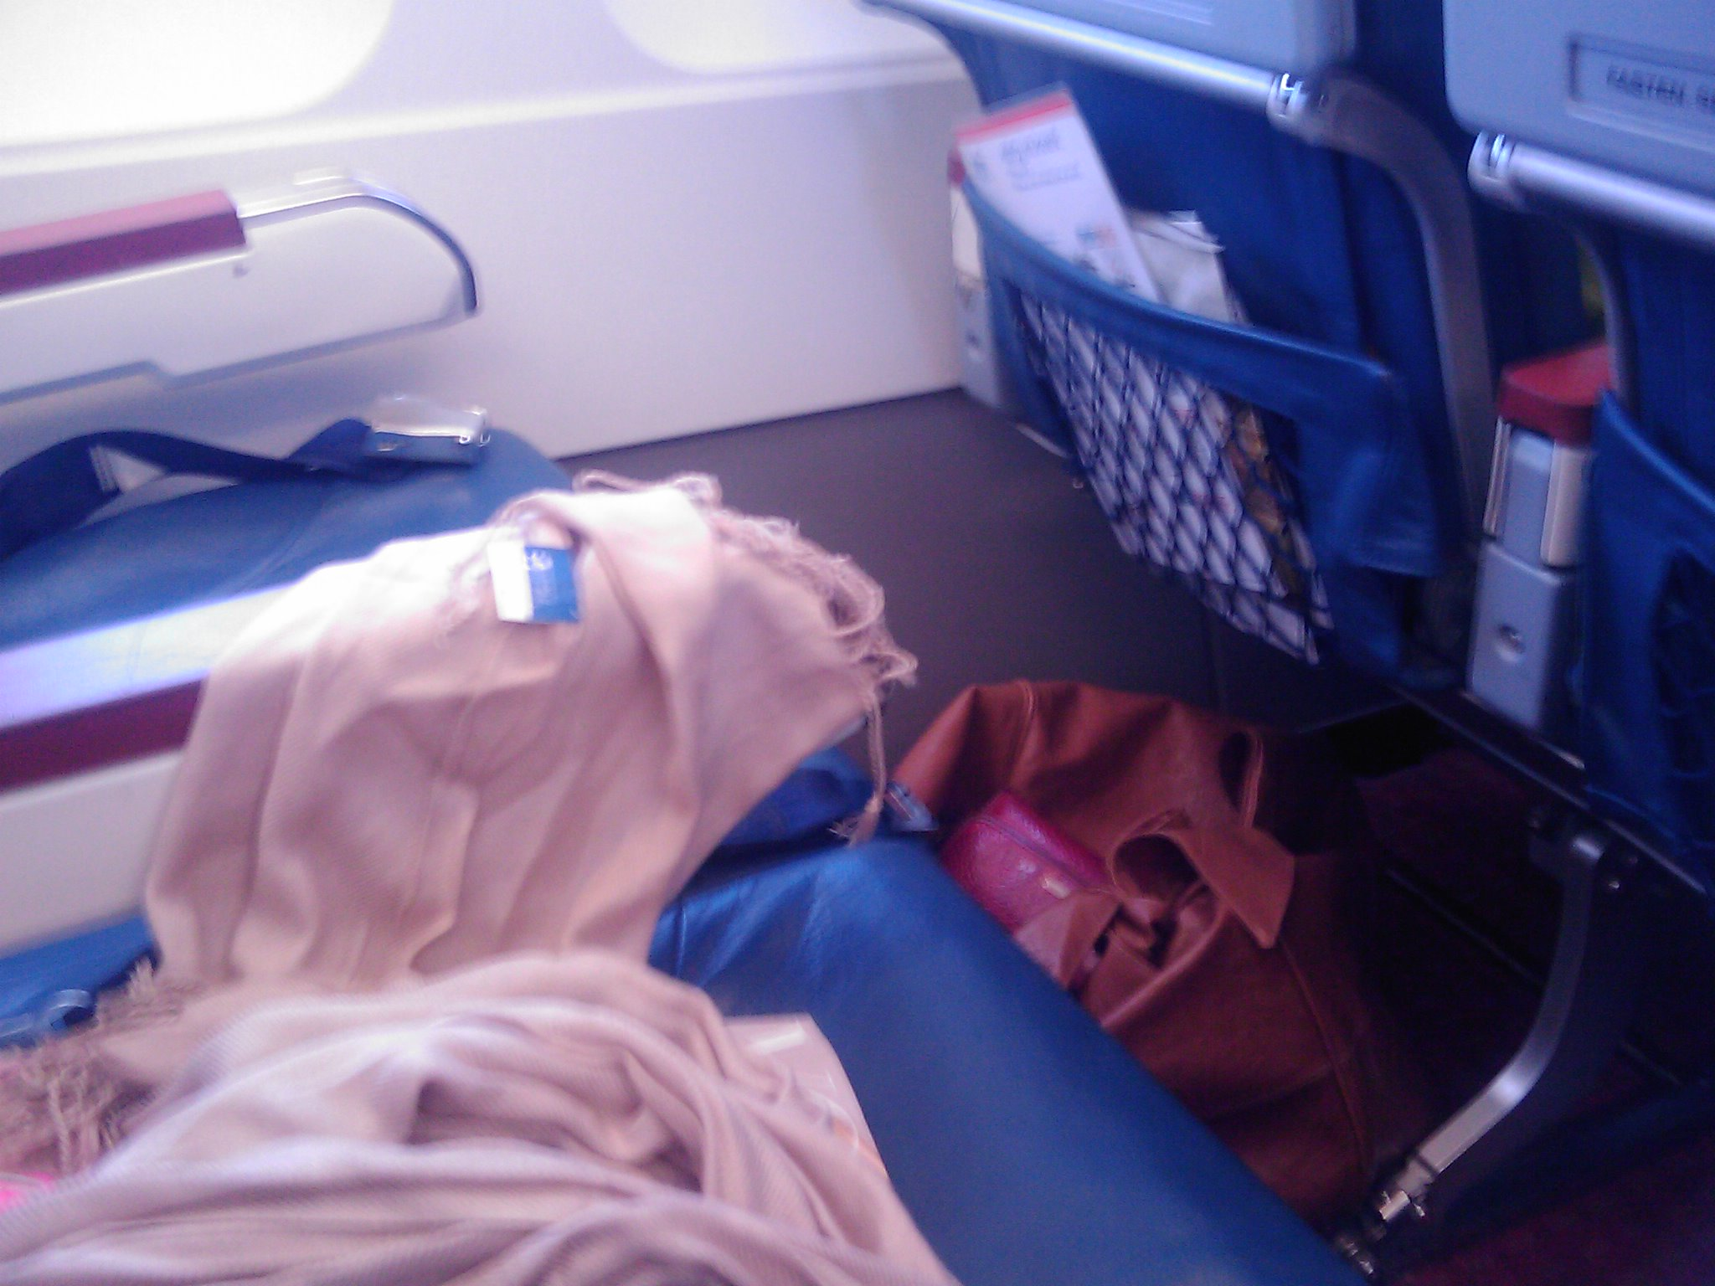
Did You Trust the Right Person?

Slide 22
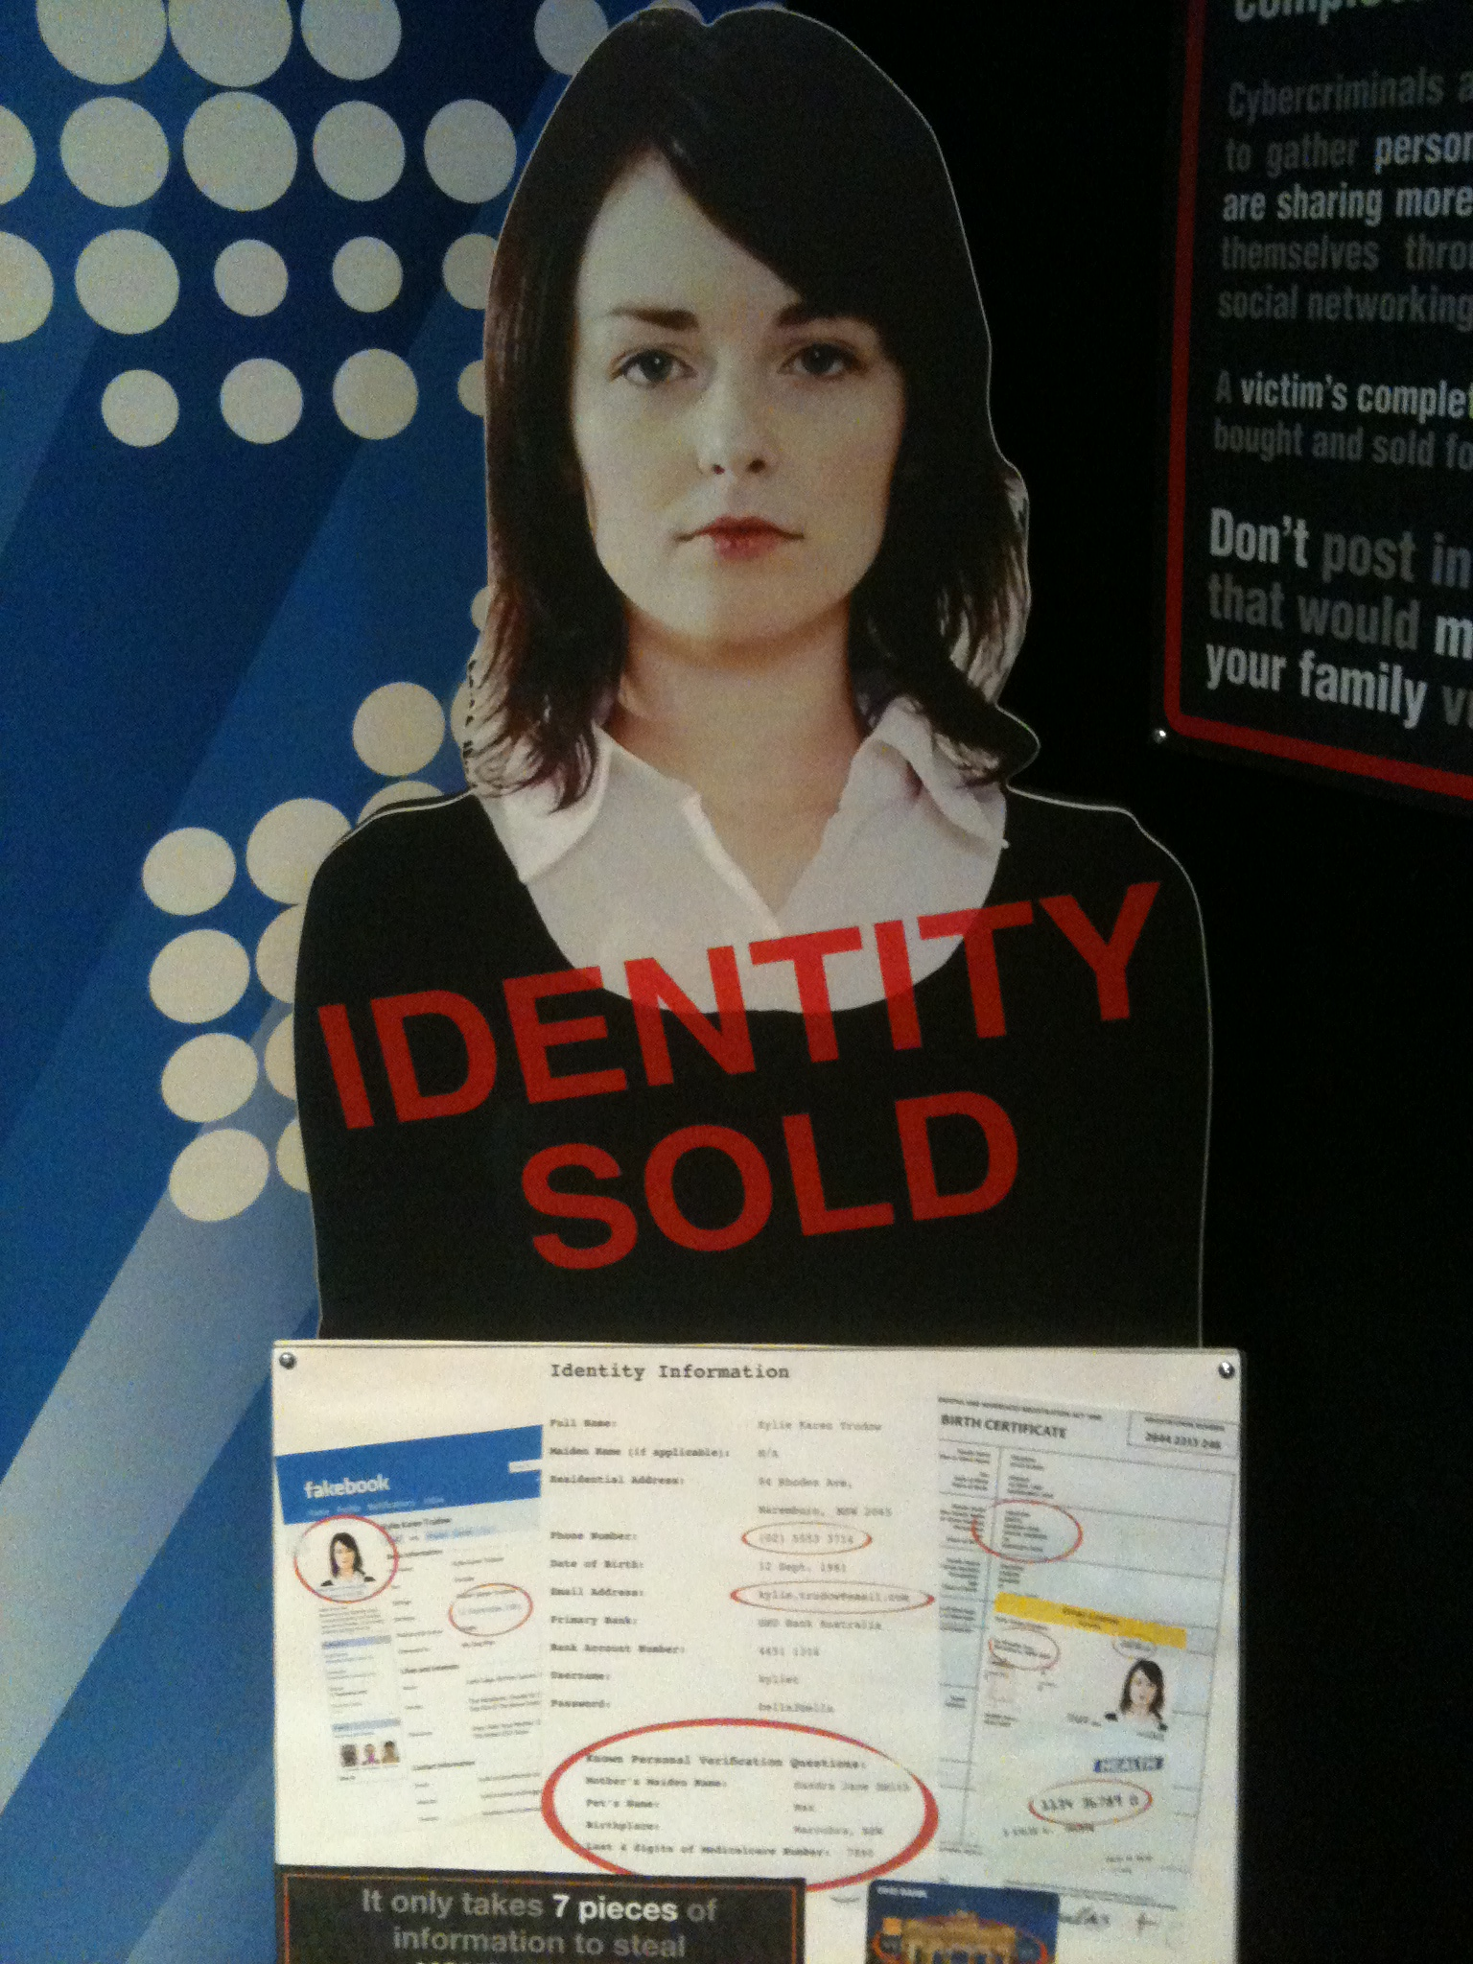
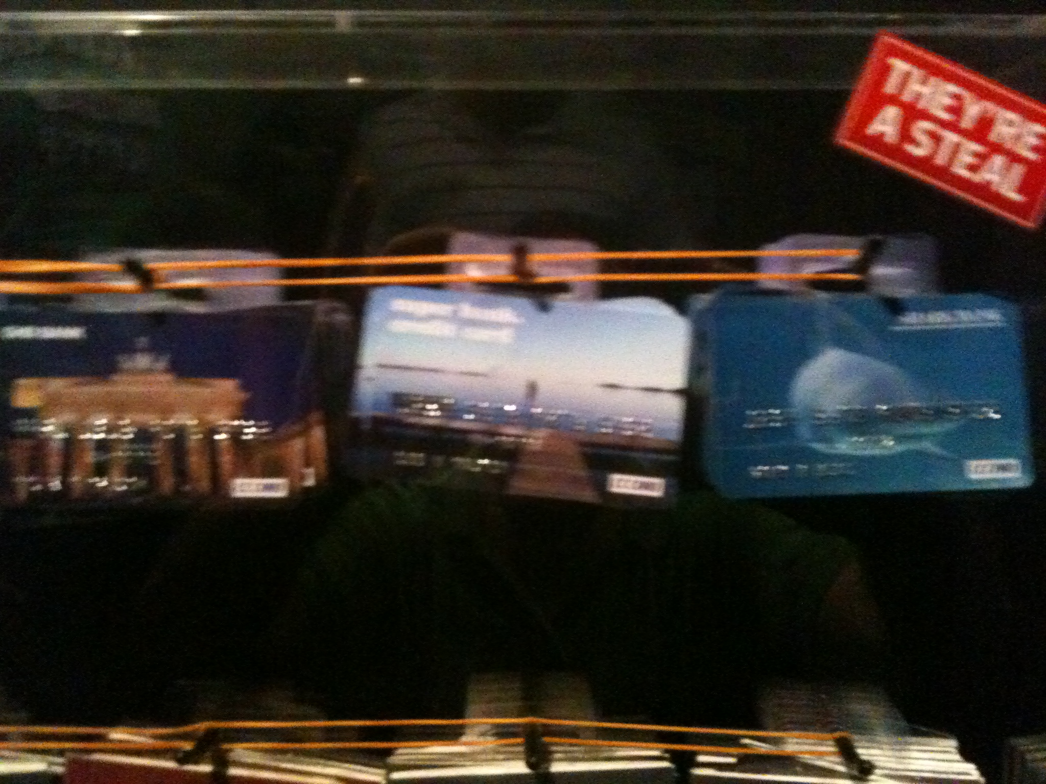
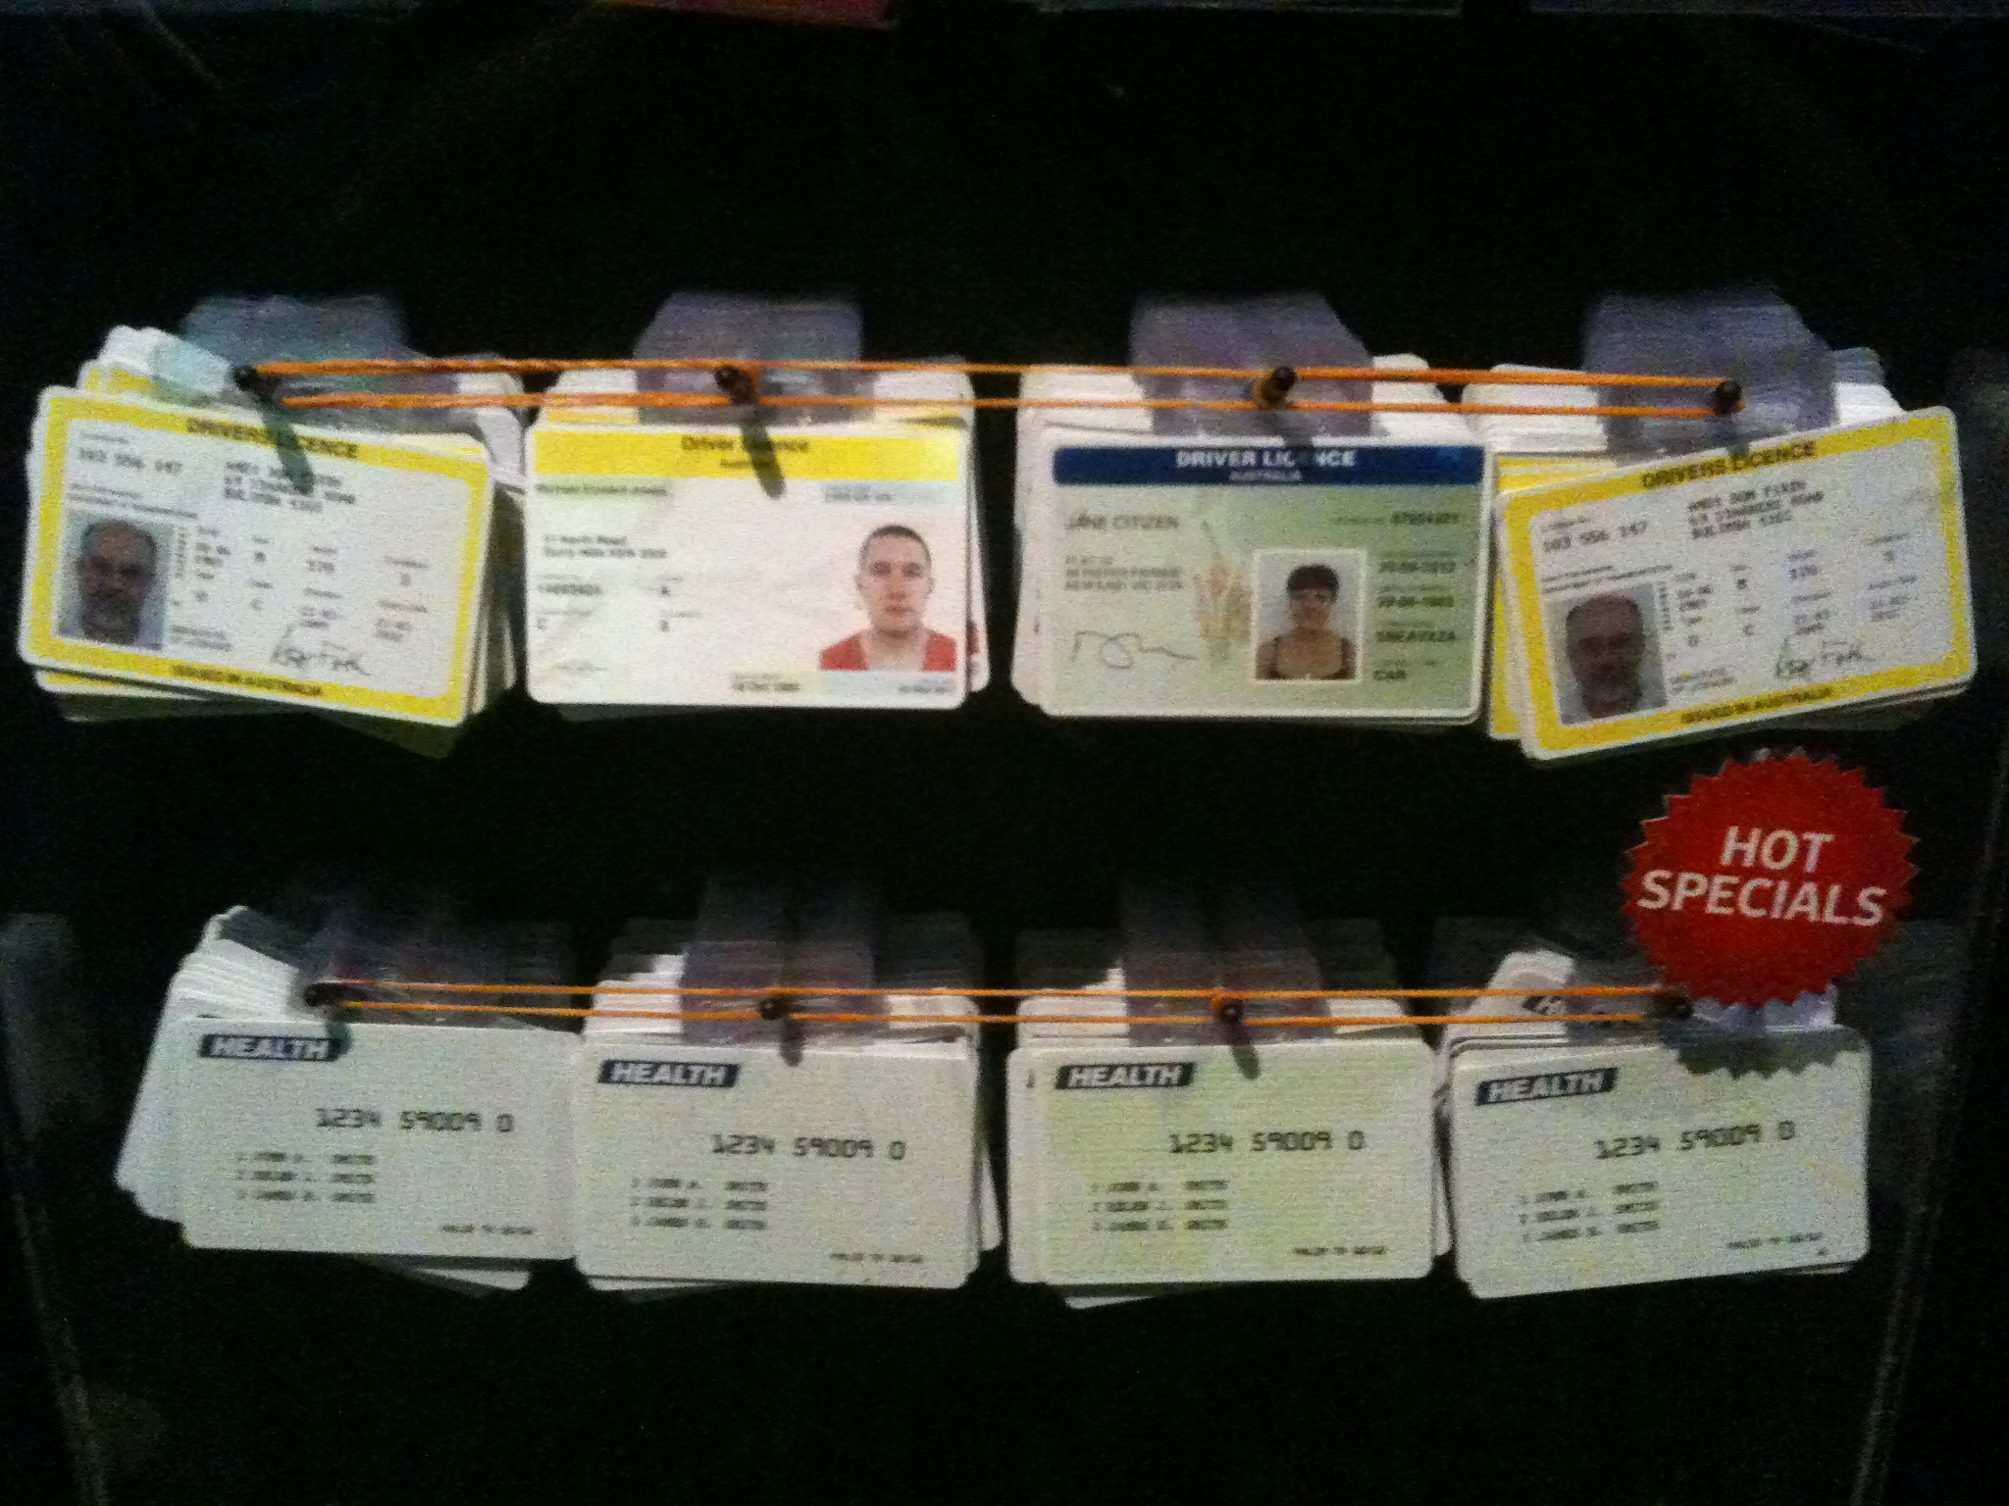
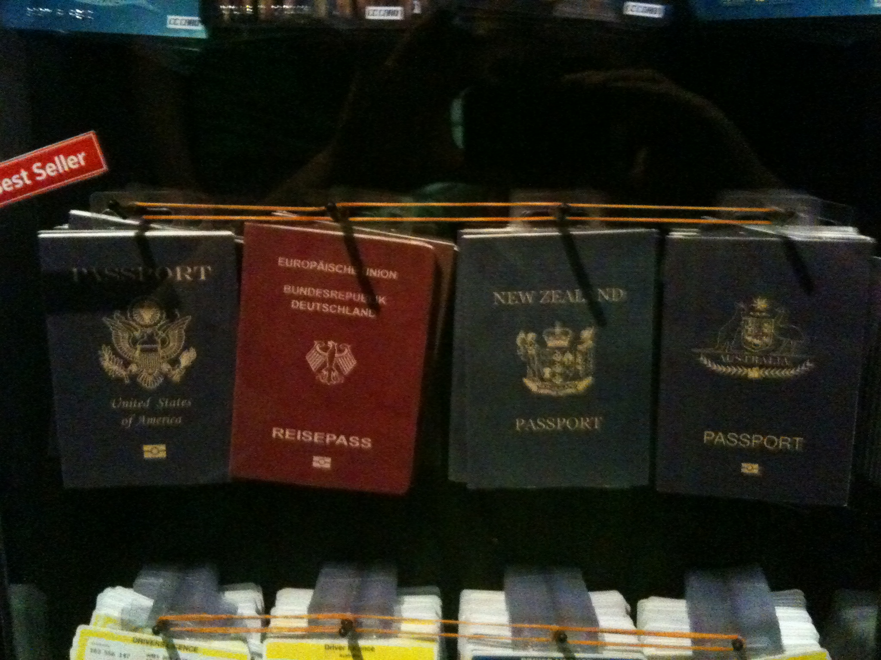
As a result

Slide 23
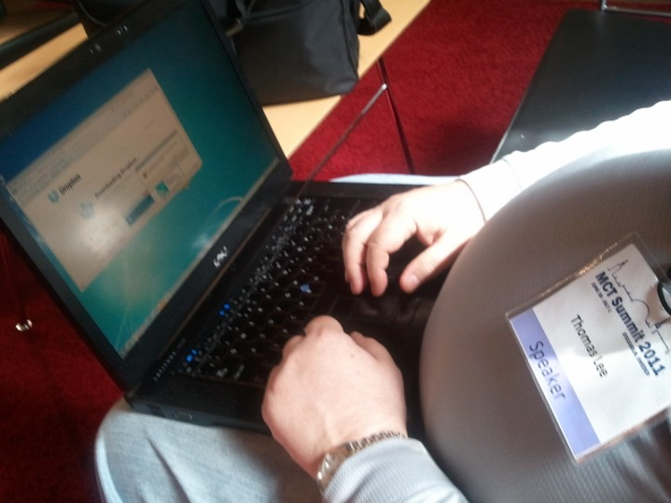
Fun ☺

Slide 24
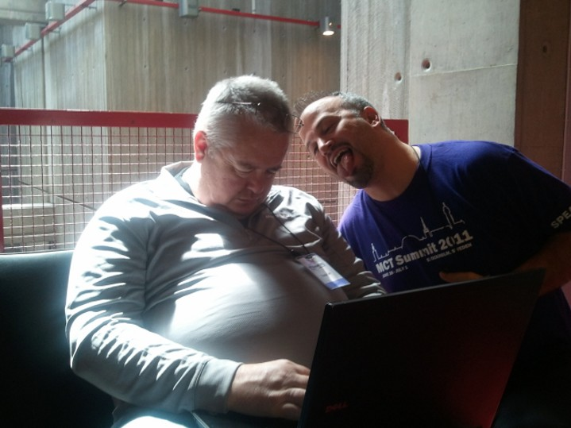
A Split Second….

Slide 25
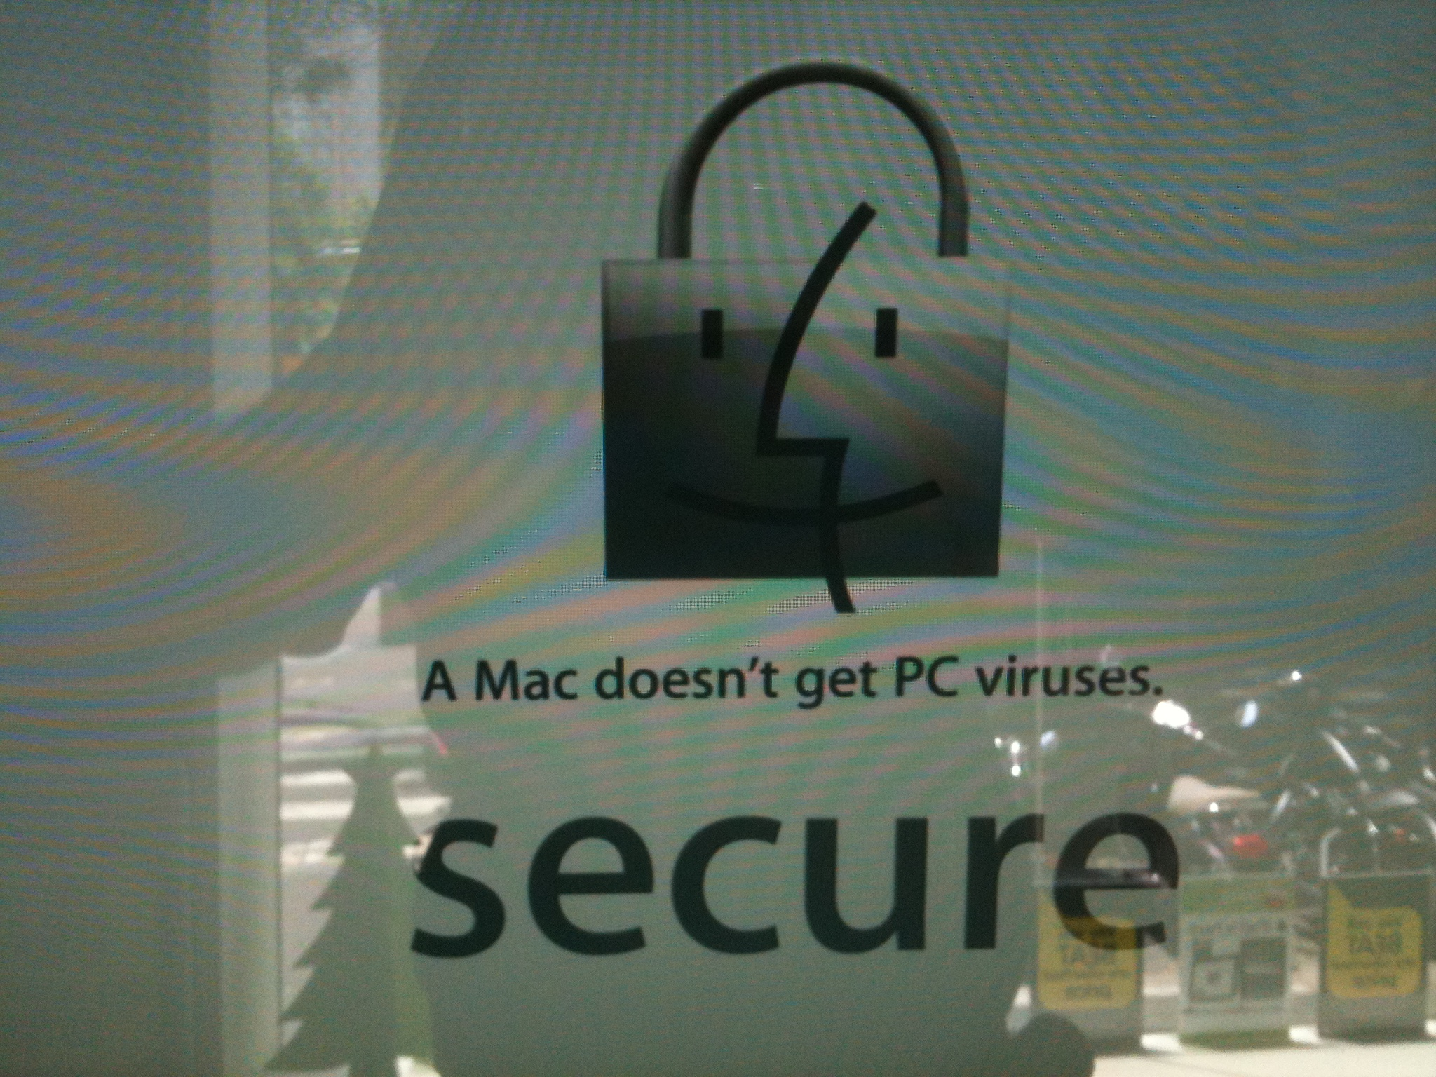
Don’t Believe Everything You See…

Slide 26
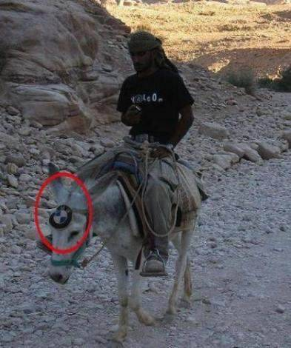
Don’t You?!

Slide 27
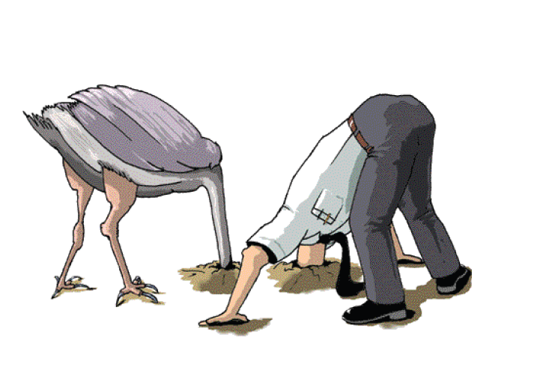
TAKE ACTION

Slide 28
Finding Malware on Your Computer

Slide 29
First Step
Volatile Information, can be easily modified or lost when system is shut down or rebooted
Volatile data resides in registries, cache and RAM
Determine a logical timeline of the security incident & the users who would be responsible

Slide 30
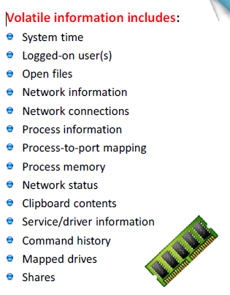

Slide 31
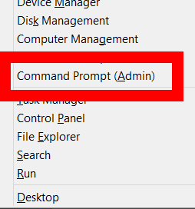
Right After the Fact
Open an Elevated Command Prompt
This way you might prevent a malicious program to start

Slide 32

System Time
Gives a great deal of context to the info collected

Slide 33
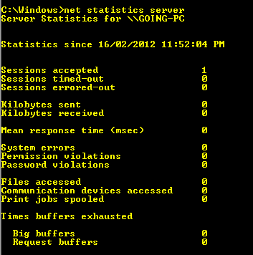
Net Statistics Server
How many sessions
Permission Violations
Password Violations
Files Accessed

Slide 34
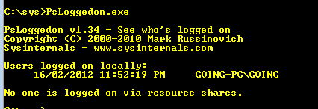
Logged-On Users
Collect info about users logged on to the system
PSLoggedon from SysInternals

Slide 35
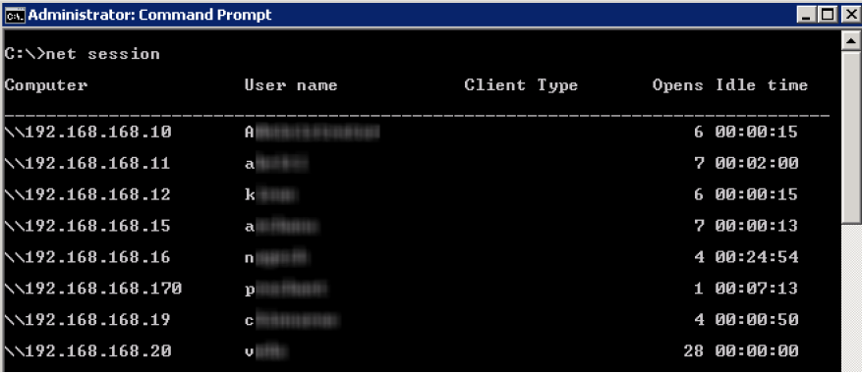
Net Session

Slide 36
Netstat
Commandline Utility
Displays:
Network Connections (Inbound and Outbound)
Routing Tables
Network Statistics

Slide 37
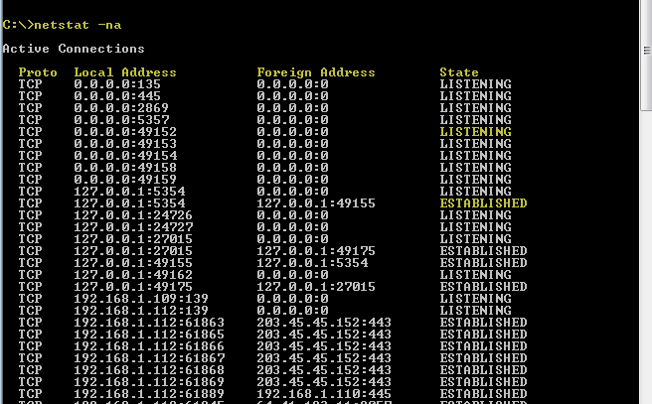
Netstat -na

Slide 38
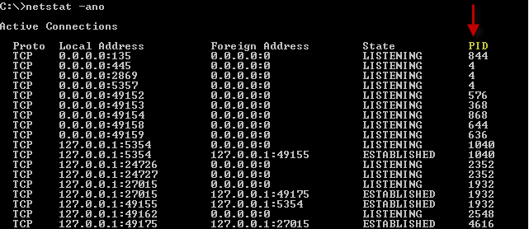
Netstat -ano

Slide 39
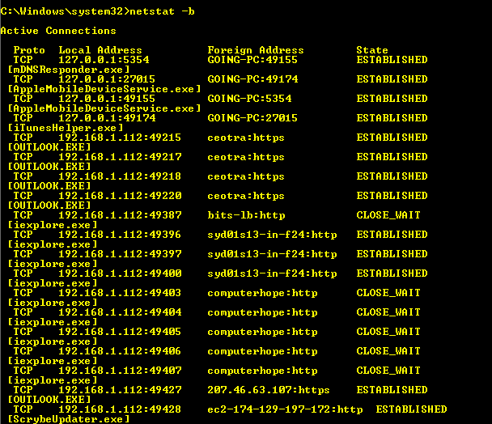
Netstat -b

Slide 40
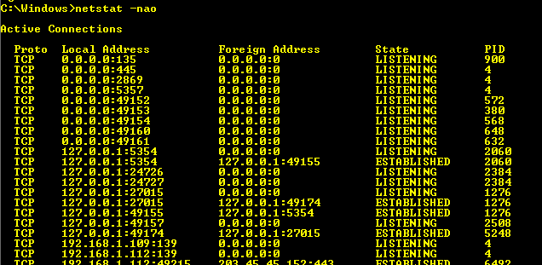
Netstat –nao

Slide 41
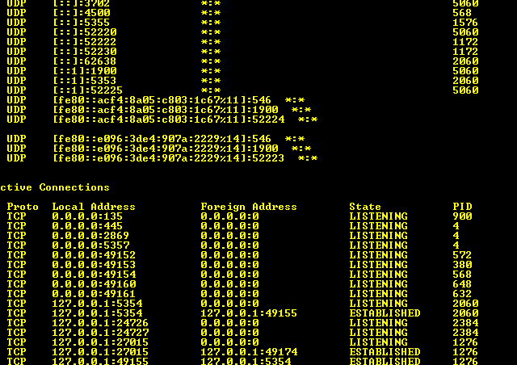
Netstat –nao 1
Shows Port Usage and How it Changes Over Time

Slide 42
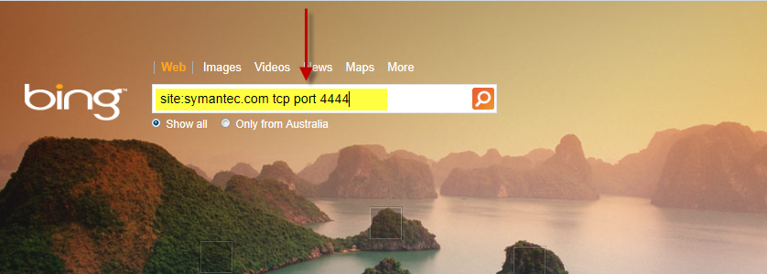
Found an Unusual Port…
Bing It!
Using “site” string with a Antivirus company , to find faster and more trustable results

Slide 43
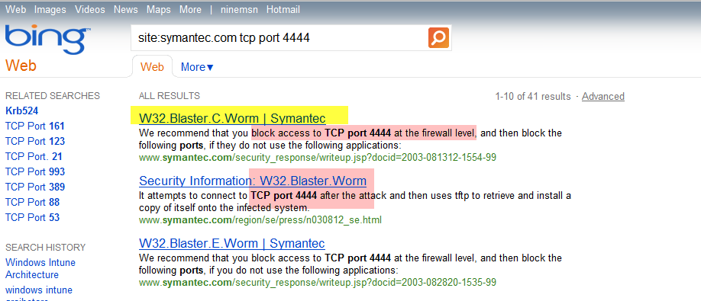
Result

Slide 44
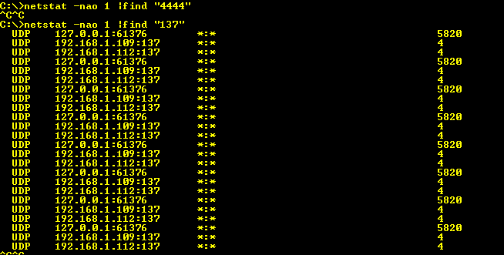
Netstat –nao 1 | “4444”

Slide 45
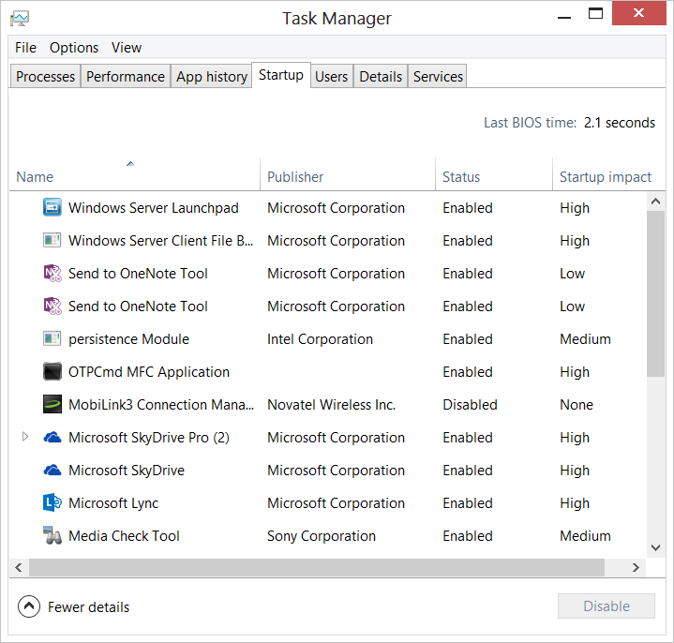
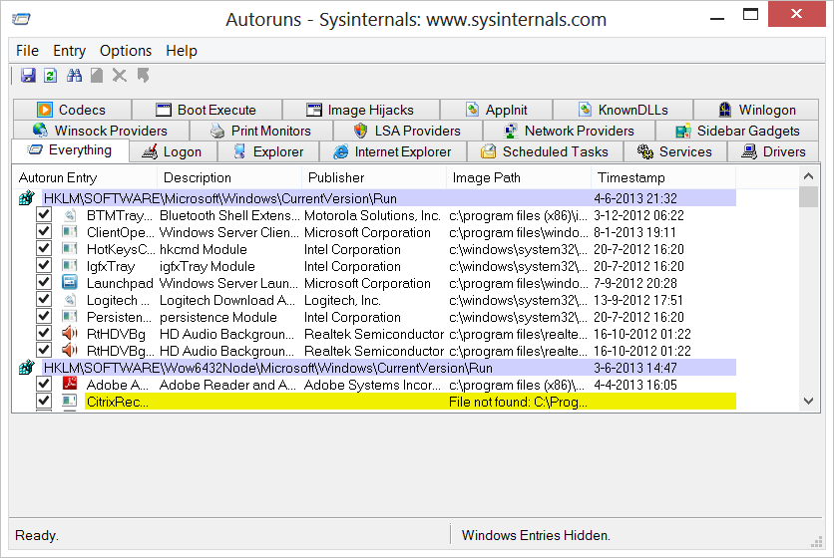
What is Automatically Starting Up?
MSConfig in Vista/Windows 7
Task Manager in Windows 8
Better: Autoruns from SysInternals

Slide 46
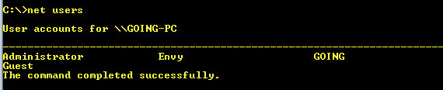
Net user
Double check that the malware did not add Users to our PC

Slide 47
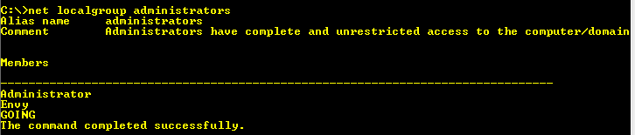
Net localgroup administrators
BOTS can add unwanted admin accounts to our system

Slide 48
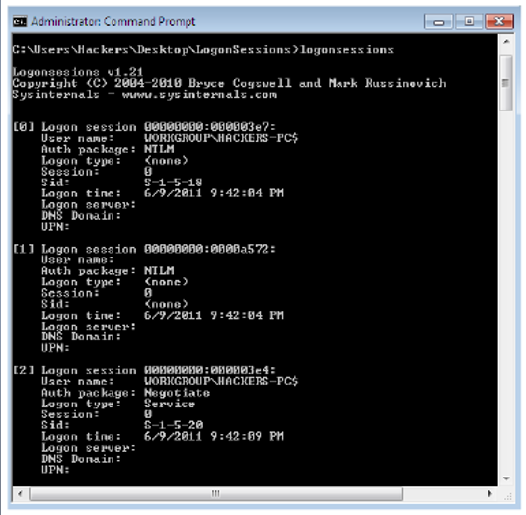
Logon Sessions Tools

Slide 49
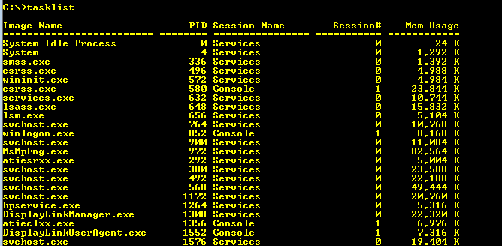
Tasklist
Will provide info about the running processes.

Slide 50
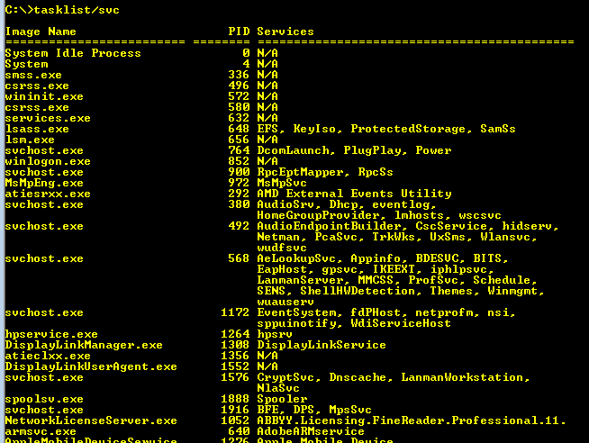
Tasklist /svc
Reveals all of the services running out of each process.
This provides more to search for “ when researching whether the investigated system may be infected with evil programs”.

Slide 51
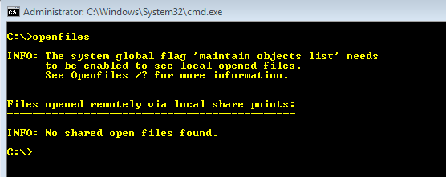

Openfiles –Deep Security
1) openfiles /local on -> needs reboot
or
After reboot

Slide 52
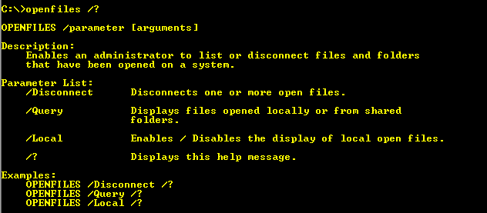

Slide 53

Don’t forget!

Slide 54
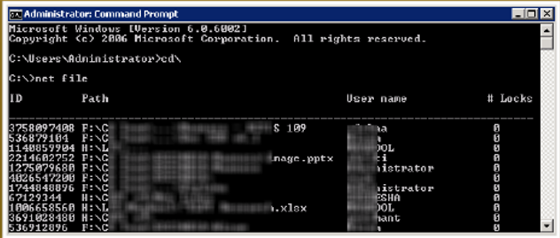
Net file command

Slide 55
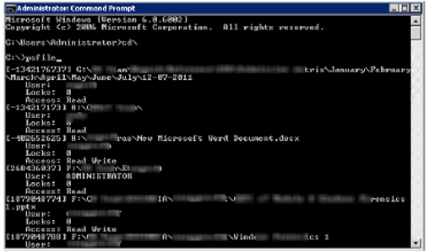
PSFile
From SysInternals

Slide 56
WMIC
Windows Management Instrumentation Command-line (WMIC) is not merely a command;
it's a world unto itself. Offering a command-line interface to the ultra-powerful Windows Management Instrumentation API within Windows,
WMIC lets administrative users access all kinds of detailed information about a Windows machine,
including detailed attributes of thousands of settings and objects

Slide 57
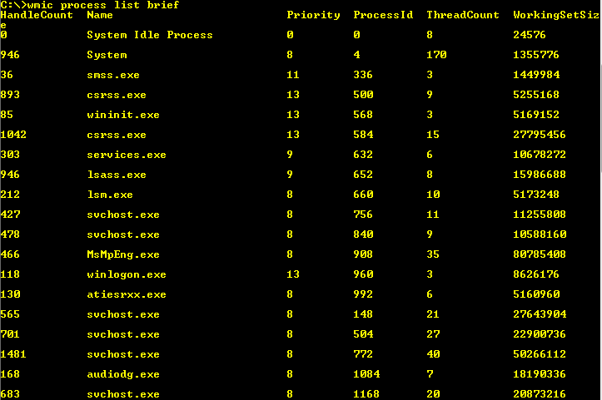
Wmic process list brief

Slide 58

Wmic process list full

Slide 59

wmic startup list (full)

Slide 60

Be Aware of Social Engineering

Slide 61

What else can be done ?

Slide 62

Create a Sheep Dip Computer

Slide 63

Hyper-V

Slide 64


Slide 65

Measuring Windows 8 Security Success

Slide 66

Resources
Learning
  Sessions on Demand
  Microsoft Certification & Training Resources
http://channel9.msdn.com/Events/TechEd
www.microsoft.com/learning
TechNet
msdn
  Resources for IT Professionals
  Resources for Developers
http://microsoft.com/technet
http://microsoft.com/msdn

Slide 67







Complete an evaluation on CommNet and enter to win!

Slide 68

© 2013 Microsoft Corporation. All rights reserved. Microsoft, Windows and other product names are or may be registered trademarks and/or trademarks in the U.S. and/or other countries.
The information herein is for informational purposes only and represents the current view of Microsoft Corporation as of the date of this presentation. Because Microsoft must respond to changing market conditions, it should not be interpreted to be a commitment on the part of Microsoft, and Microsoft cannot guarantee the accuracy of any information provided after the date of this presentation. MICROSOFT MAKES NO WARRANTIES, EXPRESS, IMPLIED OR STATUTORY, AS TO THE INFORMATION IN THIS PRESENTATION.

