Slide 2
A Drivers Saga: Mastering Windows Deployment
WCA-B305
Johan Arwidmark
Chief Technical Architect
Knowledge Factory

Slide 3
Demo
“Finding” drivers

Slide 4
General Driver Challenges
Challenges:
A constantly changing list of “supported” hardware
Rapidly-changing PC hardware
“Configuration of the day” vendors
Chipsets
CPUs
Infrastructure Optimization, standardization
Maybe even less frequent purchases

Slide 5
General Driver Solutions What approach to take
Let the tool decide
Explicitly specify
“Chaos”
Throw them all in, let the system and/or Windows figure it out
Simplifies administration, repository management
“Control freak”
Explicitly configure what drivers should be used for each model
Addresses supportability concerns, compatibility issues
Find a happy medium

Slide 6
Windows Drivers
Boot Image Drivers
Primarily Nic & Storage
Windows PE 4.0 uses Windows 8 drivers
Operating System Drivers
All drivers

Slide 7
Drivers in MDT 2012 Update 1(Lite Touch)
Deployment Share holds driver repository
Import
Folders / Selection profiles
Designed to be dynamic
Rules-based process to help filter
DriverGroup, StorageDriverGroup, StorageDriverSysprepGroup
DriverPaths (legacy)

Slide 8
Demo
MDT 2012 Lite Touch Driver Management

Slide 9
ConfigMgr 2012 SP1 Drivers
Driver catalog
Driver packages
Used for two purposes:
Driver distribution (replication)
“Forced” driver installation
Driver categories
Used as a filter when automatically detecting needed drivers
Offline injection “just in time”

Slide 10
ConfigMgr 2012 SP1 Drivers
Auto apply drivers
Drivers are matched by PnP ID
Apply driver package
Only the specified package is used
All drivers are injected

Slide 11
Demo
ConfigMgr 2012 drivers

Slide 12
Drivers Tips & Tricks
Unsigned versus signed drivers
Understanding driver ranking
Troubleshooting Driver Infs
Scratchspace
Drivers as Applications
BlueTooth, QLB, Mobile Broadband, Biometric
Hybrid Scenarios

Slide 13
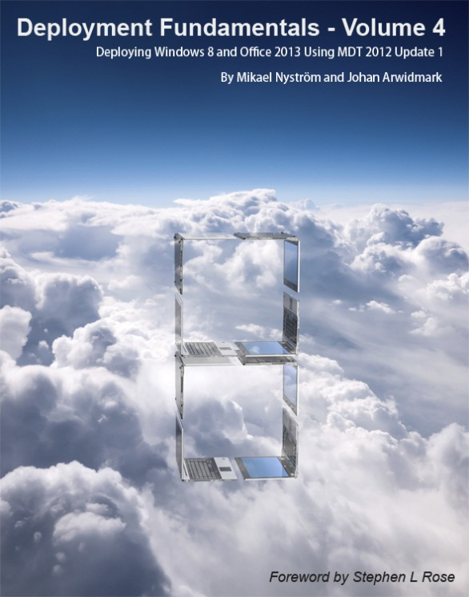
Resources – Trainings, Videos, books
deploymentartist.com

Slide 14
Related content
WCA-B351: Windows 8 Image Engineering: Notes from the Field
WCA-B302: Advanced Microsoft Deployment Toolkit 2012 Customizations: Dueling MDT Enhancements
WCA-B347: What's New with Microsoft Deployment Toolkit 2012 Update 1
WCA-B337: Replacing BIOS with a UEFI Deployment
WCA-B312: Deploying and Managing Windows 8 with Microsoft System Center 2012 SP1 - Configuration Manager

Slide 15
Windows Track Resources
Windows Enterprise: windows.com/enterprise
Windows Springboard: windows.com/ITpro
Microsoft Desktop Optimization Package (MDOP): microsoft.com/mdop
Desktop Virtualization (DV): microsoft.com/dv
Windows To Go: microsoft.com/windows/wtg
Outlook.com: tryoutlook.com

Slide 16
Resources
Learning
Sessions on Demand
Microsoft Certification & Training Resources
http://channel9.msdn.com/Events/TechEd
www.microsoft.com/learning
TechNet
msdn
Resources for IT Professionals
Resources for Developers
http://microsoft.com/technet
http://microsoft.com/msdn

Slide 17
For More Information
System Center 2012 Configuration Manager
http://technet.microsoft.com/en-us/evalcenter/hh667640.aspx?wt.mc_id=TEC_105_1_33
Windows Intune
http://www.microsoft.com/en-us/windows/windowsintune/try-and-buy
Windows Server 2012
http://www.microsoft.com/en-us/server-cloud/windows-server
Windows Server 2012 VDI and Remote Desktop Services
http://technet.microsoft.com/en-us/evalcenter/hh670538.aspx?ocid=&wt.mc_id=TEC_108_1_33
http://www.microsoft.com/en-us/server-cloud/windows-server/virtual-desktop-infrastructure.aspx
More Resources:
microsoft.com/workstyle microsoft.com/server-cloud/user-device-management

Slide 18
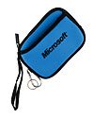
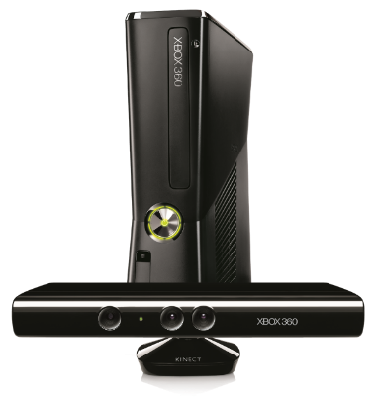
Complete an evaluation on CommNet and enter to win!

Slide 19
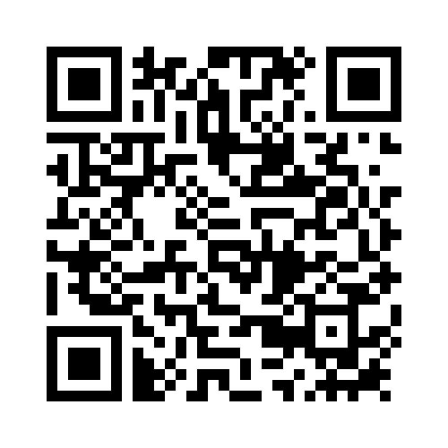
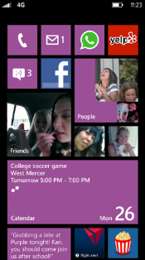
Evaluate this session
Required Slide
*delete this box when your slide is finalized
Your MS Tag will be inserted here during the final scrub.
Scan this QR code to evaluate this session and be automatically entered in a drawing to win a prize

Slide 20
© 2013 Microsoft Corporation. All rights reserved. Microsoft, Windows and other product names are or may be registered trademarks and/or trademarks in the U.S. and/or other countries.
The information herein is for informational purposes only and represents the current view of Microsoft Corporation as of the date of this presentation. Because Microsoft must respond to changing market conditions, it should not be interpreted to be a commitment on the part of Microsoft, and Microsoft cannot guarantee the accuracy of any information provided after the date of this presentation. MICROSOFT MAKES NO WARRANTIES, EXPRESS, IMPLIED OR STATUTORY, AS TO THE INFORMATION IN THIS PRESENTATION.

