Slide 2
Designing a VDI Architecture for Scale and Performance on Server 2012
WCA-B314
Ara Bernardi
Principal Program Manager
Microsoft
arabern@microsoft.com

Slide 3
Session Objectives And Takeaways
Session Objective(s):
  Quick intro to VDI in WS2012
  Design of a large scale VDI architecture
  Perf/scale analysis
  Review of the latest test results
Key Takeaway(s)
  Deep insight into several types of large scale VDI architecture
  Perf/scale requirements
  Tweaks and optimizations

Slide 4
Intro to WS2012 VDI

Slide 5
Intro to WS2012 VDI
RD Connection Brokers
2
SQL
Get list of published apps & collections
Personal Desktop
5
1
Auth user and send back routing info to the best target
Pooled Desktops
User login
VDI
User on LAN
User profile disks
Session Hosts
RD WEB
6
User profile disks
3
4
Connection to a VM or a session
Click on a published app or a collection
RDP connection
Corp LAN

Slide 6
Intro to WS2012 VDI
RD Connection Brokers
2
SQL
Get list of published apps & collections
Personal Desktop
5
1
Auth user and send back routing info to the best target
Pooled Desktops
User login
VDI
Users from internet
User profile disks
6
Session Hosts
RD WEB
Connection to a VM or a session
4
User profile disks
3
Click on a published app or a collection
RDP connection thru RD Gateway
RD Gateway
Internet
Corp LAN

Slide 7
Intro to WS2012 VDI
The WS2012 MS VDI Value Spectrum
Sessions
Pooled VMs
Personal VMs
Good
Better
Best
Personalization
App compatibility
Ease of management
Cost effectiveness

Slide 8
Designing a VDI Architecture for Scale and Performance on Server 2012

Slide 9
A word on Perf & VDI architecture
VM provisioning, updates, and boot phase
  Very expensive, but can be planned for off-hours
Login phase
  Can be expensive if all users are expected to login within a few minutes
User’s daily workload
  Typically we design for best perf/scale for this phase
← Primary focus of today’s talk

Slide 10
A word on Perf & VDI architecture
System load is very sensitive to usage patterns
  Task workers use a lot less CPU/Mem/storage than power users
Any VDI benchmarking is a simulations
  Your mileage will vary
Best strategy for developing ‘the right’ VDI architecture:
    Understand your performance requirements
    Estimate system requirements
    Test and iterate!

Slide 11
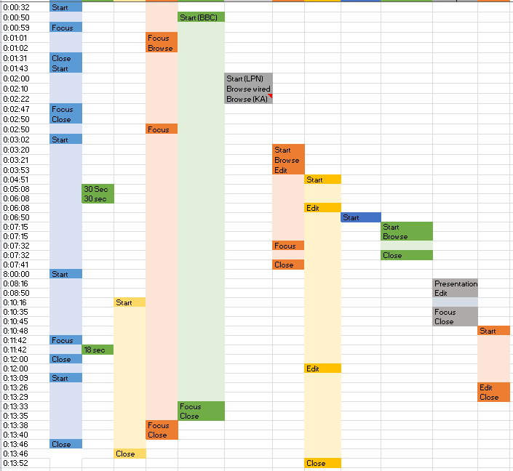
VDI Workload Simulation
Benchmarking tool: VSI 3.7 Medium workload (with Flash)
~12 minutes
http://www.loginvsi.com/documentation/v3/performing-tests/workloads

Slide 12
Designing a large scale MS VDI deployment
Walkthrough of a 5000 seat VDI deployment
          80% of users running on LAN
          20% connecting from internet
We will explore:
  Design options
  Scale & Perf characteristics
  Tweaks & optimizations

Slide 13
Designs for a large scale VDI deployment
First, the VDI Management servers

Slide 14
VDI management nodes
All services are in a HA config
Typical config is to virtualized workloads
But could use physical servers too
Optionally clustered
Infra srv-1
Infra srv-2
Gateway
RDWEB
RD Lic Srv
\\SMB\Share1: Storage for the management VMs
RD Broker
Same workload as Infra-1
SQL
Scale Out File Server
SMB-1
SMB-2
WAN
2X NIC
2X NIC
LAN
2x NIC (min), vLANs
2X SAS HBA
2X SAS HBA
Storage Network
JBOD Enclosure
SAS Module

Slide 15
VDI management nodes
Scale/Perf analysis¹
RD Gateway
  About 1000 connections/second per RD Gateway
  Need min of 2 RD Gateways for HA
  Test results:
    1000 connections/s at data rate of ~60 Kbytes/s
    The VSI³ medium workloads generates about 62kBytes/user
    Config: four cores² and 8Gigs of RAM
¹ Perf data is highly workload sensitive
² Estimation based on dual Xeon E5-2690
³ VSI Benchmarking, by Login VSI B.V.

Slide 16
VDI management nodes
Scale/Perf analysis¹
RD Broker
  5000 connections in < 5 mnts, depending on collection size
  Need min of 2 RD Brokers for HA
  Test results:
    Ex. 50 concurrent connections in 2.1 seconds on a collection with 1000 VMs.
    Broker Config: one core² and 4 Gigs per Broker
SQL (required for HA RD Broker)
  ~60 Meg DB for a 5000 seat deployment
  Test results:
    Adding 100 VMs = ~1100 transactions (this is the pool VM creation/patching cycle)
    1 user connection = ~222 transactions (this is the login cycle)
    SQL config: four core² and 8 Gigs
¹ Perf data is highly workload sensitive
² Estimation based on dual Xeon E5-2690

Slide 17
VDI management nodes
Tweaks and Optimization¹
Faster VM create/patch cycles
  Use Set-RDVirtualDesktopConcurrency to increase value to 5 (max value in WS2012)
    Default: create/update a single VM at a time (per host)
    New in WS2012 R2², max limit likely to be > 20
Benefits
  Faster VM creation & patching
  WS2012: for value=5, ~2x faster
  WS2012 R2²: for value=20, ~5x faster
¹ Perf data is highly workload sensitive
² Prelim R2 testing

Slide 18
Designs for a large scale VDI deployment
Next, VDI compute and storage nodes

Slide 19
VDI compute and storage nodes
We will look into three deployment types
  Pool-VMs (only) with local storage
  Pool-VMs (only) with centralized storage
  A mixed of Pool & PD VM deployment

Slide 20
VDI compute and storage nodes
A 5000 seat all Pool-VM deployment with local storage

Slide 21
5000 seat pool-VMs using local storage
Non-Clustered Hosts, VMs running from local storage
VDI Host -1
VDI Host -N
Pool VM
Pool VM
Pool VM
Pool VM
\\SMB\Share2: Storage for User VHD
…
…
…
Scale Out File Server
Pool VM
Pool VM
SMB-1
SMB-2
Raid10/equiv
Raid10/equiv
2X NIC
2X NIC
2X SAS HBA
2X SAS HBA
LAN
15K disks
15K disks
…
VHD storage
…
VHD storage
VHD storage
15K disks
15K disks
Storage Network
2X NIC
(min), vLAN
2X NIC
(min), vLAN
JBOD Enclosure
15K disks
15K disks
15K disks
15K disks
15K disks
15K disks
OS boot disks
OS boot disks
SAS Module

Slide 22
5000 seat pool-VMs using local storage
Scale/Perf analysis¹
CPU usage
  ~150 VSI² medium users per dual Intel Xeon E5-2690 Processor (2.9Ghz) at 80% CPU
  ~10 users/core
Memory
  ~1Gig per Win8-VM, so ~192 Gig/host should be plenty
RDP traffic
    RDP traffic ~ 500Kbits/s per user for VSI² medium workload running on LAN
        2.5Gbits/s for 5000 users
    For ~80% intranet users and ~20% connections from internet, the network load would be:
        500 Meg on the internet facing switches
        2.5 Gig on LAN
¹ Perf data is highly workload sensitive
² VSI Benchmarking, by Login VSI B.V.

Slide 23
5000 seat pool-VMs using local storage
Scale/Perf analysis¹
Storage load
  The VSI² medium workload creates ~10 IOPS per user,
  IO distribution for 150 users per host:
        GoldVM ~700 reads/sec
        Diff-disks ~400 writes/sec & ~150 reads/sec
        UserVHD ~300 writes/sec (mostly writes)
  GoldVM & Diff-disks are on local storage (per host)
        Load on local storage ~850 Read/sec and ~400 writes/sec
Storage size:
  About 5Gigs per VM for diff-disks, and about 20Gigs per GoldVM
  Assume a few collections per Host (a few GoldVMs)
        A few TBs should be enough
¹ Perf data is highly workload sensitive
² VSI Benchmarking, by Login VSI B.V.

Slide 24
5000 seat pool-VMs using local storage
Scale/Perf analysis¹
SMB load due to userVHDs:
  At ~2 IOPS/user, we need ~10,000 write-IOPS for 5000 users (Write heavy)
  ~100 Kbits/sec per user → for 5000 users we have 0.5 Gbits/sec
    Storage size:
      Scenario-dependent, but 10gig/user seems reasonable
      We need about 50 TB of storage
Overall network load
  We have the RDP traffic and the storage traffic due to userVHDs
  Total ~ 3 Gbits/sec:
    ~0.5 Gbits/sec due to userVHD
    ~2.5 Gbits/sec due to RDP
¹ Perf data is highly workload sensitive.

Slide 25
5000 seat pool-VMs using local storage
Tweaks and Optimization¹
Use SSDs for GoldVMs
  Average reduction in IOPS on the spindle-disks is ~ 45%
  Examples:
    On a host with 150 VMs, the IO load is ~850 Reads/s & ~400 Writes/s
Benefits
  Faster VM boot & login time (very read heavy)
  Faster VM creation and patching (read/write heavy)
  SSDs for GoldVM is recommended for hosts that support more users (>250)
Option 1 (all spindles)
  10x 15K RAID10
Option2 (SSD + spindles)
  2 SSDs RAID1 & 6x 15K RAID10
¹ Perf data is highly workload sensitive

Slide 26
VDI compute and storage nodes
Next…
A 5000 seat all Pool-VM deployment on SMB storage

Slide 27
5000 seat pool-VMs on SMB storage
Non-clustered hosts with VMs running from SMB
VDI Host -1
VDI Host -N
Pool VM
Pool VM
\\SMB\Share2: Storage for User VHD
\\SMB\Share3: Storage for VM VHDs
\\SMB\Share4: Storage for GoldVMs
Pool VM
Pool VM
…
…
…
Pool VM
Pool VM
Scale Out File Server
SMB-1
SMB-2
2X NIC
2X NIC
RDP on LAN
2X SAS HBA
2X SAS HBA
Storage Network
2X NIC
(min), vLAN
2X NIC
(min), vLAN
JBOD Enclosure
GoldVMs
15K disks
15K disks
15K disks
15K disks
OS boot disks
OS boot disks
SAS Module

Slide 28
5000 seat pool-VMs on SMB storage
Scale/Perf analysis¹
CPU, Mem, RDP load as discussed earlier
  About 150 VSI² medium users per dual Intel Xeon E5-2690 Processor (2.9Ghz) at 80% CPU
  About 1Gig per Win8-VM, so ~192 Gig/host should be plenty
  RDP traffic ~ 500Kbits/s per user for VSI² medium workload
SMB/Storage Load
  As discussed earlier, ~10 IOPS per user for VSI²
  medium workload
  But with centralized storage, we need about
    50,000 IOPS for 5000 Pool-VMs
  IO distribution for 5000 users:
      GoldVM ~22,500 Reads/sec
      Diff-disks ~12,500 Writes/sec & ~5000 Reads/sec
      UserVHD ~10,000 Writes/sec (Write heavy)
¹ Perf data is highly workload sensitive
² VSI Benchmarking, by Login VSI B.V.

Slide 29
5000 seat pool-VMs on SMB storage
Scale/Perf analysis¹
SMB/Storage sizing
  Gold VM
    About 20 Gig/VM per Collection
    For ~10 ~50 Collections, we need ~200 Gig ~ 1TB
  Diff Disks
    About 5 Gig/VM, need ~25 TB
  User-VHD
    About 10 Gig/user, we need ~50 TB
¹ Perf data is highly workload sensitive

Slide 30
5000 seat pool-VMs on SMB storage
Scale/Perf analysis¹
Network load
  Overall about 33 Gbits/sec
    About 2.5 Gbits/sec due to RDP
    About 0.5 Gbits/sec due to userVHD
    About 30 Gbits/sec due to 5000 VMs
¹ Perf data is highly workload sensitive

Slide 31
5000 seat pool-VMs on SMB storage
Tweaks and Optimization¹
Use CSV block cache² to reduce load on storage
  Average reduction in IOPS for Pool-VMs is ~45%, with typical cache hit of ~80%
  About 20% increase in VSI³ max (assuming storage was the bottleneck)
    Important note:
    CSV cache size is per node, and caching is per GoldVM
    100 Collections = 100 GoldVMs, so to get a 80% cache hit per Collection, we need 100x cache size²
Benefits:
  Higher VM scale per storage
  Lower storage perf requirements ( ~30,000 vs ~50,000 IOPS)
  Faster VM boot & login time (very read heavy)
  Faster VM creation and patching (read/write heavy)
¹ Perf data is highly workload sensitive
² Cache size set to 1024Meg
³ VSI Benchmarking, by Login VSI B.V.

Slide 32
5000 seat pool-VMs on SMB storage
Tweaks and Optimization¹
Use SSDs for GoldVMs
    Average reduction in IOPS on the spindle-disks is ~ 45%
    So SSDs and CSV cache block seem similar, which one to use?
      CSV uses Host’s memory, in this case SMB srv’s memory, and it is super-fast
      But if srv is near mem capacity, then putting GoldVMs on SSDs can help significantly
Benefits
    Faster VM boot & login time (very read heavy)
    Faster VM creation and patching (read/write heavy)
    Using less expensive spindle-disks
¹ Perf data is highly workload sensitive

Slide 33
5000 seat pool-VMs on SMB storage
Tweaks and Optimization¹
Load balance across SMB Scale Out Servers
  Use Move-SmbWitnessClient to load balance SMB client load across all SMB servers
  New in WS2012 R2, SMB does this automatically!
Benefits
  Optimized use of the SMB servers
¹ Perf data is highly workload sensitive

Slide 34
VDI compute and storage nodes
Next…
A 5000 seat mix of Pool-VM & PD deployment
              4000 Pool-VMs
              1000 PD-VMs

Slide 35
5000 seat mixed deployment (pool & PD)
All VDI hosts are clustered
  PD-VMs could be running anywhere
A single cluster is sufficient
  5000 VMs < max of 8000 HA objects in ws2012 cluster svc
  ~35 Hosts (150 VMs/host) < max of 64 nodes in a ws2012 cluster svc
Clustered
VDI Host -1
VDI Host -N
Pool VM
Pool VM
\\SMB\Share2: Storage for User VHD
\\SMB\Share3: Storage for VM VHDs
\\SMB\Share4: Storage for GoldVMs
PD VM
PD VM
…
…
…
Pool VM
PD VM
Scale Out File Server
SMB-1
SMB-2
2X R-NIC
2X R-NIC
RDP on LAN
2X SAS HBA
2X SAS HBA
Storage Network
2X NIC
(min), vLAN
2X NIC
(min), vLAN
JBOD Enclosure
GoldVMs
15K disks
15K disks
15K disks
15K disks
OS boot disks
OS boot disks
SAS Module

Slide 36
5000 seat mixed deployment (pool & PD)
Scale/Perf analysis¹
CPU, Mem, RDP load as discussed earlier
  About 150 VSI² medium users per dual Intel Xeon E5-2690 Processor (2.9Ghz) at 80% CPU
  About 1Gig per Win8-VM, so ~192 Gig/host should be plenty
  RDP traffic ~ 500Kbits/s per user for VSI² medium workload
SMB/Storage Load
IO distribution for 4000 Pool-VMs
        GoldVM ~18,000 Reads/sec
        Diff-disks ~10,000 Writes/sec & ~4000 Reads/sec
        UserVHD ~8,000 Writes/sec (Write heavy)
IO distribution for 1000 PD-VMs
    About 6000 Reads/s and 4000 Writes/s
¹ Perf data is highly workload sensitive
² VSI Benchmarking, by Login VSI B.V.

Slide 37
5000 seat mixed deployment (pool & PD)
Scale/Perf analysis¹
SMB/Storage sizing
  PD-VMs (1000 VMs)
    About 100 Gig/VM, we need 100 TB
  Pool-VM (4000 VMs)
    Gold VM
      About 20 Gig/VM per Collection
      For ~10 ~50 Collections, we need ~200 Gig ~ 1TB
    Diff Disks
      About 5 Gig/VM, need ~20 TB
    User-VHD
      About 10 Gig/user, we need ~40 TB
¹ Perf data is highly workload sensitive

Slide 38
5000 seat mixed deployment (pool & PD)
Scale/Perf analysis¹
Network load
  Overall network traffic ~34 Gbits/sec
      About 2.5 Gbits/sec due to RDP
      About 0.4 Gbits/sec due to userVHD
      About 24 Gbits/sec due to 4000 pool-VMs
      About 7 Gbits/sec due to 1000 PD-VMs
¹ Perf data is highly workload sensitive

Slide 39
5000 seat mixed deployment (pool & PD)
Tweaks and Optimization¹
  WS2012: Leverage H/W or SAN based dedup to reduce the required storage size of PDVMs
  New in WS2012 R2
  Live Dedup of VDI VHDs on Scale Out File Server!
    Prelim test² show 80% storage size reduction AND better storage performance at least during boot storm³
    Check out session on Dedup, I hear they have some cool demos! Reduce Storage Costs with Data Deduplication - MDC-B342
¹ Perf data is highly workload sensitive
² Very early pre-RTM benchmarking
³ Initial focus of our perf benchmarking

Slide 40
A few words on vGPU
Scale/Perf analysis¹
Min GPU memory² to start a VM:
Resolution | Maximum number of monitors in VM setting
 | 1 | 2 | 4 | 8
1024 x 768 | 48 MB | 52 MB | 58 MB | 70 MB
1280 x 1024 | 80 MB | 85 MB | 95 MB | 115 MB
1600 x 1200 | 120 MB | 126 MB | 142 MB
1920 x 1200 | 142 MB | 150 MB | 168 MB
2560 x 1600 | 252 MB | 268 MB
Run time scale:
  About 70 VMs per ATI FirePro V9800 (4Gig RAM), DL585 with 128 Gig RAM
  About 100 VMs on 2x V9800s, (our DL585 test machine ran out of memory)
    From the above, we compute:
    About 140 VMs per 2 V9800s on a DL585 with 192 Gig RAM
¹ Perf data is highly workload sensitive
² High level heuristics

Slide 41
Recap

Slide 42
VDI spec for various 5000 seat deployments
Pool-VMs on local storage
~35 VDI hosts @ 150 users/host
Local storage ~2 TBs (~10x RAID10s)
SMB for userVHDs ~50TB
Storage network 2x 1G (actual load ~0.5Gb)
Pool-VMs on SMB
  ~35 VDI hosts @ 150 users/host
  SMB storage for userVHDs ~50TB
  SMB storage for Pool-VMs ~25TB
  Storage network 2x 40G (actual load ~33G)
75 TB
Pool & PD VMs on SMB
  ~35 clustered VDI hosts @ 150 users/host
  SMB storage for userVHDs ~40TB
  SMB storage for Pool-VMs ~20TB
  SMB storage for PD-VMs ~100 TB
  Storage network 2x 40G (actual load ~34G)
VDI Management servers
  Two hosts running VDI management workloads
  Shared HA storage (a few terabytes)
  Minimal network load
Corp network (user traffic)
  RDP load on LAN ~2.5G/s, → 2x 10G/s
New in WS2012 R2: < 20 TB with dedup!

Slide 43
Exploring some perf/scale test results

Slide 44
Perf/scale test results:
2000 seat pooled-VM deployment on 14 VDI hosts with local storage
                Built jointly with Dell at Microsoft’s Enterprise Engagement Center (EEC)

Slide 45
Overview of the 2000 seat Pooled Virtual Desktop Deployment
VDI Compute and Storage nodes
Clustered
HA VDI Management infra
Infra srv-1
Infra srv-2
R720s
VDI Host -1
VDI Host
(s)
VDI Host -14
Gateway
Pool VM
RDWEB
Pool VM
AD
Same workload as Infra-1
…
…
…
SMB Scale-Out
Storage for User docs & settings (RUP)
Clustered
RD Broker
Pool VM
SQL
SMB-1
SMB-2
Raid10/equiv
15K disks
VHD storage
2x NIC
iSCSI
…
LAN
15K disks
LAN
2x NIC
iSCSI
15K disks
2x DELL S4810 switches
15K disks
15K disks
OS boot disks
iSCSI
Network: 2x10Gig with
VLANs for LAN and iSCSI traffic
10x 15K disks (Raid1+0)
EQL 6510E

Slide 46
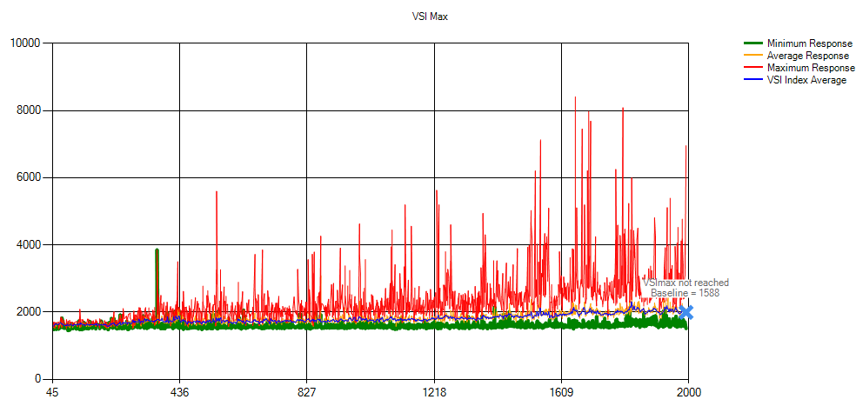
Perf/Scale explorations:
2000 seat pool deployment, 14 R720s as compute & storage nodes
2000 VMs running VSI medium workload
VMs: Win8 x86 with Office 2013
Login rate: 2000 users in 60 mnts
Results from a current Dell/Microsoft project to build & benchmark a 2000+ seat deployment

Slide 47
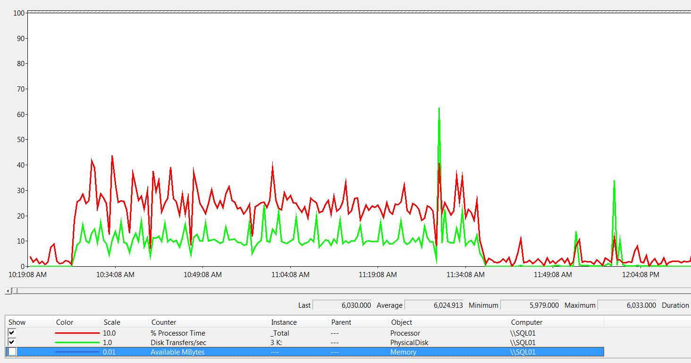
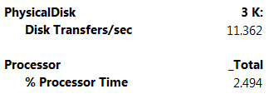
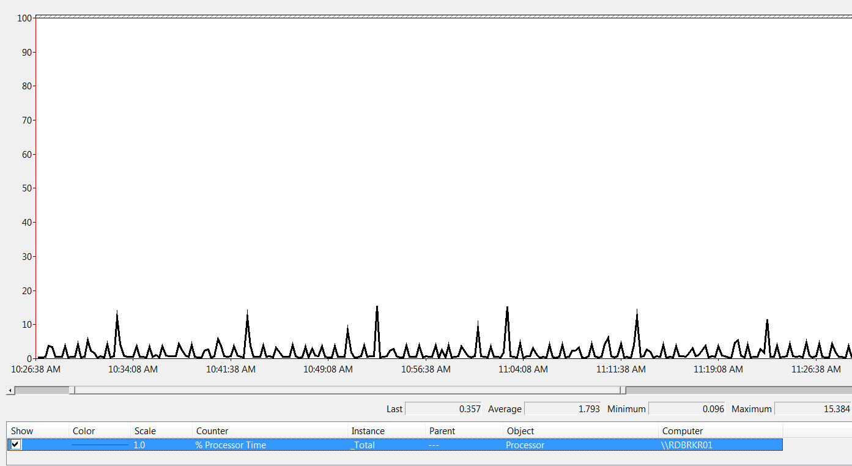

Perf/Scale explorations:
2000 seat pool deployment, 14 R720s as the compute & storage nodes
SQL load during 2000 connections
HA Broker load during the same period
4vCPUs, 8192 Gig (~6Gig free)
2000 connections in 1 hr
2vCPUs, 8192 Gig (~6Gig free)
VMs running on a host with 2x CPU: E5-2690 @2.90GHz
Results from a current Dell/Microsoft project to build & benchmark a 2000+ seat deployment

Slide 48
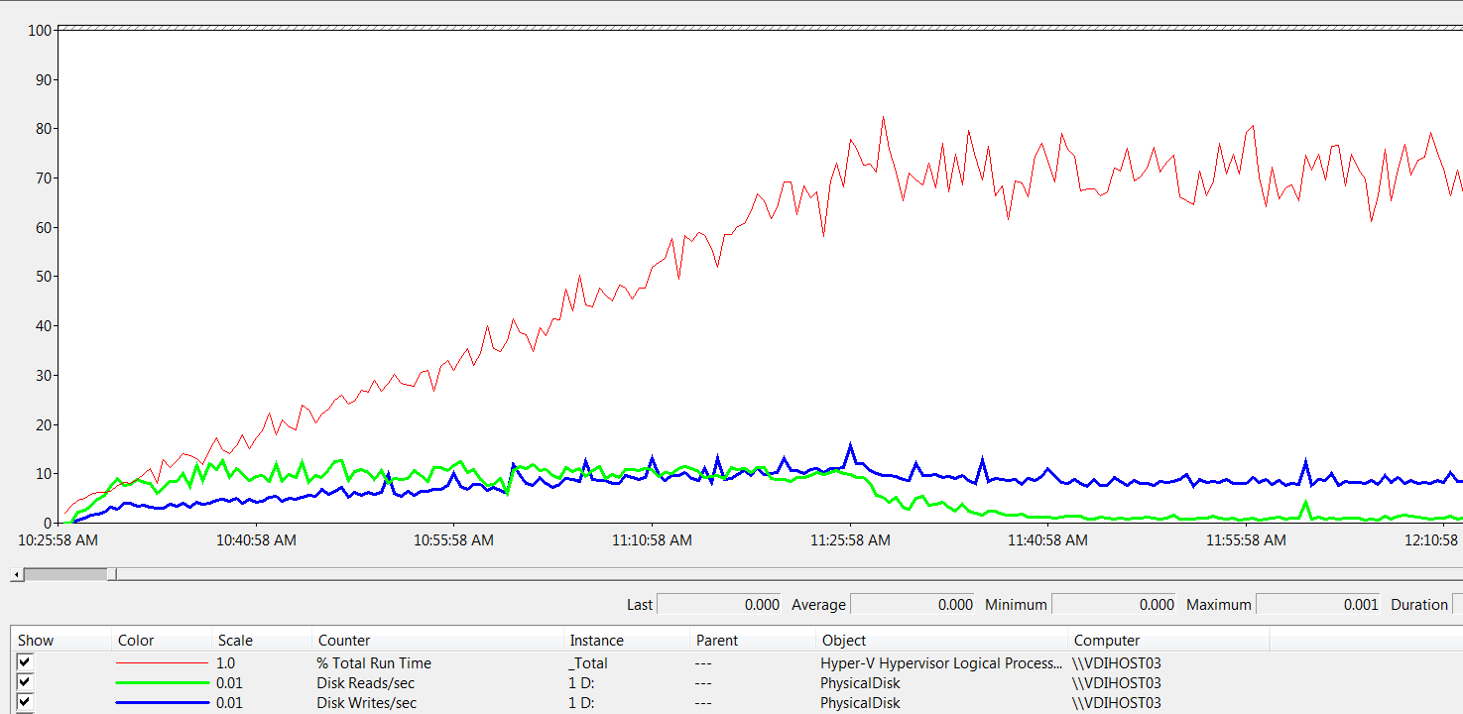
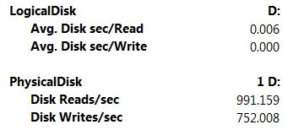
Perf/Scale explorations:
2000 seat pool deployment, 14 R720s as the compute & storage nodes
Storage perf in the peak segment:
Load on a single R720:
150 VMs running VSI medium workload
R720 CPU:
2x E5-2690
@2.90GHz
Results from a current Dell/Microsoft project to build & benchmark a 2000+ seat deployment

Slide 49
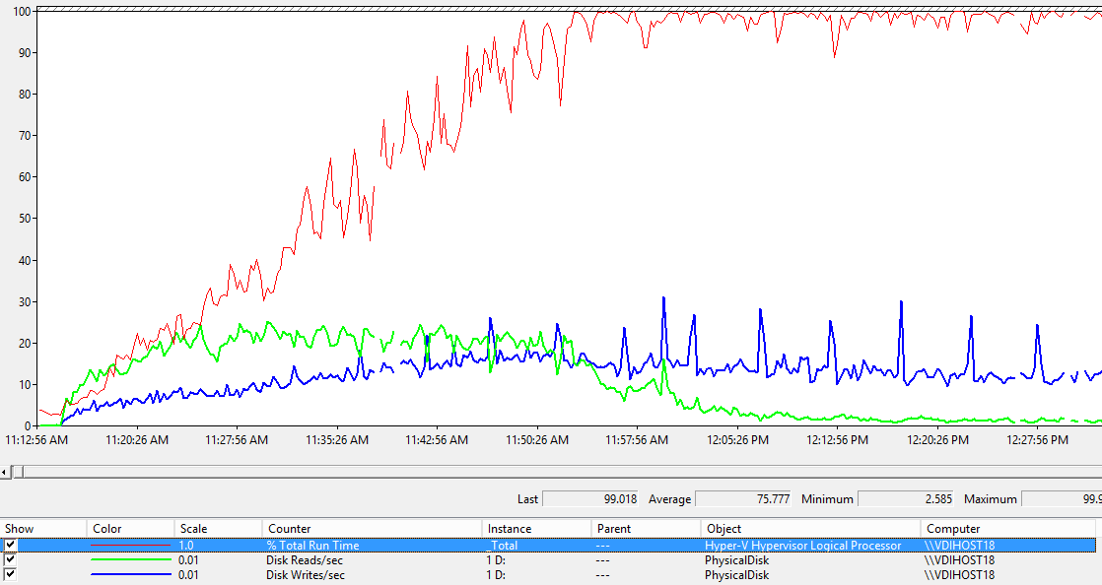
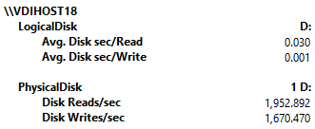
Perf/Scale explorations:
How far can we drive this design?
… more VMs, faster login…?
Max scale capacity on a single R720:
205 users logon in 35 minutes, same workload (VSI medium)
Results from a current Dell/Microsoft project to build & benchmark a 2000+ seat deployment

Slide 50
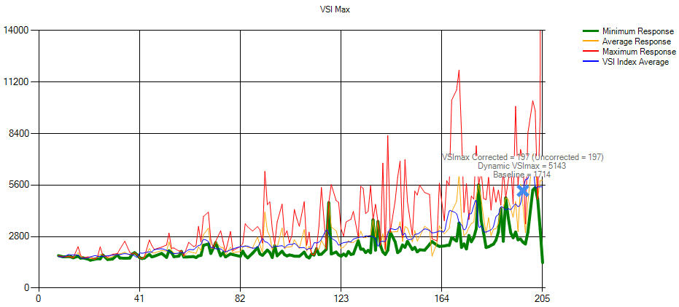
Perf/Scale explorations:
Benchmarking a single host for max capacity
Single R720 VDI host with local storage
205 users logon in 35 minutes,
VSI max = 197
R720 CPU: 2x E5-2690 @2.90GHz
Results from a current Dell/Microsoft project to build & benchmark a 2000+ seat deployment

Slide 51
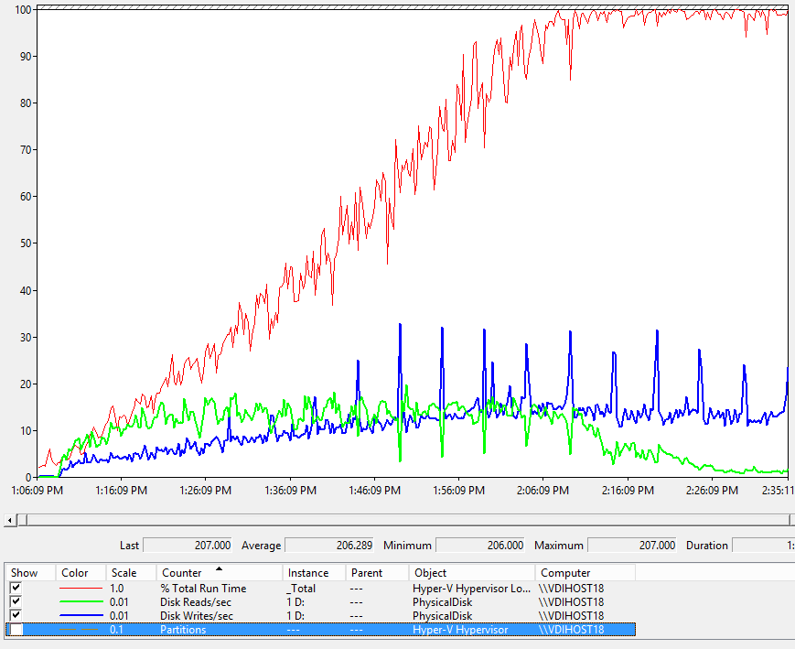
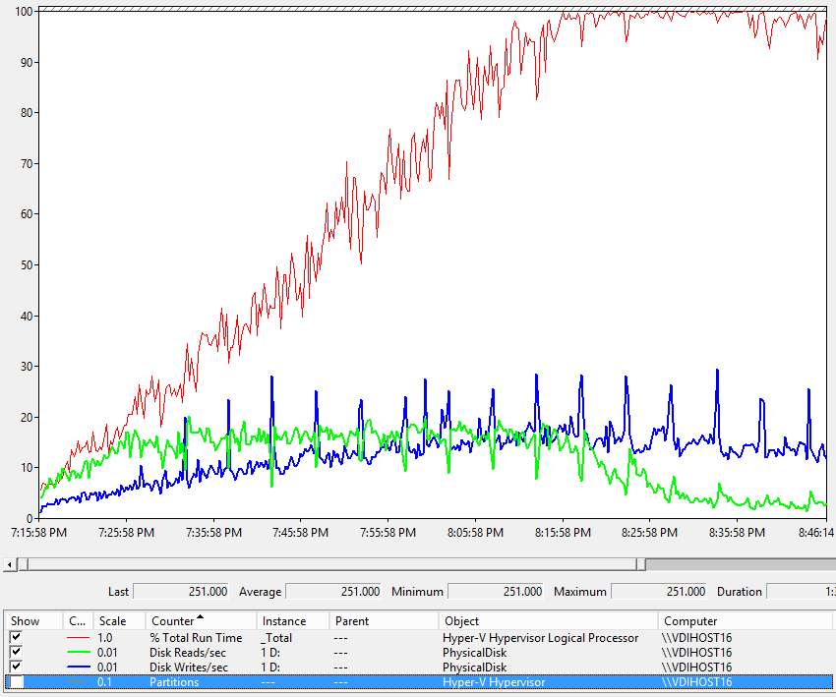
Perf/Scale explorations:
Office 2013 vs Office 2010
Great experience at a higher CPU cost
Office 2013
205 VMs
VSI Max=197
Office 2010
250 VMs
VSI Max=235

Slide 52
Perf/scale test results:
HA Broker & Provisioning

Slide 53
Perf/Scale explorations: Single vs HA Broker

Slide 54
Perf/Scale explorations:
VM create/update time vs concurrency value
WS2012
200 VMs on 10x 15K RAID1+0 storage
CPU: 2x E5-2690
@2.90GHz
Creation time in hours for 200 VMs
Max value in WS2012=5
In WS2012-R2¹, we have
validated to max value=20
Concurrency Value
¹ Very early pre-RTM benchmarking

Slide 55
Perf/scale test results:
IOPS due to VSI Medium workload

Slide 56
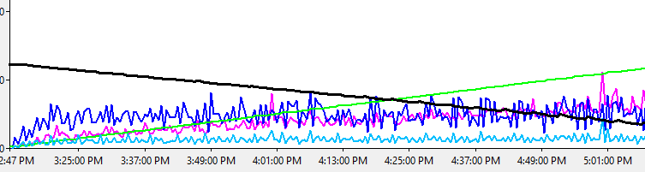
Perf/Scale explorations: disk IO due to VSI² medium workload
DL585 G7, 4x 12 cores (AMD Opt 6172), 128 GB RAM
Storage: Local array 24x RAID10
At 5:01:00PM,
we have ~110 VMs
Available memory
At 5:01pm, we have ~110VMs
Gold VM read/sec ~500 = 45%
Diff-disk write/sec ~500 = 45%
Diff-disk read/sec ~130 = 10%
Total = 1130 IOPS, ~10IOPS/VM
Just for the diff-disks:
Total = 500 + 130 = 630
Write IOPS: 500/630 = 80%
Read IOPS: 130/630 = 20%
¹ Perf data is highly workload sensitive
² VSI Benchmarking, by Login VSI B.V.

Slide 57
Perf/scale test results:
VDI host memory vs storage load

Slide 58
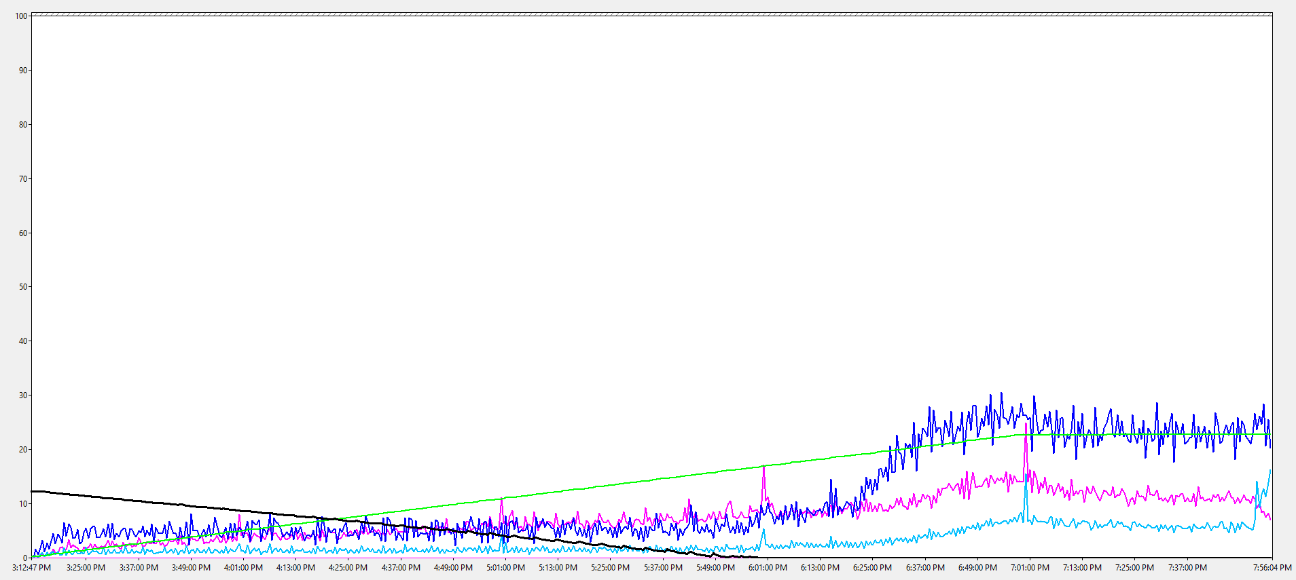
Perf/Scale explorations: Host memory vs storage load
Impact of low memory on storage IO
DL585 G7, 4x 12 cores (AMD Opt 6172), 128 GB RAM
Storage: Local array 24x RAID10
Zero available memory
Partition count (max=228)
GoldVM: Reads/sec
?
Diff-disks: Writes/sec
Available memory
Diff-disks: Reads/sec

Slide 59
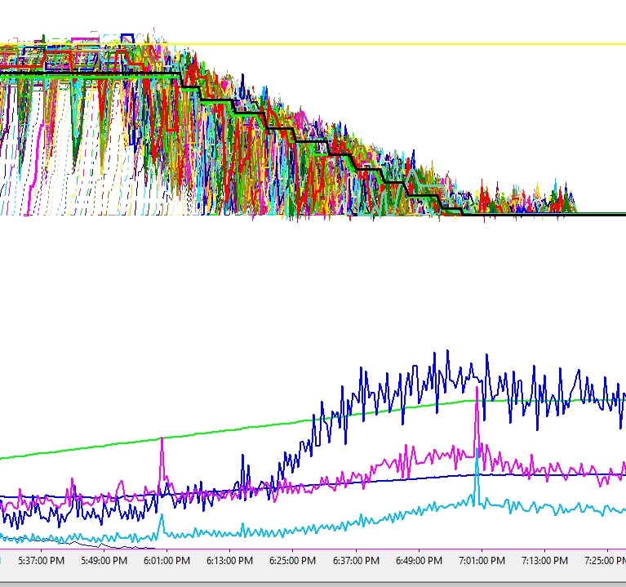
Perf/Scale explorations: Host memory vs storage load
Analysis:
  As host starts to run out of free memory, DynamicMemory reduces memory used by guest-VMs, forcing in-guest cached pages to flush
  Result: Guest OS generates more disk IOs due to smaller mem cache
Takeaway:
  Overcommitting host’s memory puts more load on the storage
Physical memory of guest-VMs
Zero available
memory

Slide 60
Perf/scale test results:
CSV Caching & VDI

Slide 61
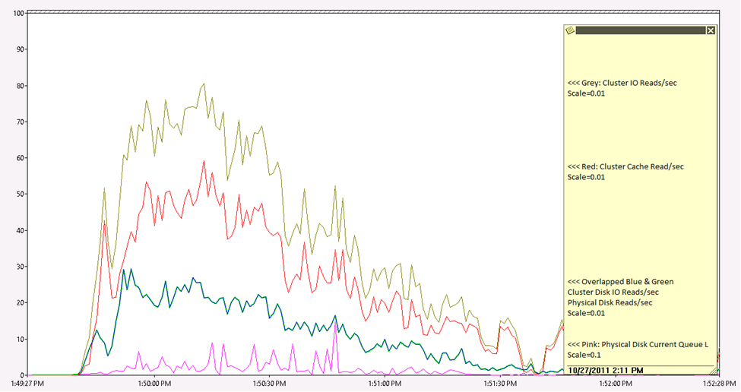
Perf/Scale explorations: CSV cache & boot storm
40 Pool-VMs starting from OFF state
CSV cache size = 1G
Benefit:
~75% reduction in disk read IOs
Cluster IO reads/s
Cluster Cache reads/s
Scale =0.01
Disk IO reads/s

Slide 62
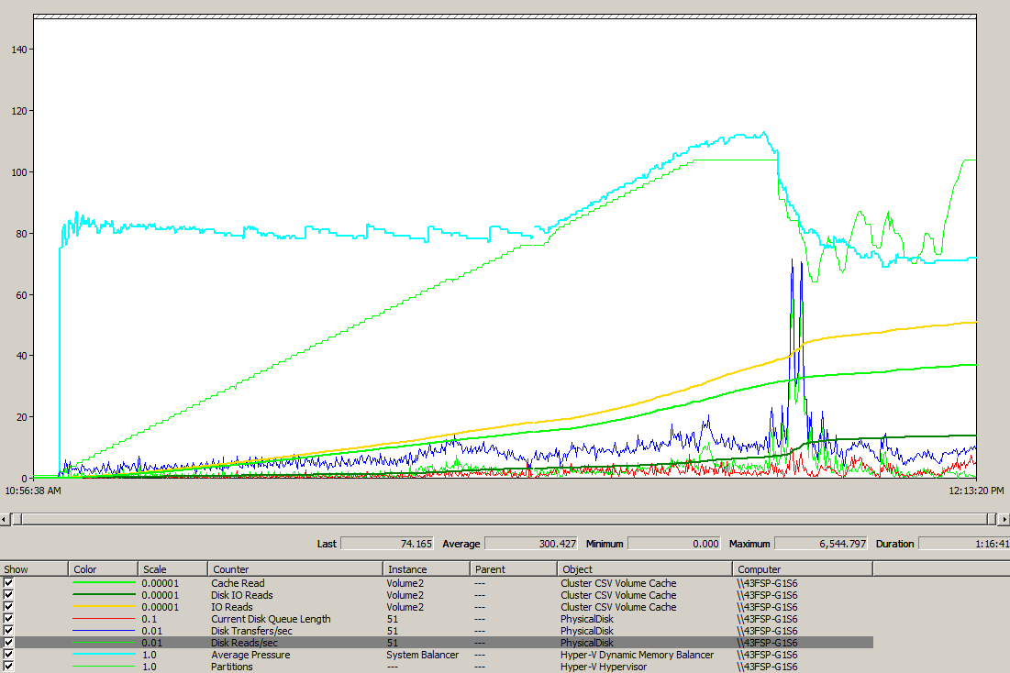
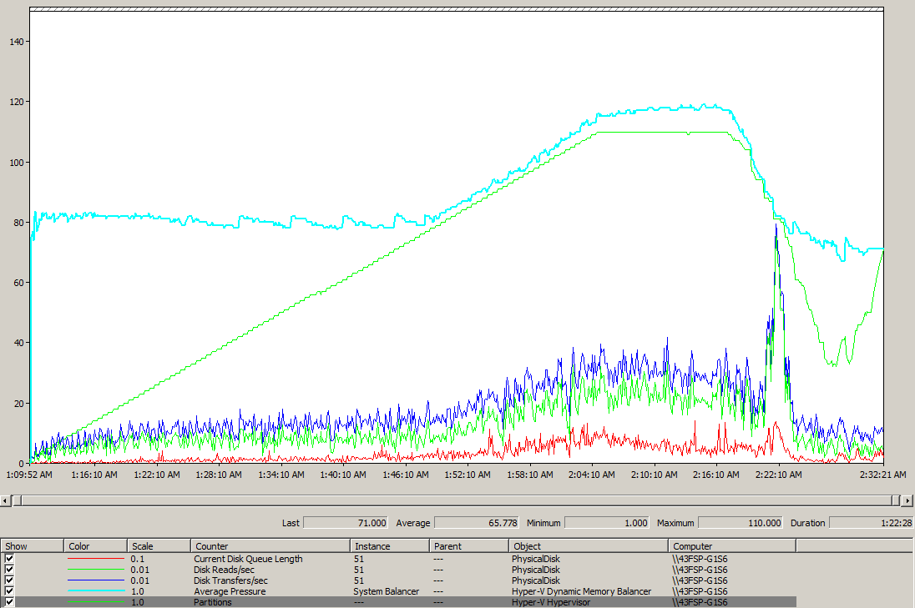
Perf/Scale explorations: CSV cache & VSI² workload
100 VMs running VSI² medium workload
CSV cache size = 1G
Benefit:
~70% reduction in disk read IOs
Partition count,
Max=100VMs
IO reads/s
Green: disk reads/s
CSV cache
reads/s
CSV block cache ON
CSV block cache OFF
¹ Perf data is highly workload sensitive
² VSI Benchmarking, by Login VSI B.V.

Slide 63
Perf/scale test results:
SMB network load due to VDI

Slide 64
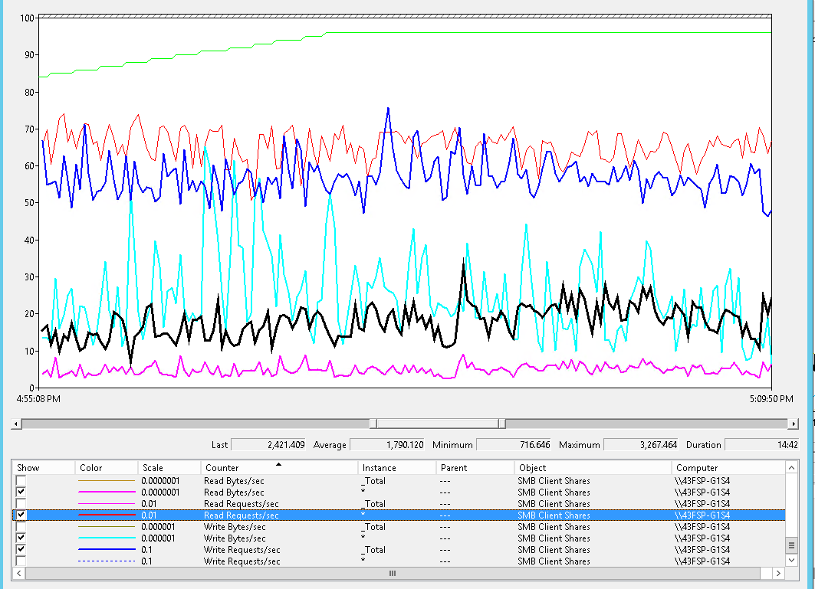
Perf/Scale explorations: ex of an SMB client load
SMB client load under VSI² medium workload
At t=5:02:09pm, 95VMs (Green line)
Blue: Write Requests/sec = 750
Black: Read requests/sec = 2100
Cyan: Write bytes/sec = 25 MBytes
Pink: Read bytes/sec = 60 MBytes
Thin-red is CPU on the VDI host
¹ Perf data is highly workload sensitive
² VSI Benchmarking, by Login VSI B.V.

Slide 65
Perf/scale test results:
VDI host’s memory and vGPU

Slide 66
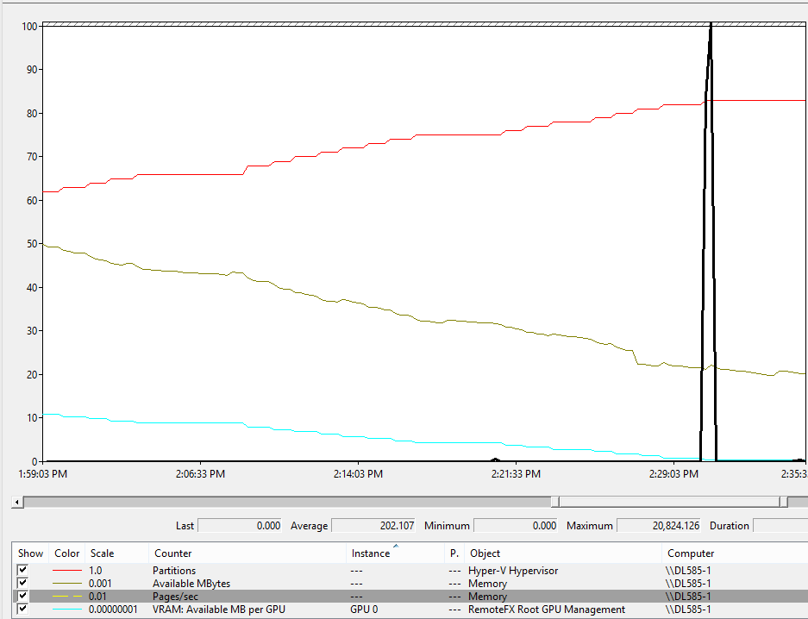
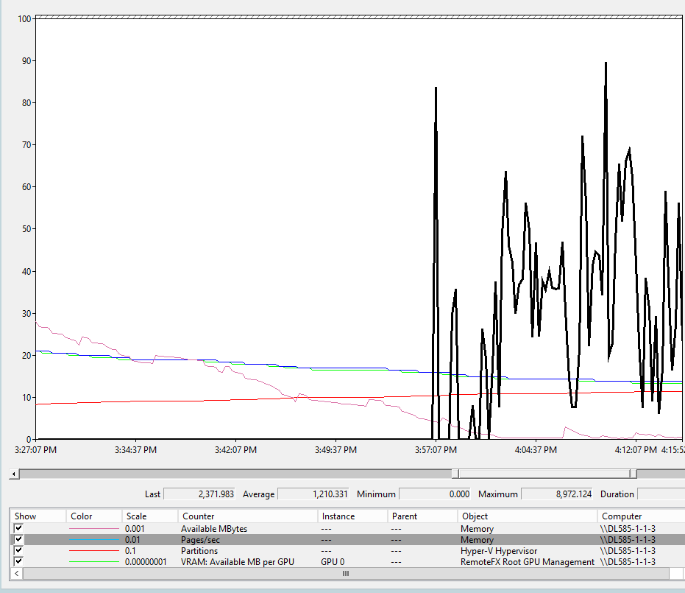
Perf/Scale explorations: vGPU & memory
SRV with 1x ATI V9800 GPU
SRV with 2x ATI V9800 GPUs
Zero sys mem
82 VMs
mem pages/s
Sys mem:
50Gig
mem pages/s
Sys mem:
28 Gig
106 VMs
GPU 0,1 VRAM:
2Gig
GPU0 VRAM:
1Gig
Zero GPU VRAM
DL585, 129Gig RAM, 1x ATI V9800 (4Gig)
Can’t create > 82 VMs, as GPU mem is exhausted
Good user experience across all VMs
DL585, 129Gig RAM, 2x ATI V9800 (4Gig)
SRV out of mem at 106 VMs
Large degradation in user experience across all VMs

Slide 67
Closing notes

Slide 68
A few final words
The inbox VDI PowerShell scripting layer was tested to 5000 seats
We’ve benchmarked a 2000 seat deployment
The inbox admin UI is design for 500 seats

Slide 69
Related sessions to attend/view
What's New in Windows Server 2012 Virtual Desktop Infrastructure and Remote Desktop Services
WCA-B350
Windows Server 2012 Desktop Virtualization (VDI) on Dell Active Infrastructure
WCA-B393
Tuning Images for VDI Usage
WCA-B341
Reduce Storage Costs with Data Deduplication
MDC-B342

Slide 70
Further Reading and Info
Remote Desktop Services Team Blog
http://blogs.msdn.com/b/rds/

Slide 71

Windows Track Resources
Windows Enterprise: windows.com/enterprise
Windows Springboard: windows.com/ITpro
Microsoft Desktop Optimization Package (MDOP): microsoft.com/mdop
Desktop Virtualization (DV): microsoft.com/dv
Windows To Go: microsoft.com/windows/wtg
Outlook.com: tryoutlook.com

Slide 72

Resources
Learning
  Sessions on Demand
  Microsoft Certification & Training Resources
http://channel9.msdn.com/Events/TechEd
www.microsoft.com/learning
TechNet
msdn
  Resources for IT Professionals
  Resources for Developers
http://microsoft.com/technet
http://microsoft.com/msdn

Slide 73


For More Information
System Center 2012 Configuration Manager
http://technet.microsoft.com/en-us/evalcenter/hh667640.aspx?wt.mc_id=TEC_105_1_33
Windows Intune
http://www.microsoft.com/en-us/windows/windowsintune/try-and-buy
Windows Server 2012
http://www.microsoft.com/en-us/server-cloud/windows-server
Windows Server 2012 VDI and
Remote Desktop Services
http://technet.microsoft.com/en-us/evalcenter/hh670538.aspx?ocid=&wt.mc_id=TEC_108_1_33
http://www.microsoft.com/en-us/server-cloud/windows-server/virtual-desktop-infrastructure.aspx
More Resources:
  microsoft.com/workstyle
  microsoft.com/server-cloud/user-device-management

Slide 74







Complete an evaluation on CommNet and enter to win!

Slide 75



Evaluate this session
Required Slide
*delete this box when your slide is finalized
Your MS Tag will be inserted here during the final scrub.
Scan this QR code to evaluate this session and be automatically entered in a drawing to
win a prize

Slide 76

© 2013 Microsoft Corporation. All rights reserved. Microsoft, Windows and other product names are or may be registered trademarks and/or trademarks in the U.S. and/or other countries.
The information herein is for informational purposes only and represents the current view of Microsoft Corporation as of the date of this presentation. Because Microsoft must respond to changing market conditions, it should not be interpreted to be a commitment on the part of Microsoft, and Microsoft cannot guarantee the accuracy of any information provided after the date of this presentation. MICROSOFT MAKES NO WARRANTIES, EXPRESS, IMPLIED OR STATUTORY, AS TO THE INFORMATION IN THIS PRESENTATION.

