Slide 2





Implementing App-V 5
Lessons Learned from a Production Rollout
WCA-B319
Ment van der Plas
Login Consultants
@mentvanderplas
www.softgridblog.com

Slide 3

App-V 4.6?

Slide 4
Prior Knowledge
Session will contain technical details of Microsoft App-V 4.x & 5.x
Familiarity with technical App-V terminology is preferred

Slide 5
Goals for this sessions
Give an overview of relevant changes in Microsoft App-V 5
Learn about the design process of an early production deployment
Share implementation pitfalls and gotchas

Slide 6
Changes in App-v 5

Slide 7
Changes in App-V 5?

Slide 8
Key changes
App-V 5.x
No dedicated drive letter required
No 4GB limit
User settings are stored on file system and in registry (open)
Rich PowerShell scripting
Web-based management
OS integration with Extension Points
Centrally managable Connection Groups
Shared Content Store
Extensive Deployment and User configuration
App-V 4.x
Uses dedicated drive letter (Q: drive)
4GB package limit
User settings in proprietary (unreadable) format
Limited command-line scripting
Installed management console
Isolated from local applications
Share middleware with Dynamic Suite Composition
Read-only Shared Cache
Limited customization in OSD

Slide 9
BASIC APP-V CLIENT
DEMO

Slide 10
Virtual Application Extensions
Extension Point is registered natively with Windows
Global Visibility
Native –to– Virtual
Virtual –to– Virtual
Supported Subsystems
Shortcuts
File Type Associations
AppPath
URL Protocols
Set Program Access and Computer Defaults (SPAD)
COM Local Servers

Slide 11
Deployment & User Configuration
AppxManifest.xml
Per User Configuration
Per Machine Configuration
_DeploymentConfig.xml
Per User Configuration
Per Machine Configuration
_UserConfig.xml
Per User Configuration
Part of the .APPV file (not editable) | Global scope: applied when package is added to the client | User scope: applied when package is published to the user

Slide 12

Connection Groups
No longer “managed” at package level
  App-V Management Server
  MS ConfigMgr 2012 SP1 (Virtual Environments)
  App-V Client
Have their own identity
  Separate configuration settings from applications
  Separate access permissions
Conflicts can be handled by
  Setting order in case of conflicting settings
  Setting priorities in case of conflicting relationships

Slide 13
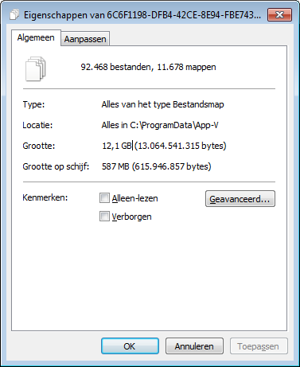
Shared Content Store
  Store applications centrally
  Save disk space in VDI/RDS
  Applications are executed from the shared store
  Applications can be updated per the usual process

Slide 14
ADVANCED APP-V CLIENT
DEMO

Slide 15
Design process

Slide 16
Customer Environment (current)
Industry Vertical: Government
4000 centrally managed desktops / laptops
Windows XP 32bit with traditional application deployment (MSI)
Roaming Profiles
Two primary sites and several small branch offices (within same city)

Slide 17
New Environment
Improve flexibility in working locations
Support diversity in end user devices
Stimulate new way of working
Result: Hosted Virtual Desktops
  Both non-persistent (majority) as well as persistent (specials)

Slide 18
Customer Considerations
Why App-V 5?
Reduced storage impact VDI (through SCS)
Avoid migration path in the near future
Adopt the latest and greatest (technology is new to the customer)

Slide 19
Environment (future)
Not your “typical” reference architecture
App- V plays a prominent role (key solution for VDI)
How would these components integrate?

Slide 20
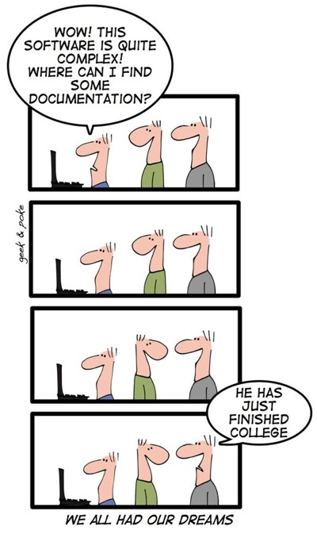
Documentation?

Slide 21
Infrastructure
© www.appvbook.com
Size | Frequency | Network dependency | Growth
MBs – GBs | Application start | First launch / Updates | #Apps #Users
KBs | Logon / Periodically | First refresh / Updates | Insignificant

Slide 22
Package Load State
Package Stream | Feature Block
Launch
Optimized (FB definition) | 0 | 1 | 2
Maximized (Full download) | 0
Launch
Launch
Minimized (Fault Streaming) | 0
Not available | Published SCS Mode | Launched | Mounted (Offline)
Package Load State

Slide 23
Service Disruption Impact
Impact
Existing applications can be continue to be started even if not started before Previously authorized applications can still be assigned and removed | Applications and Connection Groups can be fully managed but info will not reach the clients | Applications and Connection groups can be fully managed. New, updated or existing application can be started
Unable to add new, update or delete existing applications or connection groups | New or updated applications will not be delivered to the client (PubSvr down) or can’t be started on the client (StreamSvr down) Existing applications can’t be started if not started and (partially) downloaded previously | Reporting data can’t be send out and will be cached on the client and retried later Reporting data can’t be retrieved from database
Medium – Low | High | Low

Slide 24
High Level Design

Slide 25
Design Decisions - Database
Separate clustered database
  Service was already in-place
Size calculation
  Size of DB = 250 packages * 1Mb average manifest * (2 customizations+ 4 constant) = 1500Mb (1,5Gb)
Standard backup and restore procedures

Slide 26
Design Decisions – Management Server
Two separate Management Servers
  One on each site
  Not high available; not critical in the environment
No backup
  Holds no data (all in database)
  Use snapshot or rebuild in case of failure

Slide 27
Design Decisions – Publishing Server
Four separate Publishing Servers
  Two at each site; expand on demand
  Accessible through Load Balancer
Combined with Streaming Server role
  HTTP streaming only
Content replication through DFSR

Slide 28
Design Decision – Load Balancer
Three primary goals:
  Performance - load is divided between multiple targets
  Scalability - easy to add additional servers when required
  Availability – unavailability is detected and handled
Cisco ACE 4710
  One at each site (was already present)
  Active – Passive context at each site (failover)
  Easy availability check through HTTP (port 80 and 81*)
  Stickyness (device affinity) can be set accordingly
* Depends on configuration for Streaming and Publishing Server

Slide 29
Design Decision - General
No Reporting Server
  Reporting is handled by another solution
All servers are virtualized
  Standard company procedure
  VMWare ESXi
  Windows Server 2008 R2 SP1
  1 vCPU@2Ghz; 4GB Memory;
  30Gb OS / 200Gb Data (Publ/Str) HDD
Shared Content Store for VDI

Slide 30
Now...our experience?

Slide 31
AppSense
No issues with Environment Manager or Personalization Server
  Works for both Policy Configuration and User Personalization
Register executable just like any other application
  Shortcuts can even be disabled from App-V Management Console

Slide 32
AppSense (optimized)
Additional excludes in Personalization Server
  HKEY_CURRENT_USER\Software\Microsoft\AppV
  {CSIDL_COMMON_APPDATA}\App-V
Additional accessible items with Trusted Ownership disabled in Application Manager
  %LocalAppData%\Microsoft\AppV\Client
  %ProgramData%\App-V
  %ProgramData%\Microsoft\AppV

Slide 33
Sequencing
Process flow and wizard are almost the same
  Shortcuts and filetypes customization is no longer in the wizard
  Editor shows only one Files tab (but misses date/time, size info)
Converter is easily scriptable through PoSh
  Package model changes may require additional work
  OSD is per application; XML is per package

Slide 34
Package Converter Limitations
Properties | Functionality Migrated | Detected / Reported | Impact
App-V 4.5 Packages and lower | ☹ | ☺ | Medium
<OS> tag Win7 and lower | ☹ | ☺ | Medium
Scripts from OSD | ☹ | ☺ | Medium
Registry from OSD | ☹ | ☺ | Medium
Dynamic Suiting Composition (DSC) | ☹ | ☺ | Low
Existing feature blocks | ☹ | ☹ | Low*
Terminate children | ☹ | ☹ | Medium
Empty directories | ☹ | ☹ | Medium*
New App-V extension points | 😐 | 😐 | Low*
Environment Variables | 😐 | 😐 | High*
Tokenized Directories | 😐 | 😐 | High*
References to %SFT_MNT% (Q:) | 😐 | 😐 | High*
* Requires editing or rebuilding through Sequencer

Slide 35
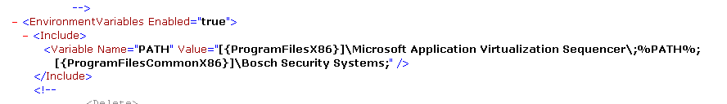
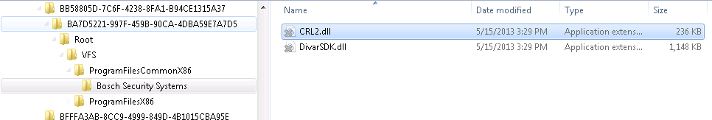
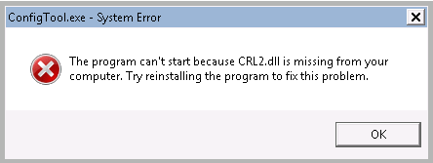
Example: Environment Variable

Slide 36
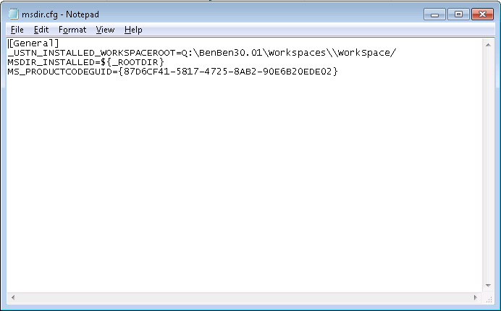
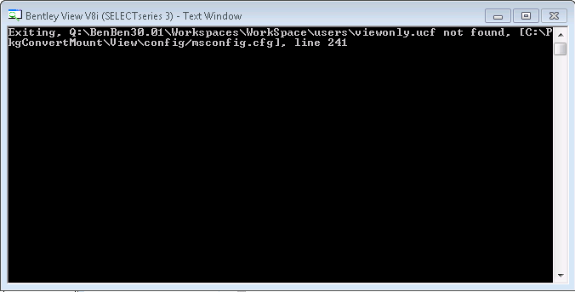
Example: reference to %SFT_MNT% (Q:)

Slide 37
PACKAGE CONVERTER
DEMO

Slide 38
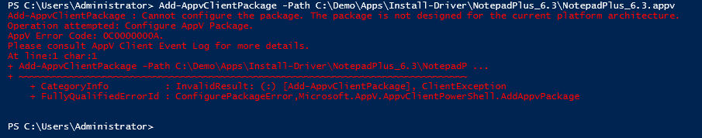
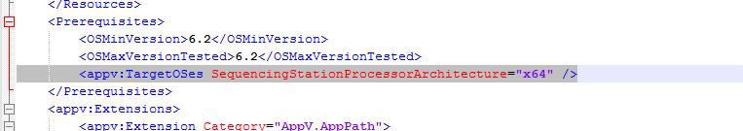
Cross Platform / Architecture
 | Application x86 | Application x64
Sequencer x86 | Client x86: Yes Client x64: Yes* | N/A
Sequencer x64 | Client x86: No Client x64: Yes | Client x86: No Client x64: Yes
*New App-V 5 extension points don’t register

Slide 39
Primary Virtual Application Directory
Gotchas:
  PVAD question is prompted before actual installation starts
  PVAD is arbitrary as the actual name becomes Root
  PVAD is not merged in Connection Groups
App-V 4.x Package | SFT_MNT | VFS
App-V 5.x Package | PVAD (Root) | VFS
Choose as installation directory (where possible)
Keep small for performance reasons*
* Arguable as this was never proven and sometimes even inevitable

Slide 40

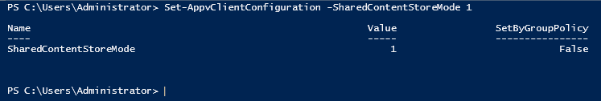
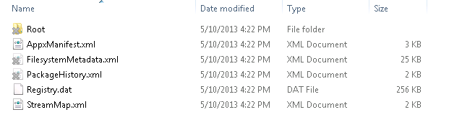
Client
Shared Content Store rocks!
  Storage reduction 80-95%
  No additional management requirements

Slide 41
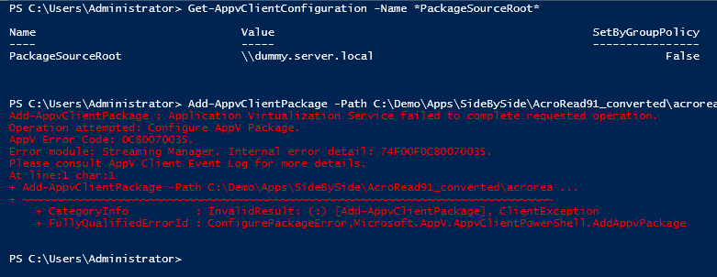
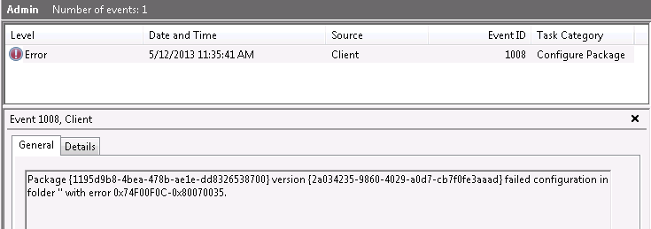
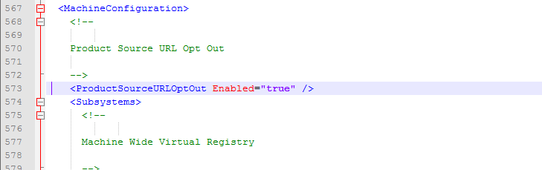
PackageSourceRoot behavior
Note: PSR does not get applied directly for active sessions!

Slide 42
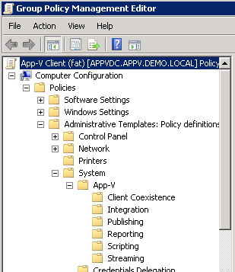
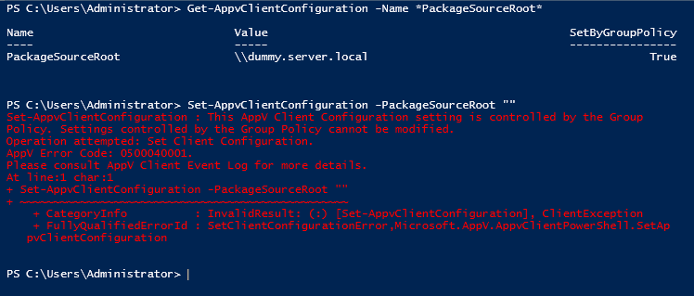
Group Policy Administration

Slide 43
Server
Split between Management and Publishing server
  Creates a more robust and scalable environment
  Use DFSR for content replication
Setup is easy
  Still needs design considerations and sizing metrics documented

Slide 44
Publishing Performance
Is no longer linear!
  No longer (directly) depends on the number of apps
Depends on
  Number and complexity of extension points (example COM objects)
  Package size (my observation)
During publishing Start Menu flickers and hardly usable

Slide 45

Performance testing with LoginVSI
Availability
Performance
www.loginvsi.com

Slide 46
Key takeaways
App-V 5 is a solid future ready release (SP1 is out ☺)
Rich feature set with new functionality worth migrating for
  But…you cannot make an omelet without breaking eggs
  Impact primarily in package convertion and migration
Take 5 if you’re not already an existing customer!

Slide 47
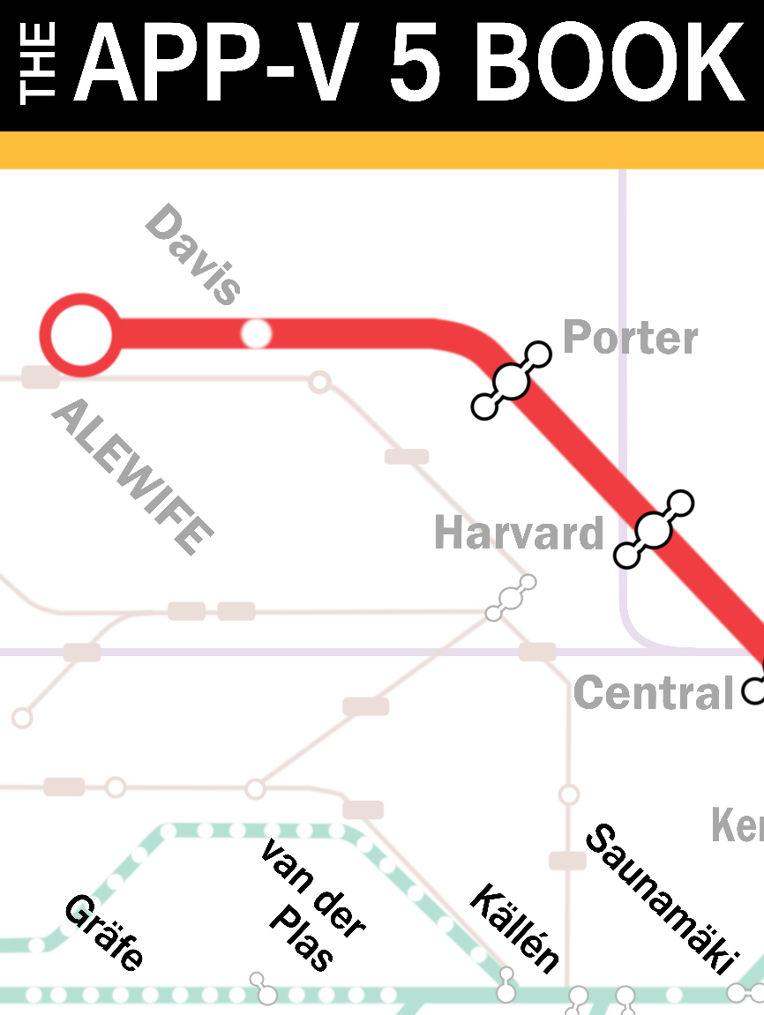

Free AppV 5 Book
www.appvbook.com

Slide 48

Thank you

Slide 49

Related Content
WCA-B208 - Microsoft Application Virtualization 5.0 Migration and Co-Existence with 4.6
WCA-B203 - Microsoft Application Virtualization 5.0 and Microsoft Office: Better Together
WCA-B311 - Deploying and Managing Virtual Applications and Settings with Microsoft System Center 2012 SP1 - Configuration Manager and MDOP
WCA-B205 - Sequencing Applications Using the New Microsoft Application Virtualization 5.0 Sequencer

Slide 50
Windows Track Resources
Windows Enterprise: windows.com/enterprise
Windows Springboard: windows.com/ITpro
Microsoft Desktop Optimization Package (MDOP): microsoft.com/mdop
Desktop Virtualization (DV): microsoft.com/dv
Windows To Go: microsoft.com/windows/wtg
Outlook.com: tryoutlook.com

Slide 51

Resources
Learning
  Sessions on Demand
  Microsoft Certification & Training Resources
http://channel9.msdn.com/Events/TechEd
www.microsoft.com/learning
TechNet
msdn
  Resources for IT Professionals
  Resources for Developers
http://microsoft.com/technet
http://microsoft.com/msdn

Slide 52


For More Information
System Center 2012 Configuration Manager
http://technet.microsoft.com/en-us/evalcenter/hh667640.aspx?wt.mc_id=TEC_105_1_33
Windows Intune
http://www.microsoft.com/en-us/windows/windowsintune/try-and-buy
Windows Server 2012
http://www.microsoft.com/en-us/server-cloud/windows-server
Windows Server 2012 VDI and
Remote Desktop Services
http://technet.microsoft.com/en-us/evalcenter/hh670538.aspx?ocid=&wt.mc_id=TEC_108_1_33
http://www.microsoft.com/en-us/server-cloud/windows-server/virtual-desktop-infrastructure.aspx
More Resources:
  microsoft.com/workstyle
  microsoft.com/server-cloud/user-device-management

Slide 53







Complete an evaluation on CommNet and enter to win!

Slide 54



Evaluate this session
Required Slide
*delete this box when your slide is finalized
Your MS Tag will be inserted here during the final scrub.
Scan this QR code to evaluate this session and be automatically entered in a drawing to
win a prize

Slide 55

© 2013 Microsoft Corporation. All rights reserved. Microsoft, Windows and other product names are or may be registered trademarks and/or trademarks in the U.S. and/or other countries.
The information herein is for informational purposes only and represents the current view of Microsoft Corporation as of the date of this presentation. Because Microsoft must respond to changing market conditions, it should not be interpreted to be a commitment on the part of Microsoft, and Microsoft cannot guarantee the accuracy of any information provided after the date of this presentation. MICROSOFT MAKES NO WARRANTIES, EXPRESS, IMPLIED OR STATUTORY, AS TO THE INFORMATION IN THIS PRESENTATION.

