Slide 2
Making PC Recovery Easier with the Microsoft Diagnostics and Recovery Toolset (DaRT)
WCA-B325
Aaron Ruckman –
Program Manager

Slide 3
Session Objectives And Takeaways
Objectives:
Explain how Microsoft Diagnostics and Recovery Toolset (DaRT) can be used by enterprise customers.
Identify the options for deploying DaRT across an enterprise.
Describe how advanced scenarios can be leveraged in the enterprise.
Takeaways:
DaRT meets machine recovery needs of a highly productive global workforce.
DaRT tool automation is seamless and robust.

Slide 4
DaRT Whirlwind Tour

Slide 5
Most Costly Hurricane in US history?
What IT disasters have impacted your Org?
Hurricane Katrina (2005) - $84 Billion
Hurricane Sandy (2012) - $75 Billion+

Slide 6
Lost Data and Files
Recovery Planning
System Failures
Distributed Workforce
Traditional approaches to machine recovery don’t meet the needs of a highly productive global workforce

Slide 7
Accelerate Desktop Repair Onsite and Remotely
Shift desktop repair planning from reactive to proactive
Identify the cause, repair the problem, restore productivity
Simple recovery image creation and deployment

Slide 8
Common Enterprise Scenarios
Recover unbootable PCs
Access deleted files, repair disk partitions
Reset passwords
Detect and remove malware while offline
Prepare PC disks for donation
Centralized IT staff

Slide 9
DaRT Tools – Tool Groupings
Disk and File
Administrative
Recovery

Slide 10
DaRT Tools
Disk Commander
Disk Wipe
Explorer
File Restore
Search
SFC Scan
Disk and File
Administrative
Recovery

Slide 11
DaRT Tools
Computer Management
Registry Editor
TCP/IP Config
Remote Connection
Disk and File
Administrative
Recovery

Slide 12
DaRT Tools
Crash Analyzer
Defender
Locksmith
Hotfix Uninstall
Disk and File Administrative Recovery

Slide 13
Deploying DaRT Image
CD/DVD
USB
Network boot
Local install

Slide 14
DaRT Tools Demo

Slide 15
Automating DaRT

Slide 16
Common Org Goals
Monitor and fix malware and viruses regularly
Assure management that their machines are clean
Minimize user impact

Slide 17
Solution
Create DaRT Image (WIM) with latest WDO Definitions
Deploy and start DaRT remotely (recommend CM)
Analyze Reports (weekly)

Slide 18
Solution
Create DaRT Image (WIM) with latest WDO Definitions
Deploy and start DaRT remotely (recommend CM)
Analyze Reports (weekly)

Slide 19
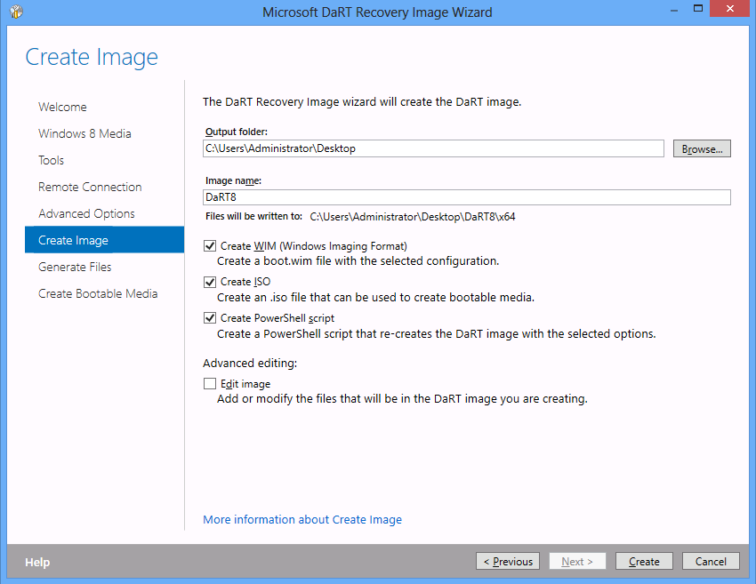
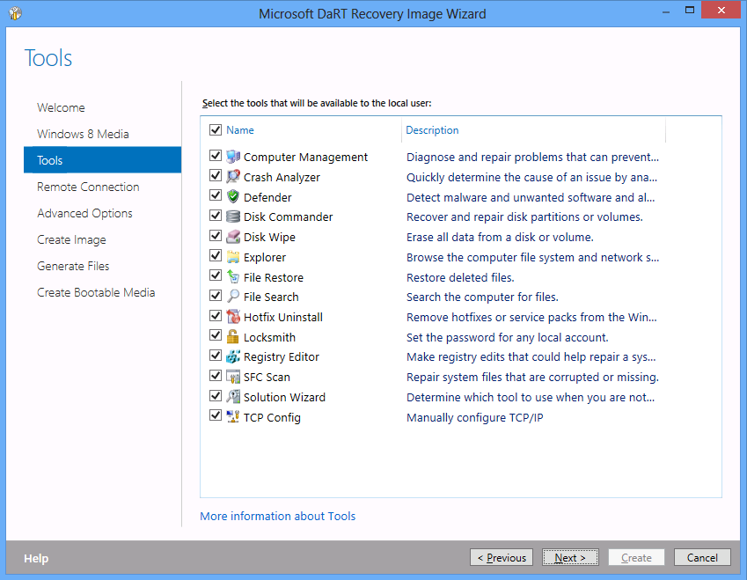
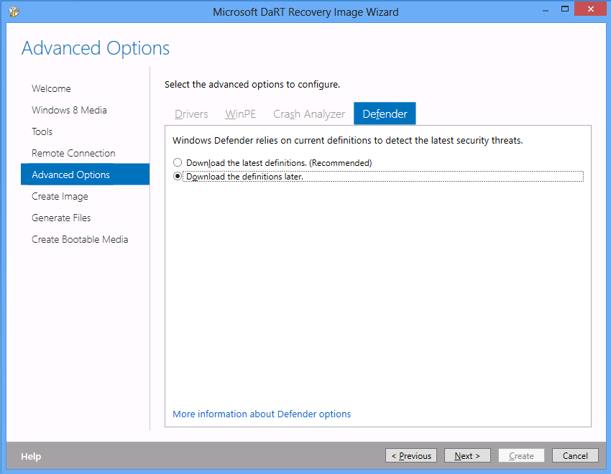
Create DaRT image w/ Latest Definitions
Install DaRT 8
Launch Recovery Image Wizard
On Tools Tab select Defender
On Advanced Options-> Defender Tab, select download the latest definitions (Recommended)
For CM, on Create Image Tab -> Ensure Create WIM is checked.

Slide 20
Creating Image via PowerShell Scripts
General Steps:
Import modules
Set target and destination Windows 8 media location
Create copy of WIM and remove read only Flag
Mount new image
Save and dismount the image
Can add manual user-specific customizations
WDO definitions choice persisted
More info: http://aka.ms/PoSHDaRTImage

Slide 21
PowerShell cmdlets
From Power Shell: Import Microsoft.Dart Module
Name | Description
Copy-DartImage | Burns an ISO to a CD, DVD, or USB drive.
Export-DartImage | Allows the source WIM file, which contains a DaRT image, to be converted into an ISO file.
New-DartConfiguration | Creates a DaRT configuration object that is needed to apply a DaRT toolset to a Windows Image.
Set-DartImage | Applies a DartConfiguration object to a mounted Windows Image. This includes adding all files, configuration, and package dependencies

Slide 22
Solution
Create DaRT Image (WIM) with latest WDO Definitions
Deploy and start DaRT remotely (recommend CM)
Analyze Reports (weekly)

Slide 23
Launching DaRT via Config Manager
Import DaRT WIM as a boot image
Build the Task Sequence
"%ProgramFiles%\Microsoft Security Client\OfflineScannerShell.exe" /autoscan
Deploy the Task Sequence, Validate & Roll-out

Slide 24
Solution
Create DaRT Image (WIM) with latest WDO Definitions
Deploy and start DaRT remotely (recommend CM)
Analyze Reports (weekly)

Slide 25
Analyze Reports
On drive of OS that was scanned, Logs can be found:
C:\windows\Microsoft antimalware\support\mpdetections*
Copy these to a central location
Tip: Find “Detect” in mpdetections for issues.
Example of MPDetections-XXXX.log
2013-02-04T21:57:37.857Z Version: Product 4.2.223.0 Service 4.2.223.0 Engine 1.1.9103.0 AS 1.143.1499.0 AV 1.143.1499.0
2013-02-04T22:04:11.068Z DETECTION Virus:DOS/EICAR_Test_File file:C:\eicar_utf8.txt->(UTF-8)

Slide 26
In Review - Solution
Create DaRT Image (WIM) with latest WDO Definitions
Deploy and start DaRT remotely (recommend CM)
Analyze Reports (weekly)

Slide 27
Weekly WDO Scans – Demo

Slide 28
Remote Connection

Slide 29
New set of Org Goals
Org’s on cost cutting spree and need to repurpose machines
Assure Management that their machines don’t lose data
Unable to log in with local admin creds

Slide 30
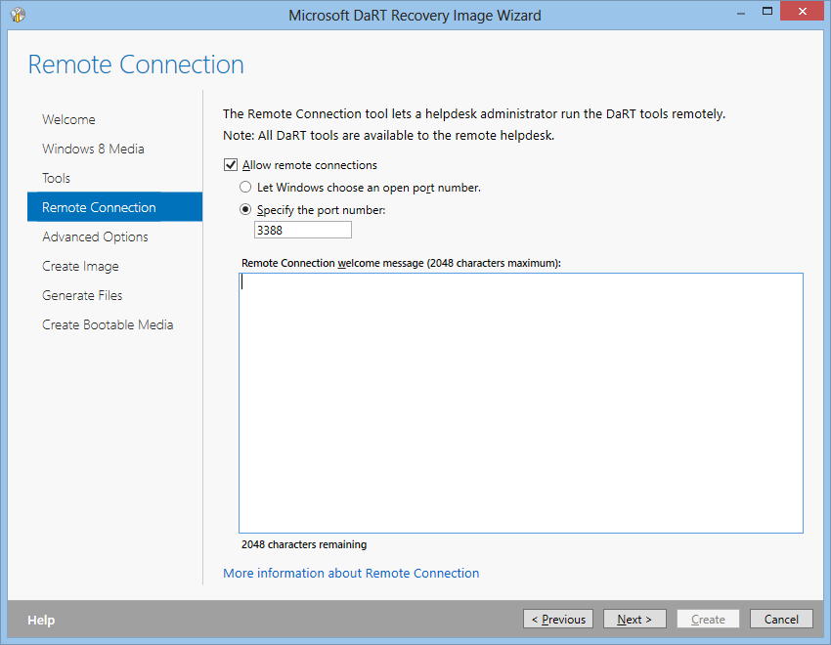
Remote Connection
Must enable in DaRT image
Random or defined port number
Create a custom message for users
Can be used to lock down tools

Slide 31
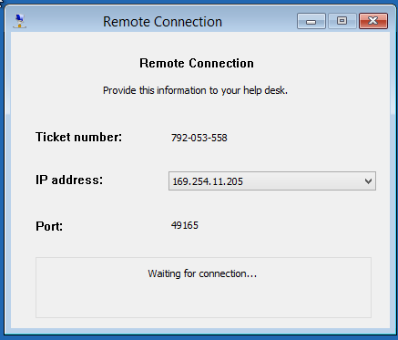
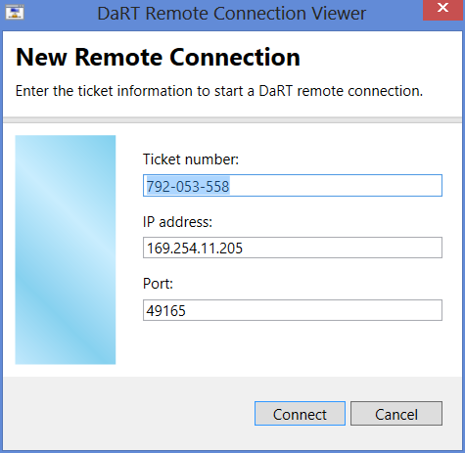
DaRT Tool – Remote Connection

Slide 32
Remote Connection Demo

Slide 33
Where to learn more About DaRT
TechNet Forum:
http://aka.ms/dartforum
Springboard:
http://aka.ms/mdopspringboard
Deployment Guide:
http://aka.ms/dart8deploy

Slide 34
Session Objectives And Takeaways
Session Objective(s):
Explain how Microsoft Diagnostics and Recovery Toolset (DaRT) can be used by enterprise customers.
Describe how advanced scenarios can be leveraged in the enterprise.
Identify the options for deploying DaRT across an enterprise.
DaRT meets machine recovery needs of a highly productive global workforce.
DaRT tool automation is seamless and robust.

Slide 35
Related content
Breakout Sessions
WCA-B208 | Microsoft Application Virtualization 5.0 migration and co-existence with 4.6 | 6/3 Monday 1:15-2:30
WCA-B203 | App-V 5.0 and Office: Better Together | 6/3 Monday 4:45-6:00
WCA-B209 | Microsoft BitLocker Administration and Monitoring (MBAM) v2 | 6/4 Tuesday 10:15-11:30
WCA-B311 | Deploying and Managing Virtual Applications and Settings with System Center Configuration Manager 2012 SP1 and MDOP | 6/4 Tuesday 1:30-2:45
WCA-B359 | Microsoft User Experience Virtualization (UE-V): How to manage and deploy UE-V across an enterprise | 6/5 Wednesday 8:30-9:45
WCA-H206 | Microsoft Diagnostics and Recovery Toolset (DaRT) | HOL
Visit the Windows Client Booth in the Expo Hall.

Slide 36
Resources
Learning
Sessions on Demand
Microsoft Certification & Training Resources
http://channel9.msdn.com/Events/TechEd
www.microsoft.com/learning
TechNet
msdn
Resources for IT Professionals
Resources for Developers
http://microsoft.com/technet
http://microsoft.com/msdn

Slide 37
Complete an evaluation on CommNet and enter to win!

Slide 38
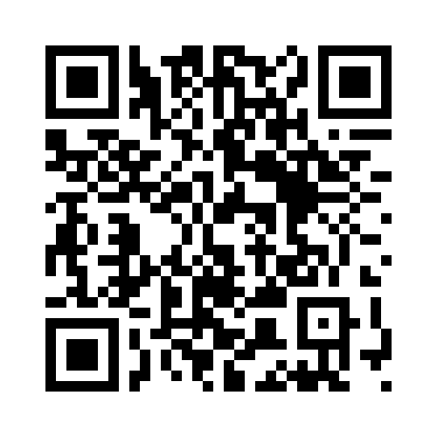
Evaluate this session
Required Slide
*delete this box when your slide is finalized
Your MS Tag will be inserted here during the final scrub.
Scan this QR code to evaluate this session and be automatically entered in a drawing to win a prize

Slide 39
© 2013 Microsoft Corporation. All rights reserved. Microsoft, Windows and other product names are or may be registered trademarks and/or trademarks in the U.S. and/or other countries.
The information herein is for informational purposes only and represents the current view of Microsoft Corporation as of the date of this presentation. Because Microsoft must respond to changing market conditions, it should not be interpreted to be a commitment on the part of Microsoft, and Microsoft cannot guarantee the accuracy of any information provided after the date of this presentation. MICROSOFT MAKES NO WARRANTIES, EXPRESS, IMPLIED OR STATUTORY, AS TO THE INFORMATION IN THIS PRESENTATION.

