Slide 2
Secure anywhere access to corporate resources such as Windows Server Work Folders using ADFS
WCA-B334
Samuel Devasahayam
Adam Skewgar
Microsoft

Slide 3
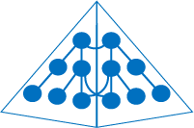
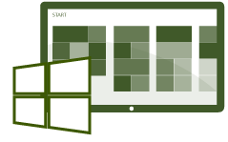
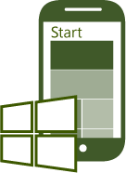
Increasing the value in Active Directory Federation Services
Organizations can connect to SaaS applications running in Windows Azure, Office 365 and 3rd party providers
SaaS Apps
Organizations can federate with partners and other organizations for seamless access to shared resources
ADFS
Active Directory
Firewall
Resources in other businesses or identity realms
ADFS
Published applications
Web Application Proxy
(includes ADFS Proxy)
Conditional access with multi-factor authentication is provided on a per-application basis, leveraging user identity, device registration & network location
Claims & Kerberos web apps
Office Forms Based Access
Restful OAuth apps
Users can register their devices to gain access to corporate data and apps and single sign-on through device authentication

Slide 4
Identity Capabilities for BYOD
AD Workplace Join
Users join their device to their workplace (Lite domain join), making the device known to the company’s Active Directory for SSO, seamless MFA & authorization
Single Sign On (SSO)
Users sign-in once to their company from any application and are not be prompted for credentials by every company application when using registered devices.
Work From Anywhere
Businesses enable users to work from anywhere while adhering to their IT governance policies around risk management
Multi-factor Authentication
Businesses require additional factors of authentication when business critical resources are accessed or when there is perceived risk
Multi-factor Access Control
Businesses set conditional access control to resources based on four core pivots: the user, the device used, the user’s network location and use of additional auth factors
AD Authentication Library
ISVs build enterprise apps that delivery SSO and allow enterprises to set the access control policies based on user, device and network location, and MFA

Slide 5
Trusted File Servers
Original server
workload
Exabytes deployed
annually
Rich
ecosystem
Simple and
efficient

Slide 7
Introducing Work Folders
Allow information workers to access their individual data
… that is centrally located on a traditional file server
… from all of their devices
… from wherever they are
… while remaining in compliance with policies

Slide 8
Work Folders Topology
Authentication
Kerberos (Windows Auth)
Digest (Windows Auth)
ADFS (OAuth)
Device management policy
Limit access to registered devices
File encryption / selective wipe
Require password / device lock
Active Directory
Contoso.com
Reverse Proxy
https://workfolders.contoso.com
File Server
User Devices
Data management
Quotas
File screens
Reporting
Classification
RMS protection
User Devices
Corporate Environment

Slide 9
Securing Access

Slide 10
How do I Secure Access?
Govern Authentication
Govern Authorization
Protect User Accounts
Protect User Devices

Slide 11
Governing Authentication

Slide 12
Governing Authentication
Primary Authentication
Governs all applications that trust ADFS
Extranet Vs Intranet Differentiation
WIA fallback to forms for enhanced user experience in intranet
Device Authentication
Always validated against the directory information in AD
Force Authentication for sensitive apps
Authentication types are limited to what is supported by Active Directory

Slide 13
Governing Primary Authentication
Demo

Slide 14
Governing Authentication
Additional Authentication (MFA) Triggers
Can be applied only for your sensitive applications
Policy can be triggered based on user, device & location context. “Only trigger additional authentication if…”
“…my users are coming from the extranet”
“…the user is part of the application administrators group”
“…the user is accessing from a non workplace joined device”
Can also be applied for all applications to support broad organization policies
In-Box Support for X509 Certificate Authentication (e.g. “Smart Cards”)

Slide 15
Governing Authentication
Extensible Additional Authentication
Framework to support web credential collection from any 3rd party MFA provider (e.g. Phone based or OTP based MFA systems)
Supports challenge response interaction
Sign-in experience is consistent with the rest of ADFS sign-in pages
3rd party MFA providers can add provide additional data to the Authentication Context

Slide 16
MFA Integration with Partners
Windows Azure Active Authentication
(a.k.a PhoneFactor)
Offers convenient out-of-band phone call, text message, and mobile app authentication, as well as one-time-passcodes
Synchronizes with Active Directory for centralized user management and automated enrollment
Features built-in support for leading on-premises applications as well as federation to cloud services
SafeNet Authentication Service delivers versatile strong authentication as-a-service
Support for Hardware/Software OTP, SMS & GrIDSure (pattern based AuthN)
Available as a Cloud Service with no additional infrastructure
Automated Provisioning
MORE ON THE WAY!

Slide 17
Governing Additional Authentication
Demo

Slide 18
Governing Authorization

Slide 19
Governing Authorization
Per-application Authorization policies
Permit/deny access to applications based on user, device & network location. Examples are
“Allow only workplace joined devices when connecting from the extranet to this application”
“Allow only users belonging to a security group when connecting from the extranet to this application”
Customized Access Denied Messages
Customized on a per-application basis

Slide 20
Governing Authorization
Demo

Slide 21
Protecting Your Users & Devices

Slide 22
Protecting your Users & Devices
Extranet Bad Password Lockout
Threshold & ‘Observation Window’ settable by admin
Once threshold has exceeded, authentication with username/pwd will be denied authentication for ‘Observation Window’ from extranet
Can be layered on top of AD Lockout policies but not required

Slide 23
Protecting your Users & Devices
Protection For Lost Devices
User@Device objects can be disabled or deleted in AD
Authentication is blocked if User@Device is disabled or not found

Slide 24
Protecting your Users & Devices
Other Security
Invalidate SSO state generated prior to specific timestamp available for rare ‘breach’ events
SSO state invalidated any time User@Device certificate does not match with information stored in SSO state

Slide 25
Protection your Users & Devices
Demo

Slide 26
Related Content
WCA-B204: AD Enables End User Productivity & IT Risk Management across a Variety of Devices
WCA-B333: Enable Work from Anywhere without Losing Sleep: Remote Access with the Web Application Proxy and VPN Solutions
FDN03: Enabling People Centric IT

Slide 27
Track Resources
ADFS Content Map http://social.technet.microsoft.com/wiki/contents/articles/2735.ad-fs-2-0-content-map.aspx
Active Directory Blog http://blogs.msdn.com/b/active_directory_team_blog/

Slide 28
Windows Track Resources
Windows Enterprise: windows.com/enterprise
Windows Springboard: windows.com/ITpro
Microsoft Desktop Optimization Package (MDOP): microsoft.com/mdop
Desktop Virtualization (DV): microsoft.com/dv
Windows To Go: microsoft.com/windows/wtg
Outlook.com: tryoutlook.com

Slide 29
For More Information
System Center 2012 Configuration Manager
http://technet.microsoft.com/en-us/evalcenter/hh667640.aspx?wt.mc_id=TEC_105_1_33
Windows Intune
http://www.microsoft.com/en-us/windows/windowsintune/try-and-buy
Windows Server 2012
http://www.microsoft.com/en-us/server-cloud/windows-server
Windows Server 2012 VDI and Remote Desktop Services
http://technet.microsoft.com/en-us/evalcenter/hh670538.aspx?ocid=&wt.mc_id=TEC_108_1_33
http://www.microsoft.com/en-us/server-cloud/windows-server/virtual-desktop-infrastructure.aspx
More Resources:
microsoft.com/workstyle microsoft.com/server-cloud/user-device-management

Slide 30
Resources
Learning
Sessions on Demand
Microsoft Certification & Training Resources
http://channel9.msdn.com/Events/TechEd
www.microsoft.com/learning
TechNet
msdn
Resources for IT Professionals
Resources for Developers
http://microsoft.com/technet
http://microsoft.com/msdn

Slide 31
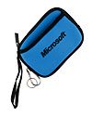
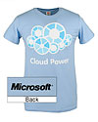
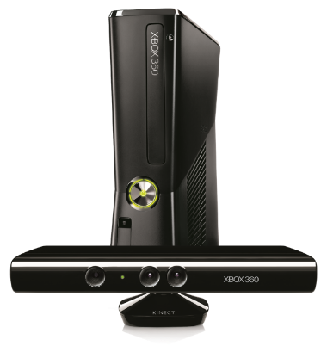
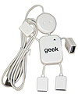
Complete an evaluation on CommNet and enter to win!

Slide 32
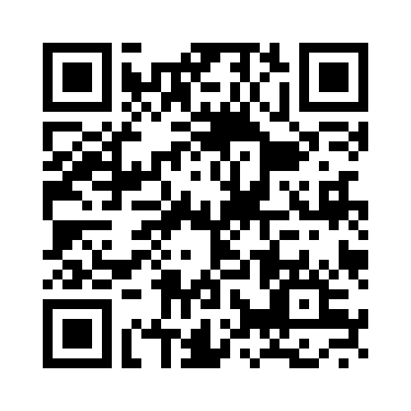
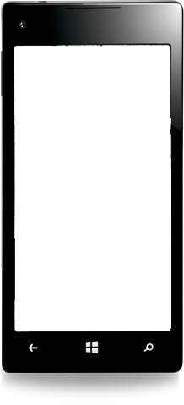
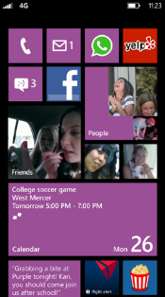
Evaluate this session
Required Slide
*delete this box when your slide is finalized
Your MS Tag will be inserted here during the final scrub.
Scan this QR code to evaluate this session and be automatically entered in a drawing to win a prize

Slide 33
© 2013 Microsoft Corporation. All rights reserved. Microsoft, Windows and other product names are or may be registered trademarks and/or trademarks in the U.S. and/or other countries.
The information herein is for informational purposes only and represents the current view of Microsoft Corporation as of the date of this presentation. Because Microsoft must respond to changing market conditions, it should not be interpreted to be a commitment on the part of Microsoft, and Microsoft cannot guarantee the accuracy of any information provided after the date of this presentation. MICROSOFT MAKES NO WARRANTIES, EXPRESS, IMPLIED OR STATUTORY, AS TO THE INFORMATION IN THIS PRESENTATION.

