Slide 2
Next Generation Remote Access with DirectAccess
WCA-B339
Richard Hicks – MVP
Iron Networks
@richardhicks

Slide 3
The Remote Access Challenge…

Slide 4
Agenda
What is DirectAccess?
What are the Benefits of DirectAccess?
What’s New in Windows Server 2012 DirectAccess
DirectAccess Components
Limitations of DirectAccess
How DirectAccess Works
Demonstration
Security Considerations

Slide 5
What Is DirectAccess?

Slide 6
What Is DirectAccess?
Next Generation Remote Access
Always On
Seamless and Transparent
Bi-Directional Connectivity
NOT a VPN!

Slide 7
DirectAccess vs. Legacy VPN
VPN
Intrusive
User Initiated
Remote User Connects to the Corporate Network…
DirectAccess
Seamless and Transparent
No User Action Required
Extend Corporate Network to the User!

Slide 8
DirectAccess Benefits
End User
Streamlined User Experience
Familiar Access
Increased Productivity
Administrator
Always Managed
Improved Compliance
Reduced Administration Costs

Slide 9
Evolution of DirectAccess
Windows Server 2008 R2
Forefront Unified Access Gateway (UAG) 2010
Windows Server 2012

Slide 10
What’s New in Server 2012 DirectAccess?

Slide 11
What’s New in Windows Server 2012
DirectAccess and RRAS Coexistence
Simplified Deployment
No PKI
Perimeter/DMZ Deployment
Integrated Network Load Balancing
Multi-Domain Support
NAP Integration
OTP/Virtual Smartcard
Automated Force Tunneling
IP-HTTPS Improvements
Manage Out
Multi-Site
Server Core
PowerShell
Monitoring and Reporting

Slide 12
New Feature Highlights
Easier to Deploy
Simplified Deployment
Flexible Network Placement
Performs Better
Single IPsec Tunnel*
IP-HTTPS Improvements
More Scalable
Load Balancing
Geographic Redundancy
Improved Management
Monitoring, Reporting, and Diagnostics
PowerShell

Slide 13
DirectAccess Components
Windows Server 2012
Windows 8 Enterprise
IPv6 and IPsec
Active Directory and Group Policy

Slide 14
DirectAccess Components (Cont’d)
Certificates
PKI is optional (Strongly Recommended!)
PKI required for Windows 7 clients
Network Location Server (NLS)
HTTPS web server
DNS64/NAT64
IPv6 to IPv4 translation
Name Resolution Policy Table (NRPT)
Policy based name resolution routing
Windows Firewall w/Advanced Security

Slide 15
DirectAccess Requires IPv6 End to End

Slide 16
IPv6 Transition Technologies
6to4
Teredo
IP-HTTPS
ISATAP
Public Client IP Address
IP Protocol 41
Private Client IP Address
UDP Port 3544
6to4/Teredo Not Available
SSL/TLS
Intranet Manage Out
ISATAP Router
DNS

Slide 17
A Word About ISATAP…
ISATAP NOT Recommended
Global In Scope
Lower Layer Protocols Depend on Upper Layer Protocols
Lack of Monitoring and Management
Deploy IPv6
Restrict ISATAP to Specific Hosts
Group Policy
Powershell [SetNetIsatapConfiguration –Router NameOrIPAddress]
Netsh [netsh interface isatap set router NameOrIPAddress]
HOSTS file

Slide 18
DirectAccess Limitations

Slide 19
DirectAccess Limitations
Supported Clients
Non-Supported Clients
Windows 8 Enterprise
Windows 7 Enterprise
Windows 7 Ultimate
Domain-Joined
Windows 8 Professional
Windows Vista
Windows XP
Non Domain-Joined

Slide 20
DirectAccess Limitations
Client Compatibility Issues
Protocols with Embedded IPv4 Addresses
Applications with Hard Coded IPv4 Addresses
IP Protocol Communication

Slide 21
How DirectAccess Works

Slide 22
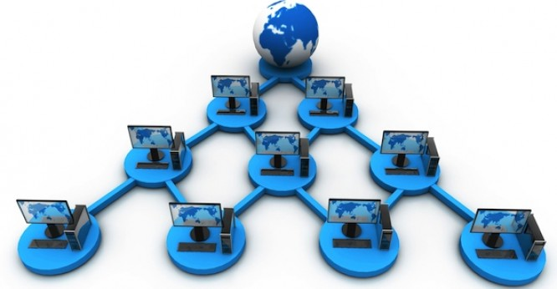
How DirectAccess Works
Client on the Intranet…
Client Assumes it is Not Connected to the Intranet
Establishes HTTPS Connection to NLS
Domain WFAS Profile Activated
NRPT Disabled
No DirectAccess IPsec Tunnels

Slide 23
How DirectAccess Works
Client on the Internet…
Client Assumes it is Not Connected to the Intranet
Fails to Establish HTTPS Connection to NLS
Public or Private WFAS Profile Activated
NRPT Enabled
DirectAccess IPsec Tunnels Enabled

Slide 24
Implementing DirectAccess
Install RemoteAccess Feature
GUI
PowerShell
Install-WindowsFeature remoteaccess –IncludeManagementTools –Restart
Configure RemoteAccess
Simplified Deployment
Complex Deployment

Slide 25
Demonstration
Richard Hicks – MVP
Iron Networks
@richardhicks

Slide 26
Security Considerations
Authentication
Endpoint
Infrastructure
Password Policy
SmartCards
Dynamic Passwords (OTP)
Whole Disk Encryption
Boot PIN
Anti-Virus
NAP Integration
Remote Content Filtering
Disable Computer Account for Lost/Stolen Machines

Slide 27
Closing Thoughts…

Slide 28
Thank You!
Richard Hicks – MVP
Iron Networks
richardh@ironnetworks.com
richardhicks.com/connect

Slide 29
Windows Track Resources
Windows Enterprise: windows.com/enterprise
Windows Springboard: windows.com/ITpro
Microsoft Desktop Optimization Package (MDOP): microsoft.com/mdop
Desktop Virtualization (DV): microsoft.com/dv
Windows To Go: microsoft.com/windows/wtg
Outlook.com: tryoutlook.com

Slide 30
Resources
Learning
Sessions on Demand
Microsoft Certification & Training Resources
http://channel9.msdn.com/Events/TechEd
www.microsoft.com/learning
TechNet
msdn
Resources for IT Professionals
Resources for Developers
http://microsoft.com/technet
http://microsoft.com/msdn

Slide 31
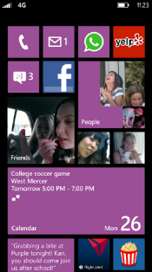
Evaluate this session
Required Slide
*delete this box when your slide is finalized
Your MS Tag will be inserted here during the final scrub.
Scan this QR code to
evaluate this session.

Slide 32
© 2013 Microsoft Corporation. All rights reserved. Microsoft, Windows and other product names are or may be registered trademarks and/or trademarks in the U.S. and/or other countries.
The information herein is for informational purposes only and represents the current view of Microsoft Corporation as of the date of this presentation. Because Microsoft must respond to changing market conditions, it should not be interpreted to be a commitment on the part of Microsoft, and Microsoft cannot guarantee the accuracy of any information provided after the date of this presentation. MICROSOFT MAKES NO WARRANTIES, EXPRESS, IMPLIED OR STATUTORY, AS TO THE INFORMATION IN THIS PRESENTATION.

