Slide 2
Unified Modern Device Management with Microsoft System Center 2012 Configuration Manager SP1 Integrated with Windows Intune
WCA-B343
Martin Booth
Craig Morris

Slide 3
Agenda
Overview of mobile device management
Device enrollment
Device inventory
Settings management
Corporate data protection

Slide 4
Today’s challenges
Users
Devices
Apps
Data
Users expect to be able to work in any location and have access to all their work resources.
The explosion of devices is eroding the standards-based approach to corporate IT.
Deploying and managing applications across platforms is difficult.
Users need to be productive while maintaining compliance and reducing risk.

Slide 5
People-centric IT
Enable your end users
Allow users to work on the devices of their choice and provide consistent access to corporate resources.
Unify your environment
Deliver a unified application and device management on-premises and in the cloud.
Users
Devices
Apps
Data
Protect your data
Help protect corporate information and manage risk.
Management. Access. Protection.

Slide 6
Selecting the Management Platform
Unified Device Management
System Center 2012 R2 Configuration Manager with Windows Intune
Build on existing Configuration Manager deployment
Full PC management (OS Deployment, Endpoint Protection, application delivery control, rich reporting)
Deep policy control requirements
Scale to 100,000 devices
Extensible administration tools (RBA, PowerShell, SQL Reporting Services)
Cloud-based Management
Standalone Windows Intune
No existing Configuration Manager deployment
Simplified policy control
Less than 7,000 devices and 4,000 users
Simple web-based administration console

Slide 7
Configuration Manager MDM Features
Features
Over the air device enrollment
User-targeted available app deployment
User and device settings management
Device inventory
Remote device retirement
Remote device wipe

Slide 8
Windows Intune integrated with System Center 2012 R2 Configuration Manager
Windows PCs
(x86/64, Intel SoC),
Windows to Go
Windows Embedded
Mac OS X
IT
Single Admin
Console
Windows RT, Windows Phone 8 iOS, Android

Slide 9
Platform Support in ConfigMgr R2
OS Platform | Management Agent | End User Experience
Windows 8.1 PC | ConfigMgr Agent Or Management Agent(OMA-DM) | Software Center/Application Catalog Windows Company Portal app
Windows PC (Win8,Win7,Vista,XP) | ConfigMgr Agent | Software Center/Application Catalog
Windows RT | Management agent (OMA-DM) | Windows Company Portal app
Windows Phone 8 | Management agent (OMA-DM) | Windows Phone 8 Company Portal app
iOS | Apple MDM Protocol | Native iOS Company Portal App
Android | Android MDM agent (OMA-DM) | Native Android Company Portal App
Mac | ConfigMgr Agent | Limited self service experience
Linux/Unix | ConfigMgr Agent | N/A

Slide 10
Registering and Enrolling Devices
Users can enroll devices that configure the device for management with Windows Intune; the user can then use the Company Portal for easy access to corporate applications
Data from Windows Intune is in sync with Configuration Manager, which provides unified management across both on-premises and in the cloud
Active Authentication
Users can register BYO devices for single sign-on and access to corporate data with Workplace Join. As part of this, a certificate is installed on the device
Active Directory
Web Application Proxy
ADFS
As part of the registration process, a new device object is created in Active Directory, establishing a link between the user and their device
IT can publish access to corporate resources with the Web Application Proxy based on device awareness and the user’s identity.; multi-factor authentication can be used through Windows Azure Active Authentication (formerly PhoneFactor)

Slide 11
Mobile Device Enrollment in R2
Establishes mutual trust between the device and the management server
User-initiated process over SSL
Admin defines which users are authorized to enroll devices
License allows 5 mobile device enrollments per user
Supports Windows RT, Windows Phone 8, iOS 5.0+
New for R2: Direct Management of Android
End result: A user certificate is installed on the device and the management agent is configured.
WinCE, Windows Embedded Handheld, Windows Mobile 6.5, etc. still supported via ConfigMgr on-prem infrastructure

Slide 12
Demo - Enrollment

Slide 13
Troubleshooting Device Enrollment
There are a couple of possible reasons why device enrollment may not succeed:
Admin has not configured mobile device management
Admin has not enabled enrollment for specific device types
User is trying to enroll several devices at the same time or has more than 20 mobile devices in the system
User is not provisioned by their IT admin
Windows Phone 8 Only: WP8 code signing certificate not configured properly
iOS only: Apple Push Notification Service certificate is not configured or expired. Or device is not running iOS 5.0 +
Recommendation from TAP customers is to test configuration thoroughly and provide user education

Slide 14
What’s New in Mobile Device Inventory?
Personal vs. Corporate Owned Devices
App inventory
App Management
By default, user-enrolled devices are “Personal”
Admin can specify corporate-owned devices
Personal devices – Inventory of applications installed by ConfigMgr/Intune only
Corporate devices – Complete inventory of all applications on the device*
New global condition to differentiate app installs on corporate versus personal
* iOS – Apple MDM allows only inventory of MDM provisioned apps

Slide 15
Demo - Inventory

Slide 16
Settings management
Settings can be applied to devices managed via Windows Intune and devices managed through the Exchange Server Connector
Single security policy template can be used to manage settings on all managed mobile devices. System figures out applicability to each platform.
Reporting available on each setting (applicable, conformant or error)
If a device is receiving policy from more than 1 authority, the most secure value for a setting is applied.

Slide 17
Mobile Device Settings in ConfigMgr 2012 R2
Category | Win 8.1 PC & RT | WP8 | iOS | Android
VPN | ✓ |  | ✓
Wi-Fi | ✓ | ✓ | ✓ | ✓
Certificates | ✓ | ✓ | ✓ | ✓
Password | ✓(*) | ✓(*) | ✓ | ✓ (*)
Device restrictions | ✓ (*) |  | ✓ | ✓ (*)
Store access |  |  | ✓
Browsers | ✓ (*) |  | ✓ (*)
Content Rating |  |  | ✓
Cloud Synch | ✓ (*) |  | ✓
Encryption | ✓ (*) |  | ✓ (*) | ✓ (*)
Security | ✓(*) |  | ✓(*) | ✓(*)
Roaming | ✓ (*) |  |  | ✓(*)
Windows Server Work Folders | ✓
* Subset of settings Note: Table applicable to direct MDM and not EAS

Slide 18
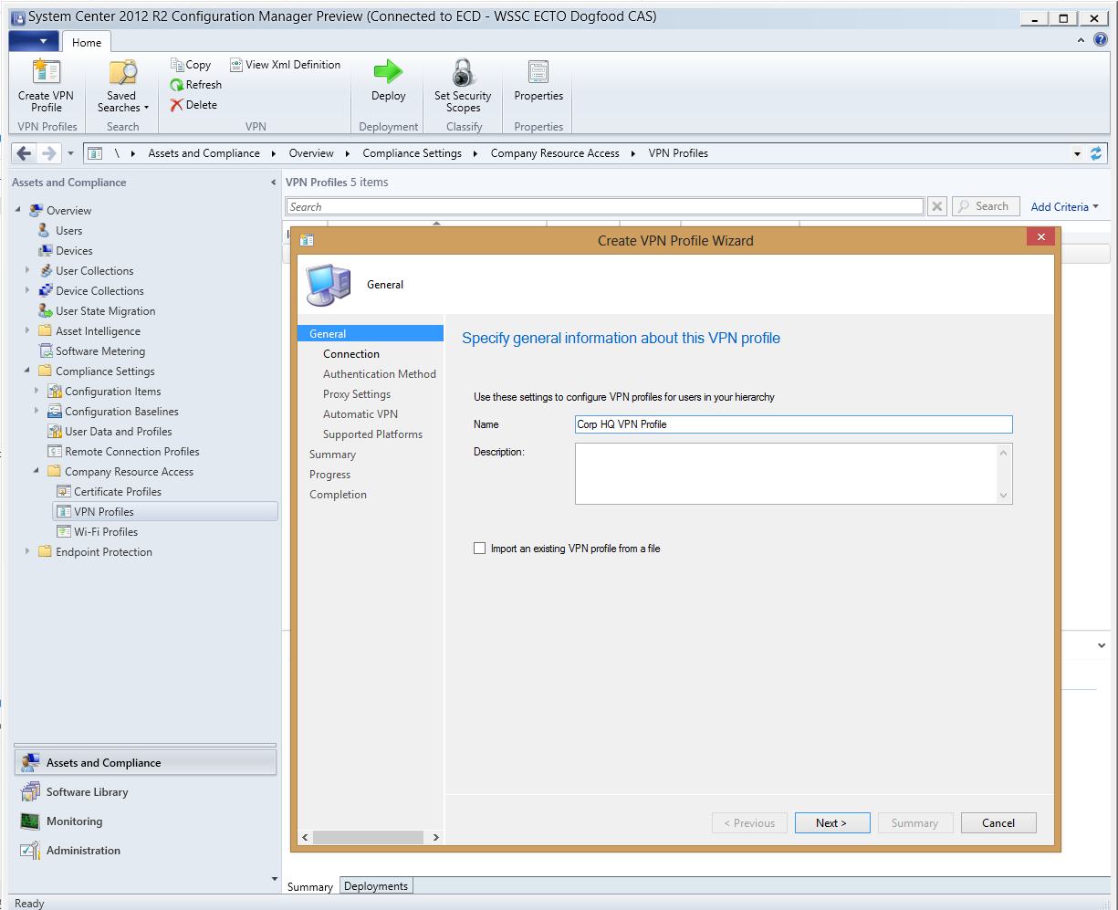
Resource Access Configuration
New Features*
Configure networking profiles VPN profiles
Support for Windows 8.1 Automatic VPN
Wi-Fi protocol and authentication settings
Management and distribution of certificates
Benefits
End users get access to company resources with no manual steps for them
Platforms
Windows 8.1
Windows 8.1 RT
iOS
Android
* Varies based on device platform

Slide 19
VPN Profile Management
Support for major SSL VPN vendors
Support for VPN standards
Automatic VPN connection
SSL VPNs from Cisco, Juniper, Check Point, Microsoft, Dell SonicWALL, F5
Subset of vendors have Windows Windows RT VPN plug-in
PPTP ,L2TP, IKEv2
DNS name-based initiation support for Windows 8.1 and iOS
Application ID based initiation support for Windows 8.1

Slide 20
Wi-Fi and Certificate Profiles
Wi-Fi settings
Manage and distribute certificates
Manage Wi-Fi protocol and authentication settings
Provision Wi-Fi networks that device can auto connect
Specify certificate to be used for Wi-Fi connection
Deploy trusted root certificates
Support for Security Center Endpoint Protection(SCEP) protocol

Slide 21
Work Folders
Sync files and data across devices
Configuration Manager and Windows Intune support
New feature in Windows 8.1 client and Windows Server 2012 R2
New settings to help provision the Work Folder discovery settings
Company Portals have links to Work Folders

Slide 22
Demo – Settings Management

Slide 23
Corporate Data Protection
Full wipe effects depend on the platform and management type (EAS or native)
iOS and WP: Complete wipe and reset to factory defaults
Android: EAS mailbox removal only
Windows RT and Windows 8: Only EAS mailbox removal if managed through EAS
Retire
User or Admin initiated
Removes the record of the device from the system
Disables further MDM app installation and settings management on the device & selectively wipes corporate app data
Uninstalls MDM-installed apps and removes data
Removes enterprise EFS certs and email

Slide 24
Selective Wipe
Based on platform capabilities
What gets removed or access revoked
Email
Apps installed through our MDM channel
Profiles (WiFi/VPN)
Certificates
MDM Policies (Settings)
Management Agent
Corp App Data
Support Platform
Windows 8.1, Windows 8.1 RT
iOS
Android

Slide 25
Full and Selective Wipe
Category | Windows 8.1 (x86/RT OMA-DM managed) | Windows 8 RT | Windows Phone | iOS | Android
Full Wipe |  |  | ✓ | ✓ | ✓
Selective Wipe
Email | ✓ (Email through EAS) | ✓ (Email through EAS)
Corporate Apps (from ConfigMgr / Intune) | ✓ (Uninstalled + sideloading key removed) | Sideloading key removed | ✓ | ✓
VPN and Wifi Profiles | ✓ | ✓ | ✓ | ✓ | ✓
Certificates | Revoked on server | N/A | Revoked on server | Revoked on server | Revoked on server
Settings | Policy enforcement is removed | Policy enforcement is removed | Policy enforcement is removed | Policy enforcement is removed | Policy enforcement is removed
Management Agent | N/A. Built into OS | N/A. Built into OS | N/A. Built into OS | Management profile removed | “Device administrator” privilege is revoked
Corporate App Data | Data remains encrypted if app is EFS aware |  | App container removed during uninstall | App container removed during uninstall

Slide 26
Demo – Retire & Wipe

Slide 27
Unified Device Management Recap
 | Unregistered | Registered | MDM Enrolled | Fully Managed
Publish email to users (EAS) | Yes | Yes | Yes | Yes
Publish work folders to users | Yes | Yes | Yes | Yes
Conditional access based on user, device, location | Block device only | Yes | Yes | Yes
Audit logging and monitoring |  | Yes | Yes | Yes
Unified Device Management |  |  | Yes | Yes
Unified Application Management |  |  | Yes | Yes
Selective data wipe |  |  | Yes | Yes
Compliance reporting |  |  | Yes | Yes
Group Policy and login scripts |  |  |  | Yes
OS deployment and imaging |  |  |  | Yes
Configuration management |  |  |  | Yes
Patch management |  |  |  | Yes
Anti malware management |  |  |  | Yes
Full application management |  |  |  | Yes
BitLocker management |  |  |  | Yes

Slide 28
Related content
Breakout Sessions (session codes and titles)
WCA-B328 - Microsoft System Center 2012 SP1 Configuration Manager Overview
WCA-B310 - Deploying and Configuring Mobile Device Management Infrastructure with Microsoft System Center 2012 SP1 Configuration Manager and Windows Intune
WCA-B343 - Unified Modern Device Management with Microsoft System Center 2012 SP1 Configuration Manager Integrated with Windows Intune
WCA-B304 - Application Delivery with Microsoft System Center 2012 SP1 Configuration Manager and Windows Intune
WCA-B313 - Deploying Microsoft System Center 2012 SP1 - Configuration Manager with Windows Intune at Microsoft

Slide 29
Windows Track Resources
Windows Enterprise: windows.com/enterprise
Windows Springboard: windows.com/ITpro
Microsoft Desktop Optimization Package (MDOP): microsoft.com/mdop
Desktop Virtualization (DV): microsoft.com/dv
Windows To Go: microsoft.com/windows/wtg
Outlook.com: tryoutlook.com

Slide 30
Resources
Learning
Sessions on Demand
Microsoft Certification & Training Resources
http://channel9.msdn.com/Events/TechEd
www.microsoft.com/learning
TechNet
msdn
Resources for IT Professionals
Resources for Developers
http://microsoft.com/technet
http://microsoft.com/msdn

Slide 31
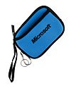
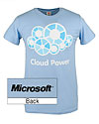
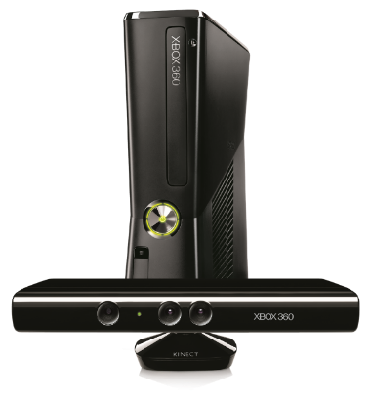
Complete an evaluation on CommNet and enter to win!

Slide 32
For More Information
System Center 2012 Configuration Manager
http://technet.microsoft.com/en-us/evalcenter/hh667640.aspx?wt.mc_id=TEC_105_1_33
Windows Intune
http://www.microsoft.com/en-us/windows/windowsintune/try-and-buy
Windows Server 2012
http://www.microsoft.com/en-us/server-cloud/windows-server
Windows Server 2012 VDI and Remote Desktop Services: http://technet.microsoft.com/en-us/evalcenter/hh670538.aspx?ocid=&wt.mc_id=TEC_108_1_33
http://www.microsoft.com/en-us/server-cloud/windows-server/virtual-desktop-infrastructure.aspx
More Resources:
microsoft.com/workstyle microsoft.com/server-cloud/user-device-management

Slide 33
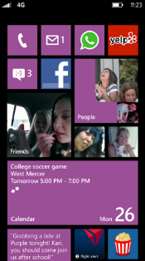
Evaluate this session
Required Slide
*delete this box when your slide is finalized
Your MS Tag will be inserted here during the final scrub.
Scan this QR code to evaluate this session and be automatically entered in a drawing to win a prize

Slide 34
© 2013 Microsoft Corporation. All rights reserved. Microsoft, Windows and other product names are or may be registered trademarks and/or trademarks in the U.S. and/or other countries.
The information herein is for informational purposes only and represents the current view of Microsoft Corporation as of the date of this presentation. Because Microsoft must respond to changing market conditions, it should not be interpreted to be a commitment on the part of Microsoft, and Microsoft cannot guarantee the accuracy of any information provided after the date of this presentation. MICROSOFT MAKES NO WARRANTIES, EXPRESS, IMPLIED OR STATUTORY, AS TO THE INFORMATION IN THIS PRESENTATION.

