Slide 2

VDI Smackdown
WCA-B345
Ruben Spruijt
CTO @ PQR
Microsoft MVP, Citrix CTP, VMware vExpert
rsp@pqr.nl @rspruijt

Slide 3

Welcome!

Slide 4

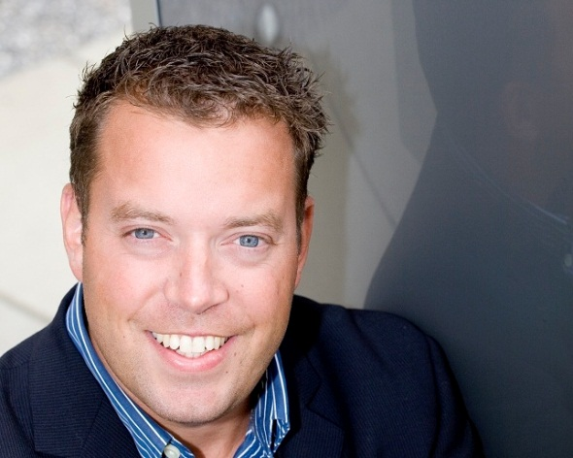


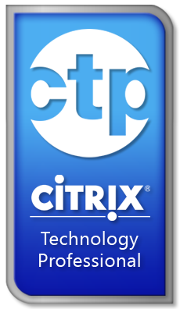
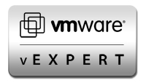




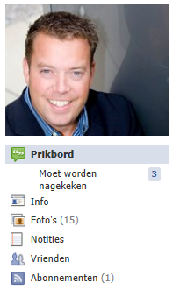
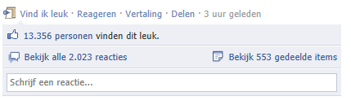
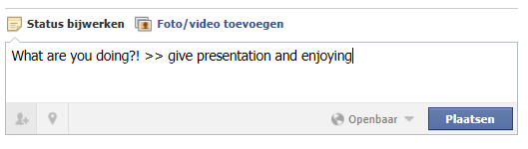
Ruben Spruijt, Technology Officer
@rspruijt
rsp@pqr.nl

Slide 5

Proud to be Dutch

Slide 6
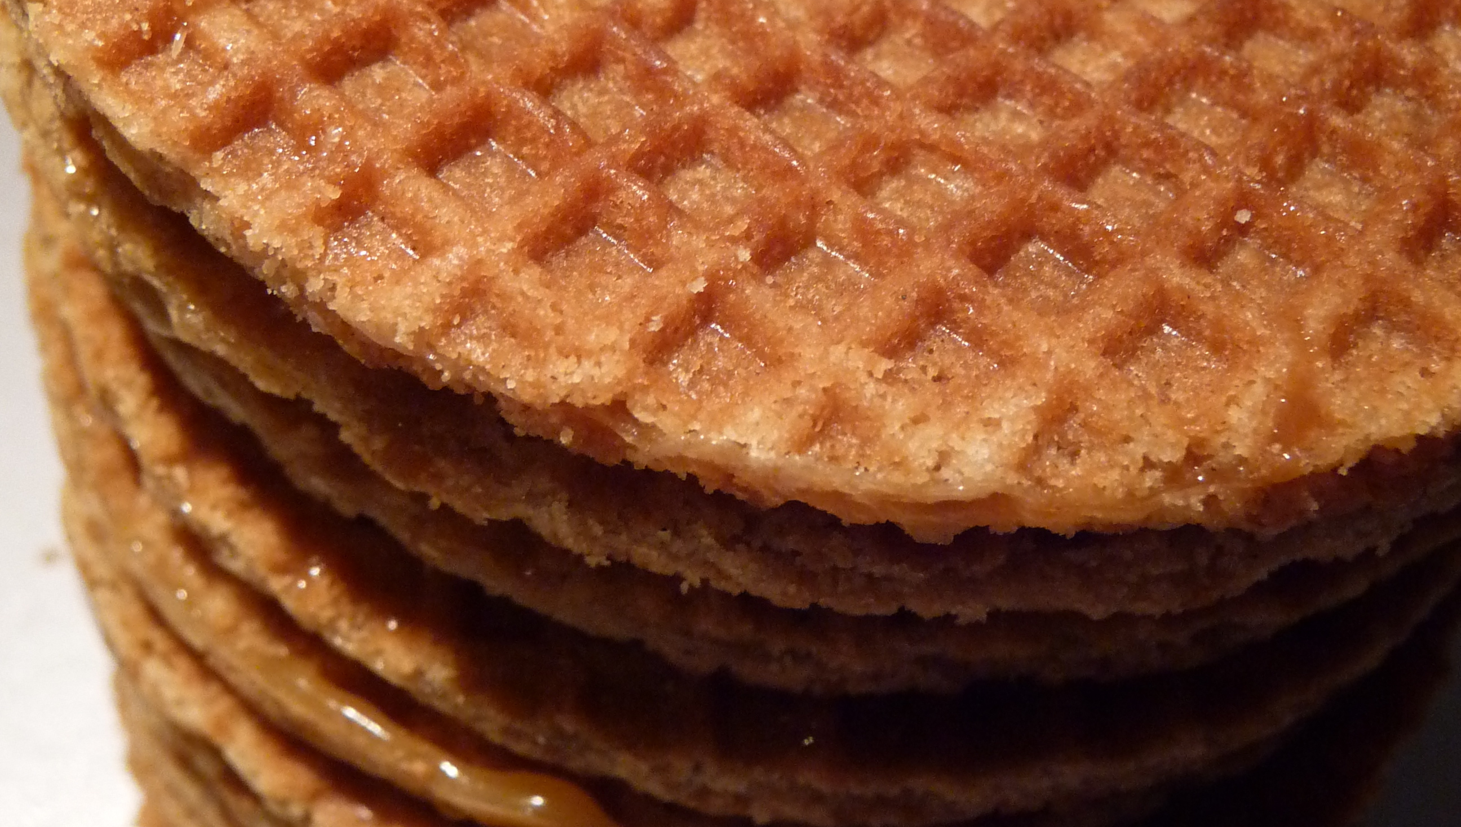

Slide 7
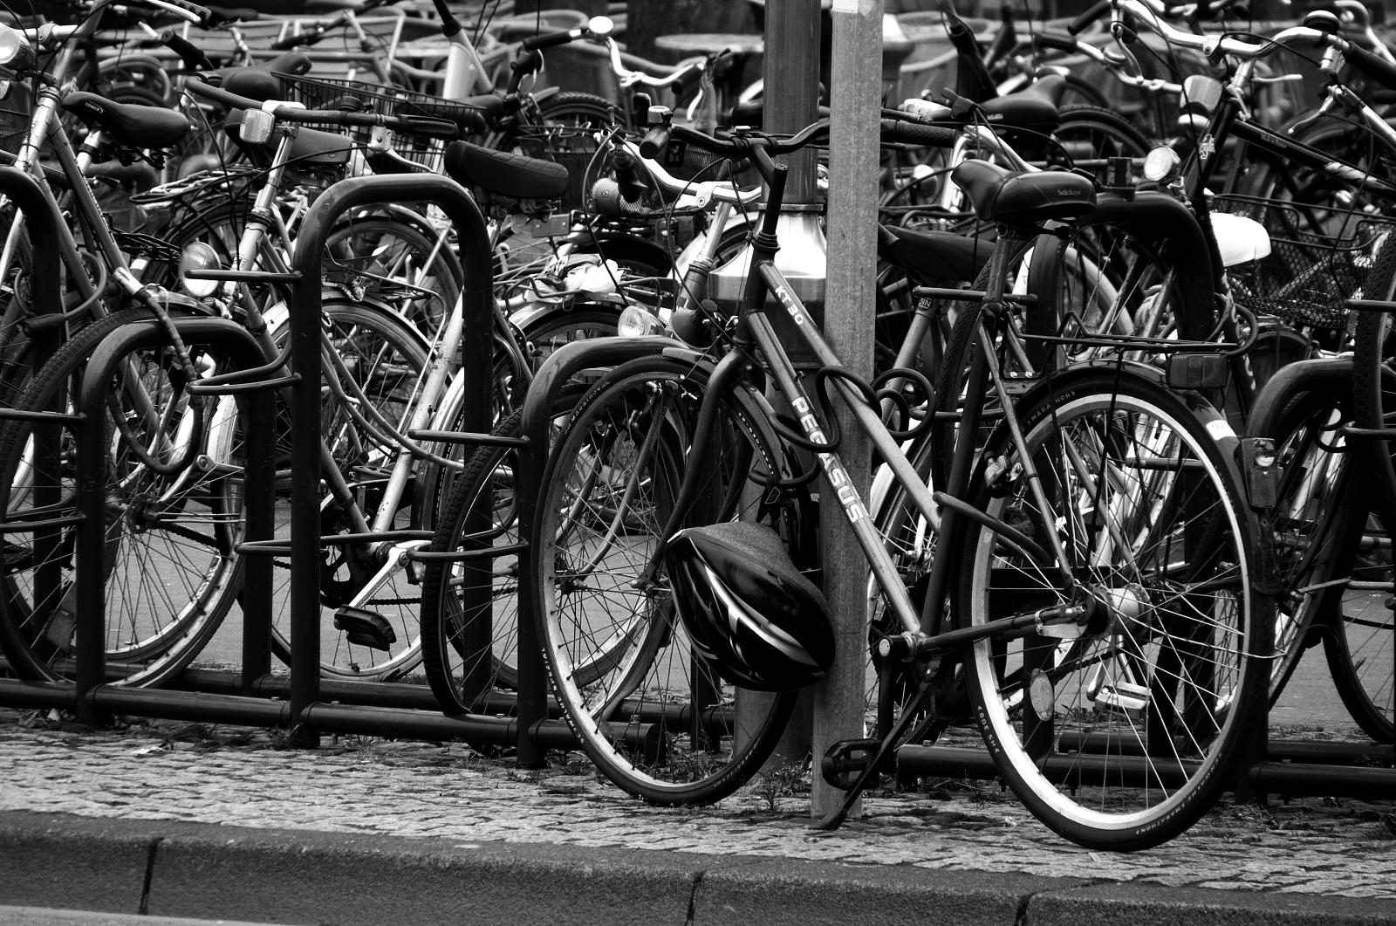

Slide 8
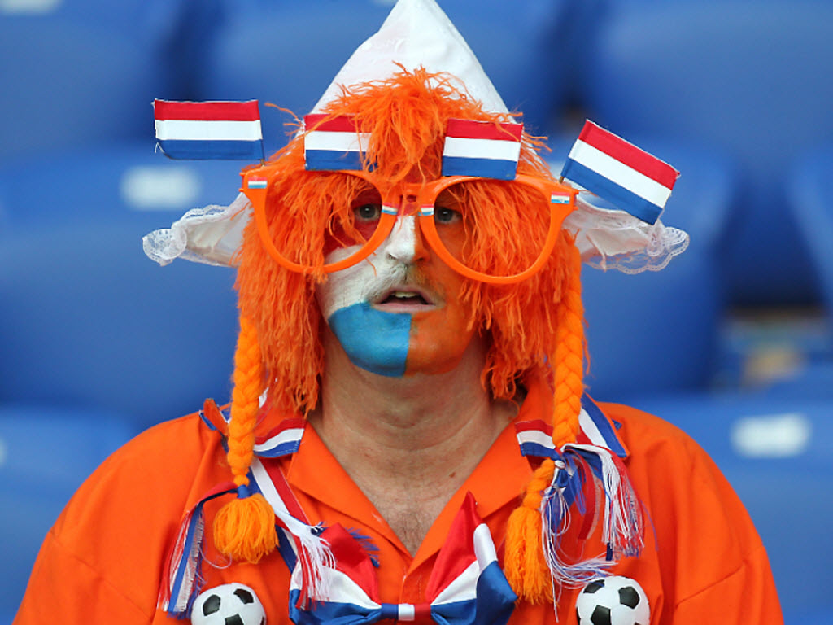

Slide 9


Slide 10

Objectives

Slide 11
Session Objectives And Takeaways
10 points to implement VDI correctly
Storage design has a big impact on VDI
Developments in ADD
VDI solution XYZ compares to ABC

Slide 12

Challenges!

Slide 13

Business

Slide 14
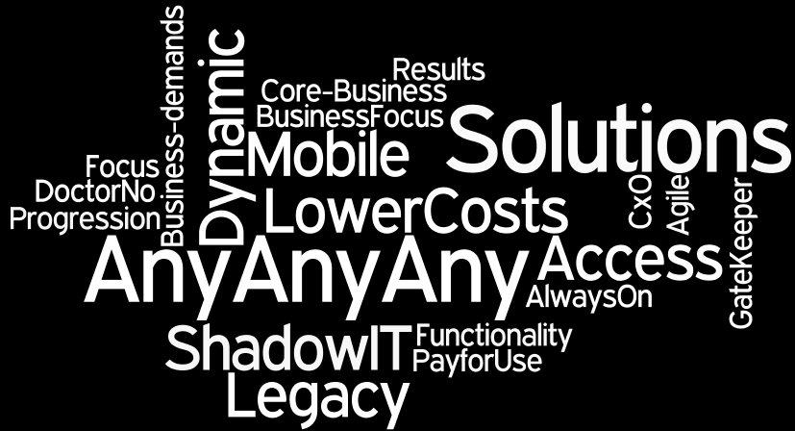

Slide 15

Choices

Slide 16

Technology Solutions

Slide 17
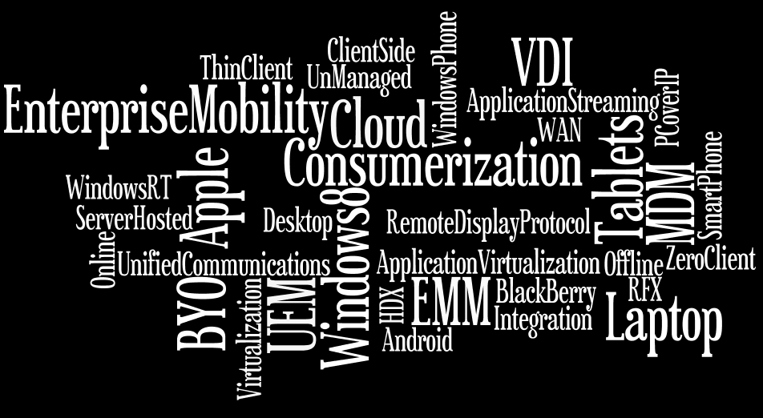

Slide 18
They:

Slide 19


Slide 20

Nice.. Challenges …

Slide 21
Solve Challenges

Slide 22
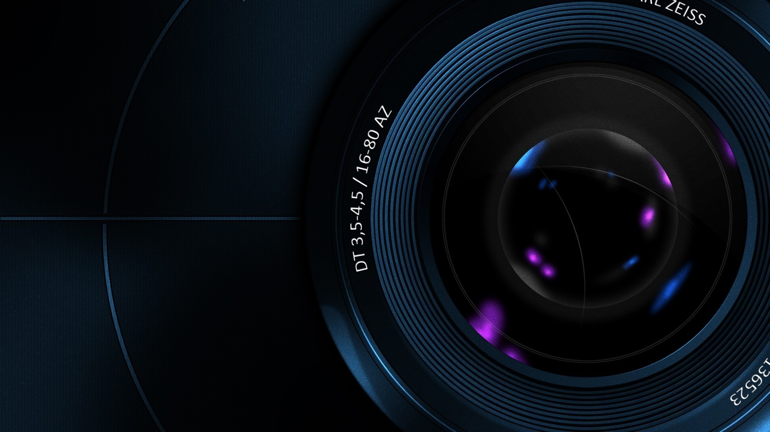
Focus

Slide 23


Me

Slide 24
“It isn’t about Apple, Google,Microsoft, devices or apps,
It’s about Me!”
Business Consumer

Slide 25

Strategy

Slide 26
ADD

Slide 27

VDI

Slide 28
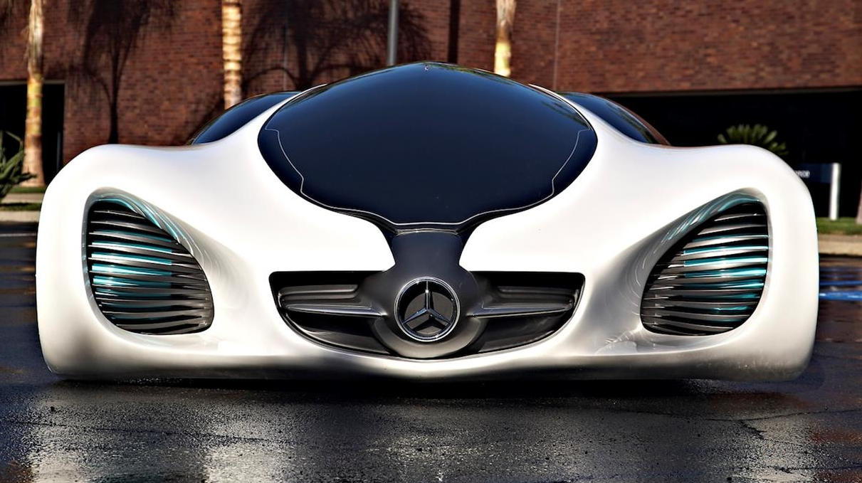
Hybrid

Slide 29
Structure
Drama + “Tomorrow”
10 points to implement VDI correctly
VDI: Good, Bad and Ugly
VDI and Storage is Deep Impact
Developments
Solutions Overview
VDI Smackdown

Slide 30
10 points to implement VDI correctly
What do you want to achieve? | VDWhy
Cost reducer ..?! TCO, ROI | Math
VDI vision, vendors, solutions | Vision
Anyx7 (includes endpoints) | Choices
ADD ≠ VDI | Solutions

Slide 31
10 points to implement VDI correctly
Who is owner of VDI strategy? | Execution
Who is in ‘VDI’ team?! | TeamWork
Storage Impact for VDI | Knowledge
User Experience and Perception | Adoption
PoC, Pilot, Acceptation Criteria | Reality Check

Slide 32

Success!?
32

Slide 33


Vision x
Execution x
Adoption

Slide 34
Structure
Drama + “Tomorrow”
10 Points to implement VDI correctly
VDI: Good, Bad and Ugly
VDI and Storage is Deep Impact
Developments
Solutions Overview
VDI Smackdown

Slide 35
VDI

Slide 36

Good

Slide 37
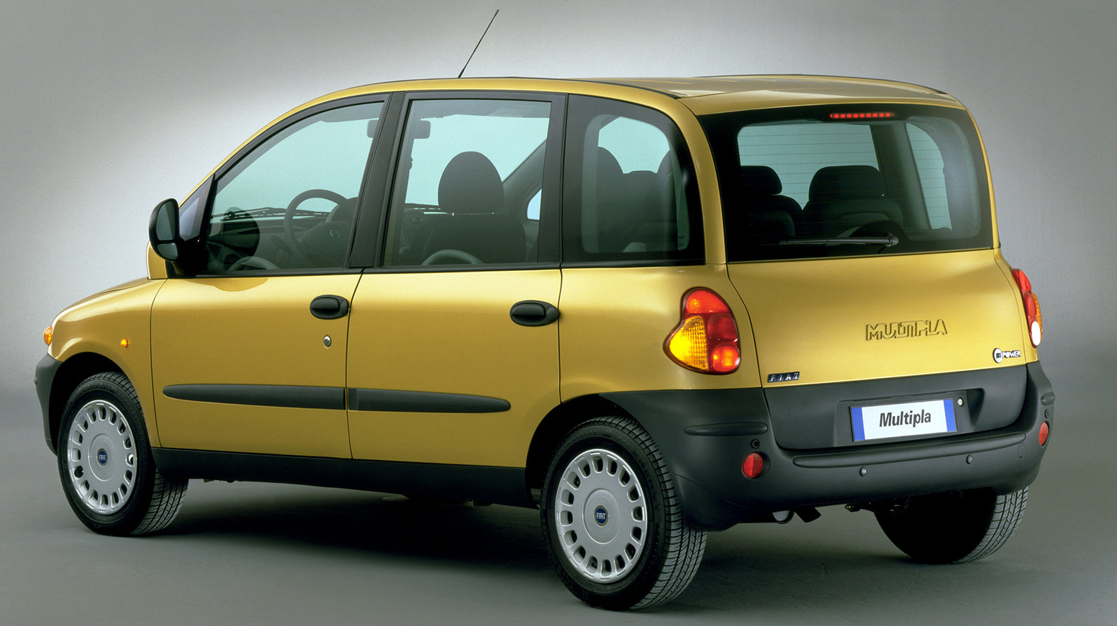
Bad & Ugly ;-)

Slide 38

Server Hosted-VDI ‘Bad and Ugly?!’
Bad and Ugly = be aware!
End-user experience (UX)
  Voice, webcam, VOIP, conferencing solutions
  Networking; Latency, Bandwidth, QoS
  Rich media; Audio/video
  2D/3D graphics
  Mobile and touch/tablet oriented devices

Slide 39
Server Hosted-VDI ‘Bad and Ugly?!’
Overall cost reduction of technology stack
Overall complexity in complete technology stack
Streamline Management between VDI and classic clients
Total Cost of Ownership and Return On Investment
Licensing (SA, VDA, CDL, Intune, SPLA, RDS, corp. issued, Office!)

Slide 40
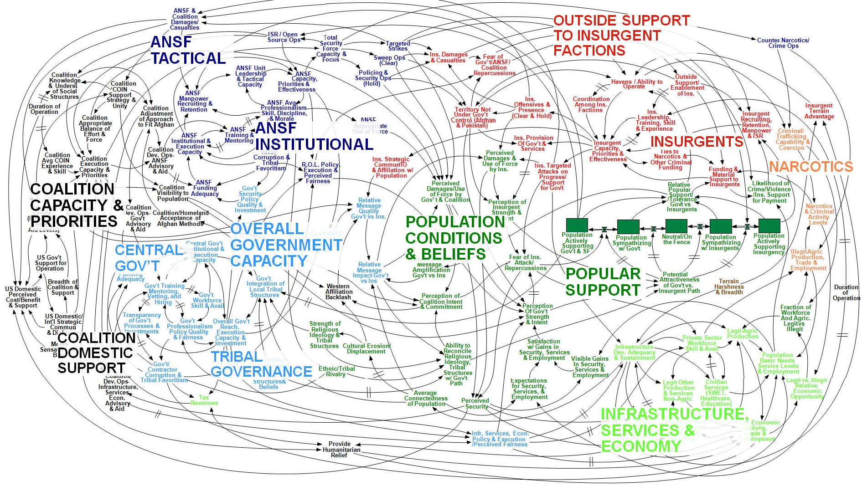
Microsoft Licensing Explained

Slide 41
Licensing Windows SA, VDA and CSL

Slide 42
Server Hosted-VDI ‘Bad and Ugly?!’
HTML5 as Remote Access solution
Skills & ‘mindset’ from IT organization
End user’s perceived performance
End user’s user Acceptance

Slide 43
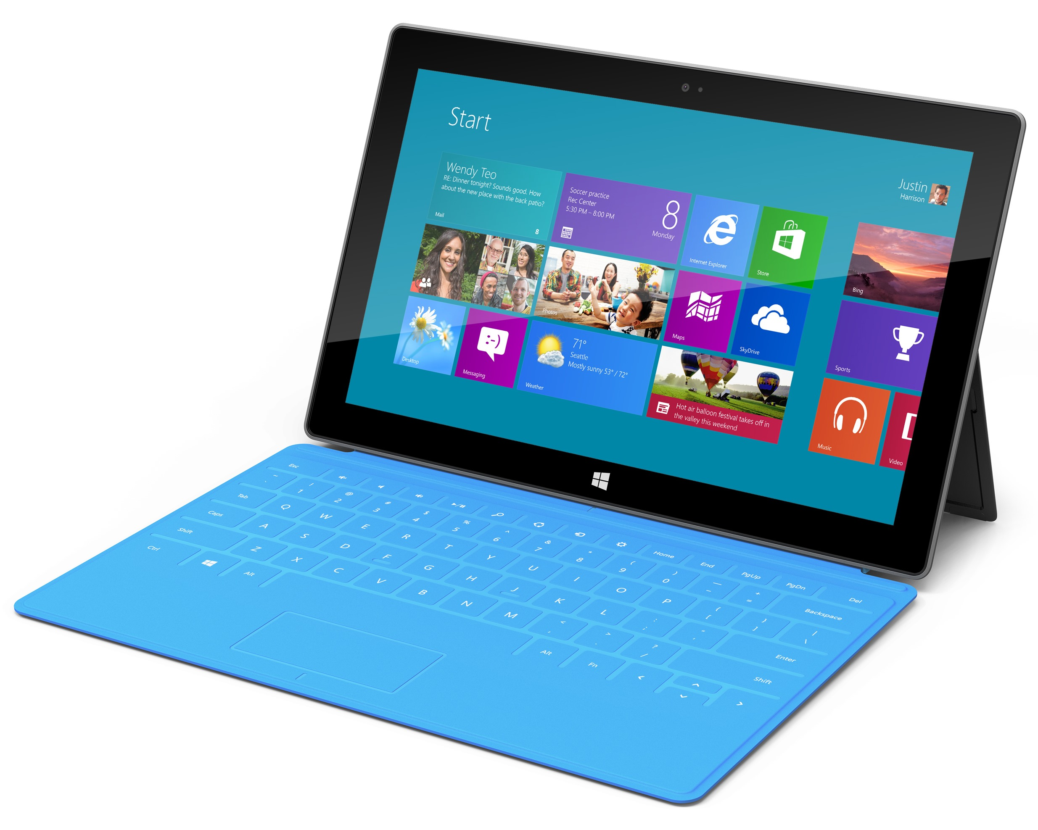
Endpoint ≠ Exciting….

Slide 44
Structure
Drama + “Tomorrow”
VDI Strategy
VDI: Good, Bad and Ugly
VDI and Storage is Deep Impact
Developments
Solutions Overview
VDI Smackdown

Slide 45
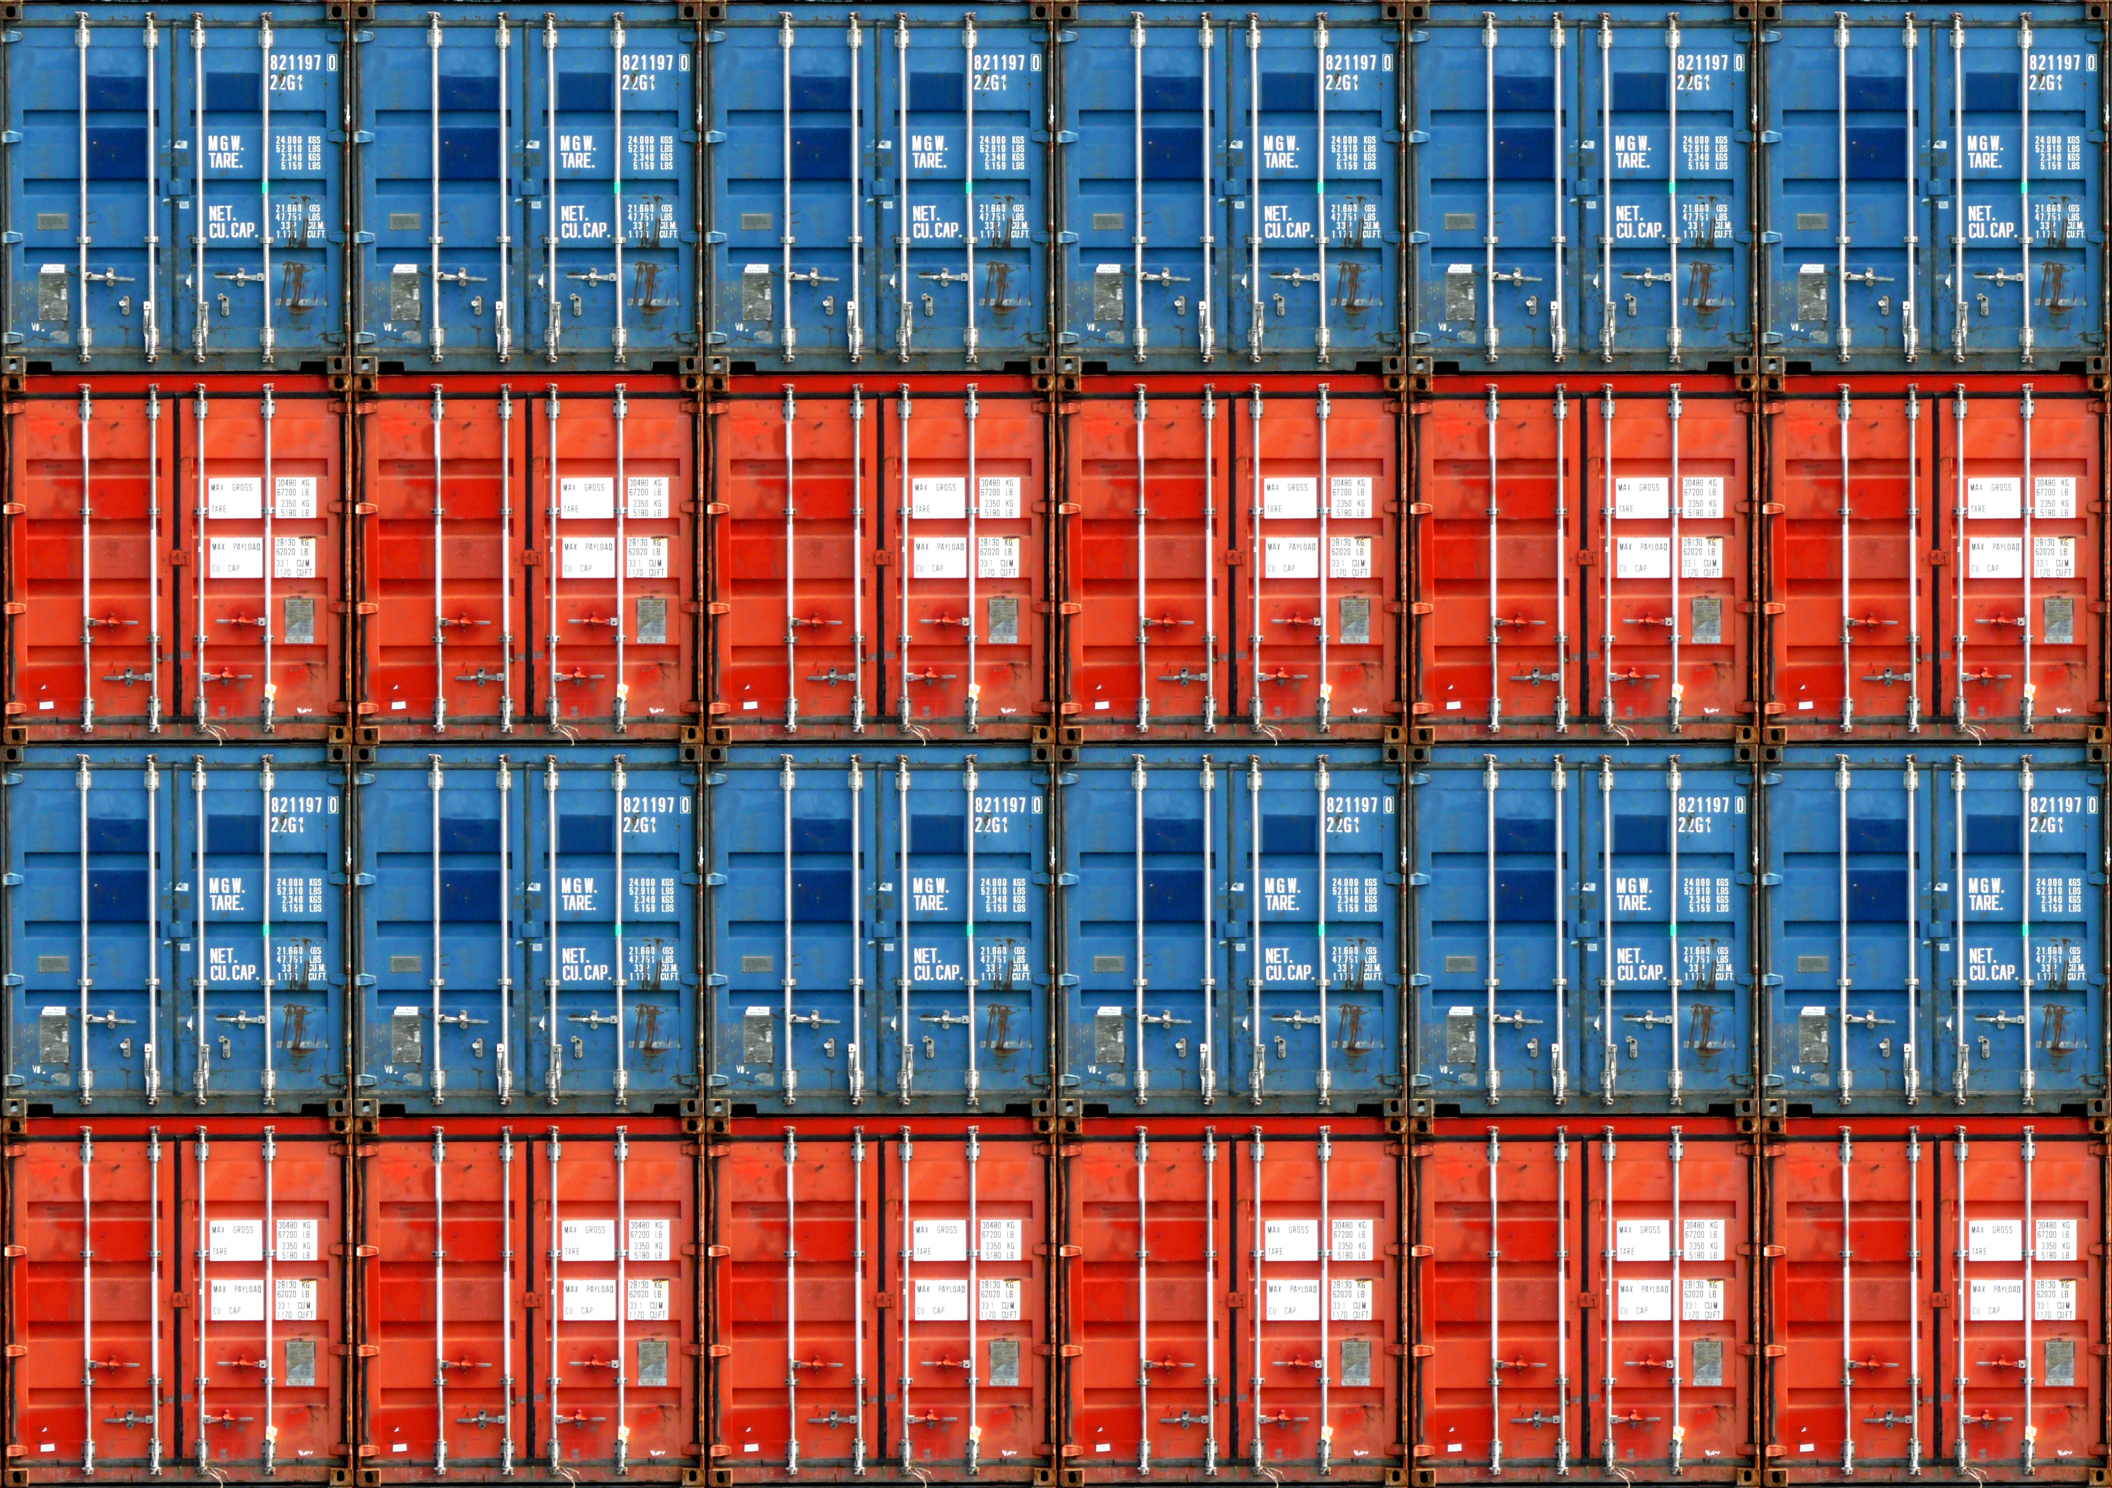
VDI and Storage

Slide 46
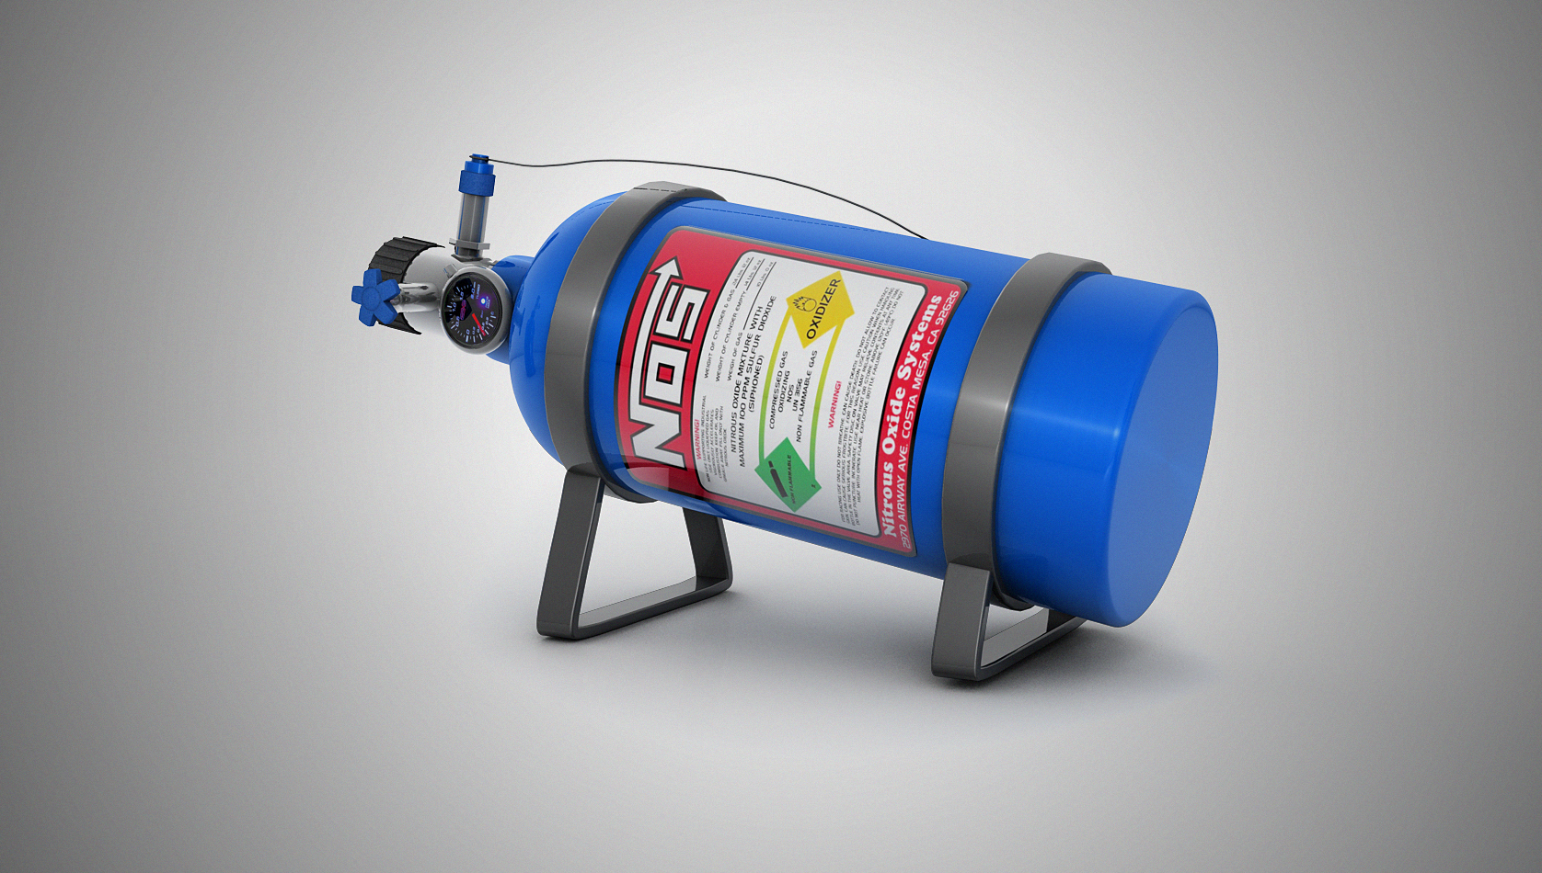
Impact

Slide 47
Input Output Operations/second (IOPS)
Labtests
  Limited set of applications and Steady State tests ;
  70-90% read, 30-10% write IOPS
Real World and good benchmarks
  Divers set of applications, Login – Logoff
  40-20% read, 60-80% write IOPS

Slide 48
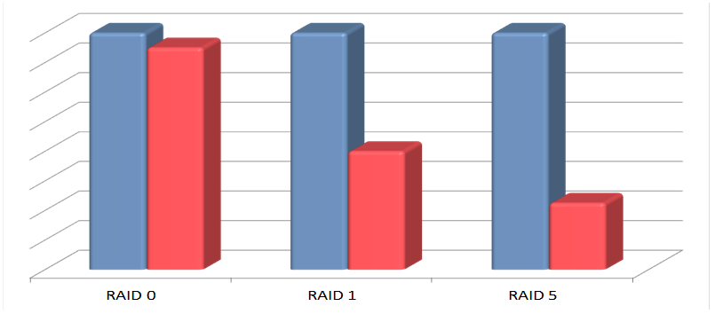
RAID impact (Write penalty)

Slide 49
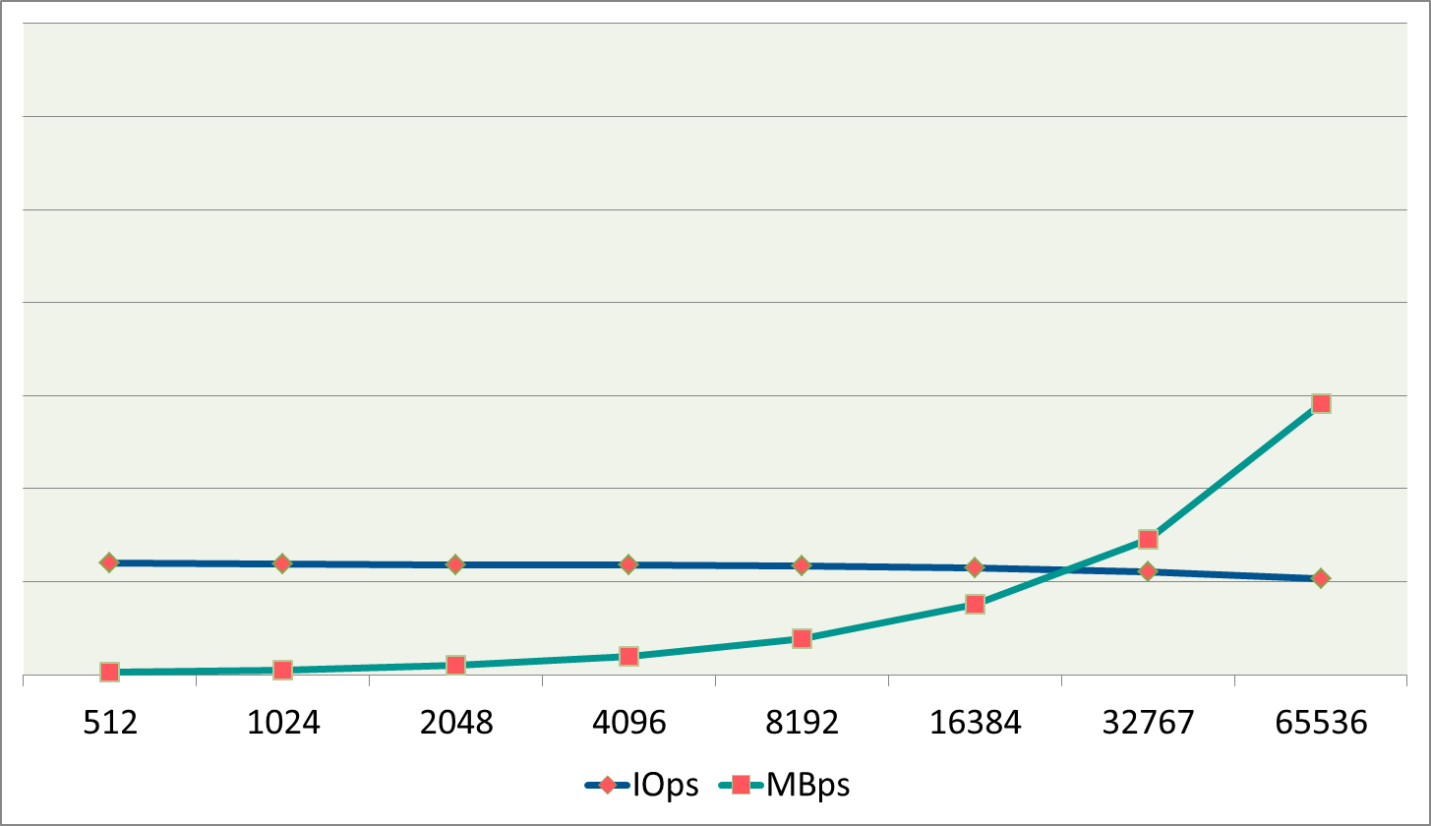
IOPS and MB/s per blocksize xATA

Slide 50
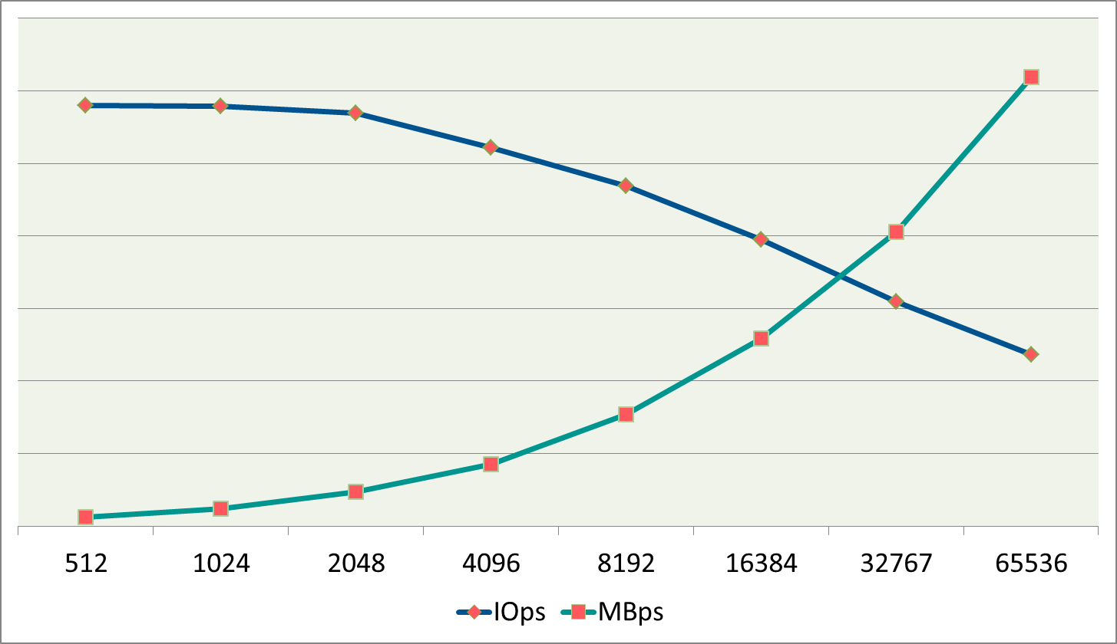
IOPS and MB/s per blocksize SAS/SCSI

Slide 51
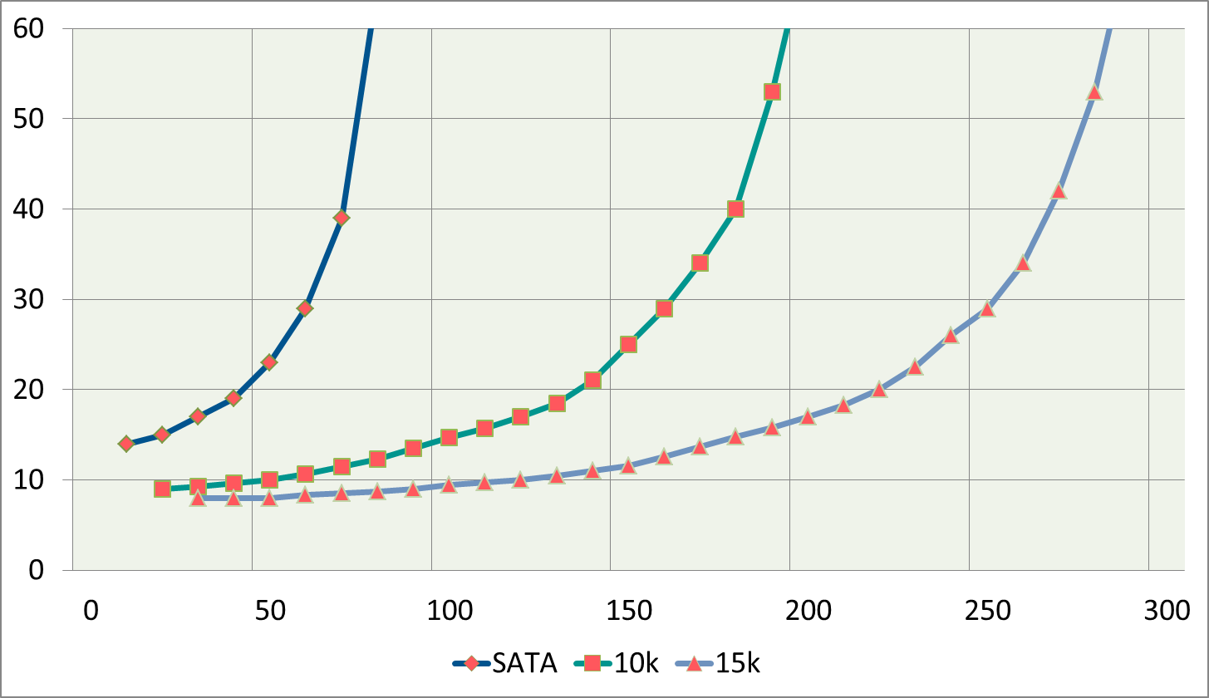
Latency
Latency (ms)
IOPS

Slide 52
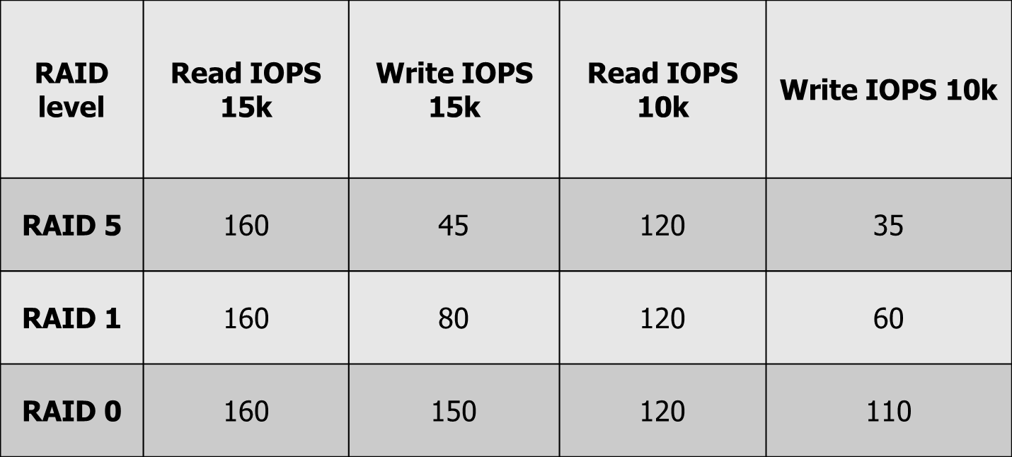
Netto IOPS table

Slide 53
Impact R/W and RAID penalty
1000 CCU with 30 Read and 70% Write IOPS; 12 IOPS/VM
RAID1 -> 128 disks
  With 160 read IOPS per disk and 80 write IOPS we need:
  3600/160 + 8400/80 = 23 + 105 = 128 discs
RAID5 -> 210 disks
  12000 IOPS → 30% read = 3600, 70% write = 8400
  With 160 read IOPS per disk and 45 write IOPS we need:
  3600/160 + 8400/45 = 23 + 187 = 210 discs

Slide 54
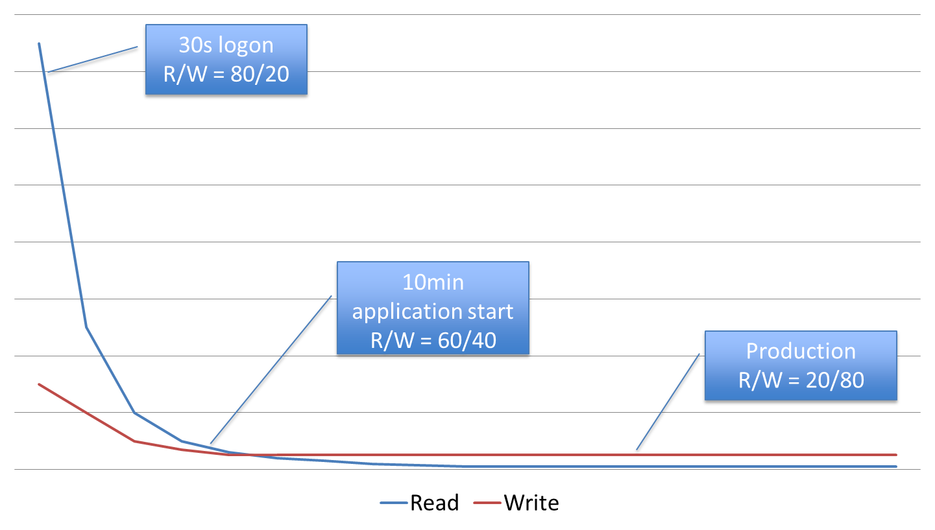
Read vs Write IOPs

Slide 55

Is this it.. (nope)

Slide 56
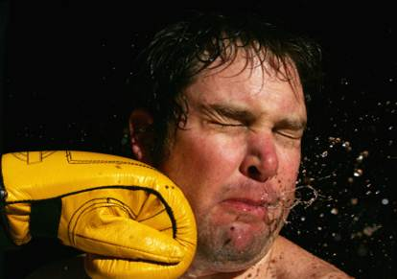
.. There is even more.. &#$&*#$

Slide 57
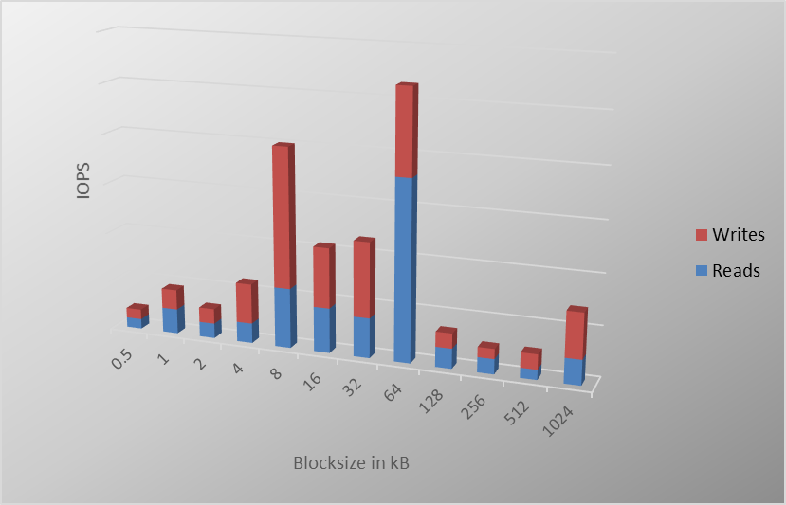
Typical Office server backend profile

Slide 58
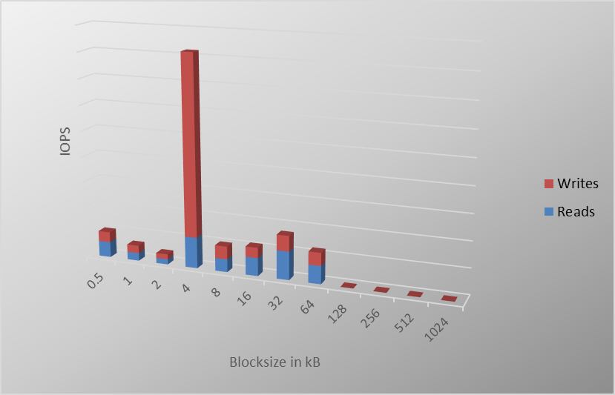
Typical VDI profile

Slide 59
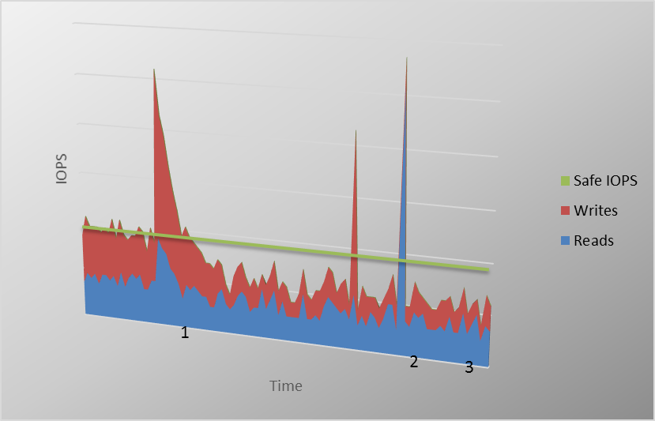
IO peaks

Slide 60
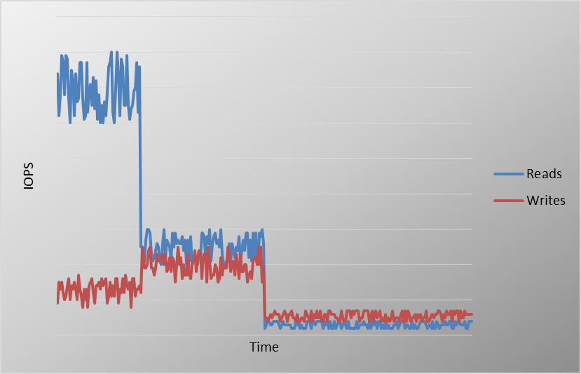
BOOTSTORMS, LOGONSTORMS AND STEADY STATE

Slide 61
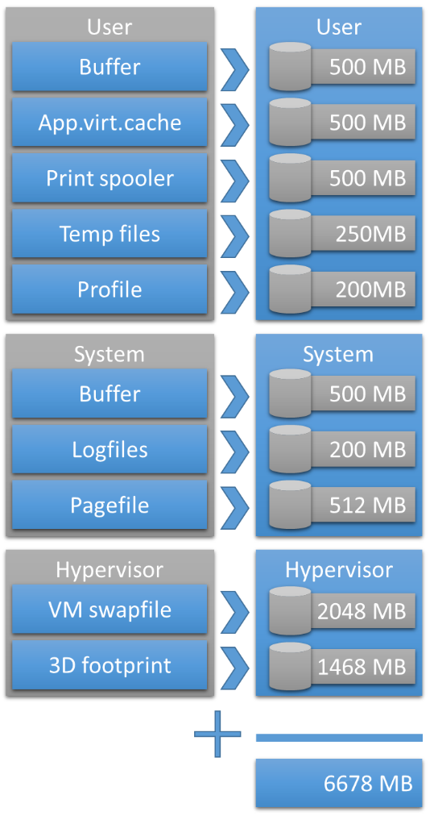
It’s all about IOPS … NOT!
It’s about finding the balance between Capacity (IOPS) and Capacity (GBs)

Slide 62
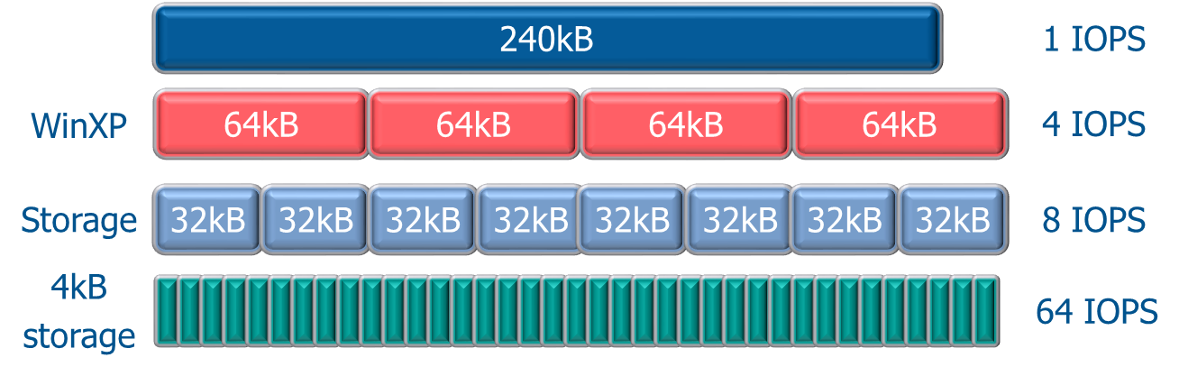
Blocksize and IO impact, “Lunch Storms”

Slide 63
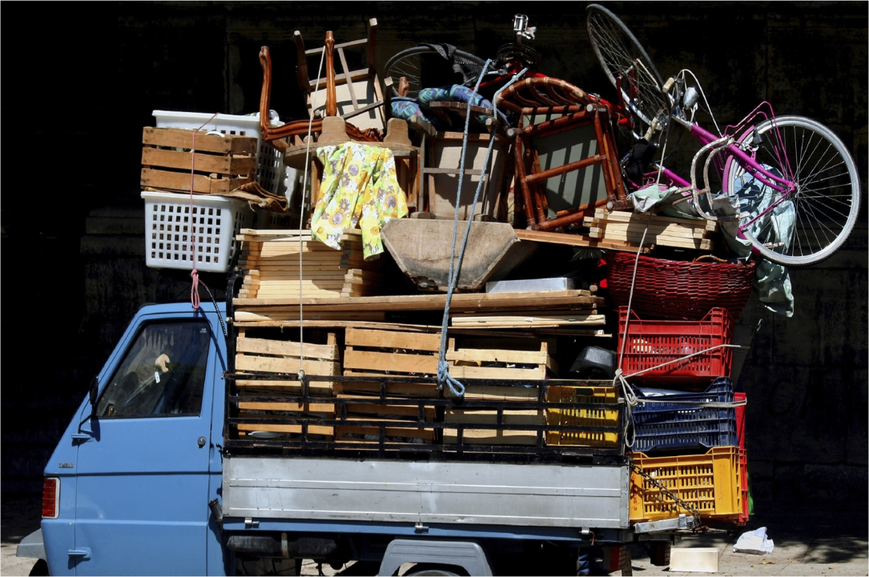
Storage solution directions

Slide 64
Storage Solution directions for VDI
Disks/spindles
Minimize IOPS check ProjectVRC
Cache (Boot, Logon, Reads);
SSD (costs, endurance, warranty, %Read/%Write)
IO consolidation; De-duplication
Random -> Sequencial
(Hot block) AutoTiering
Memory (NAND)

Slide 65
Structure
Drama + “Tomorrow”
10 Points to implement VDI correctly
VDI: Good, Bad and Ugly
VDI and Storage is Deep Impact
Developments
Solutions Overview
VDI Smackdown

Slide 66
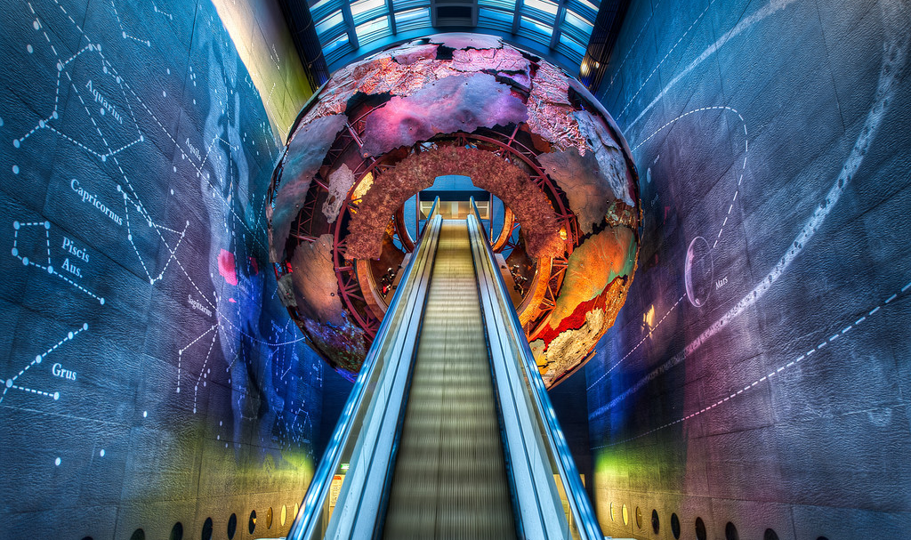
Developments

Slide 67
Developments in ‘VDI’ space 1/2
HyperConverged Infrastructures
Storage: Appliances, SSD, PCIe, De-dupe, tiering
Intellicache, CBRC/VSA, HyperCache, CSV
GPU: Sharing, Virtualization, PassThrough
Unified Communication and VDI
Microsoft RDVH with Win7/Win8 – Server 2012

Slide 68
Developments in ‘VDI’ space 2/2
HTML5 for RemoteAccess
Reverse Seamless
VDI + SBC Infrastructure converged
VDI more mature
TCO is getting better
..
.. add another hour ☺

Slide 69
Structure
Drama + “Tomorrow”
10 Points to implement VDI correctly
VDI: Good, Bad and Ugly
VDI and Storage is Deep Impact
Developments
Solutions Overview
VDI Smackdown

Slide 70

Head2Head
Landscape

Slide 71


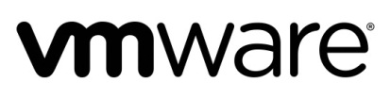



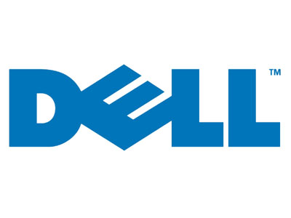






Server Hosted:
VDI

Slide 72
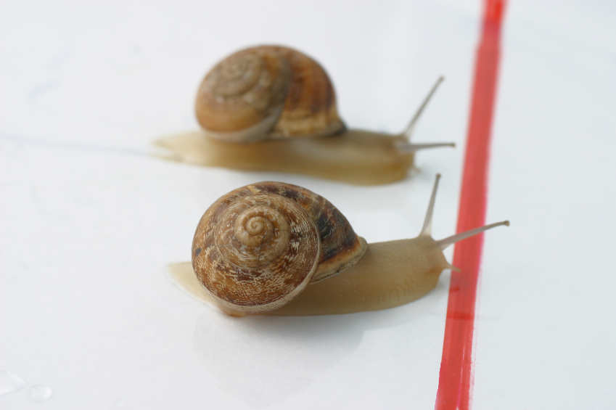
Which product is THE Best..

Slide 73
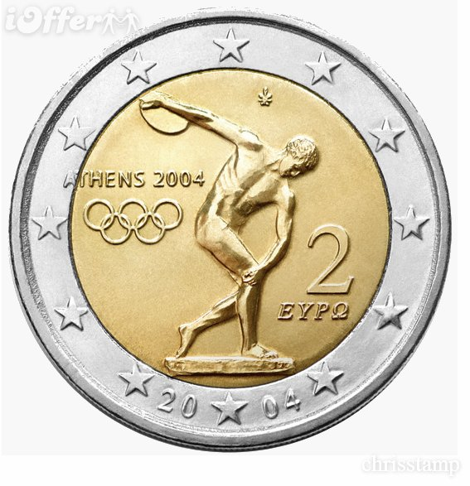

How to make a decision (easy)

Slide 74
Structure
Drama + “Tomorrow”
10 Points to implement VDI correctly
VDI: Good, Bad and Ugly
VDI and Storage is Deep Impact
Developments
Solutions Overview
VDI Smackdown

Slide 75


Slide 76
Citrix with XenDesktop 5.6 FP1
+
Vision and strategic acquisitions in Enterprise Mobility
Choice;
  FlexCast (Client-side, Server hosted solutionS)
  Image Management (PVS/MCS)
  VI and Management platform (Citrix, Microsoft, VMware)
  RDP: Client/side and Server Hosted
  RemotePC (≠GoToMyPC)
UX: LAN and WAN scenario’s

Slide 77
Citrix with XenDesktop 5.6 FP1
+
UX: 3D applications, OCS/Lync*, Voice, Webcam
Extensive Endpoint support
Deep Integration with SASN solutions
VDI Assessment software included
Personal vDisk, Intelli-cache, Universal Printer Server
Active community, handbooks/guides, reference architectures, Huge Partner ecosystem

Slide 78
Citrix with XenDesktop 5.6 FP1
No GPU sharing (yet) – nVidia VGX & XD to come
Client-side and Server Hosted RDP
Personal vDisk no real image management
Way too much deployment solutions in Citrix stack
Complexity (broker, VDA, license server, SQL Receiver, StoreFront, CAG/NS, PVS/MCS)

Slide 79
Citrix with XenDesktop 5.6 FP1
Amount of consoles
VDI + EdgeSight .. Edgesigh
No integration XenClient and XenDesktop (infra)
No integration XenDesktop and XenApp (infra)
Citrix XD56FP1 +SCVMM 2012 SP1 .. #@#@
No Windows 8 support

Slide 80
What’s coming – XenDesktop 7
FlexCast Management Architecture - FMA
XenApp >> XenDesktop
2 Consoles – Director and Studio
Windows 8 and server 2012 support
New EdgeSight
Seamless Local applications
Windows Application refactoring for Mobile Devices
HDX Mobile – e.g. Flash content on e.g. iOS/Android
Citrix Application Streaming => AppV

Slide 81


Slide 82

Microsoft VDI – RDVH (win8/srv2012)
+
It’s Microsoft .. Microsoft unless
It’s good enough, why pay more?! (I am a Dutch guy)
Easy Deployment of Server 2012 roles
No SCVMM required
Active-Active connection broker
Straightforward Image management
Pooled VMs: shared and Local storage scenarios

Slide 83
Microsoft VDI – RDVH (win8/srv2012)
+
RFX = First GPU ‘sharing’ solution in VDI space
RFX Progressive Display, MediaStreaming
RFX and WAN, Touch and ModernUI,
RFX encode is GPU or CPU
Good use of the CSV read cache
Server 2012 - Hyper-V mature and performs well

Slide 84
Microsoft VDI – RDVH (win8/srv2012)
Is Microsoft as company interested in RDVH?!
Enterprise Management functionality
RFX = Hyper-V only
RDP and RFX = Limited endpoint support
RFX ≠ CAD/CAM, high performance 3D applications
User Profile Disk ~

Slide 85
Microsoft VDI – RDVH (win8/srv2012)
UX: ≠ 3D applications, Lync, UC, Webcam support
RFX: Price tag/VM (encoding)
Printing Management and bandwidth compression
Shadowing ..zzzZz
Process kill from central console ..ZzzzZ
Guest OS support (Win7 SP1 and higher)
Client OS support for RDP8 (Apple and Android)

Slide 86
Microsoft VDI – RDVH (win8/srv2012)
RFX ≠ OpenGL hardware support (<1.1)
RFX Ready ZeroClients
Custom RDP properties not saved in database
Microsoft documentation, reference architectures, guidelines, feature explanation, etc. .. #@#
UAG + RemoteApp = NoGo
Little OT: UAG no iOS and Android support

Slide 87
Windows Server 2012 R2 – VDI related
RDS - Shadowing is back | mstsc /shadow
  Works with RemoteApp, MultiMonitor etc.
  Is 1:1, admin rights needed
RemoteFX performance 25-50% savings here
Remote Desktop App improve graphics experience
  Move and resize, Thumbnail preview, Live Taskbar, Aeropeak
  Rotate and extend monitor support
Quick Reconnect especially in 3G/WAN scenario’s
Updated Modern Remote Desktop App
  Touchkeyboard access in typebar, subscriptions in settings bar

Slide 88
Windows Server 2012 R2 – VDI related
Generation 2 VMs (UEFI support)
  More flexible configuration, could be 10-20% faster – win8x64;
Storage QoS; restrict IOPS/VM
Storage Spaces – Tiered Storage
Storage Spaces – Write Back Cache
Online Disk-deduplication

Slide 89
Microsoft only VDI solution:
“What RDP Client can we use
for None-Windows Clients?!”

Slide 90
3rd Party RDP/RemoteFX Clients
Solutions:
iTap mobile RDP,
Ericom AccessToGo,
2X Client RDP,
Dell PocketCloud,
Nulana Remoteix,
Remote RDP Enterprise,
Thinstuff RDC,
VMLite Remote Client

Slide 91
3rd Party RDP/RemoteFX Clients
Our findings, overall:
Tough to find details: e.q. which RDP version supported, RD Gateway support; UAG support, RemoteFX support
Some need manual creation of .RDP file and publish on webserver (anno 2013)
Some have In-App payment to receive additional support
Some cost $30/device

Slide 92
3rd Party RDP/RemoteFX Clients
Our findings: 3rd Party RDP Clients for Apple OSX and Mobile platforms such as Apple iOS, Android, BlackBerry, WindowsPhone
Overall:
To expensive
Lacking functionality
“Nice for ITPro’s”
In mature in documentation, tough to find details
“Not really impressed”…

Slide 93
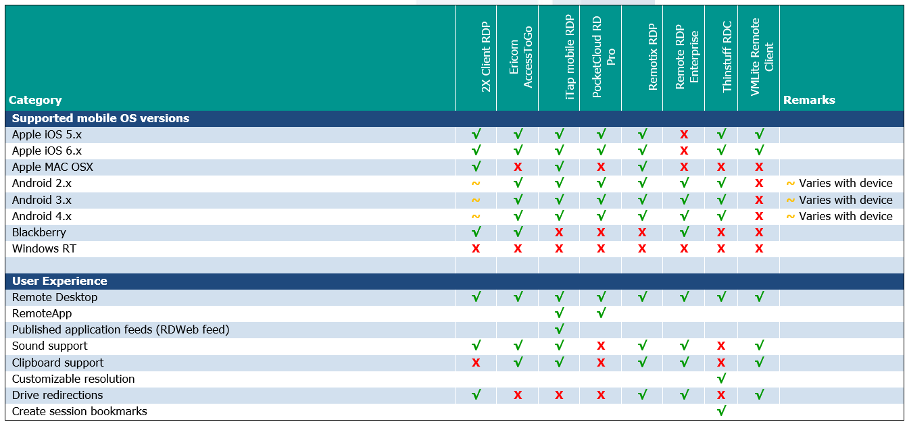
Details in VDI Smackdown 2.1

Slide 94
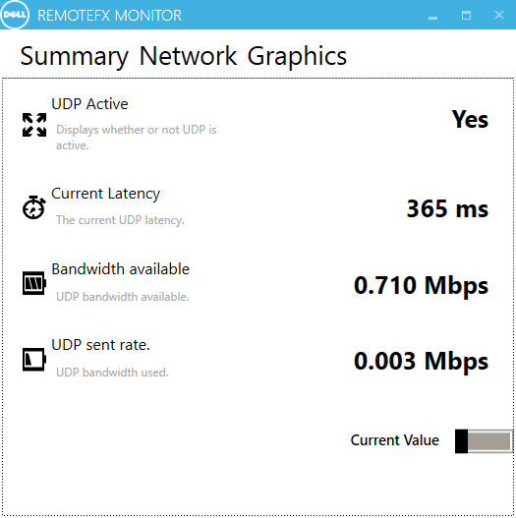
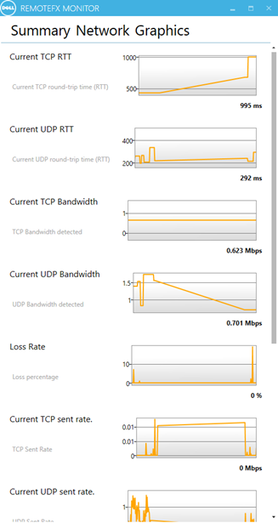
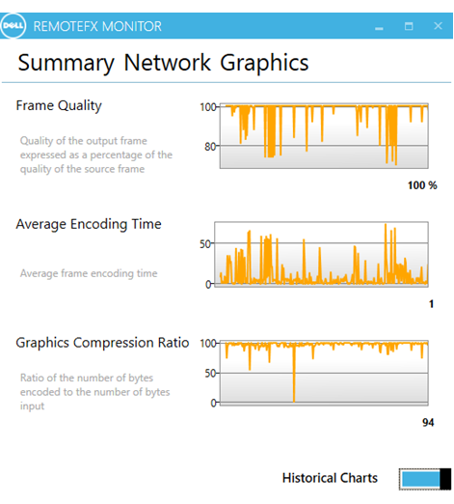
Dell - RemoteFX Monitor… Soon!
Contact:
@MichelRoth
@rspruijt

Slide 95
Smackdown … let’s continue

Slide 96


Slide 97
VMware Horizon View 5.2
+
Yes!, vision and clear communication (since 5.0)
VMware is solid name in Virtualization space
Application Virtualization is part of stack
ThinApp and VDI is good combination
Enterprise Reference Architectures

Slide 98
VMware Horizon View 5.2
+
Image Management is easy and strong (pooled VMs)
Hardware Accelerated 3D graphics
Teradici Server Offload card for PCoverIP
PCoverIP is doing well in LAN and WAN
PCoverIP - server-side rendering
Clientless access via HTML5

Slide 99
VMware Horizon View 5.2
+
UPM (Persona) part of the solution
View composer Array Integration (VCAI)
Virtual Storage Accelerator; In memory cache (CBRC)
Windows 8 (x86) support incl. MultiTouch
Lock-in: choice for VI and Management is VMW only

Slide 100
VMware Horizon View 5.2
Impact of PCoverIP on server-side
Server offload card >> energy and €
UPM = UPM only
Multidatacenter support, Pool Management (VM/LAN config), 1000VMs/Pool, user assignment per pool
Secure Access solutions for PCoverIP (4172 TCP and UDP)

Slide 101
VMware Horizon View 5.2
UX ≠ 3D applications, OCS/Lync, Voice, Webcam
Scalability and it’s managebility needs attention in large env. (vCenter, webAdmin)
Clientless access via HTML5 – basic -
View Client for WinRT = RDP only
Image Layering Technology (Mirage) ≠ VDI

Slide 102

The others …

Slide 103
Structure
Drama + “Tomorrow”
10 Points to implement VDI correctly
VDI: Good, Bad and Ugly
VDI and Storage is Deep Impact
Developments
Solutions Overview
VDI Smackdown

Slide 104
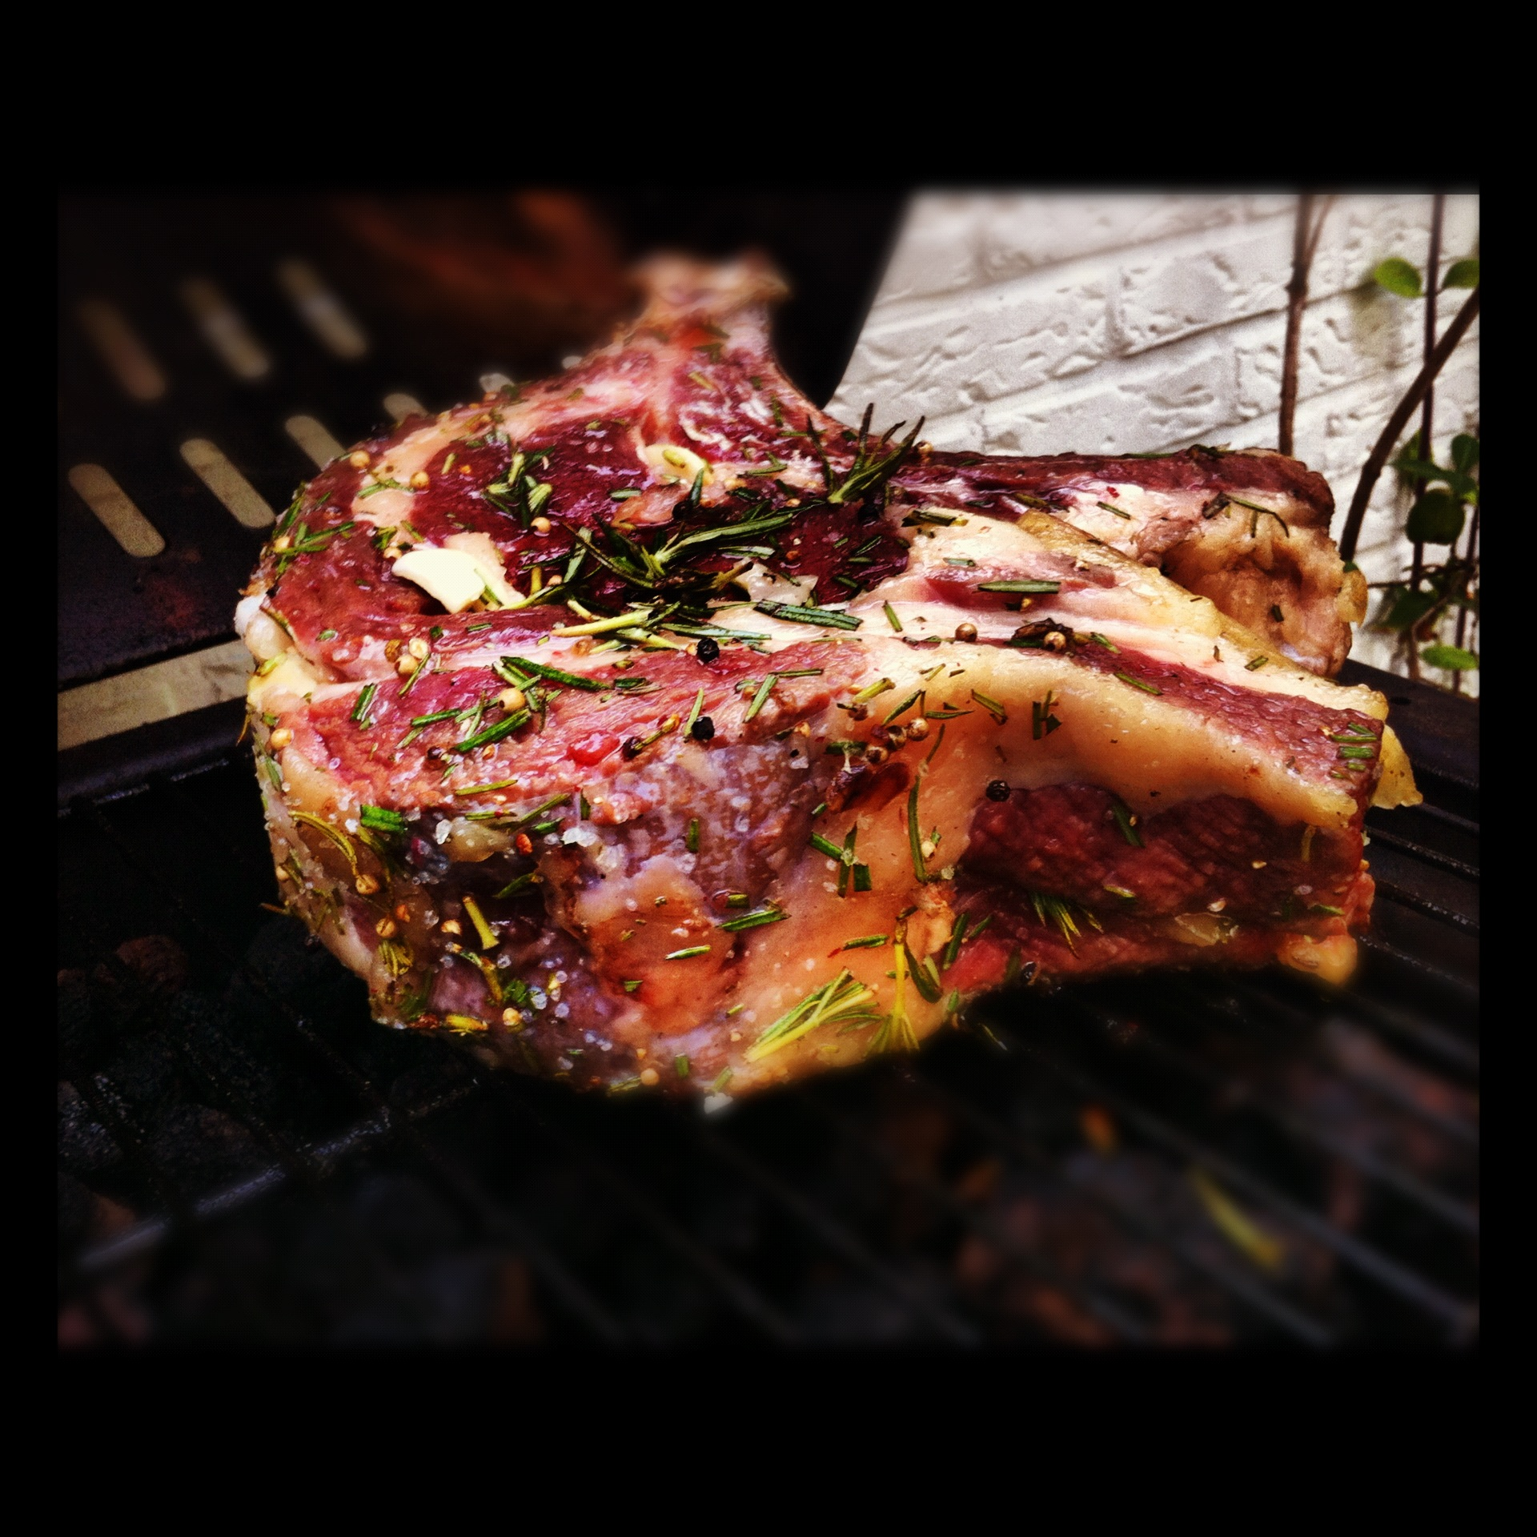
Ingredients for success (with VDI)

Slide 105
Ingredients for success
Focus on EndUsers and scenario’s | Persona
What is Your Desktop Strategy!? | Focus
Focus on User Experience | Adoption
RealityChecks and PoC | Experience
Understand “VDI + Storage = Deep Impact”
Do not focus instantly on vendor features
#JustDoIT

Slide 106
Session Objectives And Takeaways
10 points to implement VDI correctly
Storage design has a big impact on VDI
Developments in ADD
VDI solution XYZ compares to ABC

Slide 107

“All the related docs, whitepapers and blogs at once”
MailTo: rsp@pqr.nl
Subject: GOVDI

Slide 108

rsp@pqr.nl
@rspruijt

Slide 109
BIG Thanks!

Slide 110

Windows Track Resources
Windows Enterprise: windows.com/enterprise
Windows Springboard: windows.com/ITpro
Microsoft Desktop Optimization Package (MDOP): microsoft.com/mdop
Desktop Virtualization (DV): microsoft.com/dv
Windows To Go: microsoft.com/windows/wtg
Outlook.com: tryoutlook.com

Slide 111


For More Information
System Center 2012 Configuration Manager
http://technet.microsoft.com/en-us/evalcenter/hh667640.aspx?wt.mc_id=TEC_105_1_33
Windows Intune
http://www.microsoft.com/en-us/windows/windowsintune/try-and-buy
Windows Server 2012
http://www.microsoft.com/en-us/server-cloud/windows-server
Windows Server 2012 VDI and
Remote Desktop Services
http://technet.microsoft.com/en-us/evalcenter/hh670538.aspx?ocid=&wt.mc_id=TEC_108_1_33
http://www.microsoft.com/en-us/server-cloud/windows-server/virtual-desktop-infrastructure.aspx
More Resources:
  microsoft.com/workstyle
  microsoft.com/server-cloud/user-device-management

Slide 112

Resources
Learning
  Sessions on Demand
  Microsoft Certification & Training Resources
http://channel9.msdn.com/Events/TechEd
www.microsoft.com/learning
TechNet
msdn
  Resources for IT Professionals
  Resources for Developers
http://microsoft.com/technet
http://microsoft.com/msdn

Slide 113







Complete an evaluation on CommNet and enter to win!

Slide 114



Evaluate this session
Required Slide
*delete this box when your slide is finalized
Your MS Tag will be inserted here during the final scrub.
Scan this QR code to evaluate this session and be automatically entered in a drawing to
win a prize

Slide 115
© 2013 Microsoft Corporation. All rights reserved. Microsoft, Windows and other product names are or may be registered trademarks and/or trademarks in the U.S. and/or other countries.
The information herein is for informational purposes only and represents the current view of Microsoft Corporation as of the date of this presentation. Because Microsoft must respond to changing market conditions, it should not be interpreted to be a commitment on the part of Microsoft, and Microsoft cannot guarantee the accuracy of any information provided after the date of this presentation. MICROSOFT MAKES NO WARRANTIES, EXPRESS, IMPLIED OR STATUTORY, AS TO THE INFORMATION IN THIS PRESENTATION.

