Slide 2
What’s New in Windows Server 2012 Active Directory
WCA-B346
John Craddock
Infrastructure and security architect, XTSeminars Ltd

Slide 3
With Windows Server 2012 AD you can
Use GUI management for:
    The Recycle Bin
    Fine Grain Password Policies
Perform simplified and more robust DC installations
Safely virtualize DCs
Clone DCs
Implement Kerberos claims identity
Control access to files and folders with Dynamic Access Control
Protect the RID pool
Use PowerShell for everything
And more…

Slide 4
Active Directory
Windows Active Directory (AD)
  You host it, on-premises / Cloud
  You manage the infrastructure and the data
  Services:
    AD Directory Services (AD DS)
      Kerberos authentication
      NTLM authentication
    AD Lightweight Directory Services (AD LDS)
    AD Federation Services (AD FS)
    AD Certificate Services (AD CS)
    AD Rights Management Services (AD RMS)
Windows Azure Active Directory (WAAD)
  Microsoft hosts it in their datacenters
  Microsoft manages the infrastructure
  You manage the data
  Services:
    Directory Services
      Federated authentication
        WS-Federation
        SAML-P
        Oauth 2.0
        More to come...
    Access Control Services (ACS)
synchronization

Slide 5
Demo…
AD GUI enhancements

Slide 6
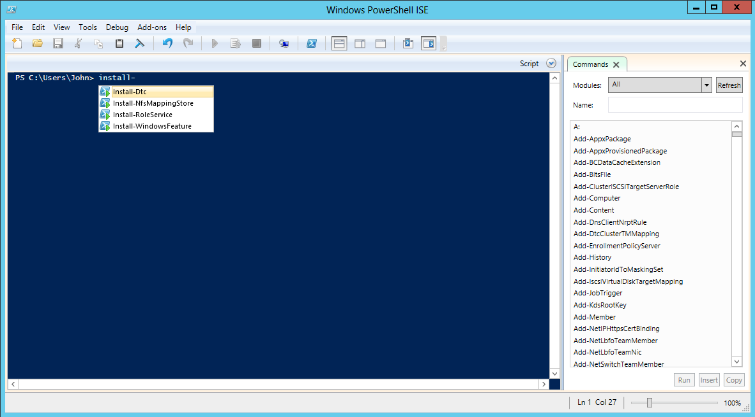
Make sure PowerShell is your best friend
PowerShell 3.0 with over 2000 cmdlets
  Allows creation scripts with workflow
  AD PowerShell history helps you get started
  Comprehensive cmdlets for replication management
  Newest help files download on demand: Update-Help

Slide 7
Installing Domain Controllers

Slide 8
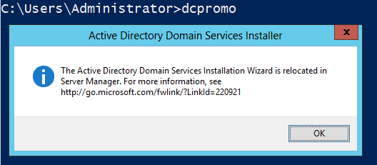
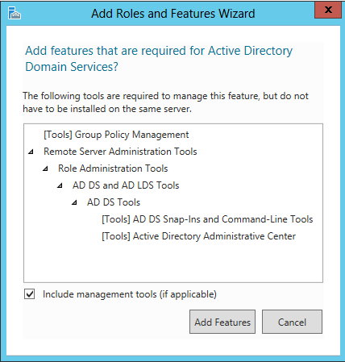
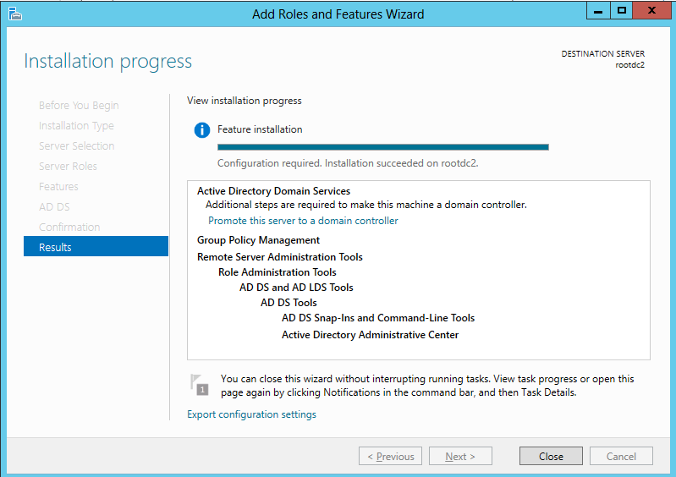
Dcpromo RIP
Provides XML file and PowerShell command to automate adding the role
Can be run remotely

Slide 9
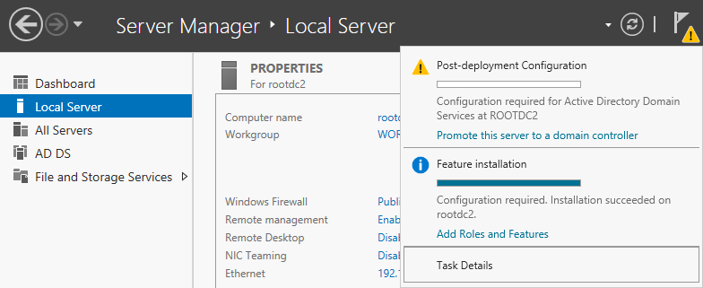
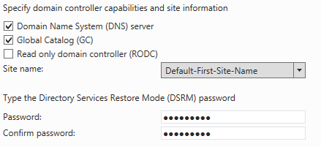
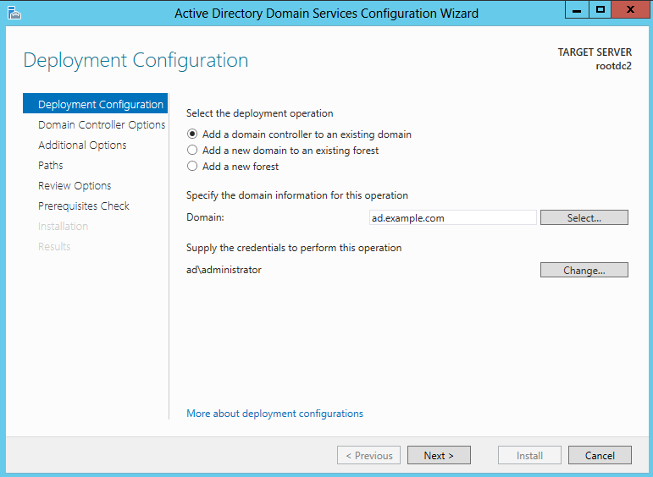
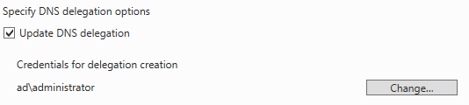
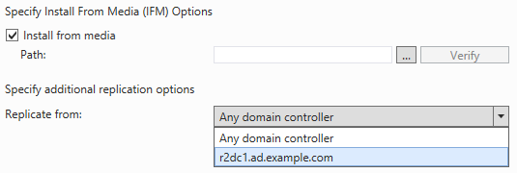
Target forest must be Server 2003 functional level or higher
Create IFM seed with NTDSUTIL
IFM seed generation no longer requires offline defrag (on by default)

Slide 10

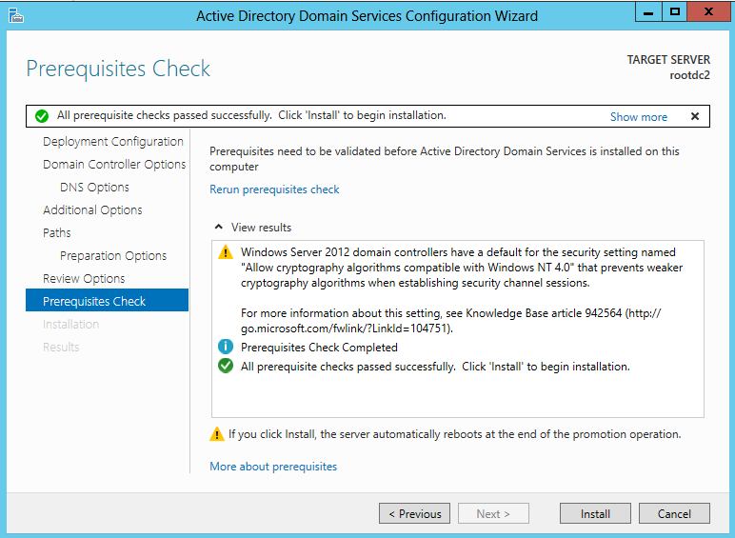

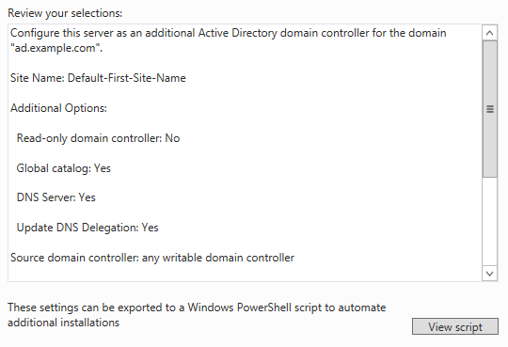
Requires Enterprise Admin privilege
Adprep can still be run manually if required
PowerShell
Checks are performed at each stage of the Wizard and
any issues highlighted before the final validation

Slide 11
DC virtualization

Slide 12
Restoring from an image
One DC fails
  We can restore an image backup
Any problems?

Slide 13
USN rollback…
snapshot
DSA-GUID = A
DSA-GUID = B
InvocationID = E
InvocationID = M
highestCommitedUSN =1000
highestCommitedUSN = 3000
Time
HW vector M,3000
HW vector E,1000
DSA-GUID = A
DSA-GUID = B
InvocationID = E
InvocationID = M
highestCommitedUSN =4567
highestCommitedUSN = 5679
HW vector M,5679
HW vector E,4567
DSA-GUID = A
DSA-GUID = B
Restore
InvocationID = E
InvocationID = M
highestCommitedUSN = 4567
highestCommitedUSN = 3000
HW vector M,5679
HW vector E,1000

Slide 14
What happens next?
Add users
DC1
DC2
DSA-GUID = A
DSA-GUID = B
InvocationID = E
InvocationID = M
highestCommitedUSN = 4567
highestCommitedUSN = 3000
HW vector M,5679
HW vector E,1000
3050
Send me your changes from 1000
Checks UTD vectors from
DC2 and sends changes
✓ Replication OK
It gets worse!
Send me your changes from 5679
There aren’t any!

Slide 15
Post Server 2003 SP1 quarantining
DSA-GUID = A
DSA-GUID = B
InvocationID = E
InvocationID = M
highestCommitedUSN = 4567
highestCommitedUSN = 3050
HW vector M,5679
HW vector E,1000
Send me your changes from 5679
There aren’t any!
Appears more up to date than me, that’s not right!
Replication
log
Write event log messages
Disable inbound and outbound replication
Stop Netlogon service

Slide 16
Windows Server 2012 solution
The hypervisor creates an identifier VM-Generation ID (128 bits)
  Exposed to the guest OS via the BIOS ACPI namespace
  Stored by the DC on promotion in the msDS-GenerationID attribute
    An attribute of the DC computer object
The VM-Generation ID is set during a VM import, copy or application of a snapshot
When the DC boots, if the VM-Generation ID and the
msDS-GenerationID are not the same
  The DC assumes an AD restore
    InvocationID Changes
      Seen as a new replication source
    RID pool discarded
    Non-authoritative restore of SYSVOL

Slide 17
Hypervisor support…
Windows Server 2012 Standard Edition (Hyper-V)
Windows Server 2012 Enterprise Edition (Hyper-V)
Hyper-V Server 2012 (Hyper-V)
Windows 8 Professional (Hyper-V)
Windows 8 Enterprise (Hyper-V)
VMware Workstation 9.0
VMware vSphere 5.0 with Update 4
VMware vSphere 5.1
Watch this space

Slide 18
Demo…
Virtualization safe

Slide 19
DC cloning

Slide 20

Cloning steps
Source DC
CloneableDomainControllers
Check for incompatible components
Get-ADDCCloningExcludedApplicationList
PDCE
W2012
Remove incompatible components or declare them as safe
Hypervisor support for
VM-Generation ID
Shutdown
& copy
Cloned DC
Create new VM
XML
DCCloneConfig.XML
Hypervisor support for
VM-Generation ID
Deploy XML to source DC
or mounted vhd/vhdx copy
(can be on removable media)
If ID has changed cloning starts if XML exists

Slide 21
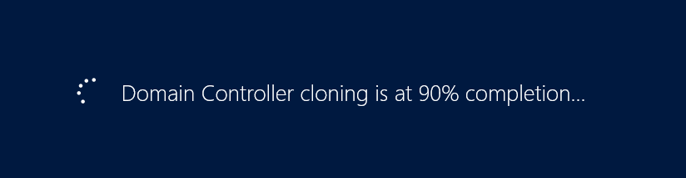
Start the copied DC and…

Slide 22
DefaultDCCloneAllowList.XML
Get-ADDCCloningExcludedApplicationList displays any services or applications that are running that are NOT included in the XML
These applications or services must either be removed or if considered safe added to CustomDCCloneAllowList.XML
Generate XML using:
  Get-ADDCCloningExcludedApplicationList -GenerateXML
    Xml added to %windir%\NTDS

Slide 23
DCCloneConfig.XML
New-ADDCCloneConfigFile –Static -IPv4Address "192.168.137.202"
-IPv4DNSResolver "192.168.137.200" -IPv4SubnetMask "255.255.255.0" -CloneComputerName "AD-DC3" -IPv4DefaultGateway "192.168.137.1" -SiteName "London"
<?xml version="1.0"?>
<d3c:DCCloneConfig xmlns:d3c="uri:microsoft.com:schemas:DCCloneConfig">
<ComputerName>rootdc4</ComputerName>
<SiteName>London</SiteName>
<IPSettings>
<IPv4Settings>
<StaticSettings>
<Address>192.168.137.202</Address>
<SubnetMask>255.255.255.0</SubnetMask>
<DefaultGateway>192.168.137.1</DefaultGateway>
<DNSResolver>192.168.137.200</DNSResolver>
</StaticSettings>
</IPv4Settings>
</IPSettings>
</d3c:DCCloneConfig>
Create using New-ADDCCloneConfigFile
or create from sample:
..\windows\system32\SampleDCCloneConfig.XML
DCCloneConfig.xml placed in …\windows\NTDS
Alternate locations are available

Slide 24
Demo…
Cloning

Slide 25
Kerberos enhancements

Slide 26
Kerberos changes
There are a number of changes to Kerberos to enhance day to day operations
  Increase to the maximum Kerberos SSPI context buffer size
  PAC group compression
  Warning events for large token sizes
  Increased logging
Major changes
  New Kerberos constrained delegation support
  Claims support

Slide 27

Delegation
Block cross forest delegation
by setting netdom trust to “no”
for /EnableTGTDelegation
Protect backend services by setting services account parameter – PrincipalsAllowedToDelegateToAccount
Prior to Windows Server 2012, constrained delegation required the front- and back-end service accounts to be in the same domain
2012 allows delegation across domains and forest trusts

Slide 28
Adding claims to the Kerberos token
Pre-Windows 8 & Server 2012
Windows 8 & Server 2012
Compound ID
PAC contains a user’s group and claims information
+
Device information
User’s Kerberos Token
User
Groups
Claims
PAC
Groups
Device
Claims
User’s group memberships added to PAC
Authorization based on group membership
Authorization can be based on group membership, user and device claims

Slide 29
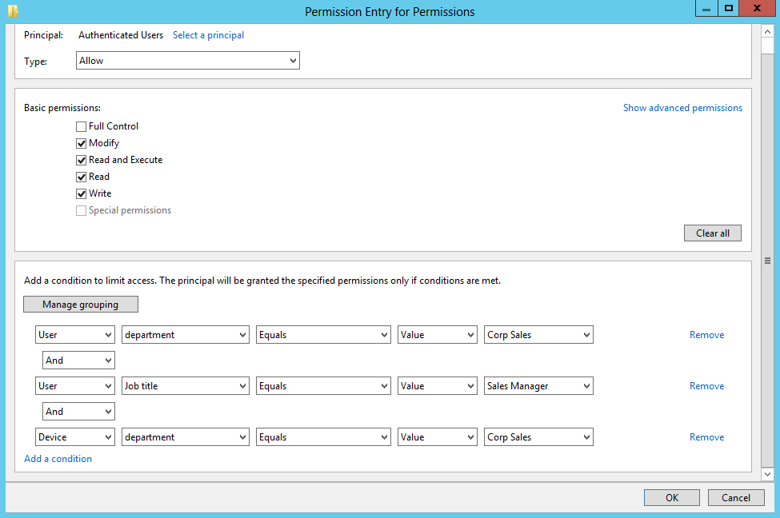
Dynamic Access Control
Files can be classified (tagged) and access and audit policies applied based on the files classification
Expression based access control and auditing
Expressions can contain groups, users, and user and device claims
Access based on compound ID
user and device claims

Slide 30
Enabling Kerberos for claims
Enable the KDC administrative template for Support for Dynamic Access Control and Kerberos armoring
Kerberos armoring also referred to as Flexible Authentication Secure Tunneling (FAST) provides:
  A protected channel between the Kerberos client and the KDC
    Protection against offline dictionary attacks
  Signs Kerberos error messages
    Prevent spoofing
  Compound identity

Slide 31
Exhaustible resources

Slide 32
DNTs
Each DC keeps track of object written to its database using a Distinguished Name Tag (DNT)
  The DNT is held in a 2^31 bit number (~ 2 billion)
  The DNT is incremented as each new object is written
  A DNT value is never reused even if an object is deleted
When you run out of DNTs the DC must be demoted and then repromoted
The DNT value is now exposed through a constructed attribute of RootDSE
  approximateHighestInternalObjectID

Slide 33
SIDs
  S-1-5-21-1539329446-2123584859-1544097757-5023
Domain
subauthority
RID
SIDs must be unique throughout and across forests
The RID is incremented by one each time a new SID is generated
  This is simple to implement in a single-master environment
  A RID master is required in a multi-master domain controller environment

Slide 34
RID problems
The maximum available RID is held as a 30 bit number
  1073,741,824
    10,000 RIDs/day for the next 294 years
  So why is it an issue?
    Rogue script creating millions of security principles
    Very large RID Block size set
    Incorrect values entered when elevating the RID pool during recovery
    Large numbers of domain controllers removed and re-added
    Bug – new RID pool requested every 30 seconds can occur under certain rare circumstances
      See KB 2618669 for Windows 2008 R2 hotfix

Slide 35
Windows Server 2012
Warnings at 10% usage of remaining pool size
  After warning recalculates the 10% marker and repeats
  First event at 100 million
    If you receive this you probably have a problem
Ceiling at 90% usage – intervention required to issue more RIDs
Max RID block size capped at 15K
  HKEY_LOCAL_MACHINE\SYSTEM\CurrentControlSet\Services\NTDS\RID Values\RID Block Size
Global RID Space Size Unlock
  Global space can use 31 bit number doubling the RIDs available
    2003 & 2008 DCs cannot use the 31 bit RID values

Slide 36
And there’s more….

Slide 37
Lots of other improvements
Support for deferred index creation
Off-premises domain join
  Supports DirectAccess clients
Enhanced LDAP logging
New LDAP behaviours
Active Directory Based Activation (AD BA)
  Automatic activation for Windows 8 and Windows Server 2012 machines
  You still require KMS to support downlevel volume-licensing

Slide 38
Lots of other improvements (continued)
Group Managed Service Accounts (gMSA)
  gMSA accounts can run a service across multiple servers
    Services running gMSA accounts only supported on Windows 8 and Windows Server 2012
PowerShell Cmdlets for replication support

Slide 39
So what do we get?
Better GUI support
More robust deployment of DCs
Simplified Active Directory upgrade path
Virtualization safe
Quick deployment via cloning
Fast domain and forest recovery through cloning
Cross-domain and forest constrained delegation
Rich access control and auditing via Dynamic Access Control
Recovery from depleted RID pools
PowerShell everywhere…

Slide 40

Related content
Active Directory Deployment and Management Enhancements MDC-IL305-R & MDC-H202
Upgrading the Platform - How to Get There! Part 2: Reimagining and Migrating Your Active Directory WCA-B336

Slide 41
Windows Track Resources
Windows Enterprise: windows.com/enterprise
Windows Springboard: windows.com/ITpro
Microsoft Desktop Optimization Package (MDOP): microsoft.com/mdop
Desktop Virtualization (DV): microsoft.com/dv
Windows To Go: microsoft.com/windows/wtg
Outlook.com: tryoutlook.com

Slide 42


For More Information
System Center 2012 Configuration Manager
http://technet.microsoft.com/en-us/evalcenter/hh667640.aspx?wt.mc_id=TEC_105_1_33
Windows Intune
http://www.microsoft.com/en-us/windows/windowsintune/try-and-buy
Windows Server 2012
http://www.microsoft.com/en-us/server-cloud/windows-server
Windows Server 2012 VDI and
Remote Desktop Services
http://technet.microsoft.com/en-us/evalcenter/hh670538.aspx?ocid=&wt.mc_id=TEC_108_1_33
http://www.microsoft.com/en-us/server-cloud/windows-server/virtual-desktop-infrastructure.aspx
More Resources:
  microsoft.com/workstyle
  microsoft.com/server-cloud/user-device-management

Slide 43

Resources
Learning
  Sessions on Demand
  Microsoft Certification & Training Resources
http://channel9.msdn.com/Events/TechEd
www.microsoft.com/learning
TechNet
msdn
  Resources for IT Professionals
  Resources for Developers
http://microsoft.com/technet
http://microsoft.com/msdn

Slide 44







Complete an evaluation on CommNet and enter to win!

Slide 45
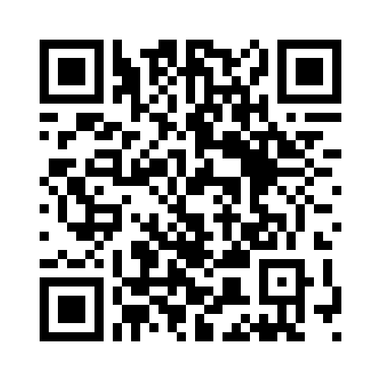


Evaluate this session
Required Slide
*delete this box when your slide is finalized
Your MS Tag will be inserted here during the final scrub.
Scan this QR code to evaluate this session and be automatically entered in a drawing to
win a prize

Slide 46

© 2013 Microsoft Corporation. All rights reserved. Microsoft, Windows and other product names are or may be registered trademarks and/or trademarks in the U.S. and/or other countries.
The information herein is for informational purposes only and represents the current view of Microsoft Corporation as of the date of this presentation. Because Microsoft must respond to changing market conditions, it should not be interpreted to be a commitment on the part of Microsoft, and Microsoft cannot guarantee the accuracy of any information provided after the date of this presentation. MICROSOFT MAKES NO WARRANTIES, EXPRESS, IMPLIED OR STATUTORY, AS TO THE INFORMATION IN THIS PRESENTATION.

