Slide 2
Internet Explorer 10 Administration
WCA-B355
Fred Pullen

Slide 3
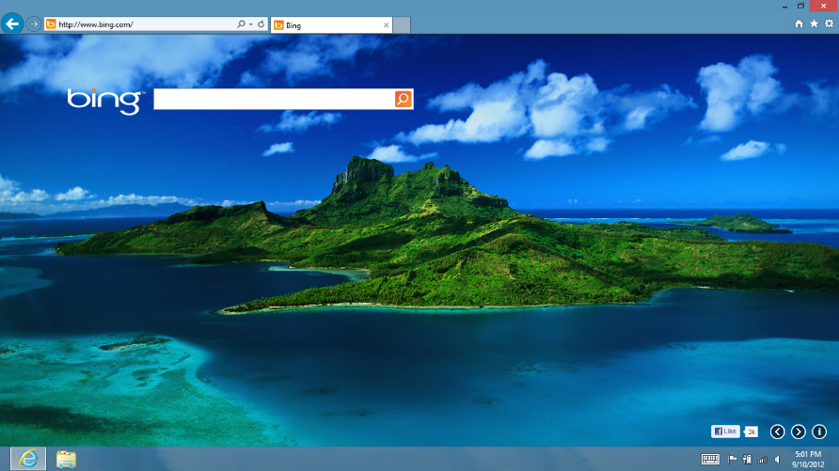
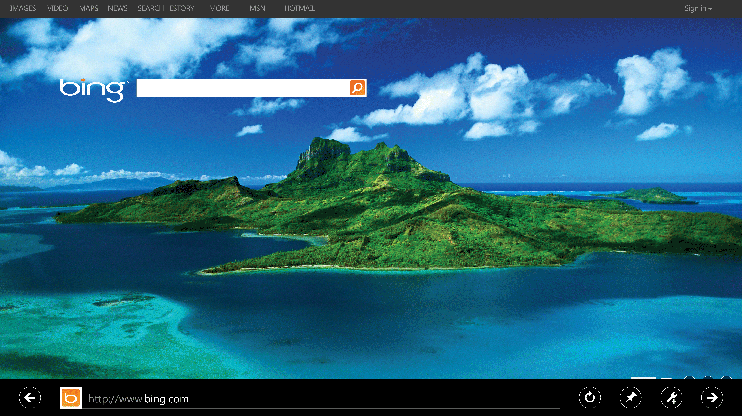
Internet Explorer 10 Administration
Customizing the Browser
Deploying IE10
Browser Management
App Compat

Slide 4
Customizing the Browser

Slide 5
Common Browser Customizations
Title bar,
branding, graphics
Connection settings
Security settings
Add-on components
Preset web pages / links

Slide 6
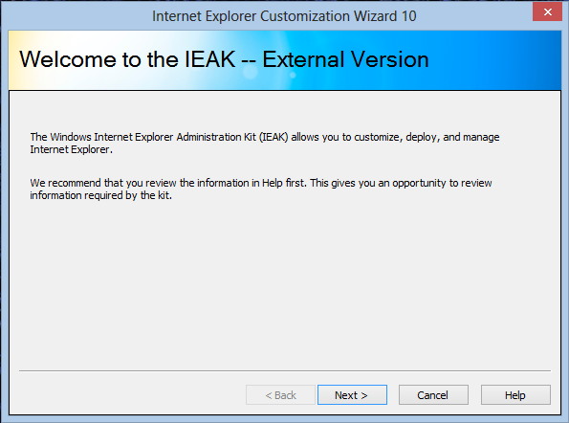
IE Administrator Kit (IEAK)
Contains the Internet Explorer Customization Wizard 10, used to create custom versions of IE10 for:
Windows 8 (64/32)
Windows 7 (64/32)

Slide 7
IEAK Demo

Slide 8
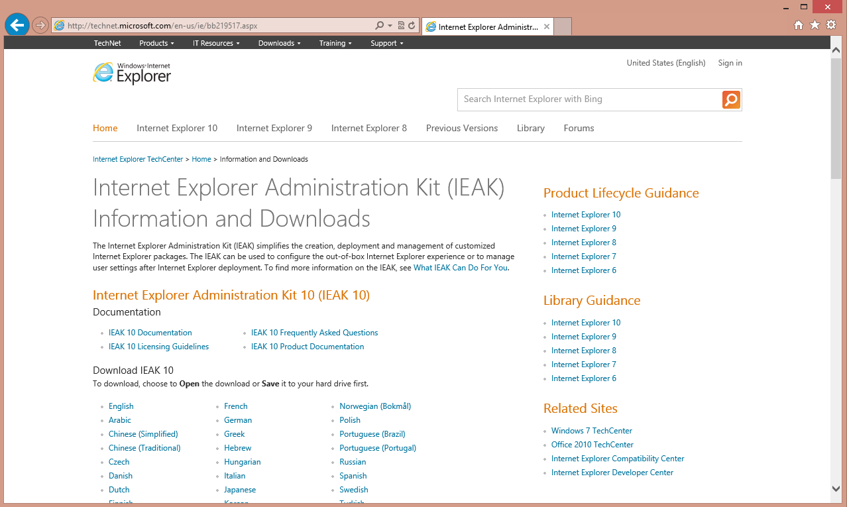
Getting the IEAK
http://ieak.microsoft.com
Wizard is available in 24 languages
Creates IE packages for all Windows languages

Slide 9
Deploying IE10

Slide 10
Deployment Scenarios
Existing Computers Running Windows
Part of a Windows Deployment

Slide 11
IE Deployment Demo

Slide 12
Internet Explorer Deployment Guidance
Explore
Plan/Test
Explore
Plan/Test
Pilot
Deploy
Switch to Deploying
IE10 with Windows

Slide 13
Internet Explorer Deployment Guidance
Explore
Plan/Test
Explore
Plan/Test
Pilot
Deploy
Continue Deployment Plans,
Add Pilot for IE10

Slide 14
Browser Management

Slide 15
Group Policy Settings
~1500
Group Policies
for all versions of IE
GP Search Tool
http://gpsearch.azurewebsites.net
28
New Group Policies
for Internet Explorer 10
Policy vs. Preference
IEAK for preferences,
Group Policies for enforcement

Slide 16
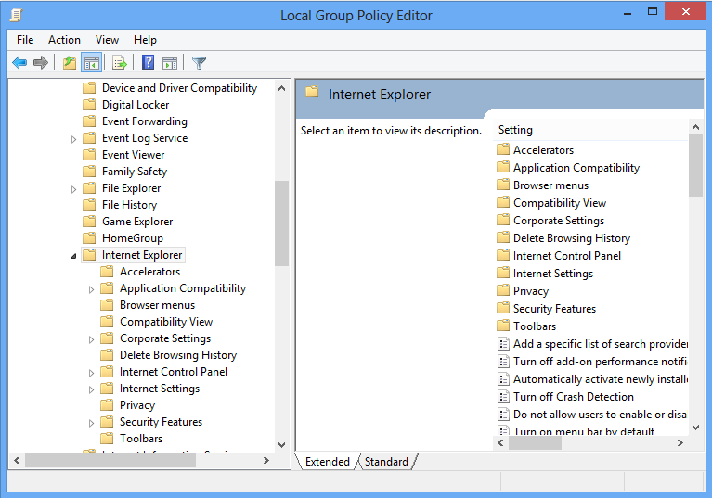
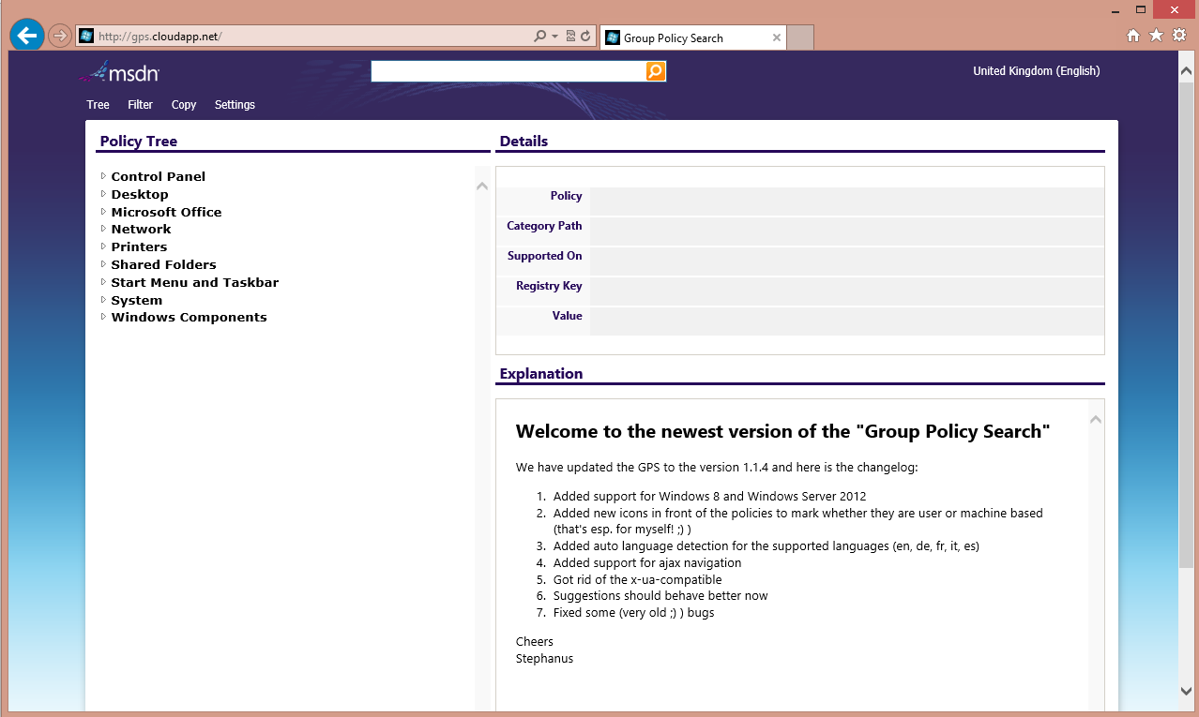
Group Policy Demo

Slide 17
App Compat

Slide 18
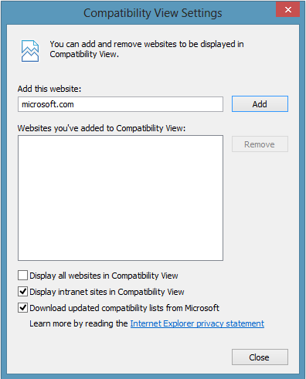
Compatibility View
Easiest manual, end-user compatibility mitigation
Renders in IE7 Standards mode
By default, IE10 will automatically recover from page layout errors with Compatibility View

Slide 19
Compatibility View List (CVL)
Dynamically-updated XML list of sites, compatibility modes
More flexible than Group Policies or Compatibility View
Pro Tip
Press F10 and use the “Tools” menu to access the Compatibility View settings dialog

Slide 20
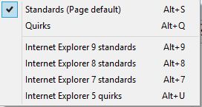
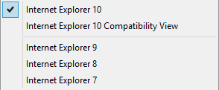
F12 Developer Tools
Rich set of utilities for testing and troubleshooting sites
Document Mode is the mode used to render the page
Browser Mode is the user-agent string sent to the server

Slide 21
App Compat Demo

Slide 22
Compatibility View Group Policies
Policy | Description
Include updated website lists from Microsoft | This policy controls the website compatibility lists that Microsoft provides. The updated website lists are available on Windows Update.
Turn off Compatibility View, Turn off Compatibility View button | This policy setting controls the Compatibility View feature, which allows the user to fix website display problems that he or she may encounter while browsing
Turn on Internet Explorer 7 Standards Mode | This policy setting allows you to turn on Internet Explorer 7 Standards Mode. Compatibility View determines how Internet Explorer identifies itself to a web server and determines whether content is rendered in Internet Explorer 7 Standards Mode or the Standards Mode available in the latest version of Internet Explorer.
Turn on Internet Explorer Standards Mode for local intranet | This policy setting controls how Internet Explorer displays local intranet content. Intranet content is defined as any webpage that belongs to the local intranet security zone.
Use Policy List of Internet Explorer 7 sites | This policy setting allows you to add specific sites that must be viewed in Internet Explorer 7 Compatibility View.
Use Policy List of Quirks Mode sites | Compatibility View determines how Internet Explorer identifies itself to a web server and determines whether content is rendered in Quirks Mode or the Standards Mode available in the latest version of Internet Explorer.

Slide 23
Summary of App Compat Steps
Troubleshoot with Compatibility View and F12 Developer Tools.
Consider one of these methods:
Compatibility View (IE7), on by default for Intranet sites
Group Policies for IE7/Quirks Modes on Intranet/Internet Sites
X-UA-Compatible Meta Tag to explicitly set Document Mode
Compatibility View List for Public Sites
Updating the site for modern web standards

Slide 24
IE10 Administration Summary
Customizing the Browser
Deploying IE10
Browser Management
App Compat

Slide 25
Related Content
WCA-B303, App Compat for Nerds – June 6, 2:45PM
WPH-B304, All Aboard for the Future of HTML5 Mobile and Hybrid Web Apps – June 4, 10:15AM
Find Me Later at the Windows Client Booth, Level 1

Slide 26
IT Pro Resources
TechNet: technet.microsoft.com/ie
IE Deployment Guide: technet.microsoft.com/library/jj822335.aspx
IEAK: ieak.microsoft.com
GP Search Tool: gpsearch.azurewebsites.net

Slide 27
Developer Resources
MSDN: msdn.microsoft.com/ie
modern.ie: modern.ie
IE10 Compatibility Cookbook: http://msdn.microsoft.com/library/ie/hh801219.aspx
IE Testing Center: samples.msdn.microsoft.com/ietestcenter

Slide 28
Informational Resources
Internet Explorer: www.beautyoftheweb.com
IE Engineering Blog: blogs.msdn.com/b/ie
IE Marketing Blog: blogs.windows.com/ie/b/ie

Slide 29
Windows Track Resources
Windows Enterprise: windows.com/enterprise
Windows Springboard: windows.com/ITpro
Microsoft Desktop Optimization Package (MDOP): microsoft.com/mdop
Desktop Virtualization (DV): microsoft.com/dv
Windows To Go: microsoft.com/windows/wtg
Outlook.com: tryoutlook.com

Slide 30
Resources
Learning
Sessions on Demand
Microsoft Certification & Training Resources
http://channel9.msdn.com/Events/TechEd
www.microsoft.com/learning
TechNet
msdn
Resources for IT Professionals
Resources for Developers
http://microsoft.com/technet
http://microsoft.com/msdn

Slide 31
For More Information
System Center 2012 Configuration Manager
http://technet.microsoft.com/en-us/evalcenter/hh667640.aspx?wt.mc_id=TEC_105_1_33
Windows Intune
http://www.microsoft.com/en-us/windows/windowsintune/try-and-buy
Windows Server 2012
http://www.microsoft.com/en-us/server-cloud/windows-server
Windows Server 2012 VDI and Remote Desktop Services
http://technet.microsoft.com/en-us/evalcenter/hh670538.aspx?ocid=&wt.mc_id=TEC_108_1_33
http://www.microsoft.com/en-us/server-cloud/windows-server/virtual-desktop-infrastructure.aspx
More Resources:
microsoft.com/workstyle microsoft.com/server-cloud/user-device-management

Slide 32
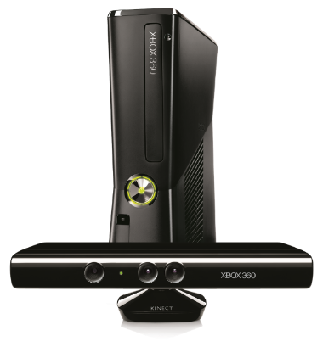
Complete an evaluation on CommNet and enter to win!

Slide 33
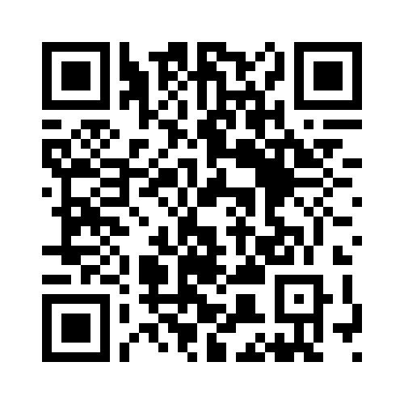
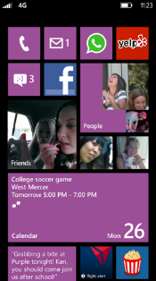
Evaluate this session
Required Slide
*delete this box when your slide is finalized
Your MS Tag will be inserted here during the final scrub.
Scan this QR code to evaluate this session and be automatically entered in a drawing to win a prize

Slide 34
© 2013 Microsoft Corporation. All rights reserved. Microsoft, Windows and other product names are or may be registered trademarks and/or trademarks in the U.S. and/or other countries.
The information herein is for informational purposes only and represents the current view of Microsoft Corporation as of the date of this presentation. Because Microsoft must respond to changing market conditions, it should not be interpreted to be a commitment on the part of Microsoft, and Microsoft cannot guarantee the accuracy of any information provided after the date of this presentation. MICROSOFT MAKES NO WARRANTIES, EXPRESS, IMPLIED OR STATUTORY, AS TO THE INFORMATION IN THIS PRESENTATION.

