Slide 2
The Power of collaboration Integrating Windows Phone with Office 365, Exchange and SharePoint Online
WPH-B201
Alan Meeus & Robert Hoover
Windows Phone Division

Slide 3
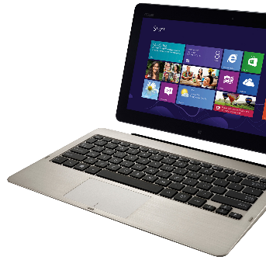
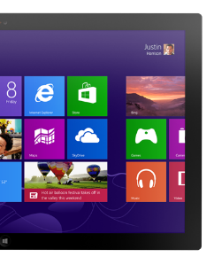
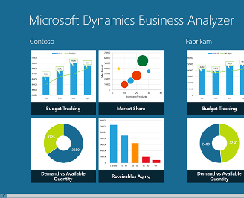
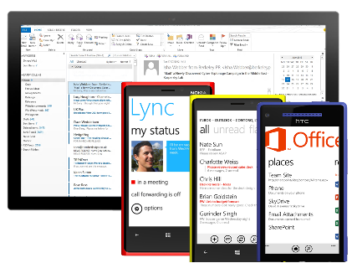
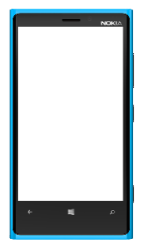
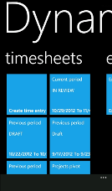
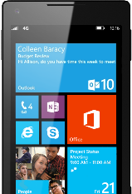
Windows the right choice for business
Great, consistent experience across devices
Built-in communication and collaboration
Robust platform for mobile apps
Unified app and device management
Common core and security architecture
http://www.windowsphone.com/business

Slide 4
The Power of collaboration
Anywhere access to communication and collaboration in a global world is critical to success. We all know this. Can your business be agile without it?
Windows Phone 8 delivers the essential communication and collaboration tools business users need.
Some guidance on how to deploy Windows Phone 8 in an IT infrastructure with Exchange Server, SharePoint and Lync or Office 365.
Technical level 200

Slide 5
Works seamlessly with your Microsoft platform investments
Business users
IT professionals
LOB developers

Slide 6
Works seamlessly with your Microsoft platform investments
Business users
IT professionals
LOB developer

Slide 7
Communicate and Collaborate
Efficient Communication | Documents and collaboration | Social
Group e-mails by conversation for efficiency | Bring together all Office documents Office Hub | Access corporate training and events
Pinnable e-mail folders for at-a-glance viewing | Access corporate resources and libraries | Pin contacts and groups
View meeting requests in e-mail | View, edit and comment in Word, PowerPoint and Excel | View availability and chat with work colleagues
Search server for e-mails not stored on phone | Take and sync notes with OneNote Mobile | Chat with multiple colleagues at the same time
Set your Out of Office message | Use SkyDrive, SkyDrive Pro or Sharepoint for document storing | Update status to show your availability to colleagues
Manage work and personal calendars | Manage group calendars on SharePoint | Search for corporate contacts
Sort, scan, and manage work and personal e-mail | Recent document list stays in sync across devices | People Hub with Groups
Lync and Skype VOIP and Video Conferences | Real-time collaboration with OneNote | SharePoint Social and Yammer apps for Windows Phone
Read protected e-mail – IRM | Read protected documents - IRM

Slide 8
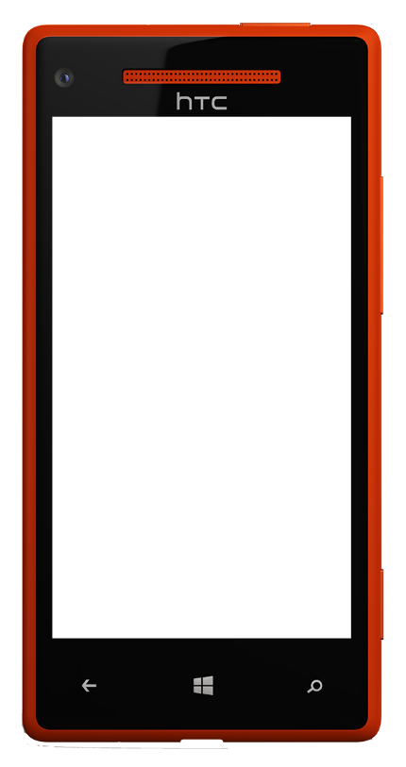
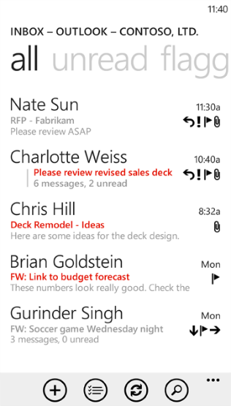
Stay organized with Outlook Mobile
Filter email in different ways
Read email grouped by conversation
View email from multiple email accounts
Sort email in folders
Pin email folders to start
Search for email on the server
Business users

Slide 9
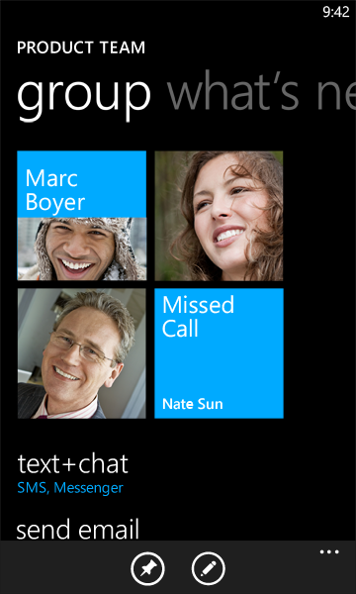
Connect with people
Add people to work and personal groups
Connect with people or groups for easier email, IM, Skype, and SMS communications
Live Tiles offer updates from leading social networks
Business users

Slide 10
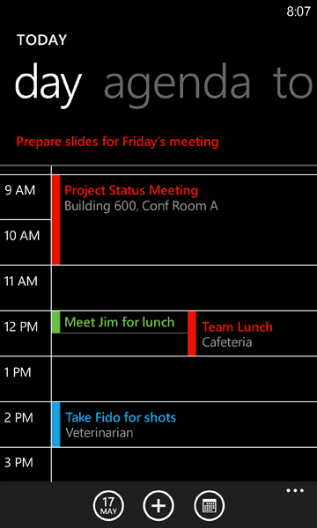
Manage the day with integrated calendars
Manage multiple calendars
Manage tasks and to-dos in the calendar view
Business users

Slide 11
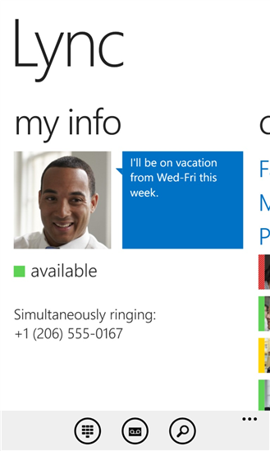
Lync Mobile - communicate in real-time
Corporate presence, IM, VOIP and Video calls.
Multi-party chat, and collaboration while on a conference
Search for corporate contacts, update corporate status
Single tap to join conference from appointment or from the app.
App in the Windows Phone Store
Business users

Slide 12
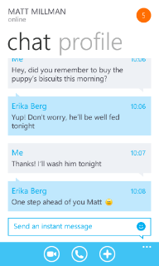
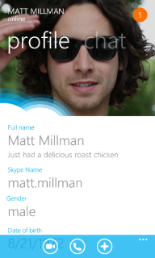
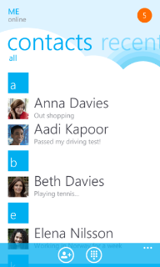
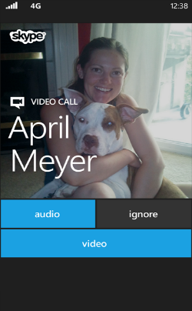
Reach business partners with Skype
Call Skype accounts (free) or phone
Catch up over a video call
Send instant messages to one person or an entire group even while you’re in a video or phone call
Download Skype for free from the Windows Phone Store
Business users

Slide 13
demo

Slide 14
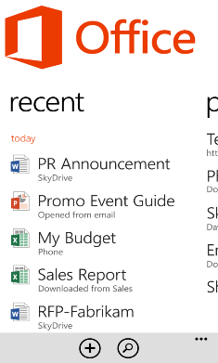
Always in sync and ready
Documents and notebooks stay in sync when using Microsoft Office
Keep your recent documents and notes synchronized across PC and phone
Edit, save on one and continue working right where you left off on the other.*
*Requires Office 2013

Slide 15
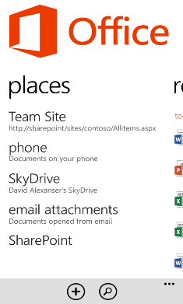
Quickly access documents
A simple way to access all your documents, no matter where they are
Quickly access documents stored in SkyDrive, SharePoint, or Office 365
Email attachments you read on the phone are available too

Slide 16
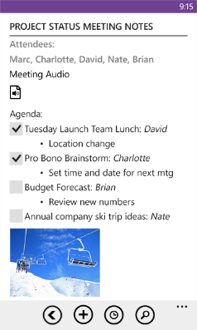
OneNote, never lose an idea
Note-to-self: dictate and it is transcribed*
Take control of syncing Notebooks: pre-sync, limit scope, sync over free Wi-Fi
Take notes while on the go and sync with your PC
* Only EEFIGSs

Slide 17
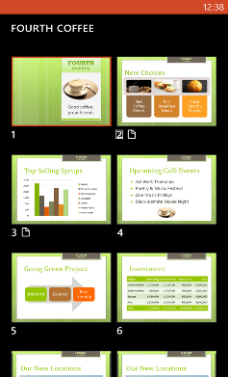
PowerPoint
Get ready for the presentation
View your slides and speaker notes in one view for a good presenter experience
Navigate a PowerPoint presentation quickly using slide sorter view
View slides in portrait or landscape mode

Slide 18
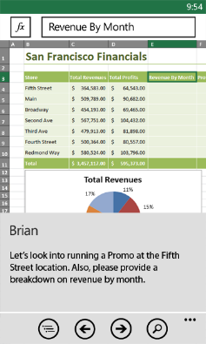
All the familiar Office apps right there
No need to purchase or install, Office Mobile is built-in
Edit and comment in Word, Excel, and PowerPoint
No formatting or data gets lost
Templates to help users create new documents
Excel data stats and formula assist
IRM support for documents

Slide 19
Demo

Slide 20
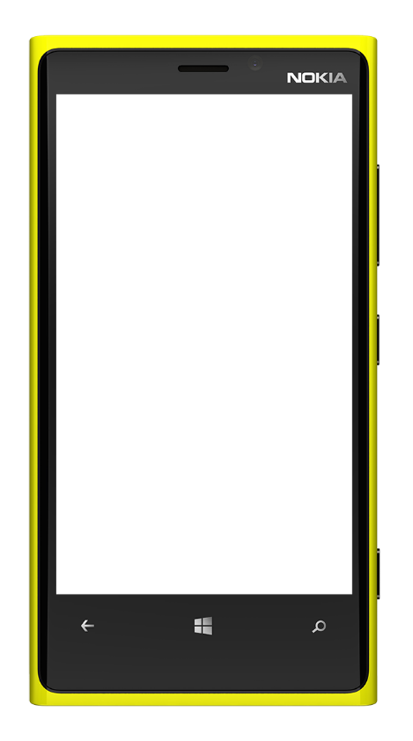
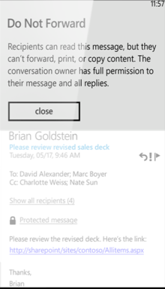
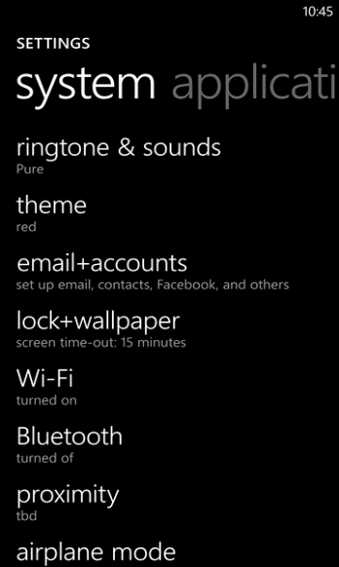
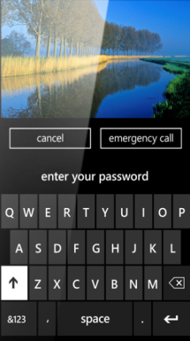
Deploy on premise or in the cloud
Exchange ActiveSync Implementation
Auto-discovery lets users easily connect
Auto provisioning of Office 365
Supports multiple EAS accounts
Full support for IRM

Slide 21
Enterprise ActiveSync Integration
Password Required
Password Expiration
Password History
Allow Simple Password
Password Length
Idle Timeout Value
Device Wipe Threshold
Complex Password Required
Password Complexity
Device Encryption Required
Remote Wipe

Slide 22
ActiveSync Feature Support
EAS Feature | Exchange Server 2003 | Exchange Server 2007 | Exchange Server 2010/3
Direct Push | X | X | X
Email Sync | X | X | X
Calendar Sync | X | X | X
Contacts Sync | X | X | X
Remote Wipe | X | X | X
Sync Multiple Folders | X | X | X
128-bit SSL Encrypted Transmission | X | X | X
User Initiated Remote Wipe |  | X | X
HTML E-mail |  | X | X
GAL Lookup | X | X | X
Follow-up Flags |  | X | X
Meeting Attendee Information |  | X | X
Autodiscover |  | X | X
Bandwidth Reductions |  | X | X
Reply State |  |  | X
Nickname Cache |  |  | X
Block/Allow/Quarantine List |  |  | X
Allow Attachment Download |  |  | X
256-bit SSL Encrypted Transmission |  |  | X
Server Search |  |  | X
IRM Email |  |  | X

Slide 23
Demo

Slide 24
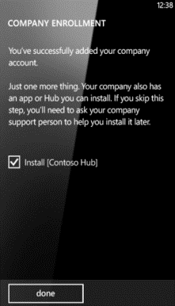
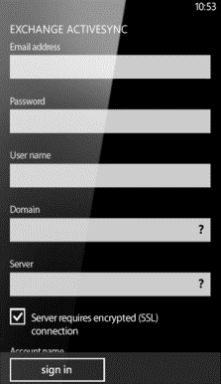
Mobile Device Management Choices
Exchange ActiveSync
Windows Intune
Mobile Iron
Airwatch
Citrix XenMobile
and others

Slide 25
Windows Phone policy and reporting
EAS
Enterprise policies
and reporting
✓
✓
✓
✓
✓
✓
✓
✓
✓
✓
✓
✓
✓
✓
✓
✓
✓
✓
✓
(NA)
✓
✓
✓
✓
✓
Simple password
Alphanumeric password
Minimum password length
Minimum password complex characters
Password expiration
Password history
Device wipe threshold
Inactivity timeout
IRM enabled
Remote device wipe
Device encryption (new)
Disable removable storage card (new)
Remote update of business apps (new)
Remote or local un-enroll (new)
Server configured policy values
Query installed enterprise app Device name
Device ID
OS platform type
Firmware version
OS version
Device local time
Processor type
Device model
Device manufacturer
Device processor architecture
Device language

Slide 26
Deployment topography
Microsoft Exchange Servers
DMZ
Internet
GSM
Corporate firewall and reverse proxy
Wireless Networks
Corporate Application Servers
Windows Phone & other devices

Slide 27
Benefits of HTTPS Publishing
Efficient
Bandwidth – Very minimal overhead for most of the applications
Battery efficient – No need to maintain a connection over time
Seamless & Always-on
No need to open explicitly, applications get data when requested
Always Working
Supported on all cellular data networks (Unlike IPSec)
More Control
Admin has a tight control over what is exposed and what is not
No need for full network access

Slide 28
Using Certificates with Exchange
Installing certificates via Windows Internet Explorer®
Any device accessible URL
User can inspect and optionally choose to install the certificate
Installing certificates via e-mail
Certificate installer supports using .cer, .p7b and .pfx files
Root Certificates
Self-signed certs are possible but recommend chaining off an existing root certificate
http://www.windowsphone.com/business

Slide 29
Information Rights Management Requirements
The Client Access servers in your organization must be running Exchange 2010 SP1 or later
An AD RMS server must be deployed in your org
IRM must be enabled for internal messages. This is a prerequisite for all IRM features in Exchange Server.
For details, see Enable or Disable IRM for Internal Messages http://technet.microsoft.com/en-us/library/bb124077.aspx
IRM must be enabled in the Exchange ActiveSync mailbox policy. You can enable or disable IRM for different sets of users using different Exchange ActiveSync mailbox policies.

Slide 30
SharePoint Integration
SharePoint Server 2010 or later
On-premises or hosted
Office 365
Uses SSL connection

Slide 31
Lync Mobile Deployment
Extend Lync access with mobility service
Mobile Enterprise grade unified communication
Single client and user identity
Supported by both Lync Server and Lync Online
Active Directory based authentication
RESTful APIs to minimize battery usage
VOIP, Video over IP* or PSTN callbacks
Lync 2010 Client still available for Windows Phone 8 with PSTN callback, not video and VOIP

Slide 32
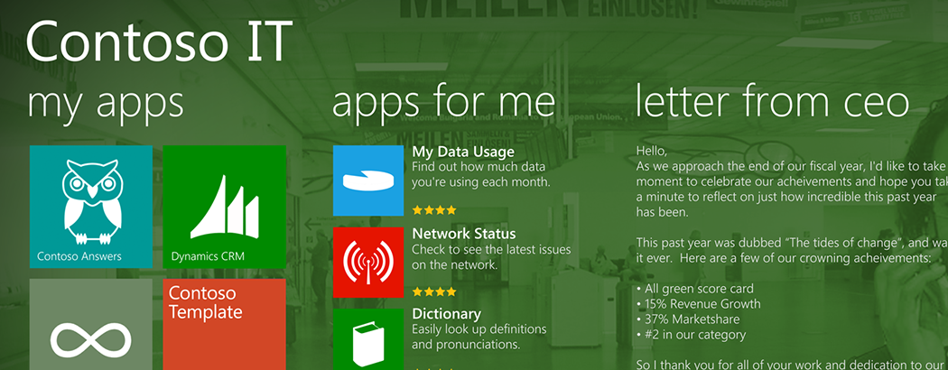
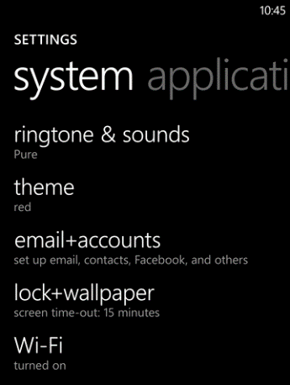
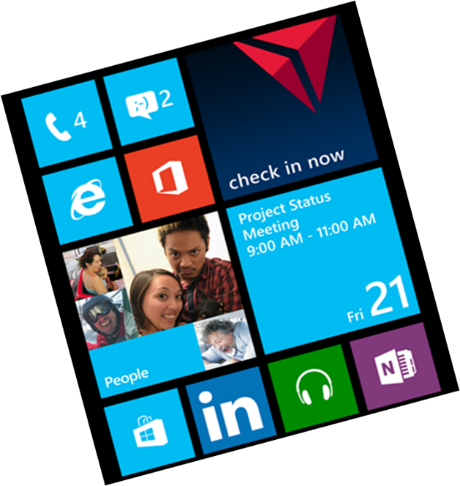
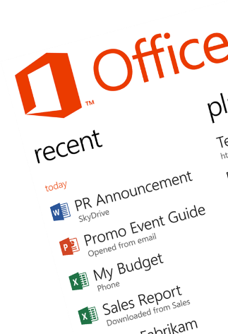
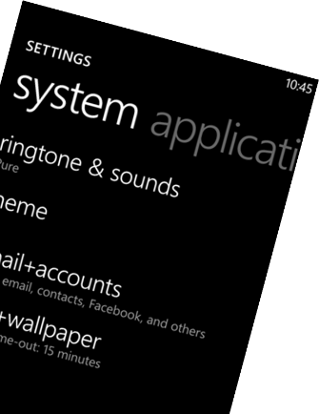
Ready for business
Great, consistent experience across devices
Collaborate and communicate
Native device management
Shared core and security
App lifecycle management

Slide 33
Windows Phone Breakout Sessions
Monday, June 3:
1:15pm - The phone that has everything the enterprise needs: Windows Phone 8
3:00pm – The top down guide for developers: Windows Phone 8
4:45pm – Radical perspectives on mobility strategy
Tuesday, June 4:
8:30am – The power of collaboration: Integrating Windows Phone with Office 365, Exchange and SharePoint Online
10:15am – All aboard for the future of HTML5 mobile & hybrid web apps for Windows Phone 8 and Windows Tablets
1:30pm – The Windows Phone 8 networking survival kit
3:15pm – Build it once for both: Writing code and designing for Windows 8 and Windows Phone 8
5:00pm – Secrets of using background agents for Windows Phone 8

Slide 34
Windows Phone Breakout Sessions
Wednesday, June 5:
8:30am – Mobile security in the enterprise: Windows Phone 8 answers the call
10:15am – Using C and C++ in your Windows Phone 8 applications
1:30pm – Developing large-scale enterprise mobile apps for Windows Phone 8
3:15pm – Speechifying your Windows Phone 8 applications
Thursday, June 6:
8:30am – Manage Windows Phone enterprise apps
10:15am – Support your demanding LOB apps with SQLite and Windows Phone 8
1:00pm – Creating Windows Phone 8 apps for SharePoint

Slide 35
Windows Phone Hands On Labs
Porting Windows 8 to Windows Phone 8
Windows Phone 8: File and Protocol Association
Windows Phone 8: Lock Screen Wallpaper
Windows Phone 8: Voice Command
Windows Phone 8: Tiles
Windows Phone 8: Purchase
Windows Phone 8: Wallet
Windows Phone 8: Running Tracker

Slide 36
Windows Phone Booth
Device Bar featuring the latest Windows Phones in the marketplace
Expert Area – Stop by the booth to get all your Windows Phone questions answered by Windows Phone experts
Theater Presentations:
The Windows connected experience
Get Hands on with Windows Phone for Business
Windows Phone 8 Developer focused sessions

Slide 37
Windows Phone Promotions
Windows Phone Hats – Stop by the Windows Phone booth to get your free hat. Wear the hat for a chance to win a Windows Phone.
Attend a Windows Phone theater session to be entered into a drawing for Windows Phones and other prizes.
Windows Phone Breakout Sessions – Attend Windows Phone breakout sessions and be entered into a drawing to win a Windows Phone.
Windows Phone Hoodie’s – Get a demo from the Windows Phone roaming demo team in the expo hall. Wear the hoodie for a chance to win a Windows Phone.

Slide 38
Track Resources
For more information about Windows Phone:
http://www.windowsphone.com/business

Slide 39
Questions?

Slide 40
Resources
Learning
Sessions on Demand
Microsoft Certification & Training Resources
http://channel9.msdn.com/Events/TechEd
www.microsoft.com/learning
TechNet
msdn
Resources for IT Professionals
Resources for Developers
http://microsoft.com/technet
http://microsoft.com/msdn

Slide 41
Complete an evaluation on CommNet and enter to win!

Slide 42
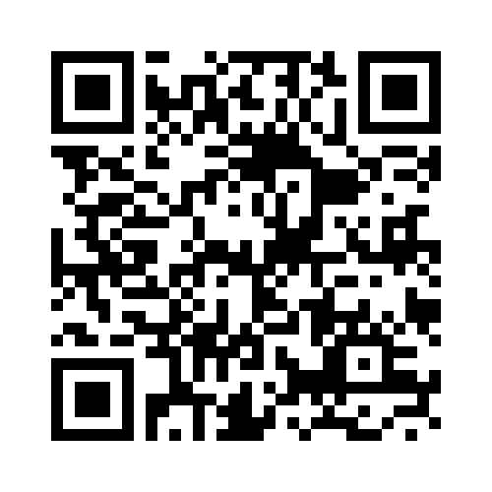
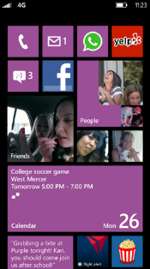
Evaluate this session
Required Slide
*delete this box when your slide is finalized
Your MS Tag will be inserted here during the final scrub.
Scan this QR code to evaluate this session and be automatically entered in a drawing to win a prize

Slide 43
© 2013 Microsoft Corporation. All rights reserved. Microsoft, Windows and other product names are or may be registered trademarks and/or trademarks in the U.S. and/or other countries.
The information herein is for informational purposes only and represents the current view of Microsoft Corporation as of the date of this presentation. Because Microsoft must respond to changing market conditions, it should not be interpreted to be a commitment on the part of Microsoft, and Microsoft cannot guarantee the accuracy of any information provided after the date of this presentation. MICROSOFT MAKES NO WARRANTIES, EXPRESS, IMPLIED OR STATUTORY, AS TO THE INFORMATION IN THIS PRESENTATION.

