Slide 2
Developing Large-Scale Enterprise Mobile Apps for Windows Phone 8 and Windows Tablets
WPH-B305
Rob Tiffany

Slide 3

Rob Tiffany
  Mobile Strategist at Microsoft
  Created the Microsoft Windows Mobile Line of Business Accelerator
  Author, Cloud Architect, Entrepreneur, Speaker, Teacher, Submariner
  Check out my blog at http://robtiffany.com
  Follow me on Twitter at http://twitter.com/robtiffany
  Connect on LinkedIn at http://linkedin.com/in/robtiffany
  Watch Building Apps for Windows Phone 8 Jumpstart at http://channel9.msdn.com/Series/Building-Apps-for-Windows-Phone-8-Jump-Start/

Slide 4
Session Objectives And Takeaways
Session Objective(s):
  Learn mobile enterprise concepts
  Learn how to build mobile middleware with SQL Server 2012 + IIS
  Learn how to securely publish enterprise data out to the Internet
  Learn how to consume and work with data on Windows Phone 8 and Windows Tablets
Between 50% - 70% of your enterprise mobile app development takes place on the backend.
Microsoft’s Mobile Enterprise Application Platform (MEAP) extends an organization’s backend systems out to mobile devices in a reusable way saving money and accelerating time to market.

Slide 5
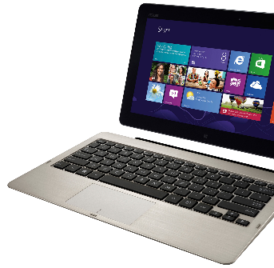
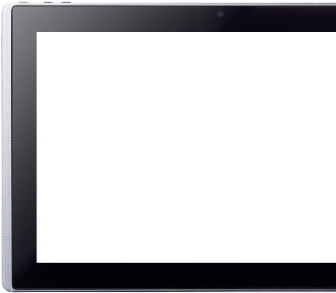
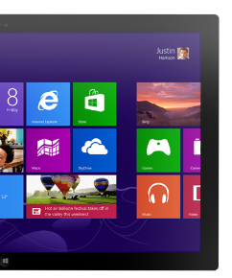
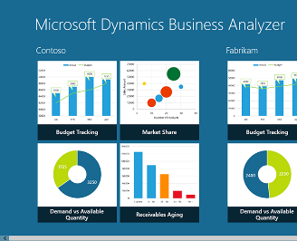
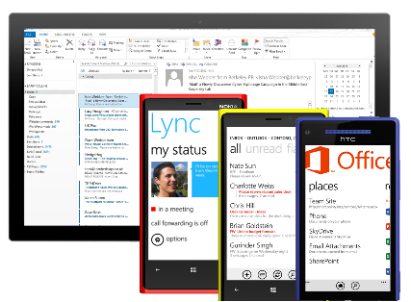
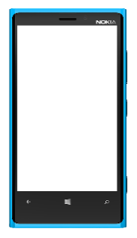

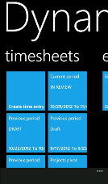
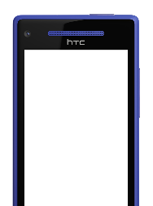

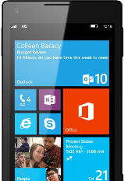
Windows Phone is Built for Business
Great, consistent experience across devices
Productive
and connected
Robust platform for
mobile apps
Unified app and
device management
Common core and security architecture

Slide 6
Mobile Enterprise Concepts

Slide 7
Why are Companies Going Mobile?
Productivity and efficiencies are gained by letting employees work anytime from anywhere
Real-time vs. batch-mode speeds up the cadence of decision-making to gain a competitive advantage
Timely information allows employees to make better decisions at the point of activity
Extending backend systems to mobile users is a top priority for CIOs
Data captured from the field is used in analytics

Slide 8
How does a Company Make this Happen?
Mobile Middleware integrates multiple data sources, act as a server façade, & exposes composite data via Web Services in a format consumable by any device
A Multi-channel Access Gateway securely publishes data out to the Internet
Development tools create server logic, client logic + UX, and integration with backend systems
Devices running apps and web browsers consume data and complete transactions in an offline state

Slide 9
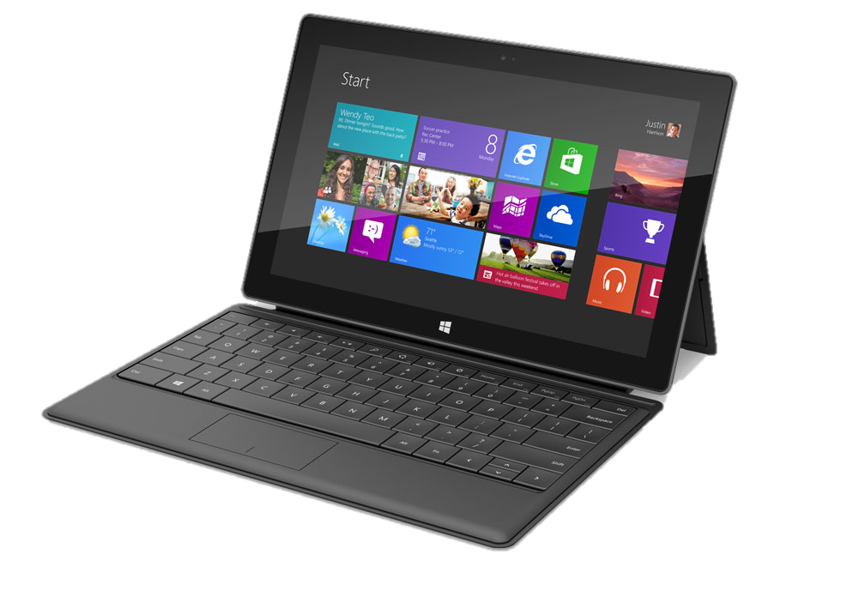
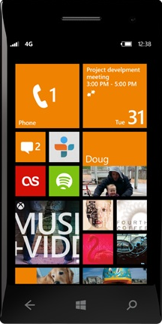

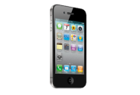


Mobile Enterprise Application Platform
Enterprise Application Integration
Data
Sources
Back End
Systems
Database Connections
EAI Adapters
Data
Aggregation
Web
Services
Mobile Middleware
Multi-Channel
Access
Gateway
HTTPS
HTTPS
Data Center
Internet

Slide 10
Building Mobile Middleware with
SQL Server 2012 + IIS

Slide 11
Mobile Middleware
Enterprise application integration (EAI) with backend systems and data sources
Aggregate and cache composite data retrieved from those systems
Create business entities that model the schema created by the aggregated data
Build RESTful Web Services to expose business entities to mobile clients

Slide 12
Back End Systems + Data Sources via SSIS
Packages
  SAP, Siebel, Oracle, Salesforce, Hyperion, Dynamics, SharePoint, Custom
Databases
  Oracle, DB2, Teradata, Sybase, MySQL, Informix, PostgreSQL, Access, FoxPro, Ingres
  VSAM, IMS, LDAP, Lotus Notes, ADABAS, ADO.NET, OLEDB, ODBC, SQL Server Compact
Messaging
  MSMQ, MQ Series, Tibco Rendezvous, SMTP, EDI, Flat Files, XML, WebSphere, webMethods, SeeBeyond
Internet
  Web Services, FTP, HTTP

Slide 13
Visually Connecting Adapters
Use SQL Server Data Tools to Create SSIS Packages
Create a Data Flow Task
  Create an OLE DB Source that points to a data source
  Perform needed data transformations along the way
  Create an OLE DB Destination that points to SQL Server
Encrypt SSIS Package and data via password or user key to secure integration data movement
SSIS holds the world record for ETL operations at over 2 TB transferred per hour

Slide 14
EAI + Data Aggregation via SSIS
Flat
Files
EAI
Back End
Package
Message
Bus
EAI
Private Cloud
EAI
EAI
Database
SSIS
Adapters
EDI
Web
Service
EAI
SQL
Server

Slide 15
Demo
Using SSIS to Pull Data from Multiple Backend Systems
Rob Tiffany

Slide 16
Scaling Out SQL Server 2012
Replication is a SQL Server database engine feature
  Why allow all your devices to overwhelm a single database…
  …when smaller groups of devices can connect to multiple, replicated copies of that same database
Databases, tables, and columns can be filtered and replicated to other SQL Server nodes
  Database shards are smaller and therefore faster because disk I/O is reduced since the ratio between memory and data on disk is improved
  Most nodes download read-only database shards to accommodate SELECTs (READS)
  A small number of write-only nodes will be used to upload INSERTs, UPDATEs, and DELETEs (WRITES)
Geo-replication across data centers is facilitated by Peer to Peer Transactional Replication
  Complete copies of the database is replicated and kept up to date

Slide 17
Shared-Nothing Horizontal Partitioning
Remote
Data Center
Private Cloud
SQL
Server
Replication
Peer
Geo-Replication
Replication
SQL
Server
Subscriber
SQL
Server
Subscriber
SQL
Server
Subscriber
Replication
SQL
Server
Subscriber
SQL
Server
Publisher

Slide 18
Demo
Using Replication to Scale out SQL Server 2012
Rob Tiffany

Slide 19
Creating Web Services
Use Multichannel Transports and Data Formats
  REST is how the mobile Internet communicates
  JSON is how the mobile Internet serializes data
Business Objects are modeled on database schema
  Retrieve Data from SQL Server to hydrate your Business Objects
  Serialize collections of business objects as JSON
Performance + Scalability
  Boost performance and scalability with .NET MemoryCache or AppFabric Caching
  Increase scalability by load-balancing IIS servers
SSL + Basic authentication to secure data in transit

Slide 20
Scaling and Caching Web Services
Remote
Data Center
Private Cloud
SQL
Server
IIS
SQL
Server
Subscriber
(Write)
SQL
Server
Subscriber
(Read)
IIS
SQL
Server
Subscriber
(Read)
SQL
Server
Subscriber
(Read)
Load
Balanced
IIS
Cache
Load
Balanced
Cache
Load
Balanced
IIS
Load
Balanced
IIS
IIS
IIS
IIS
IIS
IIS

Slide 21
Demo
Building REST Web Services with the ASP.NET Web API
Rob Tiffany

Slide 22
Getting Corpnet
Data out to Devices

Slide 23
Securely Publish Data to the Internet
Unified Access Gateway (UAG)
Sits in the DMZ between front and back firewalls with inbound and outbound network interface cards
  Secured with a certificate
Listens for web requests on external IP and routes internally to a single web site or load balancer (VIP)
Specify a public DNS name “mobile.contoso.com” and a path “/” for the non-public virtual directory and folder of your web services or site

Slide 24
Securely Publish Data to the Internet
Terminate and offload SSL traffic or pass it through to the web site via SSL bridging
Pre-authenticate or allow web site to authenticate
Inspect both clear and encrypted packets for malware or other exploits
NO VPN REQUIRED because you’re publishing discreet services instead of exposing the entire network
  You already follow this model to publish Exchange email to devices

Slide 25
Mobile Gateway
Remote
Data Center
Private Cloud
IIS
Firewall
IIS
UAG
Firewall
IIS
IIS
IIS
IIS
Back
Firewall
IIS
IIS
IIS
IIS
UAG
Reverse
Proxy
Front
Firewall

Slide 26
Syncing Data in Windows Phone 8 and Windows Tablets

Slide 27
Mobile Data
Consume REST web services from native or web apps
De-serialize JSON into an in-memory object collection
Save data offline
  Web: IndexedDB, Web Storage, App Cache
  App: SQLCE, SQLite, Object serialization
Capture, change, and edit local data based on business logic requirements and then upload
Password protect and encrypt local data at rest
  BitLocker + Password enforcement via device management

Slide 28
Sync Data via Web Services
Remote
Data Center
Private Cloud
Firewall
UAG
Firewall
SSL
Windows
Offline
Data
(File)
Offline
Data
(SQLCE)
Back
Firewall
Offline
Data
(DB)
UAG
Reverse
Proxy
Offline
Data
(SQLite)
Front
Firewall
SSL
Windows
Offline
Data
(File)

Slide 29
Demo
Syncing Data in Windows Phone 8 + Windows Tablets
Rob Tiffany

Slide 30
Logical MEAP Architecture
Flat
Files
EAI
Back End
Package
Remote
Data Center
Message
Bus
EAI
Private Cloud
EAI
EAI
Database
SSIS
Adapters
IIS
SQL
Server
Geo-Replication
EDI
Firewall
IIS
SQL
Server
Subscriber
(Read)
SQL
Server
Subscriber
(Write)
UAG
Replication
EAI
SQL
Server
Subscriber
(Read)
SQL
Server
Subscriber
(Read)
SQL
Server
Publisher
Firewall
Web
Service
Replication
Load
Balanced
SSL
IIS
Cache
Windows
Load
Balanced
Cache
Load
Balanced
IIS
Load
Balanced
IIS
IIS
Offline
Data
(SQLCE)
Offline
Data
(File)
Back
Firewall
IIS
Offline
Data
(DB)
IIS
IIS
IIS
UAG
Reverse
Proxy
Offline
Data
(SQLite)
Front
Firewall
SSL
Windows
Offline
Data
(File)

Slide 31
In Review
Session Objective(s):
  Learn mobile enterprise concepts
  Learn how to build mobile middleware with SQL Server 2012 + IIS
  Learn how to securely publish enterprise data out to the Internet
  Learn how to consume and work with data on Windows Phone 8 and Windows Tablets
You should now be equipped with the building blocks and architectural blueprint needed to build a large-scale, private cloud, Mobile Enterprise Application Platform using the Microsoft stack.

Slide 32

Windows Phone Breakout Sessions
Monday, June 3:
  1:15pm - The phone that has everything the enterprise needs: Windows Phone 8
  3:00pm – The top down guide for developers: Windows Phone 8
  4:45pm – Radical perspectives on mobility strategy
Tuesday, June 4:
  8:30am – The power of collaboration: Integrating Windows Phone with Office 365, Exchange and SharePoint Online
  10:15am – All aboard for the future of HTML5 mobile & hybrid web apps for Windows Phone 8 and Windows Tablets
  1:30pm – The Windows Phone 8 networking survival kit
  3:15pm – Build it once for both: Writing code and designing for Windows 8 and Windows Phone 8
  5:00pm – Secrets of using background agents for Windows Phone 8

Slide 33
Windows Phone Breakout Sessions
Wednesday, June 5:
  8:30am – Mobile security in the enterprise: Windows Phone 8 answers the call
  10:15am – Using C and C++ in your Windows Phone 8 applications
  1:30pm – Developing large-scale enterprise mobile apps for Windows Phone 8
  3:15pm – Speechifying your Windows Phone 8 applications
Thursday, June 6:
  8:30am – Manage Windows Phone enterprise apps
  10:15am – Support your demanding LOB apps with SQLite and Windows Phone 8
  1:00pm – Creating Windows Phone 8 apps for SharePoint

Slide 34
Windows Phone Hands On Labs
Porting Windows 8 to Windows Phone 8
Windows Phone 8: File and Protocol Association
Windows Phone 8: Lock Screen Wallpaper
Windows Phone 8: Voice Command
Windows Phone 8: Tiles
Windows Phone 8: Purchase
Windows Phone 8: Wallet
Windows Phone 8: Running Tracker

Slide 35
Windows Phone Booth
Device Bar featuring the latest Windows Phones in the marketplace
Expert Area – Stop by the booth to get all your Windows Phone questions answered by Windows Phone experts
Theater Presentations:
  The Windows connected experience
  Get Hands on with Windows Phone for Business
  Windows Phone 8 Developer focused sessions

Slide 36
Windows Phone Promotions
Windows Phone Hats – Stop by the Windows Phone booth to get your free hat. Wear the hat for a chance to win a Windows Phone.
Attend a Windows Phone theater session to be entered into a drawing
for Windows Phones and other prizes.
Windows Phone Breakout Sessions – Attend Windows Phone breakout sessions and be entered into a drawing to win a Windows Phone.
Windows Phone Hoodie’s – Get a demo from the Windows Phone roaming demo team in the expo hall. Wear the hoodie for a chance
to win a Windows Phone.

Slide 37
Track Resources
For more information about Windows Phone:
http://www.windowsphone.com/business

Slide 38

Resources
Learning
  Sessions on Demand
  Microsoft Certification & Training Resources
http://channel9.msdn.com/Events/TechEd
www.microsoft.com/learning
TechNet
msdn
  Resources for IT Professionals
  Resources for Developers
http://microsoft.com/technet
http://microsoft.com/msdn

Slide 39







Complete an evaluation on CommNet and enter to win!

Slide 40
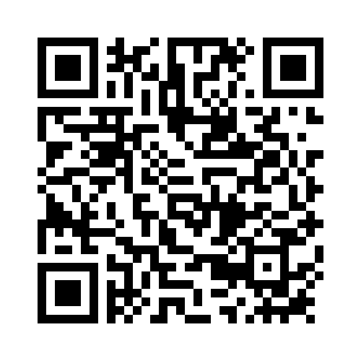
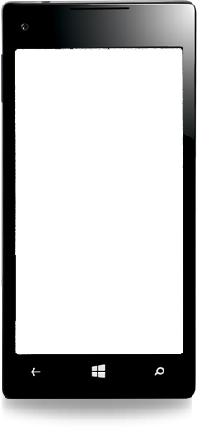

Evaluate this session
Required Slide
*delete this box when your slide is finalized
Your MS Tag will be inserted here during the final scrub.
Scan this QR code to evaluate this session and be automatically entered in a drawing to
win a prize

Slide 41

© 2013 Microsoft Corporation. All rights reserved. Microsoft, Windows and other product names are or may be registered trademarks and/or trademarks in the U.S. and/or other countries.
The information herein is for informational purposes only and represents the current view of Microsoft Corporation as of the date of this presentation. Because Microsoft must respond to changing market conditions, it should not be interpreted to be a commitment on the part of Microsoft, and Microsoft cannot guarantee the accuracy of any information provided after the date of this presentation. MICROSOFT MAKES NO WARRANTIES, EXPRESS, IMPLIED OR STATUTORY, AS TO THE INFORMATION IN THIS PRESENTATION.

